Slide 1
VCSL: Video Compressive Sensing with Low-complexity
ROI Detection in Compressed Domain
Jian Yang
Hosei University
Japan
jian.yang.4f@stu.hosei.ac.jp

Slide 2
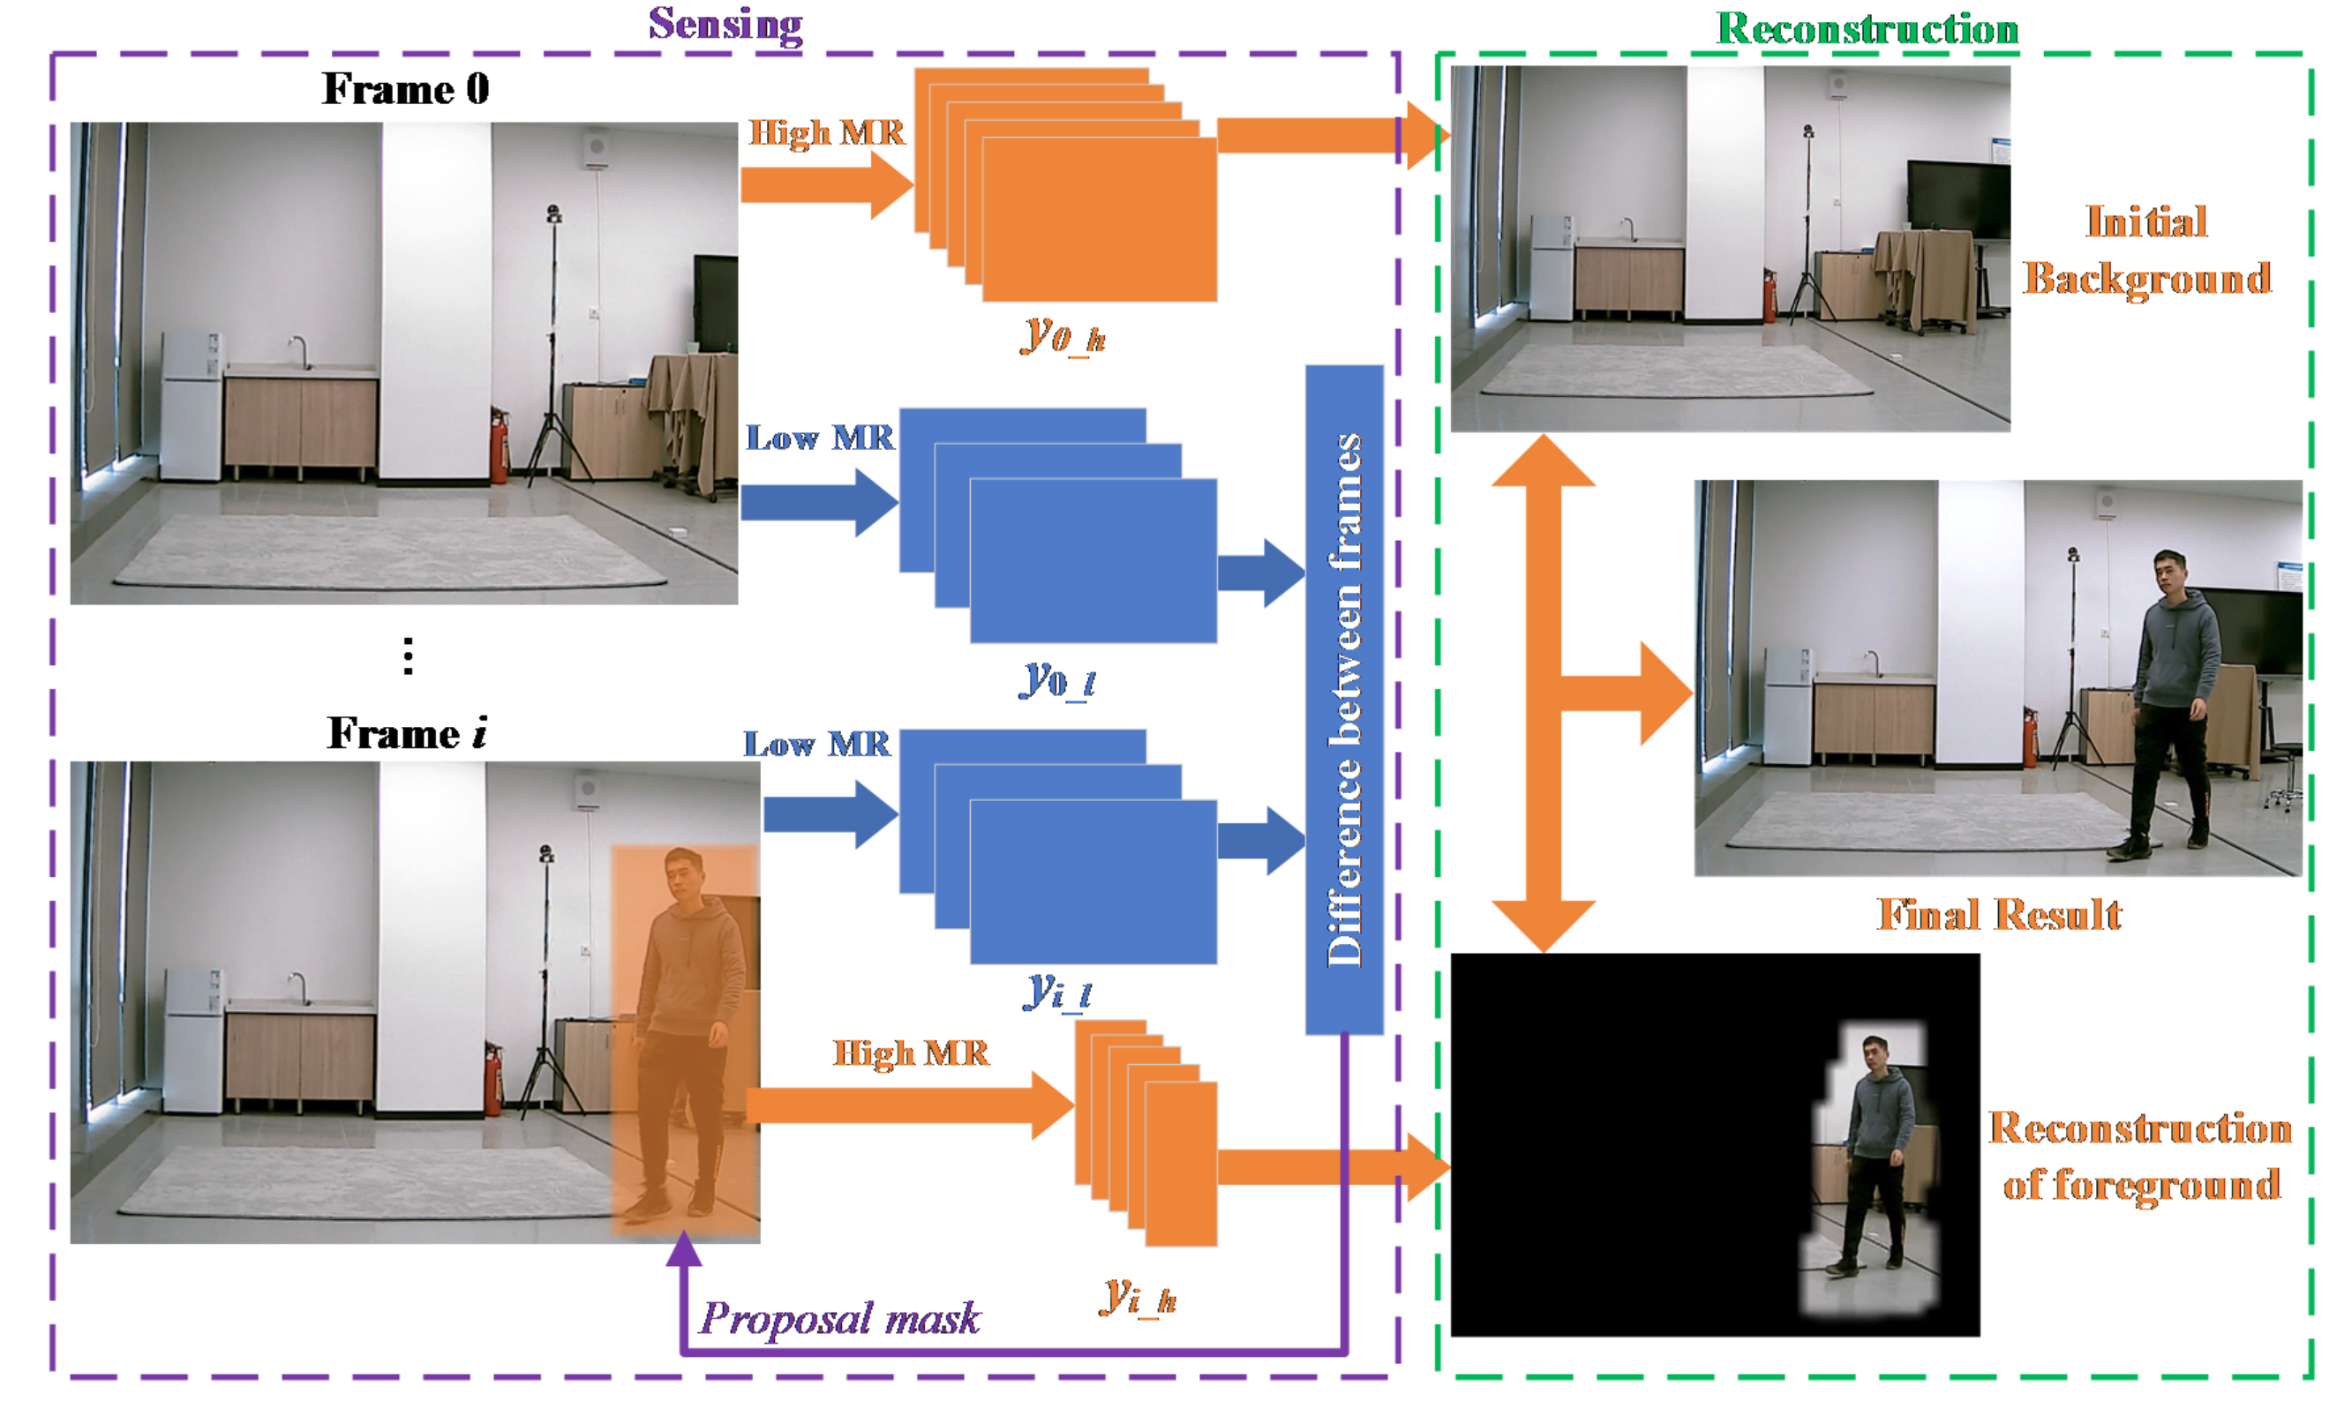
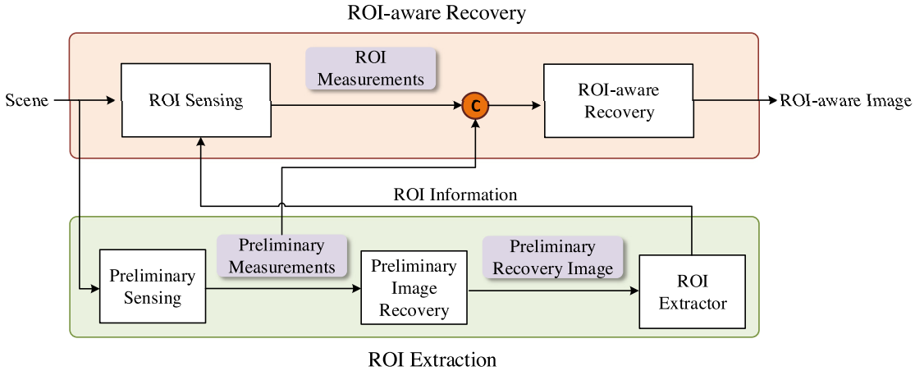
Ⅰ
Introduction and related works
ROI-CSNet [1]:
MRCS [2]:
MRVCS [3]:
In the ROI extraction part, the preliminary measurements are obtained at a low sampling rate.
Then, a salient object detection method is utilized to extract ROI from the reconstructed image.
1) Object detection with MYOLO3 for raw image.
2) Multiple sampling rate for different regions.
The measurement sampled at low SR is used to determined the ROI without introducing other object detection model.
Drawbacks:
Drawbacks and takeaways:
Drawbacks:
1) Good quality in ROI but bad in Non-ROI.
2) The measurement sampled with low SR is not only used for locating ROI but also transmitted to help recover high SR in reconstruction.
3) The sampling rate of whole video sequence can be decreased further if do not transmit the low SR measurement.
1) Leading into additional network for ROI detecting.
1) Additional network for ROI detecting.
2) Good quality in ROI but bad in Non-ROI.
3) The spatial and temporal correlation is not be utilized.
2) Sensing and Reconstructing the image twice.
3) Good quality in ROI but bad in Non-ROI.
[1] Zhao, Zhifu, et al. "ROI-CSNet: Compressive sensing network for ROI-aware image recovery." Signal Processing: Image Communication 78 (2019): 113-124.
[2] Liao, Longlong, et al. "Low-cost image compressive sensing with multiple measurement rates for object detection." Sensors 19.9 (2019): 2079.
[3] Du, Jiang, Xuemei Xie, and Guangming Shi. "Multi-rate Video Compressive Sensing for Fixed Scene Measurement." 2021 The 5th International Conference on Video and Image Processing. 2021.

Slide 3
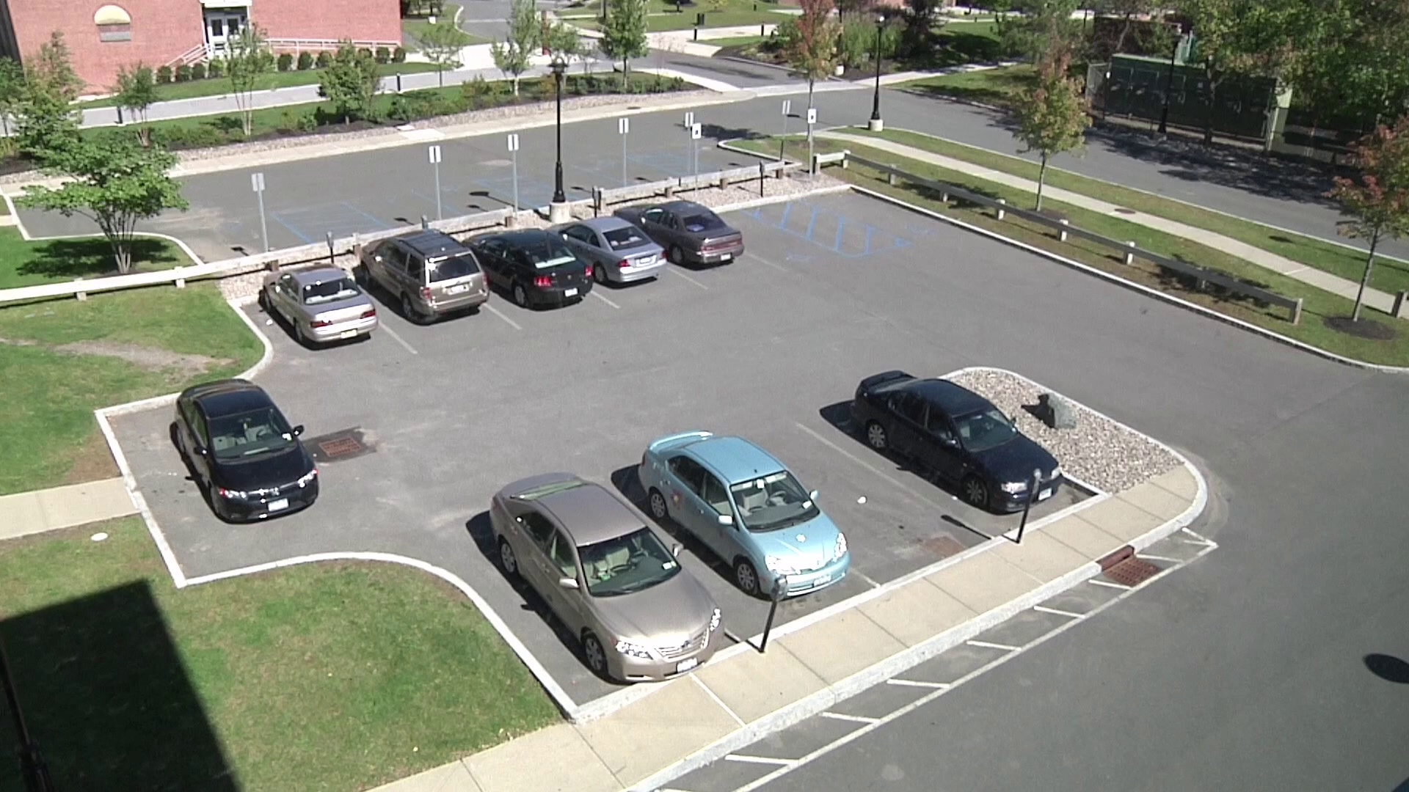
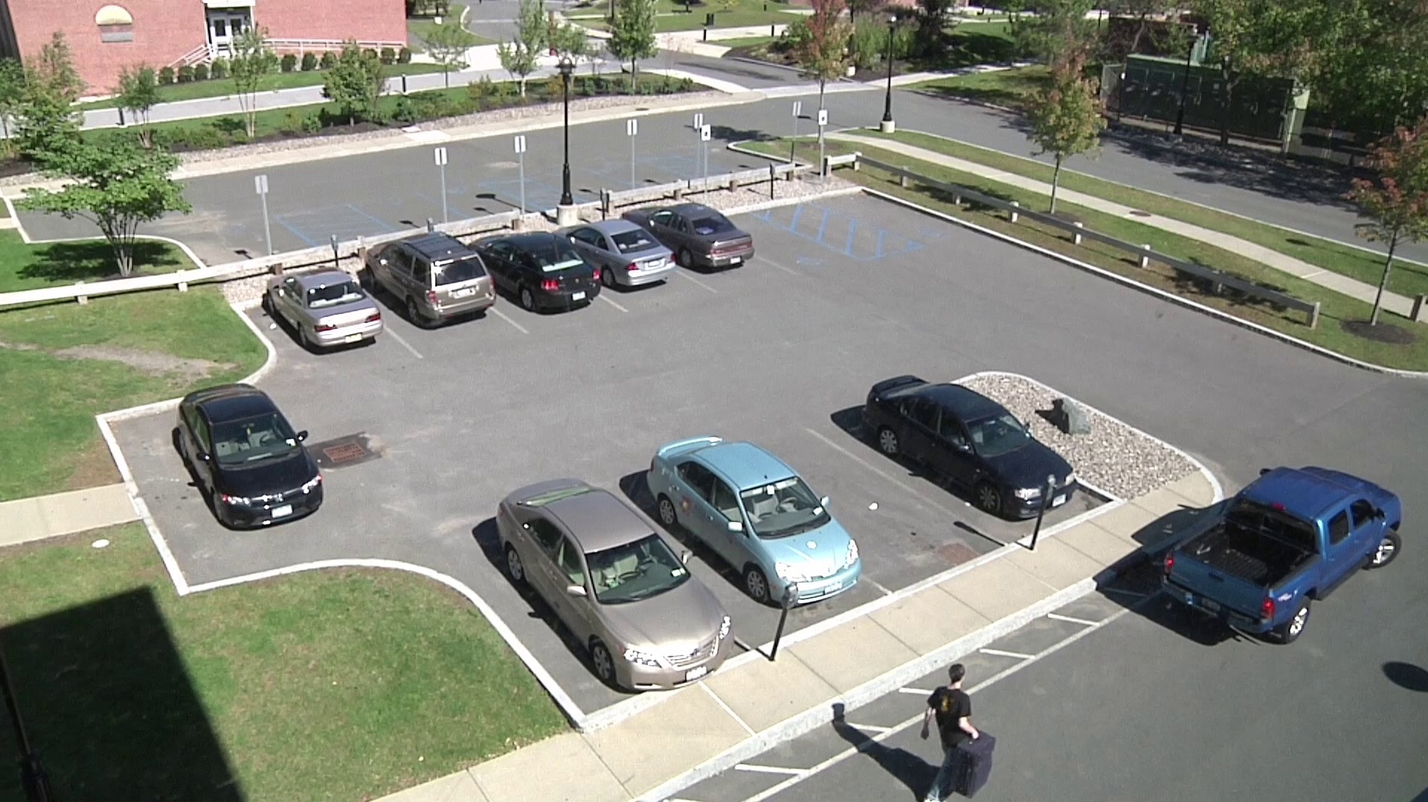
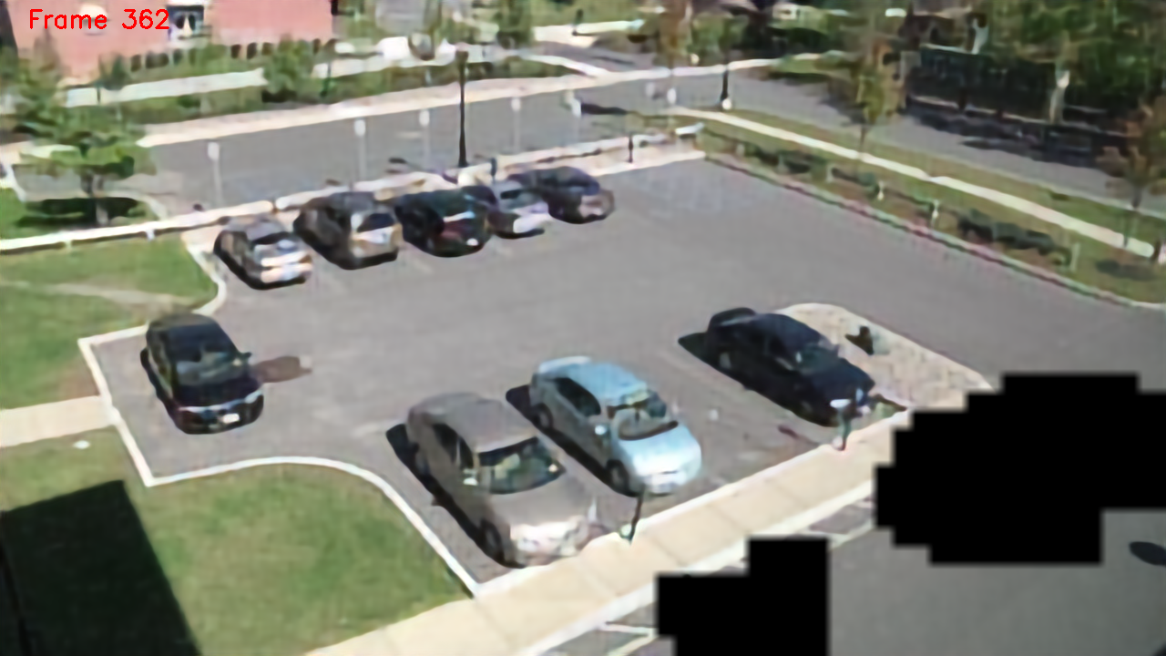
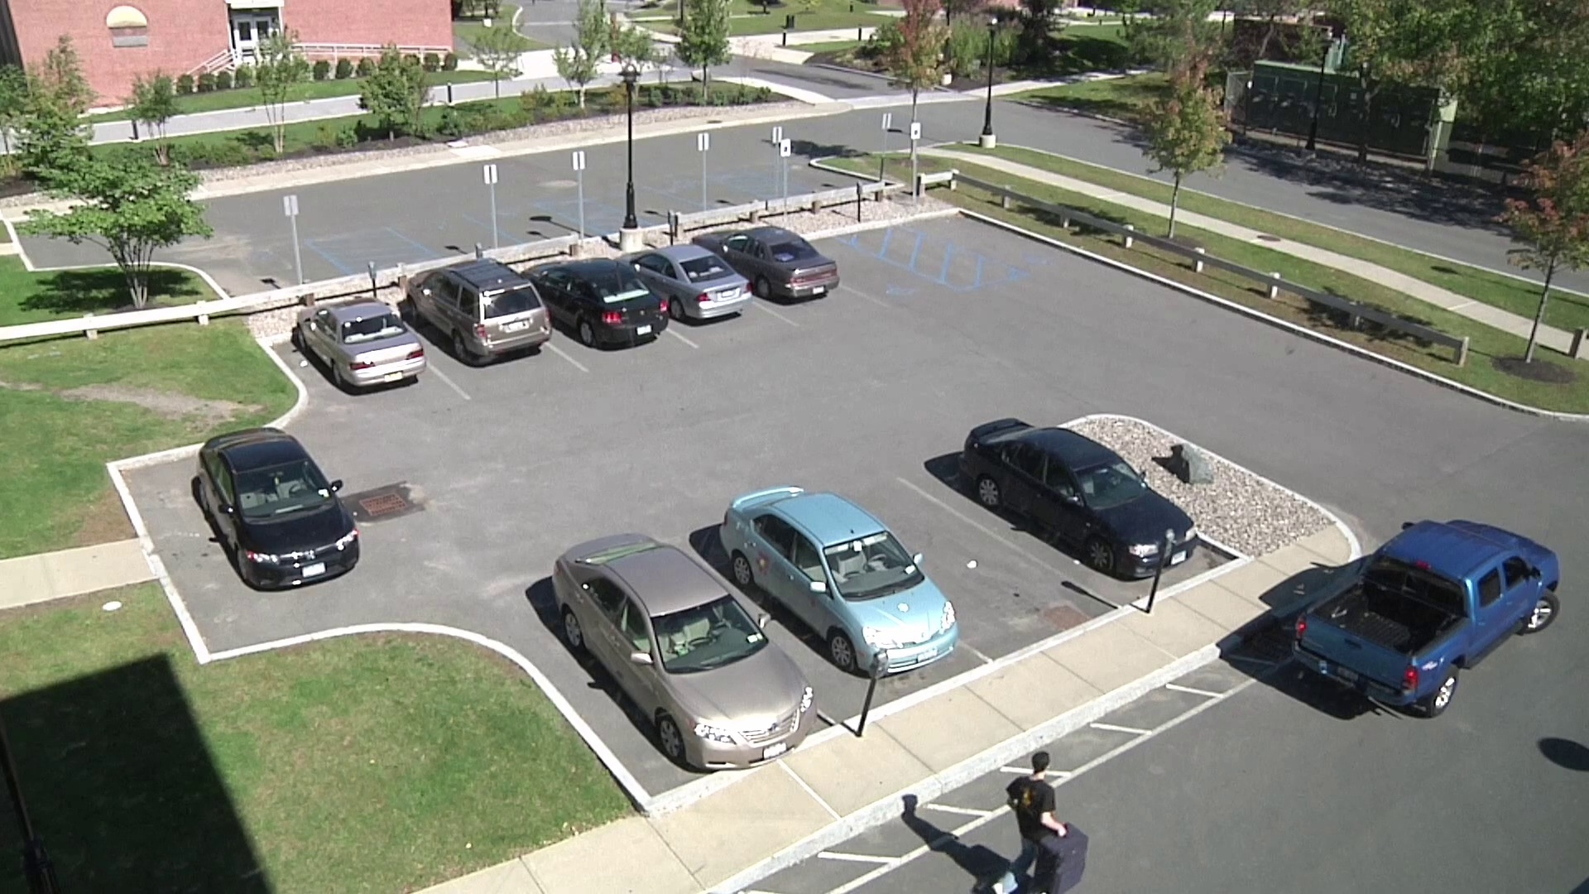
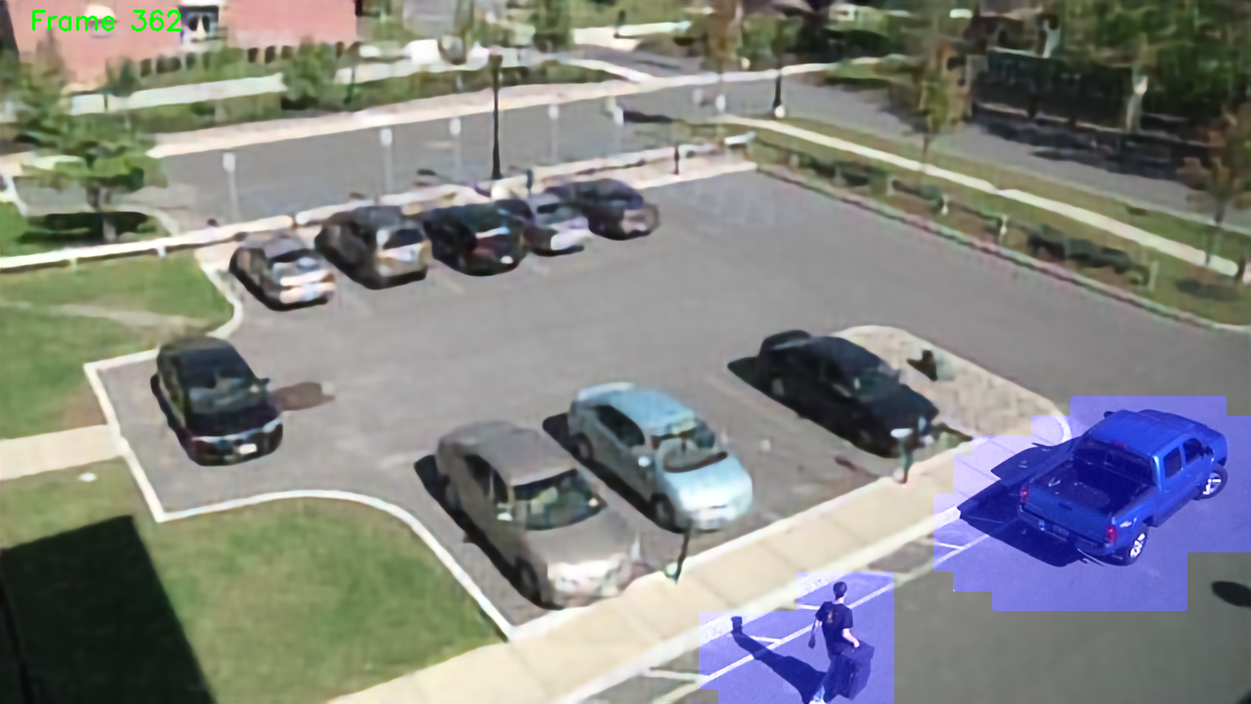
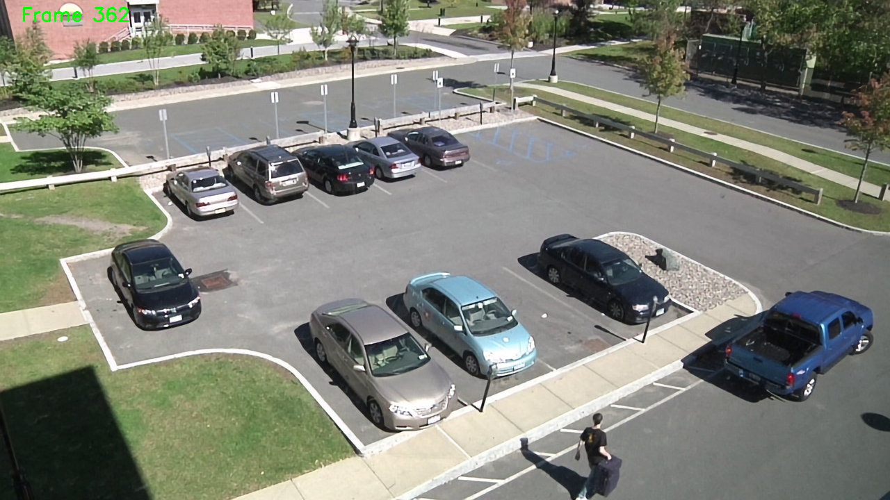
II
Proposal: Overall Framework
Sequence
Encoder
Decoder
Low SR
High SR
Reference Frame
(initialization = 1)
Reconstructed Reference Frame
Low SR
High SR
一
i-1th Frame
λ
i-1th Frame with ROI mask
Reconstructed i-1th Frame
Low SR
High SR
i^{th} Frame
i^{th} Frame with ROI mask
Reconstructed i^{th} Frame
Reference Frames
(without ROI)
Compare difference of measurement
……
Final Reconstructed
i-1th Frame
Final Reconstructed
i^{th} Frame
Detected Regions
ROI masks and coordinates

Slide 4
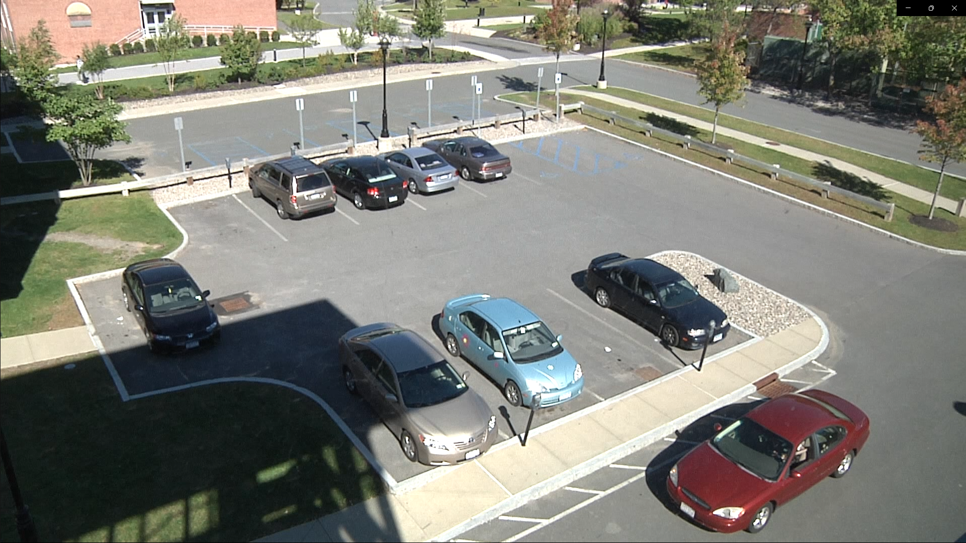
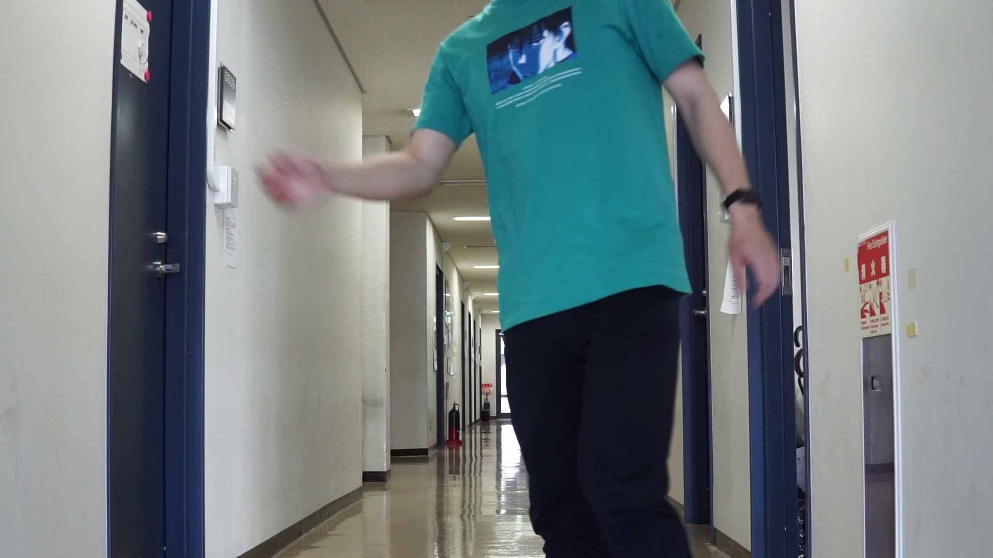
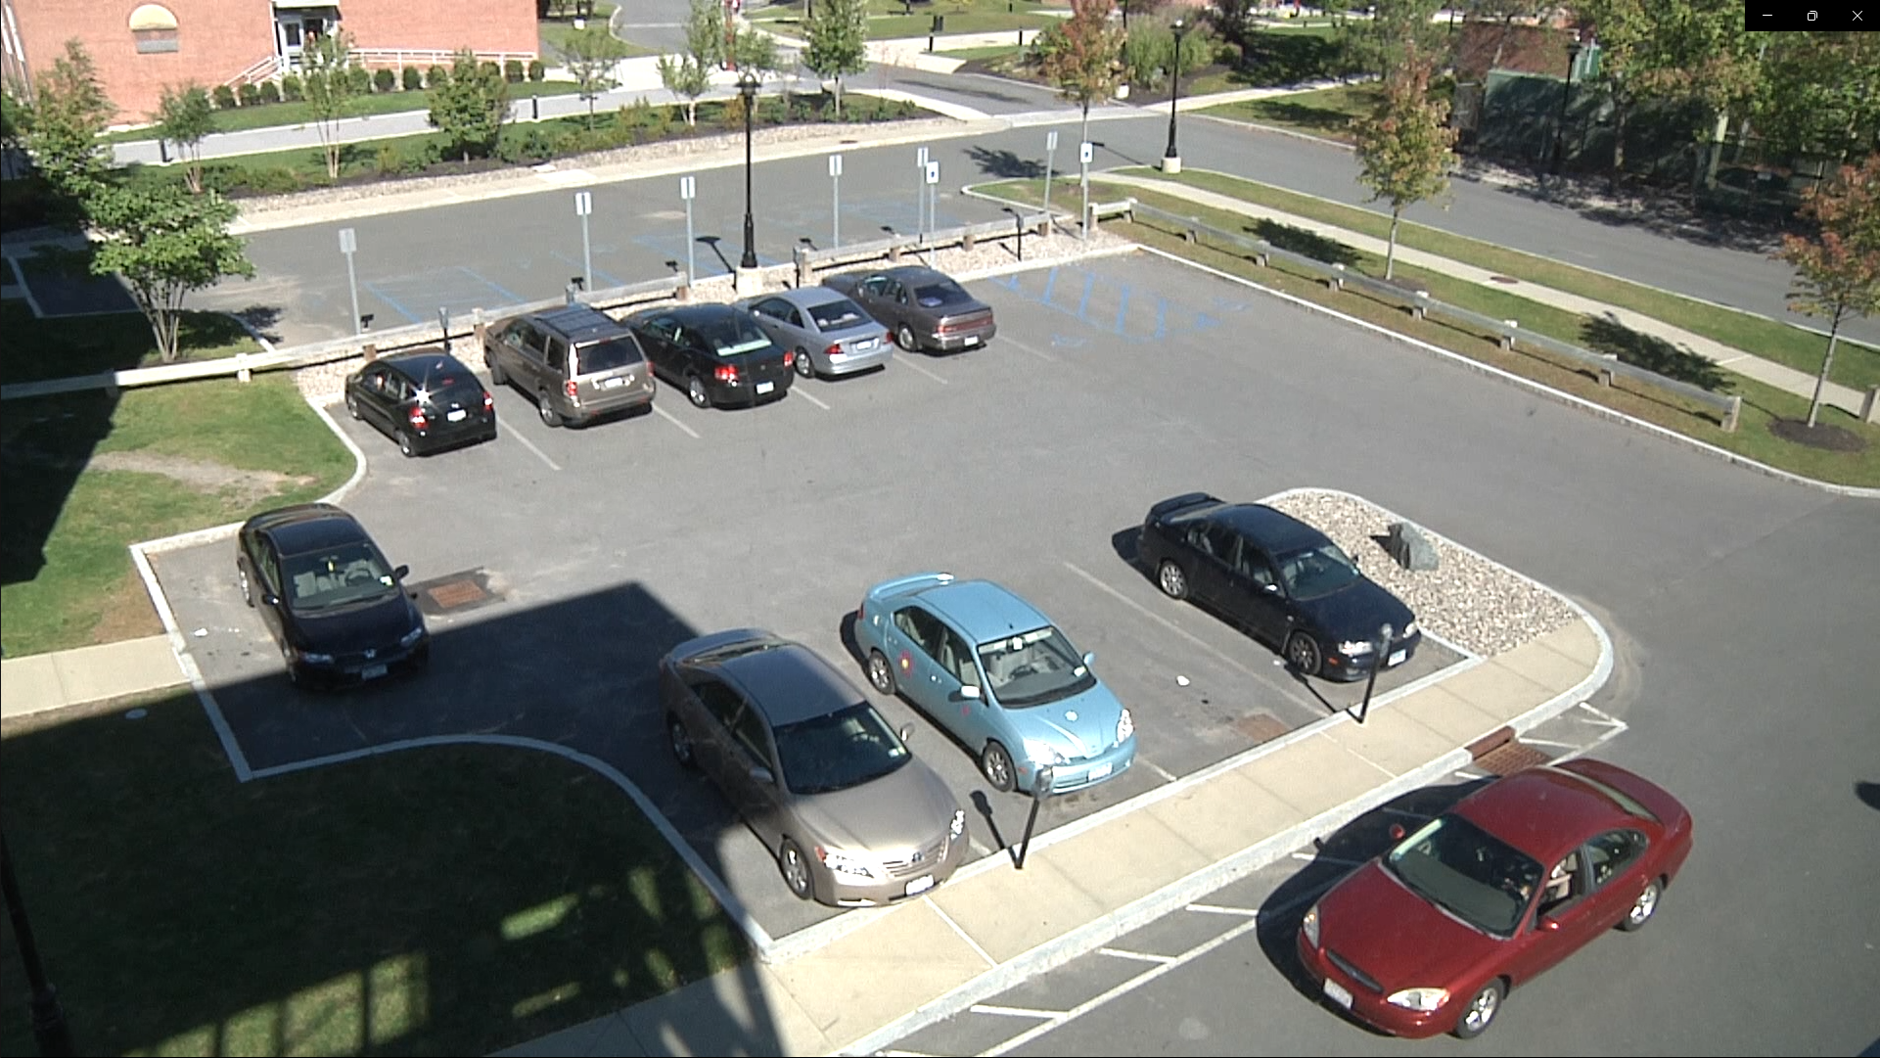
II
Proposal: Reference Frame Renewal (RFR)
2)
1)
The first frame is not background
The background changes

Slide 5
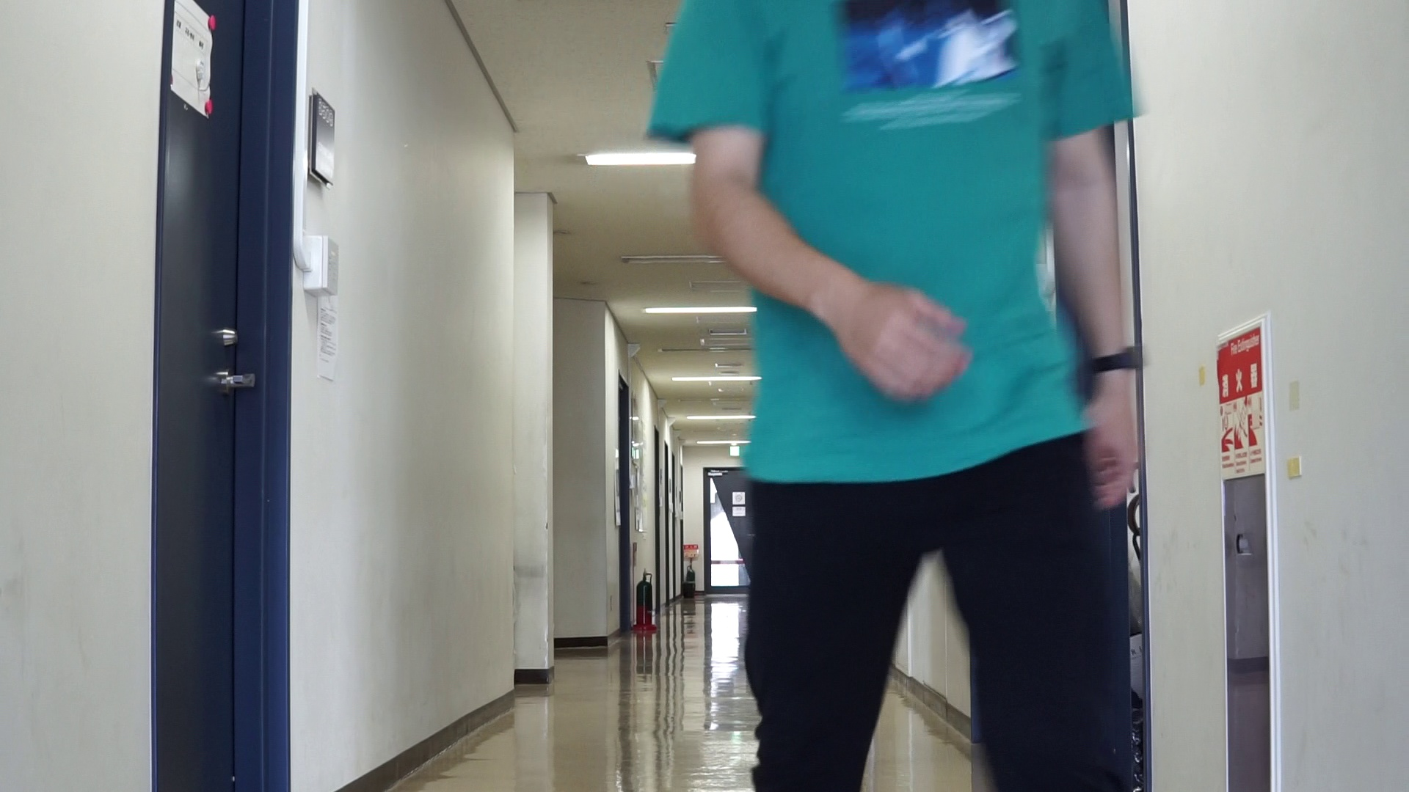
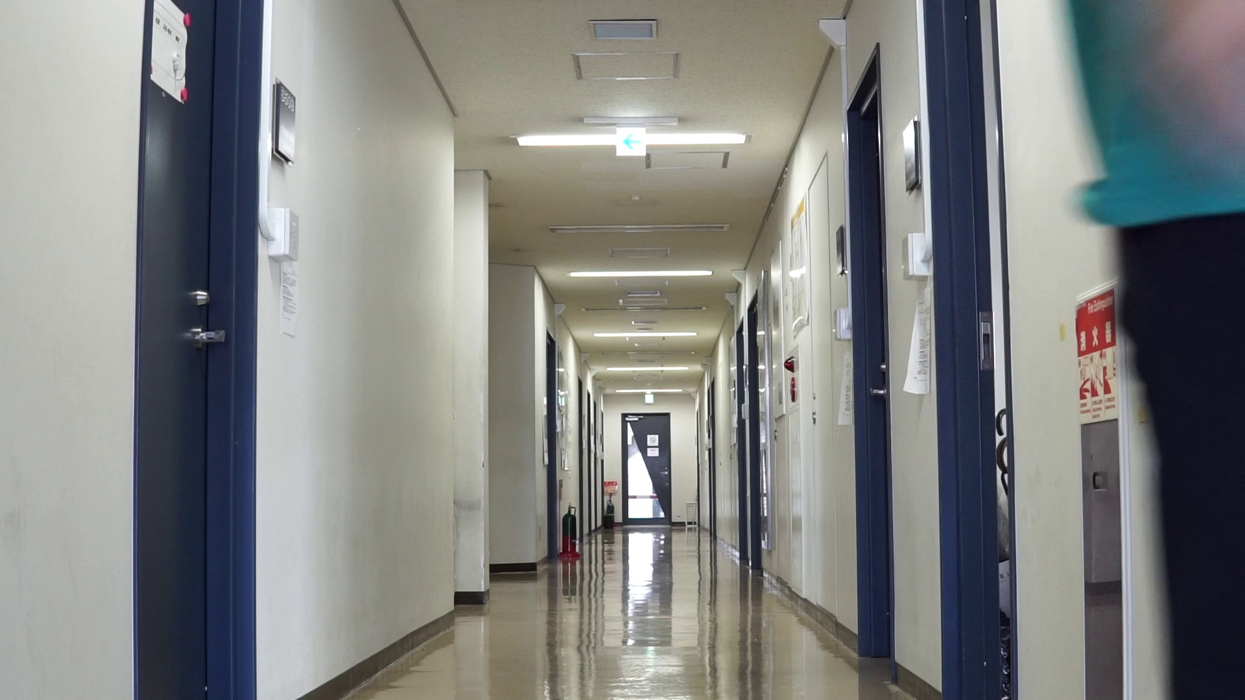
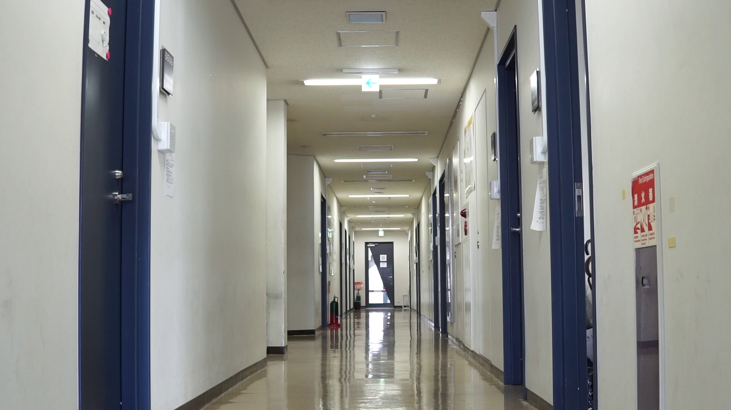
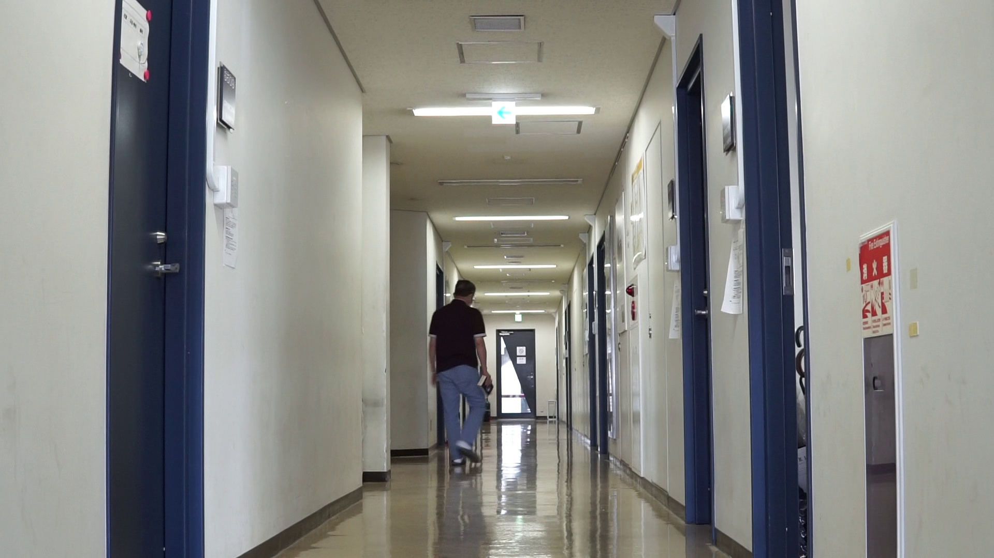
II
Proposal: Reference Frame Renewal (RFR)
Low sampling rate
Low sampling rate
Low sampling rate
一
一
High sampling
rate
High sampling
rate
……
……
……
1st Frame
i-1th Frame
i^{th} Frame
i+t^{th} Frame
Last Frame
Reference Frame 1
(initialization = 1)
Reference Frame 2
The difference of measurement
is less than k, renew the reference
k and t are constants set manually

Slide 6
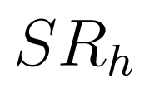
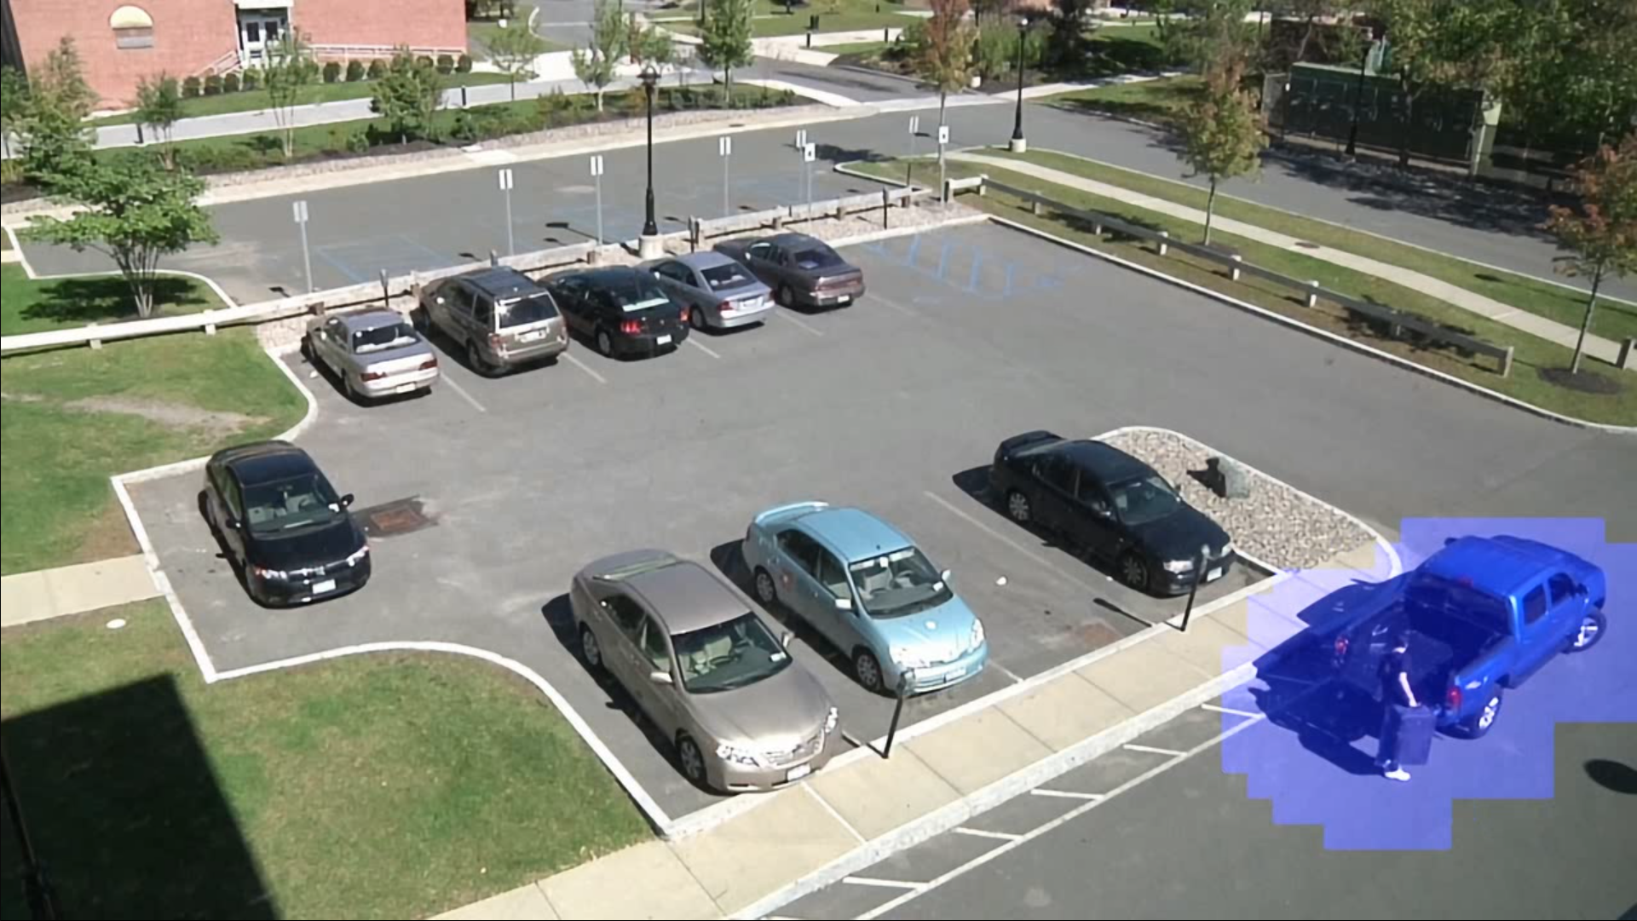
II
Calculation of sampling rate (SR)
The SR for reference frame:
The SR for i^{th} frame:
S_{block} and S_{or} indicate the area of the reconstruction block and video sequence, respectively. The m donates total number of how many blocks are selected as ROI.
The SR for the whole video sequence:
where λ indicates the number of reference frame.

Slide 7
III
Experimental Setting
Reconstruction model: MRVCS[4]
Training Dataset: DIV2K dataset
Testing Dataset: VIRAT [3], some sequences that created by ourselves
Compare with the other SOTA: ISTA-Net[5], COAST[6], OPINE-Net[7], MRVCS[4]
Evaluation Metric: PSNR / SSIM / Average SR
[5] Zhang, Jian, and Bernard Ghanem. "ISTA-Net: Interpretable optimization-inspired deep network for image compressive sensing." Proceedings of the IEEE conference on computer vision and pattern recognition. 2018.
[6] You, Di, et al. "Coast: Controllable arbitrary-sampling network for compressive sensing." IEEE Transactions on Image Processing 30 (2021): 6066-6080.
[7] Zhang, Jian, Chen Zhao, and Wen Gao. "Optimization-inspired compact deep compressive sensing." IEEE Journal of Selected Topics in Signal Processing 14.4 (2020): 765-774.

Slide 8
III
Visual results

Slide 9
III
Visual results

Slide 10
III
Results of SR reduction

Slide 11
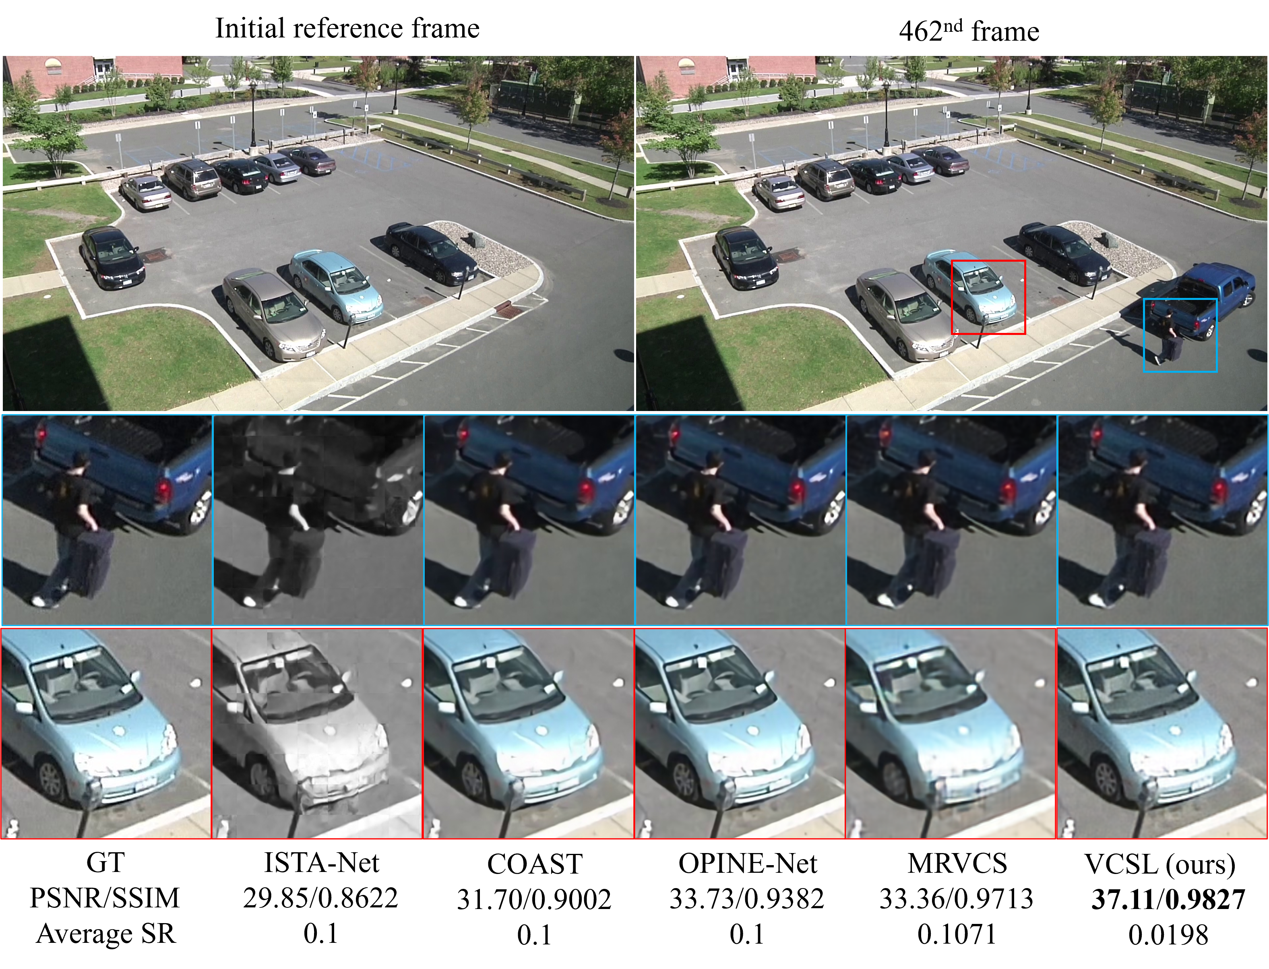
III
Results with SOTA
* The SR_{l} and SR_{h} used for MRVCS and VCSL are 0.05 and 0.20, respectively.

Slide 12
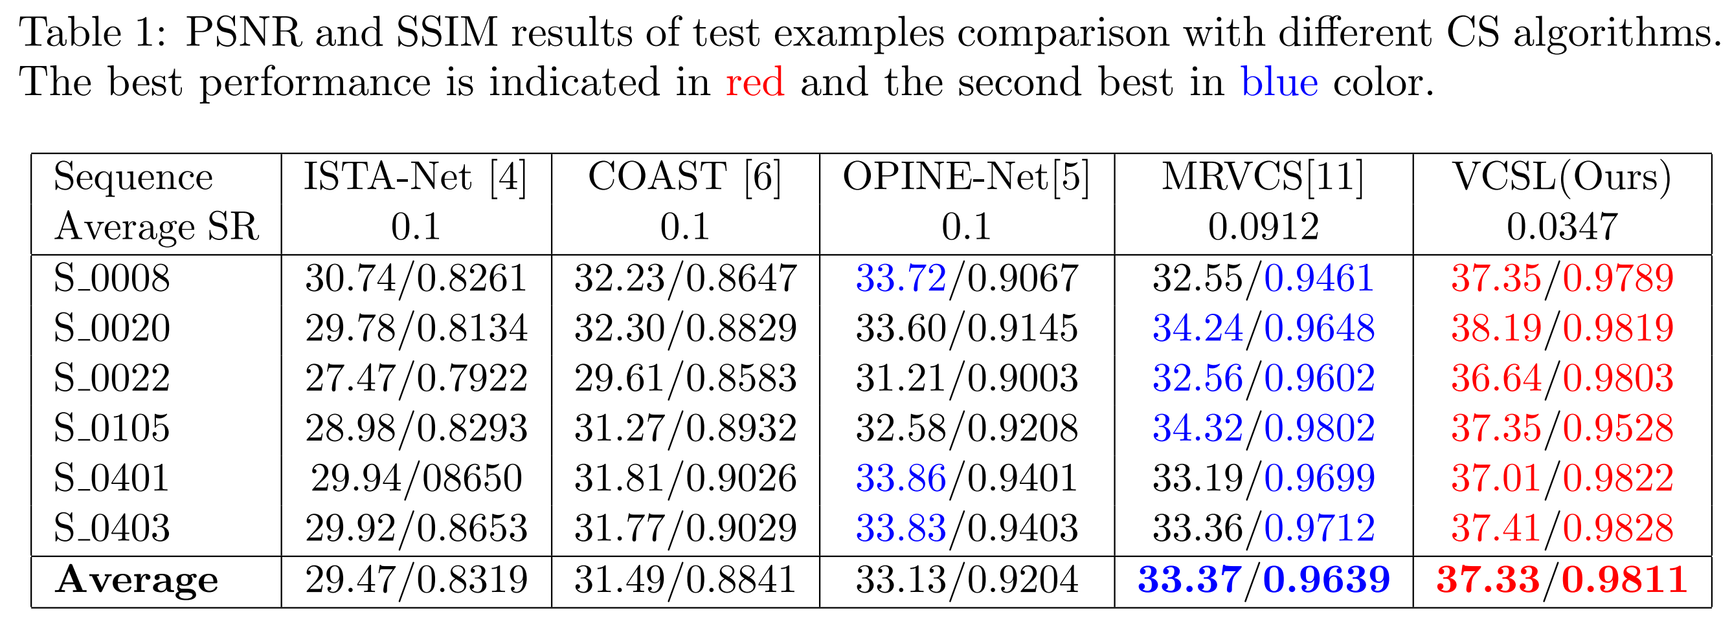
III
Results with SOTA
* The SR_{l} and SR_{h} used for MRVCS and VCSL are 0.05 and 0.20, respectively.

Slide 13
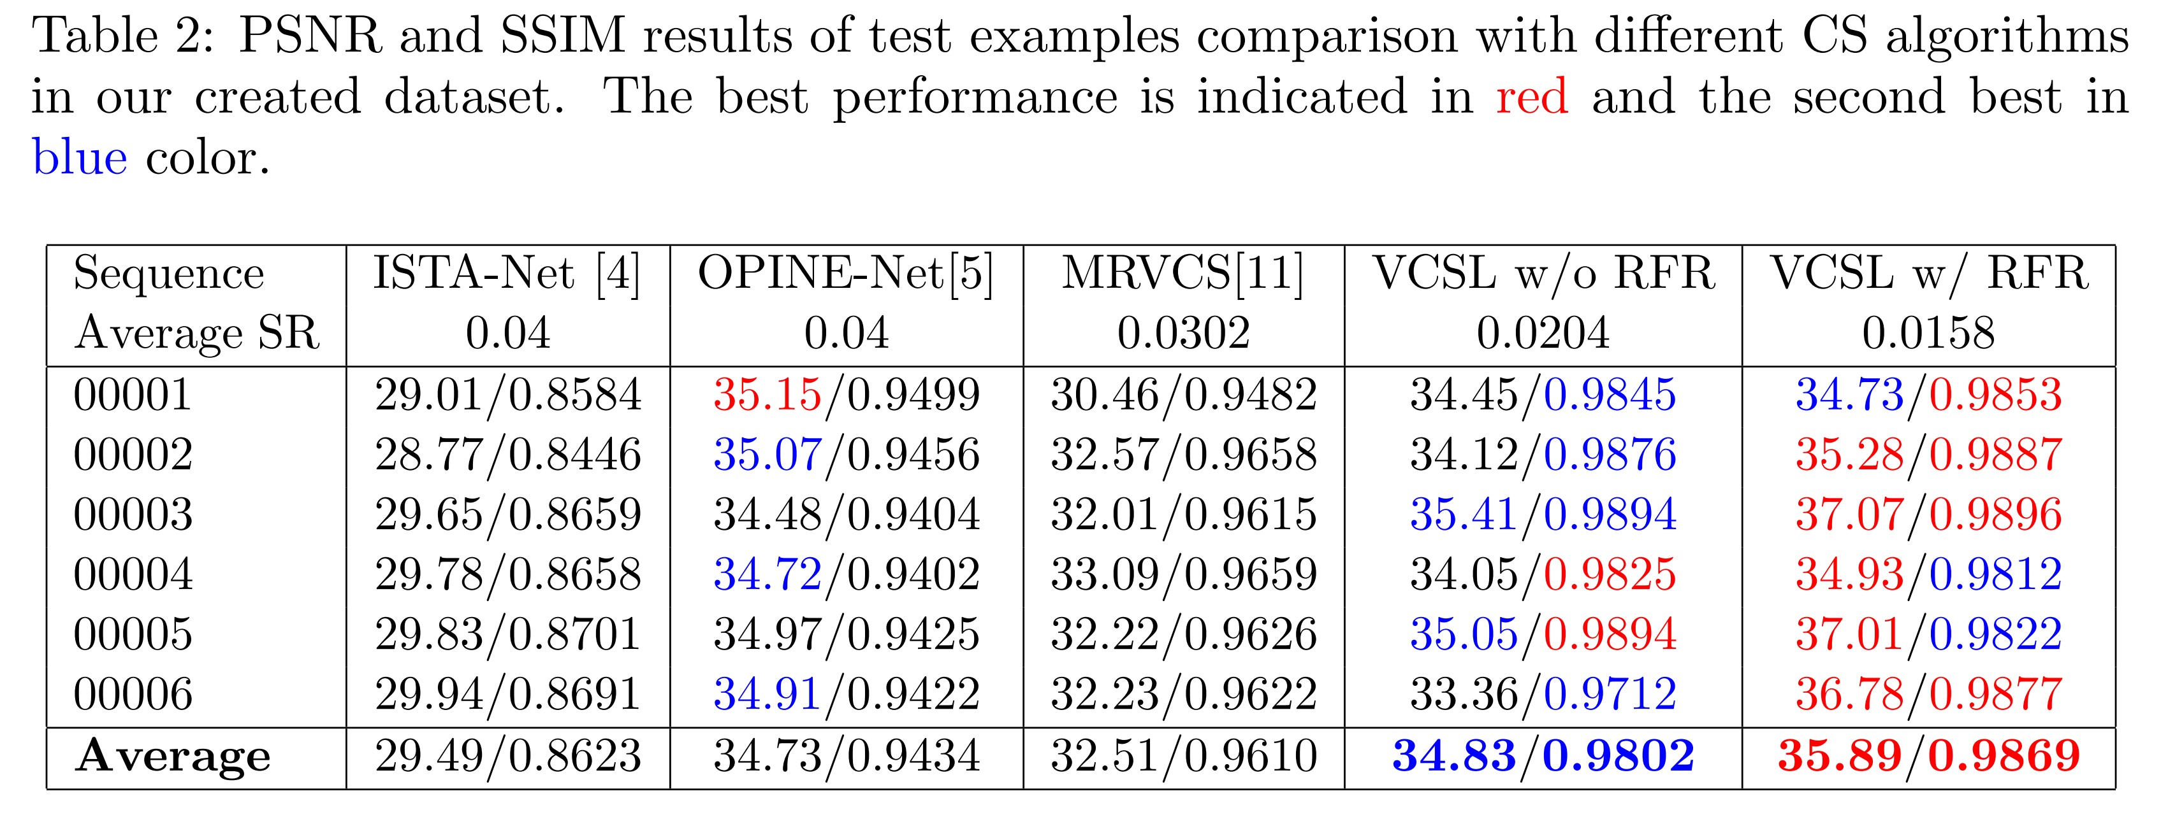
III
Results with SOTA
* The SR_{l} and SR_{h} used for MRVCS and VCSL are 0.01 and 0.10, respectively.

Slide 14
IV
Conclusion
Not only focus on the ROI, the quality of whole reconstructed video is acceptable.
Using a low SR to detect the ROI but only transmit the coordinates instead of measurements can reduce the required total SR.
The proposed RFR method successfully solve the problem of the background changing and reduce the required SR furtherly.
The proposed framework can be integrated to the other existing work to reduce the required sampling rate.

Slide 15
Reference
[1] Zhao, Zhifu, et al. "ROI-CSNet: Compressive sensing network for ROI-aware image recovery." Signal Processing: Image Communication 78 (2019): 113-124.
[2] Liao, Longlong, et al. "Low-cost image compressive sensing with multiple measurement rates for object detection." Sensors 19.9 (2019): 2079.
[3] “Virat description, available at,” http://www.viratdata.org/.
[4] Du, Jiang, Xuemei Xie, and Guangming Shi. "Multi-rate Video Compressive Sensing for Fixed Scene Measurement." 2021 The 5th International Conference on Video and Image Processing. 2021.
[5] Zhang, Jian, and Bernard Ghanem. "ISTA-Net: Interpretable optimization-inspired deep network for image compressive sensing." Proceedings of the IEEE conference on computer vision and pattern recognition. 2018.
[6] You, Di, et al. "Coast: Controllable arbitrary-sampling network for compressive sensing." IEEE Transactions on Image Processing 30 (2021): 6066-6080.
[7] Zhang, Jian, Chen Zhao, and Wen Gao. "Optimization-inspired compact deep compressive sensing." IEEE Journal of Selected Topics in Signal Processing 14.4 (2020): 765-774.

Slide 16
Thanks for your listening

