Slide 1
Test-Time Detection of Backdoor Triggers for Poisoned Deep Neural Networks
Xi Li, Zhen Xiang, David J. Miller, George Kesidis
School of EECS, Pennsylvania State University

Slide 2
Introduction
Backdoor (Trojan) attacks are an important type of training-data poisoning attacks against deep neural networks (DNN).
After training, the attacked DNN will then:
(mis)classify to the target class when a test sample is embedded with the same backdoor pattern used in poisoning;
correctly classify clean (backdoor-free) samples.
Fig. 1. A stop sign from the U.S. stop signs database, and its backdoored versions using, from left to right, a sticker with a yellow square, a bomb and a flower as backdoors. The backdoored images are mislabeled to speed limit sign. (This figure is from [1].)
Notes:
poisoning

Slide 3
Introduction (cont.)
Existing backdoor detection methods:
Pre-training detections of training samples embedded with the backdoor pattern:
Require access to the training set of the DNN.
So, are impractical in cases where the training set is not available.
Post-training detections of backdoor-poisoned DNNs:
Possesses a small, clean (backdoor-free) dataset but has no access to the training set.
Infers the possible target class and reverse-engineers the associated backdoor pattern.
Cannot catch entities in the act of exploiting the backdoor mapping at test-time.
Reverse-engineered backdoor pattern may be unreliable in the image space (cf. Fig.2).
Fig. 2. Comparison between original trigger and reverse engineered trigger in (a) Trojan Square and (b) Trojan Watermark. (This figure is from [2].)

Slide 4
Contributions
We propose an unsupervised method that, at test-time, detects backdoor triggers and infers the source class for detected backdoor trigger images, given the reverse-engineered backdoor pattern and the target class obtained from a post-training backdoor detector.
Our detector requires no access to the DNN's training set nor any DNN training/fine-tuning.
We show the effectiveness and wide application of our detector experimentally for a wide variety of DNN architectures, datasets, and backdoor attack configurations.

Slide 5
Threat Model and Defender’s Knowledge & Goals
Attacker’s goal: The attacker aims to have the DNN mis-classify to the target class $t$ when an image from a source class $s∈S_{A}⊆C\backslash \{t\}$ is embedded with a specific backdoor pattern; while not degrading the DNN’s accuracy on backdoor-free images.
Attack strategy: The attacker poisons the training set by a small number of valid images from $S_{A}$, which are embedded with the backdoor pattern that will be used at test-time. These poisoning images are (mis)labeled to the target class.
Defender’s knowledge:
A small set of clean images from all classes $D_{c}, ∀c∈C$, which are not enough to train a clean DNN from scratch.
The DNN detected as attacked, the target class, and the backdoor pattern inferred by a post-training reverse-engineering defense (RED).
Defender’s goal: Detect whether the test image classified to the target class contains the backdoor pattern; and if so, infer its source class.
Notes:
Formally define the threat model of backdoor attack and defense

Slide 6
Related Works
Neural Cleanse (NC) [2]:
Find neurons that are most relevant to the (estimated) backdoor pattern.
Observed how a test image activates these backdoor neurons.
If its activations are higher than a given threshold, it is a backdoor trigger image, otherwise, it is clean.
The DNN fine-tuned on correctly labeled backdoor trigger images can infer the source class of the detected backdoor trigger image.
Black-box backdoor detection (B3D) [3]:
Embed the estimated backdoor pattern to the incoming test image.
Feed the original test image and the one with backdoor pattern embedded into the DNN.
If the similarity between the DNN posteriors of the two inputs is larger than a given threshold, it is a backdoor trigger image, otherwise, it is clean.
B3D may falsely report clean target class images & does not infer the source class of a detected backdoor trigger image.
STRong Intentional Perturbation (STRIP) [4]:
Blend the incoming test image with a few clean images.
Feed these blended images into the DNN and compute the average entropy of DNN posteriors.
If the average entropy is smaller than a given threshold, it is a backdoor trigger image, otherwise, it is clean.
STRIP does not infer the source class of a detected backdoor trigger image.
Notes:
Under the threat model, All supervised detections, needs properly chosen detection threshold.

Slide 7
Our Method - Intuition
The true backdoor pattern and its estimation will likely activate the same set of deep layer neurons (when they are embedded in images from the same source class). These neurons are likely different from those activated by typical target class images.
Thus, if an image classified to the target class t is a backdoor trigger image, then its deep layer activations are expected to be
similar to the activations for most images from the same source class embedded with the estimated pattern;
different from the activations for typical images from the target class.
Notes:
Estimated pattern is unreliable in images space

Slide 8
Method – Step 1
Step1. Embed estimated backdoor pattern in clean images of non-target classes,
${\hat{D}}_{c}=\left\{g\left(x,\hat{∆}\right) | x∈D_{c}\right\}, ∀c≠t$.

Slide 9
Method – Step 2
Step 2. Feed samples in $\bigcup_{c≠t}{{\hat{D}}_{c}}$ and $D_{t}$ into attacked DNN and get their internal layer (layer L) features $Z_{c}=\left\{f_{L}\left(\hat{x}\right) | \hat{x}∈{\hat{D}}_{c}\right\},∀c≠t$,
$Z_{t}=\left\{f_{L}(x) | x∈D_{t}\right\}$.

Slide 10
Method – Step 3
Step 3. Learn a density model for each class c on its normalized internal layer features:
$θ_{c}={argmax}_{θ}\prod_{z∈Z_{c}}{P[z|θ]}$.

Slide 11
Method – Step 4
Step 4. For a test image w with $f\left(w\right)=t$, we measure its likelihood $L_{c}=P\left[f_{L}\left(w\right) | θ_{c}\right],∀c$.
If ${s=argmax}_{c}L_{c}≠t$, w is deemed to contain the backdoor pattern, and we infer s is its source class; otherwise, w is deemed clean, and we accept the DNN’s class prediction.
Notes:
Backdoor attack is targeted attack

Slide 12
Experimental Set-Up on CIFAR-10
Dataset: CIFAR-10, 10 classes, 5k training images per class, 1k test images per class
Target DNN: ResNet-18
Data allocation: split the test set – 100 images per class are preserved for the defender, the remaining are used for testing.
Attack settings: We create the attacks following the threat model.
Target class: class 9
3 backdoor patterns: 1) an additive perturbation “chess board” (CB) used in [5]; 2) a random single pixel set to 255 (SP) [6]; and 3) a 3X3 white box (WB) [1].
2 attacks for each pattern: 1) single class attack – embed the backdoor pattern in 1000 training images of class 0; 2) multi-class attack – embed the backdoor pattern in 100 training images of all non-target class.
Embed the backdoor pattern into copy of test images of the source class(es) for test-time attack.
Defense settings: Apply NC[2] and TNNLS’20[5] to infer the target class and estimate the backdoor pattern. Learn a Gaussian mixture model on the penultimate layer features for each class.
Notes:
Backdoor pattern, attack settings
2 test sets, one is clean , the other contains backdoor trigger

Slide 13
Experimental Results on CIFAR-10
Illustration of training samples embedded with backdoor pattern
“chess board” (CB) (enhanced for visualization)
a random single pixel set to 255 (SP)
a 3X3 white box (WB)

Slide 14
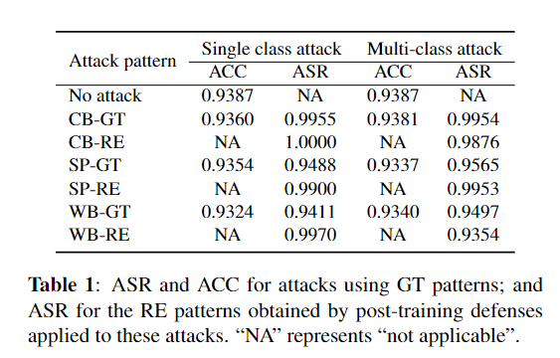
Experimental Results on CIFAR-10 (cont.)
We measure the effectiveness of backdoor attacks using ground truth (GT) pattern and reverse-engineered (RE) pattern by
attack success rate (ASR): the fraction of test images embedded with backdoor pattern that are misclassified to the target class.
clean test accuracy (ACC): (poisoned) DNN’s accuracy on clean test samples
Notes:
CIFAR10

Slide 15
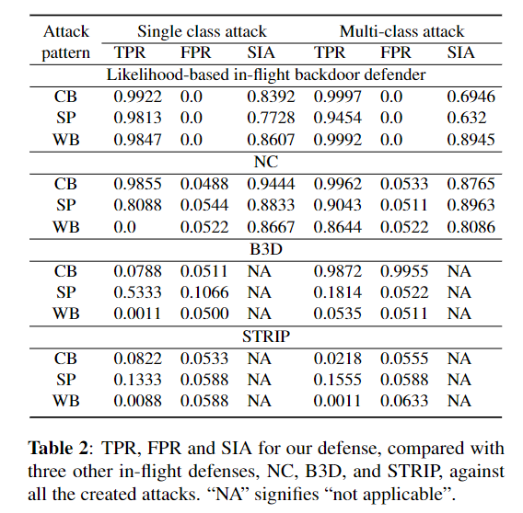
Experimental Results on CIFAR-10 (cont.)
We measure the performance of our defense method with NC[2], B3D[3], and STRIP[4] by:
true positive rates (TPR): the fraction of backdoor-trigger images correctly detected;
false positive rates (FPR): the fraction of clean images falsely detected;
source class inference accuracy (SIA): the fraction of backdoor-trigger images with correct inference of the source class.
Notes:
All supervised detection that need properly chosen hyper-parameters, like a detection threshold

Slide 16
Experimental Set-Up on PubFig, MNIST/F-MNIST
Datasets:
MNIST/F-MNIST, 10 classes, 5k training images per class, 1k test images per class
PubFig, 20 classes, 80 training images per class, 20 test images per class
Target DNN: LeNet5 on MNIST/F-MNIST, VGG-16 on PubFig
Data allocation: split the test set – 100 images per class for MNIST/F-MINIST, 5 images per class for PubFig, are preserved for the defender, and the remaining are used for testing.
Attack settings:
Target class: class 9 for MNIST/F-MNIST, class 19 for PubFig
Backdoor patterns: CB and WB for MNIST/F-MNIST; Trojan square (SQ) and Trojan watermark (WM) [7] for PubFig.
Multi-class attack: embed the backdoor pattern in 100 images for MNIST/F-MNIST, 2 images for PubFig of all non-target class.
Embed the backdoor pattern into copy of test images of the source classes for test-time attack.
Defense settings: same as CIFAR-10
Notes:
MNIST, F-MNIST, PubFig

Slide 17
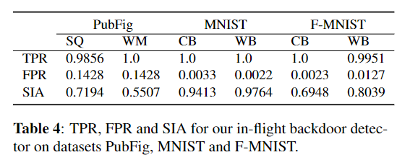
Experimental Results on PubFig, MNIST/F-MNIST
Illustration of training samples embedded with backdoor pattern
Trojan
square
(SQ)
Trojan
watermark
(WM)
Notes:
our defender achieves similarly good performance on these datasets as for the CIFAR-10 dataset.

Slide 18
Conclusions
We proposed an unsupervised detector of test-time images that contain a backdoor trigger.
For the detected backdoor trigger images, we infer their origin (source classes).
Our defense does not require setting a detection threshold, nor access to the DNN's training set or deep learning process.
We show the effectiveness and wide application of our detector experimentally for a wide variety of DNN architectures, datasets, and backdoor attack configurations.

Slide 19
References
[1] Tianyu Gu, Kang Liu, Brendan Dolan-Gavitt, and Siddharth Garg, “BadNets: Evaluating backdooring attacks on deep neural networks,” IEEE Access, 2019.
[2] Bolun Wang, Yuanshun Yao, Shawn Shan, Huiying Li, Bimal Viswanath, Haitao Zheng, and Ben Y. Zhao, “Neural Cleanse: Identifying and mitigating backdoor attacks in neural networks,” in 2019 IEEE Symposium on Security and Privacy, 2019.
[3] Yinpeng Dong, Xiao Yang, Zhijie Deng, Tianyu Pang, Zihao Xiao, Hang Su, and Jun Zhu, “Black-box detection of backdoor attacks with limited information and data,” ICCV, 2021.
[4] Yansong Gao, Change Xu, Derui Wang, Shipping Chen, Damith Chinthana Ranasinghe, and Surya Nepal, “STRIP: A defence against trojan attacks on deep neural networks,” in ACSAC, 2019.
[5] Zhen Xiang, David J. Miller, and George Kesidis, “Detection of backdoors in trained classifiers without access to the training set,” IEEE Transactions on Neural Networks and Learning Systems, 2020.
[6] Zhen Xiang, David J. Miller, and George Kesidis, “A benchmark study of backdoor data poisoning defenses for deep neural network classifiers and a novel defense,” in MLSP, 2019.
[7] Yingqi Liu, Shiqing Ma, Yousra Aafer, Wen-Chuan Lee, Juan Zhai, Weihang Wang, and Xiangyu Zhang, “Trojaning attack on neural networks,” in NDSS, 2018.

Slide 20
Thank you.

