Slide 1
2021 IEEE International Conference on Image Processing 19-22 September 2021 • Anchorage, Alaska, USA
Imaging Without Borders
MAT-NET: REPRESENTING APPEARANCE-IRRELEVANT WARP FIELD
BY MULTIPLE AFFINE TRANSFORMATIONS
Jingwei Liu(speaker), Longquan Dai
Nanjing University Of Science And Technology

Slide 2
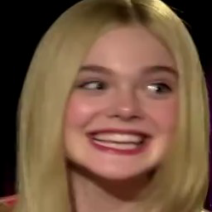
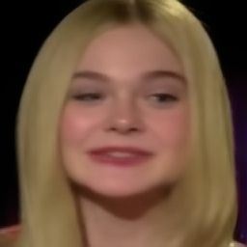
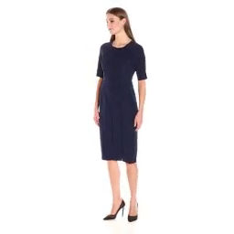
Purpose
Appearance
Pose
New image
Combine
Combine
Motion transfer task aims to combine the appearance or pose information from different images

Slide 3
Purpose
Input image
Warp
Target image
Warp field
MAT-net utilizes warp field (optical flow) to rearrange pixels of input image, then generates target image.

Slide 4
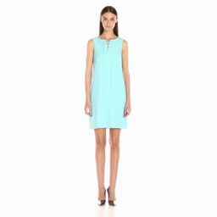
Purpose
Hair style from pose image
Appearance
Pose
1. Predict more accurate warp field

Slide 5
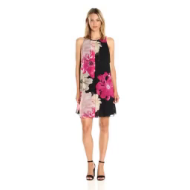
Method
Assumption:
Movement information is hidden in the concatenation of two images.
concatenation

Slide 6
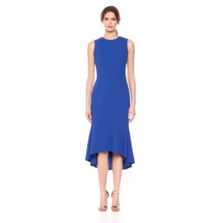
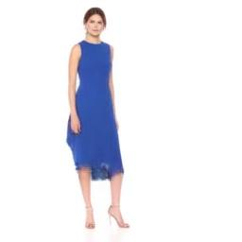
Method
Movement information
Warp
generate
Pose change
Warp field
concatenation

Slide 7
Method
$$A_{1}$$
$$A_{2}$$
…
$$A_{n}$$
Input
Model
Output
concatenation
Movement information
Each A is a matrix representing an affine transformation.

Slide 8
Method
generator
$$ℒ_{perc}$$
S
$$ℒ_{adv}$$
input
$$𝒯_{I⟵T}$$
$$A_{1}$$
$$A_{2}$$
.
$$A_{n}$$
$$M_{0}$$
$$M_{1}$$
.
$$M_{n}$$
target
T
concat
Regression net
Grid generator
Object movement capture module
T
Affine transformation
S
Sampling function
Warp field

Slide 9
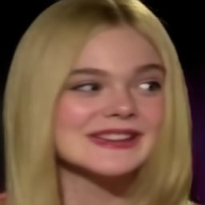
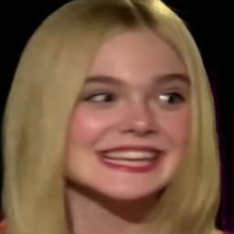
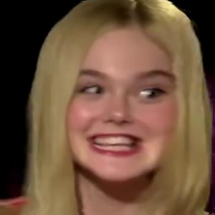
Results
Target
Input
Ours
Fir.
Mon.
X2F.

Slide 10
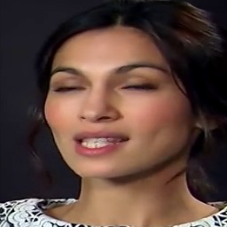
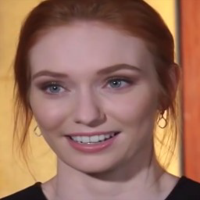
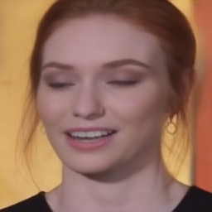
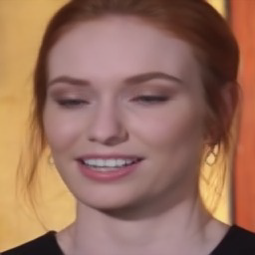
Results
Target
Input
Ours
Fir.
Mon.
X2F.

Slide 11
Results
Target
Input
Ours
Fir.
Mon.

Slide 12
Results
Target
Input
Ours
Fir.
Mon.

Slide 13
Results

Slide 14
Results

Slide 15
Results-failure case
Wrong body side

Slide 16
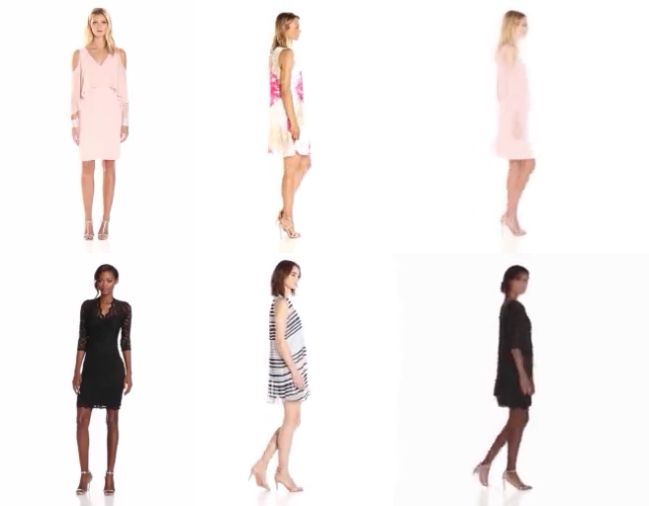
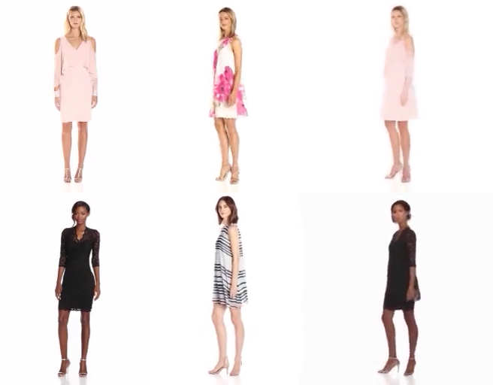
Results
body side OK

Slide 17
2021 IEEE International Conference on Image Processing 19-22 September 2021 • Anchorage, Alaska, USA
Imaging Without Borders
Thank you for listening

