Slide 1
Mixed-precision Deep Neural Network Quantization With Multiple Compression Rates
Xuanda Wang, Wen Fei, Wenrui Dai, Chenglin Li, Junni Zou, and Hongkai Xiong
Department of Electronic Engineering
Shanghai Jiao Tong University
1 March 2023

Slide 2
Outline
1
Introduction and Related Works
2
Methods
3
Future Work

Slide 3
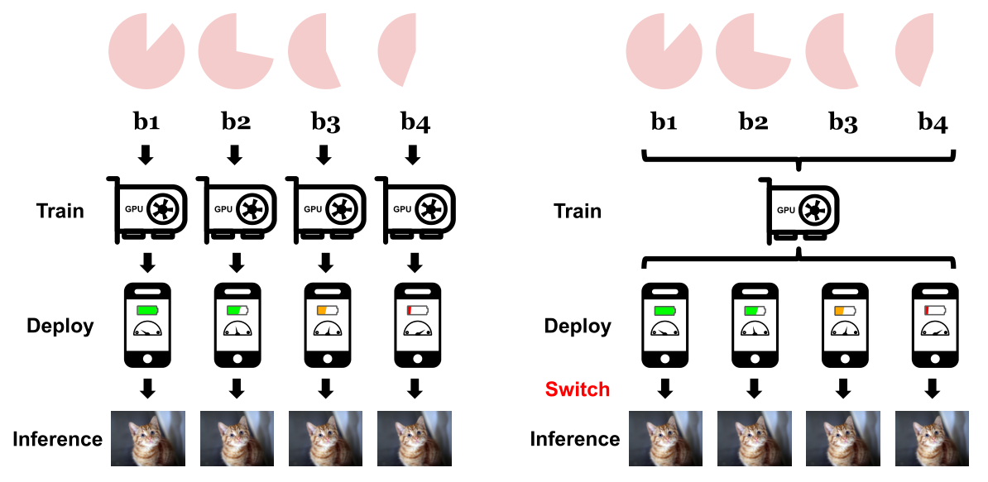
Motivation
Quantization With Multiple Compression Rates
AdaBits: Neural Network Quantization with Adaptive Bit-Widths
Figure 1. Deployment of neural networks with different bit-widths according to the computational budget.
Left: Individually train several quantized models with different bit-widths for each scenario. Right: Train a single model quantized with adaptive bit-widths and switch to the proper bit-width in real application based on the device condition.
Jin Q, Yang L, Liao Z. Adabits: Neural network quantization with adaptive bit-widths[C]//Proceedings of the IEEE/CVF Conference on Computer Vision and Pattern Recognition. 2020: 2146-2156

Slide 4
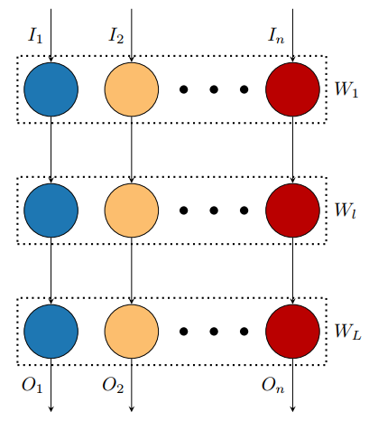
Problems
Using fixed-precision quantization for networks under multiple compression rates leads to additional errors.
Figure 2. Adabits: A single network can be quantized to any of n bit-widths at runtime. All layers inside the network share the same bit-width.
Relations based on the shared network structure is not fully utilized in joint training.
Adrian Bulat and Georgios Tzimiropoulos, “Bit-Mixer: Mixed-precision networks with runtime bit-width selection,” in 2021 IEEE/CVF Int. Conf. Comput. Vis., 2021, pp. 5188–5197.

Slide 5
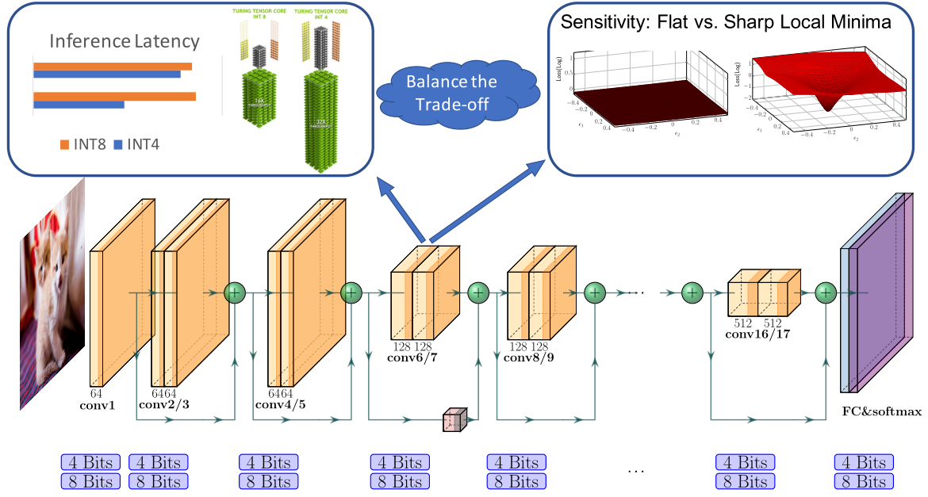
Mixed-Precision Quantization
Uniformly Quantization:
Each layer is quantized with same bit precision, which causes significant accuracy degradation.
Mixed-Precision Quantization:
Each layer is quantized with different bit precision.
Neural Architecture Search : formulate the mixed-precision configuration searching problem as a Neural Architecture Search problem and use the Differenti-able NAS (DNAS) method to efficiently explore the search space.
Hessian Aware Quantization: introduce an automatic way to find the mixed-precision settings based on second-order sensitivity of the model.
Figure 3. Illustration of mixed-precision quantization. In mixed-precision quantization the goal is to keep sensitive and efficient layers in higher precision, and only apply low-precision quantization to insensitive and inefficient layers.
Hawq:Hessian aware quantization of neural networks with mixed-precision. IEEE/CVF International Conference on Computer Vision, 2019.

Slide 6
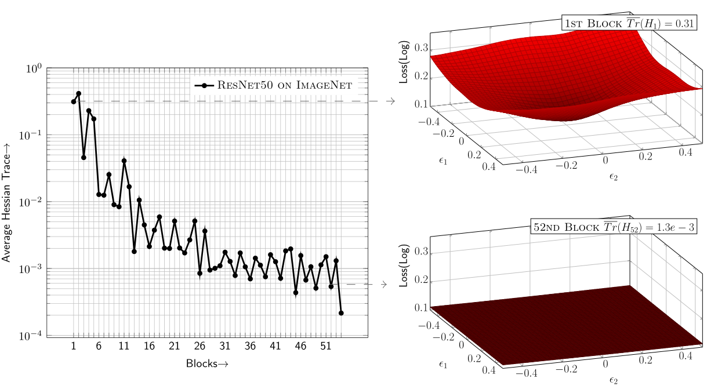
Hessian Aware Quantization
HAWQ-V2: Hessian Aware trace-Weighted Quantization of Neural Networks (NeurIPS 2020)
Measure of sensitivity: Average Hessian trace
Figure 6. Average Hessian trace of different blocks in ResNet50 on ImageNet.

Slide 7
Outline
1
Introduction and Related Works
2
Methods
3
Experiments

Slide 8
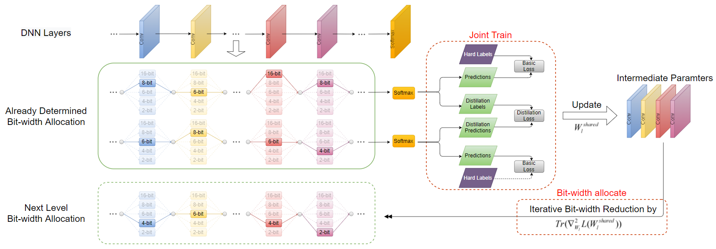
Overview
We develop a progressive bit-width allocation strategy to jointly optimize mixed-precision quantization of different layers under multiple compression rates.
We improve joint training via knowledge distillation to further exploit the correlations between quantized networks under different compression rates.
We present a switchable quantization step size (S-QS) scheme to accommodate to mixed quantization under different compressed rates.
Figure 7. Progressive joint training scheme which progressively determines the mixed precision bit-width allocations of the neural network from low to high compression rates.

Slide 9
Progressive Bit-width Allocation Strategy
Step 1 Calculate the quantization sensitivity according
to the full-precision pre-trained network
Calculate the Hessian matrix $H$ of the neural network
Step 2 Calculate the bit-width allocation under the first
compression rate based on the quantization
sensitivity and fine-tune the quantized network
Select the layer with the lowest quantization sensitivity as
$$l^{∗}=\arg{mⅈ}n\frac{\operatorname{Tr}\left(H_{l}\right){\left\|ΔW_{l}^{∗}\right\|}_{2}^{2}}{n_{l}}$$
Step 3 Recalculate the bit-width allocation under the
next level compression rate based on the fine-
tuned network in previous step
Decrease the bit-width of this layer according to the
bit-width descent strategy (such as 32-16,16-8,8-6,6-4,4-2)
Update the
quantization sensitivity
Step 4 Train the network under the compression rate
which the bit-width allocation has been
determined jointly
Whether to reach the required
compression rate?
No
Step 5
Whether to determine bit-width
allocations under all compression rates?
No
Yes
Obtain the bit-width allocation under
The required compression rate
Yes
Step 6 Obtain the quantized network with multiple compression rates

Slide 10
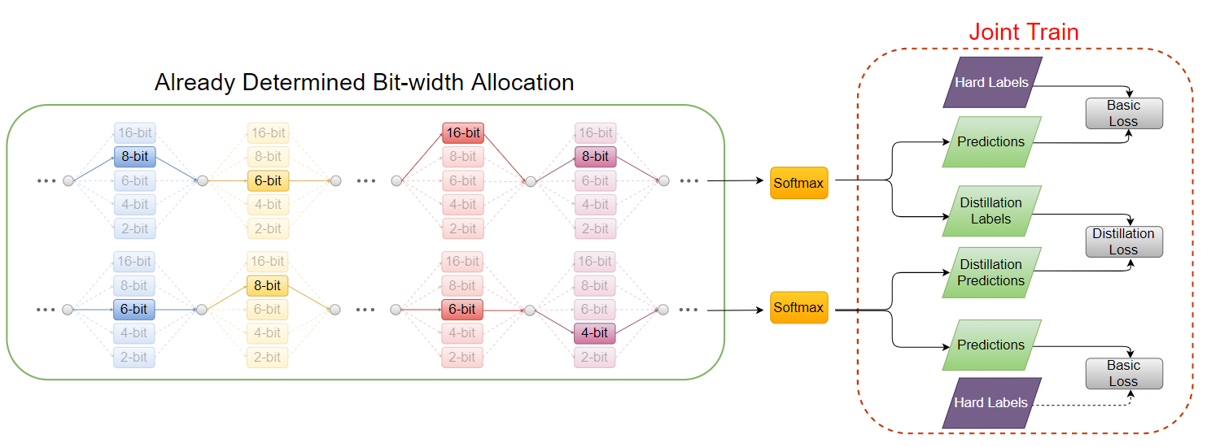
Joint Training with Knowledge Distillation
For two adjacent compression rates:
Teacher prediction
Student prediction
The loss function for distillation:

Slide 11
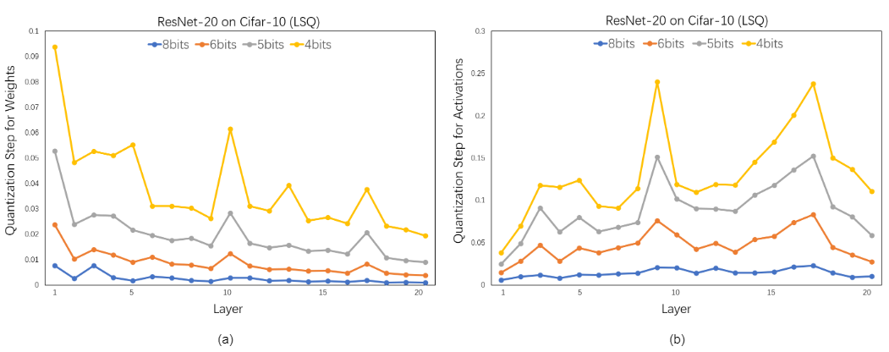
Switchable Quantization Step Size
Learn Step Size Quantization (LSQ):
Figure 8. The quantization step size of different layers of ResNet-20 on Cifar-10 at different bit-width allocations. (a) is the quantization step size of weights and (b) is the quantization step size of activations.
Steven K. Esser, Jeffrey L. McKinstry, Deepika Bablani, Rathinakumar Appuswamy, and Dharmendra S. Modha, “Learned step size quantization,” in 8th Int. Conf. Learn. Rep., 2020.

Slide 12
Switchable Quantization Step Size
Switchable Quantization Step Size (S-QS):

Slide 13
Outline
1
Introduction and Related Works
2
Methods
3
Experiments

Slide 14
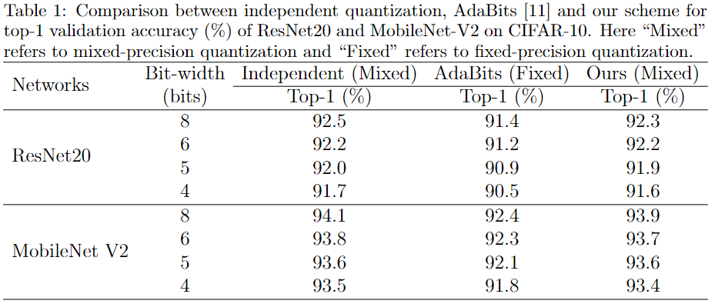
Experiment Results on CIFAR-10
Compared with independent mixed-precision quantization: Almost the same performance with accuracy loss less than 0.2%.
Compared with AdaBits: The proposed scheme with mixed-precision is superior under all the compression rates.

Slide 15
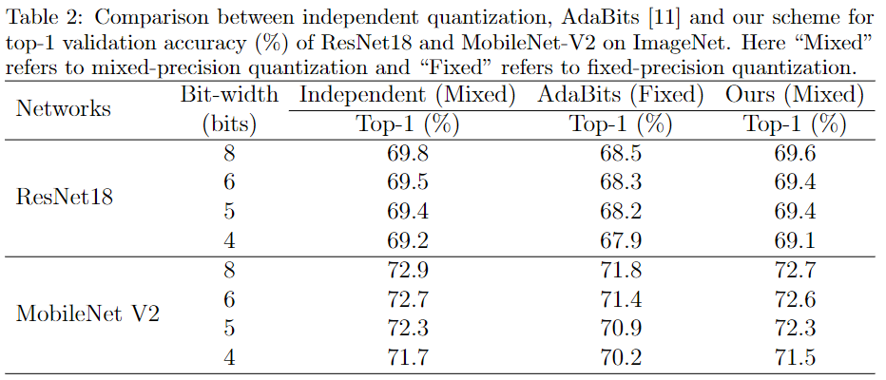
Experiment Results on ImageNet
Compared with independent mixed-precision quantization: Almost the same performance.
Compared with AdaBits: Larger gains in top-1 classification accuracy, i.e., about 1% on average for ResNet-18 and MobileNet-V2.

Slide 16
Scaling Factors of Knowledge distillation
A larger ratio of α/β can yield higher classification accuracy than a smaller ratio.
The input supervised data in progressive joint training contributes more to the final performance than the knowledge distillation information.

Slide 17
Conclusion
We propose a progressive joint training scheme to achieve a mixed-precision DNN quantization that can adapt to varying compression rate.
We achieve joint training for quantized networks under different compression rates via knowledge distillation to exploit their correlations based on the shared network structure.
We develop a progressive bit-width allocation with switchable quantization step size to enable mixed-precision quantization based on analytic sensitivity of network layers under multiple compression rates.

Slide 18
Q & A
Many Thanks

