Slide 1
Through-the-Wall Radar Signal Classification using Discriminative Dictionary Learning
A. Bouzerdoum, F. H. C. Tivive, and Jia Fei
School of Electrical, Computer and Telecommunications Engineering
University of Wollongong, Australia
Email: a.bouzerdoum@uow.edu.au, tivive@uow.edu.au, and jf981@uowmail.edu.au

Slide 2
Contents
1. Introduction
2. Signal Classification Method
3. Experimental Results
4. Conclusion

Slide 3
1. Introduction
Through-the-wall radar imaging (TWRI) aims to image objects behind opaque obstacles and inside enclosed building structures.
The TWR system transmits and receives EM signals to form a scene image.
target
Antenna array

Slide 4
1b. Applications and Challenges
Potential TWRI Applications
Search-and-rescue
Law enforcement
Imaging of building interiors
Challenges
Strong wall clutter ̶ several wall clutter removal methods have been developed: background subtraction, spatial filtering, subspace projection, etc.
Target Classification ̶ Change detection and micro-Doppler based techniques were proposed for moving targets.
However, there are only a few studies on classification of stationary targets (references in the paper).

Slide 5
1c. Existing TWRI Classification Methods
The existing TWRI classification approaches can be grouped into
image-based methods and
signal-based methods.
Image-based methods consist of several processing steps: 3D image formation, target segmentation, and feature extraction.
3D image formation is a time consuming process.
Signal-based methods extract features directly from the radar signal for classification.
Extraction of useful features characterizing the different target classes, i.e., finding useful features, is the most challenging task.

Slide 6
2. Signal Classification Method
The proposed signal classification method is based on dictionary learning and sparse representation.
It learns a set of data-driven bases to convert the received radar signal into a sparse representation.
It consists of three steps:
feature extraction,
dictionary learning and sparse representation,
classification.
Instead of applying the signal classification method directly to the HRRP* of the radar signal, two types of features are investigated:
magnitude spectrum of the HRRP, and
cepstrum coefficient of the HRRP.
* HRRP: high resolution range profile

Slide 7
2a. Feature Extraction
The HRRP of a radar signal is computed as
$z\left(k\right)=\frac{1}{M}\sum_{m=0}^{M−1}{\hat{y} (m)e^{jω_{m}(2kΔr)/c}} k=0,…,M−1$ (1)
where $\hat{y}$ is the antenna signal after wall clutter mitigation, $Δr$ is the range resolution, M is the number of range bins, and $c$ is the speed of light.
Magnitude spectrum of the HRRP
$v=ℱ\left\{\left|z\right|\right\}$. (2)
Cepstrum coefficient of the HRRP
$v= \left|ℱ^{−1}\left\{log⁡(ℱ\{\left|z\right|\right\}+1)\}\right|$, (3)
where $ℱ and ℱ^{−1}$ denote the DFT and inverse DFT.

Slide 8
2b. Sparse Representation and Dictionary Learning
The extracted feature vector $v$ is converted into a sparse representation by solving the following constrained optimization problem:
$x^{∗}=arg \min_{x}{{\left\|v−Dx\right\|}_{2}^{2}} s.t. {\left\|x\right\|}_{0}≤K$ (4)
where $K$ is the sparsity level and D is a data-driven dictionary.
The dictionary D and the sparse vector $x$ are obtained using the Label Consistent K-SVD (LC-KSVD)# dictionary learning technique.
LC-KSVD, an improvement on K-SVD, incorporates the label information of the data to improve the discriminability of the dictionary.
In addition, LC-KSVD jointly learns a dictionary and a classifier.
# Z. Jiang, Z. Lin, and L. S. Davis, “Label consistent K-SVD: learning a discriminative dictionary f or recognition,” IEEE Trans. on PAMI, vol. 35, no. 11, pp. 2651-2664, 2013.

Slide 9
2c. LC-KSVD
LC-KSVD performs dictionary learning and classifier training by solving the following constrained optimization problem:
$$\left\langle D^{∗},W^{∗},A^{∗},X^{∗}\right\rangle =arg \min_{D,W,A,X}{{\left\|V−DX\right\|}_{F}^{2}+α{\left\|Q−AX\right\|}_{F}^{2}+β{\left\|H−WX\right\|}_{F}^{2}}$$
s.t. ${\left\|x_{i}\right\|}_{0}≤K, ∀i$ (5)
$V=[v_{1},…,v_{P}]$ ̶ matrix of features for P antenna signals,
$X=[x_{1},…,x_{P}]$ ̶ matrix of sparse representations,
$Q$ ̶ discriminative sparse-code matrix,
$A$ ̶ linear transformation matrix,
$H$ ̶ label matrix,
$W$ ̶ weight matrix of the classifier

Slide 10
2c. LC-KSVD
$\left\langle D^{∗},W^{∗},A^{∗},X^{∗}\right\rangle =arg \min_{D,W,A,X}{{\left\|V−DX\right\|}_{F}^{2}+α{\left\|Q−AX\right\|}_{F}^{2}+β{\left\|H−WX\right\|}_{F}^{2}}$ (5)
${\left\|Y −DX\right\|}_{2}^{2}$ : reconstruction error (dictionary)
${\left\|Q −AX\right\|}_{2}^{2}$ : sparse-code error (discriminability)
${\left\|H −WX\right\|}_{2}^{2}$ : classification error (classifier)
$α$ and $β$ : regularization parameters (here $α=$ 16 and $β=4$)
Problem (5) can be re-written as
$\left\langle D^{∗},W^{∗},A^{∗},X^{∗}\right\rangle =arg \min_{D,W,A,X}{{\left\|\left(\begin{matrix}V \\ \sqrt{α}Q \\ \sqrt{β}H\end{matrix}\right)−\left(\begin{matrix}D \\ \sqrt{α}A \\ \sqrt{β}W\end{matrix}\right)X\right\|}_{F}^{2}}$ s.t. ${\left\|x_{i}\right\|}_{0}≤K, ∀i$ (6)
Problem (6) can now be solved using the iterative K-SVD algorithm.

Slide 11
2d. Classification
With the learnt dictionary $D^{∗}$ and the weight matrix $W^{∗}=[w_{ij}^{∗}]$, the classification of a radar signal is performed as follows:
select the radar signal whose energy is greater than $τ$,
$τ=\frac{1}{N}{\sum_{n=1}^{N}{\sum_{k=0}^{M−1}{\left|z_{n}\left(k\right)\right|}}}^{2}$,
where N is the number of received signal across the array aperture,
compute the feature vector $v$ of the selected radar signal,
estimate the G-dimensional sparse representation $x^{∗}=\left[x_{1}^{∗},…,x_{G}^{∗}\right]$,
$x^{∗}=arg \min_{x}{{\left\|v−D^{∗}x\right\|}_{2}^{2}} s.t. {\left\|x\right\|}_{0}≤K$ ,
determine the class label of the radar signal as
$l=\arg{\max_{i}{\sum_{j=1}^{G}{w_{ij}^{∗}x_{j}^{∗}}}} i=1,…, C$.

Slide 12
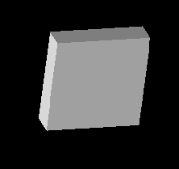
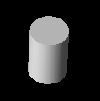
3. Experimental Setup
A TWRI scene with different types of targets placed behind the wall is simulated using the XFDTD software.
A 41-element antenna array is placed at a standoff distance of 1m in front of a homogeneous wall of thickness 0.15m.
A radar signal with a bandwidth of 1.1GHz centered at 2.75 GHz is used to image the TWRI scene.
Wall reflections are removed using background subtraction.
Five metallic objects are used as targets:
Dihedral
Trihedral
Square plate
Cylinder
Sphere

Slide 13
3. Experimental Setup
Each target is placed at five different positions in the scene: P1, P2, P3, P4, and P5.
Five-fold cross-validation is employed to estimate the classification and error rate .
Each validation fold:
radar signals from 4 positions are used for training, and
radar signals from the remaining position are used for testing.
The classification rates of the five different test sets are combined together to obtain the final rate.

Slide 14
3a. Performance of the Feature Extraction Methods
Three types of features are investigated:
magnitude of the HRRP,
magnitude of the Fourier coefficient of HRRP
cepstrum coefficient of HRRP
The classification rate of LC-KSVD for different features:
Cepstrum and magnitude Fourier coefficients achieve better CR than the magnitude of HRRP.
Cepstrum features are used in the remaining experiments.
Feature | Classification rate
Cepstrum coefficient of HRRP | 96.0%
Magnitude Fourier coefficient of HRRP | 93.9%
Magnitude of HRRP | 87.9%

Slide 15
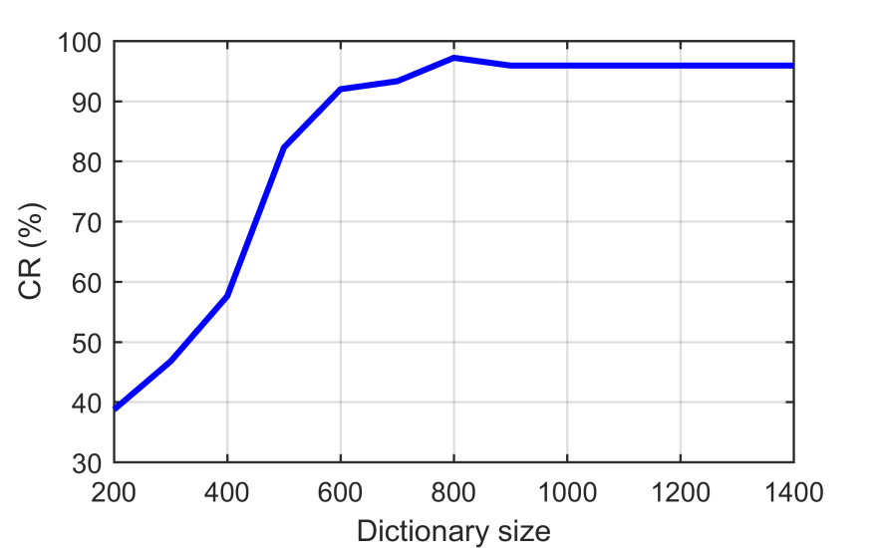
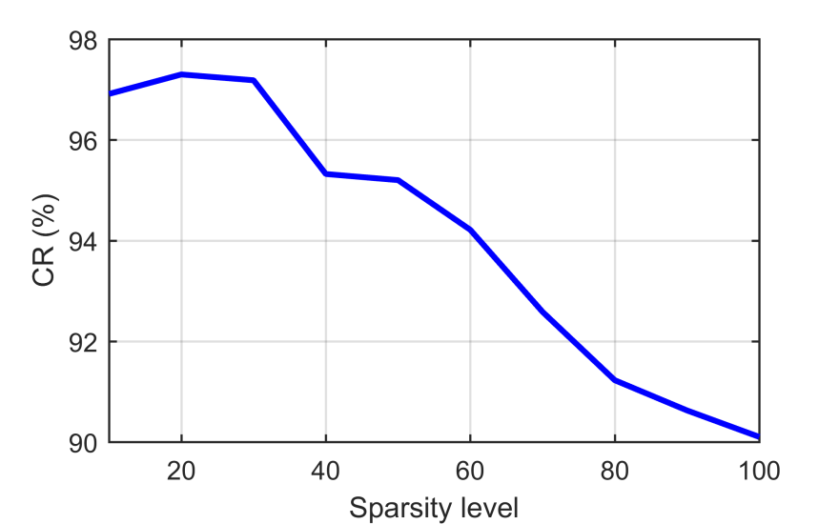
3b. Dictionary size and Sparsity Level of LC-KSVD
Classification rate (CR) of LC-KSVD as a function of the dictionary size.
LC-KSVD achieves the highest CR when the dictionary size reaches 800.
Further increasing the number of atoms in the dictionary barely changes the CR.
Classification rate of LC-KSVD as a function of the sparsity level.
A sparsity level between 10 to 30 achieves CR around 97%.
Beyond a sparsity level of 30, the CR of LC-KSVD decreases.

Slide 16
3c. Effect of Target Position on Classification Rate
Radar signals from four positions are used for training and the remaining position is kept for testing.
The low CR at P3 may be due to signal attenuation, which has not been learnt by LC-KSVD.
To improve the CR at P3 position,
a normalization technique can be used before LC-KSVD,
or we can use additional signals at that particular range to learn the dictionary.
 | Target Position
 | P1 | P2 | P3 | P4 | P5
Classification rate | 100% | 100% | 93% | 100% | 100%

Slide 17
3d. Confusion Matrix of LC-KSVD
The confusion matrix with the overall CRs of different target types.
The highest error rate happens when the dihedral is classified as a plate.
Therefore, a separate classifier can be trained to distinguish between a dihedral and a plate.
 | Predicted (%)
 |  | Plate | Cylinder | Dihedral | Sphere | Trihedral
 | Plate | 100 | 0 | 0 | 0 | 0
 | Cylinder | 2.6 | 97.4 | 0 | 0 | 0
 | Dihedral | 5.3 | 0 | 94.7 | 0 | 0
 | Sphere | 0 | 0 | 0 | 100 | 0
 | Trihedral | 0 | 0 | 1.7 | 0 | 98.3
Actual (%)

Slide 18
4. Conclusion
A signal classification method was proposed for through-the-wall radar imaging, without recourse to image formation.
The classification method employs LC-KSVD to jointly learn a discriminative dictionary and a classifier.
Three types of features extracted from HRRP were considered: HRRP magnitude, magnitude of Fourier coefficients and Cepstrum.
Cepstrum features yields the highest classification rate of 96.0%.
Classified 5 target types placed at 5 different locations behind a wall:
sphere (100%), plate (100%), cylinder (97.4%),
trihedral (98.3 %), and dihedral (94.7%).

Slide 19
Acknowledgement
This work is supported by a grant from
Australian Research Council (ARC)

