Slide 1
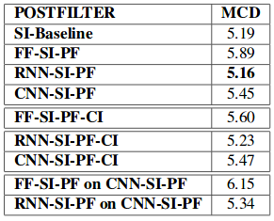
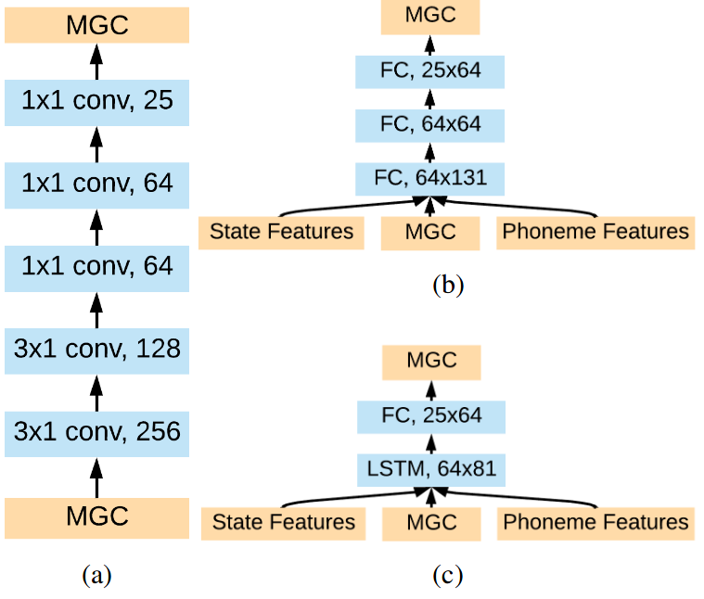
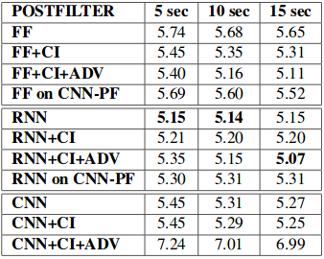
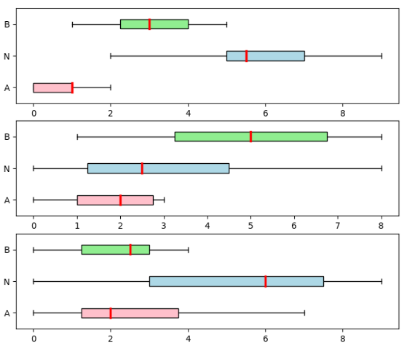
DNN-BASED SPEAKER-ADAPTIVE POSTFILTERING WITH LIMITED ADAPTATION DATA FOR STATISTICAL SPEECH SYNTHESIS SYSTEMS
Mirac Goksu Ozturk¹, Okan Ulusoy¹, Cenk Demiroglu²
Bogazici University¹, Ozyegin University², Istanbul, TURKEY
Abstract
Results
Deep neural networks (DNNs) have been successfully deployed for acoustic modelling in statistical parametric speech synthesis (SPSS) systems. Moreover, DNN-based postfilters (PF) have also been shown to outperform conventional postfilters that are widely used in SPSS systems for increasing the quality of synthesized speech. However, existing DNN-based postfilters are trained with speaker-dependent databases. Given that SPSS systems can rapidly adapt to new speakers from generic models, there is a need for DNN-based postfilters that can adapt to new speakers with minimal adaptation data. Here, we compare DNN-, RNN-, and CNN-based postfilters together with adversarial (GAN) training and cluster-based initialization (CI) for rapid adaptation. Results indicate that the feedforward (FF) DNN, together with GAN and CI, significantly outperforms the other recently proposed postfilters.
Figure 1: Generation of enhanced acoustic features.
Table 1: Mel cepstral distortion (MCD) scores of the speaker-independent postfilters with and without cluster-based initialization (CI) are shown. Scores for tandem use of FF- and RNN-based postfilters with the CNN-based postfilter are also shown.
Previously proposed DNN-based postfilters were trained for speaker independent systems where large amount of data is available for a single speaker.
A major advantage of the SPSS approach is its ability to adapt to different speakers with limited amounts of data.
To retain the rapid adaptation advantage of SPSS, post-filters that perform well with few shots of data is needed.
3 architectures are compared: FF, CNN, and RNN. Networks are trained with and without the GAN approach. Moreover, a cluster-based initialization method is used where the postfilter is initialized with a model that is trained with speakers similar to the target speaker.
1.3. CNN Network
Batch normalization layers followed by ReLU nonlinearities are used between the convolutional layers
Different from DNN-based and RNN-based postfilters, state and phoneme features are not used as inputs.
A T×M feature matrix is used at the input producing a reconstructed T×M matrix at the output.
DNN Architectures ( Postfilters )
Adaptation
Cluster-Based Initialization
Because adaptation is performed with very limited data, the optimization algorithm can quickly fall into a nearby local optima.
Thus, good initialization is important to improve the performance. We hypothesized that a PF model that is pre-adapted with the speakers in the training set whose voice characteristics are similar to a target speaker can be a better initialization for the target speaker’s PF model than a more general initialization.
We clustered the reference speakers into 5 groups using i-vectors with the k-means method.
Adversarial Training
When GAN is not used, the PF is trained using the standard Mean Squared Error (MSE) loss as below:
In the adversarial approach, in addition to the MSE loss, a binary cross entropy loss function is used.
The loss function with the adversarial approach is below where EL_{MSE} and EL_{BCE} are the expected values of MSE and binary cross entropy losses. ap_{cpf} is the prediction of the adversarial network when its input is the parameters generated by the PF network.
Figure 2: (a) CNN-based postfilter, (b) Feedforward postfilter,(c) RNN-based postfilter
Introduction
DNN Architectures ( of Postfilters )
Let c= [c^{T},∆c^{T},∆²c^{T}]^{T} be the output vector of the baseline network model where c^{T},∆c^{T},∆²c^{T} are the cepstral,delta-cepstral and delta-delta-cepstral coefficients, and pn and st be the phoneme and the state information of utterance. We used T, M, P, S to denote the number of frames in an utterance,the number of MGC coefficients, the size of pn vector, and the size of st vector, respectively.
Feedforward Network
Fully-connected model with one hidden layer having 64 units.
Since the PF structure does not include any recurrent layer, the context information is provided to the PF model by giving the previous,c_{i−1}, and the next frame’s,c_{i+1}, feature vectors together with the current feature vector c_{i}.
In addition, the PF model also takes pni and sti as inputs, resulting in a (3M+P+S) dimensional input vector I_{i}= [c_{i-1}^{T}, c_{i}^{T},c_{i+1}^{T}, pn_{i}^{T}, st_{i}^{T}]^{T} whereas the corresponding output vector is M dimensional c_{pfi}.
RNN Network
A fully connected layer on top of a long short-term memory (LSTM).
T×(M+P+S) matrix including state, phoneme and MGC features is used sequentially, one frame at a time, at the input producing an M-dimensional vector at the output for each input frame.
Table 2: Mel cepstral distortion (MCD) scores of the speaker-adapted postfilters with 5, 10, and 15 seconds of adaptation data.
Methods
Experimental Setup
All experiments were conducted on the Wall Street Journal(WSJ) speech database 154 features including 25 Mel-Generalized Cepstrum Coefficients (MGC), 1 log of fundamental frequency (LF0) and 25 Band Aperiodicity (BAP) .
Together with their delta and delta-delta features were extracted from speech data at a sampling rate of 16 KHz and 5 msec frame rate.
5-state HMM model was applied to model and align phonemes.
Total of 156 speakers, 135 of them were used for training, whereas the test and adaptation processes were performed on the remaining 21 target speakers’ data. Adaptation was performed with 5, 10, and 15 seconds of data.
Figure 3: In the top figure, SI-baseline system (A) is compared with the RNN-SI postfilter (B) using the AB test. Significance(p-value) is 0.01. In the middle figure, SI-baseline system (A) is compared with the RNN-SI postfilter (B) using the AB test. Significance (p-value) is 0.01. In the bottom figure, RNN-SI postfilter (A) is compared with the CNN-SI postfilter (B)using the AB test. Significance (p-value) is 0.55

