Slide 1
LOFT: Latent Space Optimization and Generator Fine-Tuning for Defending Against Deepfakes
Shaoyou Zeng, Wenhao Wang, Fangjun Huang✉ Yanmei Fang
School of Cyber Science and Technology, Shenzhen Campus of Sun Yat-sen University, Shenzhen, China

Slide 2
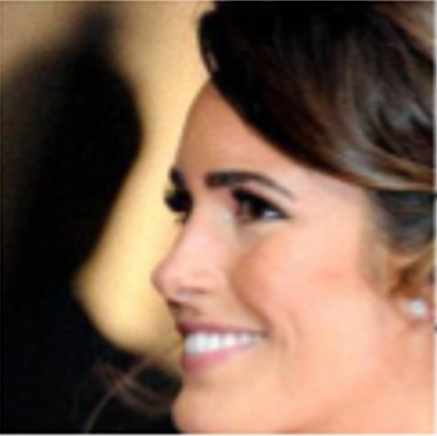
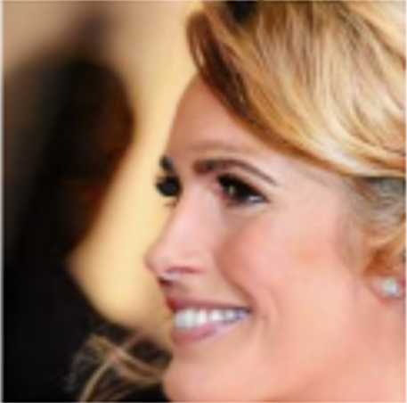
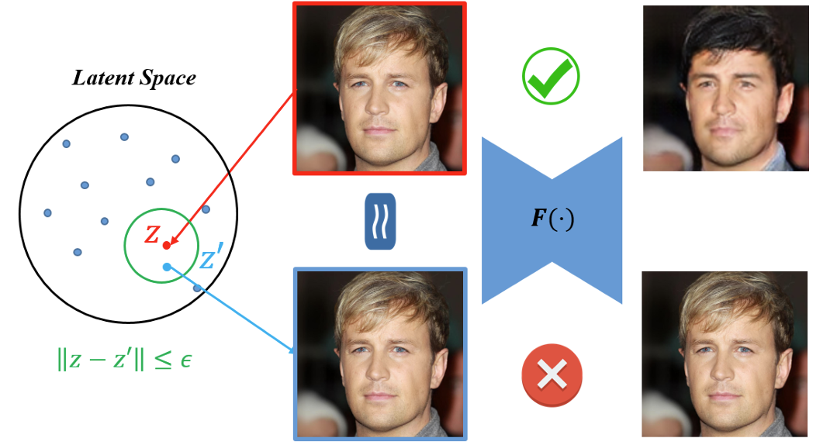
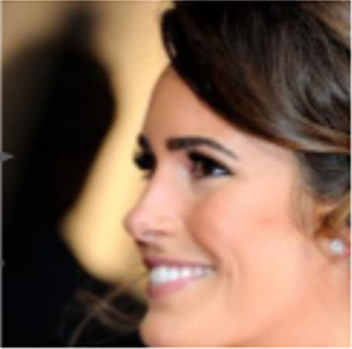
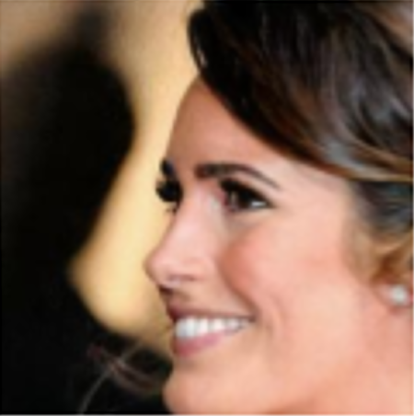
Motivation
Original image
Deepfake output
Original Image
Deepfake Output
Add
adversarial noise
Adversarial image
Protected output
Reconstructed input
Protected output
Proactive Defense with adding noise^{[1]}
LAE^{[2]}
[1] Yeh, et al. Attack as the best defense: Nullifying image-to-image translation gans via limit-aware adversarial attack, ICCV, 2021
[2] He, et al. Defeating deepfakes via adversarial visual reconstruction, ACM MM, 2022

Slide 3
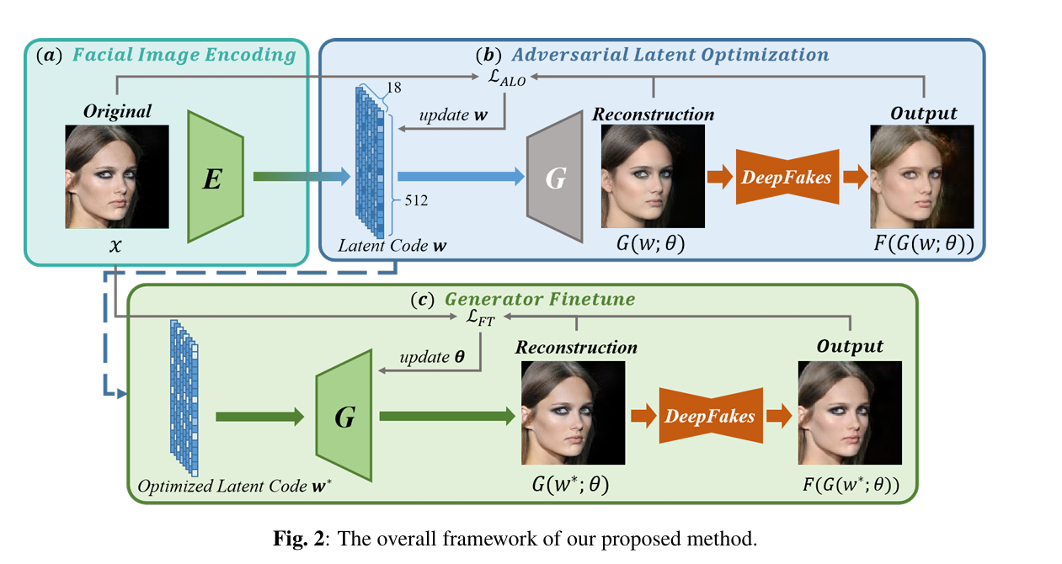
Method
Core Idea:
Facial Image Encoding
Adversarial Latent Optimization
Generator Fine-Tuning

Slide 4
Motivation
Facial Image Encoding
(1)

Slide 5
Motivation
Adversarial Latent Optimization
(2)
(3)
(4)
(5)

Slide 6
Motivation
Generator Fine-Tuning
(6)
(7)

Slide 7
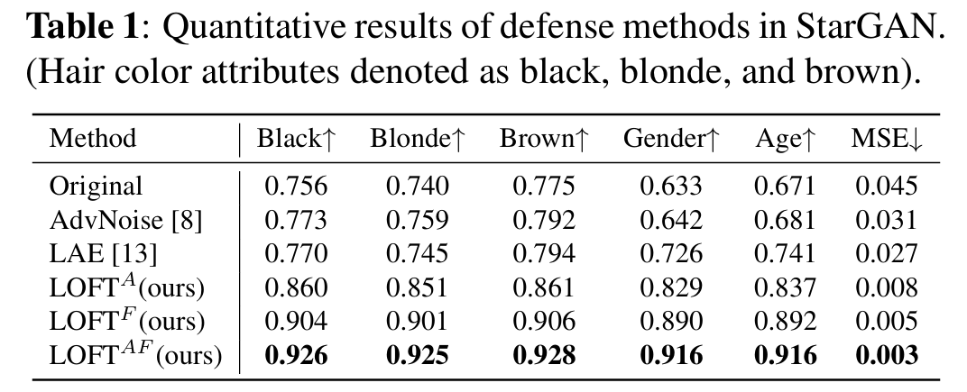
Quantitative result of defense methods in StarGAN

Slide 8
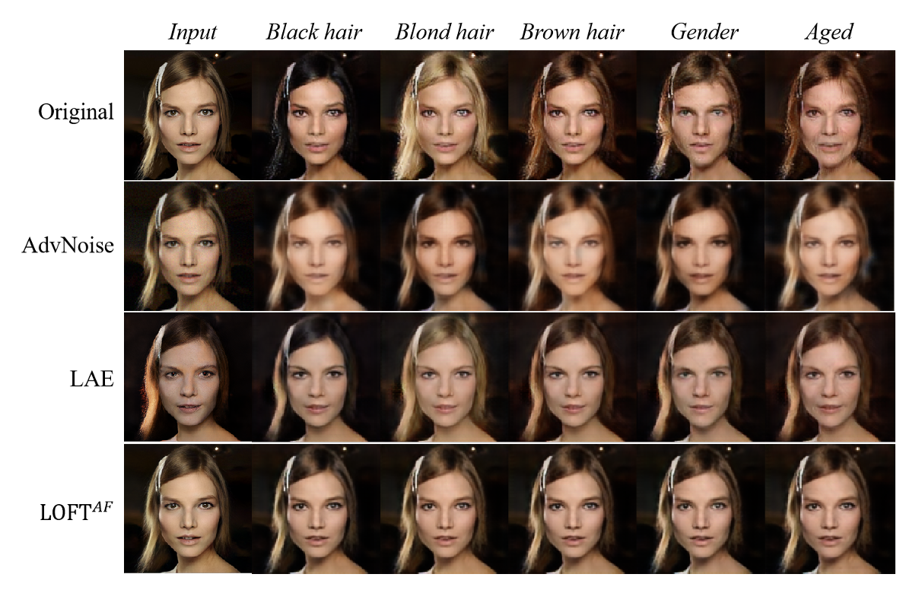
Visualization of StarGAN
Fig. 3: Example of reconstruction and defense against StarGAN attribute editing. The first column presents the input image, i.e., original image, adversarial noise-added image, and reconstructed images by LAE and ${LOFT}^{AF}$ .

Slide 9
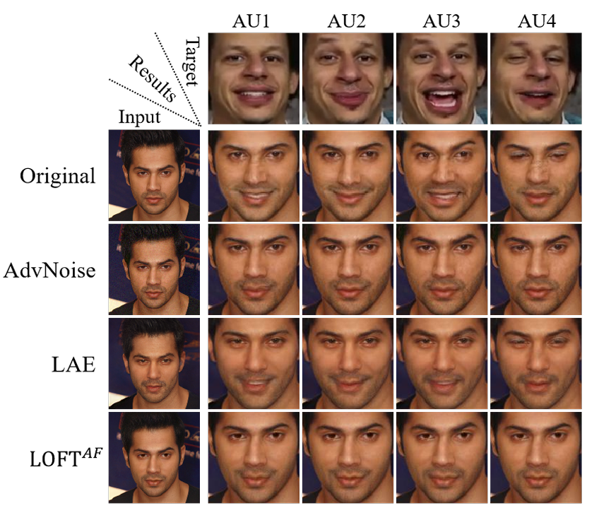
Visualization of GANimation
Fig. 4: Visual demonstrations of defense against GANimation: The first row displays target expressions, the second row displays modifications on the original image, and the remaining rows present modifications on images using three different defense methods.

Slide 10
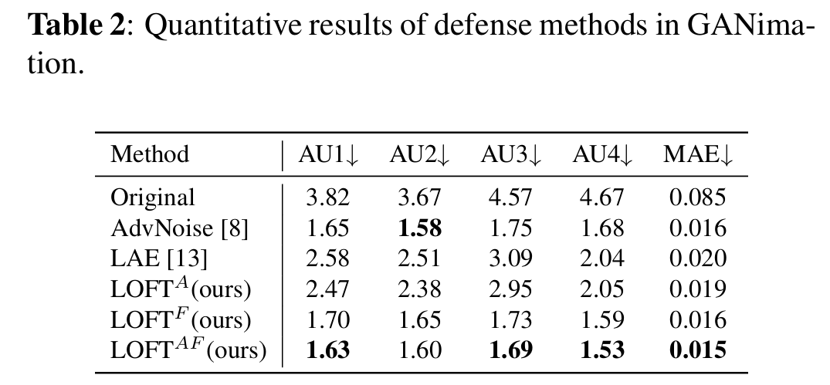
Quantitative Results of defense methods in GANimation

Slide 11
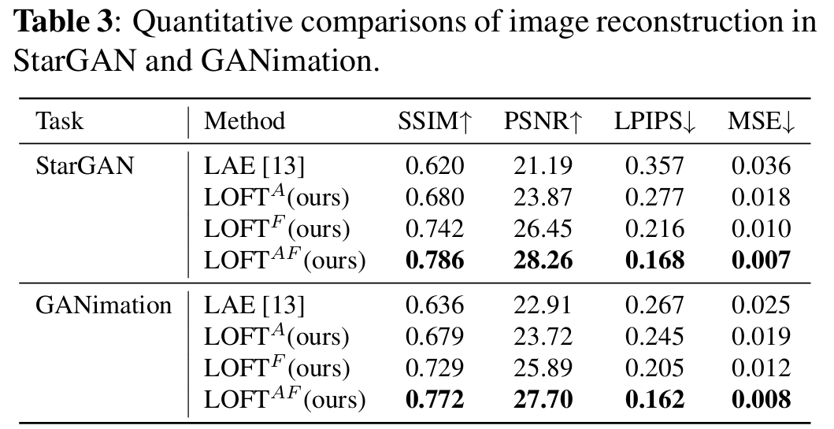
Visualization of image reconstruction

Slide 12
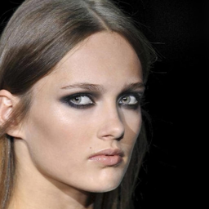
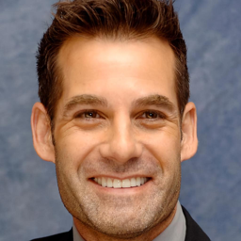
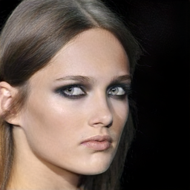
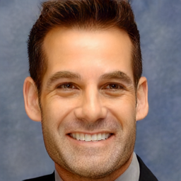
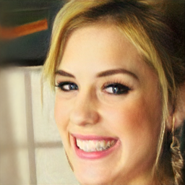
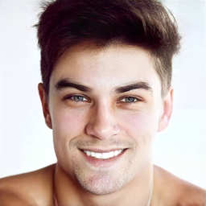
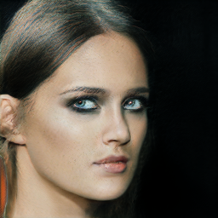
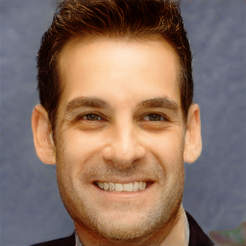
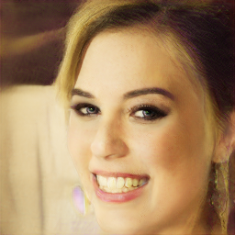
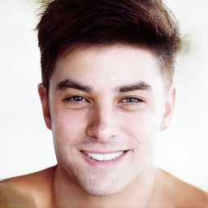
Visualization of image reconstruction
Original
Fig. 5: Visual demonstrations of the restricted images
$${\text{LOFT}}^{AF}$$
LAE

Slide 13
Thank you
for listening!

