Slide 1
Joint Regression Modeling and Sparse Spatial Refinement for High-Quality Reconstruction of Distorted Color Images

Slide 2
Outline
Introduction and Problem Statement
State-of-the-Art Techniques
Novel Joint Regression Modeling and Sparse Spatial Refinement
Evaluation
Conclusion and Outlook

Slide 3
PROBLEM STATEMENT
Introduction

Slide 4
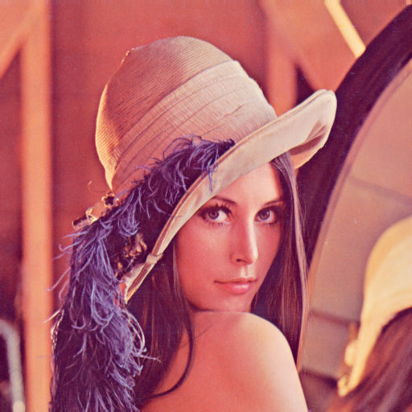
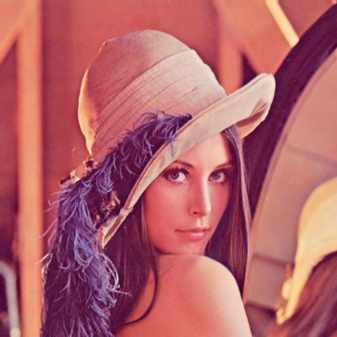
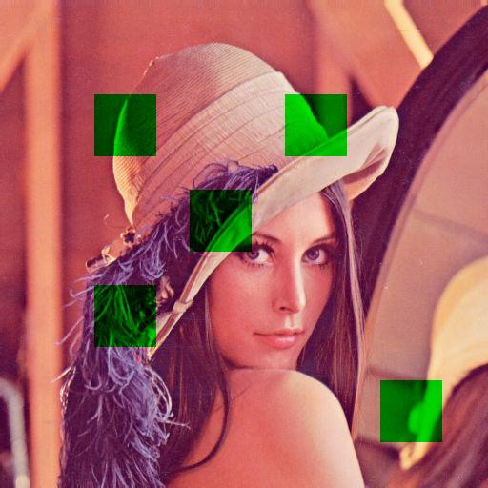
Use Case: Error Concealment
Wireless Video Communication
→ Transmission errors

Slide 5
Use Case: Error Concealment
Wireless Video Communication
Depending on codec, profile, and distortion
Distortions in single/multiple color channels
Reconstruction shown for RGB (similar performance of proposed method for YCbCr)
Traditionally: Spatial error concealment
For at least one undistorted color component
Cross-color reconstruction possible

Slide 6
Use Case: Multi-Color Multi-Camera Setups
[1] Kiesel et al., “Color Channel Reconstruction for Multi-Color Multi-
View Images Using Disparity and Color Similarity-based Local Linear
Regression,” in Proc. Electronic Imaging - Image Sensors and Imaging
Systems Conference, Jan. 2018
Registration and Projection
Color Channel Reconstruction

Slide 7
Multi-Color Multi-Camera Setups
?
Registered and projected image
Reconstructed image

Slide 8
THE COMMON WAY
State-of-the-Art Techniques

Slide 9
State-of-the-Art Reconstruction I
Exploit spatial similarity:
Very well investigated problem in inpainting and error concealment
Popular approach: Total Variation (TV) [2]
Better (in terms of quality): Frequency Selective Extrapolation (FSE) [3]
Sparse model: $g=\sum_{k∈𝒦}{c_{k}φ_{k}}$, with expansion coefficients $c_{k}$, Fourier basis functions $φ_{k}$, and set $𝒦$
Goal: Estimation of coefficients $c_{k}$
[2] Dahl et al., “Algorithms and software for total variation image reconstruction via
first-order methods,” in Numerical Algorithms, Jul. 2009
[3] Genser et al., “Spectrally constrained frequency selective extrapolation for rapid
image error concealment,” in Proc. International Conference on Systems, Signals
and Image Processing, Jun. 2018

Slide 10
State-of-the-Art Reconstruction II
Reconstruct across color channels:
Idea: Color components highly correlated
Model for predicting missing information (using existing components)
State of the art: Color Similarity-Based Local Median Filtering (CSLMF) [1]
Pixel-wise processing of missing samples
Reconstruction → median-filtered local neighborhood
Reference channel supplies candidates
[1] Kiesel et al., “Color Channel Reconstruction for Multi-Color Multi-View Images Using Disparity and Color
Similarity-based Local Linear Regression,” in Proc. Electronic Imaging - Image Sensors and Imaging Systems
Conference, Jan. 2018

Slide 11
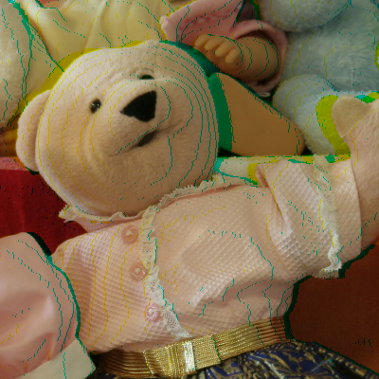
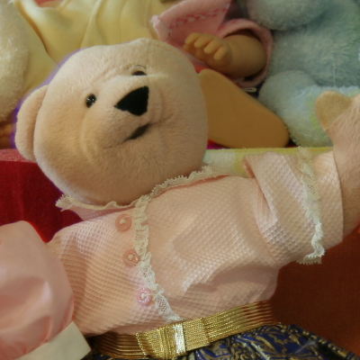
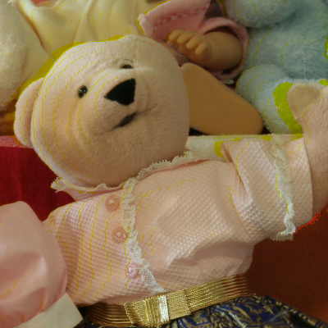
State-of-the-Art Reconstruction III
CSLMF vs. FSE (multi-camera setup):
Distorted (warped)
FSE
CSLMF

Slide 12
THE NOVEL SOLUTION APPROACH
Joint Regression Modeling and Sparse Spatial Refinement (JRR)

Slide 13
Idea
Cross-color reconstruction
Well suited for highly-correlated regions
Bad results for loosely connected color areas
Idea: Spatial extrapolation as refinement step after cross color reconstruction

Slide 14
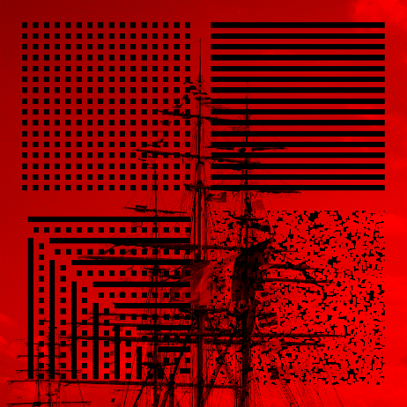
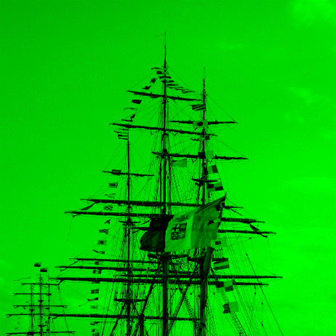
Overview of the Proposed Approach
Distorted channel
Reference channel
Optimized
Processing Order [4]
Spatial Refinement [3]
*
*
Prediction Error Modeling
Distorted channel
Reference channel
Finished?
No
Linear Regression Model
Yes
Reconstructed channel
[3] Genser et al., “Spectrally constrained frequency selective extrapolation for rapid image error concealment,” in Proc. International
Conference on Systems, Signals and Image Processing, Jun. 2018
[4] Seiler et al., “Optimized and parallelized processing order for improved frequency selective signal extrapolation,” in Proc. European
Signal Processing Conference, Aug. 2011

Slide 15
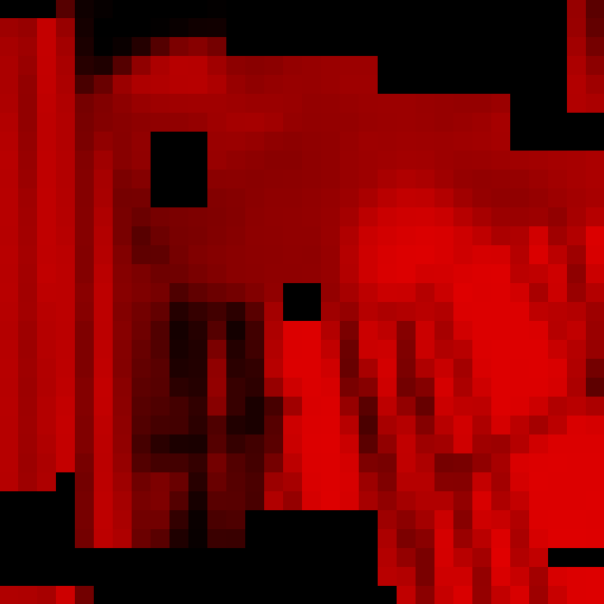
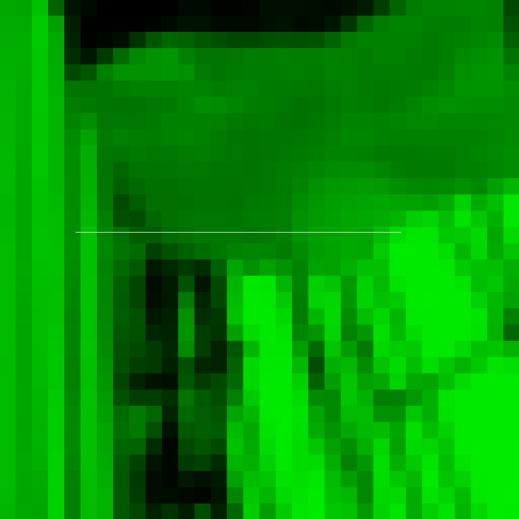
Processing Order
Distorted channel
Reference channel
Optimized
Processing Order [4]
Spatial Refinement [3]
*
*
Prediction Error Modeling
Distorted block $s$
Reference block $r$
Finished?
No
Linear Regression Model
Yes
Reconstructed channel
[3] Genser et al., “Spectrally constrained frequency selective extrapolation for rapid image error concealment,” in Proc. International
Conference on Systems, Signals and Image Processing, Jun. 2018
[4] Seiler et al., “Optimized and parallelized processing order for improved frequency selective signal extrapolation,” in Proc. European
Signal Processing Conference, Aug. 2011

Slide 16
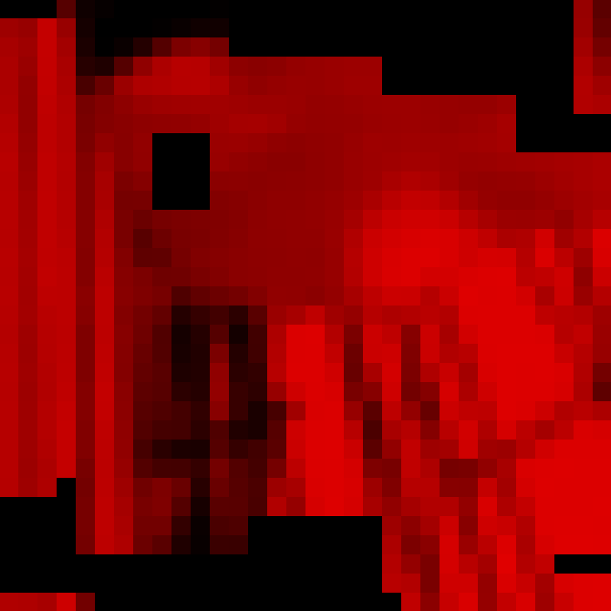
Cross-Color Prediction: Linear Regression Modeling
Distorted channel
Reference channel
Optimized
Processing Order [4]
Spatial Refinement [3]
*
*
Prediction Error Modeling
Reconstructed block (regression)
Reference block
Finished?
No
Linear Regression Model
Yes
Reconstructed channel
[3] Genser et al., “Spectrally constrained frequency selective extrapolation for rapid image error concealment,” in Proc. International
Conference on Systems, Signals and Image Processing, Jun. 2018
[4] Seiler et al., “Optimized and parallelized processing order for improved frequency selective signal extrapolation,” in Proc. European
Signal Processing Conference, Aug. 2011

Slide 17
Cross-Color Prediction: Linear Regression Modeling
Assume linear relation
Given: Distorted blocks $s$ and reference $r$
Aim: Find good reconstruction $\hat{s }$
Goal: Model prediction $\hat{s}≈p=ar+b$ (slope $a$, offset $b$)
Estimate $a$ and $b$ (least-squares)
Prediction replaces lost samples

Slide 18
Cross-Color Prediction: Prediction Error Modeling
Distorted channel
Reference channel
Quantify regression model quality
Spatial refinement for bad models
Optimized
Processing Order [4]
Spatial Refinement [3]
*
*
Prediction Error Modeling
Finished?
No
Linear Regression Model
Yes
Reconstructed channel
[3] Genser et al., “Spectrally constrained frequency selective extrapolation for rapid image error concealment,” in Proc. International
Conference on Systems, Signals and Image Processing, Jun. 2018
[4] Seiler et al., “Optimized and parallelized processing order for improved frequency selective signal extrapolation,” in Proc. European
Signal Processing Conference, Aug. 2011

Slide 19
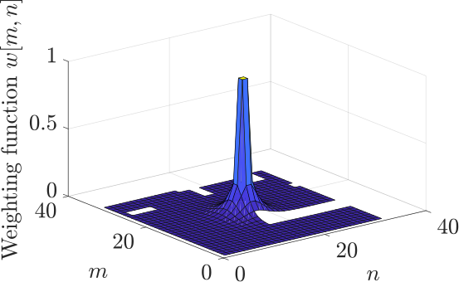
Cross-Color Prediction: Prediction Error Modeling
Measure model quality
Distorted block $s$ and reference $r$ share prediction support
Measure prediction error $e_{RMS}$ (Root-mean-squared error)
$$w\left[m,n\right]= \left\{\begin{aligned}{\hat{ρ}}^{\sqrt{(m−\frac{M−1}{2})^{2}+(n−\frac{N−1}{2})^{2}}}, \\ {δ \hat{ρ}}^{\sqrt{(m−\frac{M−1}{2})^{2}+(n−\frac{N−1}{2})^{2}}}, \\ 0, \\ 0,\end{aligned}\right.$$
$$w\left[m,n\right]= \left\{\begin{aligned}{\hat{ρ}}^{\sqrt{(m−\frac{M−1}{2})^{2}+(n−\frac{N−1}{2})^{2}}}, \\ {δ\hat{ρ}}^{\sqrt{(m−\frac{M−1}{2})^{2}+(n−\frac{N−1}{2})^{2}}}, \\ w_{fact}\max\left(0, 1−{w_{const} e}_{RMS}\right), \\ 0,\end{aligned}\right.$$
$$\left(m,n\right)∈ 𝒜$$
$$\left(m,n\right)∈ 𝒜$$
FSE:
JRR:
$$\left(m,n\right)∈ ℛ$$
$$\left(m,n\right)∈ ℛ$$
$$\left(m,n\right)∈ ℬ_{i}$$
$$\left(m,n\right)∈ ℬ_{i}$$
$$\left(m,n\right)∈ ℬ_{o}$$
$$\left(m,n\right)∈ ℬ_{o}$$

Slide 20
Spatial Refinement
Distorted channel
Reference channel
Optimized
Processing Order [4]
Spatial Refinement [3]
*
*
Prediction Error Modeling
Reconstructed block (regression)
Reference block
Finished?
No
Linear Regression Model
Apply state-of-the-art FSE [3]:
Regression model and adjacent pixels
Weighting function $w\left[m,n\right]$
Yes
Reconstructed channel

Slide 21
Spatial Refinement
Distorted channel
Reference channel
Optimized
Processing Order [4]
Spatial Refinement [3]
*
*
Prediction Error Modeling
Spatially refined reconstruction
Reference block
Finished?
No
Linear Regression Model
Yes
Reconstructed channel
[3] Genser et al., “Spectrally constrained frequency selective extrapolation for rapid image error concealment,” in Proc. International
Conference on Systems, Signals and Image Processing, Jun. 2018
[4] Seiler et al., “Optimized and parallelized processing order for improved frequency selective signal extrapolation,” in Proc. European
Signal Processing Conference, Aug. 2011

Slide 22
Overview of the Proposed Approach
Distorted channel
Reference channel
Optimized
Processing Order [4]
Spatial Refinement [3]
*
*
Prediction Error Modeling
Reconstructed channel
Reference channel
Finished?
No
Linear Regression Model
Yes
Reconstructed channel
[3] Genser et al., “Spectrally constrained frequency selective extrapolation for rapid image error concealment,” in Proc. International
Conference on Systems, Signals and Image Processing, Jun. 2018
[4] Seiler et al., “Optimized and parallelized processing order for improved frequency selective signal extrapolation,” in Proc. European
Signal Processing Conference, Aug. 2011

Slide 23
Performance Analysis
Evaluation

Slide 24
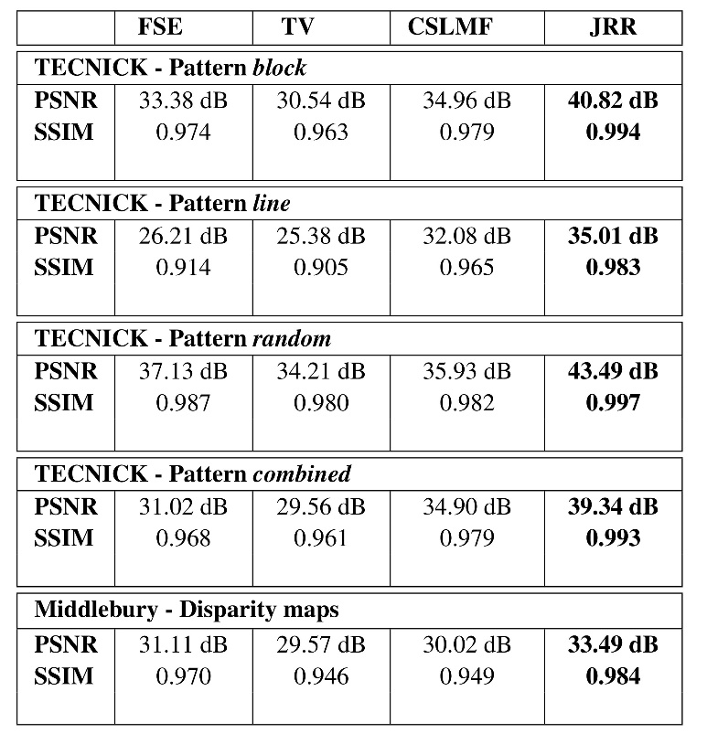
Objective Evaluation I
JRR:
Parameters trained on Kodak data, block losses
Evaluated on TECNICK and Middlebury
Outperforms:
State-of-the art error concealment algorithms
State-of-the-art color reconstruction approaches
Suited for all kind of error patterns
[3] [2] [1]

Slide 25
Objective Evaluation II
Computation time:
All methods given as MATLAB code
Averaged over 100 executions
Calculation time depends on FSE
Here: Reference implementation in MATLAB
But: FSE real time implementation in C++ [5]
JRR implementable (at least) in near real-time
[3] [2] [1]
[5] Genser et al., “Demonstration of rapid frequency selective reconstruction for image resolution
enhancement,” in Proc. IEEE International Conference on Image Processing, Sep. 2017

Slide 26
Visual Evaluation I
Ground truth
Distorted

Slide 27
Visual Evaluation II
Ground truth
State-of-the-art CSLMF [1]

Slide 28
Visual Evaluation III
Ground truth
State-of-the-art FSE [3]

Slide 29
Visual Evaluation IV
Ground truth
State-of-the-art TV [2]

Slide 30
Visual Evaluation V
Ground truth
Proposed JRR

Slide 31
AND FUTURE WORK
Conclusion

Slide 32
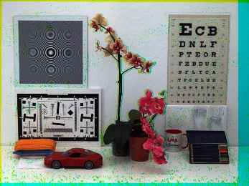
Conclusion
Distorted color components: E.g., in video coding or multi-camera setups
State-of-the-art techniques
Either cross-component or spatial reconstruction
Insufficient quality
Novel JRR algorithm: Hybrid model
Spatial and cross-color reconstruction
Outstanding visual and objective quality

Slide 33
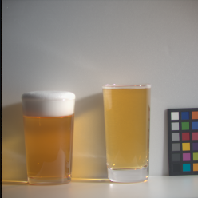
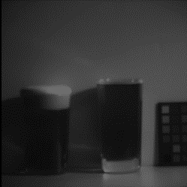
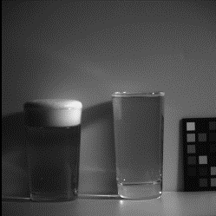
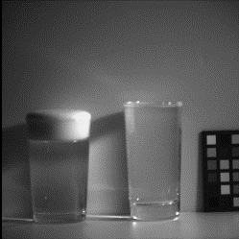
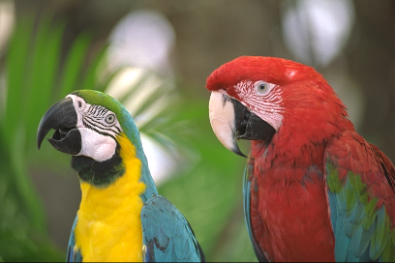
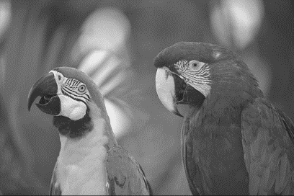
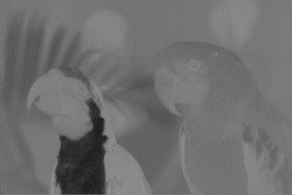
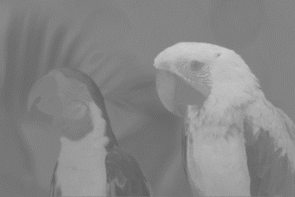
Outlook
Up to now: reconstruction only for color images
What about multi-/hyper-spectral images?
Influence of (linear) color transformations, e.g., YCbCr?
→
→

Slide 34
Reference Implementation
JRR framework :
Color component reconstruction using a reference channel
https://gitlab.lms.tf.fau.de/lms/jrr
FSE/FSR framework:
Highly flexible framework (reconstruction, inpainting, error concealment, compressed sensing)
https://gitlab.lms.tf.fau.de/lms/rapid-fsr

