Slide 1
Brief
Related work
Methods
Experiments
Conclusion
MICRO-EXPRESSION RECOGNITION
BASED ON
VIDEO MOTION MAGNIFICATION AND
PRE-TRAINED NEURAL NETWORK
Mengjiong Bai, Roland Goecke, Damith Herath
Human-Centred Technology, Faculty of Science and Technology, University of Canberra

Slide 2
Brief
Related work
Methods
Experiments
Conclusion
OVERVIEW

Slide 3
Outline
based on amplitude and phase, respectively, to amplify small facial movements
apply the pre-trained VGGFace2 model to transfer learn the magnified micro-expression movement
encode the spatial information and decode the spatial and temporal information by Bi-LSTM model

Slide 4
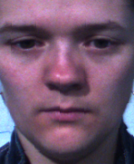
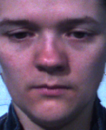
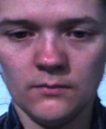
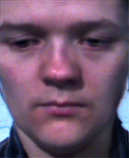
Dataset -- The spontaneous micro-expression corpus (SMIC)
contains High Speed (HS) micro-expression samples recorded at 100fps.
shortest recorded expression was about 0.11s (= 11 frames)
Average expression length was about 0.30s (= 29 frames).
In total, 164 videos in the SMIC HS, 70 for negative, 51 for positive and 43 for surprise [17].
Data pre-process:
Extract the fixed-length video segments {S0,S1, …, Sn} from original video
V={f0, f1, …, fn} by overlapping sliding window
S1
S2
S3
S4
S5
S6
S7
S8
S9
[17]T. Pfister, X. Li, G. Zhao, and M. Pietik¨ainen, “Recognising spontaneous facial micro-expressions,” IEEE International Conference on Computer Vision, p.1449–1456, 6 2011

Slide 5
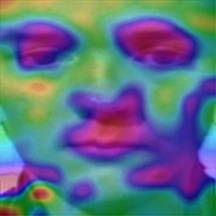
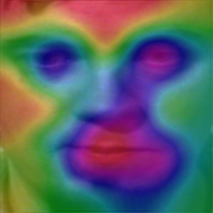
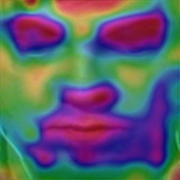
Motion Magnification:
Phase-based Motion magnification, α = 10
I (x, t) → an image profile at location x and time t
δ (t) → translation motion of the image.
I (x, t) = f (x+ δ(t)) while I (x, t) = f (x)
α → amplification factor
Î (x, t) = f ((x) + (1+α) δ(t))
final goal is synthesising the signal based on the α[7]
[7] H.-Y. Wu, M. Rubinstein, E. Shih, J. Guttag, F. Durand, and W. Freeman, “Eulerian video magnification for revealing subtle changes in the world,” ACM Trans. Graphics, vol. 31, no. 4, pp. 1–8, Jul 2012.

Slide 6
Visualize operating mechanism
negative
positive
surprise
Activation heat maps to visualize the operating mechanism by highlighted different face regions correspond to different micro-expressions. For negative, it focuses more on the eyes; for positive, on the mouth corners; and for surprise, more on the eyebrows.

Slide 7
Related work – Spatial temporal model
Khor et al. used optical flow to learn the spatial relationships, plus VGG-16 and pre-trained VGGFace models to enrich the input channel and deep feature stacking [3].
Xia et al. proposed a model consisting of several recurrent convolutional layers to connect the spatial and temporal domains. The connectivity occurred both on pixels within the micro-expression area and optical flow [4].
In contrast, Verburg & Menkovski only implemented RNN on the histogram of oriented optical flow features and encoded temporal movements within selected facial regions, reducing required computations and time to learn the model [5].
Lei et al. used a graph-temporal convolutional network (Graph-TCN) to manage the graph structures developed on the facial landmarks, extracting both node and edge features from dual channels [6].
[3] H.-Q. Khor, J. See, R.C.W. Phan, and W. Lin, “Enriched Long-term Recurrent Convolutional Network for Facial Micro-Expression Recognition,” in 2018 13th IEEE Int. Conf. Automatic Face & Gesture Recognition (FG 2018), 2018.
[4] Z. Xia, X. Hong, X. Gao, X. Feng, and G. Zhao, “Spatiotemporal Recurrent Convolutional Networks for Recognizing Spontaneous Micro-expressions,” IEEE Trans. Multimedia, Mar. 2020.
[5] M. Verburg and V. Menkovski, “Micro-expression detection in long videos using optical flow and recurrent neural networks,” in 2019 14th IEEE Int. Conf. Automatic Face Gesture Recognition (FG 2019), 2019.
[6] L. Lei, J. Li, T. Chen, and S. Li, “A Novel Graph-TCN with a Graph Structured Representation for Microexpression Recognition,” in Proc. 28th ACM Int. Conf. Multimedia. Oct 2020, ACM.

Slide 8
Related work – Amplify the facial movements
Wu et al. proposed Eulerian video magnification (EVM) to reveal the subtle motions in a video by decomposing the spatial information and amplifying the specific amplitude bandpass by temporal filters. This method outperforms the Lagrangian perspective algorithm. However, the error would grow quadratically with the increase of magnification factor α. [7]
To counter these issues, Wadhwa et al. proposed a novel method to amplify the motion by computing and enhancing the phase variations in the selected temporal bandpass. This phase-based algorithm supports larger amplification factors and is notably less sensitive to noise. [8]
[7] H.-Y. Wu, M. Rubinstein, E. Shih, J. Guttag, F. Durand,and W. Freeman, “Eulerian video magnification for revealing subtle changes in the world,” ACM Trans. Graphics, vol. 31, no. 4, pp. 1–8, Jul 2012.
[8] N. Wadhwa, M. Rubinstein, F. Durand, and W.T. Freeman, “Phase-based video motion processing,” ACM Trans. Graphics, vol. 32, no. 4, pp. 1, Jul 2013

Slide 9
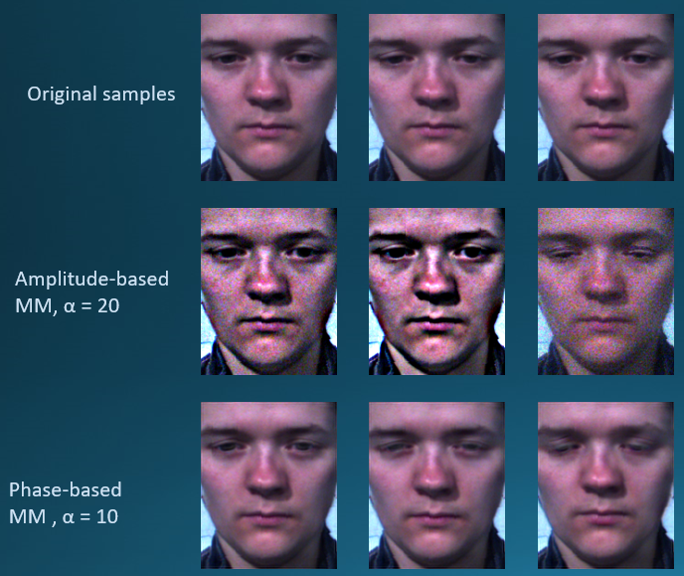
Related work – Amplify the facial movements
Wang et al. introduced an EVM with a 2nd order IIR bandpass filter. [9]
Peng et al. combined the EVM with a Time Interpolation Model (TIM) to reconstruct the input by magnifying the micro-expression motion and extending the temporal duration within the same model. [10]
Liu et al. introduced an Expression Magnification and Reduction (EMR) domain adaptation method based on the EVM to minimise the difference between micro-expression and macro-expression. [11]
Liu et al. combined EVM with optical flow to extract and magnify subtle movement changes for more accurate results. [12]
[9] Y. Wang, J. See, Y.-H. Oh, R. C.-W. Phan, Y. Rahulamathavan, H.-C. Ling, S.-W. Tan, and X. Li, “Effective recognition of facial micro-expressions with video motion magnification,” Multimedia Tools and Applications, vol. 76, no. 20, pp. 21665–21690, Nov 2016.
[10] W. Peng, X. Hong, Y. Xu, and G. Zhao, “A Boost in Revealing Subtle Facial Expressions: A Consolidated Eulerian Framework,” in 2019 14th IEEE Int. Conf. Automatic Face & Gesture Recognition (FG 2019).
[11] Y. Liu, H. Du, L. Zheng, and T. Gedeon, “A neural micro-expression recognizer,” in 2019 14th IEEE International Conference on Automatic Face Gesture Recognition (FG 2019), 2019, pp. 1–4..

Slide 10
Motion Magnification Methods
Amplitude-based Motion Magnification(AMM) uses first-order Taylor expansion to approximate the image
Phase-based Motion Magnification(PMM) uses the Fourier series decomposition to approximate the motion field.

Slide 11
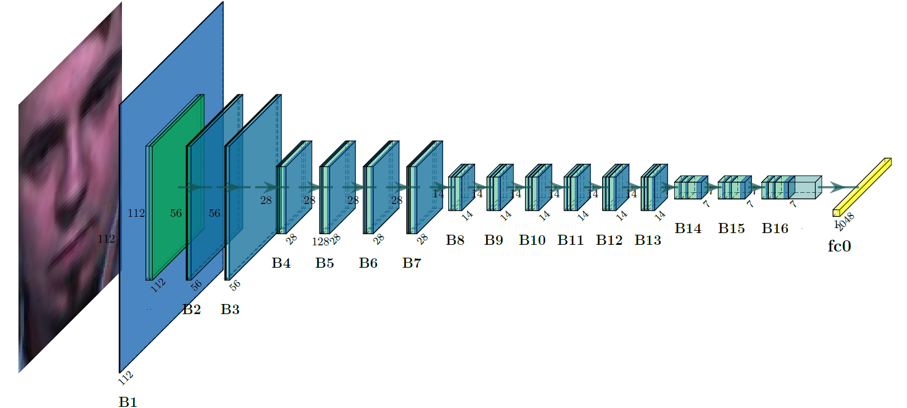
Encoding and Decoding Methods
The VGGFace2 model is a pre-trained network based on the ResNet-50 model and the VGGFace2 database. [13]
Employ a Bi-LSTM network to capture the micro-expression features from sequential samples. [16]
$$Freeze$$
$$Retrain$$
[13] Q. Cao, L. Shen, W. Xie, O.M. Parkhi, and A. Zisserman, “VGGFace2: A dataset for recognising faces across pose and age,” in 2018 13th IEEE Int. Conf. Automatic Face & Gesture Recognition (FG 2018). May 2018, IEEE.
[16] A. Graves, A. Mohamed, and G. Hinton, “Speech Recognition with Deep Recurrent Neural Networks,” in 2013 IEEE Int Conference on Acoustics, Speech and Signal Processing, May 2013, pp. 6645–6649.

Slide 12
Experiments -- Prediction results with on different training sample size and two motion magnification methods
 | N | 7 | 8 | 9 | 10 | 11 | 12 | 13 | 14
AMM | Average | 0.67 | 0.67 | 0.74 | 0.68 | 0.68 | 0.64 | 0.62 | 0.73
 | Negative | 0.54 | 0.70 | 0.61 | 0.57 | 0.73 | 0.63 | 0.64 | 0.72
 | Positive | 0.70 | 0.70 | 0.78 | 0.62 | 0.75 | 0.71 | 0.50 | 0.80
 | Surprise | 0.80 | 0.42 | 0.56 | 0.50 | 0.60 | 0.60 | 0.63 | 0.70
PMM | Average | 0.70 | 0.70 | 0.76 | 0.71 | 0.73 | 0.70 | 0.67 | 0.79
 | Negative | 0.67 | 0.71 | 0.65 | 0.75 | 0.68 | 0.63 | 0.65 | 0.74
 | Positive | 0.75 | 0.71 | 0.75 | 0.67 | 0.86 | 0.60 | 0.80 | 0.75
 | Surprise | 0.73 | 0.67 | 0.67 | 0.71 | 0.71 | 0.67 | 0.64 | 1.00

Slide 13
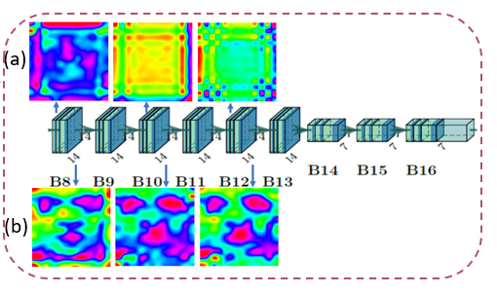
Experiments -- Employed the Grad-CAM technique in experiments to visualise the activation maps of each residual block

Slide 14
Experiments -- Employed the Grad-CAM technique in experiments to visualise the activation maps of each residual block

Slide 15
Experiments – Testing individual contributions of each component within the framework
Utilizing 20% data for testing; totally, there are 33 videos of variable length -- overlapping sliding window is not applied during testing, so, sequences for testing is not fixed length.
Using only the VGGFace2 pre-trained model with a fully-connected layer for classification, achieved an average accuracy of 41.9%.
Replacing the VGGFace2 model with a ResNet-50 model pre-trained on ImageNet, with a fully-connected layer for classification, achieved an average accuracy of 37.9%.
Compared with baseline which without motion magnification, a performance improved from 60.60% to 75.76%.

Slide 16
Source paper | Method | Year | Accuracy
[19] | 3D-FCNN | 2018 | 55.49%
[20] | Hierarchical scheme | 2018 | 55.49%
[21] | MicroExpSTCNN | 2019 | 68.75%
[10] | EVM+TIM | 2019 | 68.90%
[18](baseline) | VGGFace2+Bi-LSTM | 2020 | 60.60%
[22] | SETFNet | 2020 | 70.25%
Proposed | EVM+VGGFace2+Bi-LSTM | 2021 | 75.76%
Conclusion
The Eulerian motion magnification exaggerated the micro-expression deformation at spatial and temporal level and indeed increased the recognition rate.
This research was supported partially by the Australian Government through the Australian Research Council's Discovery Projects funding scheme (project DP190101294).
[10] W. Peng, X. Hong, Y. Xu, and G. Zhao, “A Boost in Revealing Subtle Facial Expressions: A Consolidated Eulerian Framework,” in 2019 14th IEEE Int. Conf. Automatic Face & Gesture Recognition (FG 2019).
[18] J. Li, Y. Wang, J. See, and W. Liu, “Micro-expression recognition based on 3D flow convolutional neural network,” Pattern Analysis and Applications, vol. 22, no. 4, pp. 1331–1339, Nov 2018.
[19] Y. Zong and X. Huang, “Learning from Hierarchical Spatiotemporal Descriptors for Micro-Expression Recognition,” IEEE Trans. Multimedia, pp. 1520–9210, 2018.
[20] S. P. Teja Reddy, S. Teja Karri, S. R. Dubey, and S. Mukherjee, “Spontaneous facial micro-expression recognition using 3d spatiotemporal convolutional neural networks,” in 2019 International Joint Conference on Neural Networks (IJCNN), 2019, pp. 1–8.
[21] M. Bai and R. Goecke, “Investigating LSTM for Micro-Expression Recognition,” in 2020 Int. Conf. Multimodal Interaction (ICMI). Oct 2020, ACM.
[22] L. Yao, X. Xiao, R. Cao, F. Chen, and T. Chen, “Three stream 3d cnn with se block for micro-expression recognition,” in 2020 International Conference on Computer Engineering and Application (ICCEA), 2020, pp. 439–443.

Slide 17
Thank you

