Slide 1
Defending DNN Adversarial Attacks with Pruning and Logits Augmentation
Siyue Wang , Xiao Wang , Shaokai Ye, Pu Zhao & Xue Lin
1. Department of ECE, Northeastern University
2. Department of Computer Science, Boston university
3. Department of EECS, Syracuse University
* Equal Contribution
GlobalSip 2018
1*
2*
3
1
1

Slide 2
Outline
Background
Introduction to Adversarial Attacks
Related work
Our defense techniques
Pruning + Logits Augmentation
Conclusion

Slide 3
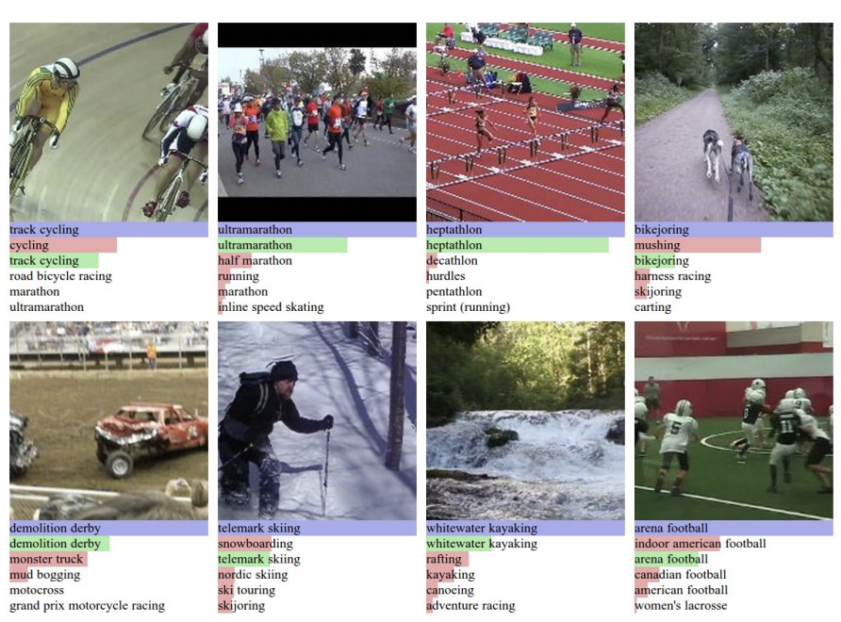
Background
Deep neural networks (DNNs) have been shown to be powerful models and perform extremely well on many complicated artificial intelligent tasks.
Some are security critical like facial recognition and self-driving cars.
Krizhevsky, A., Sutskever, I. and Hinton, G. E.. “ImageNet Classification with Deep Convolutional Neural Networks”. NIPS 2012.
Kaiming He, Xiangyu Zhang, Shaoqing Ren, & Jian Sun. “Deep Residual Learning for Image Recognition”. arXiv 2015.
Shaoqing Ren, Kaiming He, Ross Girshick, & Jian Sun. “Faster R-CNN: Towards Real-Time Object Detection with Region Proposal Networks”. NIPS 2015.
https://selfdrivingcars.mit.edu/
https://www.apple.com/iphone-xs/face-id/

Slide 4
Adversarial Attacks
DNN models are vulnerable to adversarial attacks.
Intentionally added imperceptible perturbations to DNN inputs can easily mislead the DNNs with extremely high confidence.
J. Goodfellow, J. Shlens, and C. Szegedy, “Explaining and harnessing adversarial examples,” ICLR, 2015.
N. Papernot, P. McDaniel, X. Wu, et al., “Distillation as a defense to adversarial perturbations against deep neural networks,” IEEE Symposium on Security and Privacy (SP), 2016.

Slide 5
Problem Formulation
Wang, Siyue et al. “Defensive Dropout for Hardening Deep Neural Networks under Adversarial Attacks.”, ICCAD, 2018.

Slide 6
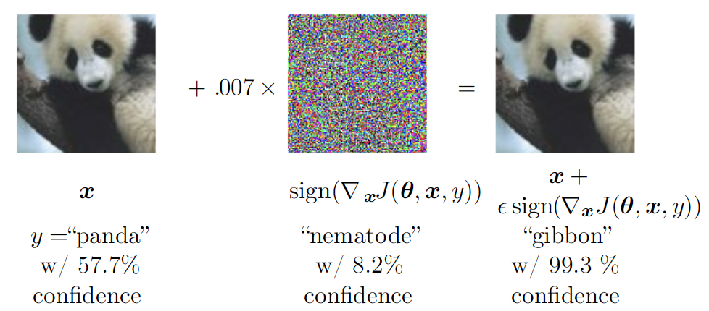
Fast Gradient Sign Method (FGSM)
Adversarial examples are generated directly as
Designed to be fast, not optimal
J. Goodfellow, J. Shlens, and C. Szegedy, “Explaining and harnessing adversarial examples,” ICLR, 2015.

Slide 7
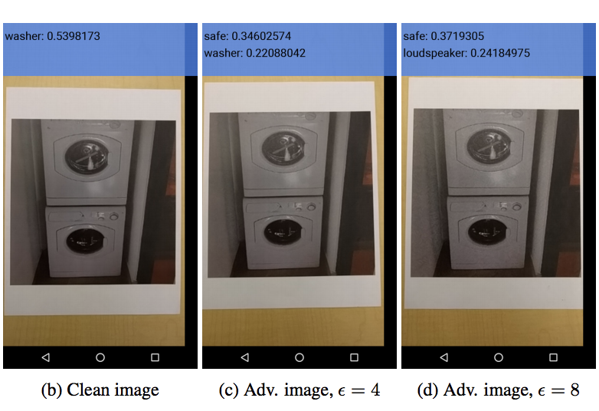
Basic Iterative Method (BIM)
BIM gives a further modify of FGSM. Instead of taking a single step , BIM takes multiple steps a. Given an initial setting:
for each iteration, it calculates:
Notice that here BIM clips pixel values of intermediate results after each step to ensure that they are in an epsilon-bounded neighbourhood of the original image.
A. Kurakin, I. Goodfellow, and S. Bengio, “Adversarial examples in the physical world,”

Slide 8
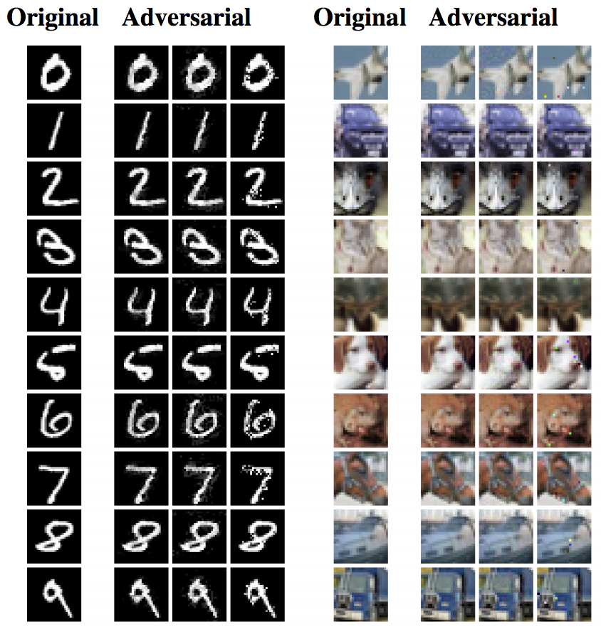
Carlini and Wagner Attack (CW)
Solve an optimization problem：
L_0, L_2, and L_infinity attacks
The strongest iterative attack in the literature
N. Carlini and D. Wagner, “Towards evaluating the robustness of neural networks,” IEEE Symposium on Security and Privacy (SP), 2017.

Slide 9
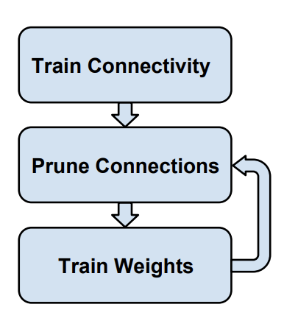
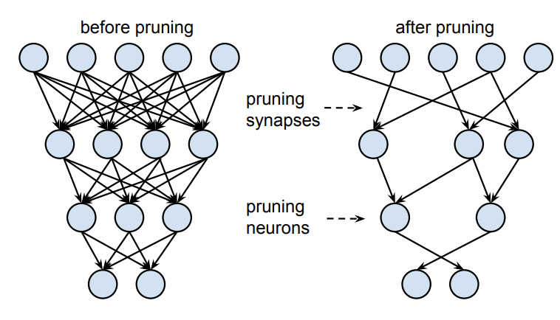
Motivations: Network Pruning
DNN pruning method reduces the number of weights while preserving the accuracy of the compressed DNN models.
We prune 10% nonzero weights for fully connected layers and 5% nonzero weights for convolutional layers.
The network model can be compressed by 7 times after pruning.
S. Han, J. Pool, J. Tran, and W. Dally, “Learning both weights and connections for efficient neural network,”, NIPS 2015

Slide 10
Logits Augmentation
To further improve the robustness of DNNs under adversarial attacks, we propose to use the logits augmentation on top of the pruning method.
Inspired by the gradient inhibition method , which changes the weights in the last few layers as:
In our logits augmentation, we modify the weights in the last fully-connected layer by
Q. Liu, T. Liu, Z. Liu, Y. Wang, Y. Jin, and W. Wen, “Security analysis and enhancement of model compressed deep learning systems under adversarial attacks,” ASP-DAC, 2018.

Slide 11
Defense Models
M0 and C0: unprotected neural network models that achieve near state-of-the-art accuracy, i.e., 99.4% and 80%, respectively, on MNIST and CIFAR-10.
M1 and C1: defense level one exploits only the pruning method.
M2 and C2: defense level two exploits both pruning and logits augmentation as defense.
N. Carlini and D. Wagner, “Towards evaluating the robustness of neural networks,” IEEE Symposium on Security and Privacy (SP), 2017.

Slide 12
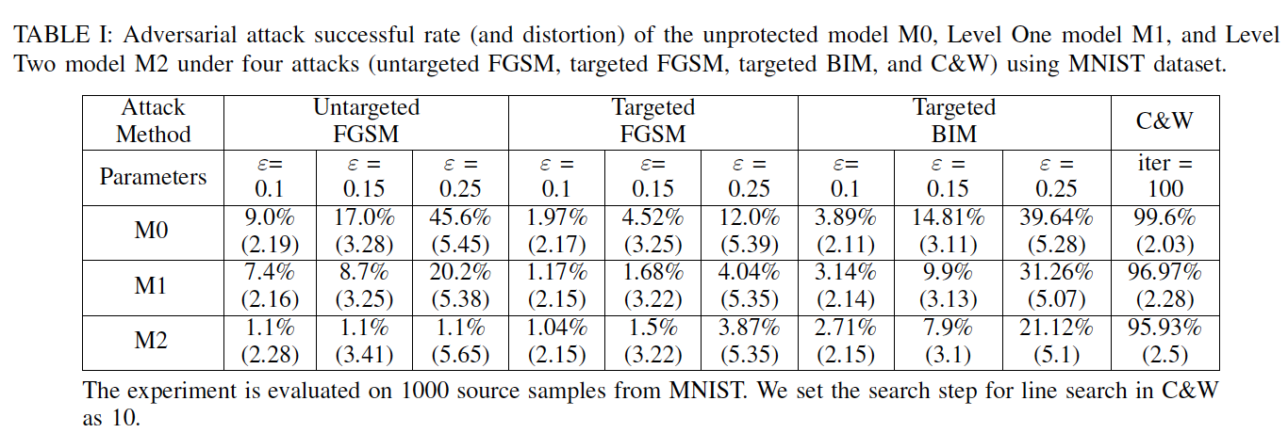
Experimental Results
Results using M0, M1 and M2 on MNIST

Slide 13
Experimental Results
Results using M0, M1 and M2 on CIFAR-10

Slide 14
Conclusion
Enhance the robustness of DNNs by using pruning method and logits augmentation
We achieve DNN model compression by 7 times while maintaining the test accuracy
Our method can effectively defend against both targeted and untargeted FGSM and BIM attacks under grey-box attack assumption

Slide 15
Thank you!

