Slide 1
ELECTROENCEPHALOGRAM SENSOR DATA COMPRESSION USING AN ASYMMETRICAL SPARSE AUTOENCODER WITH A DISCRETE COSINE TRANSFORM LAYER
2024.4.18
Xin Zhu¹ Hongyi Pan² Shuaiang Rong¹ Ahmet Enis Cetin¹
¹Department of Electrical and Computer Engineering, University of Illinois Chicago, USA
²Machine & Hybrid Intelligence Lab, Northwestern University, USA

Slide 2
Introduction: EEG Data compression
Autoencoder type neural network with a DCT layer
Classical and neural network approach
Experimental Results in BCI2 and Bonn EEG datasets
Conclusion

Slide 3
Electroencephalogram (EEG) plays a crucial role in neurological diagnosis.
In existing literature, advanced feature extraction and classification algorithms have been designed for EEG analysis.
Most of these algorithms leverages the abundance of EEG data detected by the sensor, which requires efficient compression algorithms.
Section ONE
Introduction

Slide 4
The current methods for compressing EEG signals
Introduction
Traditional signal transform methods
Neural network-based methods
Transform-based learning techniques
The discrete wavelet transform+ adaptive arithmetic encoding
Limitation: Low reconstruction accuracy
Convolutional autoencoder
Limitation: Low compression efficiency
A near-lossless compression algorithm is developed based on discrete cosine transform (DCT) and multilayer perceptron (MLP)
Limitation: Weak generalization ability

Slide 5
An asymmetrical sparse autoencoder with a DCT layer for EEG sensor data compression.
Trainable thresholding units remove the noise and improve the data compression efficiency.
Combination of the fully connected and DCT layers learn the data and improve the data compaction capability of DCT.
Scaling parameters approximately perform filtering in the transform domain and the one-by-one convolution layer reduces the dimension and produces the latent space.
Section two
Contribution

Slide 6
Classical autoencoders: Designed in a symmetric architecture; Heavy computations in the encoder side to compress the signals.
Proposed model:
(1). Low complexity in the encoder side; Suitable for implementation at the edge in sensors;
(2). More linear layers in the decoder side than the encoder side to enhance the data reconstruction ability.
Section three
Proposed Model

Slide 7
Discrete cosine transform (DCT)and convolution theorem
DCT:
(1). Approximate the KLT when there is a high correlation among the input samples.
(2). Represent a given signal in a lower dimensional latent space.
(3). Better suited to compression without requiring the covariance matrix estimation and eigen-analysis.
Convolution theorem: The elementwise multiplication in the DCT domain corresponding to symmetric convolution in the time domain.

Slide 8
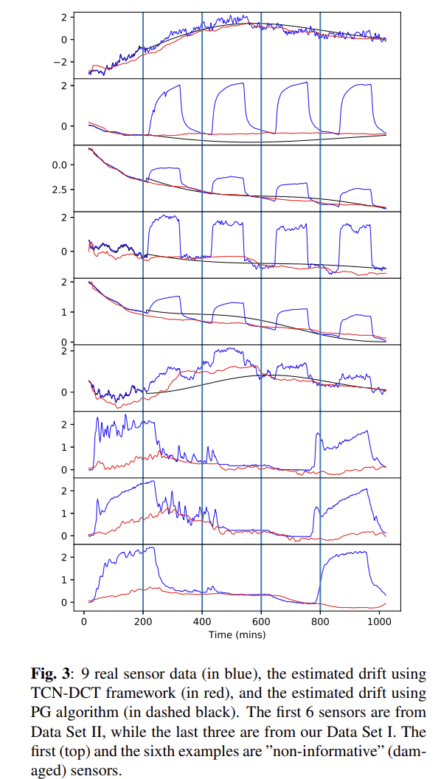
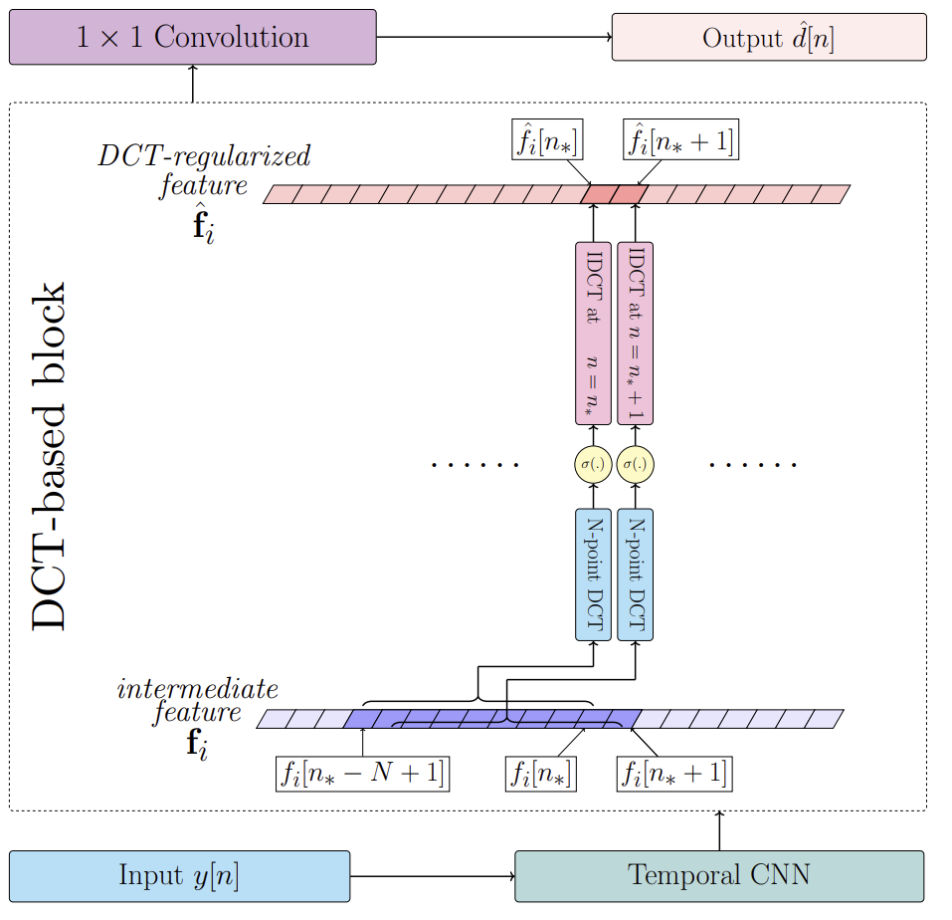
DCT layer for for drift signal estimation

Slide 9
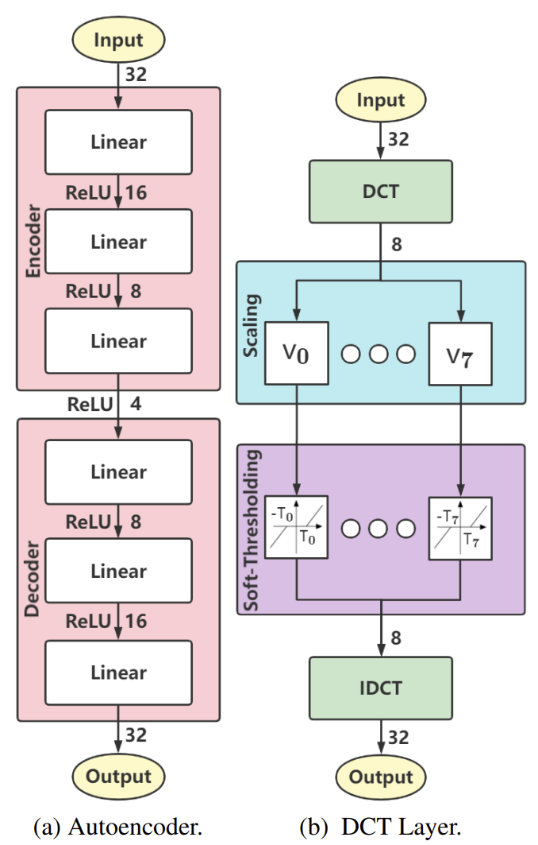
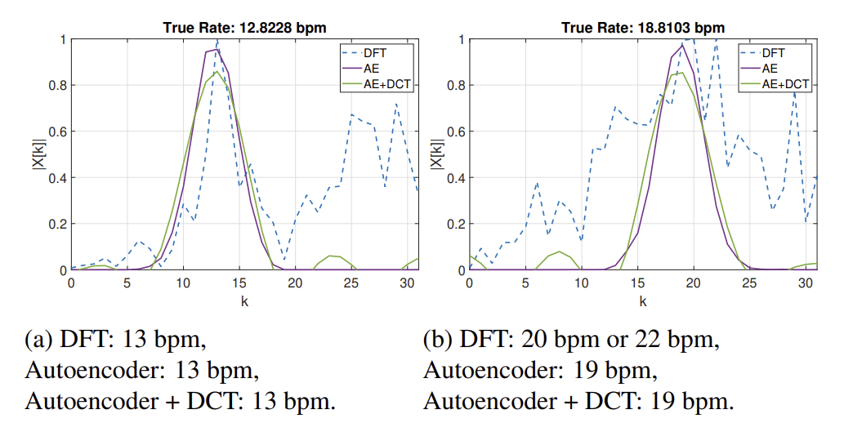
DCT layer for ECG respiration rate estimation
DCT-II:

Slide 10
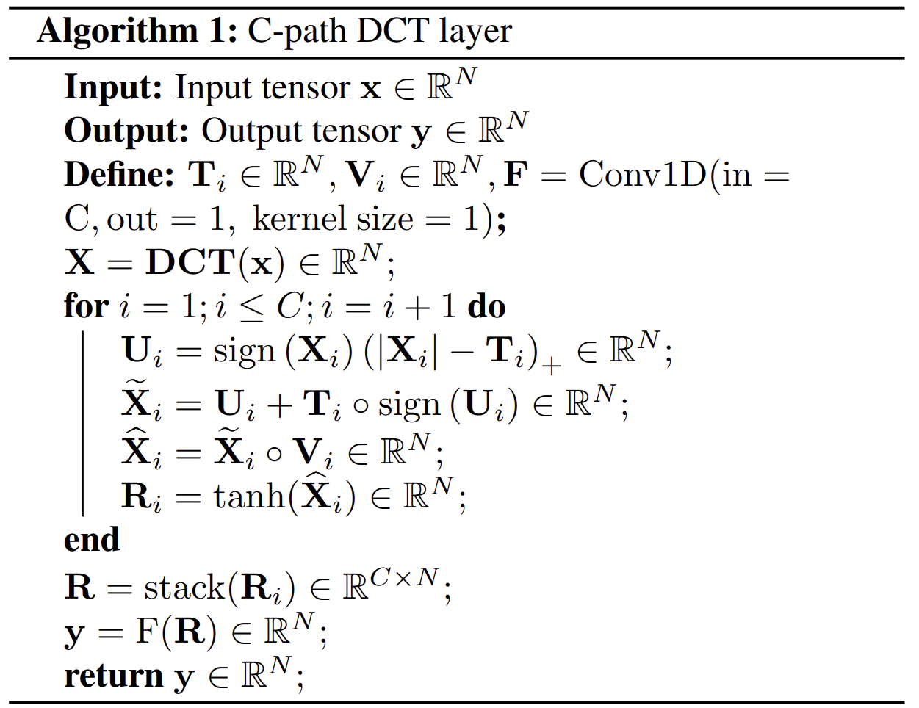
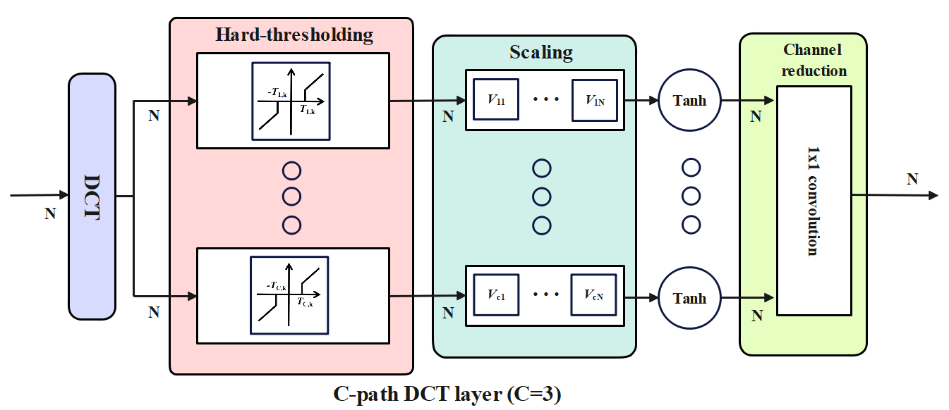
DCT layer for EEG data compression
DCT-III:
Hard-thresholding function:

Slide 11
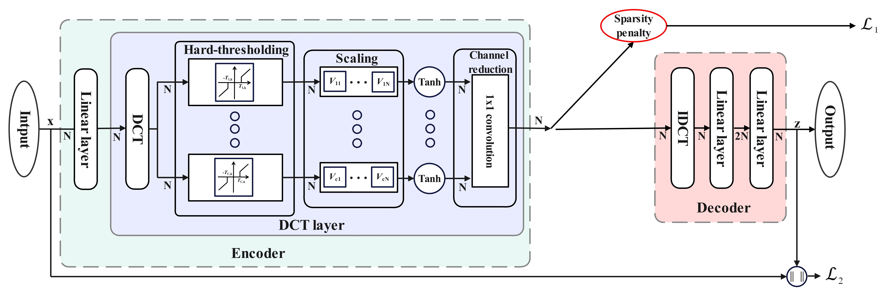
Proposed Model-Training stage
Overall loss function: Mean squared error + Sparsity penalty loss function based on Kullback–Leibler divergence

Slide 12
Proposed Model-Transmission stage
Hybrid coding algorithm: A combination of Run-Length Encoding (RLE) and Lempel–Ziv–Markov chain algorithm (LZMA)

Slide 13
Dataset:
(1). BCI2 dataset (316 training sets and 100 testing sets).
(2). Bonn University dataset.
Performance metric:
(1). Compression ratio (CR);
CR = Size of original data/ Size of reconstruction data
(2). Percent root-mean-square difference (PRD).
(3). Quality score (QS)
QS = CR/ PRD
Section four
Experimental Results

Slide 14
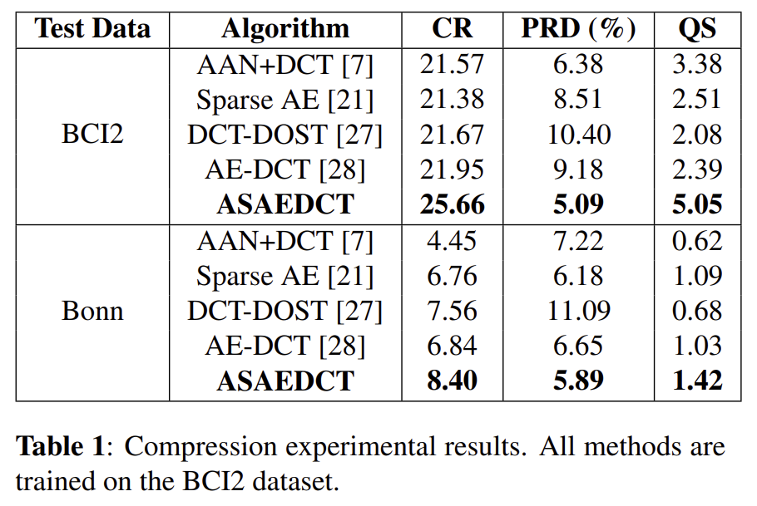
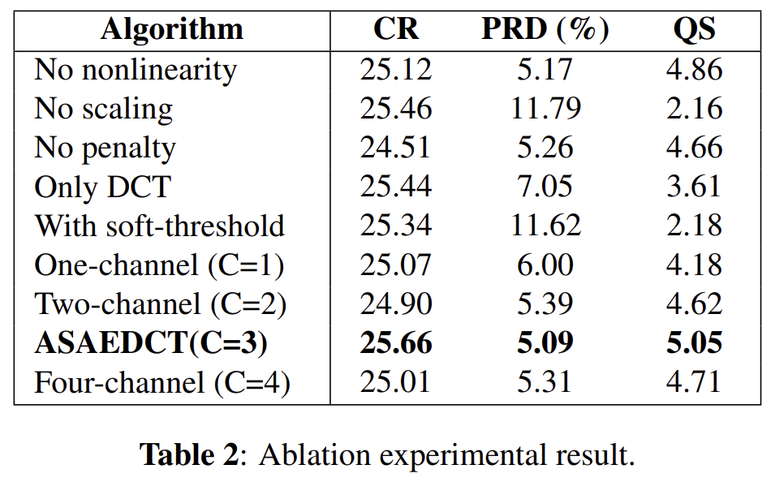
Experimental Results
Performance metric: Compression ratio (CR), Percent root-mean-square difference (PRD) and Quality score (QS)

Slide 15
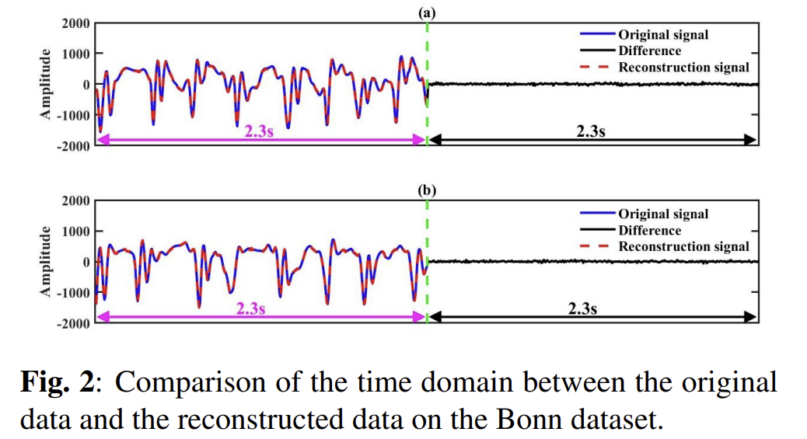
Experimental Results

Slide 16
Experimental Results
Analysis of the computational cost:
For an input with a duration of 6.4s, the compression time of the ASAEDCT network is only around 0.016s. Although this experiment is executed on the Intel Core i7-12700H CPU, the fast compression time indicates that the proposed method can be used in real-time compression of the EEG signals.

Slide 17
This study presents an asymmetrical autoencoder with a DCT layer that contains hard-thresholding nonlinearity for EEG sensor data compression.
The hard-thresholding nonlinearity and scaling layers not only enhance the data compaction capability of the DCT layer but also denoise the EEG signal.
The proposed model achieves the best compression efficiency and reconstruction accuracy compared to other methods in BCI2 and Bonn EEG datasets.
The computational load of the compression part of the ASAEDCT network is low, therefore, it can be implemented in the sensor for EEG data compression.
Section four
Conclusion

Slide 18
Thank you for your listening

