Slide 1
Refining the Bounding Volumes for
Lossless Compression of Voxelized Point Clouds Geometry
#2273
Emre Can Kaya* Sebastian Schwarz† Ioan Tabus*
*Tampere University, Tampere, Finland
† Nokia Technologies, Munich, Germany

Slide 2
BVL: METHOD OVERVIEW
[14]

Slide 3
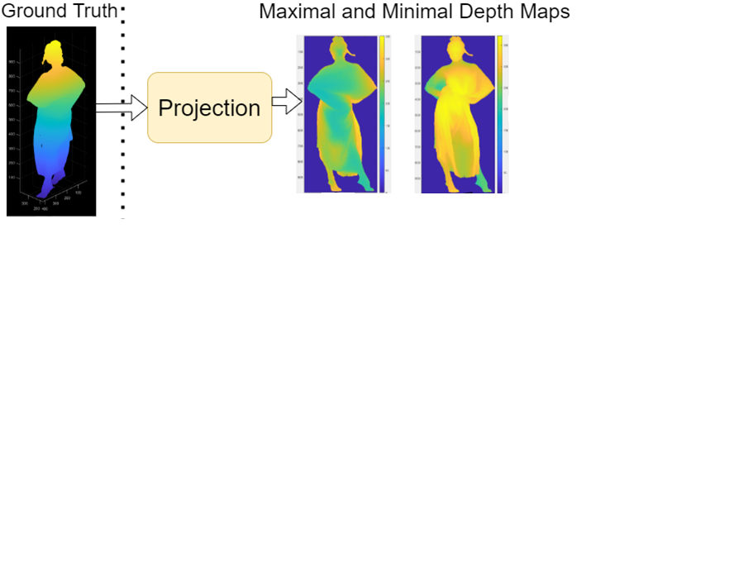

Slide 4
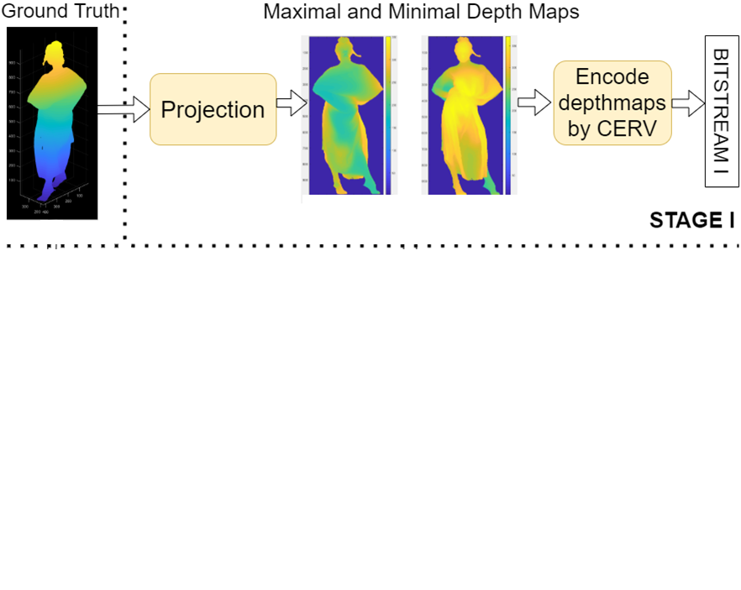

Slide 5
$$y=y_{0}$$

Slide 6
$$y=y_{0}$$

Slide 7
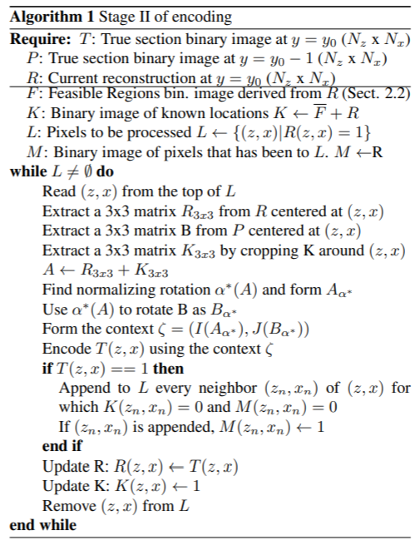
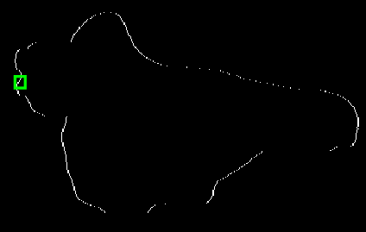
T: True Section at $y=y_{0}$
P: True Section at $y=y_{0}$-1
R: Current reconstruction $at$
$y=y_{0}$ after Stage I
F: Feasible Region at $y=y_{0}$

Slide 8
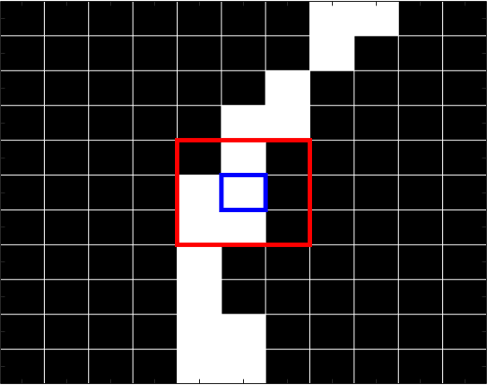
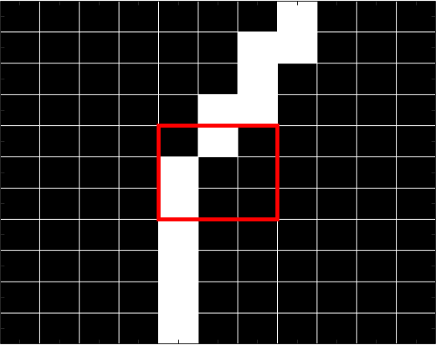
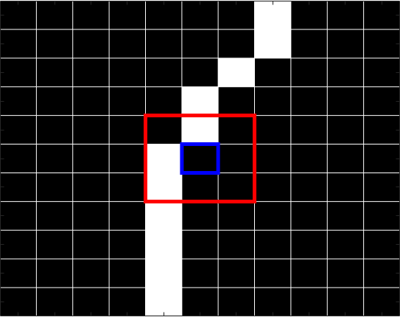
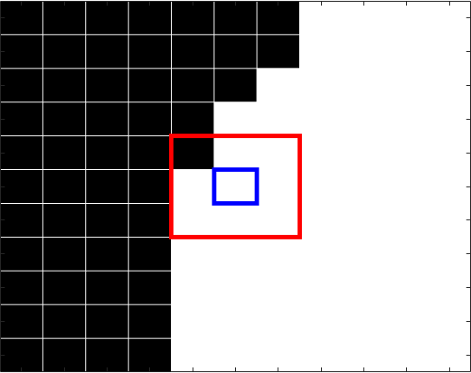
Zoom in T ($y=y_{0}$)
Zoom in P ($y=y_{0 }−1)$
(z,x)
Zoom in R ($y=y_{0}$)
Zoom in F ($y=y_{0}$)
(z,x)
(z,x)

Slide 9
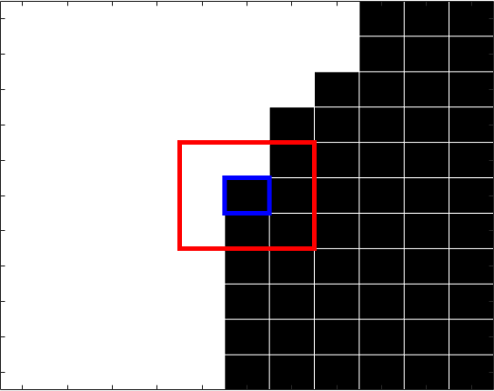
Zoom in R ($y=y_{0}$)
Zoom in F ($y=y_{0}$)
(z,x)
(z,x)
$$R_{3x3}$$
K = R+ $\overline{F}$ : Known Locations
${A=R}_{3x3}$+$K_{3x3}$
(z,x)
$$K_{3x3}$$
(z,x)

Slide 10
$$A_{0}$$
$$A_{π/2}$$
A
1 | 3 | 27
9 | 81 | 243
729 | 2187 | 6561
0,0
0,1
0,2
1,0
1,1
1,2
2,0
2,1
2,2
$$W\left(A_{0}\right)=1483$$
$$W\left(A_{π/2}\right)=521$$
${v=[A}_{00} A_{01}A_{10} A_{02} A_{11} A_{20} A_{12} A_{21}A_{22}]$
$$W\left(A\right)= \sum_{k=0}^{8}{v_{k} 3^{k}}$$
$$A_{α_{∗}}$$
$$α_{∗}=3π/2$$
$$W\left(A_{3π/2} \right)=18243$$
$W\left(A_{π} \right)=$11475
$$I\left(A_{α_{∗}}\right)=\sum_{j=0}^{2}{\sum_{i=0}^{2}{A_{ij}3^{i+3j}}}$$
$$A_{3π/2}$$
$$A_{π}$$

Slide 11
Zoom in P ($y=y_{0 }−1)$
$$A_{α_{∗}}$$
$$B$$
$$B_{α_{∗}}$$
Rotate with $α_{∗}$
$$B$$
$$I\left(A_{α_{∗}}\right)=\sum_{j=0}^{2}{\sum_{i=0}^{2}{A_{ij}3^{i+3j}}}$$
$$J\left(B_{α_{∗}}\right)=\sum_{j=0}^{2}{\sum_{i=0}^{2}{B_{ij}2^{i+3j}}}$$
$$Context Label:$$
$$\text{ζ}=(I\left(A_{α_{∗}}\right),J\left(B_{α_{∗}}\right))$$
Encode T(z,x) using $\text{ζ}$

Slide 12
Zoom in R ($y=y_{0}$)
(z,x)
$${\left(z_{n},x_{n}\right)}^{′}s$$

Slide 13
Zoom in R ($y=y_{0}$)

Slide 16
Conclusion
We proposed a lossless compression method where ;
the first stage is constructing a bounding volume for the point cloud and
the following steps succeed at adding all the remaining points at a competitive bitrate.
The proposed BVL achieves
state-of-the-art results for the full body datasets,
and comparable results to the current GPCC standard on the upper body dynamic datasets.

Slide 17
References
[8] D. C. Garcia, T. A. Fonseca, R. U. Ferreira, and R. L. de Queiroz, “Geometry coding for dynamic voxelized point clouds using octrees and multiple contexts,” IEEE Transactions on Image Processing, vol. 29, pp. 313–322, 2019.
[9] “MPEG Group TMC13,”https://github.com/MPEGGroup/mpeg-pcc-tmc13, Accessed: 2020-03-20.
[12] E. Peixoto, “Intra-frame compression of point cloud geometry using dyadic decomposition,” IEEE Signal Processing Letters, vol. 27, pp. 246–250, 2020.
[13] I. Tabus, E. C. Kaya, and S. Schwarz, “Successive refinement of bounding volumes for point cloud coding,” in2020 IEEE 22nd International Workshop on Multimedia Signal Processing (MMSP). IEEE, 2020, pp. 1–6.
[14] I. Tabus, I. Schiopu, and J. Astola, “Context coding of depth map images under the piecewise-constant image model representation,” IEEE Transactions on Image Processing, vol. 22, no. 11, pp. 4195–4210, 2013.

