Slide 1
INVESTIGATION OF ROBUSTNESS OF HUBERT FEATURES FROM DIFFERENT LAYERS
TO DOMAIN, ACCENT AND LANGUAGE VARIATIONS
By :
Pratik Kumar
Vrunda N. Sukhadia
S. Umesh

Slide 2
Table of Content
HuBERT basics
Our approach
Results
Conclusion

Slide 3
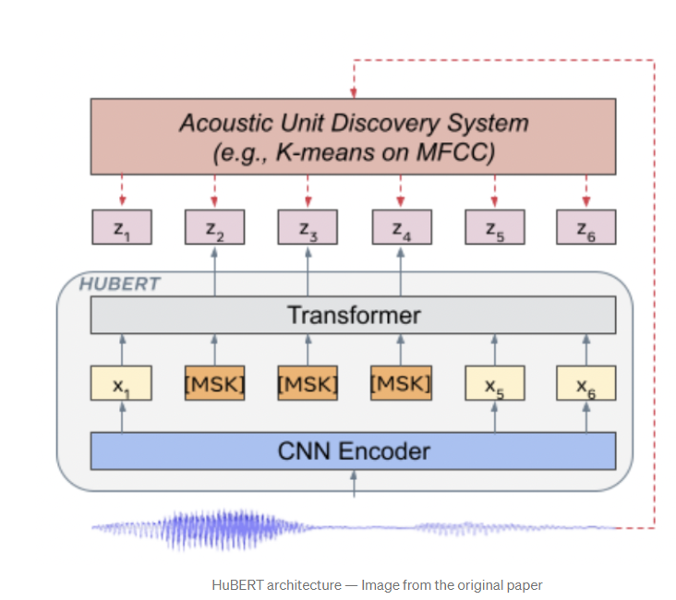
HuBERT
HuBERT consists of
Convolutional encoder
BERT encoder
Projection layer
The training consists of 2 steps:
Generating hidden units
Masked Prediction

Slide 4
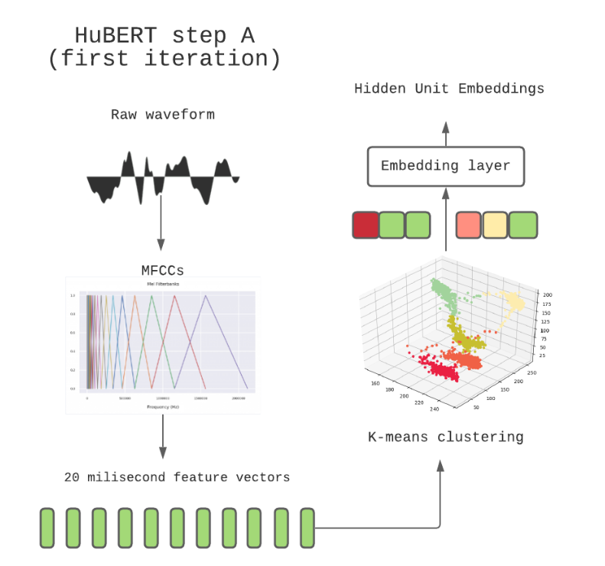
Generating Hidden Units - First Iteration

Slide 5
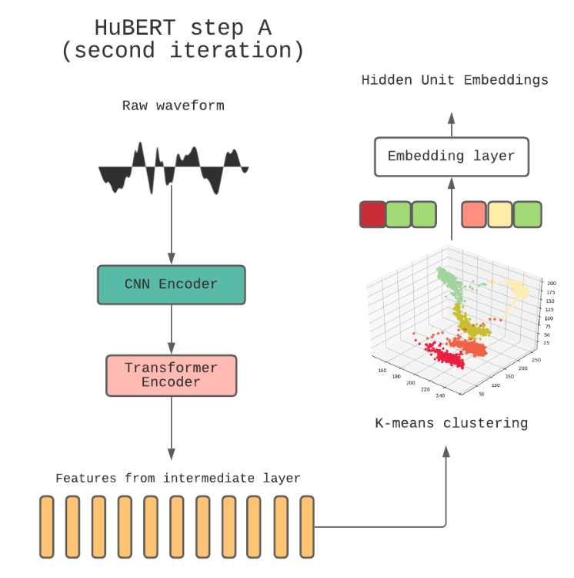
Generating Hidden Units - Second iteration

Slide 6
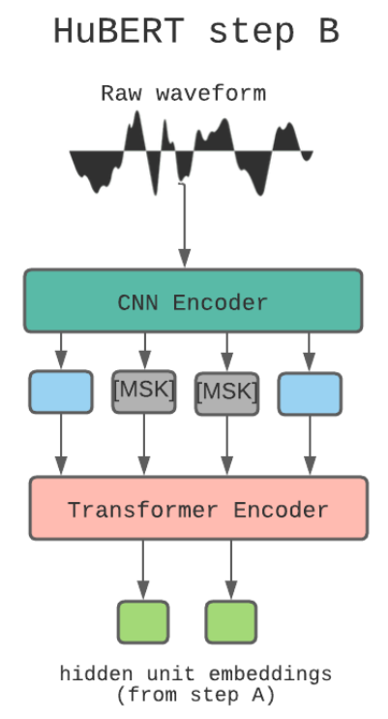
Masked Prediction

Slide 7
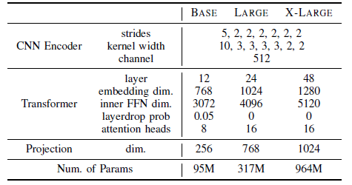
HuBERT - Available Versions
In all our experiments we have used HuBERT Large

Slide 8
Objective
Investigating the performance of ASR models using pre-trained HuBERT for data different than the HuBERT data (Libri 60k)
We have considered the following the three differences:
Domain
Accent
Language

Slide 9
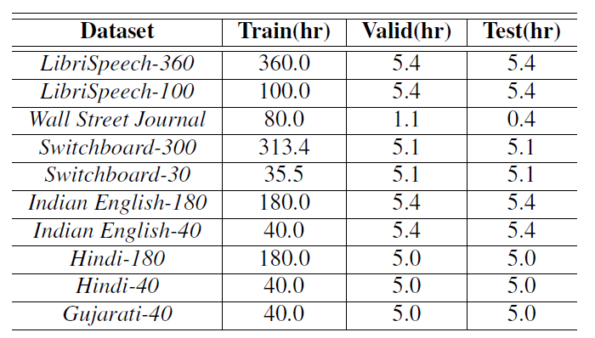
Datasets

Slide 10
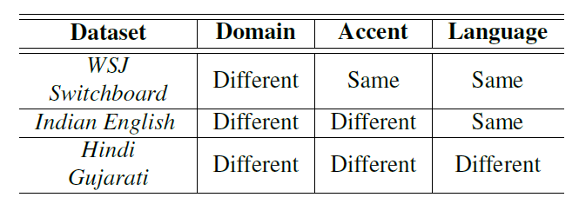
Differences in Dataset

Slide 11
Our work
We investigated:
The effect of domain, accent and language difference on the ASR performance.
The effect of embeddings from different layers of pre-trained HuBERT on the performance.
The use of latent representation obtained at the output of the feature encoder as features instead of conventional Mel-filterbank features.

Slide 12
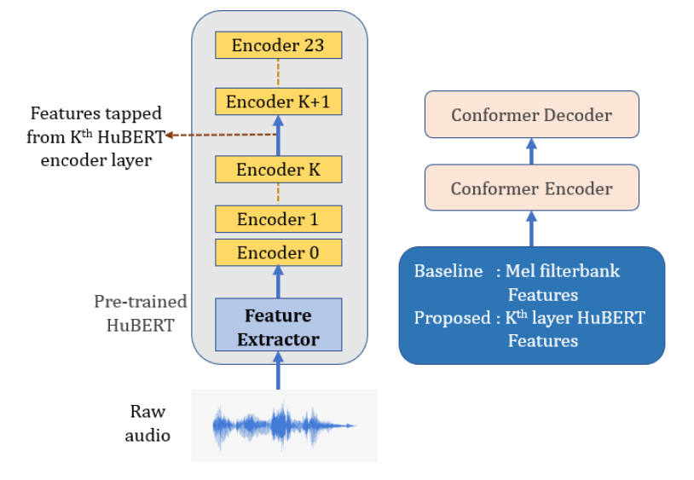
Our Approach - Tapping Embeddings from Different Layers

Slide 13
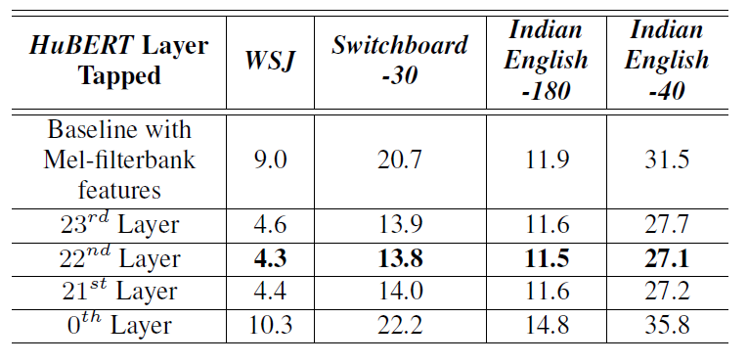
HuBERT Layer-wise Performance for US English and Indian English datasets

Slide 14
HuBERT Layer-wise Performance for US English and Indian English datasets
HuBERT features perform better than Mel-filterbank features for all the considered English datasets.
Performance gain in WSJ is high due to a match in accent and language with Libri-Light.
Switchboard gives the least improvement with HuBERT features among the US English datasets as it is baseband audio.
Indian English gives the least improvement in performance compared to the US English datasets. The reason could be due to the additional effect of accent mismatch along with the domain mismatch.
In case of domain mismatch last layer is not the most optimal.

Slide 15
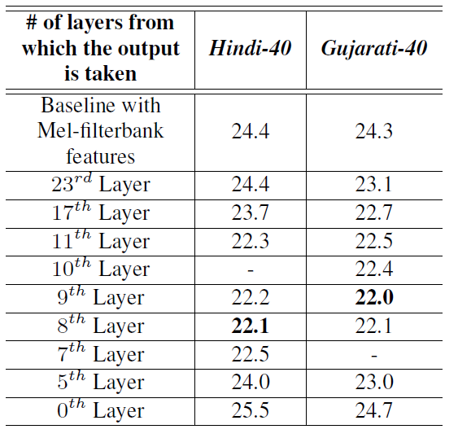
HuBERT Layer-wise Performance for the Indo-Aryan datasets

Slide 16
HuBERT Layer-wise Performance for the Indo-Aryan datasets
HuBERT features perform better than Mel-filterbank features.
The last layer is not the most optimal in case of complete mismatch
8th layer in case of Hindi & 9th layer in case of Gujarati are the most optimal ones.
0th layer is worse than Mel Filterbank

Slide 17
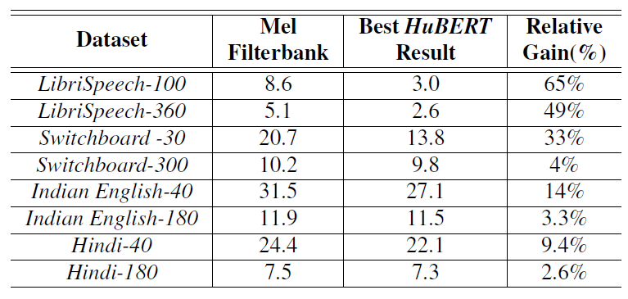
Performance Comparison of the Best HuBERT Features on Datasets of Different Sizes
As the data size increases, relative gain decreases

Slide 18
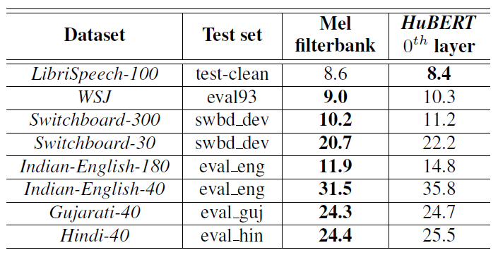
Mel-filterbank vs HuBERT 0th Layer Performance for Different Datasets

Slide 19
Mel-filterbank vs HuBERT 0th Layer Performance for Different Datasets
When the domain matches completely, in the case of LibriSpeech-100, HuBERT’s 0th layer features are better than Mel-filterbank.
For all the other datasets, 0th layer features of HuBERT are worse than the Mel-filterbank features.
This indicates that even the lowest HuBERT layer is influenced by the data used in pre-training, and results in performance degradation when there are mismatches in the target domain data.

Slide 20
Conclusion
Our experiments indicate that as domain, accent, bandwidth and language deviates from the source domain, the relative improvement over baseline decreases.
The last layer of HuBERT is very specific to the dataset on which it is trained.
As expected, the middle layers are more suited when data is from a different language, since they mostly capture the general acoustic characteristics of speech
Further, as more and more supervised data is available in the target domain, the relative improvement over baseline model decreases significantly.

Slide 21
References
https://blog.devgenius.io/hubert-explained-6ec7c2bf71fc
HuBERT: Self-Supervised Speech Representation Learning by Masked Prediction of Hidden Units by Wei-Ning Hsu, Benjamin Bolte, Yao-Hung Hubert Tsai, Kushal Lakhotia, Ruslan Salakhutdinov, Abdelrahman Mohamed

Slide 22
THANK YOU

