Slide 1
Entropy Modeling via Gaussian Process Regression for Learned Image Compression
Maida Cao*, Wenrui Dai, Shaohui Li, Chenglin Li, Junni Zou, Ying Chen, Hongkai Xiong
Shanghai Jiao Tong University
caomaida@sjtu.edu.cn
Notes:
Hello, everyone. I am Maida Cao, a PhD candidate from Shanghai Jiao Tong University. I am sorry for the absence because of COVID-19. So I make presentation here to show my work about Entropy Modeling via Gaussian Process Regression for Learned Image Compression.

Slide 2
Outline
Backgrounds and Motivations
End-to-end Optimized Image Compression Algorithms
Inflexibility of Existing Entropy Models
Our Work
Entropy Modeling via Gaussian Process Regression
Rate-Distortion Optimization
Experimental Results
Rate-Distortion Performance/Visual Quality
Computational Complexity
Conclusion and Future Works
Notes:
Here is the outline. I will introduce our work from four aspects. Firstly, I will introduce the background and explain the motivations of our work. Secondly, I will describe the methods proposed in our paper. Then I will show the experimental results comparing with other methods. Finally, I will draw a conclusion and talk about the future works of our research.

Slide 3
Outline
Backgrounds and Motivations
End-to-end Optimized Image Compression Algorithms
Inflexibility of Existing Entropy Models
Our Work
Entropy Modeling via Gaussian Process Regression
Rate-Distortion Optimization
Experimental Results
Rate-Distortion Performance/Visual Quality
Computational Complexity
Conclusion and Future Works
Notes:
Let’s begin with backgrounds and motivations

Slide 4
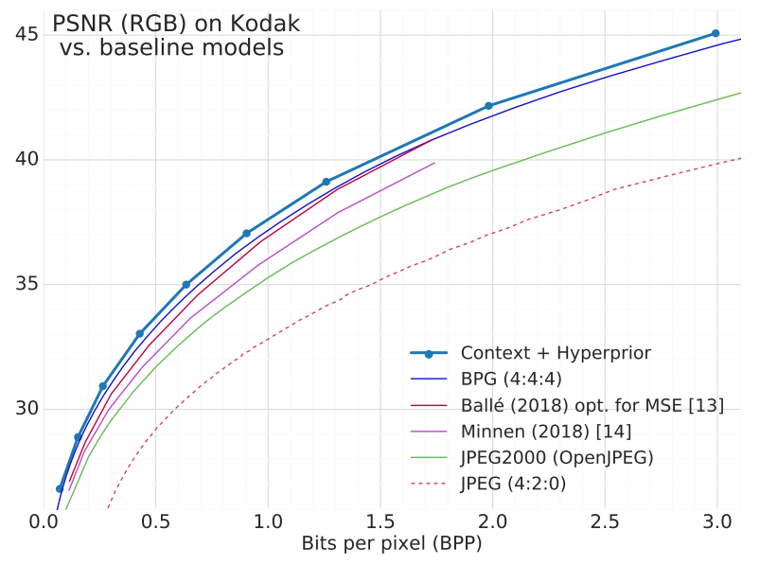
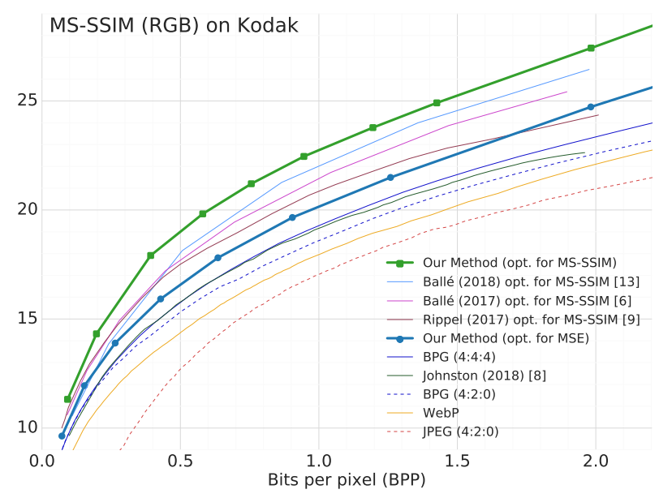
Backgrounds
General framework of end-to-end optimized image compression
Encoder
Entropy
model
Decoder
Training loss function$ℒ=R+λ∙D$
Rate-distortion performance of end-to-end optimized image compression
Ballé et al, End-to End Optimized Image Compression, ICLR 2017.
Minnen et al, Joint Autoregressive and Hierarchical Priors for Learned Image Compression, NeurIPS 2018.
Notes:
Here shows the general framework of end-to-end optimized image compression which takes the transform coding framework, consisting of an encoder, a decoder and an entropy model.
The training loss function usually defines as R plus lambda D, where R is the bit rate of the compressed file, D is distortion between original and reconstructed images, lambda is a trade-off parameter between two objectives.
I post the results of Minnen at NIPS 2018. We can see that the rate-distortion performance of existing end-to-end optimized image compression methods can outperform traditional codecs such as JPEG, JPEG2000 and BPG.

Slide 5
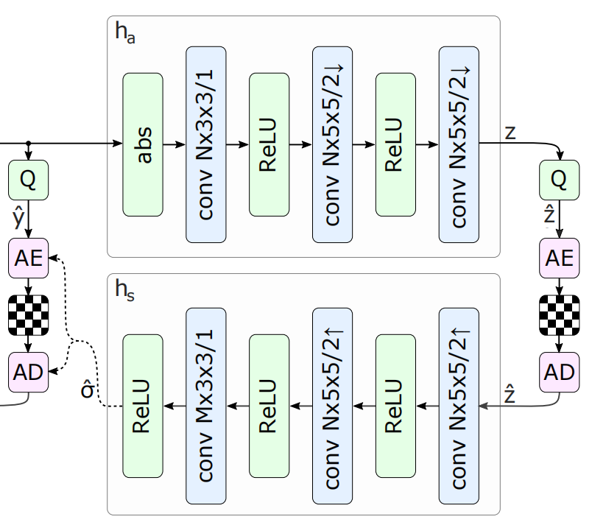
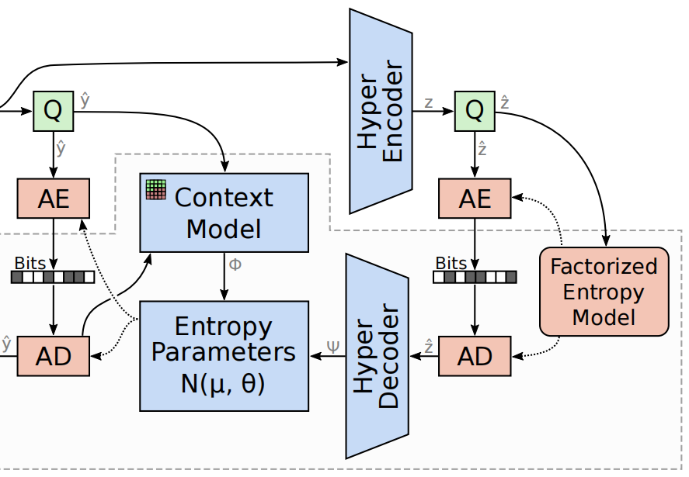
Backgrounds
Existing typical entropy models
Distribution of Elements in latents are fully factorized.
The distribution estimation of latents is based on contexts.
Hyperprior method
Combination of hyperprior and
autoregression method+
Drawbacks of existing entropy models
Generate fixed parameters for distributions of latents through CNNs.
E.g., fixed mean $μ$ and variance $σ^{2}$ for Gaussian $𝒩(μ,σ^{2})$.
Ballé et al, Variational Image Compression With a Scale Hyperprior, ICLR 2018.
Minnen et al, Joint Autoregressive and Hierarchical Priors for Learned Image Compression, NeurIPS 2018.
Notes:
Now let us focus on the entropy model since it significantly influences the bit rate of the compressed file.
Here, I show two types of existing typical entropy models.
One of them assumes distribution of elements in latents are fully factorized while the other one is based on contexts.
For context-based entropy models, the hyperprior method and autoregression method are most frequently used, as well as the combination of these two methods.
However, they all generate fixed parameters for distributions of latents, such as the mean and variance in Gaussian distributions, which is inflexible and inaccurate.

Slide 6
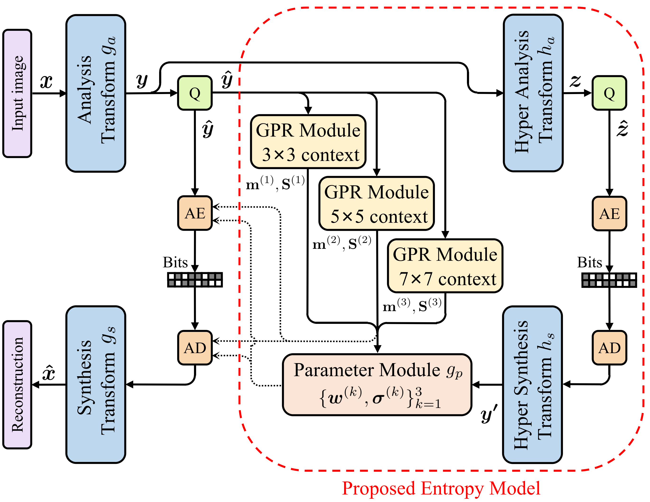
Motivations
Motivations of our work
More accurate distribution estimation
We regard the parameters of distributions as distributions.
We leverage Gaussian process regression to realize it.
Higher compression performance
Objective evaluation: PSNR.
Subjective evaluation: visual quality.
Overview of our proposed method
Notes:
Now let me introduce the motivation of our work
Firstly, instead of produce fixed parameters, we try to regard the parameters of distributions of latents as distributions as well for more accurate estimation.
Specifically, we leverage Gaussian process regression to achieve this.
Besides, we aim at higher compression performance of our method in terms of PSNR and visual quality.
Here is our proposed framework for end-to-end image compression. I will introduce it part by part.

Slide 7
Outline
Backgrounds and Motivations
End-to-end Optimized Image Compression Algorithms
Inflexibility of Existing Entropy Models
Our Work
Entropy Modeling via Gaussian Process Regression
Rate-Distortion Optimization
Experimental Results
Rate-Distortion Performance/Visual Quality
Computational Complexity
Conclusion and Future Works
Notes:
Now, let me introduce our work.

Slide 8
Our Work
Components of the proposed entropy model
Three Gaussian process regression(GPR) modules
A hyperprior module
A parameter module
Notes:
Our end-to-end image compression framework mainly consists of an Analysis transform, an entropy model, and a synthesis transform, while the propose entropy model is our main contribution.
Our entropy model has three Gaussian process regression modules with different size of contexts, a hyperprior module, and a parameter module.

Slide 9
Preliminaries
Given $N$ input-label pairs ${X=\left(x_{1},⋯,x_{N}\right)}^{T}$, $y={(y_{1},⋯,y_{N})}^{T}$ and $M(M≪N)$ additional inducing inputs ${Z=\left(z_{1},⋯,z_{N}\right)}^{T}$, a Gaussian process regression(GPR) model assumes:
$f=\text{f} \text{(}X\text{)}$, $u=\text{f} \text{(}Z\text{)}$, $p\left(\left[\begin{aligned}f \\ u\end{aligned}\right]\right)=𝒩\left(\left[\begin{aligned}m\left(X\right) \\ m\left(Z\right)\end{aligned}\right],\left[\begin{matrix}K_{XX} & K_{XZ} \\ K_{ZX} & K_{ZZ}\end{matrix}\right]\right)$
Joint density $p\left(y,f,u\right)=\underset{GPR prior}{\underbrace{p\left(f | u\right)p(u)}}\underset{likelihood}{\underbrace{\prod_{i=1}^{N}{p(y_{i}|f_{i})}}}$
Variational inference
Posterior
$q\left(f,u\right)=p\left(f | u\right)q\left(u\right)$, $q\left(u\right)=𝒩(μ,Σ)$
$$q\left(f\right)=𝒩\left(m,S\right)$$
$$=𝒩(m\left(X\right)+K_{XZ}K_{ZZ}^{−1}(μ−m\left(Z\right)),K_{XX}−K_{XZ}K_{ZZ}^{−1}(K_{ZZ}−Σ)K_{ZZ}^{−1}K_{ZX})$$
Evidence lower bound
$$ELBO=𝔼_{q(f,u)}\left[\frac{p\left(y,f,u\right)}{q\left(f,u\right)}\right]=\sum_{i=1}^{N}{𝔼_{q\left(f_{i}\right)}\left[log p(y_{i}|f_{i})\right]}−KL\left[q\left(u\right)||p(u)\right]$$
Notes:
Next, I will detail how to build an entropy model via GPR.
To begin with, I will introduce some preliminaries of Gaussian process regression.
Given N input-label pairs X and y, and M additional inducing inputs, a GPR model assumes a joint Gaussian prior for any finite number of targets characterized by a mean function m and a covariance function k.
The joint density of y, f, and u can be expressed as the GPR prior multiply the likelihood.
Then we employ the variational inference method.
We assume the joint posterior of f and u is conditional on u.
The evidence lower bound is the sum of taking the expectation of the posterior of targets on the log likelihood minus a KL divergence term
Each term in ELBO is analytically tractable.

Slide 10
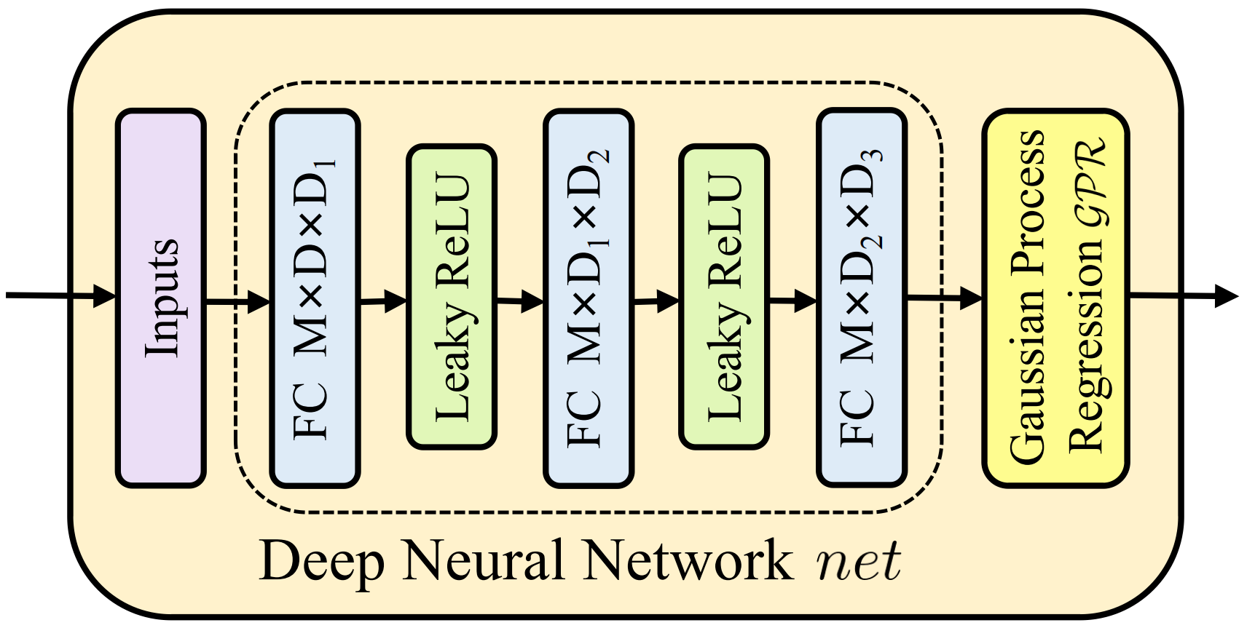
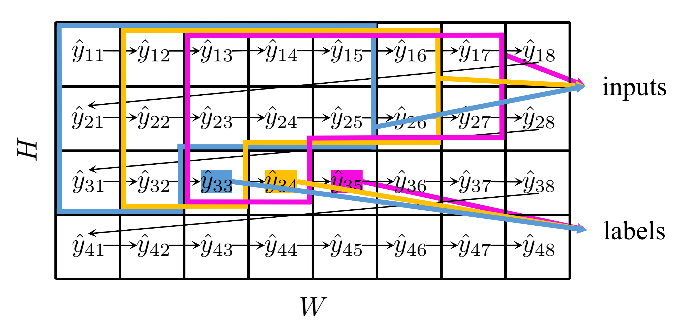
Entropy Modeling via GPR
GPR module
Autoregressive process
Whitening and dimensionality reduction
Variational inference method
Covariance function $k\left(x_{i},x_{j}\right)=σ_{f}^{2}\prod_{d=1}^{D}{exp⁡(−\frac{{(x_{i}^{d}−x_{j}^{d})}^{2}}{2{(l^{d})}^{2}})}$ (RBF)
Bit-rate estimation
$$ELBO=\sum_{i=1}^{N}{\underset{⇓}{\underbrace{𝔼_{q\left(f_{i}\right)}\left[log p(y_{i}|f_{i})\right]}}−KL\left[q\left(u\right)||p(u)\right]}$$
${\hat{y}}_{i}\sim (𝒩(f_{i},σ^{2})∗𝒰(−0.5,0.5))({\hat{y}}_{i})$ with $f_{i}\sim q(f_{i})$
Sampling ${\hat{f}}_{i}={\left[m\right]}_{i}+ε∙\sqrt{{\left[S\right]}_{ii}}$ with $ε\sim 𝒩(0,1)$
Notes:
Here is the structure of a GPR module, which consists of a deep neural network and a Gaussian process regression part.
The deep neural network is for whitening and dimensionality reduction for the input.
The input label pairs used for training GPR modules are obtained in an autoregressive way, as shown in this figure.
We apply the variational inference method just mentioned to the Gaussian process regression part.
We use radial basis function as covariance function.
Then in order to use evidence lower bound to estimate bit-rate.
Let’s first look at the log likelihood, which actually represents the number of bits for encoding yi under fixed fi.
Then taking the expectation into consideration, we can obtain a generalized Gaussian model for yi with its mean being the posterior of fi.
Finally, we use re-parameterization trick to get a sample for fi to make unbiased estimation.

Slide 11
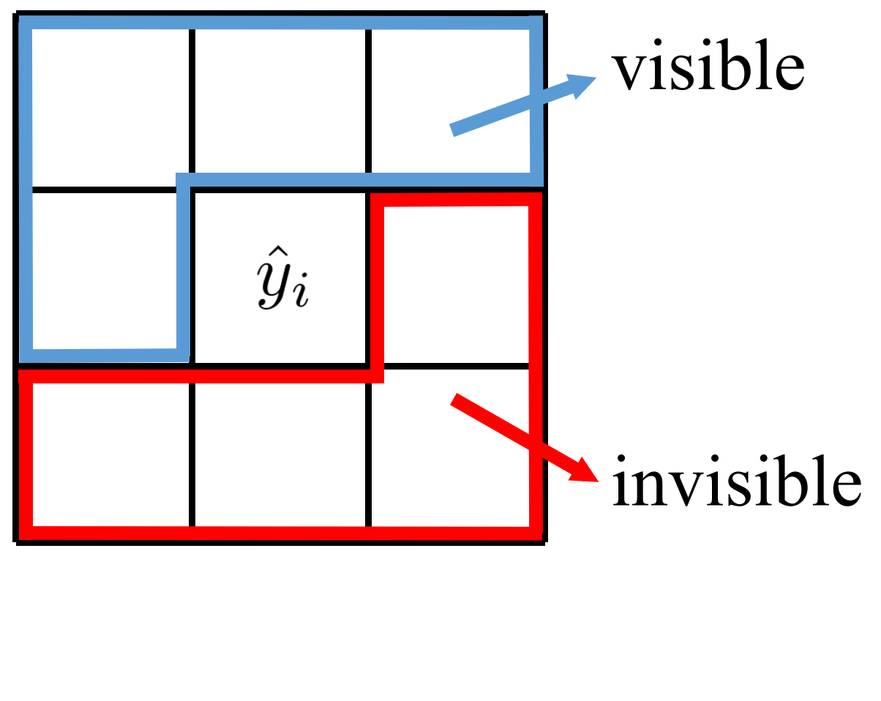
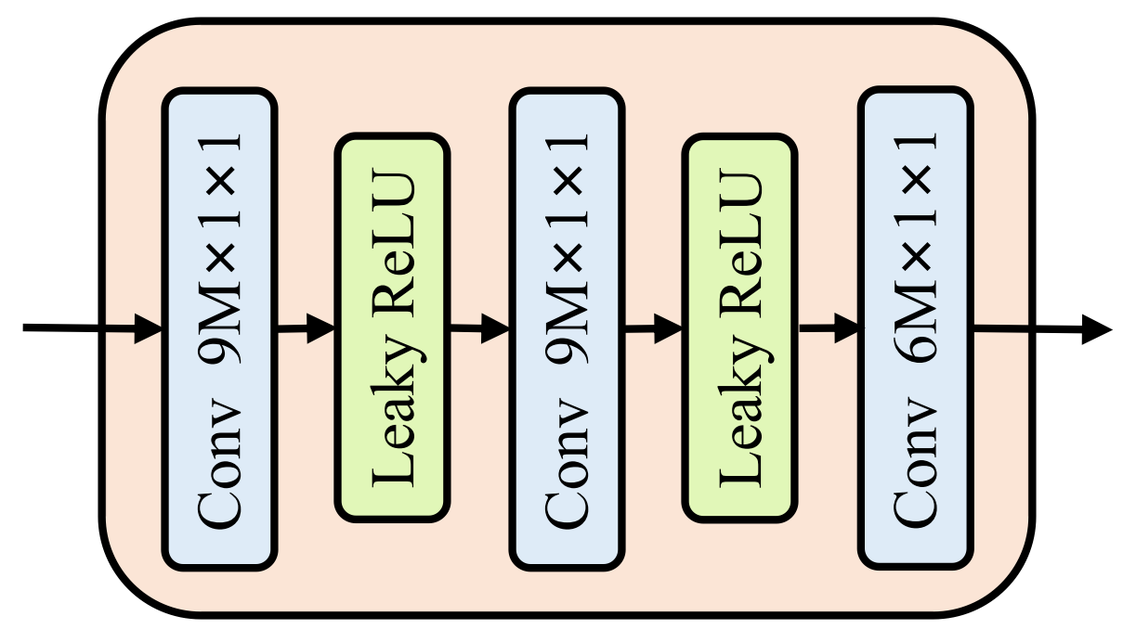
Entropy Modeling via GPR
Hyperprior
Module
Perception field of the
GPR modules
Parameter module
Notes:
Take a look at our network again.
Considering that the proposed GPR modules focus on exploiting contexts in the receptive fields, as presented in this figure, we complement them with a hyperprior module to extract global information.
Furthermore, we design a parameter module to merge the outputs from the hyperprior module and the GPR modules to produce weights and variance.

Slide 12
Rate-Distortion Optimization
Rate-distortion function
$$ℒ=R+λ∙D$$
$$\underset{bit−rate of \hat{y}}{=\underbrace{𝔼_{x\sim p_{x}}\left[−\log_{2}p_{\hat{y}|\hat{z}}(\hat{y}|\hat{z})\right]}}$$
$+\underset{penalty}{\underbrace{N_{s}/N∙\sum_{k=1}^{3}{KL\left[q\left(u^{\left(k\right)}\right)||p\left(u^{\left(k\right)}\right)\right]}}}$
ELBO
$$\underset{bit−rate of \hat{z}}{+\underbrace{𝔼_{x\sim p_{x}}\left[−\log_{2}p_{\hat{z}}(\hat{z})\right]}}$$
$$+ λ∙\underset{distortion}{\underbrace{𝔼_{x\sim p_{x}}\left[d(x,\hat{x})\right]}}$$
Bit-rate of $\hat{y}$
$p_{\hat{y}|\hat{z}}\left(\hat{y} | \hat{z}\right)=\prod_{i}{\left[\sum_{k=1}^{3}{w_{i}^{\left(k\right)}\left(𝒩\left({\hat{f}}_{i}^{(k)},σ_{i}^{(k)}\right)∗𝒰\left(−0.5,0.5\right)\right)\left({\hat{y}}_{i}\right)}\right]}$
Bit-rate of $\hat{Z}$
Additive noise instead of quantization
$p_{\hat{z}}\left(\hat{z}\right)=\prod_{i}{\left(p_{z_{i}}\left(ψ^{(i)}\right)∗𝒰\left(−0.5,0.5\right)\right)\left({\hat{z}}_{i}\right)}$
Fully factorized entropy model
KL divergence in the penalty term
$KL\left[q\left(u^{\left(k\right)}\right)||p\left(u^{\left(k\right)}\right)\right]=\frac{1}{2}\left[log\frac{\left|K_{Z^{(k)}Z^{(k)}}\right|}{\left|Σ^{(k)}\right|}+{\left[μ^{(k)}\right]}^{T}K_{Z^{(k)}Z^{(k)}}^{−1}μ^{(k)}+tr\left(K_{Z^{(k)}Z^{(k)}}^{−1}Σ^{(k)}\right)−N_{Z^{(k)}}\right]$
Distortion
$$d\left(x,\hat{x}\right)={\left\|x−\hat{x}\right\|}_{2}^{2}$$
Mean square error
Notes:
Now, I’m going to introduce the rate-distortion optimization procedure of our model.
The rate-distortion function consists of the bit-rate of y, the penalty, the bit-rate of z, and the distortion.
While the bit-rate of y and the penalty together form the evidence lower bound of GPR modules.
The proposed entropy model estimate the bit-rate of y and z as these two formulations.
Here, we build a fully factorized entropy model for z and we use additive uniform noise instead of quantization to enable backpropagation.
The penalty term can be calculate in closed form and we use mean square error for distortion.

Slide 13
Outline
Backgrounds and Motivations
End-to-end Optimized Image Compression Algorithms
Inflexibility of Existing Entropy Models
Our Work
Entropy Modeling via Gaussian Process Regression
Rate-Distortion Optimization
Experimental Results
Rate-Distortion Performance/Visual Quality
Computational Complexity
Conclusion and Future Works
Notes:
Next, I will show the experimental results of the proposed model.

Slide 14
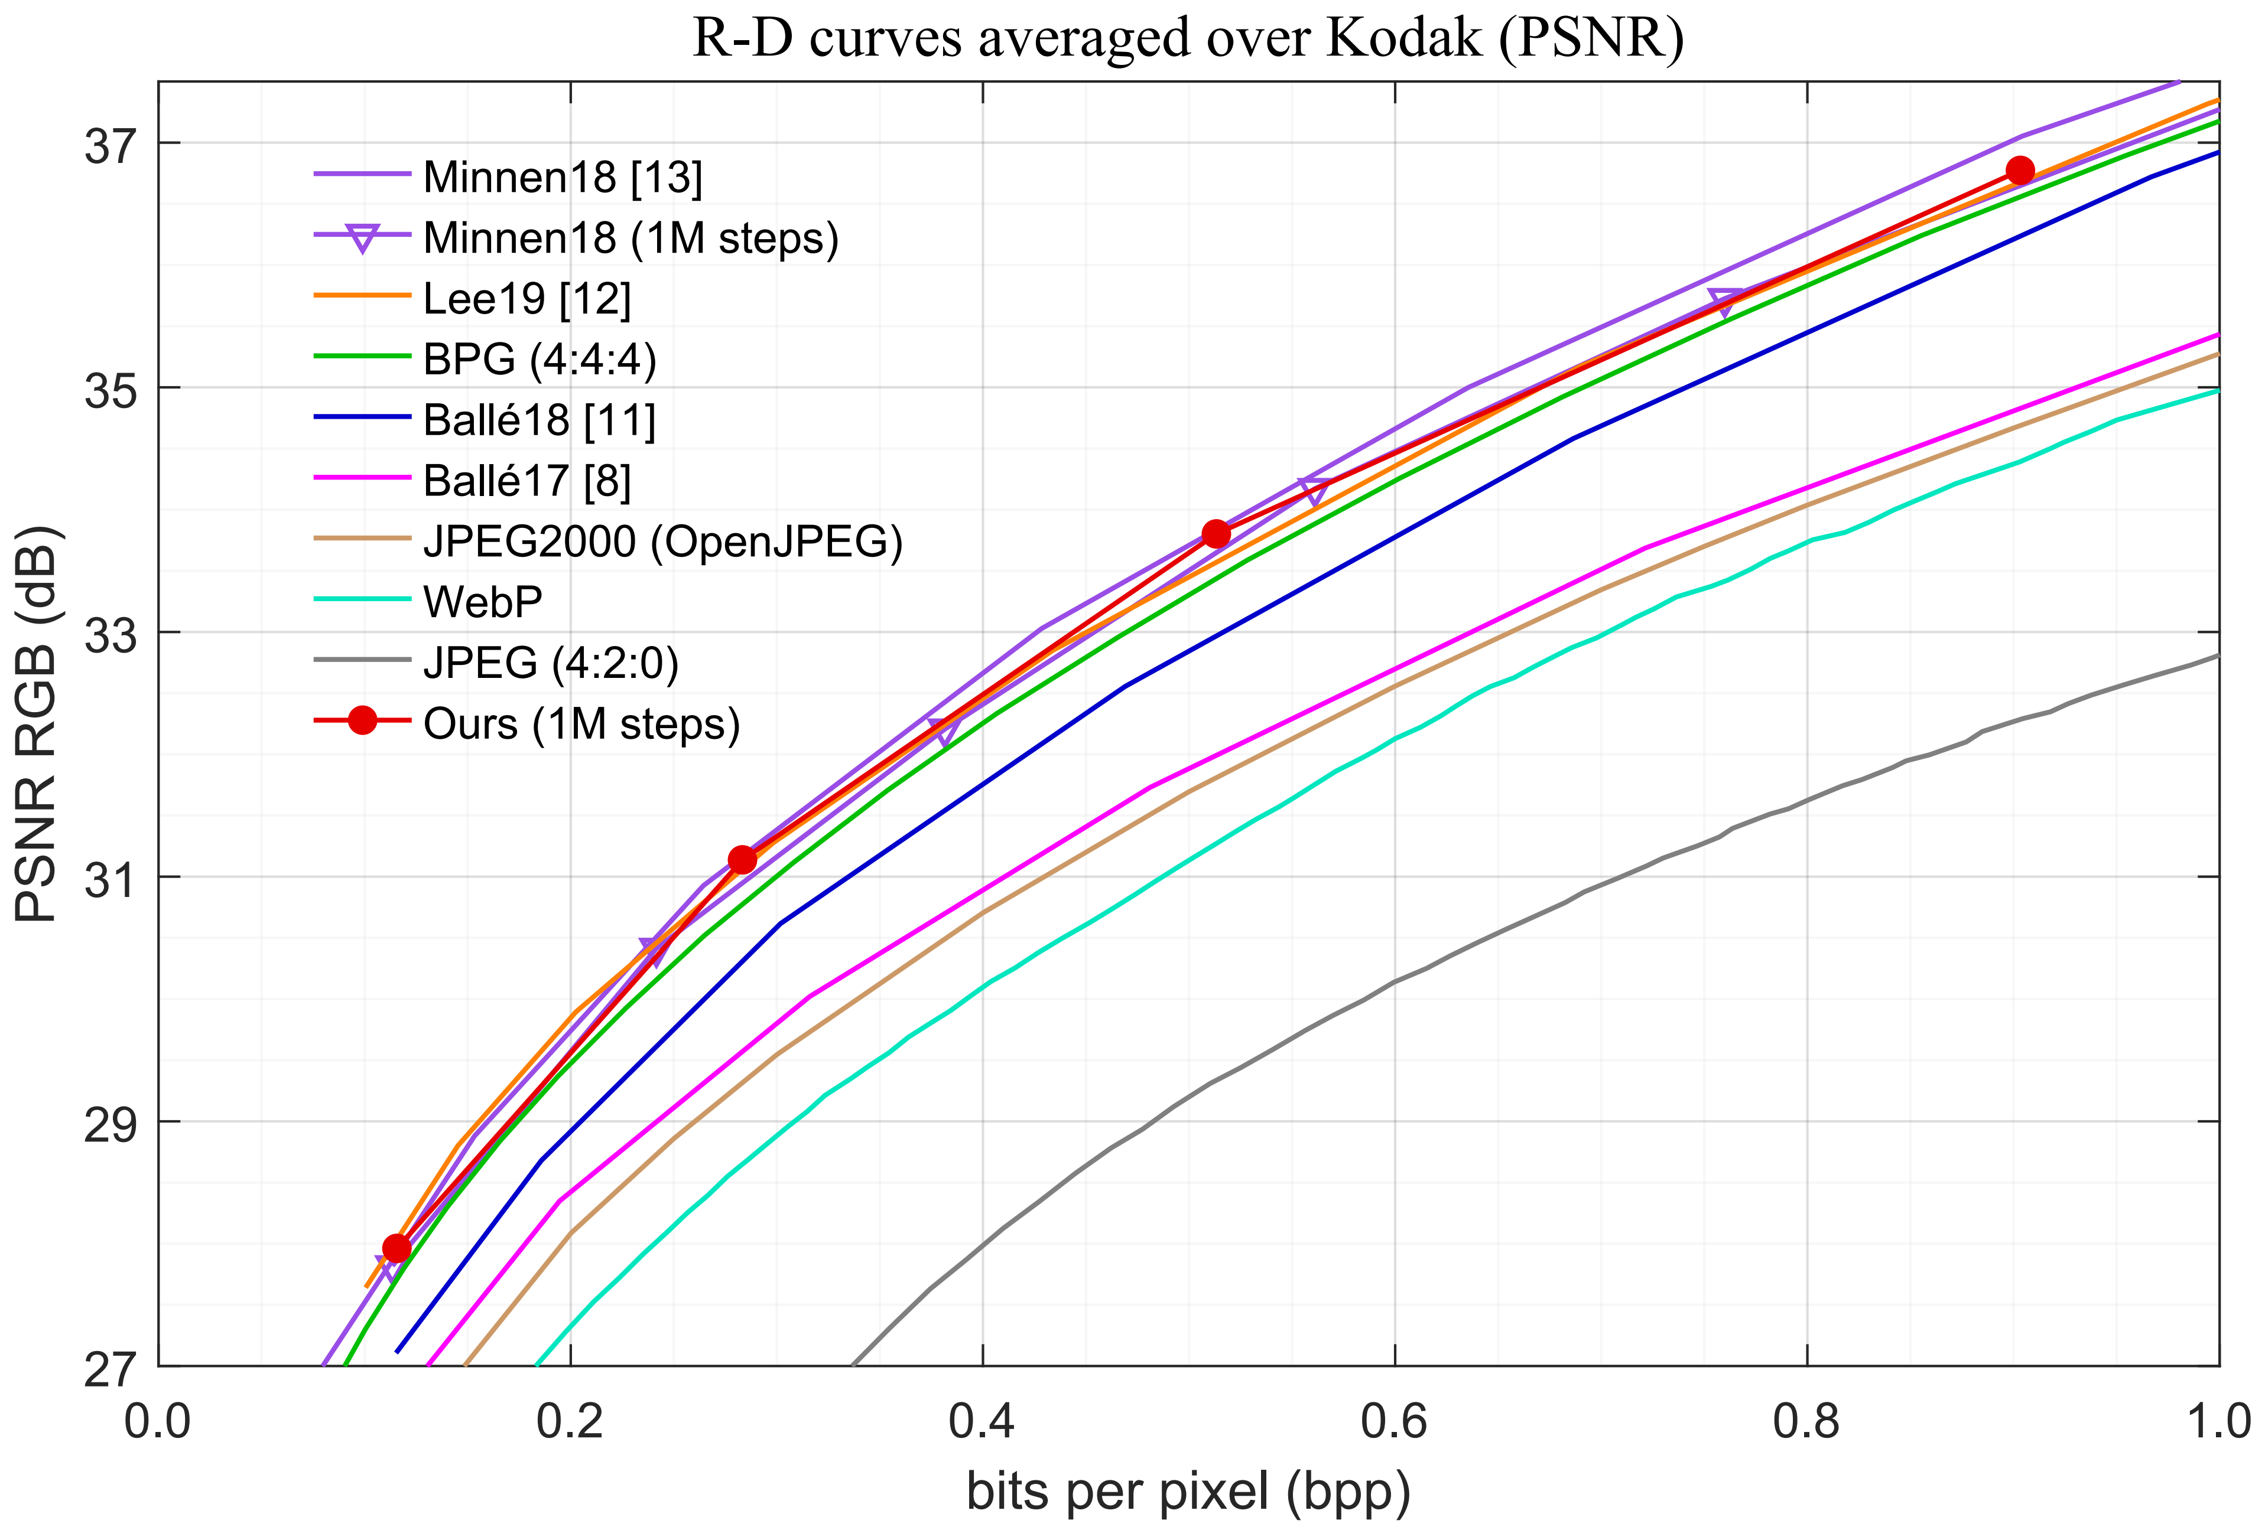
Rate-Distortion Performance
Our analysis transform and synthesis transform are the same as competitive deep learning methods.
For learning-based methods, ours performs best when training for one million steps.
Our method outperforms traditional codecs such as BPG444.
Notes:
This figure shows the rate-distortion curves tested on the Kodak dataset.
For fair comparison, our analysis transform and synthesis transform are the same as competitive deep learning methods.
We can see that for learning-based methods, ours performs best when training for one million steps.
And our method outperforms traditional codecs such as BPG444.

Slide 15
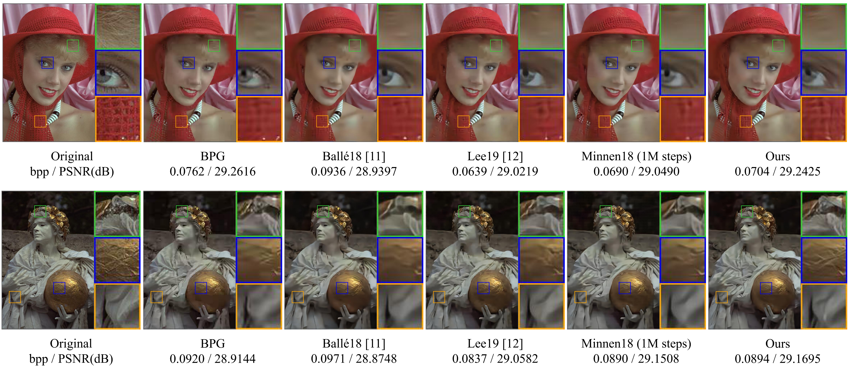
Visual Quality
Compared with learning based methods, the images decoded by BPG have block artifact.
Our method preserves more information in terms of details and textures.
Notes:
For visual quality, I post two images from Kodak dataset reconstructed by different methods below 0.1 bpp.
We can see that compared with learning based methods, the images decoded by BPG have block artifact, which is inherent in traditional codecs.
And our method preserves more information in terms of details and textures such as the scarf and the ball are closer to the original image.

Slide 16
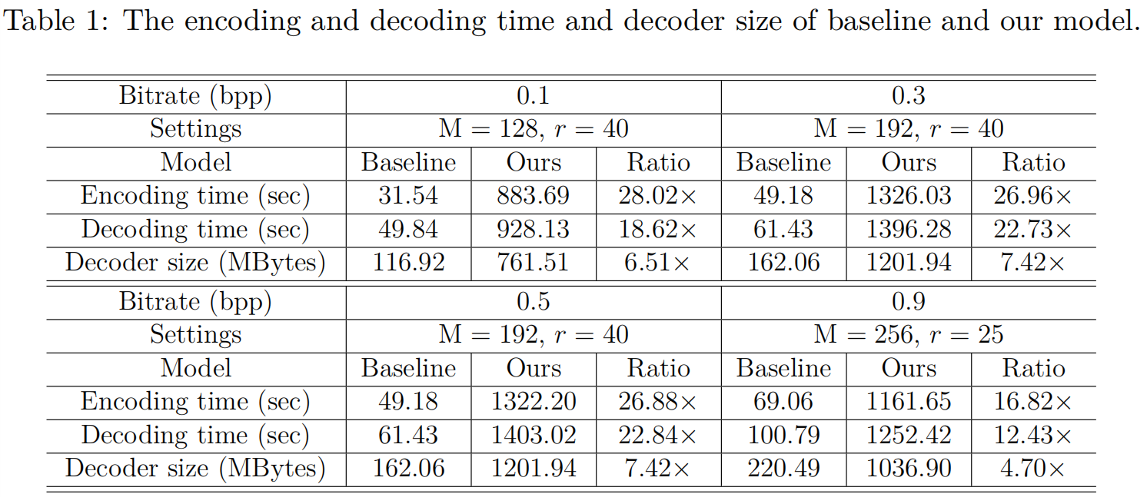
Computational Complexity
The baseline model we choose is Minnen18*.
The main contribution to the computational complexity of our model is from calculating the parameters of posterior distributions of GPR modules..
*Minnen et al, Joint Autoregressive and Hierarchical Priors for Learned Image Compression, NeurIPS 2018.
Notes:
This table shows the average encoding and decoding time on the Kodak dataset as well as the decoder size of baseline and our model.
The baseline model we choose is Minnen 2018 in NIPS since it has the best rate-distortion performance among the competitive methods.
The main contribution to the computational complexity of our model is from calculating the parameters of posterior distributions of GPR modules.

Slide 17
Outline
Backgrounds and Motivations
End-to-end Optimized Image Compression Algorithms
Inflexibility of Existing Entropy Models
Our Work
Entropy Modeling via Gaussian Process Regression
Rate-Distortion Optimization
Experimental Results
Rate-Distortion Performance/Visual Quality
Computational Complexity
Conclusion and Future Works
Notes:
Finally, I will draw a conclusion and talk about the future works.

Slide 18
Conclusion and Future Works
We propose a novel entropy model using Gaussian process regression that estimates mean with posterior distributions to deal with the problem of only fixed parameters are produced by CNNs in existing entropy models.
Reduce computational complexity
Explore the structure of variational parameters to reduce time complexity
Other probabilistic models
More accurate entropy models
…
Notes:
We propose a novel entropy model using Gaussian process regression that estimates mean with posterior distributions to deal with the problem of only fixed parameters are produced by CNNs in existing entropy models.
In the future, we can explore the structure of variational parameters to reduce time complexity.
We can also try other probabilistic models to build more accurate entropy models.
All in all, there are too many issues for us make further research.

Slide 19
Thank you!
Notes:
That’s all.
Thank you for listening.
If you have any question, please contact me via e-mail.

