Slide 1
CENET: CONTENT-AWARE ENHANCED NETWORK FOR PRACTICAL SCENE PARSING
Kai Song, Zhengtan Wang, Huhe Dai and Yuan Zheng
Code is available at https://github.com/ZY-IMU-CV/CAGFPN_CJ_2023.

Slide 2
INTRODUCTION
Scene parsing, also known as image semantic segmentation, is a fundamental and challenging task in computer vision.
Its purpose is to classify and predict each pixel within an image, and then segment an image into several meaningful class entities.
It is a key step towards visual scene understanding, and plays a crucial role for applications such as autonomous vehicles and robot navigation.
Input image
Segmentation results

Slide 3
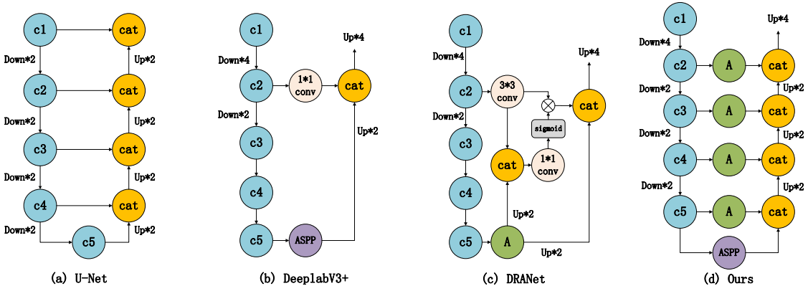
INTRODUCTION
Existing scene parsing methods generally adopt an encoder-decoder structure shown in the following figure.
Attention mechanism has been widely applied to the scene parsing methods due to its excellent performance
Fig. 1. Illustration of existing segmentation models based on encoder-decoder structure.

Slide 4
INTRODUCTION
However, spatial self-attention suffers from high computational complexity, which limits the use of scene parsing methods on mobile devices with limited resources.
The arising problem is what kind of attention more suitable for pratical scene parsing task.
Fig. 1. Illustration of existing segmentation models based on encoder-decoder structure.

Slide 5
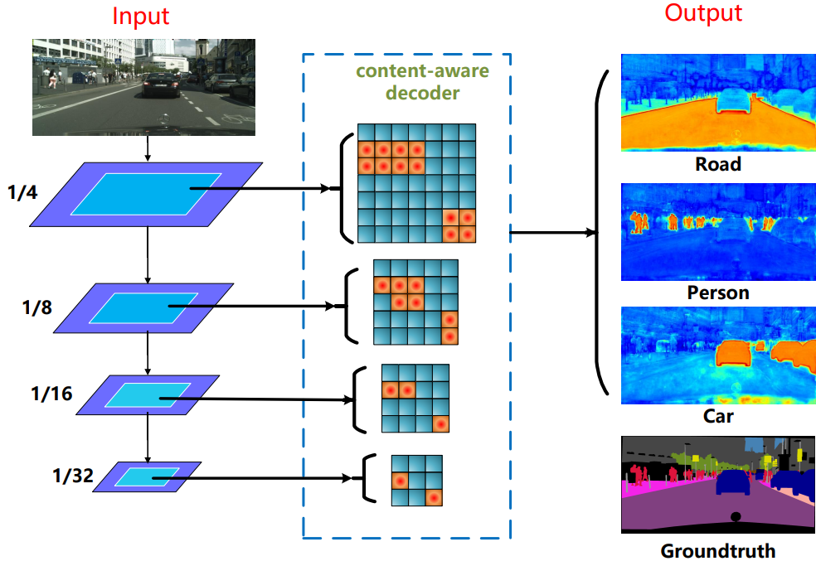
INTRODUCTION
To solve this problem, we propose a Content-Aware Attention Module (CAAM) to adaptively select the spatial pixels used for segmentation.
By introduce CAAM into the lateral connections we propose a content-aware enhanced network (CENet) for practical scene parsing.
Fig. 2. Motivation of the proposed CENet. A simple decoder with CAAM makes the spatial pixels of the same semantic categories cluster more closely, resulting in an effective semantic propagation from shallow to deep layers.

Slide 6
METHODOLOGY
With the purpose of adaptively choosing spatial pixels within the feature maps at different scales, we propose a lightweight spatial attention module, called Content-Aware Attention Module (CAAM).
Different from spatial self-attention, CAAM is carefully designed which contains two paths shown in the following figure.
Fig. 3. Overview of the proposed Content-Aware Attention Module (CAAM).

Slide 7
METHODOLOGY
Inspired by SE block, a squeeze-and-excitation operation in spatial domain is performed in the ﬁrst path of CAAM.
In the squeeze process, an average pooling operation is used to reduce both width and height of feature map.
In the excitation process, a 3 × 3 convolution is used to reﬁne feature map, a bilinear interpolation operation is used to up-sample feature map, and a sigmoid function is used to obtain a spatial attention map.
Fig. 4. Overview of the first path in CAAM.

Slide 8
METHODOLOGY
Such a squeeze-and-excitation process can be expressed by
Then, a matrix multiplication is performed and a 3 × 3 convolution is used to reﬁne the generated feature map, and the output feature map of the ﬁrst path can be obtained by
Fig. 4. Overview of the first path in CAAM.

Slide 9
METHODOLOGY
For the second path, a 3 × 3 convolution is used for feature alignment.
Finally, the output feature maps from these two paths are fused using a pixel-wise addition operation.
Accordingly, the output of CAAM is formed by
Fig. 3. Overview of the proposed Content-Aware Attention Module (CAAM).

Slide 10
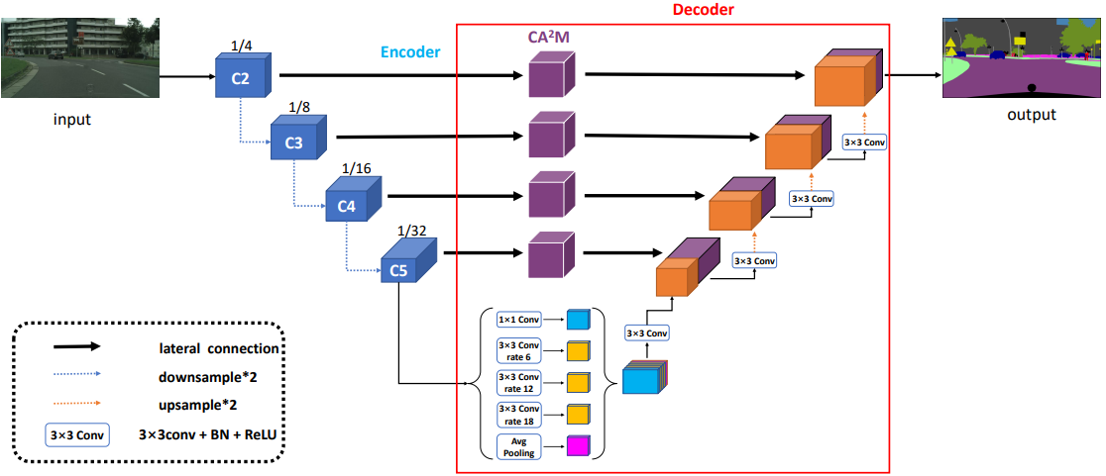
METHODOLOGY
With the CAAM, we propose a Content-aware Enhanced Network (CENet) for practical scene parsing shown in Figure 5.
CENet exploits four multi-scale features from the encoder and introduces the CAAM into the lateral connections of the decoder.
Deeplabv3+ with ASPP is chosen as baseline model.
Fig. 5. Overview of the proposed Content-aware Enhanced Network (CENet).

Slide 11
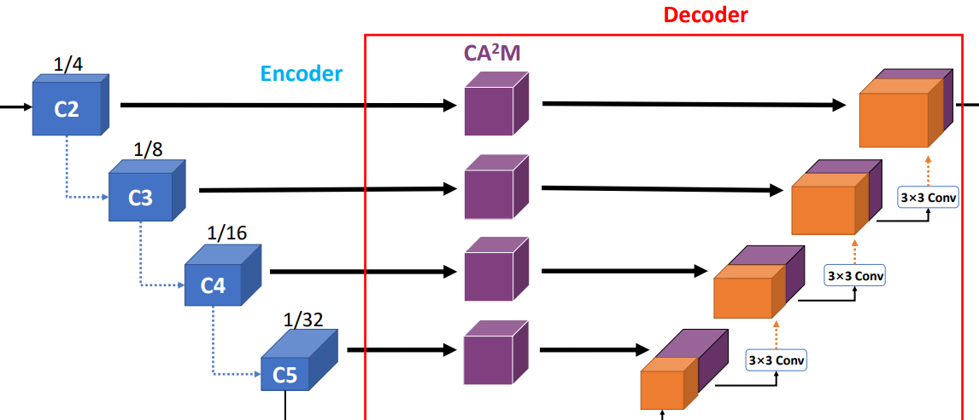
METHODOLOGY
We argue that not all pixels within feature maps is helpful for segmentation. Accordingly, we incorporate the CAAM into four lateral connections to determine which spatial pixels deﬁnitely contribute to semantic segmentation.
For feature fusion, we adopt a bottom-up pathway, where a 3×3 convolution is used to reﬁne features and reduce the channel dimension.
Fig. 5. Overview of the proposed Content-aware Enhanced Network (CENet).

Slide 12
EXPERIMENTS
Datasets:
Cityscapes, ADE20K and Pascal Context
Evaluation metric:
Mean IoU (mean of class-wise intersection over union)
Implementation details:
Using MMsegmentation framework
Using 2 GPUs with total batchsize of 8, 16 and 16 for Cityscapes, ADE20K and Pascal Context, respectively.

Slide 13
EXPERIMENTS
1. Ablation studies
Tab. 1. Ablation study of the value of the down-sampling rate used in CAAM.
Tab. 2. Ablation study of the detailed structure of CAAM

Slide 14
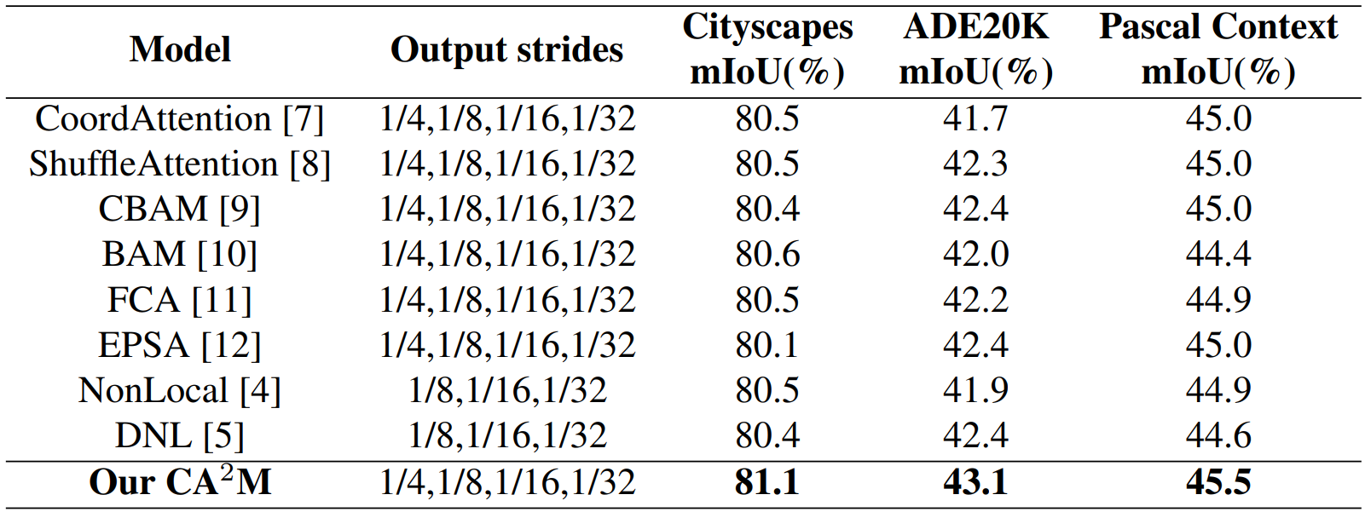
EXPERIMENTS
1. Ablation studies
Tab. 3. Ablation study of the detailed structure of CENet
Tab. 4. Ablation study of attention module used in CENet.

Slide 15
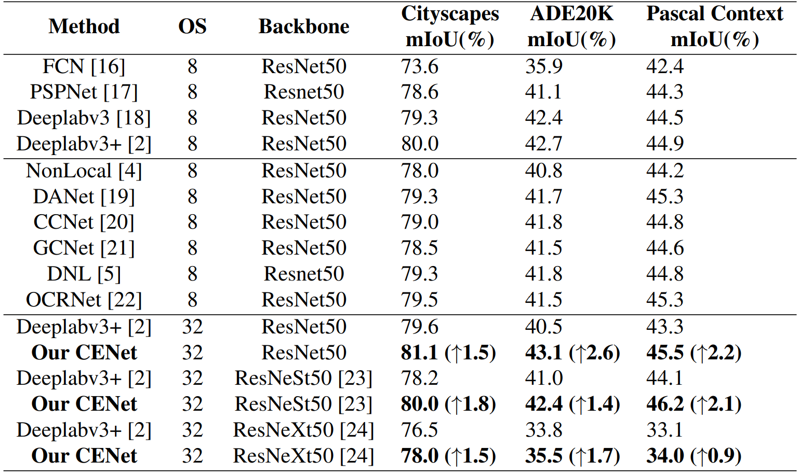
EXPERIMENTS
2. Comparison with State-of-the-art
Tab. 5. Comparison with SOTA semantic segmentation methods where OS denotes the output stride.

Slide 16
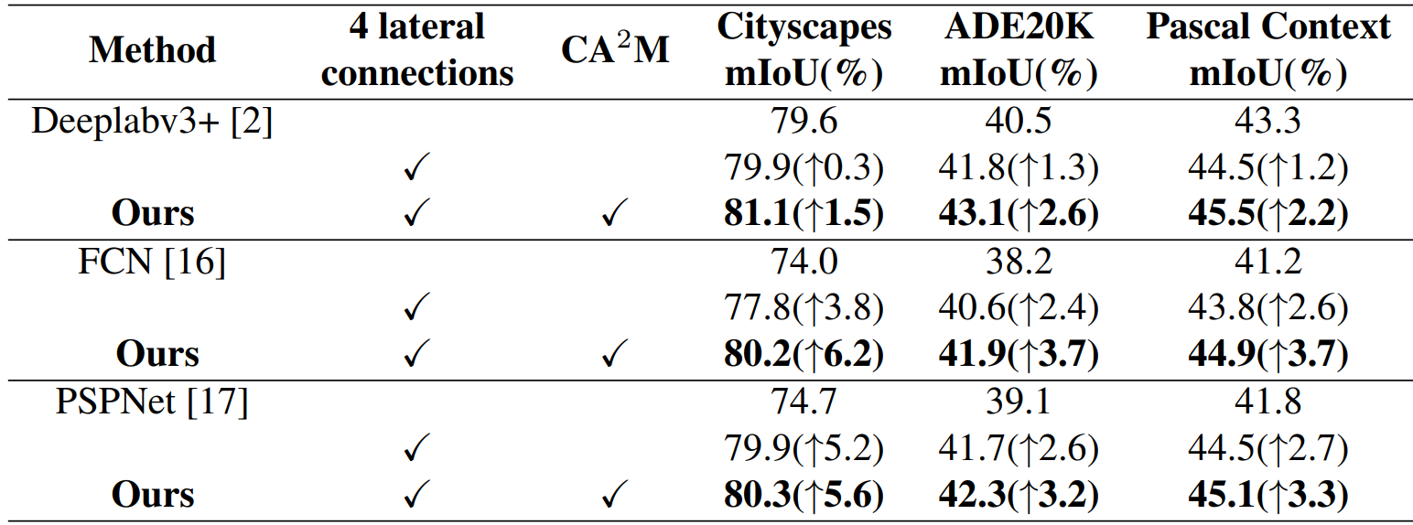
EXPERIMENTS
2. Comparison with State-of-the-art
Tab. 6. Generalization performance of our CENet for three datasets.

Slide 17
CONCLUSION
Different from self-attention, we propose a simple yet effective spatial attention, named Content-Aware Attention Module (CAAM).
With the CAAM, we provide a Content-aware Enhanced Network (CENet) for practical scene parsing, which can adaptively adjust the used pixel information at four different scales and produce more effective semantic propagation with a bottom-up pathway.
We conduct extensive experiments and achieve consistently improved performances on three popular benchmarks.
We verify its generalization ability when using different baseline models and backbone networks.

