Slide 1
Approximate Hashing for Bioinformatics
Guy Arbitman, Shmuel T. Klein, Pierre Peterlongo, and Dana Shapira

Slide 2
Deduplication
Lossless data compression allows reducing size of input
Deduplication Effectively storing duplications of large repository
Backup system for example
Splitting the repo to chunks
Applying hashes on the chunks Easily finding exact duplications
Cryptographically strong hashes
Finally storing unique chunks and pointers for the duplications

Slide 3
Similar instead of identical
Looking for similar chunks Gaining more compression
Cryptographically strong hashes are no good
Using “Approximate Hashing” as signature
Not sensitive to “small” changes
Close signature (Probably) Similar chunks
Trying to apply same logic for DNA clustering

Slide 4
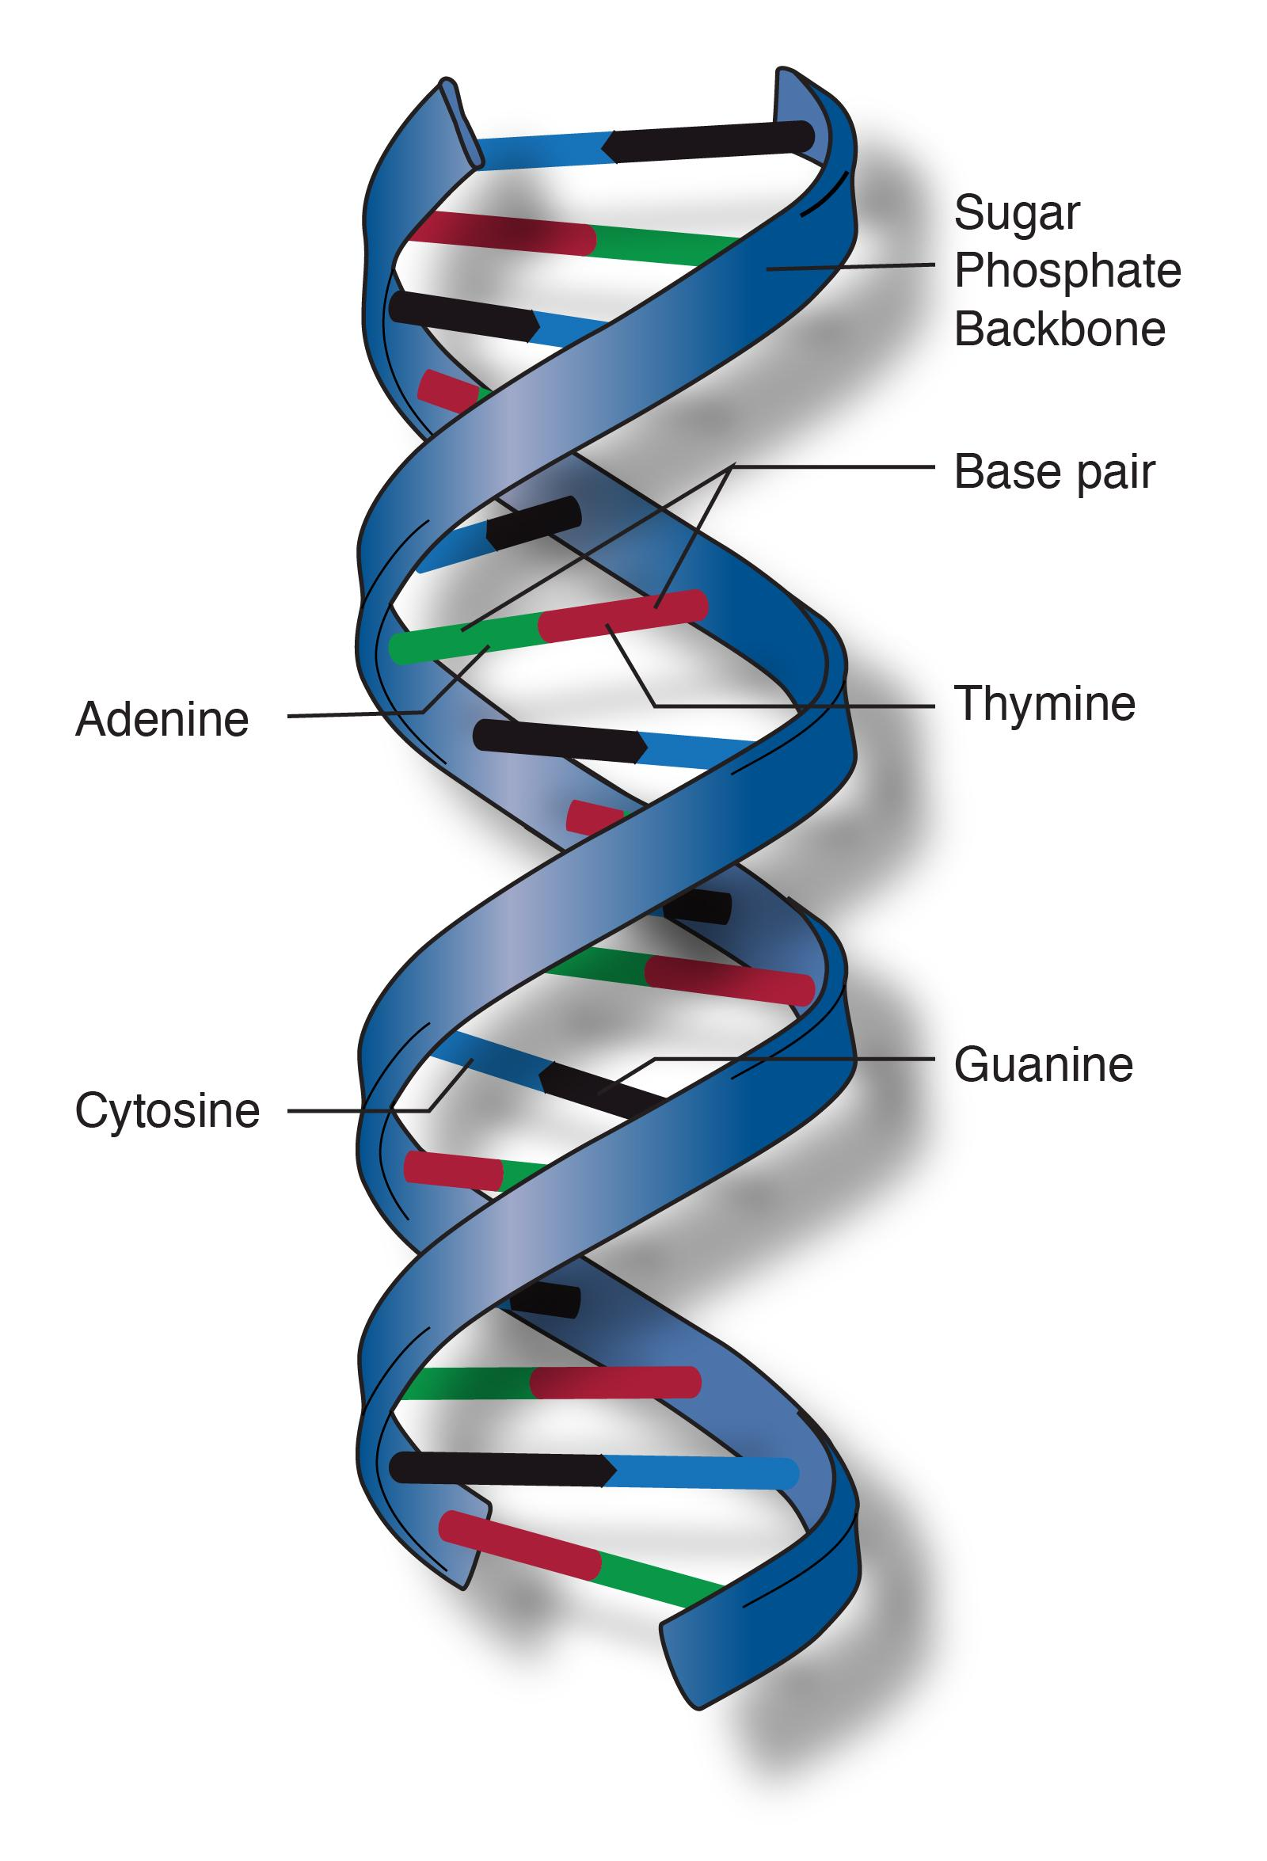
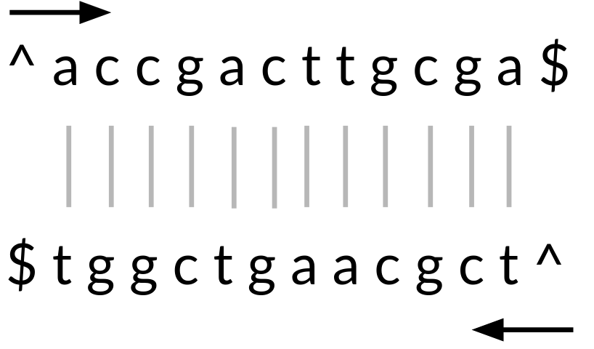
DNA
Sequence of ‘A’, ‘C’, ‘G’ and ‘T’
Length varies from dozens to billions
Determines characteristics
Build using “double helix” form
Each DNA is unique
Can be mutated

Slide 5
To cluster DNA we need to overcome the built in errors
Built in errors:
Sequencers’ errors
Mutations

Slide 6
Method
Convert sequences to small, fixed size signatures
Cluster using signatures Creates pseudo clusters
Use more accurate clustering tool to cluster the pseudo clusters
The final result will be
Very similar to the clustering performed merely on the accurate tool
Run time and memory consumption will be smaller

Slide 7
Results
3
3

