Slide 1
中国科学院自动化研究所
Institute of Automation, Chinese Academy of Sciences
A ROBUST DEEP AUDIO SPLICING DETECTION METHOD VIA SINGULARITY DETECTION FEATURE
Inner Mongolia University, China
Institute of Automation, Chinese Academy of Sciences
Kanghao Zhang, Shan Liang, Shuai Nie, Xueliang Zhang
Reporter: Kanghao Zhang
www.2022.ieeeicassp.org
Notes:
hello everyone. My name is Kanghao Zhang and im from Inner Mongolia University, Now im going to presenting our work 《A ROBUST DEEP AUDIO SPLICING DETECTION METHOD VIA SINGULARITY DETECTION FEATURE》.The other authors are Shan Liang,Shuai Nie and Xueliang Zhang.

Slide 2
OUTLINE
1. Introduction
2. Proposed Approach
3. Experiment setting.
4. Result
www.2022.ieeeicassp.org
1
Notes:
This is the outline of this presentation, we firstly introduce the task and our motivation, then we propose our architecture and approaches, the experiment setting and results will be presented in the end

Slide 3
INTRODUCTION
-BACKGROUD-
social security
privacy security
property security
...
playback
conversion
synthesis
www.2022.ieeeicassp.org
2
Notes:
The speech synthesis technology has made significant improvement over the past few years. If this technique is misused by attackers, social security, privacy security, and property
security will be threaten. Therefore, audio forgery detecting receives widespread attention in recent years.
The majority of the deep learning based techniques focus on detecting the utterance-level spoofed speech such as the spoofed utterances generated by playback, conversion, and synthesis.

Slide 4
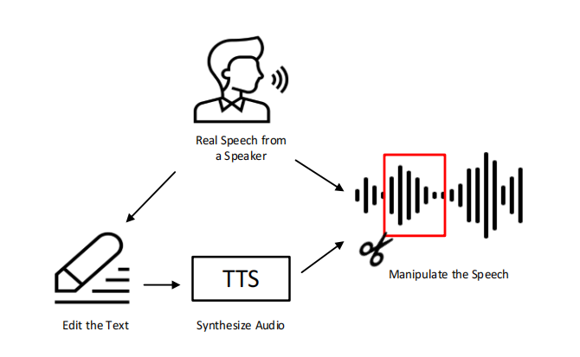
INTRODUCTION
-CONTRIBUTION-
In this paper, we address the problem of identifying splice-type fake speech.
We propose a singularity detection feature (SDF).
We apply BLSTM to observe the long-term information.
We propose a joint training strategy to train the embedding and classification sub-networks.
We conduct systematic experiments on HAD dataset demonstrate the effectiveness and robustness.
www.2022.ieeeicassp.org
3
Notes:
However, conventional systems do not detect spliced audio well because relatively short fake clips are hidden in a real speech expression.
然而，传统的系统并不能很好地检测拼接的音频，因为相对较短的假剪辑被隐藏在一个真实的语音表达中。
The problem to be solved in this paper is to identify fake speech generated by clipping
本文要解决的问题就是识别由剪辑生成的伪造语音
Our main contributions can be summarized as follows.
First, we propose a SDF which can express splicing traces straightforwardly and design a sub-network to extract the embedding.
The embedding can effectively improve the accuracy of detecting fake segments.
我们提出了一种可以直接表达拼接轨迹的SDF，并设计了一个子网络来提取嵌入。该嵌入方法可以有效地提高对假片段的检测精度。
Second, we apply BLSTM to observe the long-term information after LCNN based encode network.
我们应用BLSTM来观察基于LCNN的编码网络后的长期信息
Third, we propose a joint training strategy to train the embedding and classification sub-networks simultaneously and sufficiently.
提出了一种联合训练同时充分训练嵌入和分类子网络的训练策略。
Last, We conduct systematic experiments on HAD dataset and demonstrate the effectiveness and robustness of the proposed system
在HAD数据集[25]上进行的系统实验证明了该系统的有效性和鲁棒性

Slide 5
PROPOSED APPROACH
-SDF-
A_{M}
A_{M}
···
···
A1
D_{M}
A1
D_{M}
S
···
S
···
D1
D1
Decomposition
Selection
Reconstruction
www.2022.ieeeicassp.org
4
Notes:
Next Im going to describe the proposed method.
As mentioned earlier, splicing operations will produce singularities on the waveform. And thehigh-frequency components in wavelet analysis are particularly useful for indicating these sharply changing singularities. Therefore, we propose a high-frequency singularity detection feature(SDF) based on wavelet transform, which shows different magnitudes of forged and original segments.
The left part briefly describes the process of wavelet decomposition. In each decomposition, a (high-scale) low-frequency component(A) and a (low-scale) high-frequency
component(D) are generated. Due to the sensitivity of high frequency components to singularities, we choose the top-K high frequency components for reconstruction and the others are set to zero vectors. In this work, the decomposition M is set as 12 and the K ranges from 1 to 3.

Slide 6
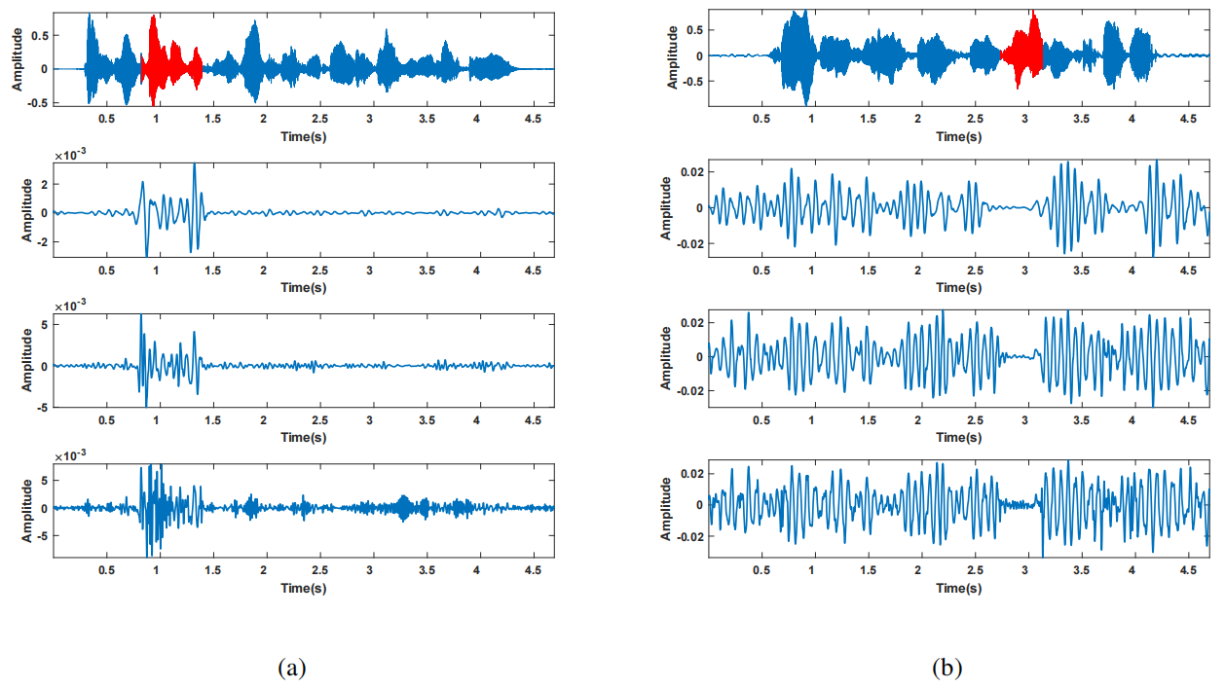
PROPOSED APPROACH
-SDF-
[1] Y. Ghanbari and M. R. Karami-Mollaei, “A new approach for speech enhancement based on the adaptive thresholding of the wavelet packets,” Speech Communication, vol. 48, no. 8, pp. 927–940, 2006.
www.2022.ieeeicassp.org
5
Notes:
An example of fake audio and the reconstructed signals are shown in Fig.3(a). The red segment denotes the fake clip, which replaces thecorresponding segment of the original audio.
In panel a, the magnitude of the spliced segment is higher than elsewhere, whereas another example in panel b shows the opposite trend.
Although the two examples exhibit different trends, the magnitude changes sharply at the splicing position, which means the splicing clip can be detect and locate by tracking these dynamic
changes via deep learning systems

Slide 7
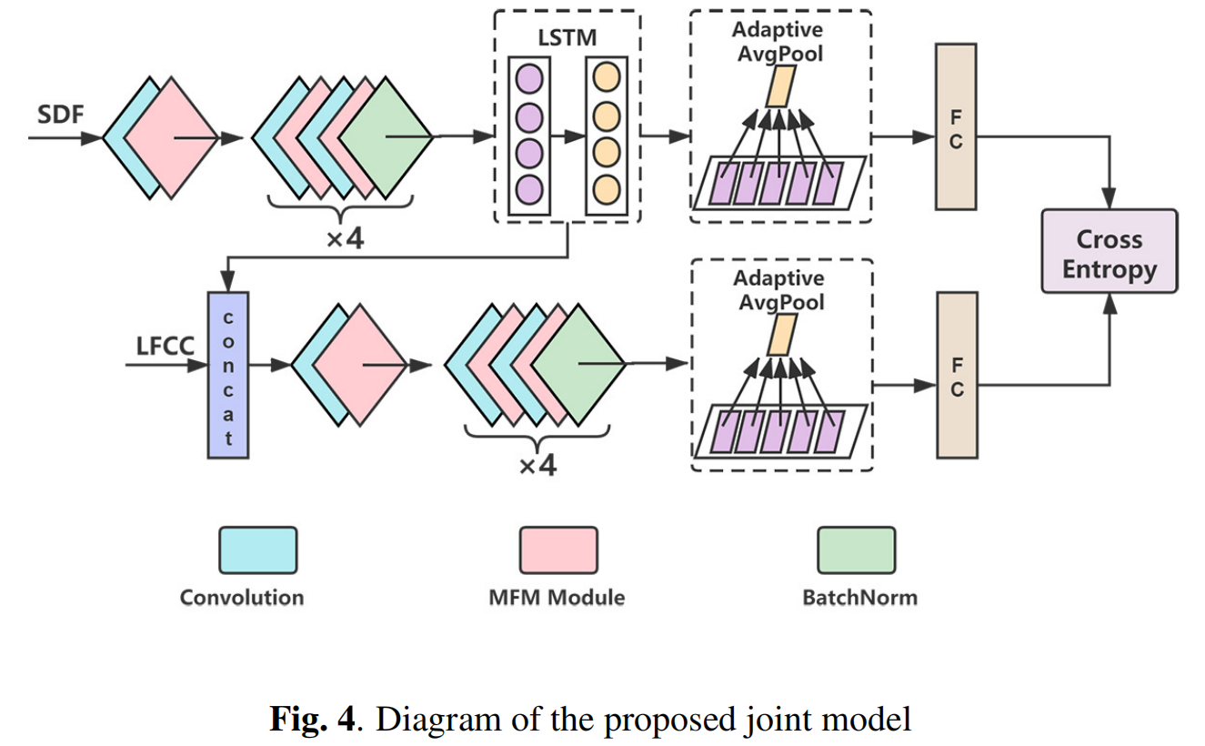
PROPOSED APPROACH
-NETWORK-
www.2022.ieeeicassp.org
6
Notes:
As usual, we transform the splicing detection and localization into a binary classification problem.
The overall structure of the proposed method is shown above.
As only high-frequency components are considered in SDF, the LFCC feature, which contains more spectral information, is concatenated as as a kind of supplementary.

Slide 8
PROPOSED APPROACH
-NETWORK-
www.2022.ieeeicassp.org
7
Notes:
Due to the fact that SDF is quite different from LFCC spectrum, a sub-network is used to extract the SDF embedding individually. The sub-network is built based on LCNN, we use
LCNN to encode features and BLSTM to detect the dynamic variations. An average pool computes an utterance-level average score from all frames. By the way, the network in the localization experiment removes this step. And then one fully connected(FC) layer followed by softmax function is used to predict the label.

Slide 9
PROPOSED APPROACH
-NETWORK-
www.2022.ieeeicassp.org
8
Notes:
Meanwhile, the outputs of the BLSTM is regarded as SDF embedding and concatenated with LFCC for subsequent modeling. the subsequent network is similar to first sub-network but without LSTM.
Finally, the full network is trained jointly using cross-entropy loss on both sub-networks.
It should be pointed out that the loss for SDF sub-network is just used for constraining the SDF embedding network in training stage and the final prediction is given by concatenated feature vector in evaluation stage.

Slide 10
EXPERIENMENT
-DATASET-
Half-truth Audio Detection (HAD) dataset
The HAD is generated based on the AISHELL-3 corpus which consists of 88035 utterances about 85 hours.
The fake clips generated by TTS and vocoder to replace named entities or attitudinal words to generate fake audios.
TRAIN:DEV:TEST = 6:2:2
Extra OOD test set: the fake clips are generated by the different TTS and vocoders to test the generalization.
[2] Jiangyan Yi, Ye Bai, Jianhua Tao, Zhengkun Tian, Chenglong Wang, Tao Wang, and Ruibo Fu, “Halftruth: A partially fake audio detection dataset,” arXiv eprint arvix:2104.03617, 2021.
www.2022.ieeeicassp.org
9
Notes:
We conduct our experiments on the HAD dataset.

Slide 11
EXPERIENMENT
-BASELINES-
Model Name | Used Feature | Network | Param.
LCNN-1 | LFCC | LCNN | 200K
LCNN-2 | LFCC | LCNN | 814K
LCNN-3 | SDF | LSTM-LCNN | 710K
Pro. | LFCC +SDF | LSTM-LCNN +LCNN | 700K +164K
www.2022.ieeeicassp.org
10
Notes:
We trained 4 networks for comparison, 3 of which are baseline systems expressed as LCNN-X. LCNN-1 has the same sturecture as the sub-network which process the concatenated feature vectors, but only processes LFCC features. And its paramter is two hundred thousand. For a fair comparison, we add paramters of LCNN-1 to eight hundred thousand as LCNN-2. LCNN-3 is similar to SDF sub-network but without downsampling.

Slide 12
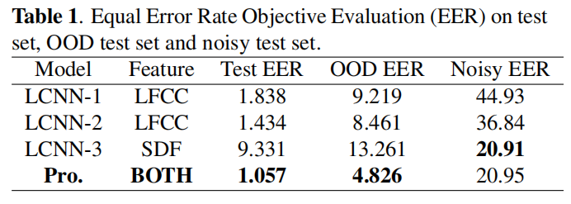
RESULT
Utterance-level
Validity
Generalizability
Robustness
www.2022.ieeeicassp.org
11
Notes:
Table 1 lists the results of utterance-level experiments on all test sets, the best scores are marked in bold. We
For the results of the test set, the proposed method outperforms the other three baseline methods. Compared with LCNN-2 and LCNN-3, the proposed method improves EER by 0.8 and 8.3 percentage point, respectively.
In addition, we can find that the increase of parameters slightly improves the performance in the OOD test set. However, the EER is significantly improved 3.6 percntage point if the proposed feature is used, which demonstrates the excellent generalization ability of the proposed method.
Moreover, to verify the noise immunity of the features, we conduct experiments on the noisy test set. Each utterance contains 15dB white noise. It can be found that LCNN almost loses the discrimination ability if only LFCC feature is used. However, the EER remains at 20% when SDF is used which improves the noise immunity.

Slide 13
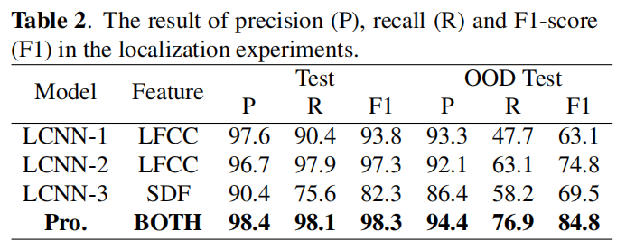
RESULT
Utterance-level
Validity
Generalizability
www.2022.ieeeicassp.org
12
Notes:
we also perform localization experiments as supple_x0002_ments. In this experiment, the model judges each frame ofaudio. It can be seen from Table 2 that the proposed method
improves the ability to locate forged clips. This further proves that the proposed SDF has a great effect on localization.

Slide 14
THANK YOU!
www.2022.ieeeicassp.org

