Slide 1
Multilingual Audio-Visual Speech Recognition with Hybrid CTC/RNN-T Fast Conformer
Maxime Burchi¹, Krishna C. Puvvada², Jagadeesh Balam², Boris Ginsburg², Radu Timofte¹
¹University of Würzburg, Germany
²Nvidia USA

Slide 2
Audio-Visual Fast Conformer: Objectives
State-of-the-art ASR architecture and performance
Fast Conformer Backbone: [2023, Rekesh et al.]
Large scale dataset training with generated transcriptions
Noise Robust ASR Model
Audio-visual inputs
Application to noisy environment (ex: driving or other real-world scenario)
Multilingual Predictions
multilingual application: Spanish, French, Italian, Portuguese, German model finetuned from English model
Flexible Usage
Audio-visual trained model supports Audio-only, Video-only and Audio-visual ASR at test time
CTC / RNN-T decoding for efficiency / performance

Slide 3
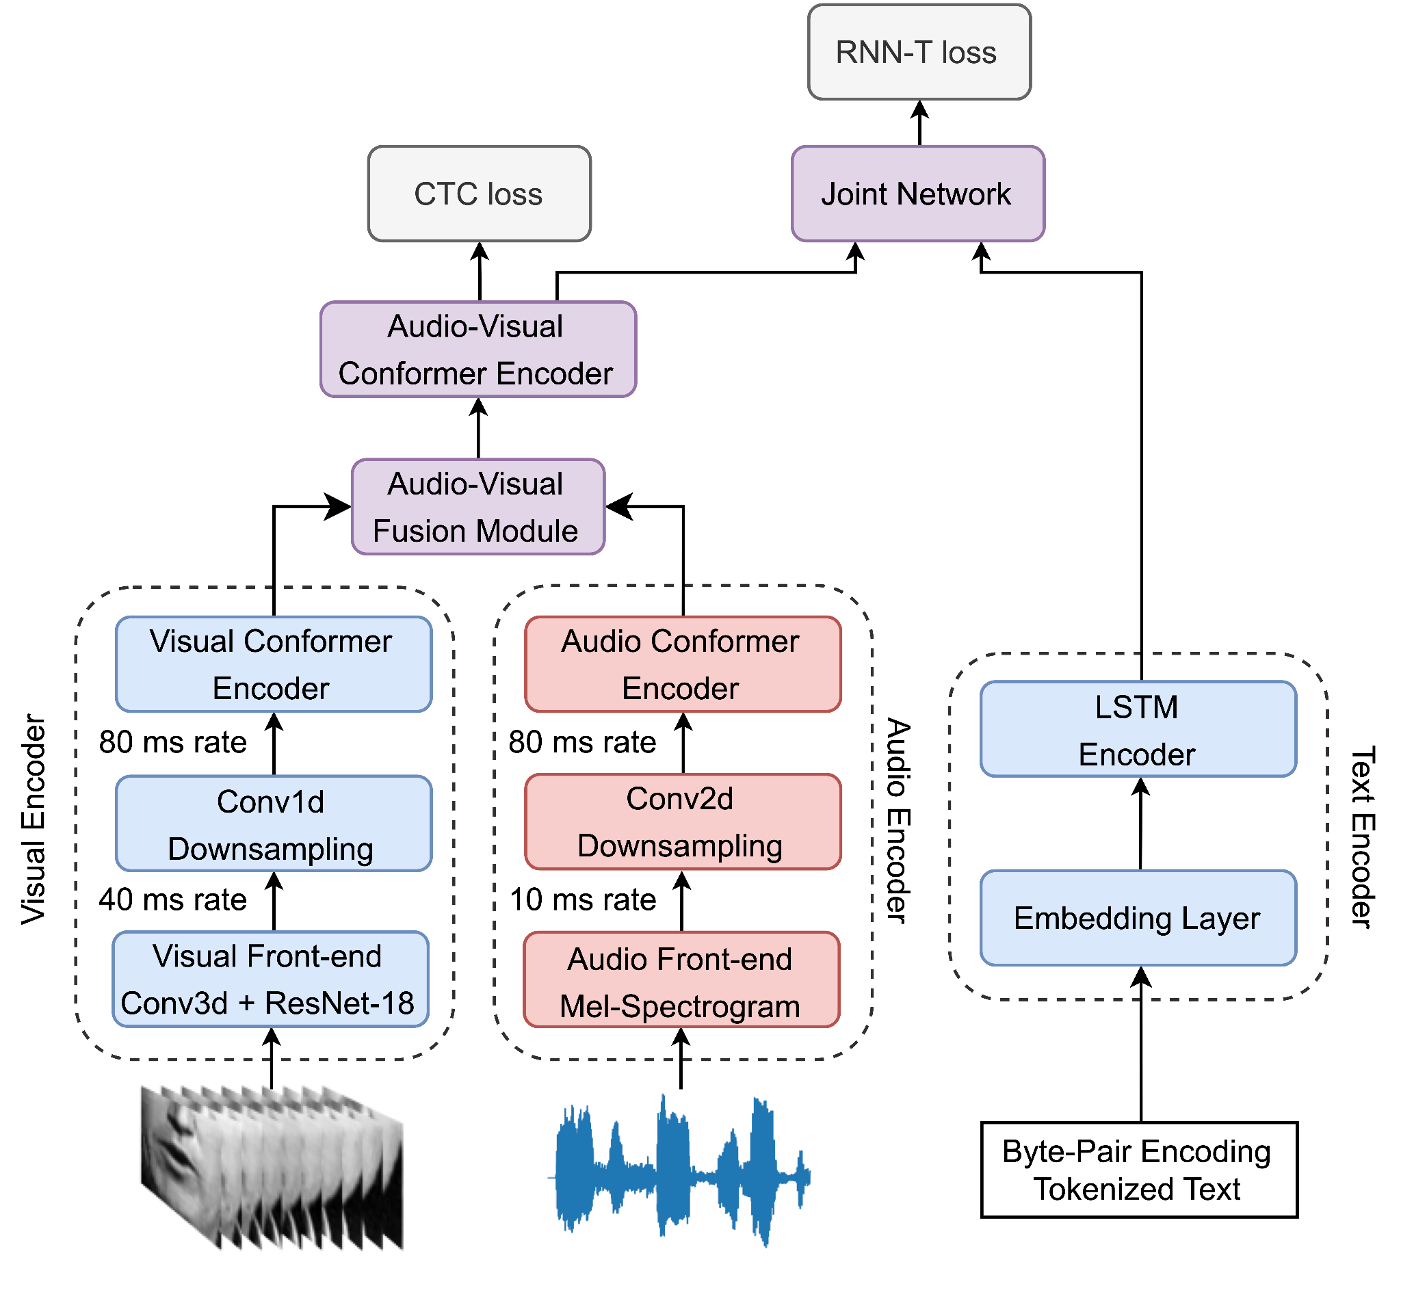
Audio-Visual Fast Conformer: Architecture
197 Millions parameters
Hybrid CTC and RNN-T loss
Mel-Spectrogram + Conformer Audio Encoder
ResNet-18 + Conformer Visual Encoder
Audio-visual fusion by feature concatenation
Conformer Audio-Visual Encoder
LSTM RNN-T decoder

Slide 4
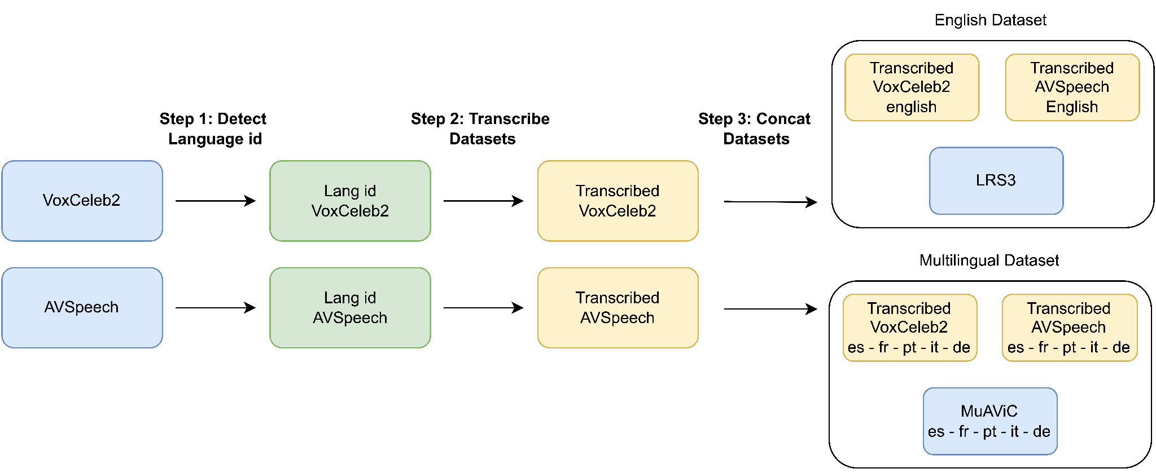
Audio-Visual Fast Conformer: Audio-Visual Datasets
LRS3: English TED talks
MuAViC: Multilingual TED talks including LRS3
VoxCeleb2: Multilingual Celebrity Speech from YouTube
AVSpeech: Multilingual Speech from YouTube
Datasets | Number of training hours per language
 | en | es | fr | pt | it | de | all
LRS3 / MuAViC | 435 | 176 | 173 | 152 | 99 | 10 | 1046
VoxCeleb2 (generated) | 1252 | 37 | 109 | 8 | 36 | 153 | 1595
AVSpeech (generated) | 1429 | 257 | 115 | 312 | 66 | 136 | 2316
Total generated | 2681 | 294 | 224 | 319 | 102 | 289 | 3910
Total | 3116 | 470 | 398 | 472 | 201 | 299 | 4957

Slide 5
Audio-Visual Fast Conformer: LRS3 results (English)
Method | Num Params AV model | Training datasets | Total Hours | LRS3 test WER (%)
 |  |  |  | AV | A | V
CM-seq2seq | 92M | LRW,LRS3 | 595 | 2.3 | 2.3 | 43.3
AVEC | 61M | LRW,LRS2&3 | 818 | 1.8 | 2.0 | 37.5
AV-HuBER | 325M* | LRS3,VoxCeleb2 | 1759 | 1.4 | 1.3 | 28.6
RAVen | 328M* | LRS3,VoxCeleb2 | 1759 | - | 1.4 | 28.2
VATLM | 325M* | LRS3,VoxCeleb2 | 1759 | 1.2 | - | 28.4
u-HuBERT | 325M* | LRS3,VoxCeleb2 | 1759 | 1.2 | 1.4 | 27.2
AV-data2vec | 325M* | LRS3,VoxCeleb2 | 1759 | 1.3 | 1.4 | 28.5
Auto-AVSR | 425M | LRW,LRS2&3,VoxCeleb2,AVSpeech | 3448 | 0.9 | 1.0 | 19.1
VIT 3D | 310M | YouTube-90k | 90k | 1.6 | - | 17.0
VGG Conformer | 180M | YouTube-100k | 100k | 0.9 | 1.0 | -
LP Conformer | 570M | YouTube-100k | 100k | 0.9 | - | 12.8
Fast Conformer (ours) | 197M | LRS3 | 435 | 1.7 | 1.6 | 43.8
 |  | LRS3,VoxCeleb2 | 1687 | 0.9 | 0.7 | 31.0
 |  | LRS3,VoxCeleb2,AVSpeech | 3116 | 0.8 | 0.7 | 25.5
* shows number of encoder parameters instead of total parameters
Reaches state-of-the-art audio-visual and audio-only results with WER of 0.8% and 0.7%, respectively
Visual-only model still lacks behind Auto-AVSR, which trains on LRW and LRS2 and has 250.5M params against 130M for our lip reading model

Slide 6
Audio-Visual Fast Conformer: LRS3 results
(English noisy setup, babble / white noise)
Method | Mode | Num Params | Noise | test time SNR level (dB)
 |  |  |  | 12.5 | 7.5 | 2.5 | -2.5 | -7.5
Auto-AVSR (noise robustness SOTA) | A | 243M | babble | 1.1 | 1.2 | 1.6 | 2.7 | 8.3
 | AV | 425M |  | 1.0 | 1.0 | 1.5 | 2.2 | 5.6
Fast Conformer (ours) | A | 119M | babble | 0.9 | 1.2 | 1.8 | 3.5 | 10.9
 | AV | 197M |  | 1.3 | 1.5 | 2.0 | 3.2 | 6.7
Auto-AVSR (noise robustness SOTA) | A | 243M | white | 2.1 | 4.0 | 10.4 | 30.2 | 88.9
 | AV | 425M |  | 1.4 | 2.3 | 4.3 | 9.5 | 24.2
Fast Conformer (ours) | A | 119M | white | 1.5 | 2.8 | 6.9 | 17.6 | 54.8
 | AV | 197M |  | 1.4 | 2.1 | 3.2 | 5.7 | 21.4
Model reaches state-of-the-art robustness
Audio-only models overfit to babble noise used during training for more robust ASR

Slide 7
Audio-Visual Fast Conformer: MuAViC results (Multilingual)
Method | Total Hours | Mode | Language |  |  |  |  | avg
 |  |  | es | fr | pt | it | de
Whisper Large (our inference) | 680k | A | 7.6 | 9.4 | 11.3 | 8.7 | 20.4 | 11.5
Monolingual AV-HuBERT | 2377 | A | 16.5 | 24.4 | 23.0 | 19.3 | 61.1 | 28.9
 |  | AV | 15.9 | 23.7 | 19.4 | 18.5 | 52.4 | 26.0
Multilingual AV-HuBERT | 2467 | A | 30.6 | 27.0 | 19.8 | 19.3 | 46.5 | 28.6
 |  | AV | 16.2 | 19.0 | 19.9 | 19.8 | 47.2 | 24.4
Monolingual Fast Conformer (ours) | 3735 | A | 8.5 | 11.1 | 12.2 | 11.4 | 41.3 | 16.9
 |  | AV | 9.4 | 11.4 | 12.7 | 12.4 | 43.9 | 18.0
Generated Transcriptions | 4957 | A | 7.9 | 9.6 | 10.2 | 10.2 | 21.7 | 11.9
 |  | AV | 8.2 | 9.8 | 10.2 | 10.6 | 22.4 | 12.2
Multilingual Fast Conformer (ours) | 3735 | A | 8.8 | 11.4 | 11.5 | 11.0 | 43.4 | 17.2
 |  | AV | 9.0 | 11.4 | 11.8 | 11.6 | 46.8 | 18.1
Generated Transcriptions | 4957 | A | 8.2 | 10.6 | 9.9 | 10.2 | 23.4 | 12.5
 |  | AV | 8.2 | 10.3 | 9.9 | 10.4 | 23.6 | 12.5
Multilingual model achieves 11.9% average WER reduction compared to original MuAViC baseline of 24.4%
Adding generated transcriptions improve German subset WER by ~20%
Whisper still achieves slightly better results, being trained with 680k hours of multilingual speech

Slide 8
Audio-Visual Fast Conformer: MuAViC results
(Multilingual noisy setup, white noise -5 SNR)
Method | Total Hours | Mode | Language |  |  |  |  | avg
 |  |  | es | fr | pt | it | de
Whisper Large (our inference) | 680k | A | 56.3 | 61.3 | 72.4 | 59.4 | 69.2 | 63.7
Monolingual Fast Conformer (ours) | 3735 | A | 58.7 | 57.8 | 63.0 | 61.5 | 91.4 | 66.5
 |  | AV | 35.2 | 49.5 | 46.9 | 45.8 | 75.5 | 50.6
Generated Transcriptions | 4957 | A | 40.5 | 60.6 | 54.4 | 49.8 | 62.5 | 53.6
 |  | AV | 29.8 | 41.7 | 40.1 | 37.0 | 48.1 | 39.3
Multilingual Fast Conformer (ours) | 3735 | A | 52.3 | 63.0 | 65.4 | 59.4 | 94.5 | 66.9
 |  | AV | 35.1 | 41.9 | 42.4 | 37.5 | 87.0 | 48.8
Generated Transcriptions | 4957 | A | 44.9 | 52.9 | 55.9 | 50.0 | 69.0 | 54.5
 |  | AV | 28.2 | 35.1 | 34.7 | 30.3 | 50.3 | 35.7
28% average WER reduction compared to Whisper
30.8% average WER reduction compared to Monolingual audio-only Fast Conformer
Audio-Visual Training (-15.9% avg WER)
Generated Transcriptions (-11.3% avg WER)
Multilingual Training (-3.6% avg WER)

Slide 9
Audio-Visual Fast Conformer: Learning Objective
Loss Type | Training Dataset | CTC / RNN-T LRS3 test WER
 |  | AV model | A model | V model
CTC | LRS3 | 2.3 | 2.1 | 49.7
RNN-T | LRS3 | 1.9 | 1.8 | 47.7
CTC / RNN-T | LRS3 | 2.3 / 1.7 | 2.0 / 1.6 | 49.8 / 45.9
InterCTC / RNN-T | LRS3 | 2.3 / 1.7 | 1.9 / 1.6 | 48.7 / 43.8
CTC / RNN-T | LRS3, VoxCeleb2, AVSpeech | 1.4 / 0.8 | 1.1 / 0.7 | 31.1 / 27.0
Hybrid CTC/RNN-T training slightly improve RNN-T performance while maintaining CTC results
Adding InterCTC losses in encoder helps lip reading network to reach lower WER

Slide 10
Audio-Visual Fast Conformer: Unimodal Inference of AV model
Method | Training Dataset | CTC / RNN-T LRS3 test WER
 |  | no mask | mask video features | mask audio features
Fast Conformer | LRS3 | 1.9 | 2.0 | 100.0
InterCTC | LRS3 | 1.6 | 10.2 | 48.7
Modality Dropout | LRS3 | 1.7 | 1.8 | 44.0
both | LRS3 | 1.7 | 1.9 | 44.0
Modality Dropout | LRS3, VoxCeleb2, AVSpeech | 0.8 | 1.0 | 32.2
Default Fast Conformer model ignores visual modality
Adding Inter CTC losses during training in visual encoder or modality dropout solves the problem
Training with modality dropout allows the model to be used for unimodal inference at test time

Slide 11
Audio-Visual Fast Conformer: examples (English ASR noise robustness)
groundtruth: i think what that means is that people just couldn't see what was in front of them
Visual model pred (wer: 29.41%): i think what that means is girls think what was in front of them
Audio model pred (wer: 0%): i think what that means is that people just couldn't see what was in front of them
Audio-Visual model pred (wer: 0%): i think what that means is that people just couldn't see what was in front of them
Noisy Audio model pred (wer: 29.41%): i think what that means is that people just didn't see what was inside
Nisy Audio-Visual model pred (wer: 5.88%): i think what that means is that people couldn't see what was in front of them
groundtruth: often what happens is you're planning so hard for like how do i get through the hardest part
Visual model pred (wer: 27.7%): often what happens is the plan is so hard for like how do i get through the whole
Audio model pred (wer: 5.5%): often what happens is you're planning so hard for how do i get through the hardest part
Audio-Visual model pred (wer: 5.5%): often what happens is you're planning so hard for how do i get through the hardest part
Audio model pred (wer: 50%): often what happens how do we get to the hardest part
Audio-Visual model pred (wer: 5.5%): often what happens is you're planning so hard for how do i get through the hardest part

Slide 12
Questions ?

