Slide 1
Using Multimodal Data for Automated Fidelity Evaluation in Pivotal Response Treatment Videos
CUbiC
CENTER FOR COGNITIVE UBIQUITOUS COMPUTING
Corey DC Heath, Hemanth Venkateswara, Troy McDaniel, Sethuraman Panchanathan
Center for Cognitive Ubiquitous Computing
Arizona State University
Tempe, AZ
{corey.heath, hemanthv, troy.mcdaniel, panch}@asu.edu
ARIZONA STATE UNIVERSITY

Slide 2
Pivotal Response Treatment Overview
An Applied Behavioral Analysis based treatment focusing on using natural contexts
Antecedent
Behavior
Consequence

Slide 3
Project Goal
Determine if the interventionist (parent) has demonstrated an ‘Opportunity to Respond’ (OTR)
‘Opportunity to Respond’ is a fidelity assessment category based on the interventionist delivering a clear instruction while the recipient is paying attention
Evaluate multimodal decision and feature fusion methods for classification
Notes:
Largely the current focus.

Slide 4
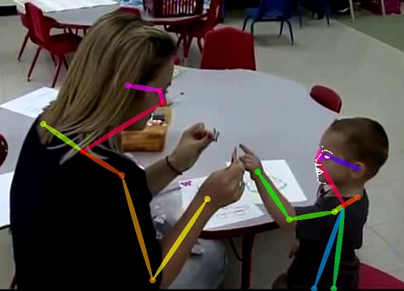
Video Probes
10 minute videos of parent-child interactions used for scoring fidelity and child vocalization
Video ref: Considine, B.: https://www.youtube.com/watch?v=VwoAYir7Vsk&t=219s, last access 10/26/2019
Notes:
10 minute video
Expected 2 clear instructions per minute

Slide 5
Dataset Description
Consists of 2 10-minute videos each for 7 child-parent dyads, 14 videos total

Slide 6
Attention and Audio Classification Results
Classification results from previous research
 | 2-Class Attention | 3-Class Attention | 2-Class Audio | 3-Class Audio
Average Accuracy | 0.55 | 0.43 | 0.81 | 0.72
Evaluation based on a ‘leave-one-dyad-out’ method
12 videos used for training model
2 videos used for validation
Accuracy represents the average across all 7 validation sets

Slide 7
Methodology
Multimodal Fusion Methods
3 Methods were evaluated
2-Class Decision Fusion
3-Class Decision Fusion
Feature Fusion
Decision fusion methods involved training separate SVM models on attention and speaker separation tasks, then using the results to infer OTR
Feature fusion consisted of concatenating pose and audio features into a single vector and training a binary class SVM on OTR

Slide 8
Results
Performance Comparison Between Methodologies

Slide 9
Limitations
Only identifying candidates for OTR, true assessment requires evaluating the parent’s language when issuing an instruction
Does not consider cases when a non-verbal instruction was given
SVM models were standardized, fine tuning parameters for each model may improve performance
Temporal relationship between samples not taken into consideration
Notes:
Largely the current focus.

