Slide 1
Approximating Optimal Bidirectional Macro Scheme
Luís M. S. Russo, Ana D. Correia, Gonzalo Navarro, Alexandre P. Francisco
This research has received funding from the European Union’s Horizon 2020 research and innovation programme under the Marie Sklodowska-Currie [grant agreement No 690941]
Bioinformatics and Information Retrieval Data Structures Analysis and Design (BIRDS)
Notes:
Hello everyone, my name is Ana Correia and I will present our paper Approximating Optimal Bidirectional Macro Scheme
This work is the result of a collaboration between INESC-ID and Instituto Superior Técnico in Portugal, and the Faculty of Physical and Mathematical Sciences at the University of Chile.
The bidirectional macro scheme provides much better compression on highly repetitive sequences that Lempel-Ziv, but is NP-Complete to find its optimal.
In this presentation, we will describe an approach that uses the simulated annealing algorithm, to obtain bidirectional macro-schemes that most the time they are 2-approximation of the optimal.

Slide 2
Introduction
Lempel-Ziv, Macro Schemes
Notes:
Next, we do simple introduction to Lempel-ziv and macro schemes

Slide 3
Lempel-Ziv
Data compression up until the late 1970’s was mainly directed towards creating better methodologies for Huffman coding.
An innovative radically different method was introduced in 1977 by Abraham Lempel and Jacob Ziv, the dictionary-based encoding – LEMPEL-ZIV
This technique consists of two considerably different algorithms - LZ77 and LZ78
Algorithm:
The source sequence is sequentially parsed into strings that have not appeared so far.
After every separation, we look along the input sequence until we come to the shortest string that has not been marked off before.
We code this phrase by giving the location of the prefix and value of the last bit.
Notes:
The Lempel-Ziv algorithm, was invented by Israeli computer scientists Abraham Lempel and Jacob Ziv in 1977.
The idea of this algorithm is to use the text itself as the dictionary, replacing later occurrences of a string by numbers indicating where it occurred before and its length.
Zip and gzip use variations of the Lempel-Ziv algorithm.

Slide 4
Lempel-Ziv (cont.) - Compression
Uncompressed S = “BAABABBBAABBBBAA”
Compressed SC = “B, A, 2B, 3B, 1A, 4B, 5A”
Notes:
The idea of Lempel-Ziv is to parse the sequence into distinct phrases. Suppose, for example, we have the string S.
We start with the shortest phrase on the left that we haven’t seen before. This will always be a single letter, in this case B, as showing in the image.
Then we take the next phrase we haven’t seen, in this case, is A.
We take the next phrase we haven’t seen. We’ve already seen A, so we take AB:
The next phrase we haven’t seen is ABB, as we’ve already seen AB in the previous phrase. In the next image show the rest of the parse.
Now, how do we encode this? For each phrase we see, we stick it in a dictionary. The next time we want to send it, we don’t send the entire phrase, but just the number of this phrase
The first row gives the index of the dictionary, and the second row their phrase.
That is, when we’re encoding the ABBB from the sixth phrase, we encode it as 4B. This maps to ABBB since the Fourth phrase was ABB, and we add B to it.
In the end the compressed version of the string S will be SC

Slide 5
Macro Scheme
Bidirectional macro schemes partitions the sequence into a sequence of phrases such that each phrase is either an explicit symbol or it can be copied from somewhere else in the text, as long as cycles are not introduced in the copying process.
Bidirectional macro schemes can produce parsings to $θ(\log{n})$ times smaller than Lempel-Ziv, on a text of length $n.$
1
2
3
4
5
6
7
8
9
10
11
12
13
14
15
16
17
18
19
20
21
22
a
b
a
a
b
a
b
a
a
b
a
a
b
a
b
a
a
b
a
b
a
$
Pointer to another position where the phrase occours;
Length of the phrase;
Letter that ends the phrase;
Encoding: (6,6,b),(16,4,a),(0,0,b), (9,8,$)
Notes:
In his 1982, James Storer and Thomas Szymanski presented a study of an exhaustive classification of macro schemes.
Macro schemes are based on the principle of finding redundant strings or patterns and replacing them by pointers to a common copy.
In this study they presented the Bidirectional macro schemes that partition the text into a sequence of phrases, so that each phrase is either an explicit symbol
or it can be copied from somewhere else in the text, as long cycles are not added in the copying process.
The following example shows a valid macro scheme. Encoding of this scheme is (6, 6, b), (16, 4, a), (0, 0, b), (9, 8, $), where each tuple describes a phrase by giving a pointer to another position where the phrase occurs, the length of the phrase and the letter that ends the phrase.
For example, last phrase encode like this (9,8,$), so 9 represents that the last phrase points to position 9, the size of the last phrase is 8 and the last letter is dollar.
For technical convenience, we use a special terminator letter in the last phrase. This macro scheme is valid because all the letters can be decoded without falling in loops.
For example, last phrase encode like this (9,8,$), so 9 represents that the last phrase points to position 9, the size of the last phrase is 8 and the last letter is dollar.

Slide 6
Problem:
Finding the optimal bidirectional macro scheme is $NP−complete$.
S = “abaababaabaababaababa$”
1
2
3
4
5
6
7
8
9
10
11
12
13
14
15
16
17
18
19
20
21
22
a
b
a
a
b
a
b
a
a
b
a
a
b
a
b
a
a
b
a
b
a
$
But this is an optimal bidirectional macro scheme?
NO
1
2
3
4
5
6
7
8
9
10
11
12
13
14
15
16
17
18
19
20
21
22
a
b
a
a
b
a
b
a
a
b
a
a
b
a
b
a
a
b
a
b
a
$
Notes:
Such macro schemes can produce parsing's up to O(log n) times smaller than a Lempel-Ziv but unfortunately finding the optimal bidirectional macro scheme is NP-Complete.
For example, we have this macro scheme that is valid but is a optimal bididectional macro scheme? NO
Because the optimal is (9,11,a),(0,0,b),(9,8,$)

Slide 7
Approach
Annealing Algorithm, Optimizations
Notes:
Now lets talk about how the out approach works

Slide 8
Local Search Algorithms
Search algorithms like breadth-first or depth-first explore all the search space systematically by keeping one or more paths in memory and by recording which alternatives have been explored
When a goal is found, the path to goal constitutes a solution.
Local search algorithms can be very helpful if we are interested in the solution state but not in the path to the goal. They operate only on the current state and move into neighboring states.
These algorithms have two key advantages:
They use less memory
They can find reasonable solutions in large or infinite state space
Notes:
Local search is a heuristic method for solving computationally hard optimization problems. Local search can be used on problems that can be formulated as finding a solution maximizing a criterion among a number of candidate solutions. This algorithms move from solution to solution in the space of candidate solutions (the search space) by applying local changes, until a solution deemed optimal is found or a time-bound is elapsed.
In our approach, we use an algorithm of this type to get a possible macro-scheme that is very close to optimal.
The algorithm that we choose was Simulated Annealing Algorithm.

Slide 9
Simulated Annealing Algorithm (SA)
The method was described by Kirkpatrick, Gelatt Jr.,Vecchi, for a solution of the traveling salesman problem in 1983.
It was motivated by the analogy between the physical annealing of metals and the process of searching for the optimal solution in a combinatorial optimization problem.
Annealing is the process by which a metal cools and freezes into a minimum-energy crystalline structure.
The main objective of SA method is to escape from local optima and so to delay the convergence.
Notes:
In 1983, this approach was used for a solution of the traveling salesman problem.
The simulated annealing algorithm was originally inspired from the process of annealing in metallurgy. Annealing involves heating and cooling a material to alter its physical properties due to the changes in its internal structure.
As the metal cools its new structure becomes fixed, as a result causing the metal to keep its newly received properties.

Slide 10
Simulated Annealing Algorithm (cont.)
Simulated Annealing proceeds in several iterations from an initial solution $x_{0}$
At each iteration, a random neighbour solution $x^{′}$is generated.
The neighbour solution that improves the cost function is always accepted.
Otherwise, the neighbour solution is selected with a given probability that depends on the current temperature $T$ and the amount of degradation $E$ of the objective function.
The probability follows the Boltzmann distribution
Many trial solutions are generated as an exploration process at a particular level of temperature.
The temperature is updated until the stopping criteria is satisfied.
Notes:
This algorithm contains a temperature variable to simulate this heating process.
Initially variable contains a very high temperature and then allow it to slowly 'cool' as the algorithm runs.
This algorithm start with a initial solution and for each iteration is generated randomly a neighbour solution.
When this neighbour solution is best solution that the previous is always accept.
If is not and given a probability is can be accepted or not.
While the temperature variable is high the algorithm will be allowed, with more frequency, to accept solutions that are worse than our current solution.
This gives the ability to jump out of any local optimums it finds itself in the early stage.
As the temperature is reduced the probability of accepting worse solutions is small, therefore allowing the algorithm to gradually focus in on area of the search space in which hopefully, a close to optimum solution.
This gradual 'cooling' process is what makes the simulated annealing algorithm remarkably effective at finding a close to optimum solution when dealing with large problems which contain many local optimums.
###E represents the difference in the objective value between the current solution x and the generated neighboring solution x'.

Slide 11
Approach
Use the simulated annealing algorithm to find a possible small macro scheme.
Each configuration is a state and a neighbor configuration can be obtained by merging or splitting phases.
A transition that successfully merges two phrases is always accepted
A transition that splits phrases may be accepted or rejected depending on following equation:
Current temperature ($t$)
Increase in the number of phrases ($δ$)
Random number ($p$)
$δ ≤−t\ln{p}$
Notes:
We use the simulated annealing to find small bidirectional macro scheme that is closer to the optimal.
Each iteration of the SA we start with a configuration and obtain a neighbor configuration by merging or/and splitting phrases.
A configuration that merges two phrases and is a valid macro scheme is always accepted.
A configuration that we need to spilt may be accepted or reject depending on the current temperature, the increase in the number of phrases, and a random number chosen uniformly from 0,1.
The Equation that is presented holds this decision.

Slide 12
Approach (cont.) - Initialization
Configuration parameters for the simulated annealing:
Hot temperature and Cold Temperature
Number of iterations
Initial configuration (Macro scheme)
Example: S = “abaababaabaababaababa$”
Initial Configuration:
1
2
3
4
5
6
7
8
9
10
11
12
13
14
15
16
17
18
19
20
21
22
a
b
a
a
b
a
b
a
a
b
a
a
b
a
b
a
a
b
a
b
a
$
Notes:
So how this approach works:
Firstly, the algorithm calculates the hot temperature and the cold temperature that is going to use and receives the number of iterations and the initial configuration.

Slide 13
Approach (cont.) – Create a new configuration and Merge phrases
Chooses a phrase uniformly at random
Try to merge with the next phrase
Search by substrings that equals to merged string
Create a new pointer of this new phrase
If the new pointer does not create cycle the new configuration is accepted
Example: Let’s remove the letter of index 7
1
2
3
4
5
6
7
8
9
10
11
12
13
14
15
16
17
18
19
20
21
22
a
b
a
a
b
a
b
a
a
b
a
a
b
a
b
a
a
b
a
b
a
$
Notes:
At each iteration, the algorithm chooses a phrase random and tries to merge it with the next phrase.
In this example we choose to merge the first and second phrases.
Using Suffix array we locate other copies of the new phrase.
In this example occurs at positions 1 and 9.
The suffix always returns the first position of the substring that we are looking for, and the approach never chooses that position for pointer because it would lead to loops in the decoding process.
In this example we choose position 9 for pointer yielding a valid macro.
At the end of this iteration, the new configuration is accepted.

Slide 14
Approach (cont.) – Split Phrase
But what if the new pointer leads to loops in the decoding process ???
We need to Break the cycle
Choose a random position of the cycle
This position becames an explicit letter/symbol
Remake the pointer for the right sub-phrases

Slide 15
Approach (cont.) – Split Phrase example
1
With this configuration it’s not possible to decode the letter at position 21 because it gets captured in loop involving the positions 11 and 6.
2
3
4
5
6
7
8
9
10
11
12
13
14
15
16
17
18
19
20
21
22
a
b
a
a
b
a
b
a
a
b
a
a
b
a
b
a
a
b
a
b
a
$
1
2
3
4
5
6
7
8
9
10
11
12
13
14
15
16
17
18
19
20
21
22
a
b
a
a
b
a
b
a
a
b
a
a
b
a
b
a
a
b
a
b
a
$
right_pointer = original_pointer + lenght _of_left_sub_phrase.
Notes:
Lets see exemple of this operation.
we do a operation merge and result was the first phrase, and after 4 attemps of create a pointer that don't leads to loop we add invalid pointer.
For example, the letter at position 21 cannot be decoded, because it gets captured in a loop involving 11 and 6. However, when we select a new pointer, we only need to try to decode the letters inside the newly created phrase, and not all the letters in the text. This means that 21 is not tested by this process. Instead, position 1 is, and it will expose the underlying issue, because it also gets captured into the cycle formed by 11 and 6. We break this cycle by choosing uniformly between the positions in the cycle, in our case 11 and 6. The selected position becomes an explicit letter.
Splitting a phrase is simpler than merging because we do not need to select new pointers. This division did not produce two sub-phrases, only the left one. Left sub-phrases always retain their pointer, in this case to position 3.
But If slipt generate a right sub-phrase it would need change the pointer like this :right_pointer = original_pointer + lenght _of_left_sub_phrase.

Slide 16
Data Structures – Suffix Arrays
Determine the lexicographic rank of all the occurrences of the given phrase;
This operation requires $Ο(m\log{n})$ time for a phrase of size $m;$
In this approach we add two optimizations:
We cache the searches by storing the resulting suffix arrays intervals.
When two phrases get merged we combine the two intervals in $Ο(\log{n)}$ time by using inverse suffix array and a binary search;
Notes:
We use suffix arrays search copies all occurrences of the given phrase.
In general this operation requires O(m log n) time for a phrase of size m.
So we add two optimizations to improve this operation:
First, we cache the searches by storing the resulting suffix array intervals and a phrase is split, this information is discarded.
When two phrases get merged we combine the two intervals in O(log n) time by using the inverse suffix array and a binary search.

Slide 17
Data Structures – Link Cut Tree
In this approach, the merge phrase can create loops and to detect these loops it can take considerable time because the decompressing paths can be long.
To improve this step we used link cut tree data structure that can detect loops in $Ο(\log{n)}$ amortized time per letter.
The link cut tree represents the decoding paths, where the roots of the tree correspond to the position that stores explicit letters.
Notes:
Checking for loops may take considerable time, since the decompressing paths can be long.
So we use the link cut tree data structure, which detects loops in only O(log n) amortized time per letter.
Since, in a valid macro scheme, it is possible to decode the letters at every position, the decoding paths can be represented as a forest, where the roots of the trees correspond to the positions that store explicit letters.

Slide 18
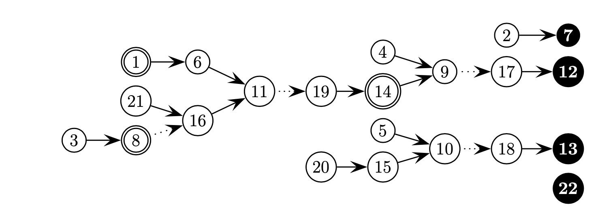
Data Structures (cont.) – Link Cut Tree
1
2
3
4
5
6
7
8
9
10
11
12
13
14
15
16
17
18
19
20
21
22
a
b
a
a
b
a
b
a
a
b
a
a
b
a
b
a
a
b
a
b
a
$
Notes:
This image shows the forest corresponding to the macro scheme
This link cut tree contains all the pointers in the macro scheme above .

Slide 19
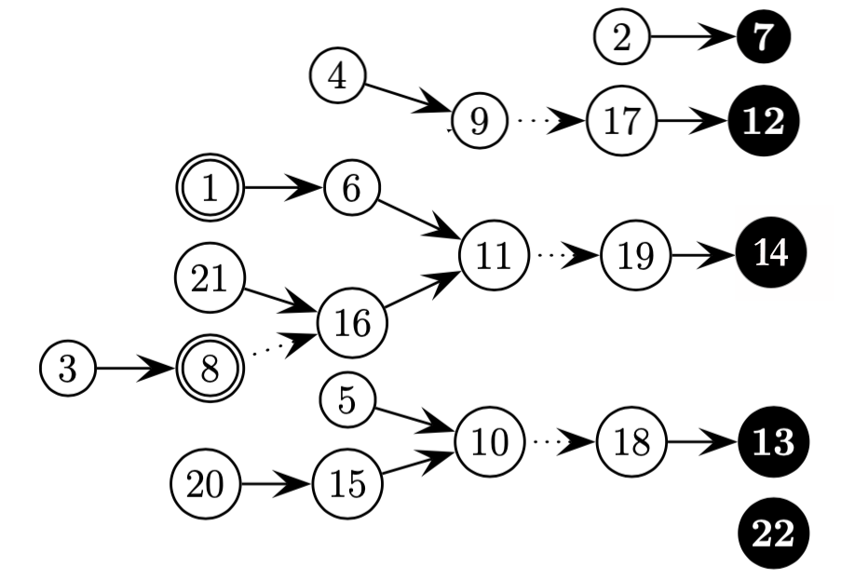
Data Structures (cont.) – Link Cut Tree and Split Phrases
Splitting phrases are simple and efficient, it just requires cutting the edge of the new letter in the path to is the parent.
1
2
3
4
5
6
7
8
9
10
11
12
13
14
15
16
17
18
19
20
21
22
a
b
a
a
b
a
b
a
a
b
a
a
b
a
b
a
a
b
a
b
a
$

Slide 20
Data Structures (cont.) – Link Cut Tree and Merge Phrases
Merging phrases requires more modifications to the link cut tree because is necessary to change all the pointers of the new phrase.
1
2
3
4
5
6
7
8
9
10
11
12
13
14
15
16
17
18
19
20
21
22
a
b
a
a
b
a
b
a
a
b
a
a
b
a
b
a
a
b
a
b
a
$
Notes:
Merging phrases requires more extensive modifications to the tree structure.
we have done the merging operation in second phrase and now we need to all the pointers this of this new phrase
We first consider the positions inside this phrase, that is, 8,9,10, and 11.
We cut the edges leaving these nodes, so they become roots in their trees.
Then we need to add the new edges (8,3);(9,4);(10,5);(11,6).
However, it is necessary to check if this change does not introduce a cycle into the forest.
This is supported by the link cut tree data structure in O(log n) amortized time.
So we first check if there is a path from 3 to 8. In fact, there is a direct edge, so it is not possible to add the edge (8,3), because it would result in an invalid macro scheme.

Slide 21
Optimizations– Simulated Annealing
Our approach does not merge phrases that are unique because they induce a trivial loop.
For those cases, we created a list of admissible phrases that will be used to select a phrase that will not be unique.
Once this is detected for a given phrase, there is no point in reconsidering the phrase in a future iteration, so the phrase gets removed from the list of admissible phrases.
With this list is possible to speed up the algorithm by skipping redundant selections of phrases.
When a phrase is split, its two-phrases need to be re-inserted into the list.
When this list is empty, the algorithm is stuck in a local minimum and will terminate.
Notes:
Another important optimization of our algorithm is related to the phrases that can- not be merged with the next phrase because they result in a unique substring.
This kind of transitions is always rejected, because they induce a trivial loop.
For those cases, we created a list of admissible phrases that will be used to select a phrase that will not be unique.
Once this is detected for a given phrase is unique, there is no point in reconsidering the phrase in a future iteration, so the phrase gets removed from a list of admissible phrases. The phrase selection procedure selects from this list, instead of from all the existing phrases.
When a phrase is split, its two sub-phrases need to be inserted in the list. Moreover, the phrase before the one being split also needs to be re-inserted into the list, in case it is not present already.
This list should not contain repetitions.
An important side effect of this approach occurs when this list becomes empty. In this case, the algorithm is stuck in a local minimum, which might go unnoticed otherwise.
And we can terminate the algorithm and return the macro-scheme.

Slide 22
2-Approximation Ratio
Theorem
Notes:
Given that our algorithm never starts by splitting phrases, it may get stuck in a local minimum. In fact, this occurred in our experiments.
Still, the particular structure of the minima turns out to be relevant.
In these minima merging any two consecutive phrases results in a phrase that is unique, that is, it happens only at its position.
We will now prove that such a configuration is a 2-approximation to the optimal macro scheme.

Slide 23
Approximate Ratio
Theorem 1 Any configuration where every pair of consecutive phrases is unique is a 2-approximation to the optimal macro scheme of the sequence.
Proof: Consider the concatenation of any two consecutive phrases, which by hypothesis is unique in the text. Such text substring cannot be inside a phrase of any macro scheme, because in that case it should occur elsewhere. Thus, every two consecutive phrases of our configuration must contain a boundary in any macro scheme.
Notes:
This image, shows such a configuration and illustrate the approximation argument.
The top string shows a local minima macro scheme such that merging adjacent phrases creates unique substrings.
The middle configuration is obtained by merging pairs of consecutive phrases, it is not a macro scheme and therefore not an optimal configuration.
The bottom configuration shows an optimal macro scheme.
We can prove an even stronger result, related to string attractors.
An attractor is a set Γ of text positions such that any text substring must have a copy containing a position in Γ. It is shown that the size γ of the smallest attractor is a lower bound to the size of any macro scheme.
Further, finding γ is NP-complete.
While it is not known even if we can always encode a text in O(γ) space, we show that our approximation also applies to the smallest attractor.

Slide 24
Approximate Ratio (cont.)
Theorem 2 For any configuration where every pair of consecutive phrases is unique, the set of the final phrase positions (i.e., the positions of the explicit symbols) is an attractor of size at most $2γ$
Proof: First, the set is an attractor because, by definition of macro scheme, any substring that is completely inside a phrase must have another occurrence containing an explicit symbol position. To see that its size is at most 2$γ$, consider again the concatenation of any two consecutive phrases, which by hypothesis is unique in the text. Therefore any attractor must contain a position inside the phrase. If there is an odd number of phrases, then there must also be an attractor position at the end of the text to cover the terminator $\$$.
Notes:
Even though this condition is not always obtain, it does occurs several times for some classes of strings. For those cases, it is a considerable improvement to the O(log n) approximation provided by the Lempel-Ziv algorithm.

Slide 25
Experimental Analysis
Data, Results

Slide 26
Data
Fibonacci sequences are binary strings defined as:
$F_{1}=b, F_{2}=a and F_{n+2}=$ $F_{n+1}$ $∙F_{n}$
Minimal macro scheme of size $3$
Thue-Morse sequences are strings defined as:
$T_{0}=0 and{ T}_{n+1}$=${ T}_{n}∙\overline{{ T}_{n}}$
Where$\overline{{ T}_{n}}$means complementing all the bits of${ T}_{n}$.
Lower bound is the number of distinct substrings of size$ℓ$divided by $ℓ$, for any $ℓ$
Bruijn sequence of order $t$contains all the distinct substrings of length $t$and is of minimum length:
$$2^{t}+t −1$$
Lower bound to the size of any macro scheme is $1+({2^{t}}/t)$
Generator sequence chooses an alphabet size $d$ and builds a text with a bidirectional macro scheme of size $d$, which must be optimal because $d$ is a lower bound.
Notes:
We tested the approach convergence speed with Fibonacci, Thue-Morse and binary de Bruijn sequences, as well as on strings obtained from a generator we developed for this purpose.

Slide 27
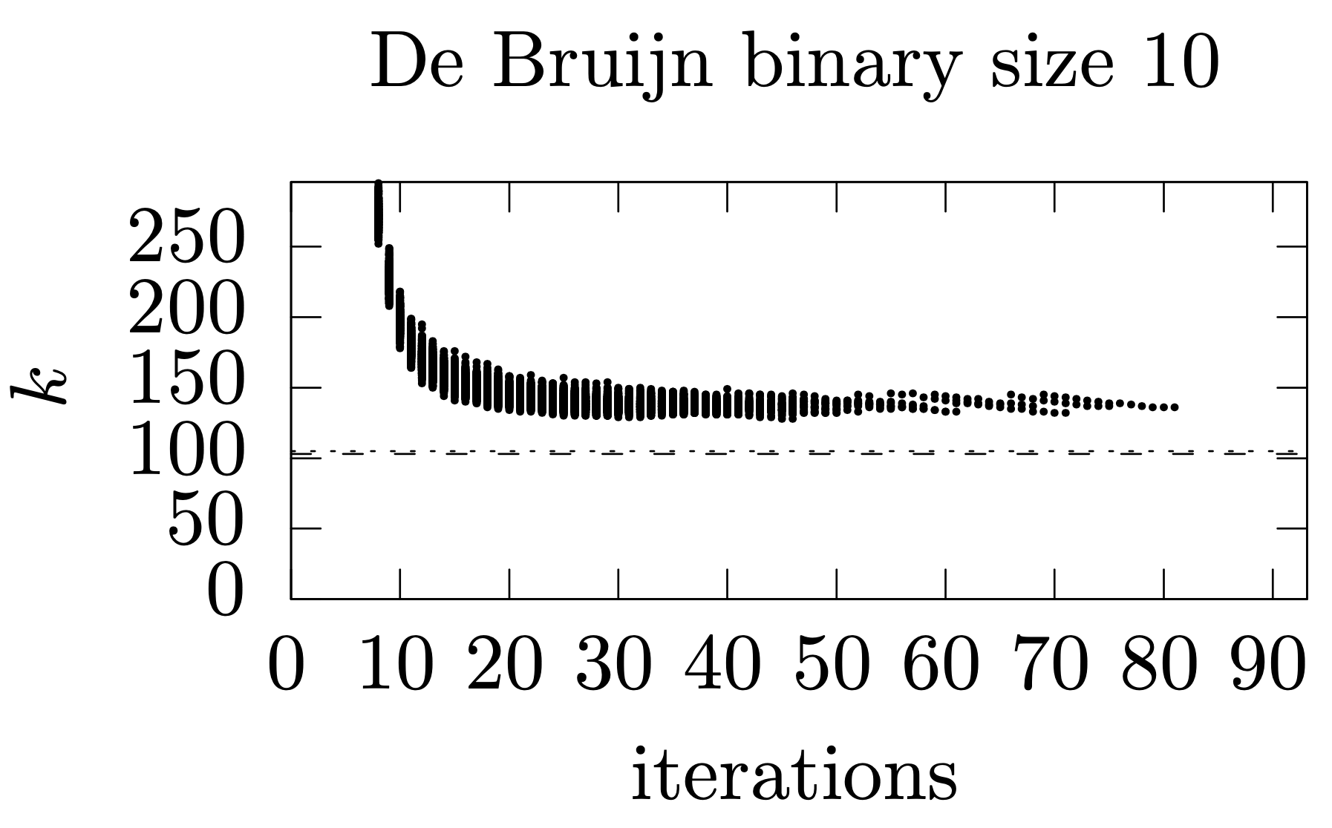
Results – De Bruijn
We need a little more phrases than the Lempel-Ziv parse;
We can obtain the 2-approximation condition;
Notes:
The de Bruijin sequences did obtain the 2-approximation condition. In fact the ratio is even better because the minimum size is 103 and the points obtained are below 200.
The ratio is closer to 4/3, which is expected on average for this kind of sequences
Out approach for de Bruijin string need more phrases to encode than Lempel-Ziv .

Slide 28
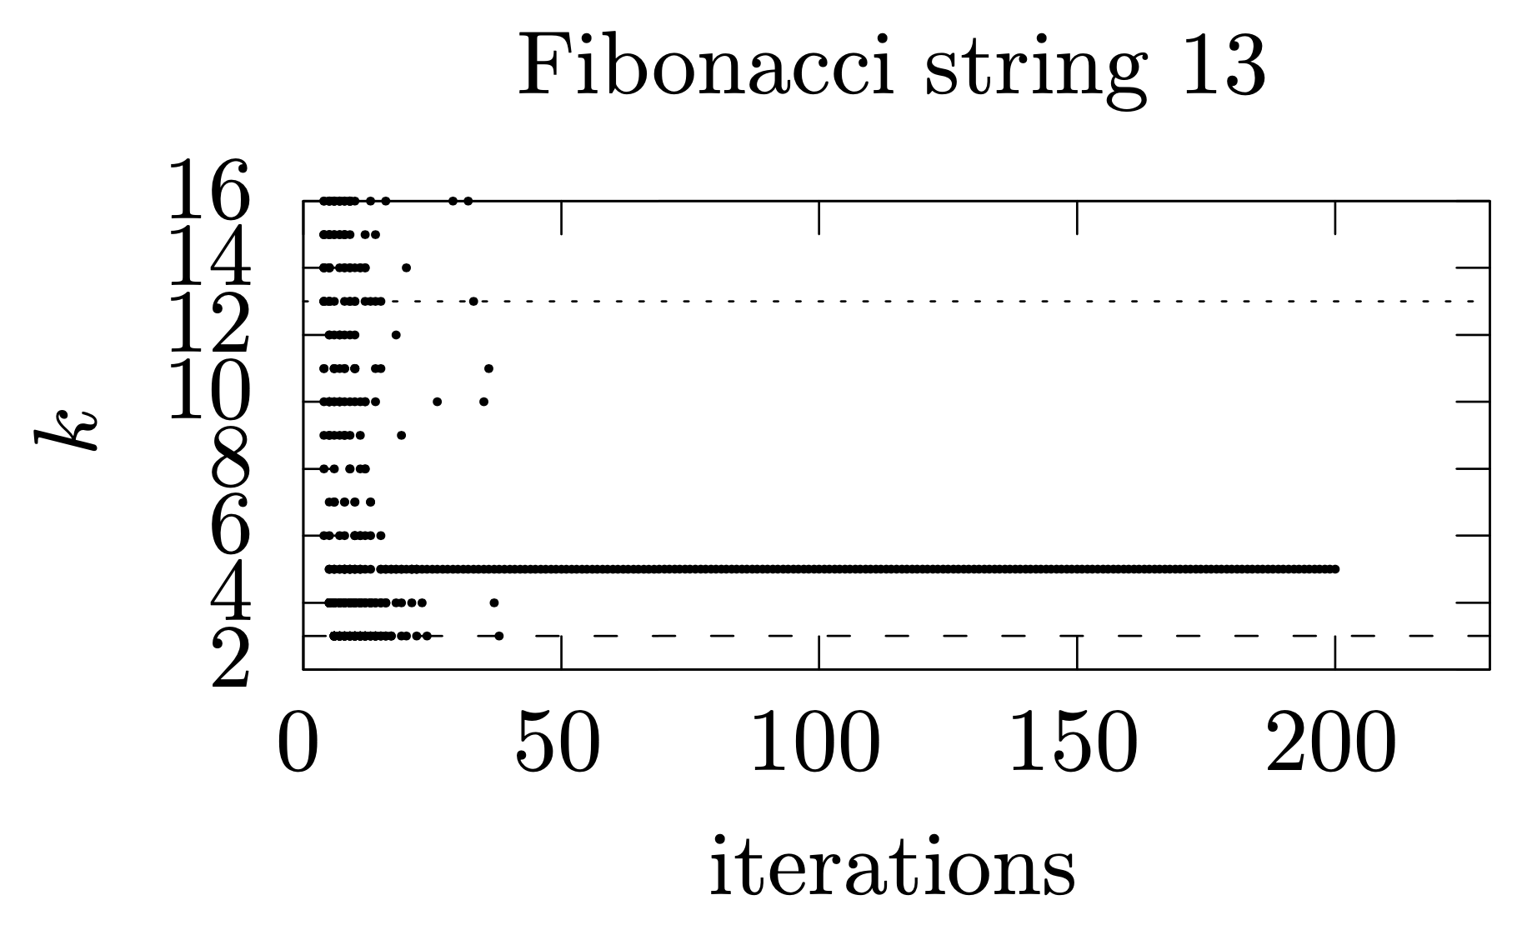
Results – Fibonnacci
Notes:
For Fibonacci strings our algorithm quickly reaches the optimum number of phrases and obtains configurations that require much fewer phrases than the Lempel-Ziv parse.
In some, it seems he needs all the iterations of the simulate annealing because he is stuck in a configuration that needs to insert more symbols but the temperature of the algorithm is very cold and therefore does not allow to do this operation.

Slide 29
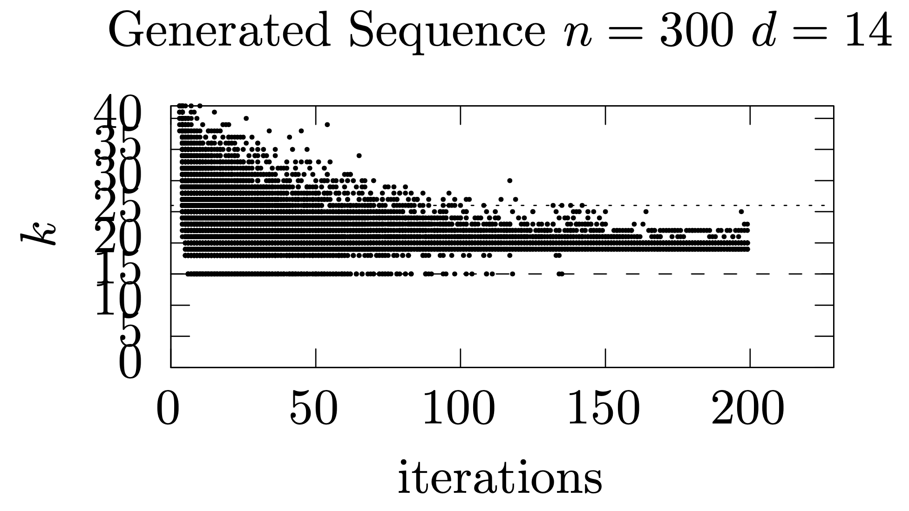
Results – Generator
Notes:
For the generated strings we did achieve the 2-approximation condition several times, and when this condition is obtained, we not need execute all the number of iterations of the algorithm
Also several iterations obtain less phrases than the Lempel-Ziv.

Slide 30
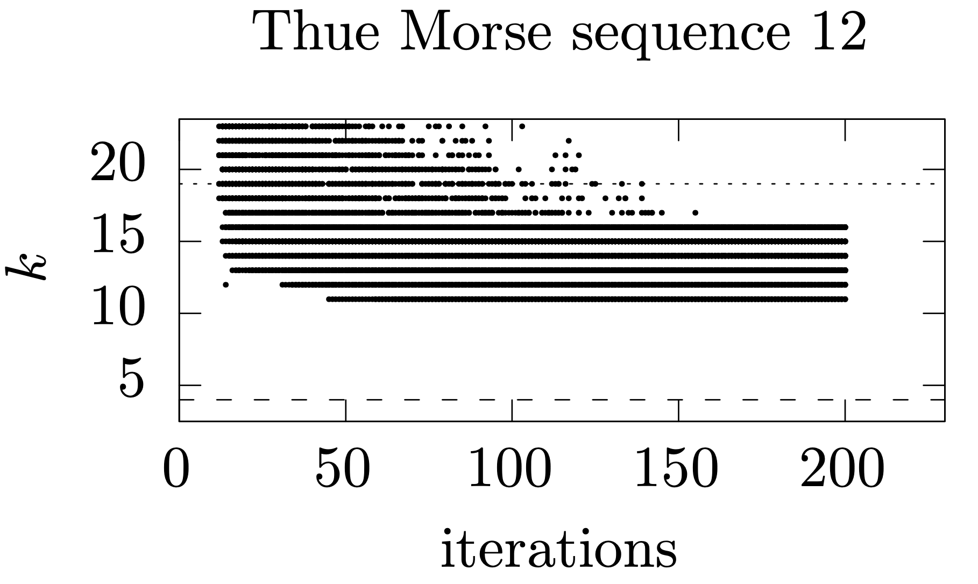
Results – Thue-Morse
Notes:
For the Thue-Morse sequences, our algorithm pro- duces macro schemes much smaller than Lempel-Ziv, albeit not a guaranteed 2- approximation.
For the Thue-Morse strings the minimum value obtained by the algorithm was 11, but this did not achieved the 2-approximation condition. The known lower bound for this sequence was 4, but this may be below optimal.

Slide 31
Conclusion
Major highlights

Slide 32
Take-home
The smallest macro schemes is NP-hard-to-compute measure of compressibility which can be practically approximated for some highly repetitive families of strings.
Our approach on most of our tests obtains much better approximations than Lempel-Ziv Algorithm.
For the future:
Compressed the link cut tree
Use Compressed suffix array
Test with large files
Notes:
We have shown that the smallest macro scheme, an NP-hard-to-compute measure of compressibility, can be practically approximated, for some highly repetitive families of strings. On most of our tests we obtain much better approximations than the popular Lempel-Ziv algorithm.
Our future steps are to devise a more practical version of our compression algorithm. While we have managed to make it practical, running over large files is still a challenge. Because the link cut tree data structure uses one node for each letter in the text.
We plan to reduce this overhead by storing fewer nodes, but still supporting the necessary operations.
We also store the suffix array and the inverse suffix array, in plain form and using a compressed representation will require less space.
We aim to reduce the size of both these structures so that the amount of extra space necessary to obtain the smallest macro scheme becomes sublinear in the size of the file to compress. Also the initialization of the list of admissible phrases will have to be delayed until it is small enough, otherwise it may require as much space as the previous data structures. A simple solution is to initialize our algorithm with a Lempel-Ziv parsing.

Slide 33
Ana Correia
ana.duarte.correia@tecnico.ulisboa.pt

