Slide 1
Social Media Analytics for Crisis Response
Shamanth Kumar
Ph.D. Thesis Defense
13 April 2015

Slide 2
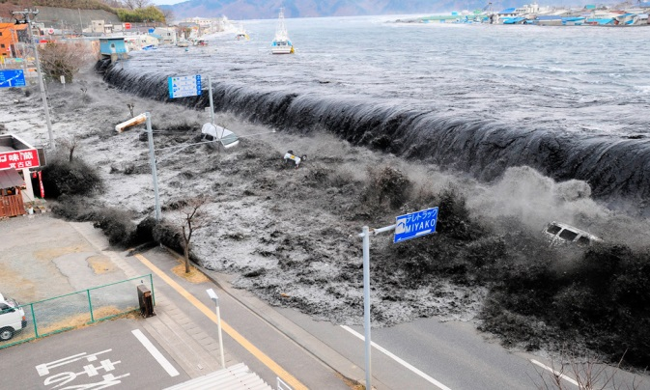
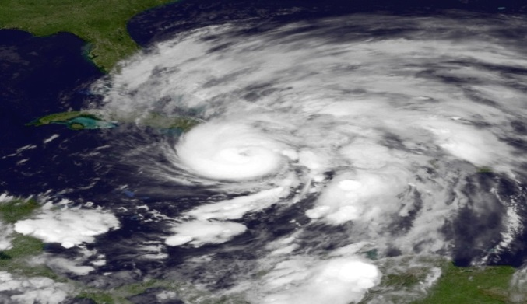
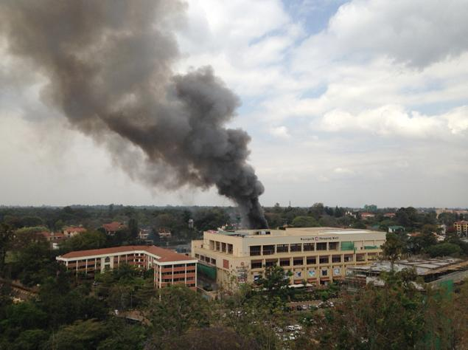
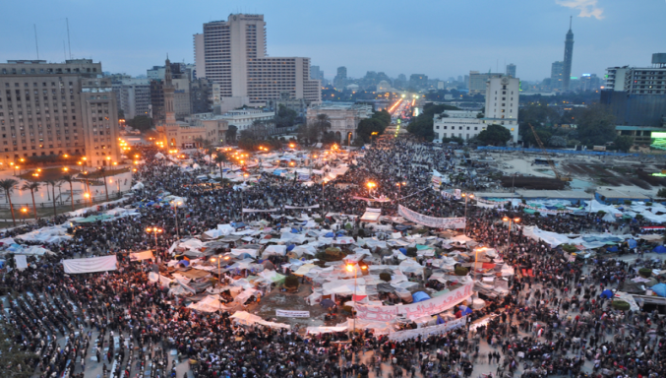
Crises are Inevitable
Natural disasters
Emergencies
Fukushima Earthquake
Hurricane Sandy
Kenya Westgate Mall Attack
Arab Spring
Image Sources: http://bit.ly/1gzSmoM, http://bit.ly/1edQfGt, http://nydn.us/1idHihg, http://bit.ly/1cSDCCh
Notes:
Script: Crisis is inevitable. In the recent years there have been several large crises. For example, we had the natural disasters like the Japanese earthquake, hurricane sandy, and large socio-political events such as the Arab Spring and the Westgate Mall attack.

Slide 3
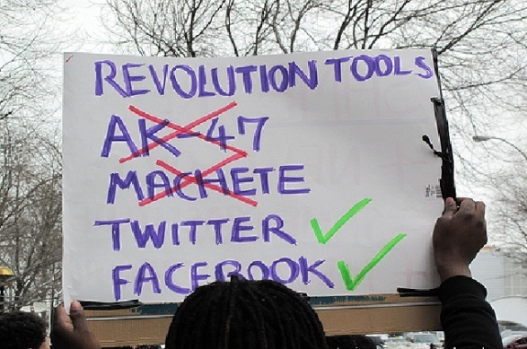
Crisis Response
Information gathering is a primary task
Mechanisms
First-hand information collected by First Responders
Traditional news sources
Social Media (New)
Advantages of Social Media
Timely
Direct access to first-hand information
Challenges
No off-the-shelf solutions for crisis response
New media ➔ New challenges
Image Source: http://bit.ly/1ixeD7x
Notes:
Script: One way to mitigate the effects of a crisis is through crisis response. Crisis response efforts require information aggregation and traditionally this has been performed using first responders and traditional news sources. However, with the popularity of social media we can now use this as an additional source of information.
The advantages of using social media is that it is timely and it gives direct access to first hand information. But, there are some challenges with using social media which necessitates new solutions to be developed and I will highlight them with respect to each problem as I discuss them.
Crisis response is a necessary task
1. Respond to requests for assistance/information
2. Obtain situational awareness
Damage reports
Casualties
3. Judge impact of relief efforts

Slide 4
Overview
Social Media
Identifying Crisis Events in Streams
Identifying Relevant Information
Monitoring & Analyzing Crisis Events

Slide 5
Identifying Crisis events in Streams
Exploring a Scalable Solution to Identifying Events in Noisy Twitter Streams, pp. 496-499, Shamanth Kumar, Huan Liu, Sameep Mehta, L Venkata Subramaniam, Proceedings of the 2015 IEEE/ACM International Conference on Advances in Social Networks Analysis and Mining, 2015
Notes:
Script: The systems support monitoring and analysis of events, so we asked the question, can we detect these crisis events automatically, to collect information as soon as a crisis occurs.
Why event detection is necessary. Examples of an event “real world example”.
Present motivation first then talk about challenges

Slide 6
Motivations
Event: “A non-trivial incident happening in a certain place at a certain time”
Existing methods considered static data
Social media – New data source
Understanding of events
Tracking event progress
Identify information leaders
Gauge public response
Notes:
Script: Here a crisis event is defined as a Non-trivial incident that happens at a place and a time. Detecting such events has several advantages, it can lead to faster access to current events, it can help in identification of user sentiment/judge the impact of relief efforts during a crisis and aid in the identification of information leaders for effective monitoring. However, there are some challenges which need to be considered. The language in tweets is informal, the usage of slang, abbreviations, new words, etc. is rampant which is exacerbated by the character limit on tweets. The data is a continuous stream of tweets and very dynamic. This stream is high volume and high velocity therefore methods should be scalable and unlike event detection approaches in traditional media, not all documents may be part of an event. As per a Pew Analytics study in 2010, almost 40% of the tweets were banal chatter which were not useful for the task of event detection.
Why detect events: identify tweets to provide better news coverage
Identify needs from the users
Impact of relief efforts
Suggest related news articles etc.
Citation: Yang, Yiming, Tom Pierce, and Jaime Carbonell. "A study of retrospective and on-line event detection." Proceedings of the 21st annual international ACM SIGIR conference on Research and development in information retrieval. ACM, 1998.
Pear Analytics 2009 – Twitter Study (found that 40% are interpersonal conversations)

Slide 7
Technical Challenges in Handling Social Media
Streaming and dynamic
Language in tweets is informal
Abbreviations
Slang
Short text
High volume and high velocity
Noisy: 40% of tweets are banal chatter (Pear Analytics 2009)

Slide 8
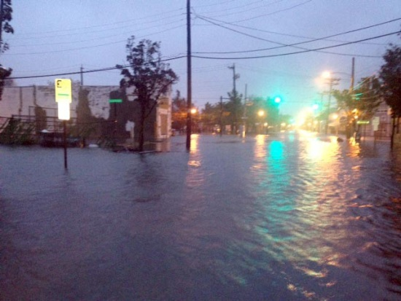
Towards a Solution
All users are sensors
Aggregating information can help us detect events
Wisdom of the crowd
Diversity of the user population to filter noise
Image Source: http://bit.ly/1CyJ58u
Notes:
Script: Given the prevalence of smartphones in US and the rest of the world, each Twitter users can now be a sensor with the ability to publish text as well as videos and images. Thus clustering the messages from these user is one way we can identify events and the diversity of the users publishing the information lends credibility to the events. Highlight that in crisis when more people talk about something it is likely to indicate an event
Image: http://blog.kalaharimeetings.com/wp-content/uploads/2013/11/smartphones1.jpg

Slide 9
Detecting Events in Streams
Given an ordered stream of tweets T = t1, t2, t3,… we want to detect events E = $e_{1}$, $e_{2}$, $e_{3}$,…
Event: An event is a collection of similar tweets with high user diversity
User Diversity:
$H\left(e\right)=−\sum_{i}{\frac{n_{u_{i}}}{N}}\log{\frac{n_{u_{i}}}{N}}$
Find events E such that
arg max$\sum_{i=1}^{|E|}{{ D(e}_{i})+ H(e_{i})}$
user diversity
The distance between events
Notes:
Script: Considering these factors we adapt the definition of an event as follows given stream, event is a collection of similar tweets with high user diversity and the diversity of a user population as the name suggests measures the diversity of the user population publishing the event related messages. From these definition we can define the clustering problem as follows, where we want to detect coherent clusters while maximizing the diversity.
F(e) is the \sum (d(e,ej)) d(e,ei) is calculated as the max(d(e^i,ej^k))
Motivate why diversity is important. Twitter has global visibility. Noise is dominant. Signal from noise. Define event the accepted way first and guide users to our interpretation.

Slide 10
Why is the Problem Hard?
A specific instance
Number of events k is known
Each tweet belongs to an event
Need to find best k-clustering which maximizes
The objective function is submodular
Maximizing submodular functions under cardinality constraint is NP-hard
Typically, k is unknown in streaming environment
$$\sum_{i=1}^{|E|}{{D(e}_{i})+H(e_{i})}$$
s.t. |E| $=$ k
Notes:
Script: Before I discuss a solution to this problem, let us study why this problem is hard. Let’s assume that we have a given number of events in the stream, and that each tweet belongs to some event, we only need to find the best clustering that maximizes this objective function. However, it turns out that this function is submodular and maximizing a submodular function under these constraints is NP hard. In addition, in the general problem we consider here, K is typically unknown and the other assumptions do not hold as well making the problem at least as hard as this specific instance.
Summation (f(e) + H(e)) both submodular. With cardinality constraint the problem is NP-hard. More general problem should be at least as hard.
Clarify whether event – cluster is one-to-one or one-to-many relationship

Slide 11
Handling Streaming Data
E1
E2
Yes
similar to an existing event?
E2
T
E3
No
E4
Incoming Tweet
Existing Events
New Event
Notes:
Script: To address this problem, I select an incremental clustering approach which does not expect a preset number of events. It works as follows: each tweet in the stream is compared with the existing events, if the tweet is found to be similar to an existing event, it is assigned to that event, otherwise we create a new event and the tweet is added to it. To perform these comparisons, we need to choose an appropriate distance measure.
Compare distance to all existing clusters. If distance is less than D_t assign it to the cluster. Otherwise create a new one.
Change this to describe events , if tweet is similar to an existing event then it is assigned to it otherwise a new event is created.
Explain the clustering process. Connect with the next slide. To judge similarity, we need to measure the distance, problems with existing techniques and why compression distance can help.

Slide 12
Handling Informal Language
Need to choose an appropriate distance measure
Requirements
Scalable to high volume
Robust to informal language
Compression Distance
Advantages
Efficient - does not require expensive transformation of data
Robust to informal language
Works on multilingual text
d(x,y) = $\frac{C(x+y)}{C\left(x\right)+C(y)}$
Notes:
Script: Specifically, the distance measure needs to satisfy the following requirements: must efficient to scale to large volume of comparisons, and should be robust to the informal language characteristics of Twitter. Therefore, we choose the compression based distance measure to perform comparisons in our method. The compression distance measures the gain in compression achieved when two texts are merged together. If the two texts are similar, the gain in compression is higher, otherwise the distance is lower. This measure has been shown to be effective on text and it is quite efficient to computer. It also does not require transformation or preprocessing of data as needed in other measures such as cosine similarity. And it is robust to informal language and can be applied on multilingual text.
Compression size in bytes, can never be zero, because the compressed size can never be zero. But bounded at 1 when there is no compression.
Fast because (And no transformations or pre-processing of data required) and the compression algorithms are very efficient so distance can be computed very quickly. C in our process is DEFLATE

Slide 13
Capturing New Events
How can we adapt to dynamic streams?
Model events as a Poisson process
$X|λ \sim Poisson\left(λ\right)$
Inter-arrival rate of tweets in an event
λ$\sim \exp\left(β\right)$
MLE of inter-arrival rate can be used to remove inactive events
Notes:
Script: Since a Twitter stream is dynamic and events evolve, we incorporate a temporal model to help determine when events are active and when they become inactive. An event here is modeled as a Poisson process where the inter-arrival time of the tweets follows the exponential distribution. Additionally, to handle noise in the stream which can be in the form of inter-personal conversations, we propose to use the user diversity previously discussed to determine if an event is a valid event. Here we measure the user diversity by reformulating the entropy measure to capture the diversity of users in an event cluster. Next I will discuss evaluation results on a topic specific stream as well as a random stream to show that the proposed approach is effective and efficient.
MLE is the average in this case. And the MLE for lambda is the inverse of beta. Since beta models the inter-arrival time. Inverse gives the number of items that arrive in a unit time.
Kleinberg’s paper which uses exponential inter-arrival time for memes.
Have a generic title for the two problems

Slide 14
Proposed Solution
Begin with empty clusters and events
Compare each tweet with existing clusters
If a match is found,
Add tweet to the cluster
Update the expected time of arrival
Otherwise,
Create a new cluster with the tweet as the first member
If a cluster exceeds the diversity threshold, then mark it an event

Slide 15
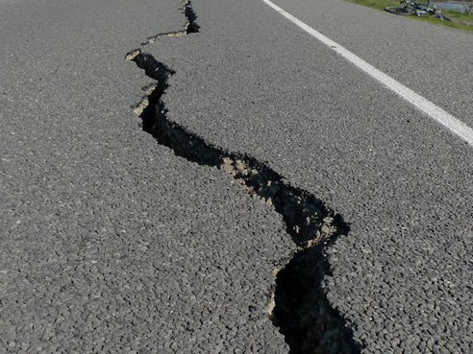
Evaluating Detected Events
How can we test the effectiveness of the approach?
Require labeled data
Earthquake events are well documented
1 million tweets between June 2011 and May 2012
Ground truth – Major earthquakes from Wikipedia
Date | Event | Magnitude
July 19, 2011 | Fergana Valley | 6.2
Sept 5, 2011 | Aceh, Indonesia | 6.7
Sept 18, 2011 | India-Nepal Border | 6.9
Oct 23, 2011 | Van, Turkey | 7.1
Nov 9, 2011 | Van, Turkey | 5.7
Feb 6, 2012 | Visayas, Philippines | 6.7
Apr 11, 2012 | Aceh, Indonesia | 8.6
May 20, 2012 | Emilia-Romagna, Italy | 6.1
Image Source: http://bit.ly/1iXzAH0
Notes:
Script: To evaluate the technique first we collected a topic specific stream capturing earthquake related tweets using generic hashtags. The dataset spanned an 11 month period and consisted of over 1 million tweets. Since manually annotating the data was not practical we used Wikipedia as an alternate data source to identify major earthquakes during this period, leading us to 8 specific events in different parts of the world.
Mention topic streams here. Also say that a random dataset will be described later
Image source: http://www.fwweekly.com/wp-content/uploads/2013/11/earthquake.jpg
Mention the hardness of obtaining labeled data. We will also discuss random tweets later.
Explain the process clearly.

Slide 16
Evaluating Event Quality
Evaluation measure
F-measure
Baseline
Petrovic et al.
Identify the most similar tweet for each tweet using LSH
Cluster similar tweets to form events
 | F₁ Score
Proposed Approach | 0.77
Petrovic et al. | 0.64
S. Petrovic, M. Osborne, and V. Lavrenko, “Streaming First Story Detection with Application to Twitter,” in HLT workshop at NAACL, vol. 10. Citeseer, 2010
Notes:
Script: To evaluate the quality of the events we measure both precision and recall, where precision represents the number of events correctly detected and recall is calculated as the number of real events successfully identified. Using these we measure the F-measure. We also compare with an existing method introduced by Petrovic et al which uses locally sensitive hashing to add tweets to buckets and then clusters tweets in a bucket using cosine similarity to identify event clusters. A comparison showed that we outperformed this approach.
High recall, lower precision in both cases.
Explain Petrovic et al. better

Slide 17
Evaluating Scalability
Day | Tweet Collection Rate (tweets/min) | Tweet Processing Rate (tweets/min) Proposed | Tweet Processing Rate (tweets/min) Petrovic et al.
July 19, 2011 | 0.613 | 23,498.00 | 793.40
Sept 5, 2011 | 1.88 | 14,788.69 | 678.68
Sept 18, 2011 | 0.32 | 18,699.73 | 527.10
Oct 23, 2011 | 3.65 | 10,646.89 | 1,984.97
Nov 9, 2011 | 1.89 | 15,611.63 | 1,068.13
Feb 6, 2012 | 13.72 | 2,834.92 | 354.19
Apr 11, 2012 | 19.75 | 2,656.06 | 208.34
May 20, 2012 | 14.33 | 3,204.44 | 97.51
Notes:
Script: Next we looked at the rate at which the proposed approach processed tweets to evaluate scalability. Our results show that on all the observed days, the processing rate significantly exceeded that of the baseline and the data collection rate.

Slide 18
Example of Events
Day | Earthquake Location | Key Event Terms
Sept 5, 2011 | Indonesia | sumatra, western, indonesian, island, #breakingnews
Oct 23, 2011 | Turkey | #turkey, eastern, turkey, magnitude, news
Nov 9, 2011 | Turkey | turkey, eastern, magnitude, rocks, usgs
Feb 6, 2012 | Philippines | pray, visayas, philippines, struck, earlier
Apr 11, 2012 | Indonesia | #indonesia, tsunami, magnitud, indonesia, sacudió
May 20, 2012 | Italy | sentito, emilia, sono, cosa, chies
Notes:
Script: Here you can see some examples of the detected events. The event is described using top keywords extracted from the tweet’s text. In all the cases the keywords sufficiently represent the real world event. On 2 days, we were unable to detect any events but on most days our approach was successful in finding events.

Slide 19
Alternative Streams – Randomly Sampled Tweets
A random sample of tweets can also be collected
1% Sample API
April 15-16, 2013, 4.2 million tweets
Event | Key Event Terms
Venezuelan Presidential elections voting controversy | votos, capriles, esto, #caprilesganótibisaymintió, fraude
Boston marathon bombing incident | marathon, boston, explosion, finish, line
Notes:
Script: Next we evaluate the proposed approach on a random stream. The data was collected on April 15-16 as a 1% random sample and consisted of 4.2 million tweets. We found that the approach was scalable to the volume of the stream and also detected reasonable events from the real-world. For example, here we present two events captured in the dataset which represent the Venezuelan elections and the Boston marathon bombings, which were the two big events of the day.
While we were expecting to find the Boston bombing incident, the Venezuelan Presidential elections was unexpected. After the death of Hugo Chavez, Venezuela held an election and there was a controversy regarding the counting of votes as the winner Nicholas Maduro won the elections by 1% margin. Capriles was the opposition candidate and ran against Maduro

Slide 20
Contributions
Novel event detection approach for Twitter streams
Robust to informal language
Scalable to high volume and high velocity streams
Can be applied to both topic-specific and random tweet streams
Notes:
Script: Here, we proposed a novel approach to handle streaming tweets, which was robust to informal language and is able to successfully capture events in high volume and high velocity streams.

Slide 21
Identifying Relevant Information during crisis
A Behavior Analytics Approach to Identifying Tweets from Crisis Regions, pp. 255-260, Shamanth Kumar, Xia Hu, Huan Liu, Proceedings of the 25th ACM conference on Hypertext and social media, 2014
Whom Should I Follow? Identifying Relevant Users During Crises, pp. 139-147, Shamanth Kumar, Fred Morstatter, Reza Zafarani, Huan Liu, Proceedings of the 25th ACM conference on Hypertext and social media, 2013
Notes:
Script: During a disaster or a crisis a large number of tweets are generated and there is too much information to process.

Slide 22
Location, Location, Location
Relevant information: Tweets from crisis regions
Situational Awareness & Disaster Response
Assess the impact of a crisis
Coordinate rescue efforts
Prioritizing information processing
Time constraints necessitate innovative approach

Slide 23
Challenges of Inferring Tweet Location
How can we infer tweet location given only crisis tweets?
User’s content history
Only limited history can be obtained
User’s network
User network is expensive to collect
Geographic content models
Variable content in the same region

Slide 24
Problem Definition
Given a crisis C and the affected geographic region R. Determine using tweet text and user profile information whether a tweet t ϵ R.
Intuition
Tweets from crisis regions exhibit different behavioral patterns

Slide 25
Methodology
Twitter in crises
Medium for information dissemination
Identify and compare user behavior
How are the tweets published
What are the tweet characteristics
What is the motivation behind publishing these tweets
Data
Tweets generated during 11 recent crises
5 crisis categories – hurricanes, earthquakes, floods, social unrest, and wildfires
Notes:
11 datasets, with data spanning different types of crisis. Data was crawled using usernames, keywords/hashtags, and geographic regions. A full list of all parameters can be found in the thesis. Using the geotagged information contained in the data, we identified tweets generated from within crisis regions and tweets generated outside crisis regions. Using the explicitly geotagged tweets we obtain the labeled examples.

Slide 26
Studying Behavioral Patterns
Data partitions
Tweets inside crisis regions
Tweets outside crisis regions
Comparison of behavioral patterns
Given behavior b
Likelihood Ratio
Hypothesis Test
H₀ : the tweets inside the crisis region and tweets outside the crisis regions demonstrate similar behavior
Two tailed t-test
α = 0.05
P(b|inside)
Likelihood Ratio
P(b|outside)
Notes:
Before I delve into the analysis of tweets, let us establish the methodology. I will be using the likelihood ratio to observe whether tweets inside crisis regions are more likely to express a behavior. Given a behavior b, this is computed by taking a ratio of the probability of observing the behavior inside vs outside the crisis regions. If this value is greater than 1 then we say that tweets inside crisis regions are more likely to express the behavior and the magnitude describes the propensity of this happening. However, we also must find out if the observed differences are statistically significant. Therefore, we will use the two tailed t-test with the null hypothesis that the mean of the observations in the two types of regions are the same. We will set the significance level at 0.05 to establish statistical significance.

Slide 27
Device and Platform Usage (How)
Are mobile devices more prevalent in crisis regions?
To capture and send media
Can be measured through the usage of mobile clients
Do crisis tweets contain original content?
Access to first hand information
Can be observed through retweets
Notes:
220 unique mobile clients and 556 unique non-mobile

Slide 28
Device and Platform Usage (How)
Findings
Tweets inside crisis regions are more likely to be generated using mobile devices
Tweets inside region are very likely to be original
Differences in behavior is statistically significant

Slide 29
Characteristics of the Generated Content (What)
Do crisis tweets reference entities?
Reference to people and places.
Provide situational awareness
POS tagger to identify noun phrases
Do the tweets from crisis regions contain novel content?
Probability under a unigram language model

Slide 30
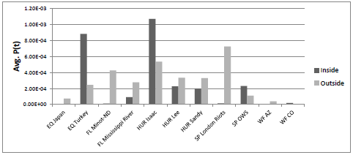
Characteristics of the Generated Content (What)
Findings
Tweets from both regions equally likely to reference entities across events
Temporal effects could be a factor

Slide 31
Motivations to Publish Content (Why)
Do tweets from crisis regions participate in conversations?
Conversations are rarely relevant to parties not involved
Conversational element: “@username”
Do crisis tweets indicate actions?
Actions represent activity during crisis
POS tagger to identify verb phrases
Do crisis tweets seek visibility?
Hashtags allow tweets to be indexed
Do crisis tweets express emotions?
Emotions indicate personal experience

Slide 32
Motivations to Publish Content (Why)
Findings
Tweets from crisis regions are less likely to be part of conversations
Tweets inside crisis regions are less likely to indicate action
Tweets inside crisis regions are less likely to express emotions
Tweets outside crisis regions are more likely to seek attention
Observed differences in behavior are statistically significant

Slide 33
Predictive Model Construction
Classification Algorithms
Naïve Bayes
Random Forest
Baseline : Content as a distinguishing factor
Bag-of-words model
Drawbacks
Very high dimensionality
Constant maintenance of the vocabulary
Evaluation Measure
weighted AUC

Slide 34
Classification Performance
Notes:
Statistically significant. Under alpha = 0.05
Wilcoxon signed rank test
Order of the bag of words model was equivalent to the order of the data. Therefore dimensionality is very high

Slide 35
Case Study: Event Summarization
AZ Wildfires
2011 Wallow fire: biggest recorded fire in AZ history
Procedure
Output
For both tweets inside and outside regions do
Identify topics using LDA
Rank tweets within a topic using
$$perplexity\left(t\right)=exp⁡(\frac{\text{−}\log{P\left(t | z\right)}}{\left|w\right|})$$
Identify top 5 tweets as summary
Inside Summary
Outside Summary
Notes:
Extract 10 LDA topics
For each topic extract the top 10 tweets based on perplexity - indicative how surprising it is to see that tweet. Lower perplexity = more commonly published content
Top 5 tweets are the summary
Goal: Find most representative tweets in a topic.
Perplexity measures the novelty of a tweet. Normalized by the number of words in tweet to reduce effect of size of tweet on the score.
Lower perplexity = more commonly published content Therefore ranking in ascending order will give us the most representative tweets of the topic.

Slide 36
Generated Summaries
Event summary from inside the region | Event summary from outside the region
it's really smokey and hazy today. #wallowfire | wildfires wreaking havoc in arizona. http://bit.ly/jsgwpv
smoke near eagar #wallowfire http://twitpic.com/5ci9i7 | #arizona - y su bonito glowing bird suena en radio paranoia :)
wildfire info: wallow fire pm update 6/19/11 (wallow wildfire) http://bit.ly/mdoigp #azfire #wallowfire | rt @radionoisefm cel mai devastator incendiu din a.. http://bit.ly/jtshyl #12 #ore #arizona #devastator
#wallow fire swept thru greer | hello #arizona, #bringit :| http://instagr.am/p/f4ife/
glenwood gazette - breaking news: #wallowfire 06/10/11 map http://t.co/xr8e23b | 1600 quadratkilometer wald durch brand vernichtet #arizona
Notes:
Novel tweets from within crisis regions are more informative and contain information regarding the progress of the crisis.

Slide 37
Conclusions & Contributions
Introduced the novel problem of identifying tweets from crisis regions
Demonstrated that tweets from crisis regions exhibit different behaviors
Showed that user behavior can be used to identify tweets from crisis regions
Notes:
Advantages:
1. Content cannot be applied to other crisis
2. Maintenance of vocabulary necessary
3. Very high dimensionality so not very practical given the scale of data

Slide 38
Monitoring & Analyzing Crisis events
TweetTracker: An Analysis Tool for Humanitarian and Disaster Relief, Shamanth Kumar, Geoffrey Barbier, Mohammad Ali Abbasi, Huan Liu, Fifth International AAAI Conference on Weblogs and Social Media, 2011
Understanding Twitter Data with TweetXplorer, pp. 1482-1485, Fred Morstatter, Shamanth Kumar, Huan Liu, Ross Maciejewski, Proceedings of the 19th ACM SIGKDD international conference on Knowledge discovery and data mining, 2013
Twitter Data Analytics, Shamanth Kumar, Fred Morstatter, Huan Liu, SpringerBriefs, 2014

Slide 39
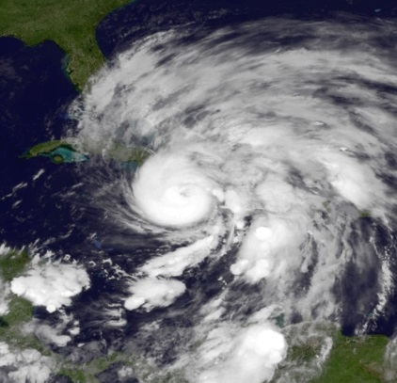
Motivations
Crisis Events:
Hurricane Sandy
Japanese Earthquake
Novel mechanisms required for social media
Manual analysis is impractical
Automated tools for crisis data analysis did not exist
Image Source: http://bit.ly/1edQfGt
Notes:
Script: The motivation for studying this problem comes from recent crises such as Hurricane Sandy and Japanese Earthquake. While working with NGOs and first responders, we realized that novel mechanisms are required for the monitoring and analysis of social media because manual analysis is not practical, at the time automated tools for social media did not exist. During a disaster analysts and first responders were interested in analyzing social media information to gauge the requirements of users and to identify interesting users and locations for faster information gathering.
Next I will discuss two systems which can help accomplish these tasks.
Image: http://upload.wikimedia.org/wikipedia/commons/7/7d/Sandy_Oct_25_2012_0400Z.JPG
How is this evaluated?
Users of Humanity Road and the reduction in time it takes them to find information. They no longer need to manually collect and analyze information. They can analyze data post event.
Challenges
Scaling to high volume
Solutions should be straightforward for first responder use
Fast and intuitive methods to analyze tweets

Slide 40
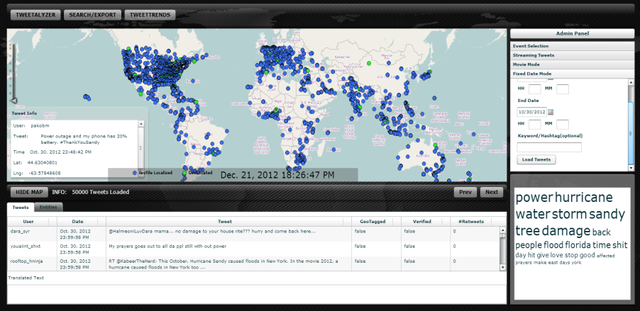
Proposed Solutions I
TweetTracker
One of the first platforms for visualizing crisis tweets
Streaming data visualization and data playback for event analysis
Collaborative system features designed with the help of end-users
Notes:
Script: First problem is efficiently monitoring crisis on Twitter. There are some challenges to addressing this problem. Analysis tools to aid monitoring need to be automated. Collaborative mechanisms are required to identify relevant parameters to monitor. Geospatial information is the most relevant information to first responders and this is not generally available. Finally, the system should be intuitive for the end users.
My solution to this problem is the system TweetTracker, which can be used to automate the monitoring of Twitter for crisis info. It supports streaming data visualization and data playback for event analysis. IT can geolocate tweets which do not contain location information using the profile information. The features and the interface in the system were created using the feedback from our end users. The system has been used in a crisis response exercise at ASU. It has been used by Humanity Road for monitoring emerging disasters.

Slide 41
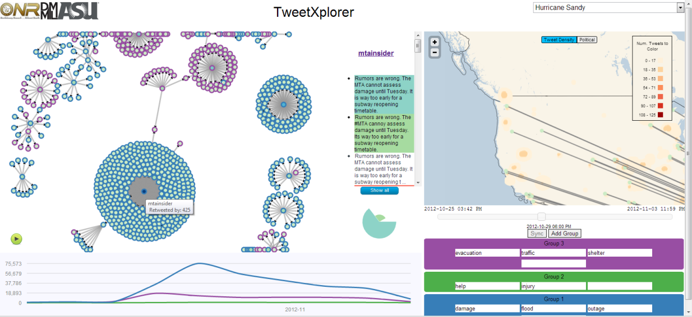
Proposed Solutions II
TweetXplorer
Topic oriented analysis
Efficient network visualization to identify information generators and information propagators
Aggregated temporal, geospatial, network, and content views

Slide 42
FUTURE WORK

Slide 43
Future Research Directions
Cross-disaster applicability of the models and techniques with applications to emerging disasters
Investigate temporal dynamics of the observed behavior
Identify methods to verify the findings on non-geotagged tweets
Notes:
http://www.nielsen.com/us/en/newswire/2013/mobile-majority--u-s--smartphone-ownership-tops-60-.html

Slide 44
Understanding Mobile Device Usage during Crises
US smartphone usage is > 60%
Citizen Journalism
Users are now empowered to produce news more than ever
Impact of mobile devices on Crises
How does crisis data differ when generated using mobile devices?
What are the characteristics of users who generate such content?
Applications
Better designed apps to promote mobile usage in a crisis
Facilitate faster detection of tweets with situational awareness
Notes:
http://www.nielsen.com/us/en/newswire/2013/mobile-majority--u-s--smartphone-ownership-tops-60-.html

Slide 45
Accomplishments
1 Book (27000 page views) and 2 Book Chapters
6 IP disclosures
1 Journal paper and 10 conference papers
200+ citations and H-index = 8
ASU President’s Award for Innovation 2014
President’s Volunteer Service Award in 2012 and 2013
Novel systems being used by
USMA, NPS, and 64 other researchers and
organizations
Press
New Scientist “One Percent” Blog
USMA Network Monitor
iRevolution.net Blog

Slide 46
Publications
Social Media Monitoring and Analyzing Platforms
Twitter Data Analytics (SpringerBriefs ’14)
Analyzing Twitter Data (Cambridge University Press ‘15)
Understanding Twitter Data with TweetXplorer (KDD ’13 Demo)
Faceted Navigation of Tweets (KDD ’12 Demo)
TweetTracker: Monitoring Crisis Tweets (ICWSM ’11 Demo)
BlogTrackers: A Blog Analysis Tool for Social Scientists (ICWSM ’09 Demo)
User Behavior Analysis in Social Media
Behavioral Approach to Identify Tweets in Crisis Region (HT ’14)
Identifying Relevant Users During Crisis (HT ’13)
Behavior of Influentials Across Social Media (Springer ’12)
User Migration Across Social Media (AAAI ’11)
A Study of Tagging Behavior across Social Media (SWSM ’11)
Relationship between identity and popularity (Under Review)
Spammer Detection: An Early Warning Approach (Under Review)
Detecting Crisis Events in Streaming Data (Under Review)

Slide 47
Acknowledgments
Committee Members
Dr. Huan Liu, Dr. Hasan Davulcu, Dr. Ross Maciejewski, and Dr. Nitin Agarwal
Members of the Data Mining and Machine Learning Lab
Dr. Rebecca Goolsby and The Office of Naval Research
Humanity Road Inc.

Slide 48
Contributions
Developed two novel visual analytics based platforms to aid first responders
TweetTracker – collaborative environment for information aggregation and analysis
TweetXplorer – deeper analysis of big data
Novel event detection approach in dynamic Twitter streams
Behavior analytics approach to Identifying tweets from crisis regions
Novel method to identify relevant users to follow during crises

Slide 49
References
Agichtein, E., Castillo, C., Donato, D., Gionis, A., & Mishne, G. (2008, February). Finding high-quality content in social media. In Proceedings of the 2008 International Conference on Web Search and Data Mining (pp. 183-194). ACM.
Aura, S., & Hess, G. D. (2004). What's in a name? CESifo Working Paper Series No. 1190. Retrieved 12 February, 2010, from http://ideas.repec.org/p/ces/ceswps/_1190.html
Cotton, J.L., O'Neill, B.S., Griffin, A. (2008) "The “name game”: affective and hiring reactions to first names", Journal of Managerial Psychology, Vol. 23 (1), pp.18 – 39
Hughes, A.L., Palen, L.: Twitter Adoption and Use in Mass Convergence and Emergency
Events. International Journal of Emergency Management 6(3), 248{260 (2009)
Laham, S. M., Koval, P., & Alter, A. L. (2012). The name-pronunciation effect: Why people like Mr. Smith more than Mr. Colquhoun. Journal of Experimental Social Psychology, 48(3), 752-756.
Kasof, J. (1993). Sex bias in the naming of stimulus persons. Psychological Bulletin, 113, 140–163
Kalist, D. E., & Lee, D. Y. (2009). First names and crime: Does unpopularity spell trouble? Social Science Quarterly, 90, 39–49.
Manning, Christopher D., Prabhakar Raghavan, and Hinrich Schütze. Introduction to information retrieval. Vol. 1. Cambridge: Cambridge University Press, 2008.

