Slide 1
Gradient-based Early Termination of CU Partition in VVC Intra Coding
Jing Cui, Tao Zhang, Chenchen Gu, Xinfeng Zhang, Siwei Ma
2020/03/25

Slide 2
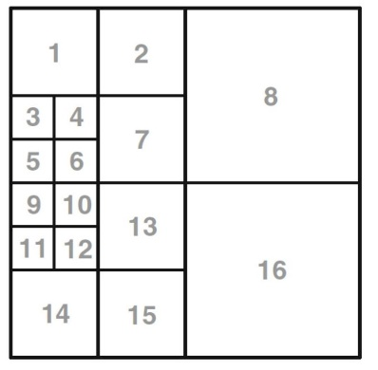
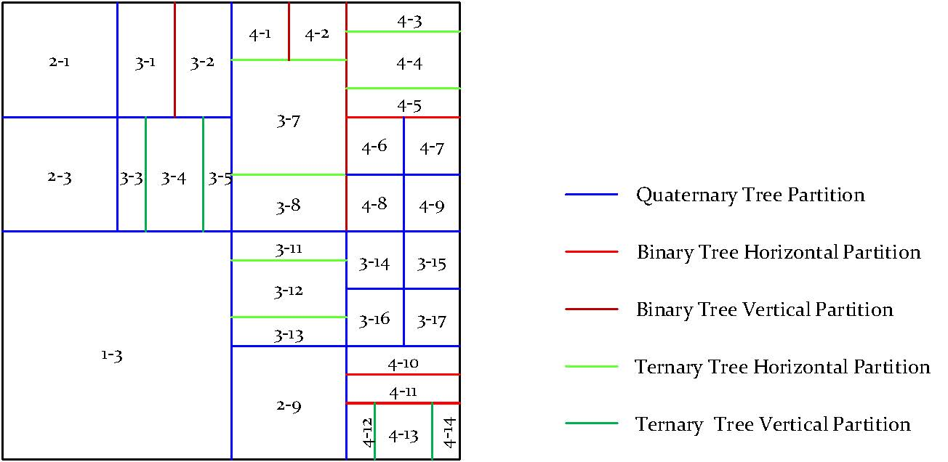
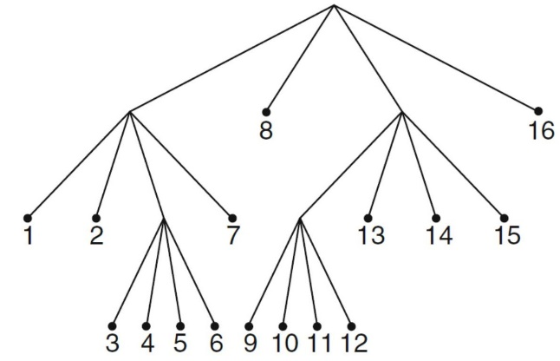
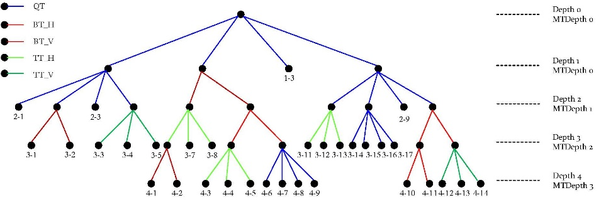
Motivation
Different from quad-tree (QT) partition only in HEVC, VVC adopts quad-tree with nested multi-type tree using binary and ternary splits segmentation structure(QT+BT+TT) in CU size decision
Block size flexible but time-consuming
HEVC
VVC

Slide 3
Statistical Analysis
Texture information is one of crucial evidences of block partition.
According to texture characteristics: Texture area, Edge area, Smooth area.
Different block partition structure in different area. In addition, we can find that the content coherence is relative to the partition direction.

Slide 4
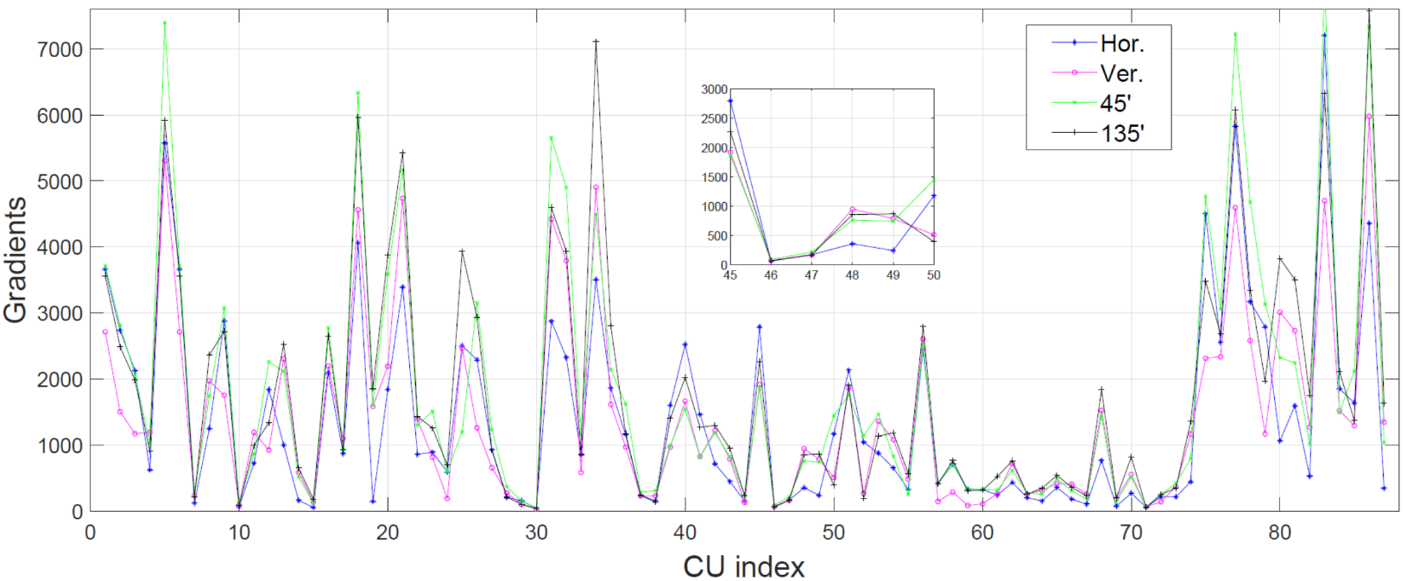
Statistical Analysis
Directional gradients provides hints to decide partition direction .
Gradients in four directions (horizontal, vertical, left-bottom to right-above (45) and left-above to right-bottom (135) ) for one CU are calculated and profiled following encoding order.
if the gradient of one direction is much smaller than that of other three, it means the content tends to follow its direction.
If the four gradients share the similar gradient near zero, it implies that current CU is smooth and likely to keep not splitting.

Slide 5
Proposed Method
For different CU with various block size, different flag is used to determine the corresponding partition structure, or skip impossible partition modes.
split_flag - 0: terminated; 1: split directly; -1: same as VVC
Where, Gradxy means the gradient of sub-block indexed y in direction x. Sub-block index and gradient direction are illustrated in the following figure. y={1,2,3,4}, x= {h, v, 45, 135}

Slide 6
Proposed Method
Determine partition direction
dir_idx - 0: binary tree vertical and ternary tree vertical partition are skipped; 1: binary tree horizontal and ternary tree horizontal partition are skipped; -1: same as VVC
Where ThrV and ThrH are two thresholds valued by empirical analysis. W and H are width and height of current CU.

Slide 7
Proposed Method
Skip binary or ternary tree partition
bt_skip – 1: skip binary partition; 0: same as VVC
tt_skip – 1: skip ternary partition; 0: same as VVC
Where sub-block region and index is defined as the following figure.

Slide 8
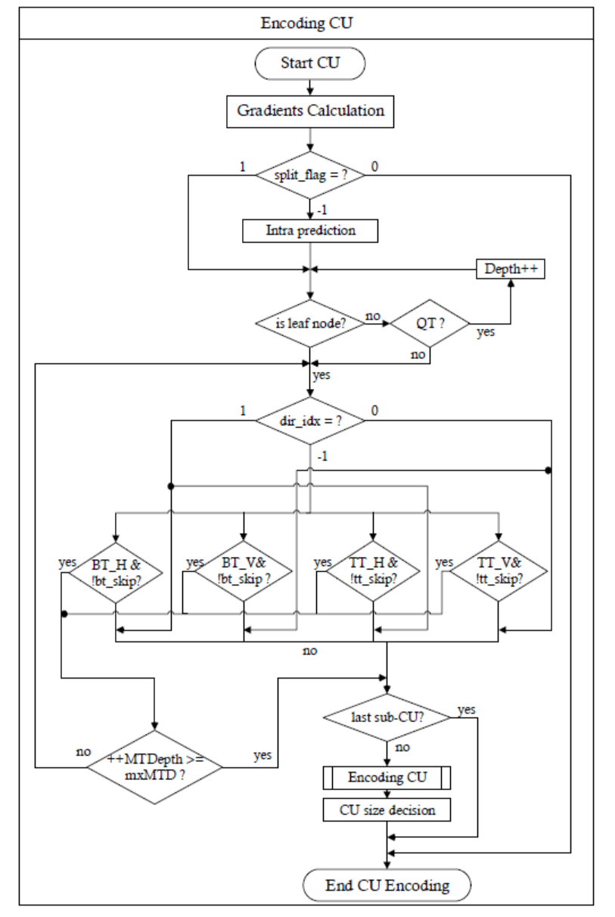
Proposed Method
Algorithm Flowchart:

Slide 9
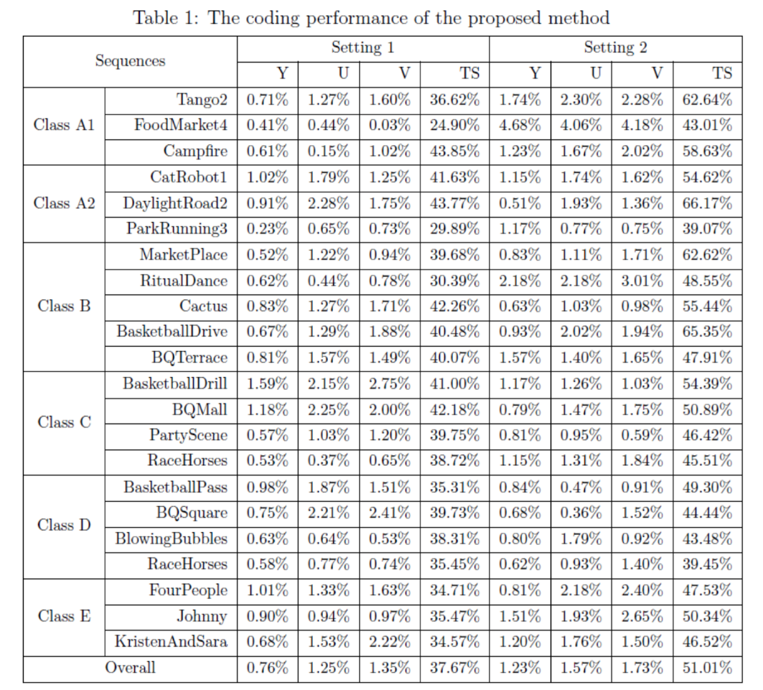
Experimental Results
Two sets: setting 1 and setting 2
Thresholds {ThrB, ThrS, ThrH, ThrV, ThrG} in proposed method are set as:
Setting 1: {5.0, 1.0, 1.1, 1.1,54}
Setting 2: {2.0, 1.2, 1.0, 1.0 ,108}
In setting 1, 0.76% BD-rate loss with 37.67% time saving. In setting 2, 51% time saving with 1.23% BD-rate increase.

Slide 10
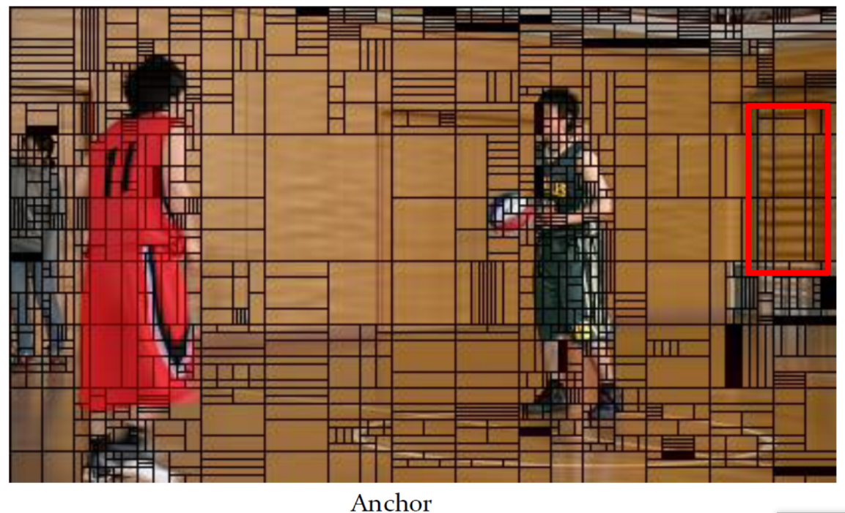
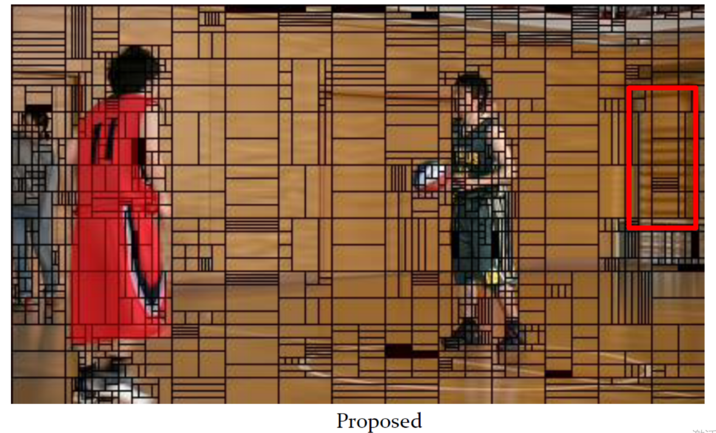
Experimental Results
CU partition comparison
Compared with anchor, the CU partition in proposed method follows the frame texture commendably, especially in the red box area where the texture is horizontal but it is split in vertical in anchor.
It may also improve intra prediction.

Slide 11
Conclusion
The proposed method can achieve a better trade-off between BD-rate performance and time saving.
Following texture characteristics may improve the intra prediction performance in some cases.

Slide 12
Thanks!
Notes:
以上就是本次汇报内容，谢谢各位老师。

