Slide 1
Enhancing Adversarial Transferability in Object Detection with Bidirectional Feature Distortion
Xinlong Ding
University of Science and Technology Beijing
Beijing, China
dingxl22@xs.ustb.edu.cn
Jiansheng Chen*
University of Science and Technology Beijing
Beijing, China
jschen@ustb.edu.cn
Hongwei Yu
University of Science and Technology Beijing
Beijing, China
yuhongwei22@xs.ustb.edu.cn
Yu Shang
Tsinghua University Beijing, China
shangy21@mails.tsinghua.edu.cn
Huimin Ma
University of Science and Technology Beijing
Beijing, China
mhmpub@ustb.edu.cn
Notes:
Hello everyone, I'm Ding Xinlong, a master's student from the University of Science and Technology Beijing.
I'm honored to share our research at ICASSP 2024, titled 'Enhancing Adversarial Transferability in Object Detection with Bidirectional Feature Distortion.’
Our work aims to boost the transferability of adversarial examples in object detection.
We introduce a method of bidirectional feature distortion to effectively enhance adversarial sample transferability across models.
I'll now detail our approach and findings.

Slide 2
Outline
Motivations
Contributions
Methods
Experiments
Conclusions
Notes:
In this presentation, we'll discuss five main points: our research motivation, contributions, method, experiments, and conclusions.
Let's begin.

Slide 3
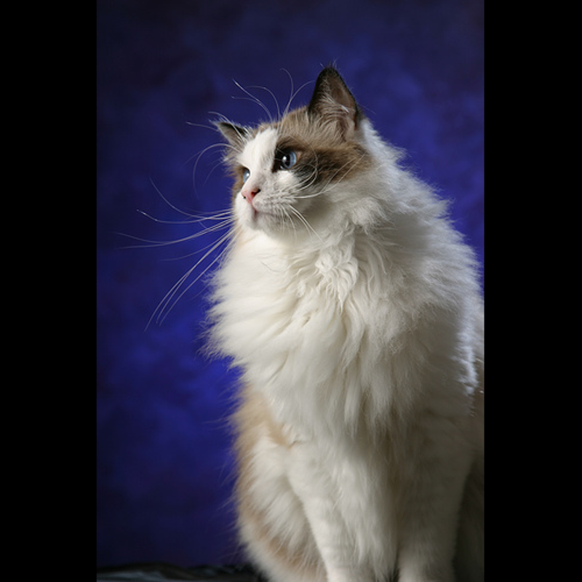
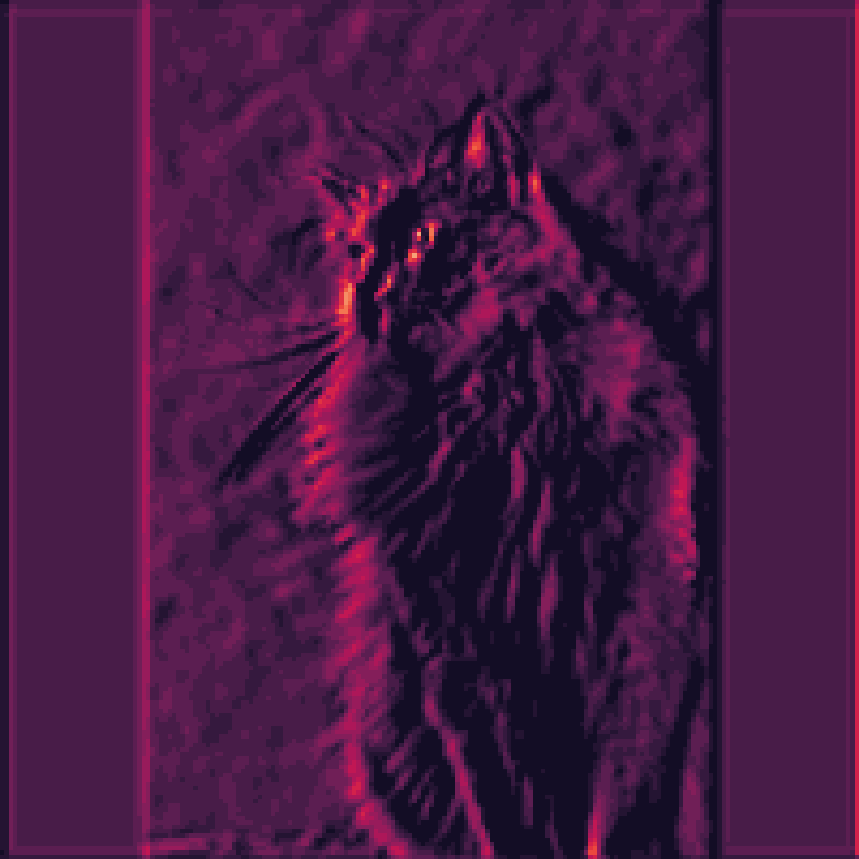
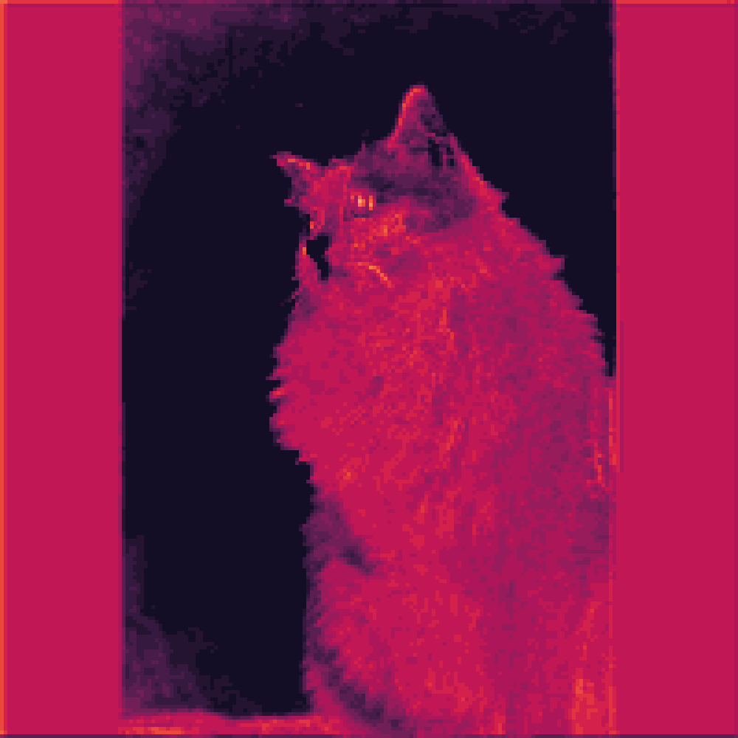
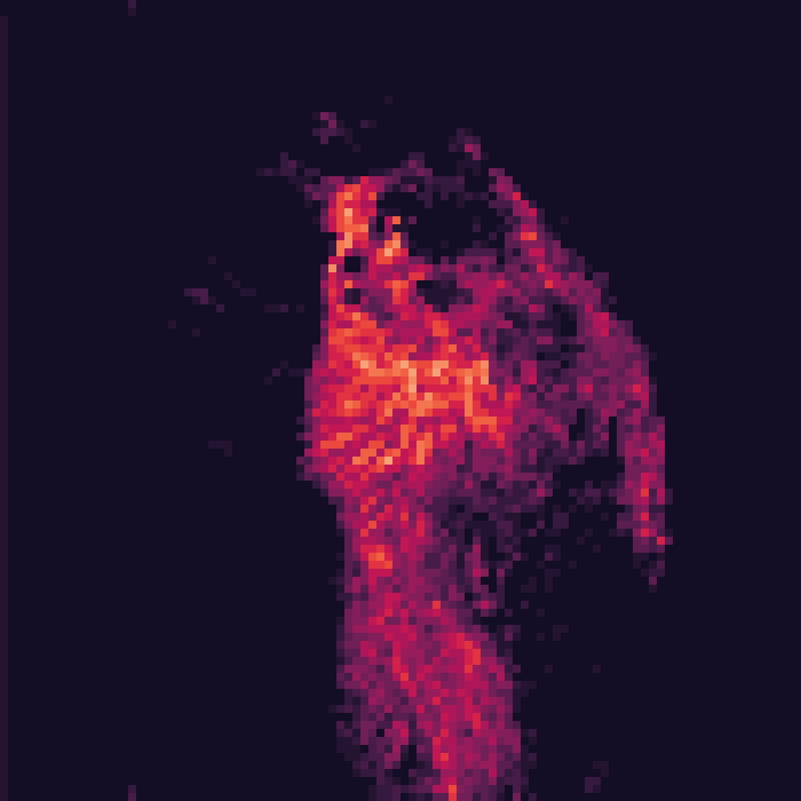
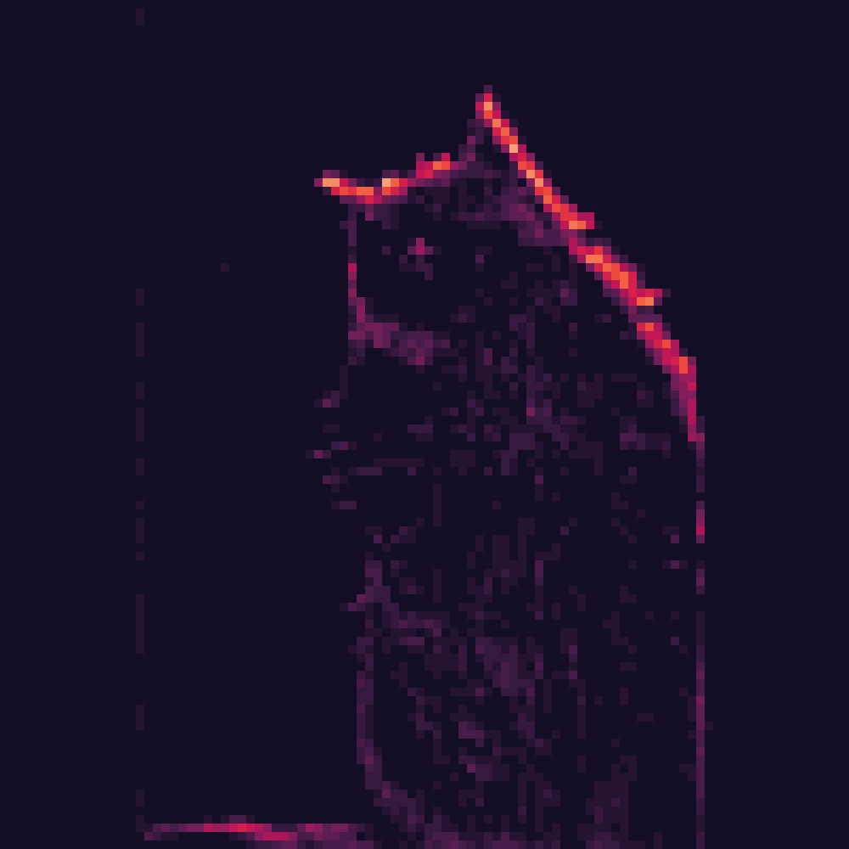
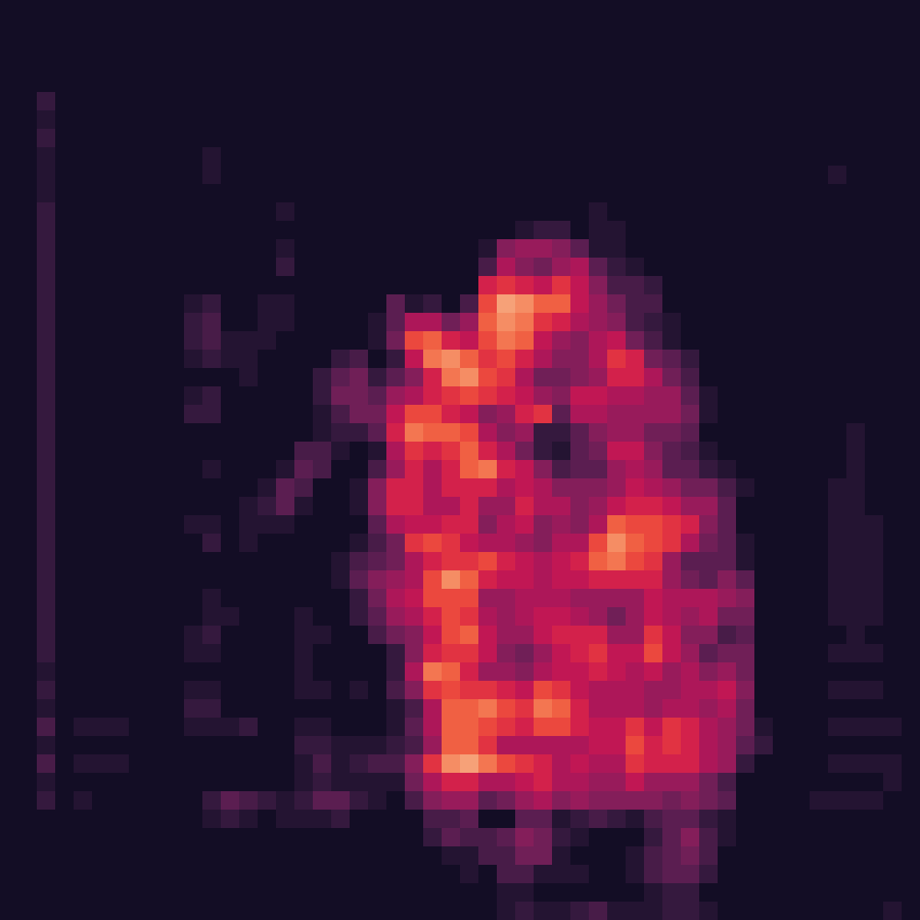
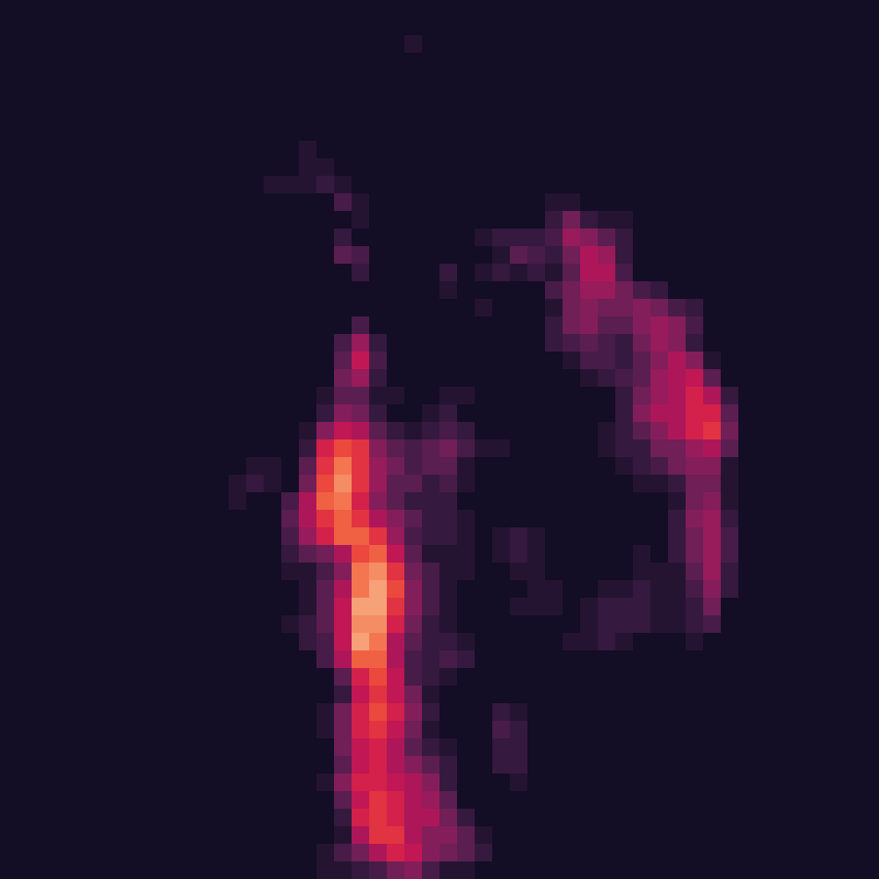
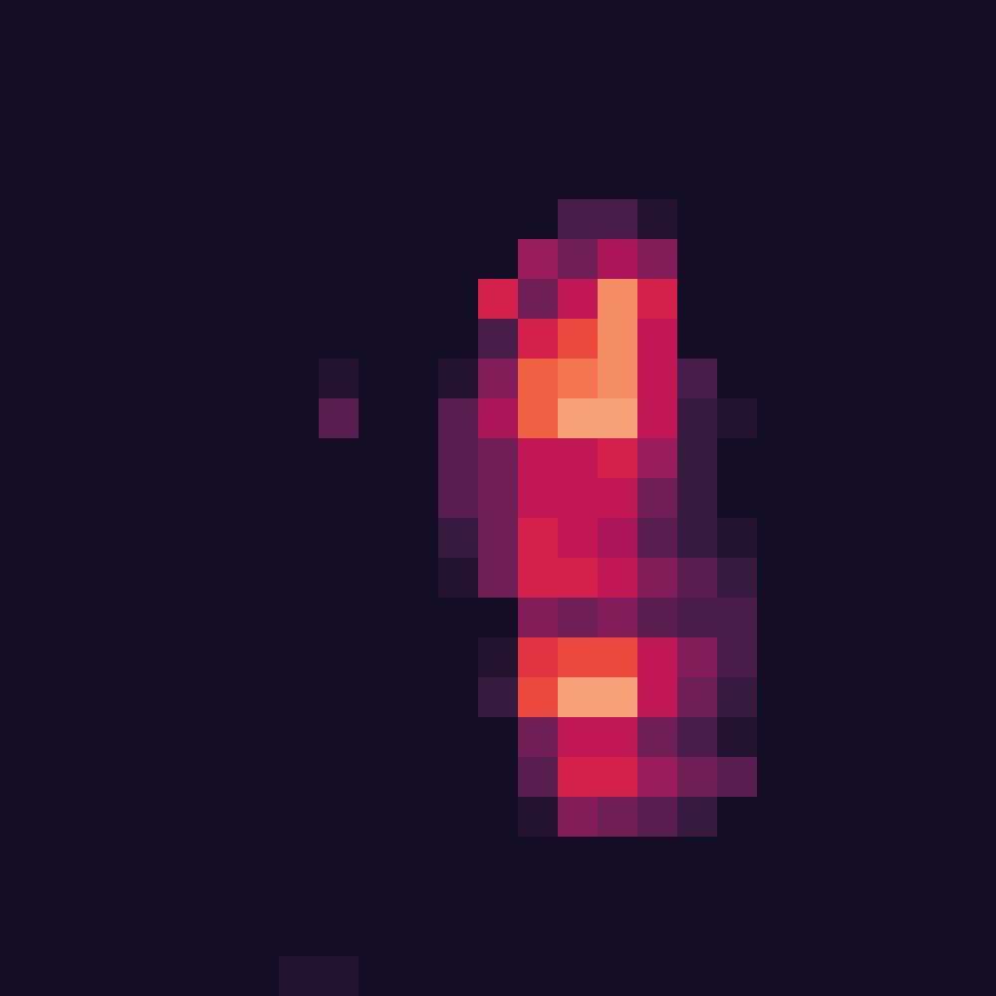
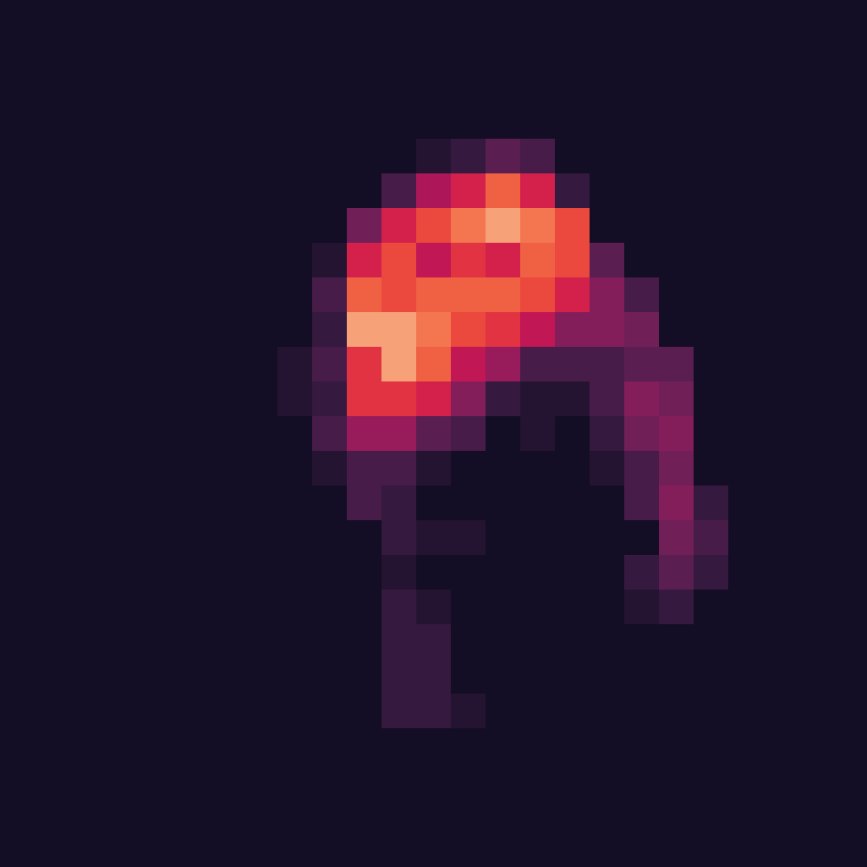
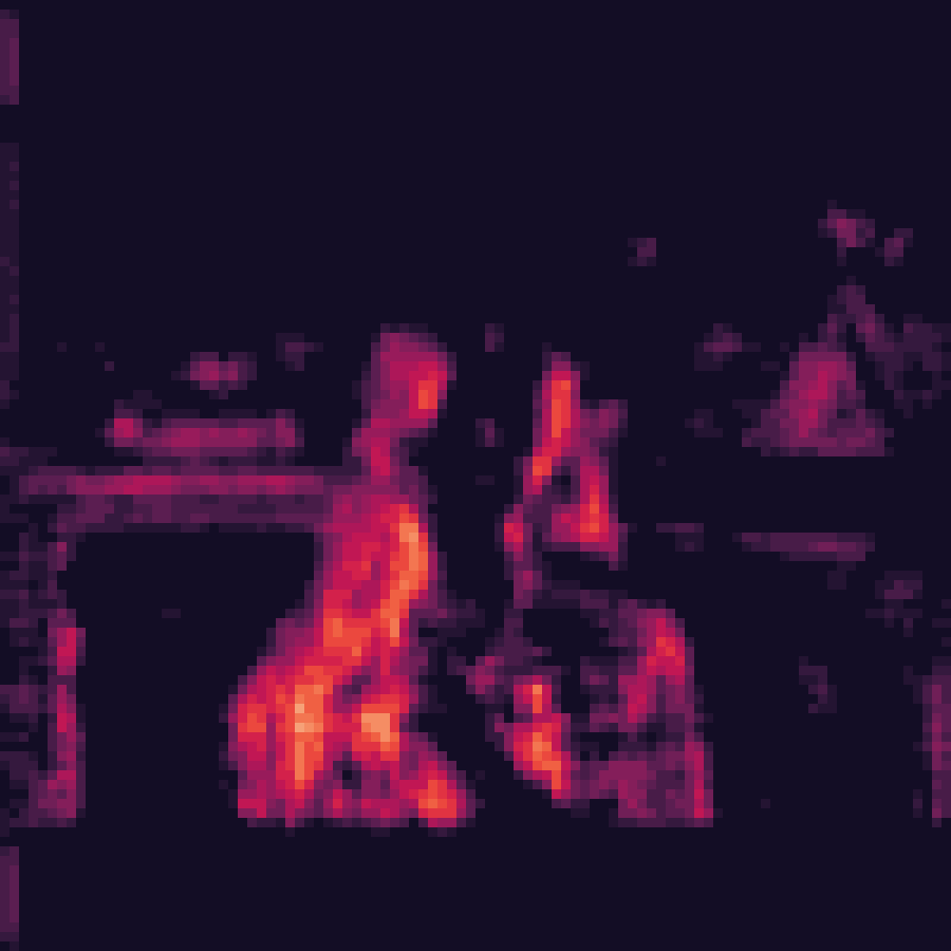
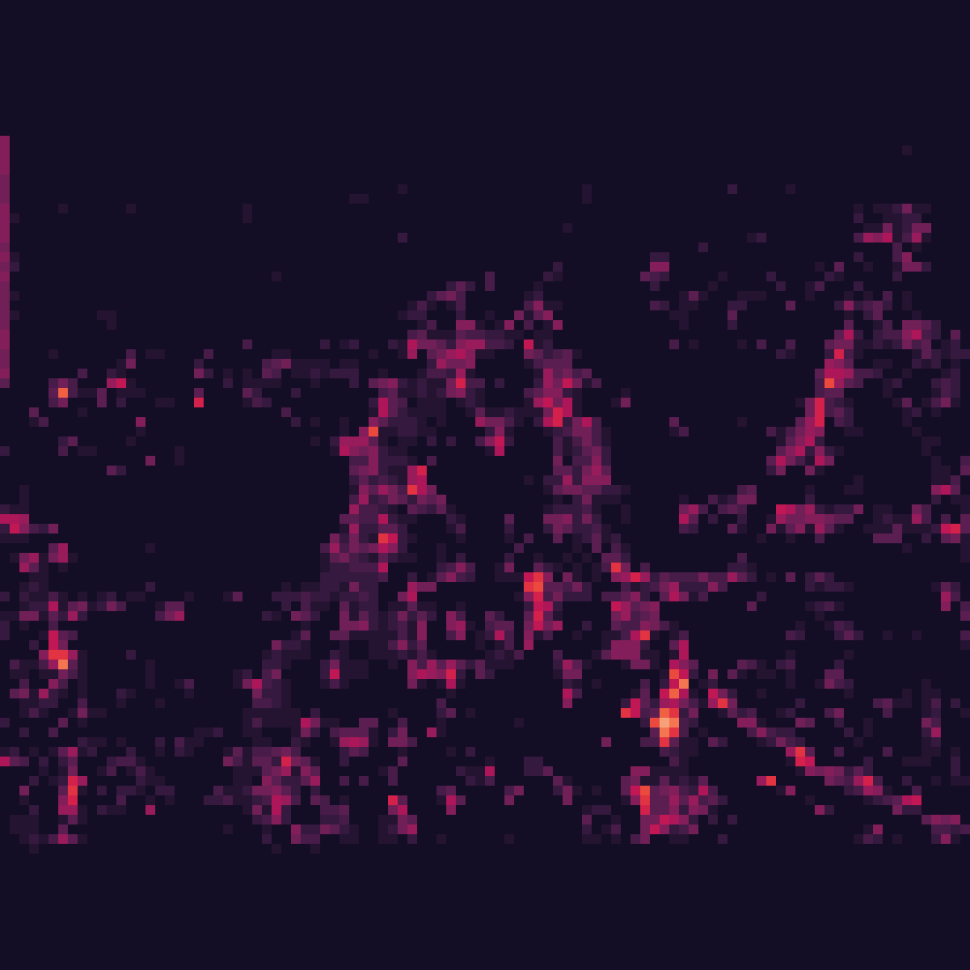
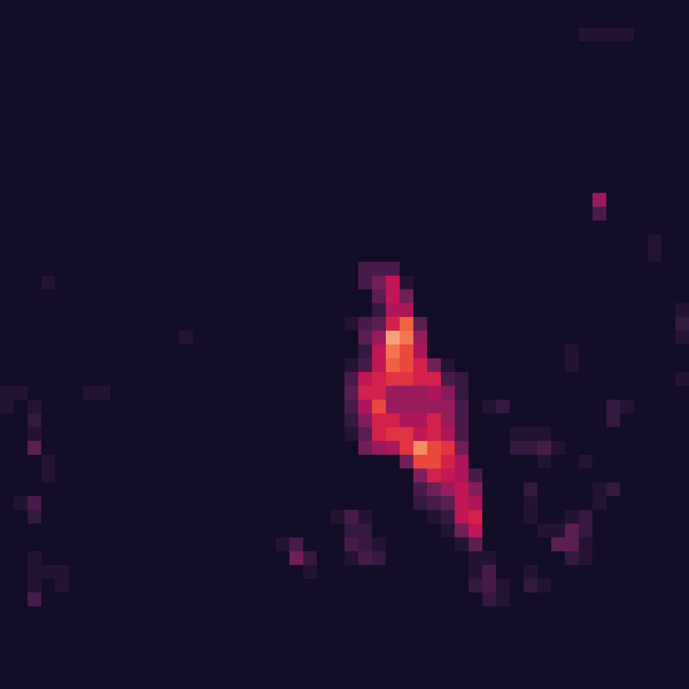
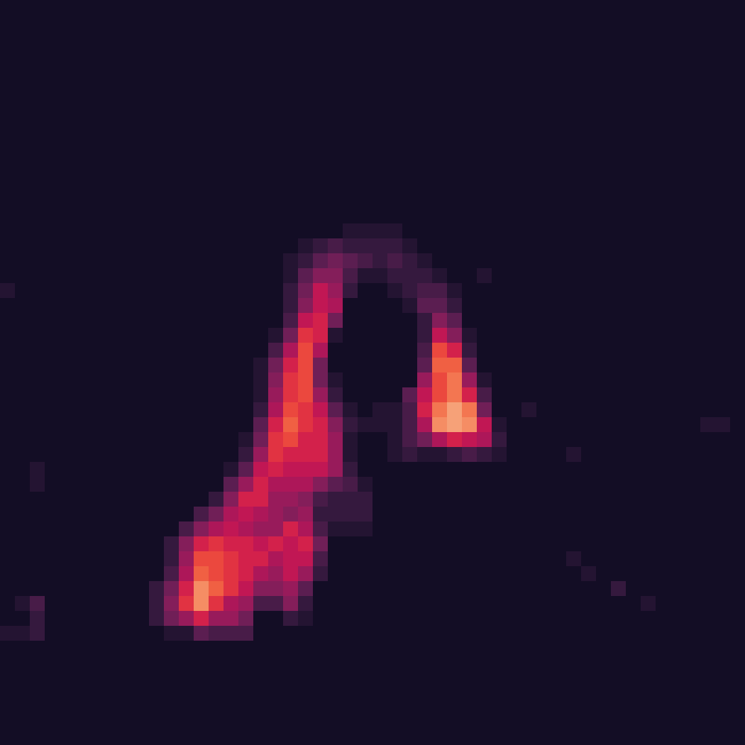
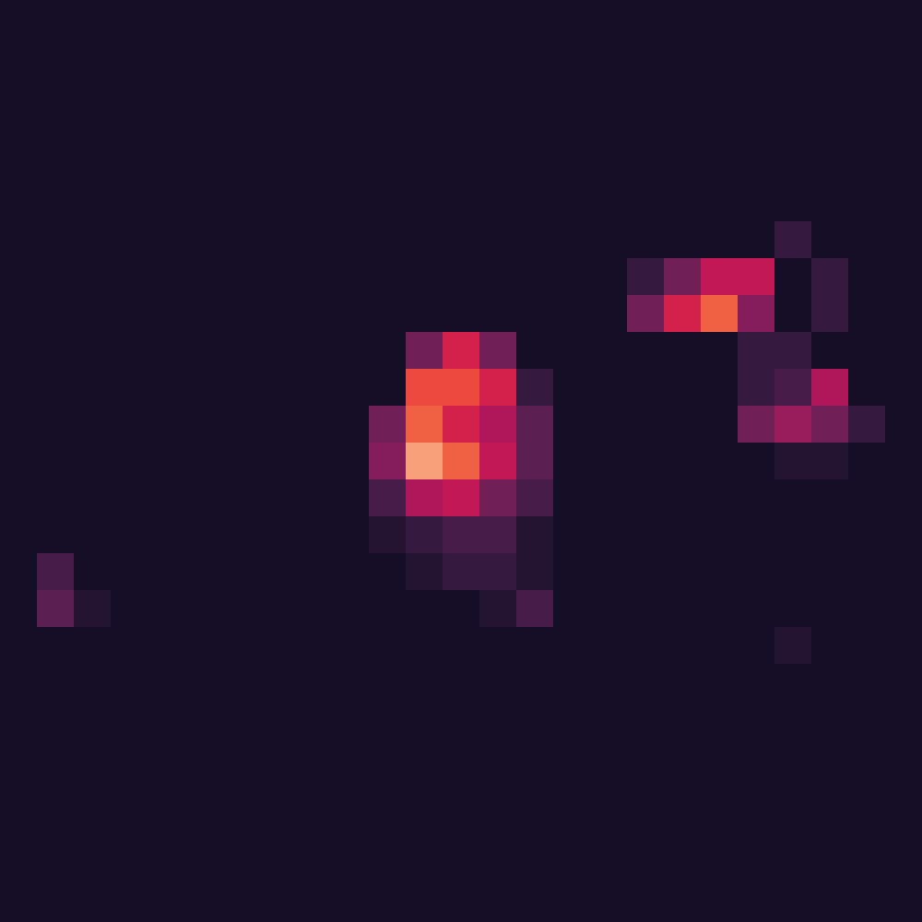
Motivations
Similar backbone models of detectors
Detectors | YOLOv3 | VFNet | FasterRCNN | MaskRCNN | YOLOF | YOLOX | FCOS | DETR
Backbone | DarkNet 53 | ResNet 50 | ResNet 101 | Swin Transformer | ResNet 50 | CSPDarkNet | ResNet 50 | ResNet 50
Critical elements of backbone features
Image
Stage 1
Stage 2
Stage 3
Stage 4
Features corresponding to objects typically show higher numerical responses.
Notes:
Compared to attacking irrelevant regions in the image, attacking the areas containing the objects and their vicinity has a greater impact on detection results.
This is because detectors rely more on local regions of the image for precise object localization, whereas classifiers mainly utilize global information for category prediction.
A detector usually has three parts: the backbone, neck, and head.
The backbone part is pretty similar across different detectors;
for example, many use ResNet.
Therefore, our work primarily focuses on perturbing the output features of the detectors' backbone.
The detector's backbone identifies areas with objects by producing strong signals, known as critical features.
These features assist the neck and head components in pinpointing object locations.
By focusing on these critical features, we aim to boost the power of our adversarial attacks across a range of detection models.

Slide 4
Motivations
Toy experiments
Features
Critical Elements
Raw
Flatten & Sort
Clip
Preserve
Padding with 0
A small proportion of feature elements with larger values plays a critical role in detection.
Notes:
We conducted a toy experiment to investigate how the distribution of numerical values within these features affects their ability to detect objects.
To achieve this, we extracted the backbone features from a detector and flattened them.
Next, we arranged these features in descending order according to their numerical values.
Our experiment was conducted in two phases:
During the 'CLIP' phase, we eliminated a portion of the features with the largest values to assess their effect on detection efficiency.
In contrast, the 'Preserve' phase involved keeping only these high-value features and zeroing out the rest, to evaluate the importance of these elements.
The table on this slide shows that for all detectors in our study, removing no more than 30% of the elements with the highest values caused the mean Average Precision (mAP) to drop below 0.100.
This drop shows detectors nearly lose all detection ability.
These findings highlight a key insight: A small proportion of high-value elements within the backbone features plays a critical role in the object detection.
Our attack is built upon this insight, leveraging the commonality in the detectors' backbone features to achieve high transferability in adversarial attacks.

Slide 5
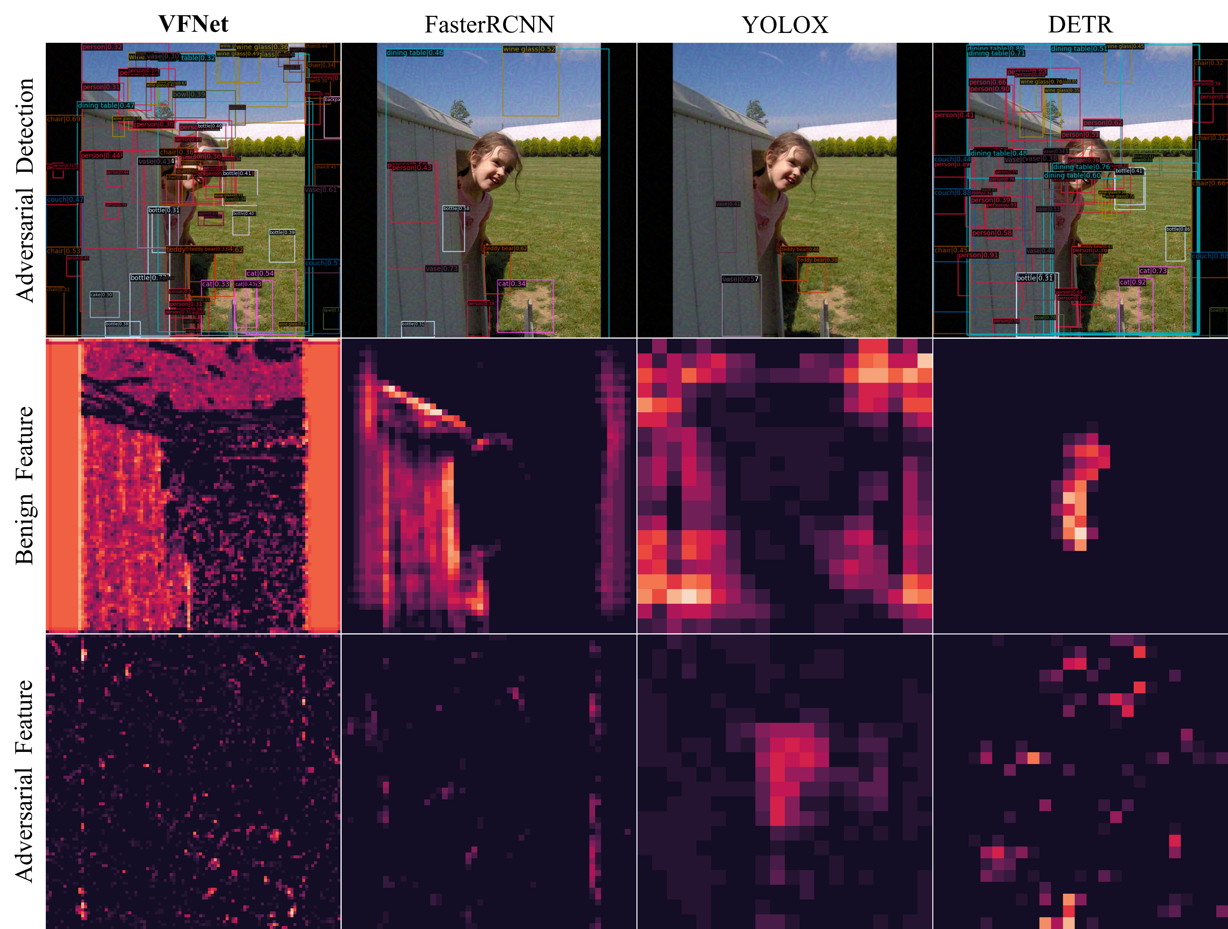
Contributions
Element-wise numerical separation: few high-value elements being key for detection. Leveraging this, our Bidirectional Feature Distortion Attack greatly enhances adversarial transferability for detectors.
We explore adversarial transferability across various detectors, including single-stage and two-stage models, and demonstrate BFDA's effectiveness and efficiency through thorough testing and validation.
Notes:
This image displays the backbone features of different detector for both adversarial example generated on VFNet and its corresponding clean sample.
Our method effectively suppresses critical features and amplifies surrounding object-relevant candidate features, both in surrogate models and target models.
Our work primarily makes two contributions:
First, we've uncovered that in detector backbones, only a few elements with high values are essential for accurate detection.
Second, using this insight, we developed the Bidirectional Feature Distortion Attack (BFDA), which boosts adversarial attack transferability across various detector models, including single and two-stage designs.

Slide 6
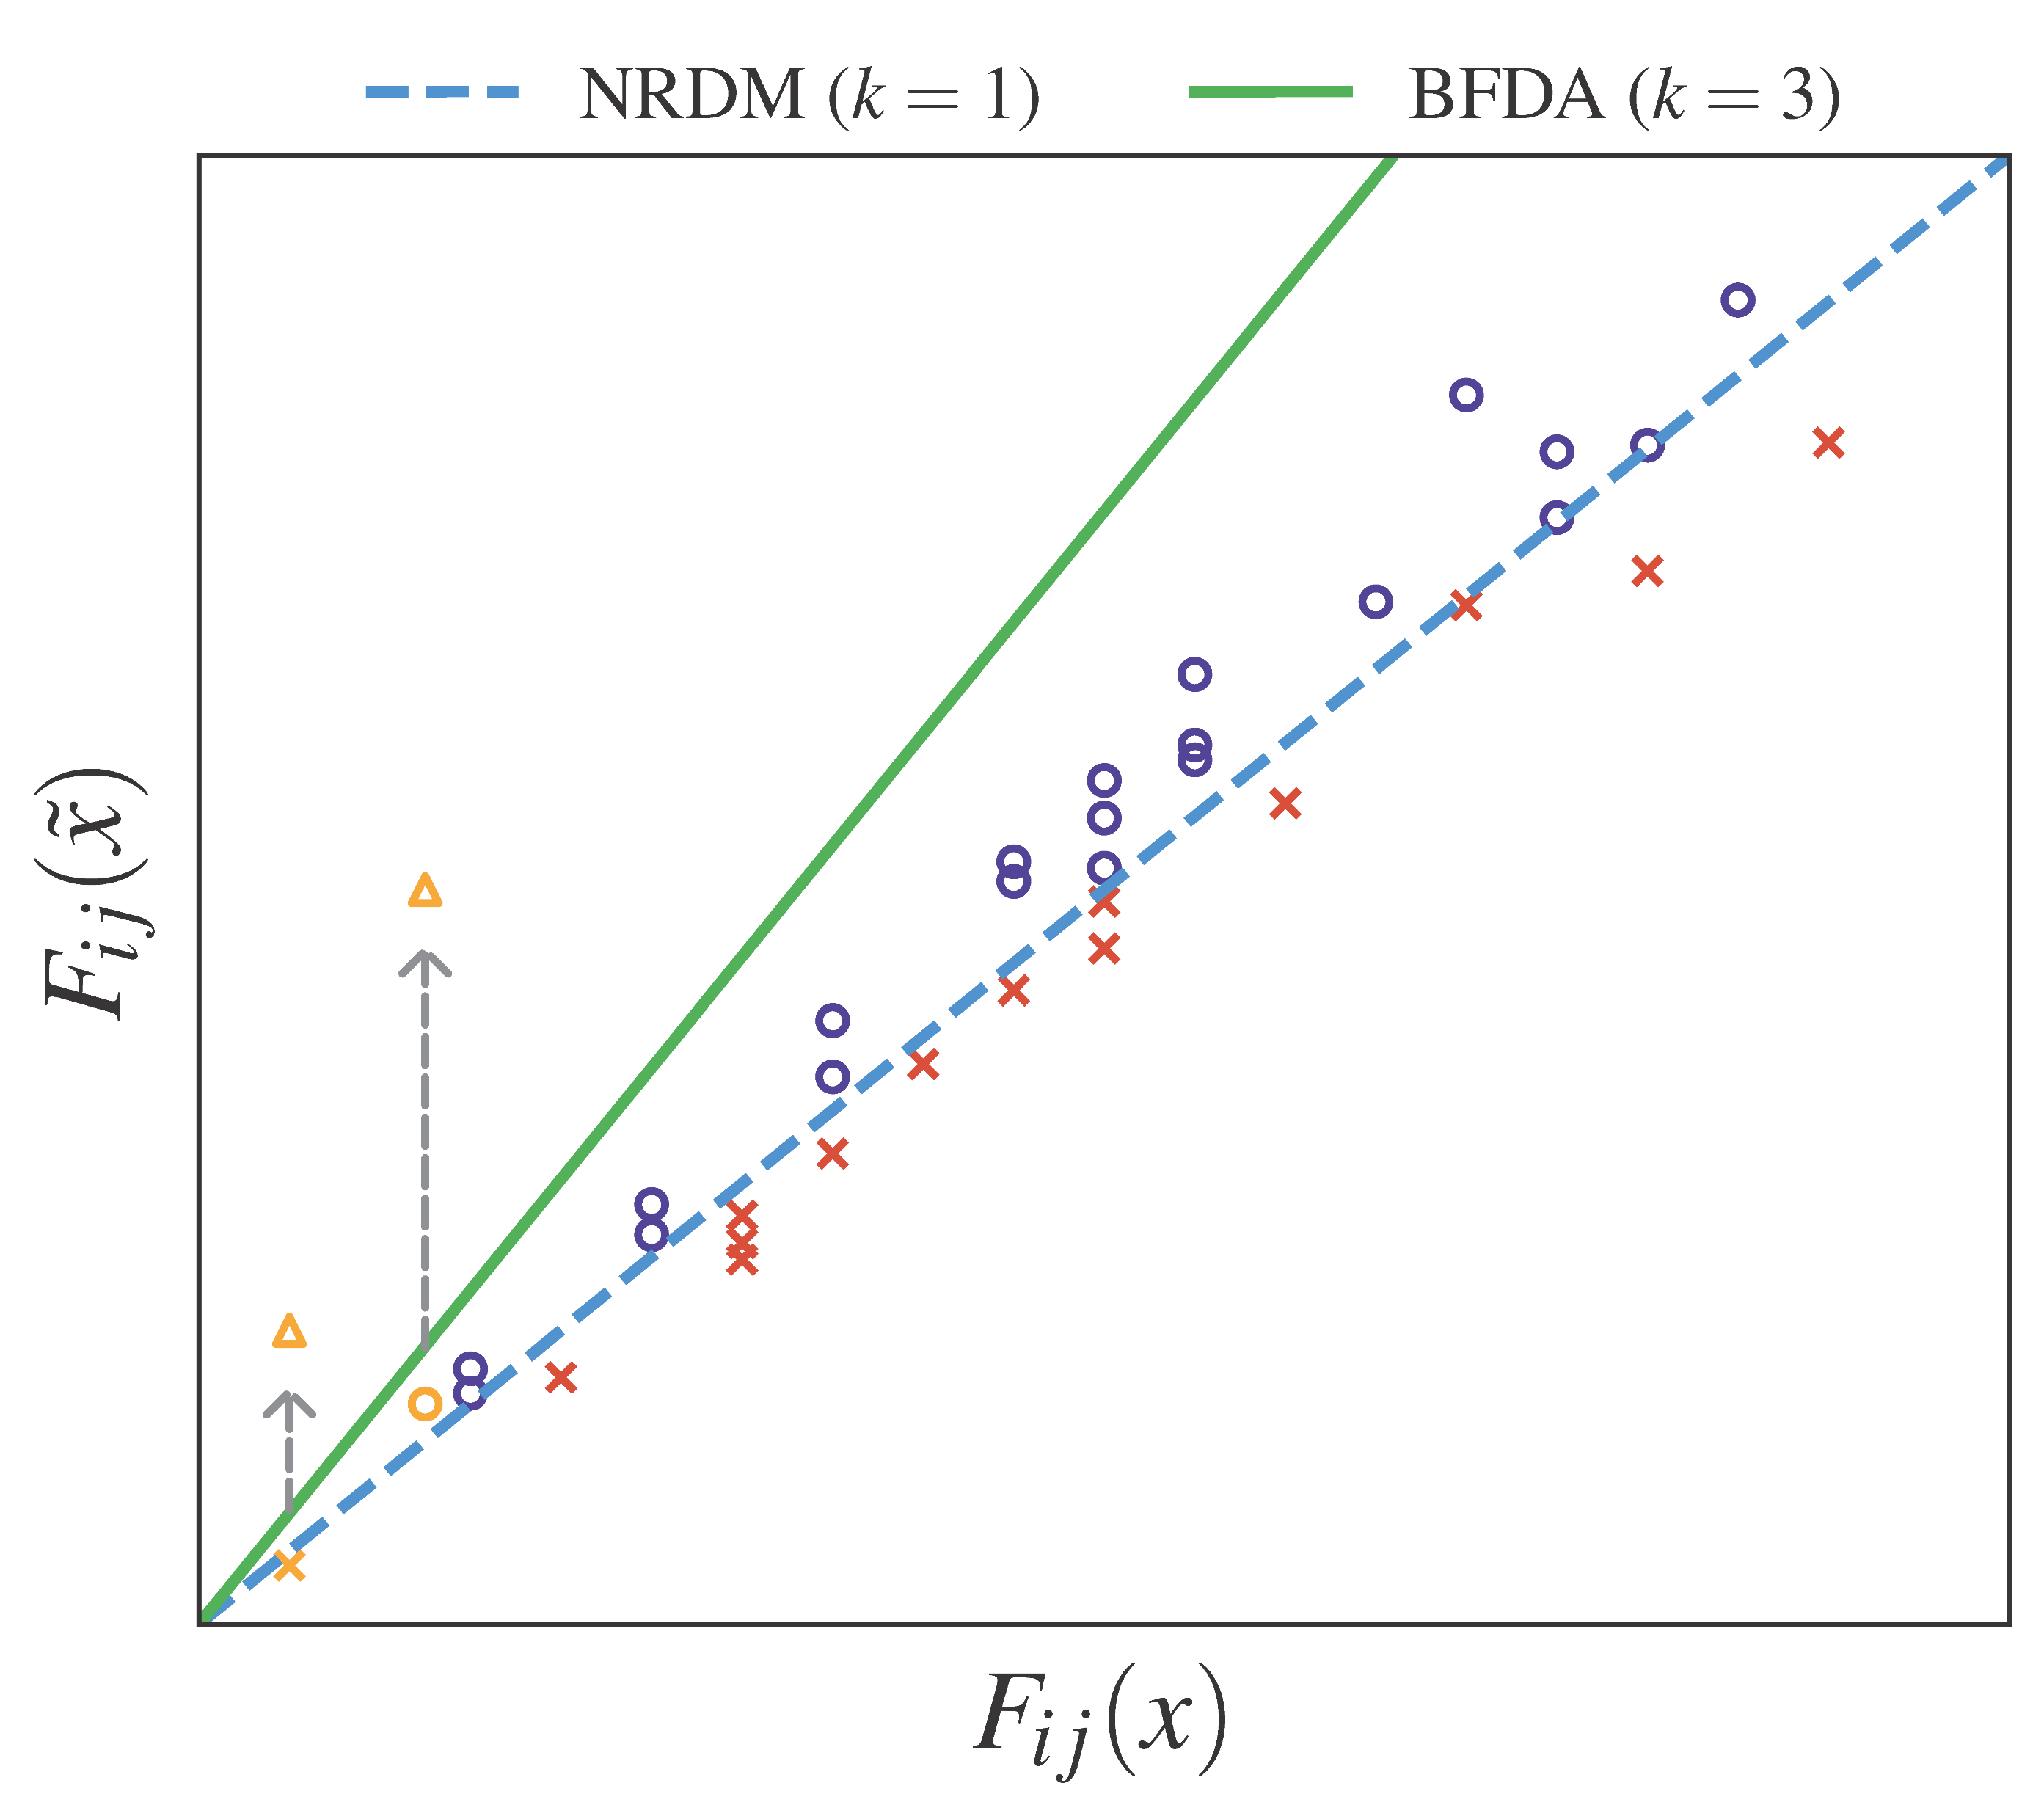
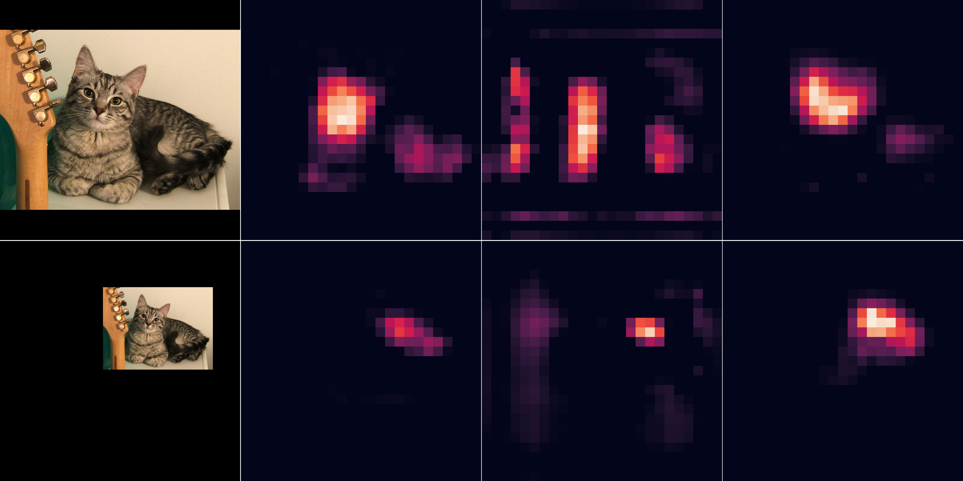
Methods
$Δ$: Randomly initialized adversarial noise
$$\tilde{x}=x+Δ$$
$$F_{ij}\left(\tilde{x}\right)=F_{ij}\left(x+Δ\right)=F_{ij}\left(x\right)+δ_{ij}$$
$$ℒ_{NRDM}=\sum_{i=1}^{S}{\frac{1}{N_{i}}}\sum_{j=1}^{N_{i}}{{\left(F_{ij}\left(\tilde{x}\right)−F_{ij}(x)\right)}^{2}}$$
Uncertainty of Feature Distortion
$$\frac{∂ℒ_{i}}{∂F_{ij}\left(\tilde{x}\right)}=2×\sum_{j=1}^{N}{(F_{ij}\left(\tilde{x}\right)−F_{ij}(x))}=2×\sum_{j=1}^{N}{δ_{ij}}$$
$$ℒ_{BFDA}=\sum_{i=1}^{S}{\frac{1}{N_{i}}}\sum_{j=1}^{N_{i}}{{\left(F_{ij}\left(\tilde{x}\right)−k⋅F_{ij}\left(x\right)\right)}^{2}}$$
Adversarial
Benign
Suppression:
$$F_{ij}\left(\tilde{x}\right)≈F_{ij}\left(x\right)<k⋅F_{ij}(x)$$
Amplification:
$$F_{ij}\left(T\left(\tilde{x}\right)\right)>k⋅F_{ij}(x)$$
[1] M. Naseer, S. H. Khan, S. Rahman, and F. Porikli, “Task-generalizable adversarial attack based on perceptual metric,” arXiv preprint arXiv:1811.09020, 2018. (NRDM)
Notes:
Adversarial examples are usually created by adding initially randomized noise to clean samples.
Since detectors are typically resistant to uniformly distributed random noise, the initial adversarial features closely resemble clean sample features, with just a small random difference delta.
Traditional methods such as NRDM focus on maximizing the Euclidean distance between adversarial and clean samples.
However, the randomness of delta poses challenges, impacting the direction of optimization.
To overcome these limitations, we propose the Bidirectional Feature Distortion Attack.
In our loss function, we multiply the features extracted from clean samples by a coefficient, k, which significantly suppresses the original critical features during the attack optimization process.
In addition to using the loss function to provide a specific suppression direction for critical features, we also employ data augmentation methods to further enhance the attack's effectiveness.
Specifically, we combine resizing and padding of suitable intensity to amplify object candidate features near critical features, facilitating the generation of new detection boxes around the object vicinity.

Slide 7
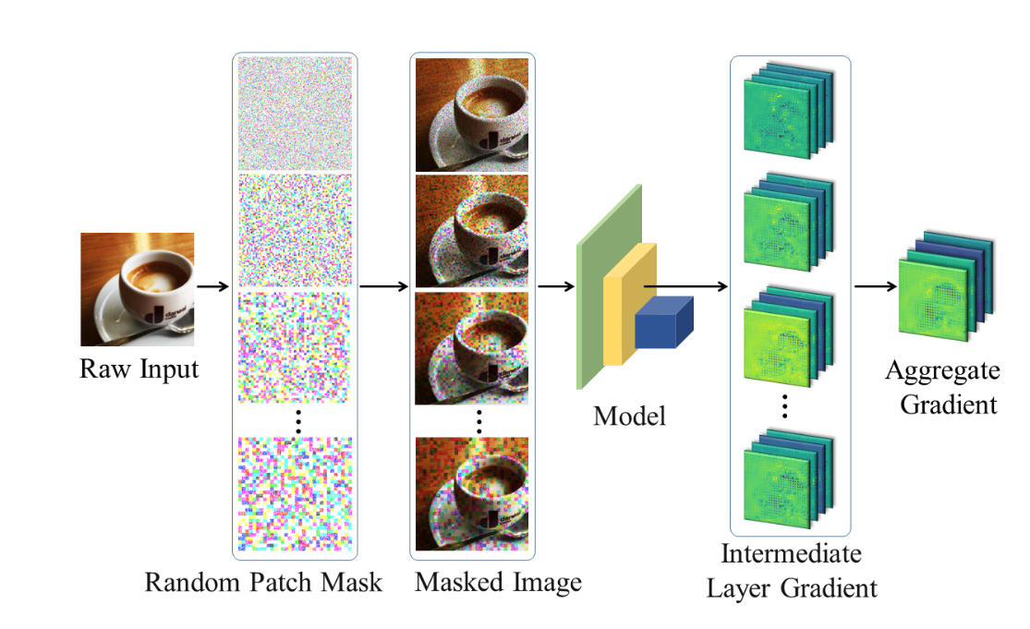
Comparative Methods
Mean activations across channels
$$ℒ_{FDA}=\sum_{i=1}^{S}{(\log{D\left(F_{i}\left(\tilde{x}\right) | F_{i}\left(\tilde{x}\right)<C_{i}\left(h,w\right)\right)}−\log{D(F_{i}(\tilde{x})|F_{i}\left(\tilde{x}\right)>C_{i}\left(h,w\right))})}$$
Fails on features w/ pos & neg value, e.g., YOLOv3
Aggregate Gradients
$$ℒ_{RPA}=\sum_{i=1}^{S}{\sum{(Δ_{i}⊙F_{i}(\tilde{x}))}}$$
Overfits to the detector's neck and head structure
[2] A. Ganeshan, V. BS, and R. V. Babu, "FDA: Feature disruptive attack," in Proceedings of IEEE International Conference on Computer Vision (ICCV), 2019, pp. 8069-8079. (FDA)
[3] Y. Zhang, Y.-a. Tan, T. Chen, X. Liu, Q. Zhang, and Y. Li, "Enhancing the transferability of adversarial examples with random patch," in Proceedings of International Joint Conference on Artificial Intelligence (IJCAI), 2022, pp. 1672-1678. (RPA)
[4] J. Zhang, W. Wu, J.-t. Huang, Y. Huang, W. Wang, Y. Su, and M. R. Lyu, "Improving adversarial transferability via neuron attribution-based attacks," in Proceedings of IEEE Conference on Computer Vision and Pattern Recognition (CVPR), 2022, pp. 14993-15002. (NAA)
Notes:
We selected NRDM, FDA, RPA, and NAA as comparative methods for our study.
Although these methods demonstrate good transferability on classifiers, they do not achieve satisfactory adversarial transfer results on detectors.
The FDA method begins by regulating feature amplification and suppression according to mean activations across channels.
Yet, this strategy faces difficulties with detectors such as YOLOv3, which employs leaky ReLU activation.
Due to negative values in features, the mean activation threshold is reduced, resulting in the excessive suppression of all feature elements.
On the other hand, RPA and NAA methods rely on extensive data augmentation and iterative forward and backward to aggregate gradients, guiding feature modulation.
This strategy might overfit to the model structure, leading to poor transfer results, particularly due to the variations in neck and head designs among detectors.

Slide 8
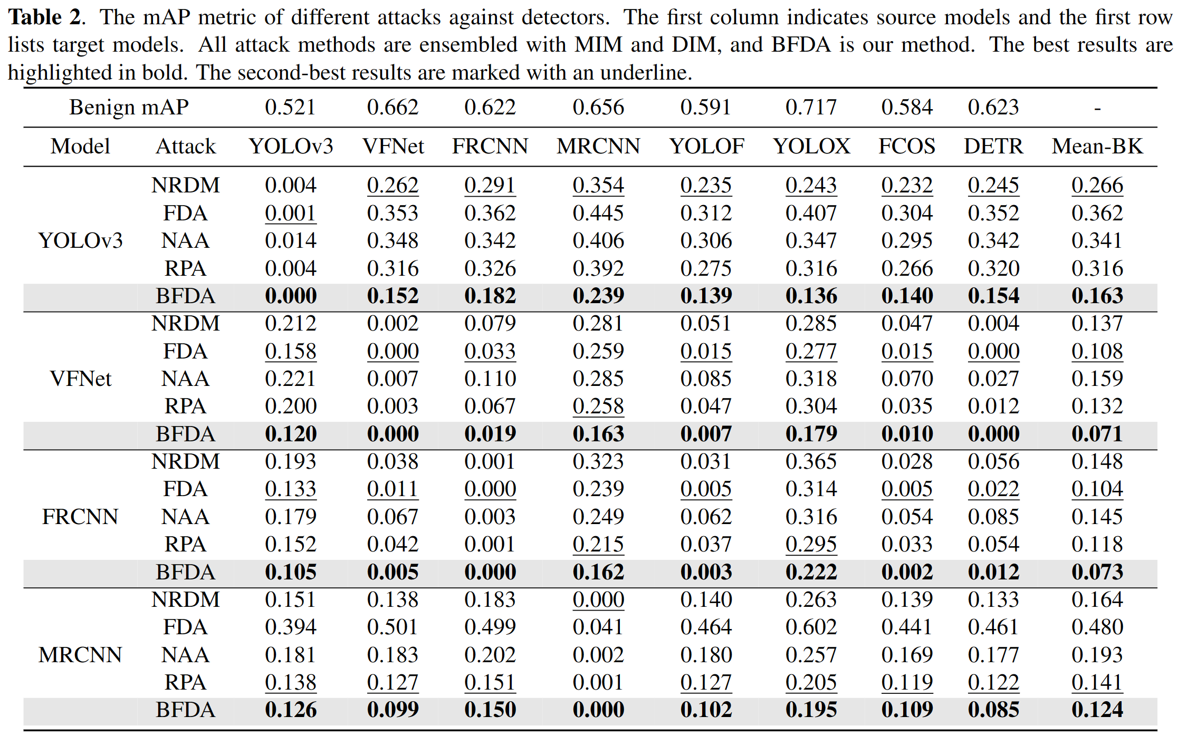
Experiments
Average mAP of BlacK-box models
Settings:
$l_{∞}=5/255$
200 iterations
2000 images
VOC2012 datasets
Surrogate Models：
YOLOv3
VFNet
FasterRCNN
MaskRCNN
Notes:
During the experimental phase, we randomly selected 2,000 images from the VOC2012 test set and padded them to 800 as input.
We selected YOLOv3, VFNet, FasterRCNN, and MaskRCNN as surrogate models, and YOLOF, YOLOX, FCOS, and DETR as target detectors.
All models were trained using the mmdetection framework on the COCO dataset.
As outlined in our results table, our BFDA outperforms other attacks regarding effectiveness on adversarial examples crafted on the four source models, both in white and black-box attacks.
The NRDM method, as an original intermediate layer adversarial attack, can serve as a reference baseline here.
The FDA method is also a label-free adversarial attack method with good transferability on the ResNet series backbone.
However, using the cross-channel mean value as the criterion to distinguish positive and negative attributes loses effectiveness on the backbones such as DarkNet53 and Swin Transformer.
When YOLOv3 and VFNet are used as source models, it can be observed that gradient aggregation methods, represented by RPA, have even worse transferability than the original NRDM, which further indicates that the aggregated gradients may introduce more model-specific information of neck and head.
Our BFDA method, with a similar complexity to NRDM, has significantly improved transferability compared to the NRDM due to introducing feature priors extracted by the detector backbone.

Slide 9
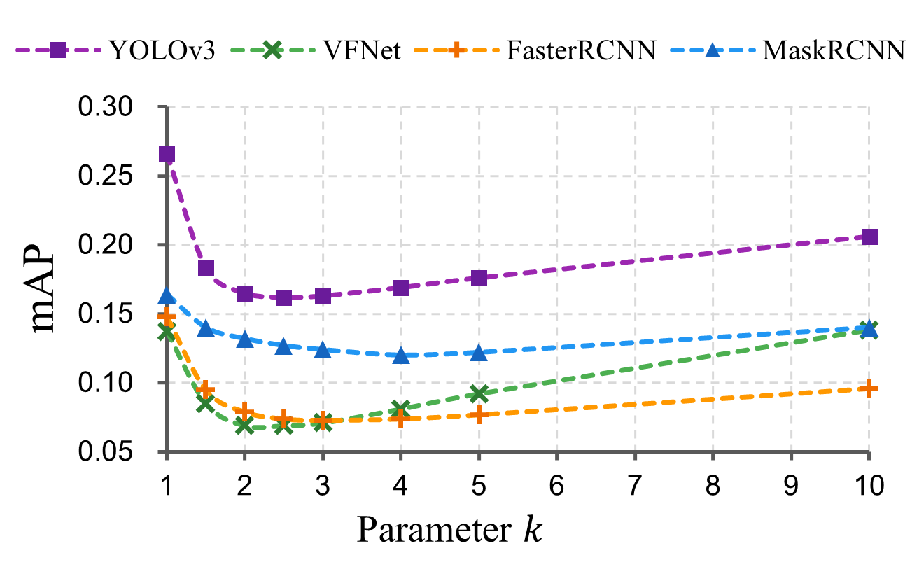
Experiments
Ablation Study
Small $k$: BFDA turns into NRDM, lacks suppression, weak transferability.
Large $k$: Over-suppression limits perturbations, reduces transferability.
In our work, $k=3$ proves to be sufficiently effective.
Notes:
We explored the importance of the scaling factor \(k\) in our BFDA method through an ablation study.
The scaling factor k is key in our approach because it determines how much we suppress features, which directly affects the transferability of the adversarial examples.
When $k=1$, BFDA degenerates into NRDM, which lacks suppression of critical feature elements and results in inferior transferability.
When $k$ is large, such as $k=10$, the strong suppression will affect small-valued elements and hinder the creation of more perturbation boxes, resulting in poor transferability as well.

Slide 10
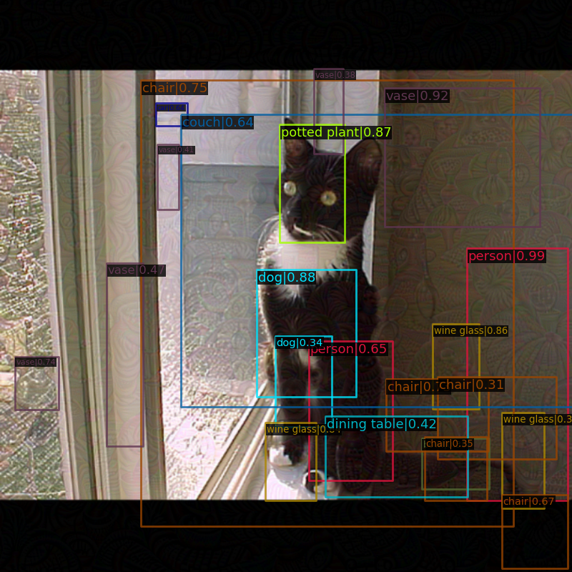
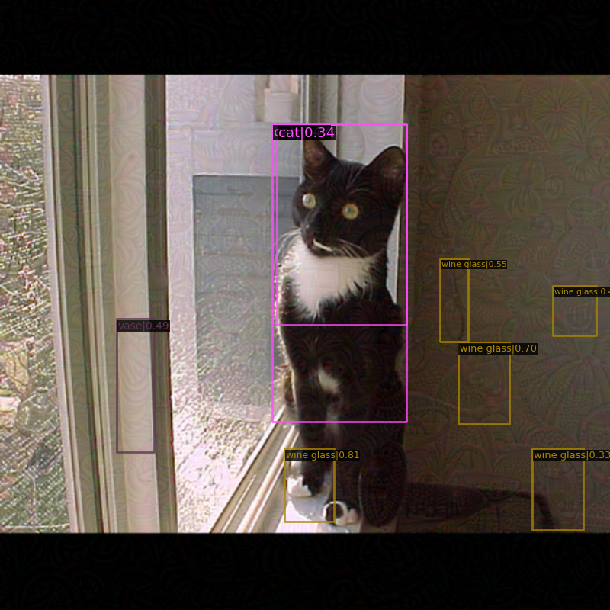
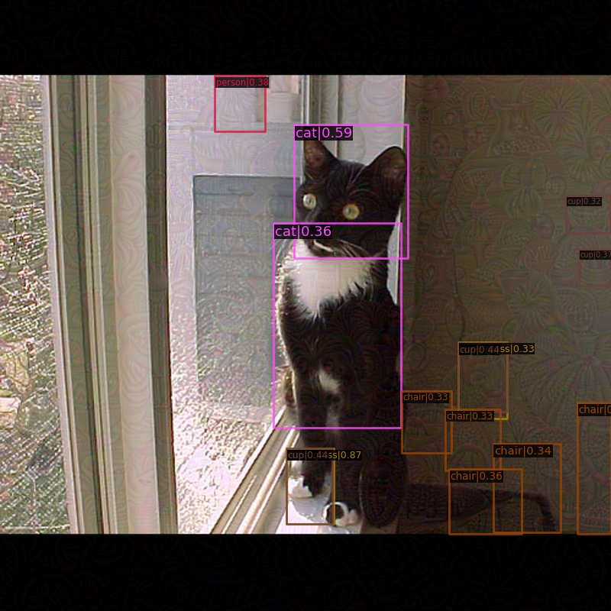
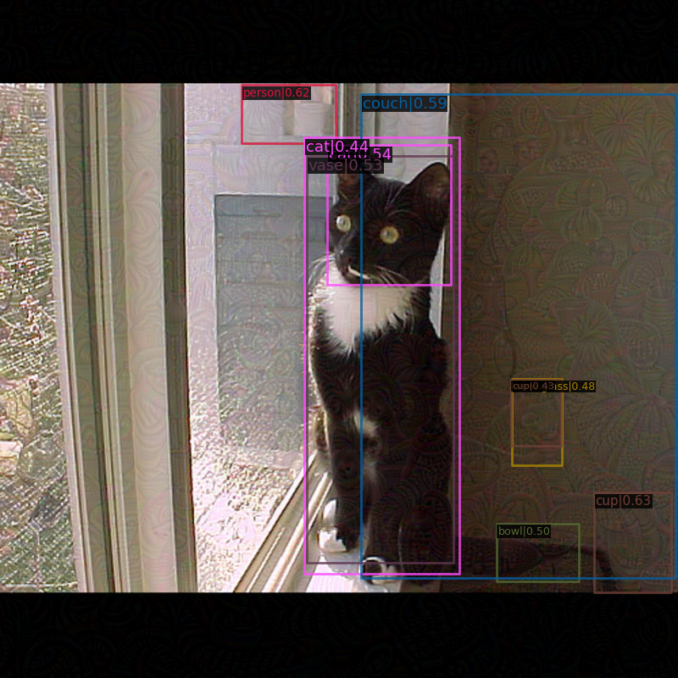
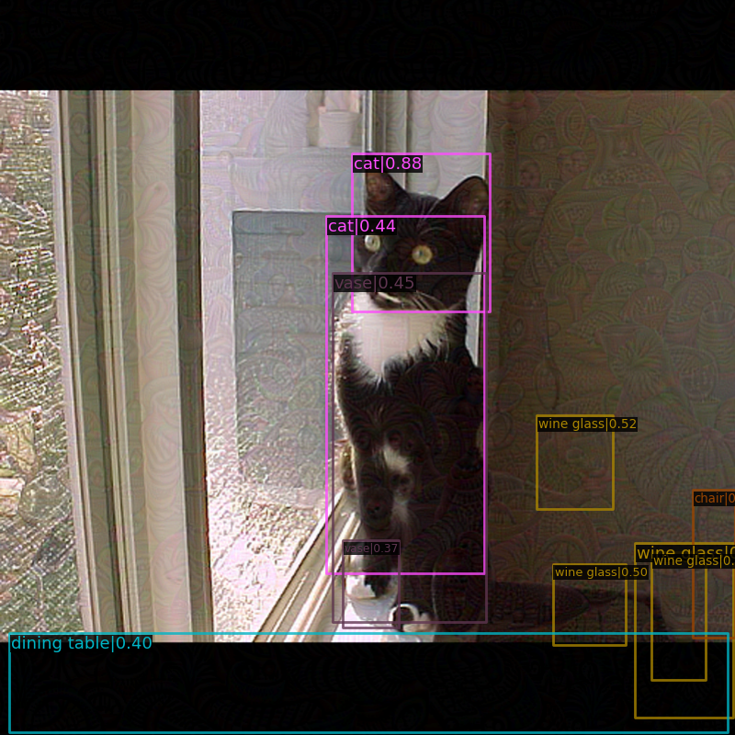
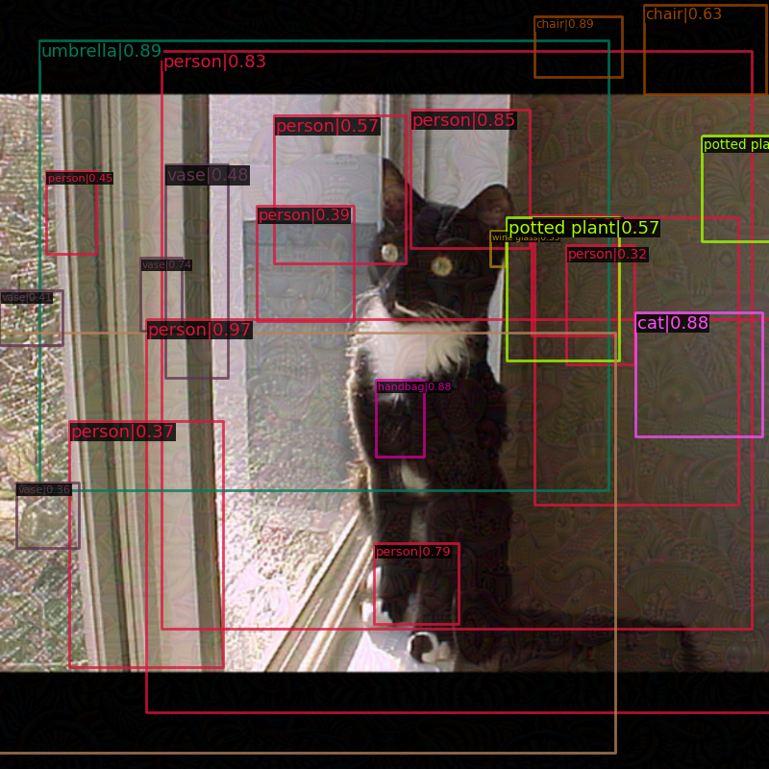
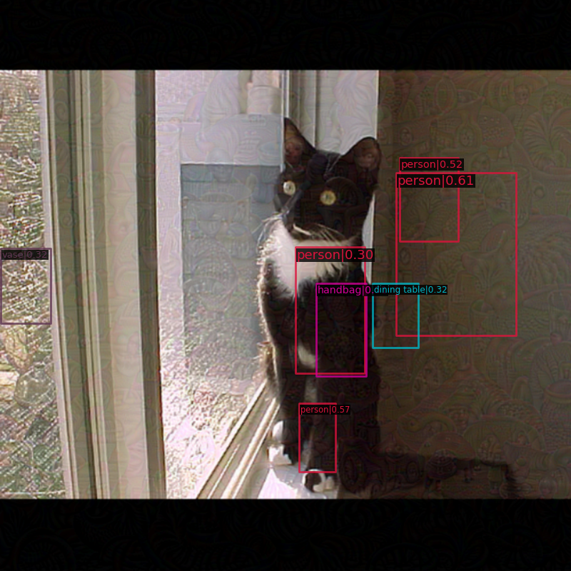
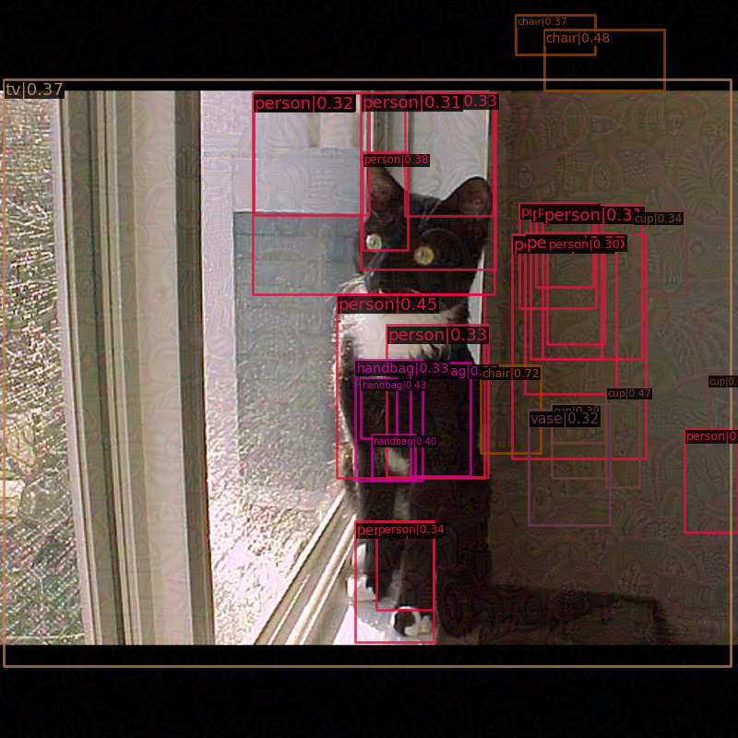
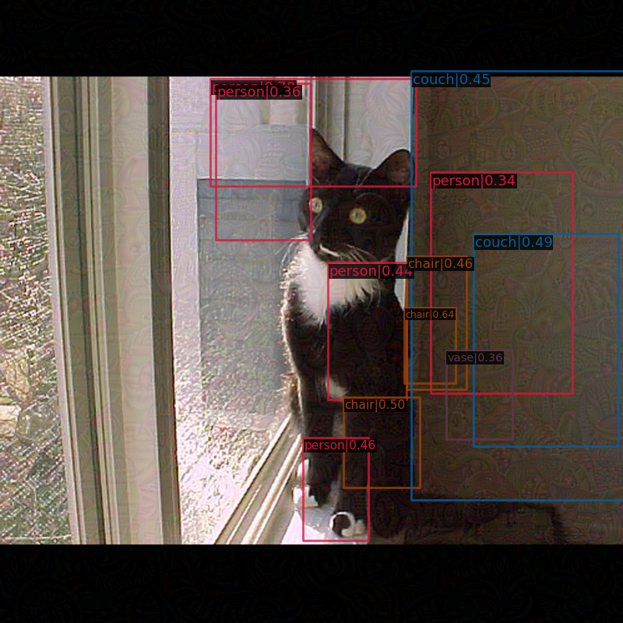
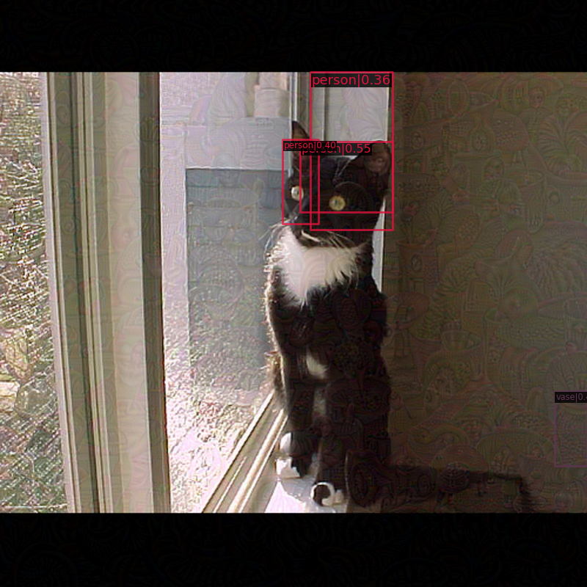
Experiments
Visualizations
Surrogate Model
Target Models
YOLOv3
YOLOX
VFNet
FRCNN
MRCNN
✓
✗
✗
✗
✗
NRDM
Cat still detected.
✓
✓
✓
✓
✓
BFDA
Notes:
This slide shows the detection results on various detectors for adversarial examples generated on YOLOv3 using both NRDM and our method, BFDA.
Although the NRDM method successfully attacks the cat detection on the surrogate model, the cat is still detectable when the attack is applied to other target models.
In contrast, our BFDA method consistently makes the cat undetectable across both surrogate and target models, while also generating numerous false detection boxes.

Slide 11
Conclusions
In this paper, we propose the Bidirectional Feature Distortion Attack (BFDA) to craft transferable adversarial examples.
By implicitly suppressing critical elements within the extracted features while enhancing object-relevant elements corresponding to possible detection box locations, we achieve both vanish and creation attack effects.
The experimental results demonstrate that our method generates adversarial examples with the best transferability among all compared methods on multiple detectors, achieving state-of-the-art performance.
Notes:
In summary, our Bidirectional Feature Distortion Attack achieves both vanishing and creation attack effects by implicitly suppressing critical elements within the extracted features while enhancing object-relevant elements corresponding to potential detection box locations.
Our method generates adversarial examples with high transferability across various detectors, surpassing the performance of all other methods.

Slide 12
Thank you!
Q & A
Xinlong Ding
University of Science and Technology Beijing
Beijing, China
dingxl22@xs.ustb.edu.cn
Jiansheng Chen*
University of Science and Technology Beijing
Beijing, China
jschen@ustb.edu.cn
Hongwei Yu
University of Science and Technology Beijing
Beijing, China
yuhongwei22@xs.ustb.edu.cn
Yu Shang
Tsinghua University Beijing, China
shangy21@mails.tsinghua.edu.cn
Huimin Ma
University of Science and Technology Beijing
Beijing, China
mhmpub@ustb.edu.cn
Notes:
Thank you for your attention.
Any questions or comments are welcome.

