Slide 1
Mobile GPU Accelerated Digital Predistortion on a Software-defined Mobile Transmitter
Kaipeng Li, Amanullah Ghazi, Jani Boutellier, Mahmoud Abdelaziz, Lauri Anttila, Markku Juntti, Mikko Valkama, Joseph R. Cavallaro
Dec. 15, 2015

Slide 2
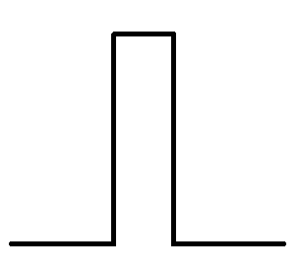
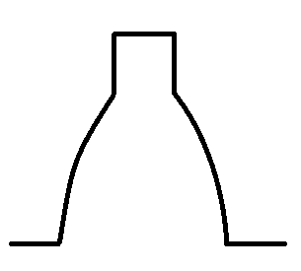
Impairments in wireless transmitters
Imperfection of analog RF and digital baseband circuits
Nonlinearity of power amplifier (PA)
I/Q imbalance
Local oscillator (LO) leakage
Original signal spectrum
Transmit signal spectrum
Impairments
of
transmitter
Spurious
spectrum
emissions

Slide 3
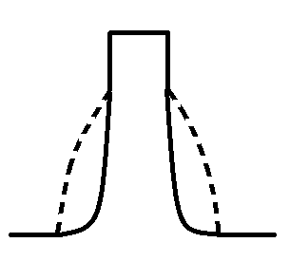
Digital predistortion (DPD)
Preprocess the signal at digital baseband before transmission
to suppress the unwanted spurious spectrum emissions
Original signal spectrum
Transmit signal spectrum
DPD
Impairments
of
transmitter
Suppress
spurious
spectrum
Pros: Better signal coverage and power efficiency
Cons: Extra baseband processing complexity

Slide 4
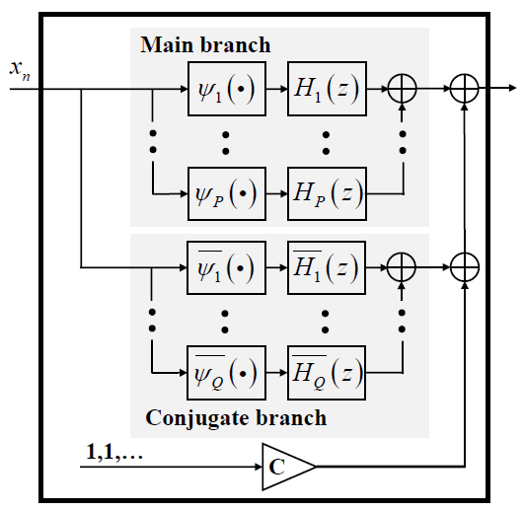
Internal structure of DPD Augmented Parallel Hammerstein (APH) structure*
Original
I/Q symbols
Predistorted
I/Q symbols
Conjugate branch:
Deal with I/Q imbalance
$ψ$: Polynomials (p^{th} or q^{th} order):
$$ψ_{p}\left(x_{n}\right)={|x_{n}|}^{p−1}x_{n}$$
$$\overline{ψ_{q}}\left(x_{n}\right)={|x_{n}^{∗}|}^{q−1}x_{n}^{∗}$$
H: DPD filters (L_{p} or L_{q} taps):
Filter coefficients:
$$h_{p}=[h_{p,0},h_{p,1}∙∙∙,h_{p,L_{p}−1}]$$
$$\overline{h_{q}}=[\overline{h_{q,0}} ,\overline{h_{q,1}} ,∙∙∙,\overline{h_{q,L_{q}−1}}]$$
c: Compensation of LO leakage
APH DPD Structure
How to obtain those DPD parameters?
* L. Anttila,et. al.“Joint mitigation of power amplifier and I/Q modulator impairments in broadband direct-conversion transmitters,” IEEE TMTT,2010

Slide 5
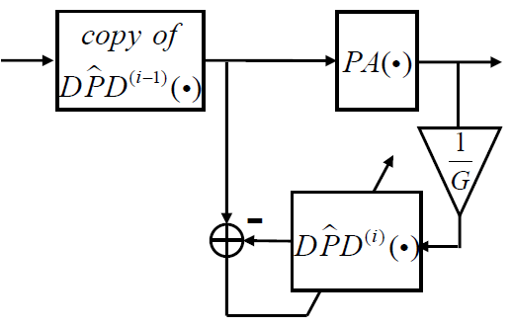
Parameter training of DPD
Minimize the error signal by least squares estimation
in feedback loops until DPD parameters (filter & LO coef.) converge
Training
samples
Inverse of
PA Gain
error
signal
i: iteration number
Indirect learning architecture*
*C. Eun and E. Powers, “A new Volterra predistorter based on the indirect learning architecture,” IEEE TSP, 1997.

Slide 6
DPD system design flow
Retraining needed ?
New radio hardware ? / Environment changes ?
DPD
parameter
training
Finalized
DPD
parameters
Map trained
DPD on
hardware
DPD
Performance
Evaluation
Offline training system:
Perform training whenever needed
Obtain and store latest DPD parameters
Do not need to be real-time
High performance predistortion system:
Perform effective predistortion continuously
Easy to reconfigure with latest parameters
High data-rate performance

Slide 7
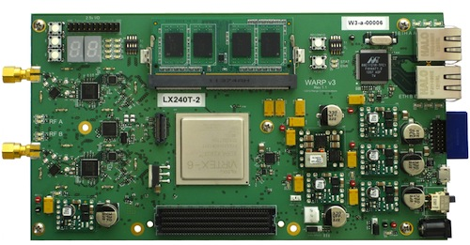
Offline DPD training system
Incorporate iterative DPD parameter training process with WARPLab framework (rapid PHY prototyping in Matlab)
When DPD parameters converge, extract and store them in PC
DPD training
algorithm
on Matlab
RX RF
Feedback
loop by
coaxial
cable
Data transfer
by Ethernet
TX RF
PC
WARP v3 radio board*
*Figure from http://warpproject.org/trac/

Slide 8
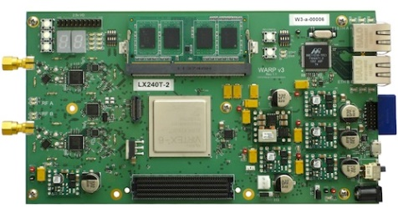
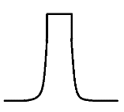
High performance predistortion system
Finalized DPD
parameters
Predistortion
design on
hardware
Predistorted
samples
Input
I/Q samples
WARP
Spectrum
analyzer
Targets:
High mobility: designed for mobile transmitter
High flexibility: configure new parameters easily; predistort various input signals
High data rate: perform predistortion efficiently and transmit continuously
Decision: Mobile GPU (CUDA)

Slide 9
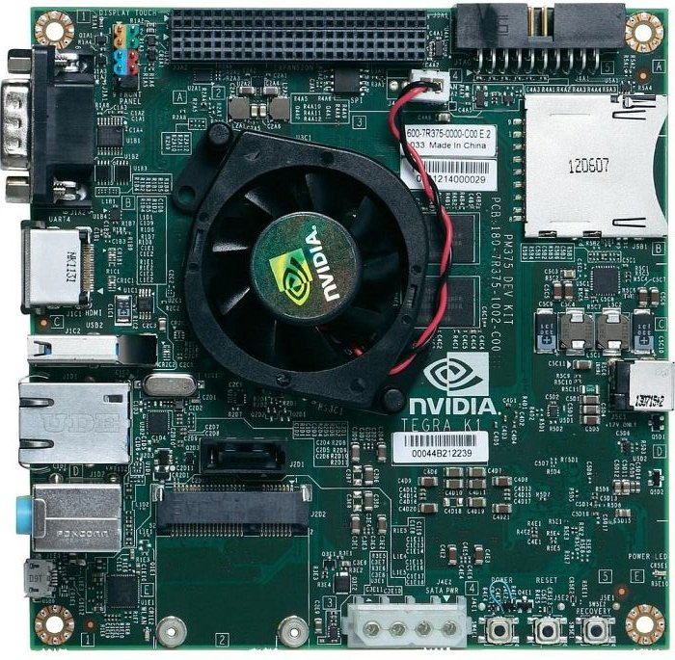
A mobile GPU development platform
Nvidia Jetson TK1 mobile development board*
Integrated with Tegra K1 28nm SOC
192 core Kepler GK20A mobile GPU
Quad core ARM Cortex A15 CPU
Linux for Tegra (L4T) operating system
*Figure from http://diydrones.com/group/volta/forum/topics/

Slide 10
Mobile GPU-based predistortion system
Finalized DPD
Parameters
CPU
Predistorted
samples
Input
I/Q samples
DPD Comp.
Mobile GPU
Ethernet
WARP
Spectrum
analyzer
Jetson TK1
Key strategies to enhance system data-rate performance:
Improve computation efficiency
Multi-threaded DPD computations on mobile GPU
Memory access optimization on mobile GPU
Reduce data transfer overhead
Reduce CPU-GPU memory copy overhead in Jetson
Reduce packet transfer overhead between Jetson and WARP

Slide 11
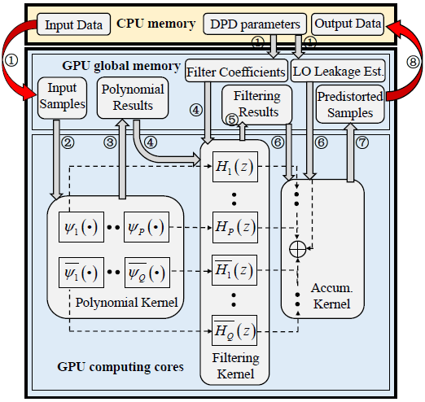
Improve computation efficiency ——Dataflow diagram
CPU
DPD Comp.
Mobile GPU

Slide 12
Improve computation efficiency ——Multi-threaded kernel execution
Parallelism analysis of DPD
DPD can perform on each of N input symbols independently
P main branch + Q conjugate branch filters can work in parallel
Parallelism degree of kernel computations
 | Polynomial | Filtering | Accumulation
Parallelism degree | N | N*(P+Q) | N
Number of threads | N | N*(P+Q) | N
P and Q: selected during training to ensure good suppression effect
N: a large number (10⁵-10⁶) to keep GPU cores busy
Notes:
Note:
P and Q are denoted in the figures at page 4 and 11,
P is the number of main branch filters: H₁ , H₂, … H_{P}
Q is the number of conjugate branch filters: H₁ , H₂, … H_{Q}

Slide 13
Improve computation efficiency ——Memory access optimization
Memory utilization schemes on GPU
GPU global memory: share intermediate results between kernels
GPU constant memory: store DPD parameters for fast broadcasting
On-chip local registers: store local variables for kernel computations
Data alignment on global memory
T₁
T₂
T_{N}
N threads
(1)Poly. comp.
T₁
x₁
x₂
…
x_{N}
Global MEM
$$ψ_{1}(x_{1})$$
$$ψ_{2}(x_{1})$$
$$ψ_{P+Q}(x_{1})$$
$$ψ_{1}(x_{2})$$
$$ψ_{2}(x_{2})$$
$$ψ_{P+Q}(x_{2})$$
…
…
…
$$ψ_{1}(x_{N})$$
$$ψ_{2}(x_{N})$$
$$ψ_{P+Q}(x_{N})$$
(2)Write to Global MEM with alignment
Register
T₁
T₂
T_{N}
N threads
$$ψ_{1}(x_{1})$$
$$ψ_{1}(x_{2})$$
…
$$ψ_{1}(x_{N})$$
Global MEM

Slide 14
Improve computation efficiency ——Memory access optimization
Memory utilization schemes on GPU
GPU global memory: share intermediate results between kernels
GPU constant memory: store DPD parameters for fast broadcasting
On-chip local registers: store local variables for kernel computations
Data alignment on global memory
(1)Poly. comp.
x₁
x₂
…
x_{N}
Global MEM
$$ψ_{1}(x_{1})$$
$$ψ_{2}(x_{1})$$
$$ψ_{P+Q}(x_{1})$$
$$ψ_{1}(x_{2})$$
$$ψ_{2}(x_{2})$$
$$ψ_{P+Q}(x_{2})$$
…
…
…
$$ψ_{1}(x_{N})$$
$$ψ_{2}(x_{N})$$
$$ψ_{P+Q}(x_{N})$$
(2)Write to Global MEM with alignment
Register
T₁
T₂
T_{N}
N threads
$$ψ_{1}(x_{1})$$
$$ψ_{1}(x_{2})$$
…
$$ψ_{1}(x_{N})$$
$$ψ_{2}(x_{1})$$
$$ψ_{2}(x_{2})$$
…
$$ψ_{2}(x_{N})$$
Global MEM

Slide 15
Improve computation efficiency ——Memory access optimization
Memory utilization schemes on GPU
GPU global memory: share intermediate results between kernels
GPU constant memory: store DPD parameters for fast broadcasting
On-chip local registers: store local variables for kernel computations
Data alignment on global memory
(1)Poly. comp.
x₁
x₂
…
x_{N}
Global MEM
$$ψ_{1}(x_{1})$$
$$ψ_{2}(x_{1})$$
$$ψ_{P+Q}(x_{1})$$
$$ψ_{1}(x_{2})$$
$$ψ_{2}(x_{2})$$
$$ψ_{P+Q}(x_{2})$$
…
…
…
$$ψ_{1}(x_{N})$$
$$ψ_{2}(x_{N})$$
$$ψ_{P+Q}(x_{N})$$
(2)Write to Global MEM with alignment
Register
T₁
T₂
N threads
T_{N}
$$ψ_{1}(x_{1})$$
$$ψ_{1}(x_{2})$$
…
$$ψ_{1}(x_{N})$$
$$ψ_{2}(x_{1})$$
$$ψ_{2}(x_{2})$$
…
$$ψ_{2}(x_{N})$$
$$ψ_{P+Q}(x_{1})$$
$$ψ_{P+Q}(x_{2})$$
…
$$ψ_{P+Q}(x_{N})$$
(3)Read from Global MEM for Filtering comp.
N*(P+Q) threads

Slide 16
Reduce data transfer overhead ——CPU-GPU memory copy
Multi-stream workload scheduling
Overlap CPU-GPU memory copy latency with kernel executions

Slide 17
Reduce data transfer overhead ——Jetson-WARP packet transfer
Packet transfer schemes
Overlap Jetson-WARP packet transfer with on board DPD processing by
producer-consumer model
Producer
Thread1
DPD
processing 1
DPD
processing 2
DPD
processing 3
Jetson
CPU
OpenMP
Packet
transfer 1
Packet
transfer 2
Packet
transfer 3
Thread2
Consumer

Slide 18
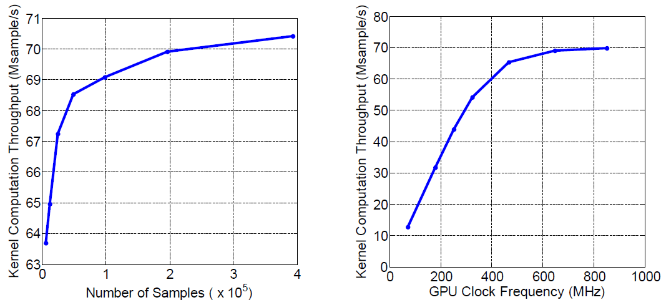
Performance evaluation ——Data rate
Throughput @ Clk=852MHz
Throughput @ N=2x10⁶
Throughput improves with the increase of N or Clk. freq. until saturation
Peak: ~70 Msample/s

Slide 19
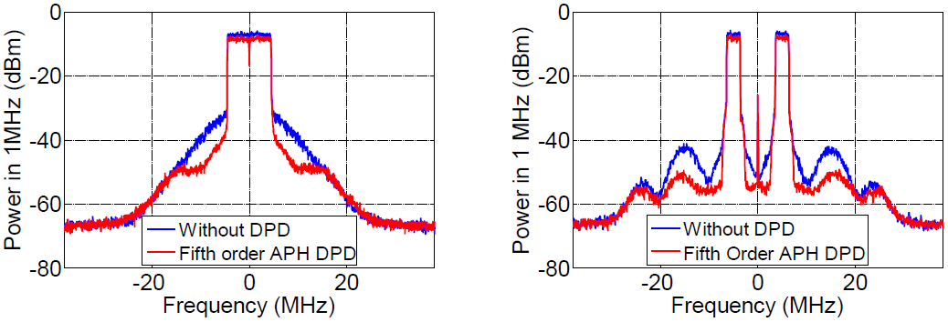
Performance evaluation ——Suppression effect
Parameter configurations
Single component carrier (CC)
Non-contiguous carrier aggregation (CA)
10MHz
3MHz
3MHz
~10dB DPD suppression on spurious spectrum emissions for both scenarios

Slide 20
Conclusion
Design of a mobile GPU accelerated digital predistortion on a software-defined mobile transmitter
High mobility
Develop on a Jetson-WARP based mobile radio platform
High data rate
Efficient kernel execution and memory utilization on GPU
Low overhead memory copy and packet transfer schemes
High flexibility
Reconfigure with latest trained DPD parameters
Support various input signals (single CC & non-contiguous CA)

