Slide 1
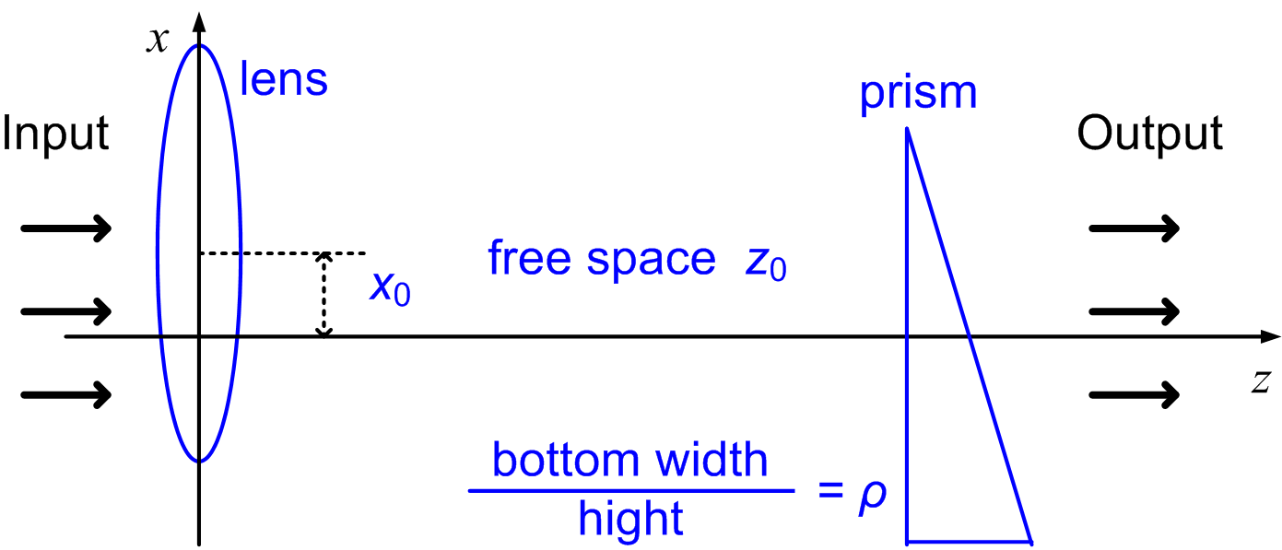
COMMUTING OPERATOR OF OFFSET LINEAR CANONICAL TRANSFORM AND ITS APPLICATIONS
Soo-Chang Pei, Shih-Gu Huang
Graduate Institute of Communication Engineering, National Taiwan University, Taipei, Taiwan
INTRODUCTION
PROPOSED OFFSET LCT AND ITS COMMUTING OPERATOR
APPLICATIONS
Linear canonical transform (LCT) can be generalized by introducing two extra parameters, called offset LCT (OLCT).
A new definition of OLCT is proposed with a more concise inverse transform.
We find the commuting operator of the proposed OLCT.
The discrete version of the commuting operator is derived.
We develop a discrete OLCT with perfect reversibility property.
1. Eigenfunctions of Commuting Operator of OLCT
The eigenfunctions obtained from the commuting operator are unique and orthogonal.
They are also the eigenfunctions of the OLCT, because the commuting operator and OLCT commute.
The discrete version of the commuting operator is proposed, and some eigenvectors are shown below.
2. Self-Imaging Phenomena
Many optical systems can be modeled by the OLCT, such as the system shown below.
The eigenfunctions of the OLCT can be used to analyze the self-imaging phenomena of the system.
3. Discrete OLCT
We develop a discrete OLCT with perfect reconstruction based on the eigenvectors.
1. Conventional OLCT
In time-frequency plane, conventional OLCT results in
$\left[\begin{matrix}u \\ ν\end{matrix}\right]=\left[\begin{matrix}a & b \\ c & d\end{matrix}\right]\left[\begin{matrix}x \\ ω\end{matrix}\right]+\left[\begin{matrix}τ \\ η\end{matrix}\right]$.
The Inverse transform of the conventional OLCT is
${\left[{\tilde{ℒ}}_{M}^{τ,η}\right]}^{−1}=e^{j\frac{cd}{2}τ^{2}−jadτη+j\frac{ab}{2}η^{2}}{ \tilde{ℒ}}_{M^{−1}}^{−dτ+bη, cτ−aη}$.
We want to develop a new definition of OLCT with a more concise inverse transform.
2. Proposed OLCT
Consider another time-frequency transformation
$\left[\begin{matrix}u \\ ν\end{matrix}\right]−\left[\begin{matrix}β \\ γ\end{matrix}\right]=\left[\begin{matrix}a & b \\ c & d\end{matrix}\right]\left(\left[\begin{matrix}x \\ ω\end{matrix}\right]−\left[\begin{matrix}β \\ γ\end{matrix}\right]\right)$.
Based on this transformation, a new OLCT is derived:
$$\begin{matrix}ℒ_{M}^{β,γ}\left\{\left.x(t\right)\right\}=\sqrt{\frac{1}{j2πb}}\text{​}\int_{−∞}^{∞}{\text{​}}\text{​}e^{\left.jγ(u−β)+j\frac{d}{2b}{\left(u−β\right)}^{2}−j\frac{1}{b}(u−β)(t−β\right)} \\ { }^{\left.+j\frac{a}{2b}{\left(t−β\right)}^{2}−jγ(t−β\right)}x\left(t\right)dt, b≠0.\end{matrix}$$
The Inverse transform of the proposed OLCT is
${\left[ℒ_{M}^{β,γ}\right]}^{−1}=ℒ_{M^{−1}}^{β,γ}$.
3. Commuting Operator of the Proposed OLCT
The goal is to find a linear operator commuting with the proposed OLCT operator, i.e.
$𝒞_{M}^{β,γ}ℒ_{M}^{β,γ}=ℒ_{M}^{β,γ}𝒞_{M}^{β,γ}$.
From the first derivative of $ℒ_{M}^{β,γ}$ and ${\left[ℒ_{M}^{β,γ}\right]}^{−1}=ℒ_{M^{−1}}^{β,γ}$,
$$\begin{matrix}𝒞_{M}^{β,γ}=b{\left(\frac{d}{dt}−jγ\right)}^{2}+j\frac{a−d}{2}\left[(t−β)\left(\frac{d}{dt}−jγ\right)\right. \\ \left. +\left(\frac{d}{dt}−jγ\right)(t−β)\right]+c{(t−β)}^{2}.\end{matrix}$$
LCT AND ITS COMMUTING OPERATOR
LCT is useful in optics, filter design, radar system analysis, signal synthesis, time-frequency analysis, etc.
Fourier transform, Fresnel transform and fractional Fourier transform are all the special cases of the LCT.
The LCT with parameters $\left.M=[a,b;c,d\right]$ can produce affine transformation
$$\left[\begin{matrix}u \\ ν\end{matrix}\right]=\left[\begin{matrix}a & b \\ c & d\end{matrix}\right]\left[\begin{matrix}x \\ ω\end{matrix}\right]$$
in time-frequency plane.
If a linear operator $𝒞_{M}$ commutes with the LCT $ℒ_{M}$, then
$𝒞_{M}ℒ_{M}=ℒ_{M}𝒞_{M}$.
The commuting operator of the LCT is
$𝒞_{M}=b\frac{d^{2}}{dt^{2}}+j\frac{a−d}{2}\left(t\frac{d}{dt}+\frac{d}{dt}t\right)+ct^{2}$.

