Slide 1
Gland Segmentation via Dual Encoders and Boundary-enhanced Attention
(Huadeng Wang, Jiejiang Yu, Bingbing Li, Xipeng Pan, Zhenbing Liu, Rushi Lan, Xiaonan Luo)
Jiejiang Yu
Guilin University of Electronic Technology
18 Apr, 2024
Notes:
Good afternoon, everyone. The topic of my presentation is "Gland Segmentation via Dual Encoders and Boundary-enhanced Attention." My name is Jiejiang Yu, and I come from the School of Computer Science and Information Security at Guilin University of Electronic Technology.

Slide 2
1. Background and Contribute
2. Methods
3. Experiments and Analysis
4. Conclusion
Notes:
I will present my introduction in four sections. First, I will discuss the background and contributions.

Slide 3
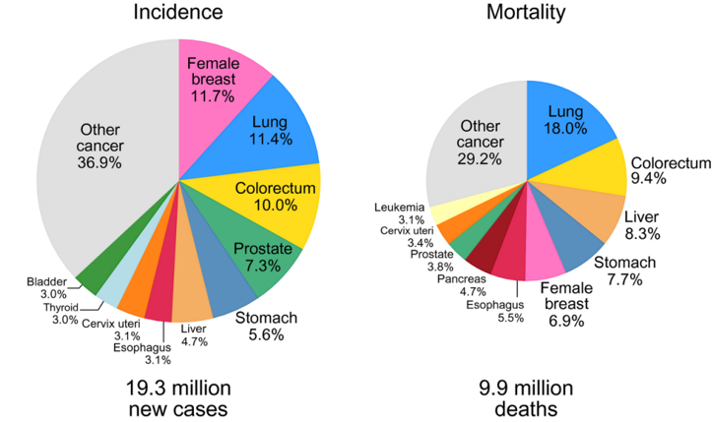
1.1 Background
1
About 10 million people die from cancer every year around the world.
Notes:
In Section 1.1, Background, About 10 million people die from cancer every year around the world. As we can see from the statistics, both the incidence and mortality rates of colorectal cancer are quite high. Accurate diagnosis of colorectal cancer is crucial and can be facilitated through deep learning techniques.

Slide 4
1.1 Background
1
Challenge: Gland morphology varies greatly
Notes:
However, accurately segmenting glands from colorectal cancer poses significant challenges. The first challenge arises from the substantial morphological differences between benign and malignant glands. The severe deformation of malignant glands makes segmentation difficult for neural networks. (As shown in the image below: benign on the left, malignant on the right.)

Slide 5
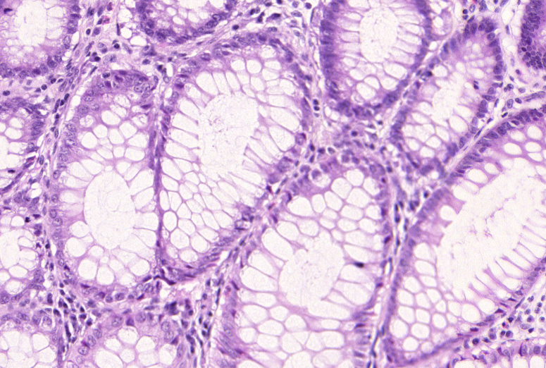
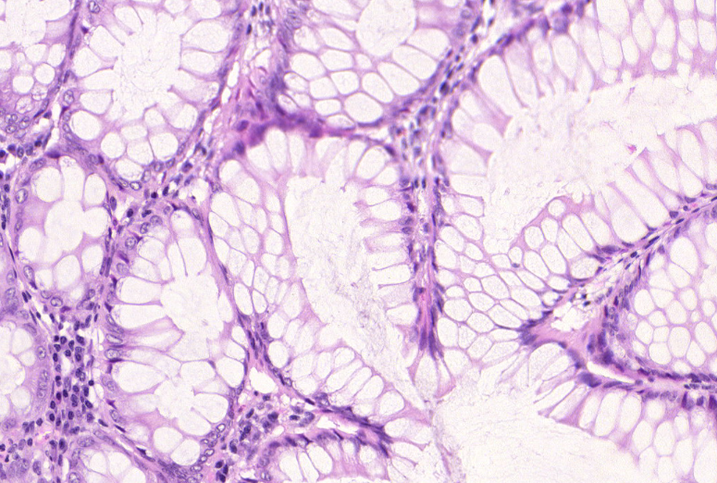
1.1 Background
1
Challenge: Difficulty identifying gland boundaries
Notes:
Challenge two: Adhesions exist between adjacent glands, making it even more difficult to separate each gland from others. Moreover, many glands exhibit inconsistent contours, sizes, and shapes, leading to under-segmentation issues. (As shown in the image below: the first and third columns represent inputs, while the second and fourth columns depict predictions. The highlighted areas are marked by red, yellow, and orange boxes.)

Slide 6
1.2 Contribute
1
A dual-encoder DEA-Net is proposed for gland segmentation, in which the pre-trained deeplabv3+ is used in the local semantic guidance encoder to extract the low-level features of the gland edge, and the main encoder uses a convolutional network to obtain contextual features.
A multi-scale feature fusionmethod is designed to fuse the features extracted by the dual-encoder, which effectively solves the problem of missing glandular edge features in the backbone network.
A feature decoder and a boundary-enhanced attention mechanism are designed on the backbone network to enhance the boundary learning of the gland and better restore the spatial feature information of the gland.

Slide 7
1. Background and Contribute
2. Methods
3. Experiments and Analysis
4. Conclusion

Slide 8
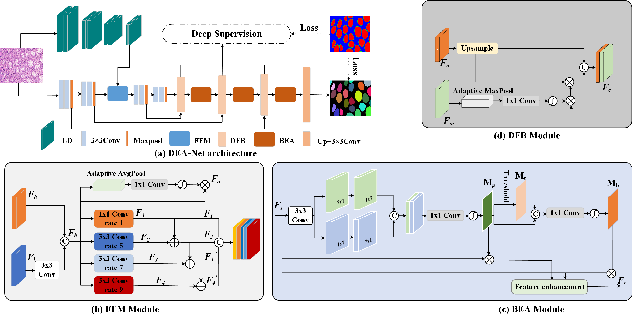
2.1 Proposed Method
2
Notes:
The DEA-Net network structure we propose, as depicted in Figure (a), comprises an encoder and a decoder and consists of several key modules, including the Local Semantic Encoder (LD), the Main Encoder, the Feature Fusion Module (FFM) Figure (b), the Decoder Feature Block (DFB) Figure (d), Boundary-Enhanced Attention (BEA) Figure (c), and the Deep Supervision Module. The LD Local Semantic Guided Encoder aims to capture edge features of gland structures using the pre-trained DeepLabv3+ network, which has undergone two downsampling layers. Its role is to compensate for the loss of edge features caused by downsampling in the main network.

Slide 9
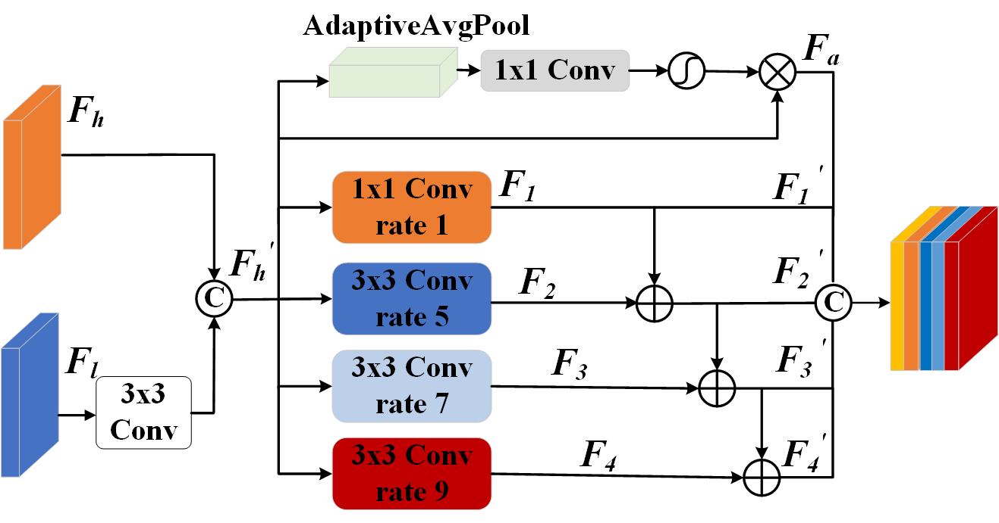
2.2 FFM Module
2
Notes:
We have introduced a multiscale feature fusion module, denoted as the Feature Fusion Module (FFM), as depicted in the figure, aiming to facilitate the fusion of edge features in the main network. This module comprises multiple scale extractors and a channel attention mechanism.

Slide 10
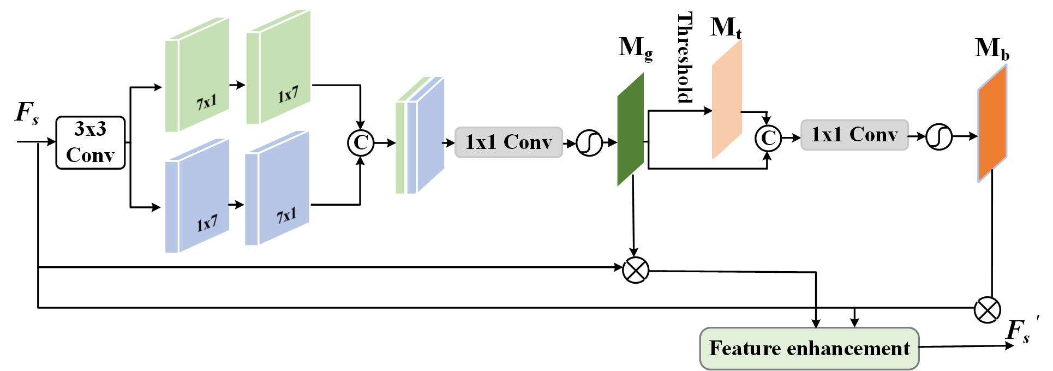
2.3 BEA Module
2
Notes:
The recognition of gland boundaries plays a crucial role in the accuracy of gland segmentation results within the network. To better enable the network to identify gland boundary features, we designed a gland boundary-enhanced attention mechanism behind the decoder DFB (BEA). Through this adaptive threshold attention mechanism, we amplify the weights of gland boundary pixels, allowing the network to focus more on the boundaries of the glands. The specific design of BEA is illustrated in the figure. Initially, a series of convolutional operations extract features, which are then processed through sigmoid to obtain weight map of the gland boundary mg. Subsequently, enhancement is achieved according to formulas 10, 11, and 12,where p1 is adaptivemaxpool, c1 is 1×1 convolution operation.

Slide 11
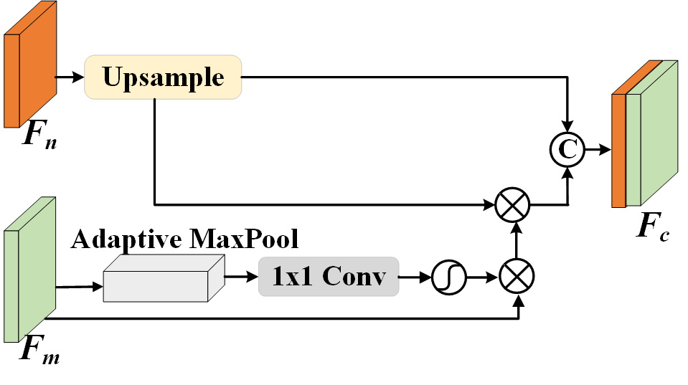
2.4 DFB Module
2
Notes:
To enhance the recovery of information fused within the dual encoders, we have designed a deep feature decoder (DFB) to restore spatial information regarding the glands. The detailed design of this decoder is illustrated in the figure, and its structure is divided into two branches: upsampling and channel weighting.

Slide 12
2.5 Loss Fuction
2
Given that gland segmentation, as an object-level segmentation task, is inherently distinct from pixel-level segmentation, traditional cross-entropy loss may not be optimally suited for this purpose. To address this limitation, this paper proposes the adoption of variance-constrained cross-entropy loss ( L_{varCE}) as follow, strategically tailored to mitigate the intricacies associated with pixel space information within the gland in the network architecture.
Notes:
where C is the number of instances, Sc is the set of pixels that belong to instance c, |Sc| is the number of pixels in set Sc, Pi is the probability of the correct class for pixel i, and µc is the mean value of pixels probabilities Pi in set Sc

Slide 13
1. Background and Contribute
2. Methods
3. Experiments and Analysis
4. Conclusion

Slide 14
3.1 Datasets
3
GlaS：
The GlaS dataset comprising 165 H&E-stained histopathology patches from 16 WSIs. And the training set consists of 85 images, and the test set consists of 80 images.
CRAG：
The CRAG dataset is extracted from 38 WSIs and includes 213 H&E-stained histopathological patches. The training set comprises 173 images, and the test set consists of 40 images with various levels of cancerous lesions.

Slide 15
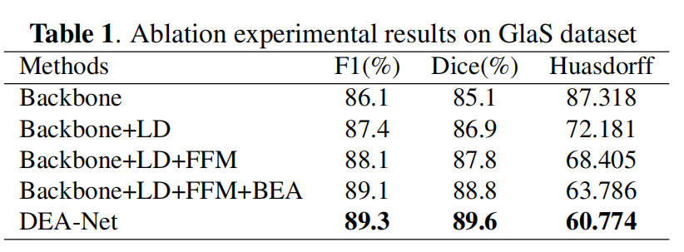
3.2 Ablation Experiment
3
Notes:
To verify the effectiveness of our proposed module, we use U-Net as a Backbone to conduct ablation experiments on the GlaS dataset, as shown in Table 1. The bold part represents the highest index

Slide 16
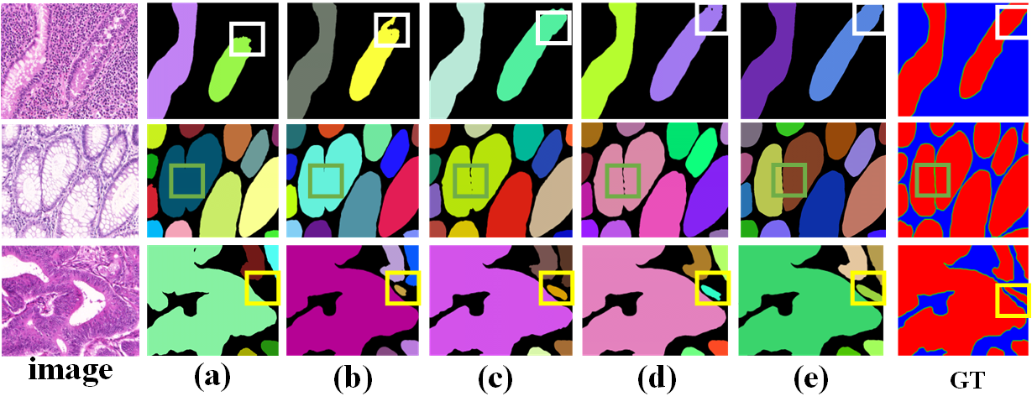
3.3 Visualization
3
Notes:
as shown in Figure 3, the white box in the first column and the orange box in the third column As shown in the highlighted part, the designed LD module and FFM module can solve the prob_x0002_lem of under-segmentation and sticking of some small glands. The designed BEA mechanism and DFB module in the high_x0002_lighted part of the green box in the second column can solve the problem. Difficulty in segmenting adherent glands

Slide 17
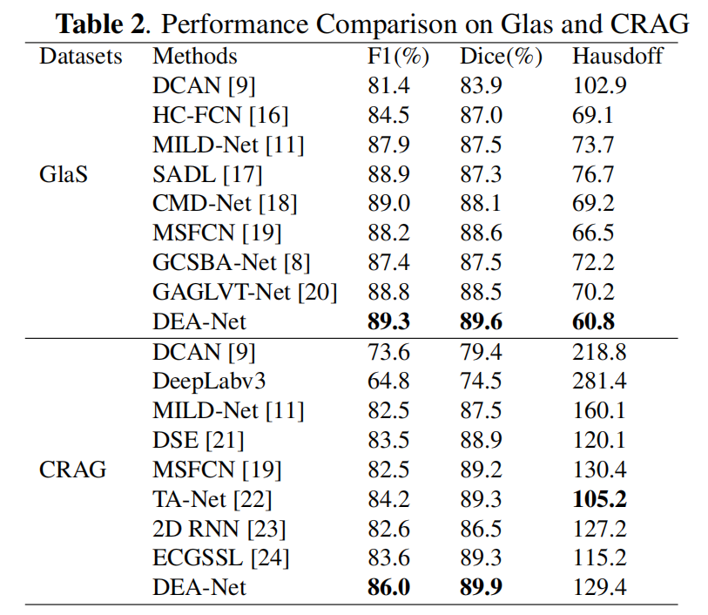
3.4 Comparative Experiment
3
Notes:
To prove the effectiveness of our proposed method, this method was compared with the other eight gland segmentation models on the GlaS and CRAG datasets, and the specific results are shown in Table 2. The bold part represents the highest index. On the GlaS data set, our proposed DEA-Net achieved the best indicators.

Slide 18
1. Introduction
2. Methods
3. Experiments and Analysis
4. Conclusion

Slide 19
4 Conclusion
4
We proposes a DEA-Net method that fuses dual encoders and boundary-enhanced attention, and guides encoding through the proposed local semantics LD and multi-scale feature fusion module FFM solve the problem of gland under-segmentation.
For closely connected glands, we propose the boundary-enhanced attention BEA and the deep feature decoder DFB to better restore feature space information.
Experimental results it shows that the index of our proposed method has been greatly improved compared with other gland segmentation methods.

Slide 20
Thank you!
JieJiang Yu
18 Apr, 2024
E-mail: yutom4739@gmail.com

