Slide 1
Enhanced Image Reconstruction From Quarter Sampling Measurements Using an Adapted Very Deep Super Resolution Network
ICIP 2020

Slide 2
Outline
Introduction
Quarter Sampling (QS)
Image Upsacling with Very Deep Super Resolution (VDSR) Network
Proposed VDSR-QS and Novel Data Augmentation
Simulation Results & Visual Comparisons
Conclusion

Slide 3
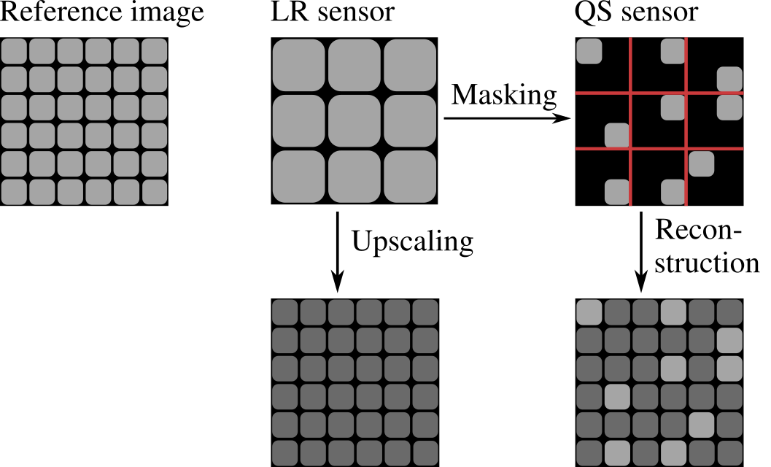
Low-resolution Sensor vs. Quarter Sampling
Too many pixels
(cost, complexity,...)
→ Aliasing
→ Higher resolution
Schöberl et al., “Increasing imaging resolution by covering your sensor,” in Proc. 18th IEEE International Conference on Image Processing, Brussels, Sep. 2011.
FSR: Seiler et al., “Resampling images to a regular grid from a non-regular subset of pixel positions using FSR,” IEEE Transactions on Image Processing, vol. 24, no. 11, pp. 4540–4555, Nov. 2015.
Notes:
LR sensor -> aliasing
-> QUARTER sampling -> Leave one quarter transparent -> higher resolution per pixel possible.

Slide 4
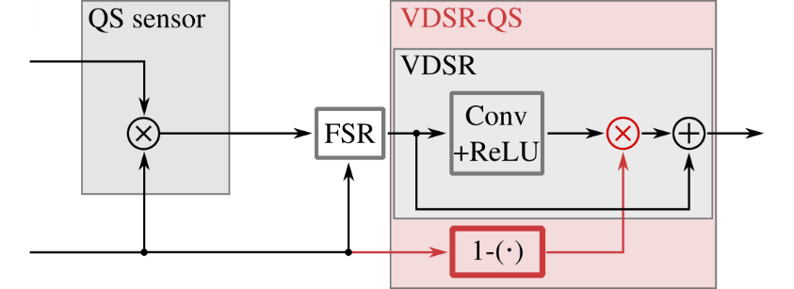
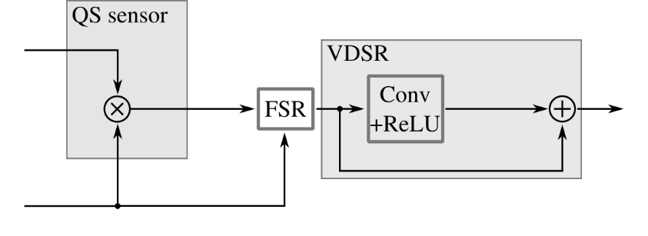
Resolution Enhancement Using VDSR and VDSR-QS
VDSR: Kim et al., “Accurate image super-resolution using very deep convolutional networks,” in Proc. IEEE Conference on Computer Vision and Pattern Recognition, Las Vegas, June 2016

Slide 5
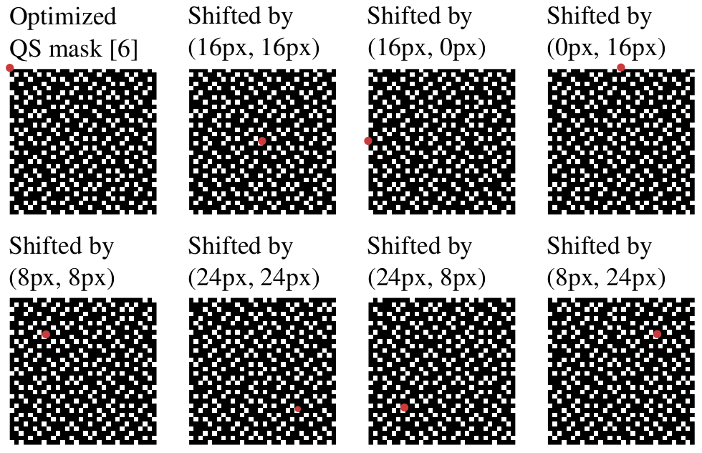
Novel Data Augmentation for VDSR-QS
VDSR: Use 4-fold rotation and flip for data augmentation
VDSR-QS: Can additionally shift the sensor mask
Additional 8-fold
data augmentation
Used Quater sampling mask: Grosche et.al., “Iterative Optimization of Quarter Sampling Masks for Non-Regular Sampling Sensors,” in Proc. IEEE ICIP, Athens, Oct. 2018

Slide 6
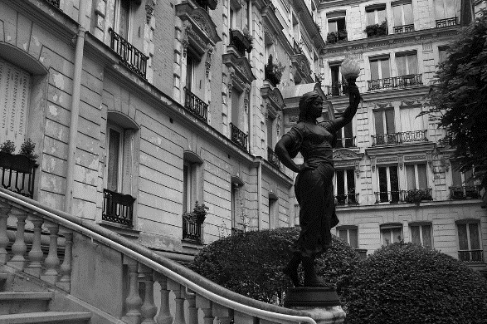
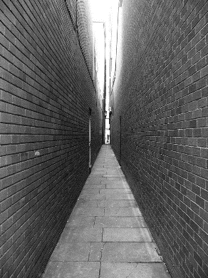
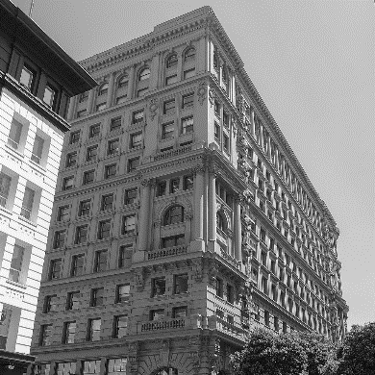
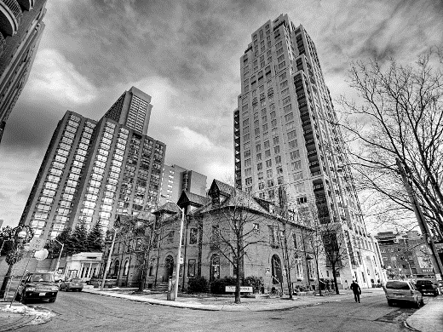
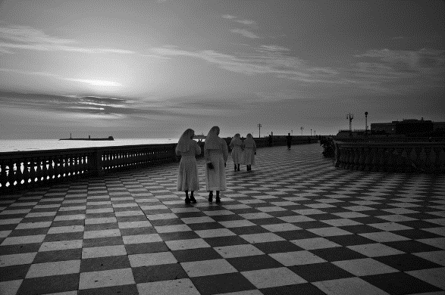
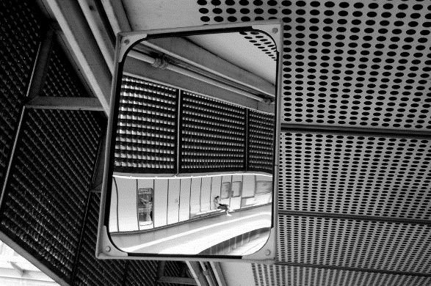
Implementation and Datasets
Newly train all networks. Custom Keras implementation.
Training dataset: Set291 (as in VDSR paper)
Testing dataset: Urban 100
Urban100: Huang et al., “Single image super-resolution from transformed self-exemplars,” in Proc. IEEE Conference on Computer Vision and Pattern Recognition, Boston, June 2015.

Slide 7
Simulation Results
 | PSNR [dB] | SSIM
Low-resolution sensor
BIC upscaling | 25.67 | 0.8818
BIC upsclaing + VDSR | 28.62 | 0.9265
Quarter sampling sensor
FSR reconstruction | 27.08 | 0.9116
FSR + VDSR | 28.40 | 0.9281
FSR + VDSR-QS + 8-fold DA | 29.29 | 0.9382
→ How does VDSR-QS and additional 8-fold data augmentation perform?
SSIM: Wang et al., “Image quality assessment: From error visibility to structural similarity,” IEEE Transactions on Image Processing, vol. 13, no. 4, pp. 600–612, Apr. 2004.

Slide 8
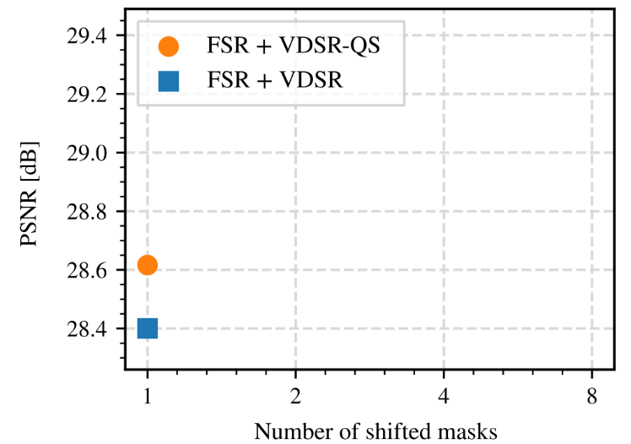
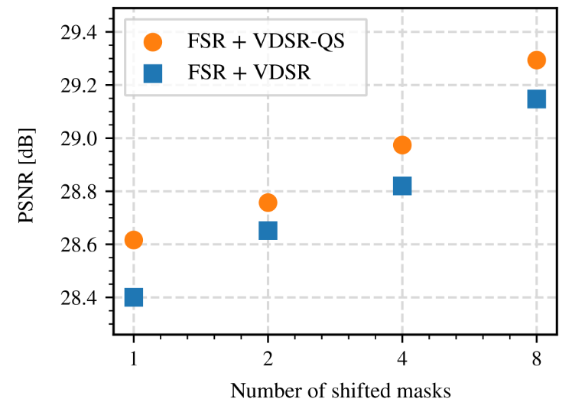
Simulation Results
+ 0.89dB
+ 0.2dB

Slide 9
Simulation Results
 | PSNR [dB] | SSIM
Low-resolution sensor
BIC upscaling | 25.67 | 0.8818
BIC upsclaing + VDSR | 28.62 | 0.9265
Quarter sampling sensor
FSR reconstruction | 27.08 | 0.9116
FSR + VDSR | 28.40 | 0.9281
FSR + VDSR-QS + 8-fold DA | 29.29 | 0.9382
+ 0.67dB
SSIM: Wang et al., “Image quality assessment: From error visibility to structural similarity,” IEEE Transactions on Image Processing, vol. 13, no. 4, pp. 600–612, Apr. 2004.

Slide 10
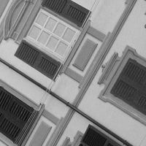
Visual Comparison
Urban100: Huang et al., “Single image super-resolution from transformed self-exemplars,” in Proc. IEEE Conference on Computer Vision and Pattern Recognition, Boston, June 2015.
Notes:
Fensterladen == window shutter

Slide 11
Visual Comparison
QS + FSR + VDSR-QS
+ (8-fold DA)
Reference
LR + BIC
QS + FSR
LR + BIC + VDSR
32.63 dB
29.04 dB
30.11 dB
32.39 dB
PSNR values for shown section.
Notes:
Fensterladen == window shutter

Slide 12
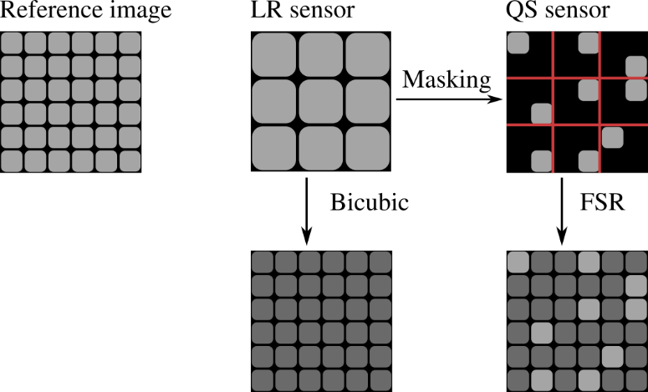
Conclusion
Applied VDSR for low-resolution sensor and quarter sampling (QS) sensor
Adapted VDSR for QS case → VDSR-QS
For VDSR-QS, additonal 8-fold DA possible
In total: +0.67 dB gain (Urban 100 dataset)

Slide 13
Enhanced Image Reconstruction From Quarter Sampling Measurements Using an Adapted Very Deep Super Resolution Network

Slide 14
Backup slides

Slide 15
FSR Implementation
NEW: FSR Matlab-Reference Implementation available at https://gitlab.lms.tf.fau.de/LMS/Rapid-FSR
Bundles latest research on FSR
Dynamic parameter estimation
Three quality profiles: fast, compromise, best

Slide 16
Frequency Selective Reconstruction
Blockwise Fourier model $g\left[m,n\right]=\sum_{kl}{c_{kl}φ_{kl}\left[m,n\right]}$
Adapt one basis function coefficient in each iteration step
Calculate best coefficient for all basis functions
Choose the basis function that reduces the residual error the most
Use the model $g\left[m,n\right]$ for all unknown pixels
Weighting functions to prefer close pixels and low frequencies
Seiler et al., “Resampling images to a regular grid from a non-regular subset of pixels using frequency selective reconstruction,” IEEE Transactions on Image Processing, vol. 24., no. 11, pp. 4540-4555, Nov. 2015.
Notes:
Similar to Matching pursuit (Greedy algorithm)
- Calculate best coefficient for all basis functions (w.r.t. minimum of residual error; analytic description available)

Slide 17
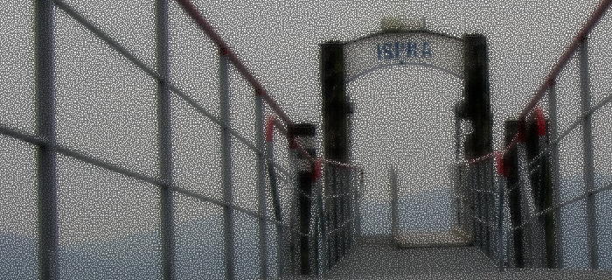
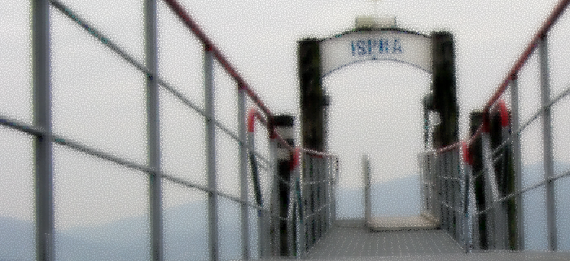
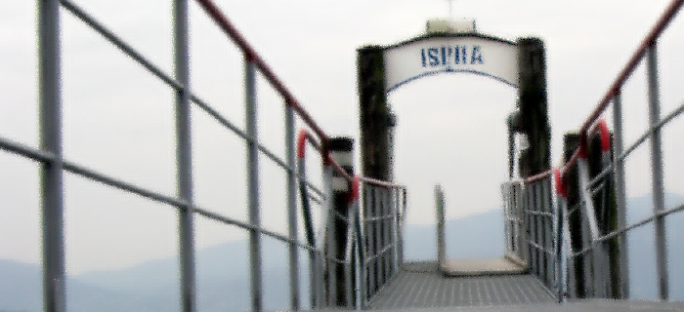
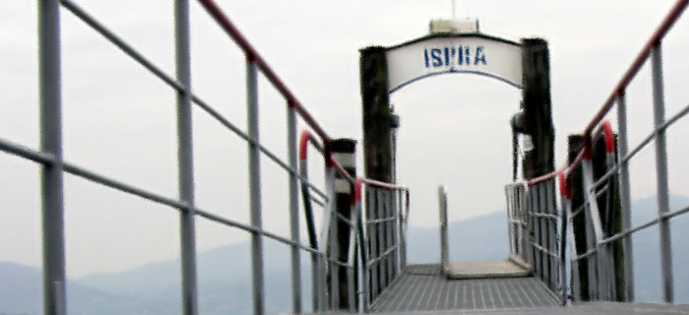
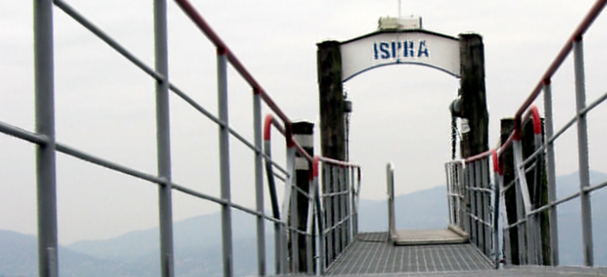
Frequency Selective Reconstruction - Example
3 iterations
8 iterations
20 iterations
1 iteration
100 iterations

Slide 18
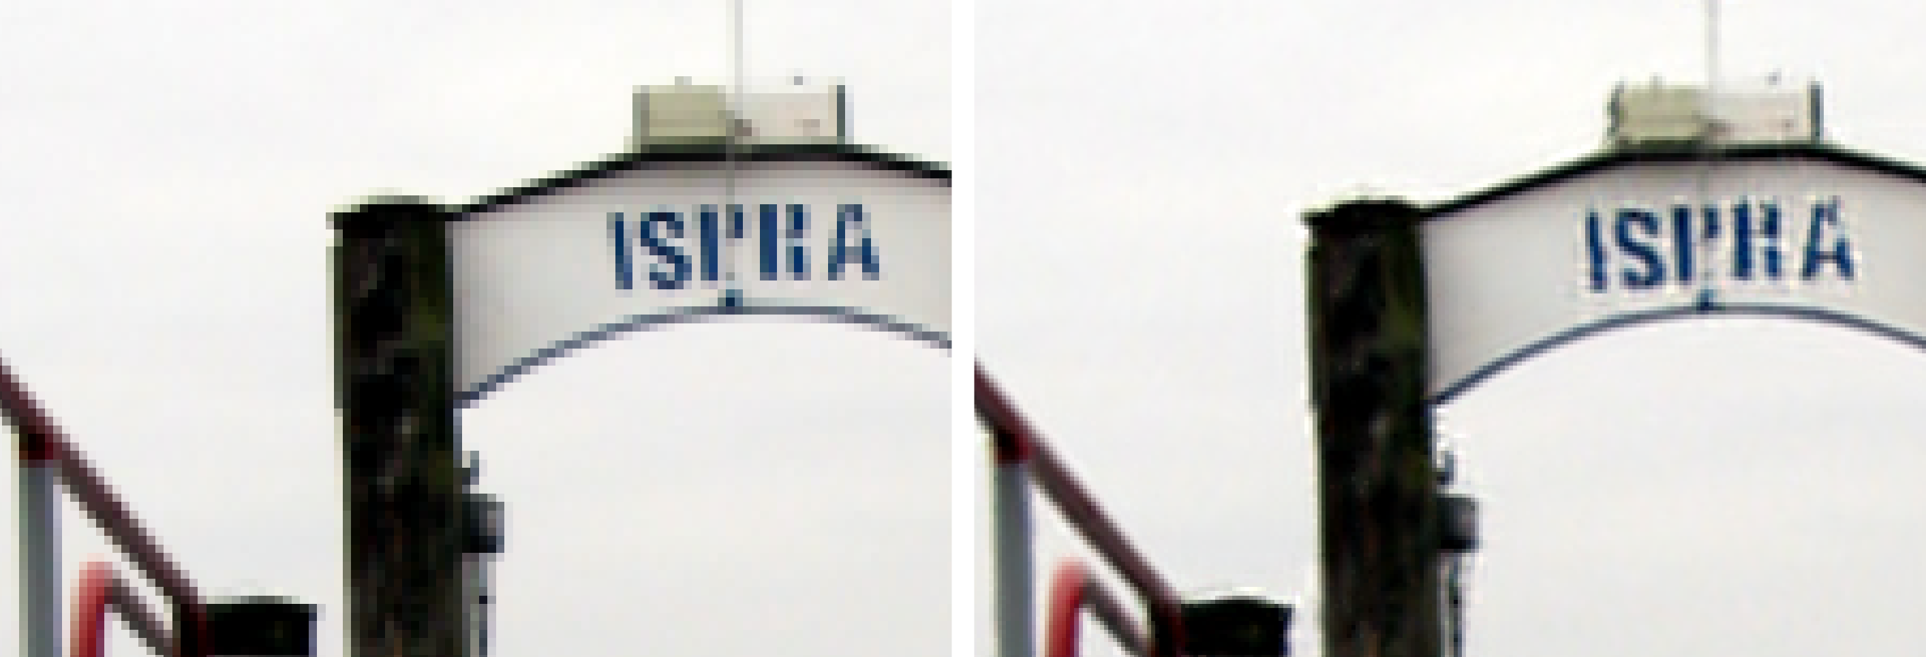
Frequency Selective Reconstruction - Example
Low resolution reference
100 iterations

