Slide 1
Paper_ID: 1633 in IEEE ICASSP 2021
Representative Local Feature Mining for Few-shot Learning
Kun Yan¹, Lingbo Liu², Jun Hou³, Ping Wang¹
¹Peking University,
²Sun Yat-Sen University,
³SenseTime Research
Notes:
This is representation for our paper: representative local feature mining for few-shot learning
My name is YanKun, a phd student at Peking University, majoring in computer vision.

Slide 2
Paper_ID: 1633 in IEEE ICASSP 2021
Introduction
Few-shot learning (FSL) aims to recognize unseen images of new classes with only a few training examples.
Preliminary
In FSL, we are given a base class set and a novel class set. Each class in base class set has sufficient labeled images, while only a few labeled samples are obtained for each class in the novel class set.
we adopt the episode-based training scheme to facilitate few-shot learning. In each episode, each classification task is performed on a support set $𝒮$ and a query set $𝒬$.
In particular, $𝒮$ follows a $N$-way $K$-shot setting. $N$ is the number of classes and $K$ is the number of labeled examples in each class. Note that $K$ is a small integer, such as 1 or 5.
In training episodes, we optimize our model with $𝒮/𝒬$ sampled from base class set. During the testing episodes, we measure the generalization performance of a model with $𝒮/𝒬$ sampled from novel class set, where labels in $𝒮$ are known and those in $𝒬$ are unknown.
Notes:
Different from conventional image classification, in few-shot learning, during test phase, we also have a few labeled images for each category.Concretely, we apply the episode training and test scheme.

Slide 3
Paper_ID: 1633 in IEEE ICASSP 2021
Problem
While great progress has been made with deep learning technology, most metric-based works rely on the measurement based on global feature representation of images, which is sensitive to background factors due to the scarcity of training data.
How to solve this problem in our paper?
“task-specific guided” strategy
Prototype Selection Module (PSM) for the support set
Task Adaption Module (TAM) for the query set
Notes:
In this paper, we focus mainly on metric-based methods due to their simplicity and efficiency.
While great progress has been made, most metric-based methods rely on the measurement based on global feature representation of images, which is sensitive to background factors due to the scarcity of training data.

Slide 4
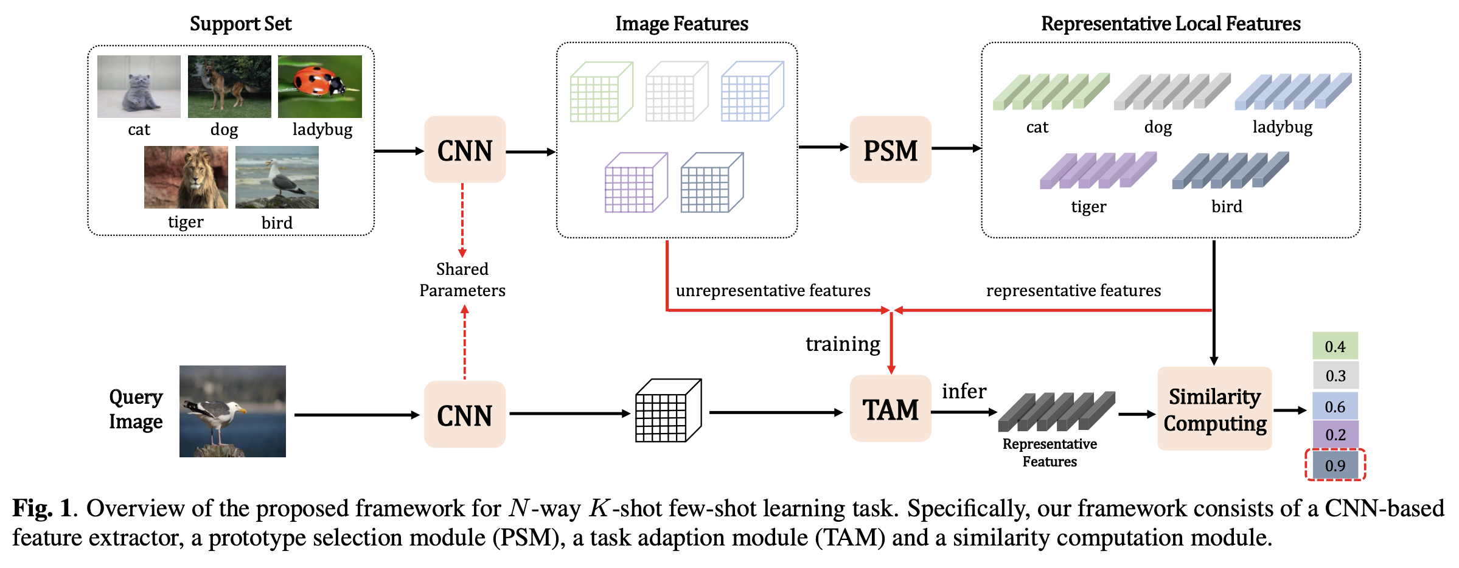
Paper_ID: 1633 in IEEE ICASSP 2021
Architecture:

Slide 5
Paper_ID: 1633 in IEEE ICASSP 2021
Prototype Selection Module (PSM)
We use the loss change of image classification to distinguishes the importance of each local feature;
each local feature is multiplied by a factor $ρ∈[0, 1]$ to describe the existence weight of each local feature;
we define the function to evaluate the importance of a local feature according to the impact on the classification loss: $g\left(ρ\right)=|ℒ\left(ρ\right)−ℒ(0)|$;
we apply the Taylor expansion to simplify the above formula. The final form of $g\left(ρ\right)$ is $|ρℒ^{\left(1\right)}(ρ)|$.
Task Adaption Module (TAM)
We sample representative and discarded local features from PSM;
use representative local features as positive samples, while discarded local features as negative samples to train a binary classifier
use the trained binary classifier mentioned above to mine representative local features for query set.
Notes:
The first derivative.
After getting representative local features, we can simply use them to calculate similarity computation. More details can be seen in our paper.

Slide 6
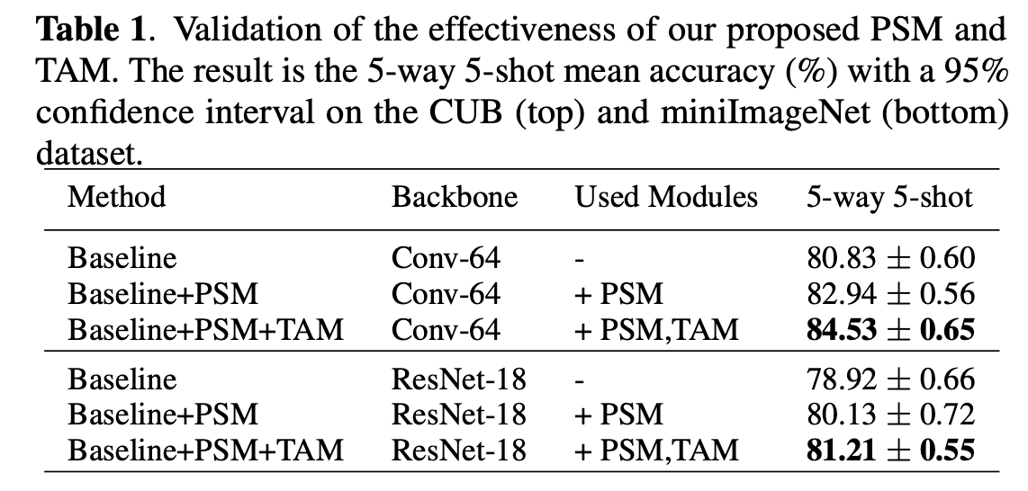
Paper_ID: 1633 in IEEE ICASSP 2021
Ablation Study
Notes:
About our ablation study,…, there is a steady improvement when combing PSM and then TAM.
As, we have to train the sub-net in PSM and TAM respectively, you may worry about the time efficiency of our method. From Table2, the time consumed by our method is in between ProtoNet and MAML.

Slide 7
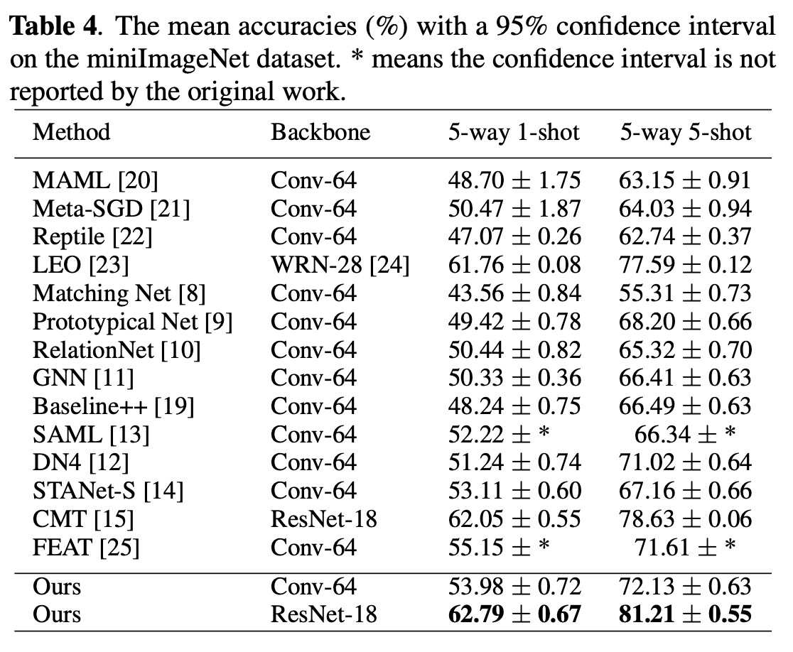
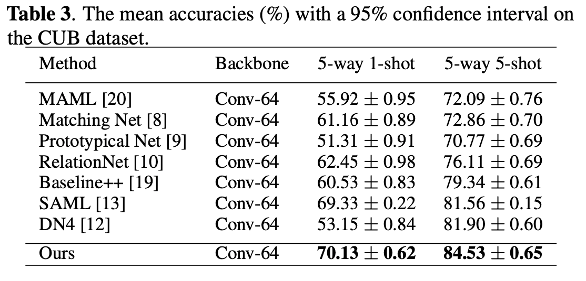
Paper_ID: 1633 in IEEE ICASSP 2021
Comparison with State-of-the-art

Slide 8
Paper_ID: 1633 in IEEE ICASSP 2021
Thanks

