Slide 1
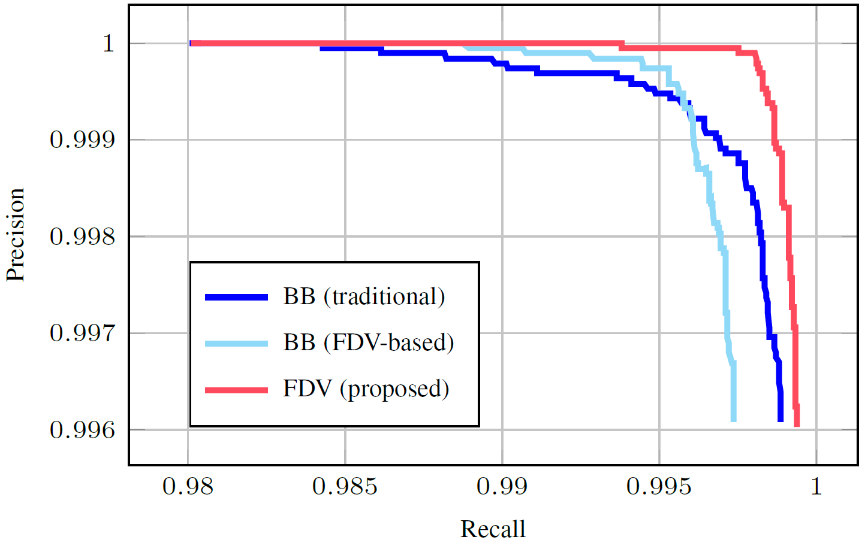
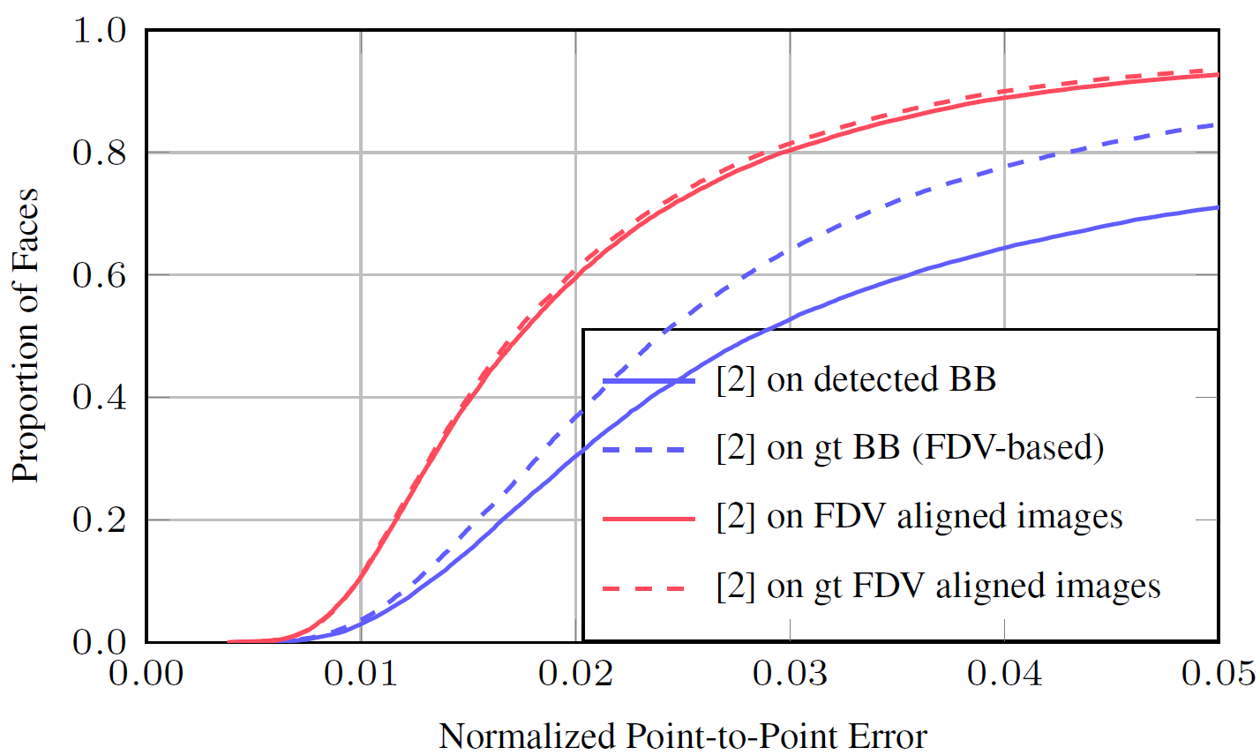
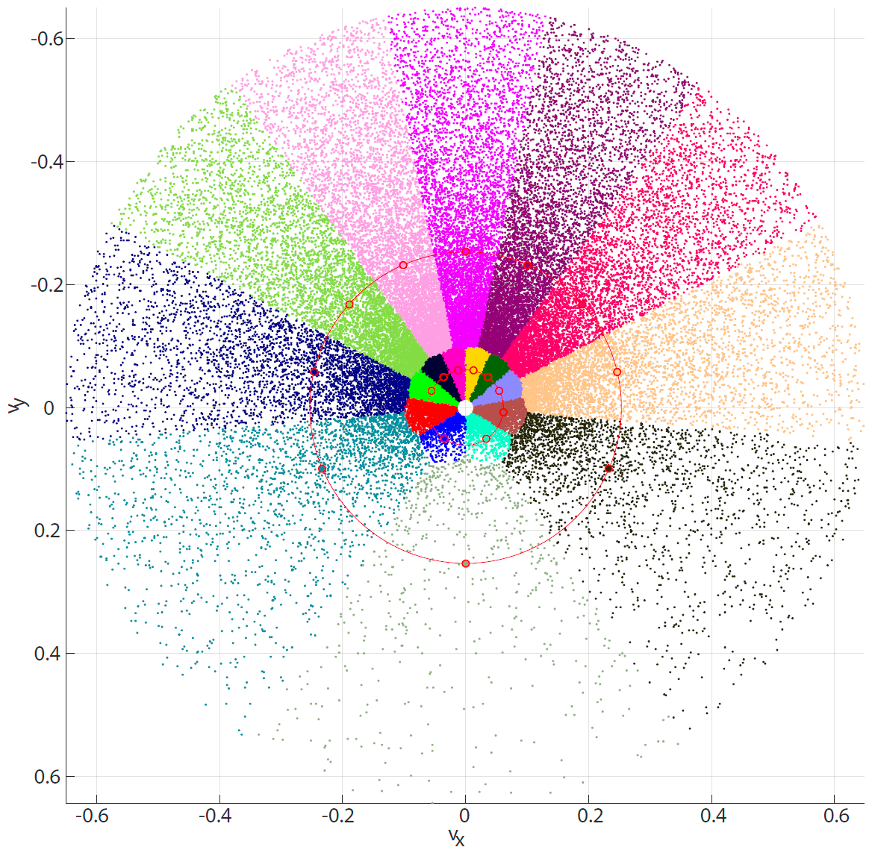
Detecting Arbitrarily Rotated Faces for Face Analysis
Frerk Saxen, Sebastian Handrich, Philipp Werner, Ehsan Othman, Ayoub Al-Hamadi
Otto von Guericke University, Magdeburg, Germany
Motivation
Face Direction Vector
Experiments
Current face detection concentrates on detecting tiny faces and severely occluded faces. Face analysis methods, however, require a good localization and would benefit greatly from some rotation information. We propose a face direction vector (FDV), a consistent definition of face location, size, and orientation. Using the FDV is promising for all succeeding face analysis methods. As an example, we show that facial landmark detection can highly benefit from pre-aligned faces.
$$l=\frac{θ}{10}\sum_{i=1}^{4}{\sum_{j=i+1}^{5}{∥lm\left(i\right)−lm\left(j\right)∥}}$$
$$c=\frac{1}{5}\sum_{i=1}^{5}{lm\left(i\right)} \\ e=\frac{1}{2}\sum_{i=1}^{2}{lm\left(i\right)}$$
$$v=l∙\frac{e−c}{∥e−c∥}$$
$$fdv=\left[c,v\right]$$
Face Detection:
Face detection performance on the original CelebA test set (low variation in face rotation and size). Almost all 20k faces in the test set are correctly detected by the three approaches.
Landmark Localization:
Facial landmark localization accura-cy with [2] (CED curve) on the augmented CelebA test set. Blue: landmark localization on traditional upright bounding boxes predicted by [3] (solid blue) and calculated from FDV ground truth (dashed blue); Red: landmark localization on prealigned faces (rotation com-pensation) using our predicted FDV (solid red) and ground truth FDV (dashed red).
Loss-Functions
We train the FDV length $l=∥v∥$ with linear activation of $x_{l}$ $L_{l}=\frac{1}{2}{\left(\log\left(\frac{∥v∥}{∥a∥}\right)−x_{l}\right)}^{2}$.$a$ is the nearest anchor to the ground truth FDV $v$ in normalized Euclidean space. We propose to train the angle offset $Δ_{α}=\tan^{−1}\left(\frac{a_{y}}{a_{x}}\right)−\tan^{−1}\left(\frac{v_{y}}{v_{x}}\right)$ between the ground truth FDV $v$and its anchor $a$with linear activation of $x_{α}: L_{α}=\frac{1}{2}{\left(Δ_{α}−x_{α}\right)}^{2}$.
In the forward pass (linear activated network output $x_{l}$ and $x_{α}$), we calculate $α=\tan^{−1}\left(\frac{a_{y}}{a_{x}}\right)−x_{α}$(rearrange the loss functions) to obtain the FDV prediction $v_{x}=\cos\left(α\right)∙e^{x_{l}}∙∥a∥$ and $v_{y}=\sin\left(α\right)∙e^{x_{l}}∙∥a∥$
Architecture
Our face detection architecture is based on the tiny version of the YOLOv3 object detection network [1].
YOLO (you only look once) is a fully convolutional neural network that simultaneously predicts the object score, location, bounding box width and height.
Conclusion
Anchor placement
The traditional bounding box is not quite suited for face analysis. We propose to predict a face direction vector (FDV), which we define based on 5 facial landmarks. It provides a consistent definition of face location, size, and orientation. We have shown that a common object detection architecture can learn the FDV more efficiently than bounding boxes.
FDV values for the augmented data distribution, anchor positions on two circles, and anchor membership of each data element in color. The anchors are placed such that each anchor covers the same amount of data
References
[1] Joseph Redmon and Ali Farhadi, “YOLOv3: An Incremental Improvement,” arXiv, 2018. 2
[2] Adrian Bulat and Georgios Tzimiropoulos, “How Far are We from Solving the 2D and 3D Face Alignment Problem?,” in ICCV 2017
[3] Shifeng Zhang, Xiangyu Zhu, Zhen Lei, Hailin Shi, Xiaobo Wang, and Stan Z. Li, “S3FD: Single Shot Scale-Invariant Face Detector,” in ICCV 2017

