Slide 1
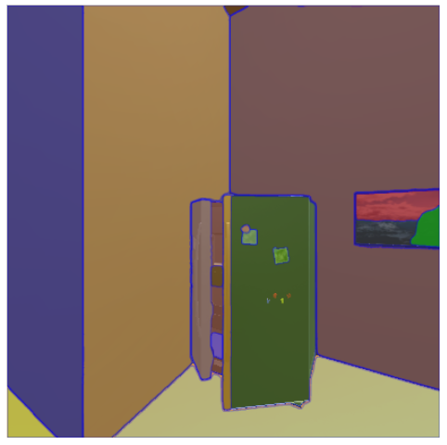
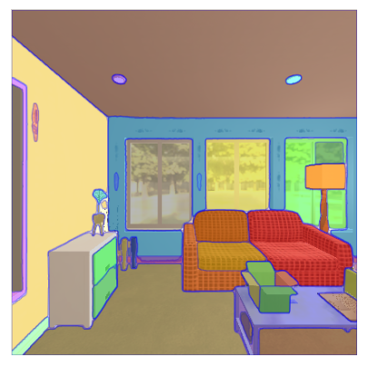
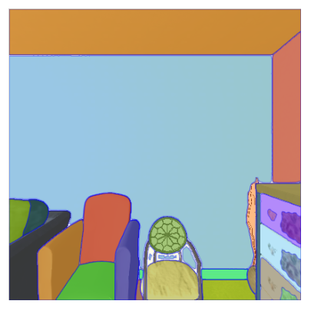
SEGMENT ANY OBJECT MODEL (SAOM): Real-to-simulation Fine-tuning Strategy for Multi-class Multi-instance Segmentation
${\text{Mariia} \text{Khan}}^{\text{‡}\text{§}}$, ${\text{Yue} \text{Qiu}}^{†}$, ${\text{Yuren} \text{Cong}}^{\text{§}}$, ${\text{Bodo} \text{Rosenhahn}}^{\text{§}}$, ${\text{Jumana} \text{Abu}\text{−}\text{Khalaf}}^{\text{‡}}{, David Suter}^{\text{‡}},$
${\text{‡} }_{\text{Edith} \text{Cowan} \text{University}\text{, }\text{School} \text{of} \text{Science}\text{, }\text{CAIML}\text{, }\text{Australia} }$
$${† }_{\text{Artificial} \text{Intelligence} \text{Research} \text{Center}\text{, }\text{AIST}\text{, }\text{Japan}}$$
$${\text{§}}_{ \text{Leibniz} \text{University} \text{of} \text{Hannover}\text{,}\text{Institute} \text{for} \text{Information} \text{Processing}\text{,} Germany}$$

Slide 2
Segment Anything (SAM)
Alexander Kirillov, Eric Mintun, Nikhila Ravi, Hanzi Mao, Chloe Rolland, Laura Gustafson, etc.
META AI, 2023
SAM is a single model that can easily perform both interactive segmentation and automatic segmentation (segmentation in “everything” mode).
SAM is a new foundation promptable segmentation system with zero-shot generalization to unfamiliar objects and images, without the need for additional training.
SAM can use a variety of input prompts:
Single point for interactive segmentation;
Bounding boxes;
Object masks.

Slide 3
SAM can work in the “everything” mode and automatically find and mask all objects in an image.
SAM can generate multiple valid masks for ambiguous prompts.

Slide 4
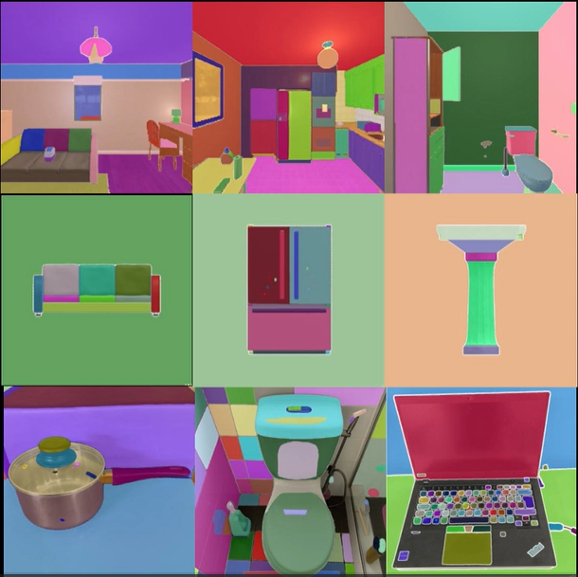
Segment Anything for Embodied AI Indoor Environments
In the “everything” mode the origianl SAM tends to output part or sub-part object masks for images, taken in both real and simulated environments
For Embodied AI tasks:
SAM can be used in the “everything” mode only;
Interest in the whole object masks for mapping and scene understanding;
General structures or not intractable objects are out of interest;

Slide 5
Segment Anything for Embodied AI Indoor Environments
Simulators
Research for Embodied AI research tasks is usually held within Embodied AI simulators;
For indoor environments only a few simulators render realistic outputs; most of the existing simulators produce animated scenes
Year | Simulator | Variety of sim. scenes | Physics: Rigid body | Interaction: Agent-driven | API Controller | Navigation interactivity | Multi-agent collaboration | Photo-Realism
2017 | Ai2-Thor | × | × | × | × | × | ×
2018 | CHALET | × | × | × | × | ×
2018 | VRKitchen |  | × | × | ×
2019 | Habitat-Sim | × |  |  |  |  |  | ×
2019 | iGibson | × | × |  | × | × | ×
2020 | SAPIEN | × | × |  | × | ×
2020 | ThreeDWorld | × | × | × | × | × | × | ×

Slide 6
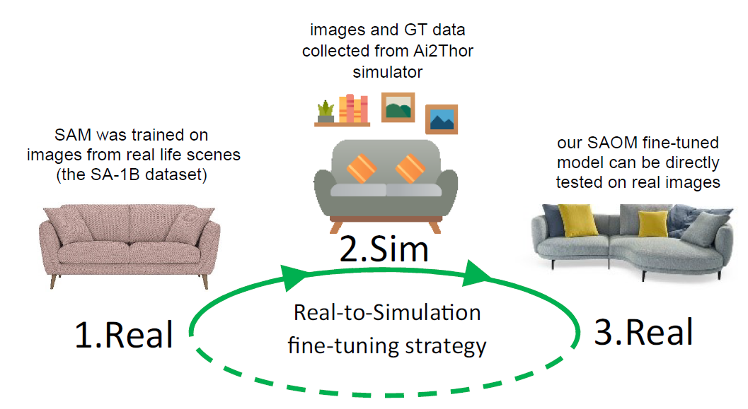
Real-Sim Fine-Tuning Strategy
A new domain invariant Real-Sim fine-tuning strategy:
is suitable for multi-class multi-instance semantic segmentation task in the “everything” mode.
In the real-to-sim training phase, images from simplified simulated environments are used to fine-tune SAM.
In the sim-to-real inference phase, the fine-tuned SAM is directly used in real-world scenarios without any training on real-world data.

Slide 7
SAOM Dataset
Fully synthetic DS, collected via Ai2Thor* simulator;
Segmentation masks and labels collected for 54 frequently-seen indoor object types:
11 openable;
25 pickupable objects;
18 receptacles;
120 Ai2Thor scenes of 4 types: living room, kitchen, bathroom and bedroom.
*E. Kolve, R. Mottaghi, W. Han, E. VanderBilt, L. Weihs, A. Herrasti, M. Deitke, K. Ehsani, D. Gordon, Y. Zhu, A. Kembhavi, A. Gupta, and A. Farhadi, “Ai2-thor: An interactive 3d environment for visual ai,” 2022.

Slide 8
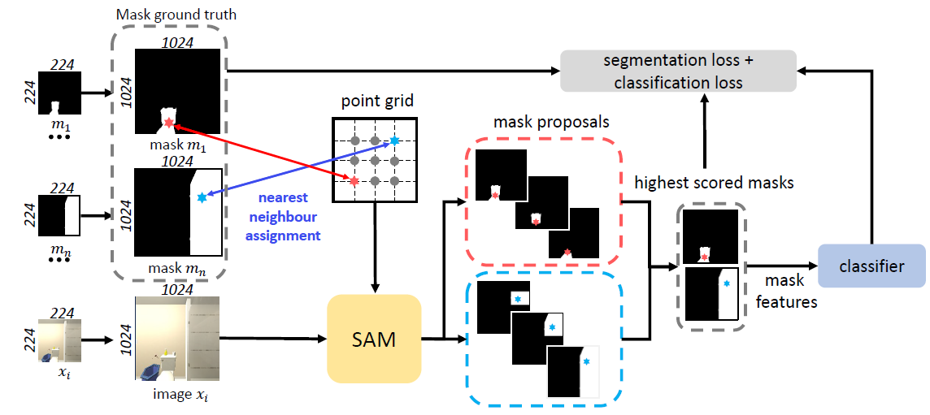
SAM Fine-Tuning Strategy
Our domain invariant SAM’s fine-tuning strategy - SAOM - designed specifically for multi-class multi-instance semantic segmentation in the “everything” mode. We used our novel nearest neighbour assignment method and substituted the original object point prompts with their nearest neighbours from a pre-defined point grid on an image to make the model functional in the “everything” mode.

Slide 9
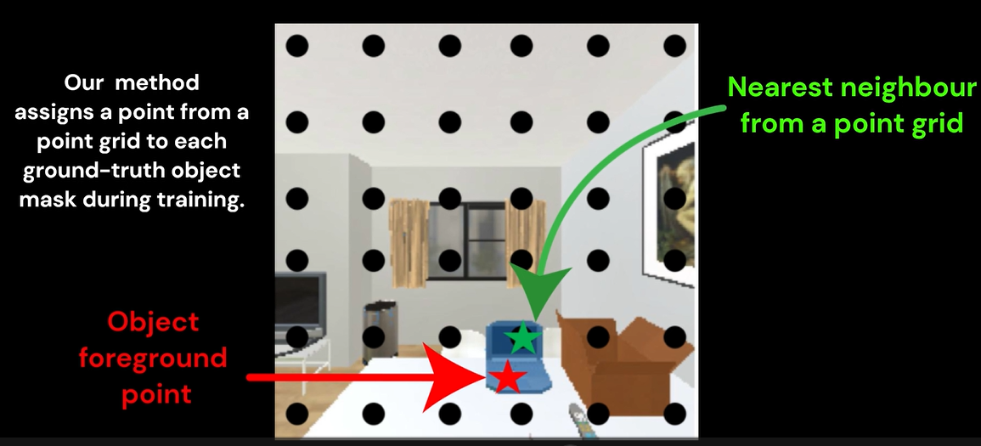
Nearest Neighbor Assignment Method
Obtain location prior of the target object in an image using original SAM
Substitute the location prior with its nearest neighbor from a pre-defined point grid on the image

Slide 10
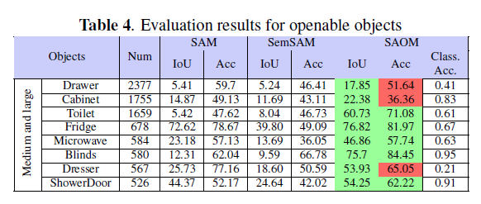
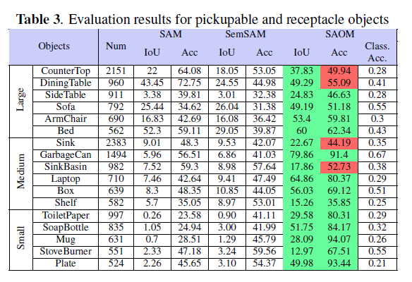
Experiments – Real-to-Sim Evaluation
Evaluation of SAOMv2 done in the personalized approach, using:
Intersection over Union (IoU) and accuracy scores from a single foreground point perspective;
then combining those metrics per class.
For all 54 object classes SAOM has an increase in mIoU from 10.82 to 39.17 (28% improvement) and in mAcc from 40.63 to 65.62 (25% improvement) in comparison with SAM.
In comparison with both Semantic-SAM and the original SAM, our SAOM model yields 39% and 81.6% fewer masks, respectively.
SAOM was trained for 200 epochs using the 32×32 point grid in the “everything” mode.

Slide 11
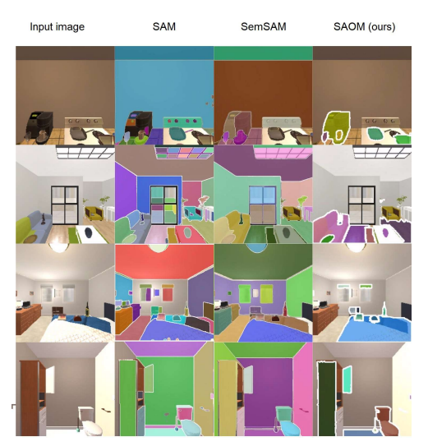
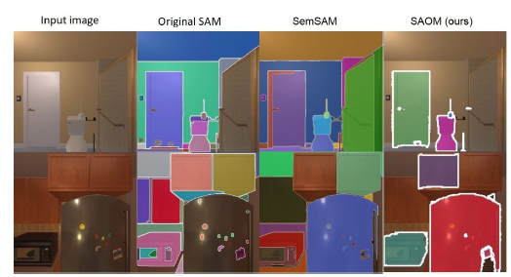
Experiments – Real-to-Sim Evaluation
SAOM tends to predict large and medium size objects with a whole object segmentation mask;
Most house general structures (such as walls and windows) and non-interactable objects (such as pictures and mirrors) are removed during predictions.
SAOM can be considered to be working in the “everything of interest” mode, as the model targets 54 frequently-seen classes in indoor environments from the fine-tuning dataset.

Slide 12
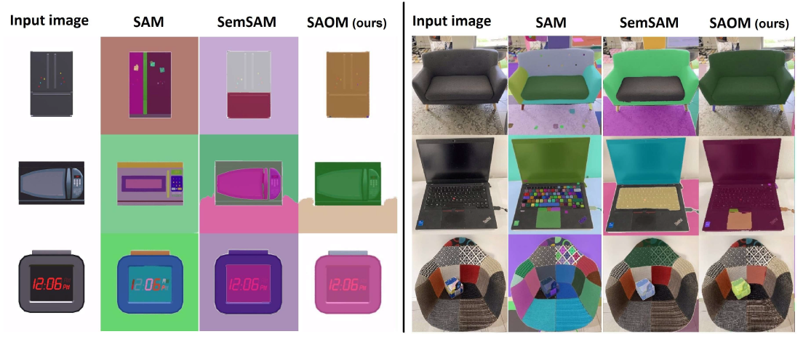
Experiments – Single Object Segmentation
Semantic-SAM tends to divide objects into a lesser number of parts in comparison with the original SAM, our SAOM received near perfect whole-object masks for both simulated and real objects

Slide 13
Experiments – Selection of Object Point Prompts
Experiment to investigate how the selection of point prompts affects the inference results in the “everything” mode, where we compared the output results for:
vanilla SAM,
Our SAOM (trained for 200 epochs) using the proposed nearest neighbor assignment method
SAOM trained for 300 epochs using simple foreground object points (without nearest neighbour assignment)
We adopt the “everything” mode to obtain segmentation masks. Note that sofa is segmented as a whole object only with SAOM.

Slide 14
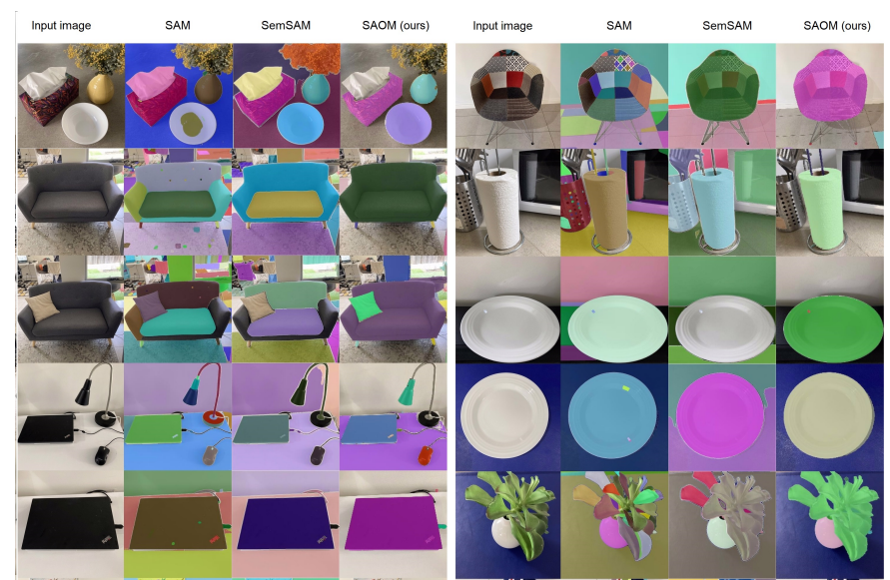
Experiments – Sim-to-Real Inference Stage
An additional challenging test set with 151 images of objects in real life environments:
with various backgrounds (a box on a table or on a sofa),
Various view points (a box visible from one side or from the top),
Various states for openable objects (closed or opened laptop)
Different variations of the same object (different sizes and colors).

Slide 15
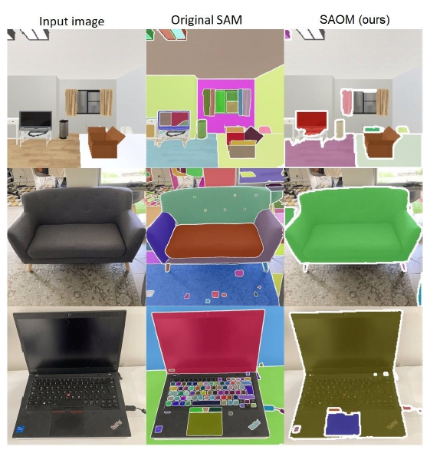
CONCLUSIONS
This paper makes three contributions for a multi-class multi-instance segmentation task in interactive indoor environments:
First, we study the possibility of direct transfer of SAM’s fine-tuning strategy trained in simulated environments to the real world without using any real-world data during training.
Second, we present a fine-tuned version of SAM - SAOM - adapted for semantic segmentation of whole objects in indoor environments. The experimental results show that our SAOM can effectively and efficiently generalize for real-life scenes with low training costs.
Moreover, we present a novel dataset collected from Ai2Thor simulator for the real-to-sim training stage.

Slide 16
Thank you!
Any questions?

