Slide 1
Attribute-Decomposable Motion Compression Network for 3D MoCap Data
Zengming Chen♣, Junxuan Bai♦♣, Ju Dai♦
♦ Peng Cheng Laboratory ♣ Beihang University

Slide 2
Contents
Introduction
Method Details
Experimental Results
Limitation and Conclusion

Slide 3
Motivation
Large Data: A large amount of motion data need to be transmitted through the Internet or stored locally.
Limited Bandwidth: The poor network bandwidth will limit data transmission, and data loss often occur during the transmission process.
Insufficient Storage: In most mobile devices, storing MoCap data locally is restricted to the insufficient storage space.
The progressively increasing 3D applications make MoCap data compression unprecedentedly important.

Slide 4
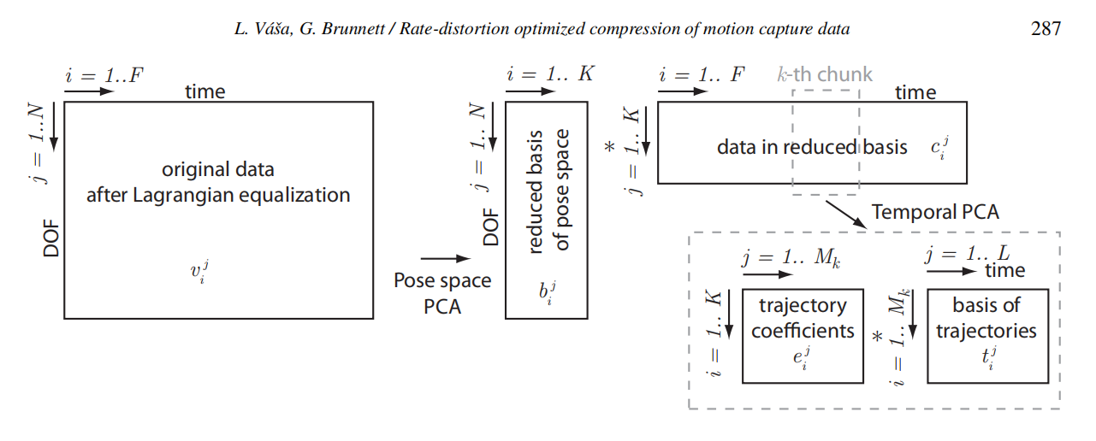
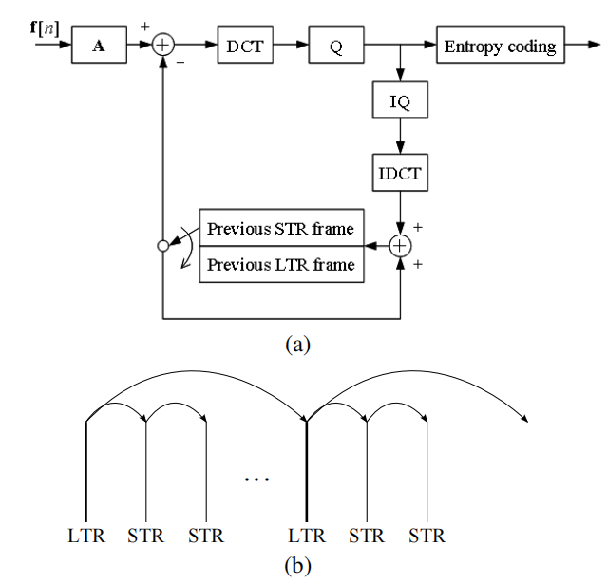
Related work
PCA-based Compression
Rate-distortion optimized compression [LG14]
Adaptive motion representation with repeated motion analysis [IJCM10]
Frequency-Domain-based Compression
Online mocap data coding [CI17]
Low-latency compression using learned spatial decorrelation transform [JLNY16]
[LG14]
[CI17]

Slide 5
Contributions
We propose a novel LSTM-based encoder-decoder network for MoCap data compression, which decomposes human motion into meaningful motion attributes.
Our method has impressive generative ability, which can generate new motion data based on arbitrary combinations with different motion attributes.
Comparing with the state-of-the-art (SOTA) methods, our method achieves a remarkable compression ratio with considerable low compression error.

Slide 6
Contents
Introduction
Method Details
Experimental Results
Limitation and Conclusion

Slide 7
Method overview
Through observation, we found that different MoCap data can be described by several highlevel semantic motion attributes: action content, motion mirror, and arm space.

Slide 8
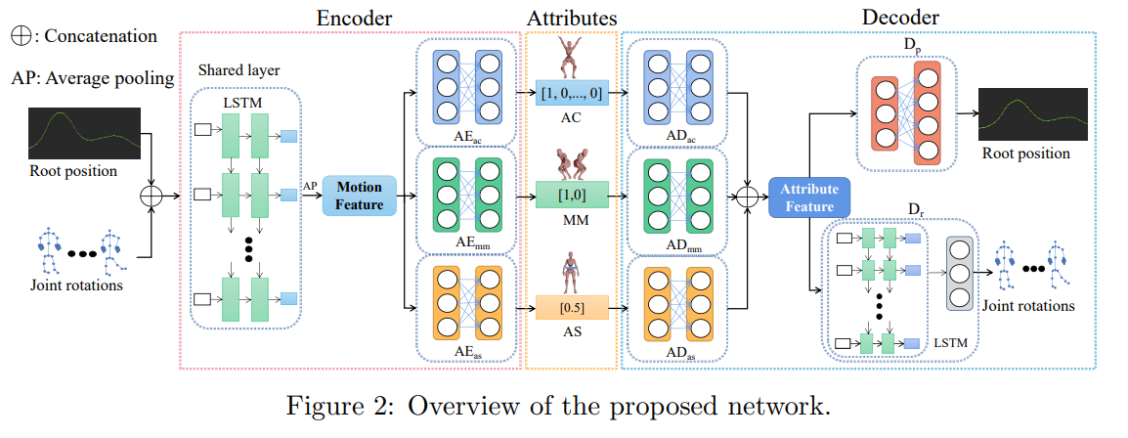
Framework
Our model is an end-to-end attribute-decomposable motion compression network using the AutoEncoder architecture.

Slide 9
Framework

Slide 10
Framework

Slide 11
Framework

Slide 12
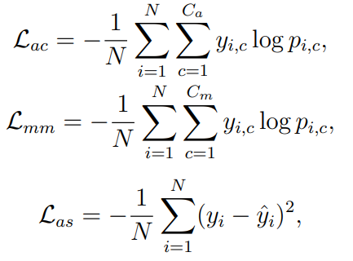
Loss function
The complete loss function
Motion attribute loss $ℒ_{ac} ℒ_{mm}$ $ℒ_{as}$

Slide 13
Loss function
Reconstruction loss $ℒ_{rd} ℒ_{pd}$
Motion consistency loss $ℒ_{mc}$

Slide 14
Contents
Introduction
Method Details
Experimental Results
Limitation and Conclusion

Slide 15
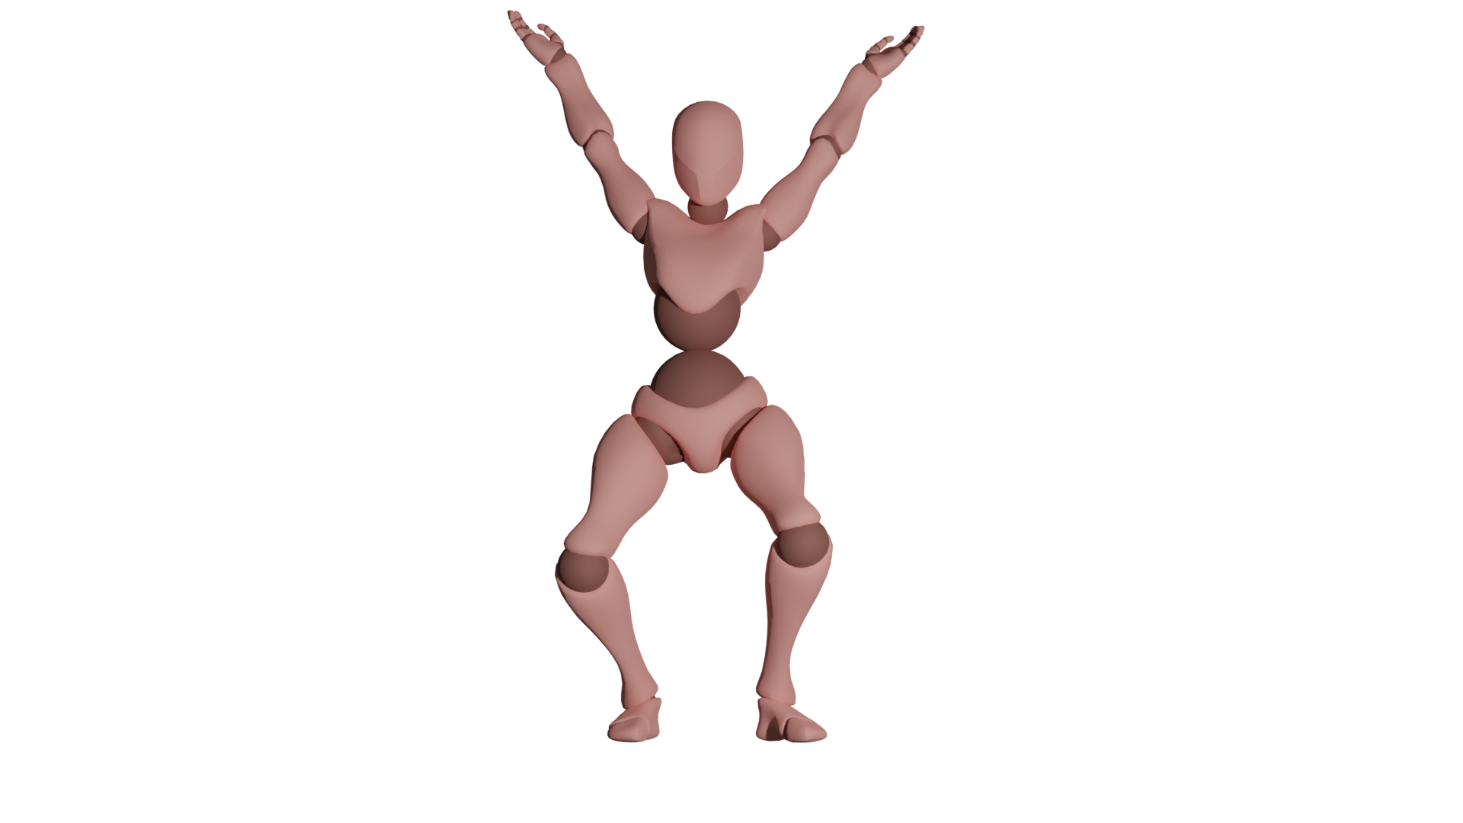
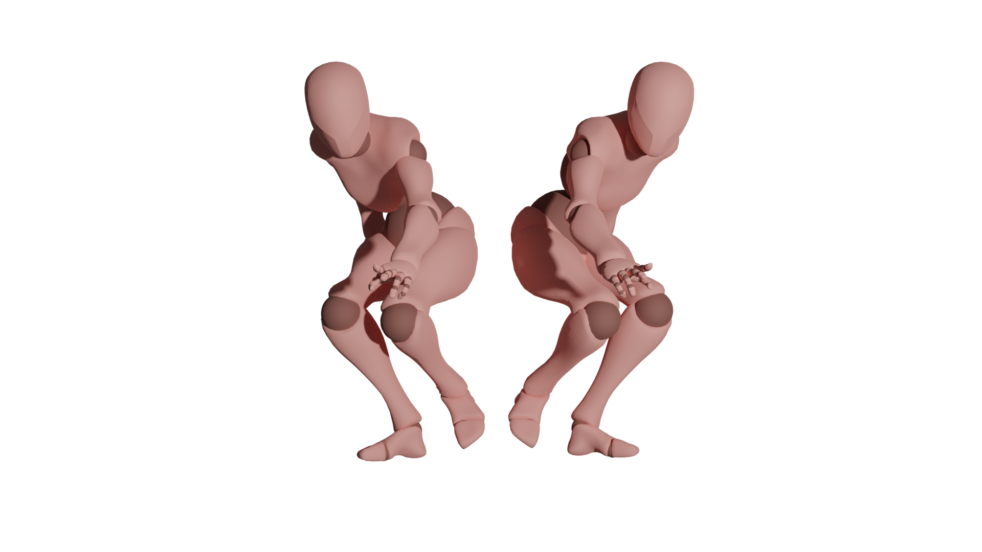
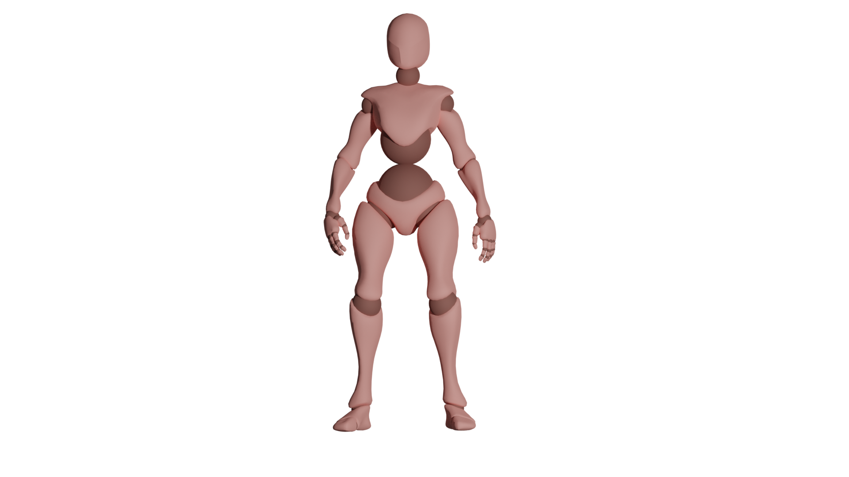
Decompress motion attributes
Attributes
Result
[1, 0,..., 0]
Action Content
Decode
[1, 0]
Motion Mirror
[0.5]
Arm Space

Slide 16
Decompress motion attributes
Attributes
Result
[0,..1.., 0]
Sneak Walk
Action Content
Decode
[1,0]
Motion Mirror
[0.5]
Arm Space

Slide 17
Decompress motion attributes
Attributes
Result
[0,..1.., 0]
Action Content
Decode
[0,1]
Motion Mirror
[0.5]
Arm Space

Slide 18
Decompress motion attributes
Attributes
Result
[0,..1.., 0]
Action Content
Decode
[0,1]
Motion Mirror
[0.01]
Arm Space

Slide 19
Ablation study
ME: mean error CT: compression time
DT: decompression time CR: compression rate

Slide 20
Comparison with SOTA
RCA, FIL are from [CI17]

Slide 21
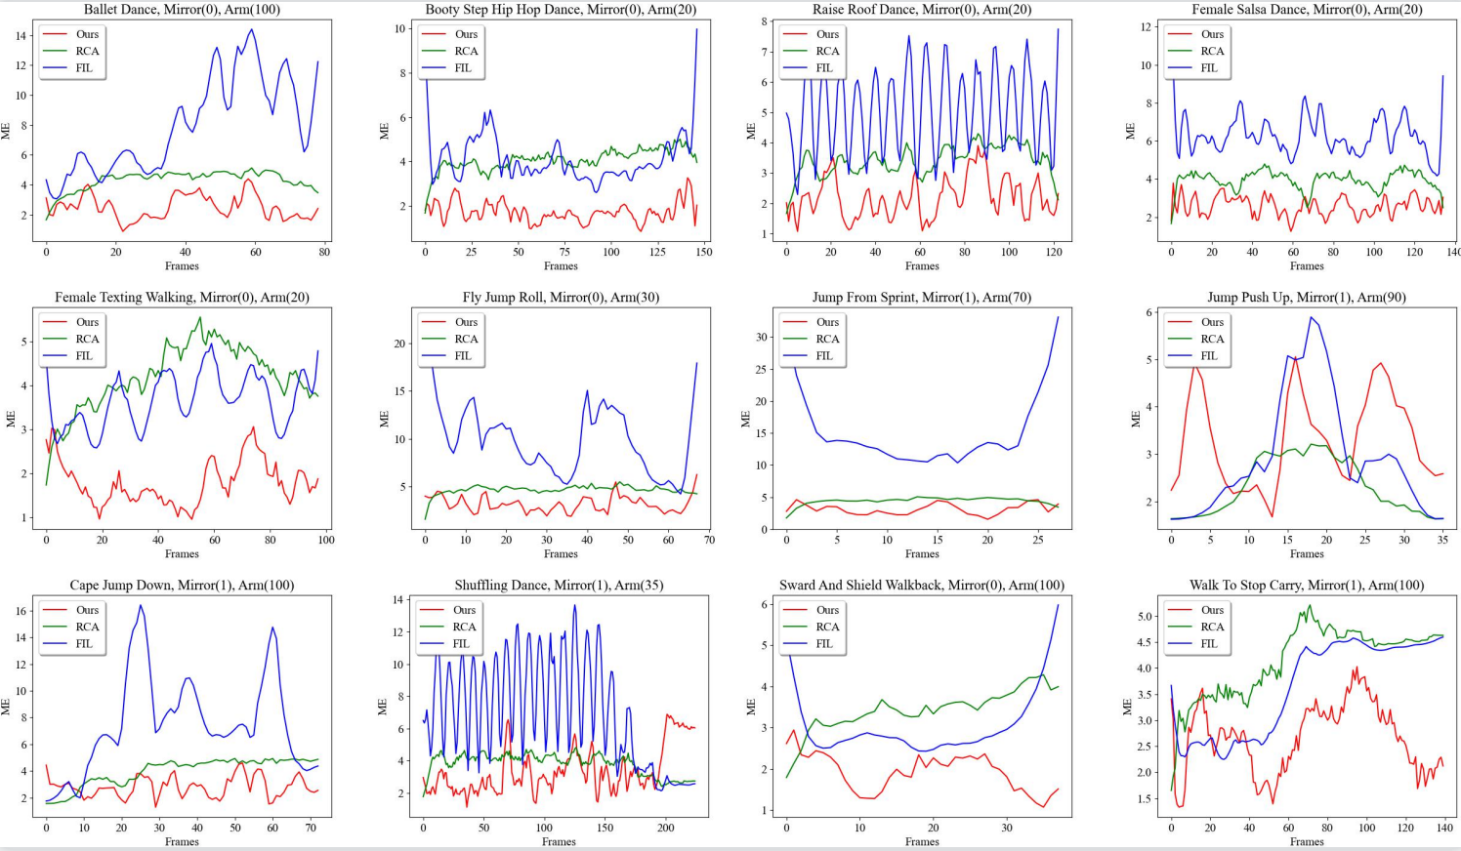
Comparison with SOTA

Slide 22
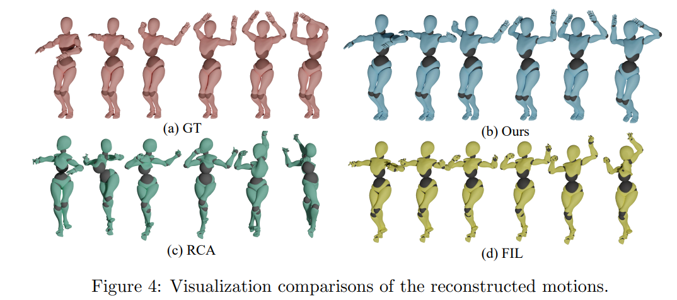
Comparison with SOTA

Slide 23
Comparison with SOTA
GT
Ours
Choong-Hoon’ method [CI17] RCA
Choong-Hoon’ method [CI17] FIL

Slide 24
Comparison with SOTA
GT
Ours
Choong-Hoon’ method [CI17] RCA
Choong-Hoon’ method [CI17] FIL

Slide 25
Comparison with SOTA
GT
Ours
Choong-Hoon’ method [CI17] RCA
Choong-Hoon’ method [CI17] FIL

Slide 26
New motion generation
Salsa Dance
Run Jump Back
Attributes
Salsa Dance + Run Jump Back
[..0.5..,0.5..]
Action Content
Decode
[0,1]
Motion Mirror
[0.01]
Arm Space

Slide 27
New motion generation
Attributes
zombie walk forward
[..1..]
Action Content
Decode
[0,1]
Motion Mirror
[1.0]
Arm Space
Attributes
zombie walk forward ( arm space = 150)
[..1..]
Action Content
Decode
[1.0,0.0]
Motion Mirror
[1.5]
Arm Space

Slide 28
New motion generation
Attributes
Run Jump Back
[..1..]
Action Content
Decode
[0,1]
Motion Mirror
[0.01]
Arm Space
Attributes
New Motion (Motion Mirror = [0.5,0.5])
[..1..]
Action Content
Decode
[0.5,0.5]
Motion Mirror
[0.01]
Arm Space

Slide 29
Contents
Introduction
Method Details
Experimental Results
Limitation and Conclusion

Slide 30
Conclusion
We formulate an end-to-end LSTM-based autoencoder model to decompose motion into attributes and compress MoCap data.
The proposed model achieves impressively compression rate, compression error, compression and decompression time.
Our method can synthesize new motions based on arbitrary combinations with different motion attributes.

Slide 31
Limitation
The main limitation of our compression method is that the generalization ability is not strong, and a large number of similar data need to be provided.

Slide 32
Thank You!
Q&A: Any questions can be sent to the authors!
Email: Ju Dai, daij@pcl.ac.cn

