Slide 1
DCC 2022
An Entropy Coding Based on Binary Encoding for
Mixed-Radix Digits
${Na Wang}^{1}$, ${Wei Yan}^{2}$, ${Sian−Jheng Lin}^{3}$, ${Yuliang Huang}^{3}$
1 University of Shanghai for Science and Technology, Shanghai, China
2 University of Science and Technology of China, Heifei, China
3 Huawei Technology Co., Ltd, Hong Kong, China

Slide 2
CONTENTS
Part 1
Part 2
Part 3
Background
Algorithm
Results

Slide 3
CONTENTS
Part 1
Part 2
Part 3
Background
Algorithm
Results

Slide 4
BACKGROUND
Data
Statistical Model
Symbol sequence $\left(s_{i},p_{i}\right)$
Entropy Coder
Bit sequence
Huffman coding
（or any prefix codes）
fast, but operates on integer number of bits, getting suboptimal compression ratio
Arithmetic coding
（or range coding）
accurate possibilities, but many times slower
Asymmetric numeral systems(ANS) providing the speed comparable with Huffman coding, as well as the compression ratio similar to arithmetic coding.

Slide 5
BACKGROUND
Given a finite symbol alphabet $Σ=\left\{0,1,⋯,z\right\}$, assuming that the frequency distribution $F=\left\{l_{0},l_{1},⋯,l_{z}\right\}$ is quantified as $m=\sum_{i=0}^{z}{l_{i}}$.
Let $b_{i}=l_{0}+l_{1}+⋯+l_{i−1}$ denote the cumulative frequency counts.
The encoding and decoding steps of range ANS(rANS) are as follows.
$$C\left(s,x\right)=m\left\lfloor x/l_{s}\right\rfloor +b_{s}+mod\left(x,l_{s}\right)$$
$D\left(x\right)=\left(s,l_{s}\left\lfloor x/m\right\rfloor +mod\left(x,m\right)−b_{s}\right)$ where $s=s\left(mod\left(x,m\right)\right)$
In the traditional rANS, $x$ becomes larger after encoding a symbol $s$.

Slide 6
CONTENTS
Part 1
Part 2
Part 3
Background
Algorithm
Results

Slide 7
ALGORITHM
In contrast, the proposed scheme directly outputs an $n$-bit digit ${V=b}_{s}+mod\left(x,l_{s}\right)$ and decrease $x$ via $x←\left\lfloor x/l_{s}\right\rfloor$, where $2^{n}=m$.Therefore, $x$ will become too small after encoding several symbols.
To solve this issue, our proposal forces the state $x$ always at a specific interval $I$:
if $x$ is within $I$, we encode it to an $n$-bit digit $V$ and decrease $x$;
Otherwise, we first read the encoded data to enlarge $x$ before encoding.

Slide 8
ALGORITHM
The specific algorithm can be implemented with the help of double ended queue.
If the current $x$ is within $I$, we push the digit $V$to the deque;
Otherwise, we first pop data from the deque to enlarge $x$ before encoding.

Slide 9
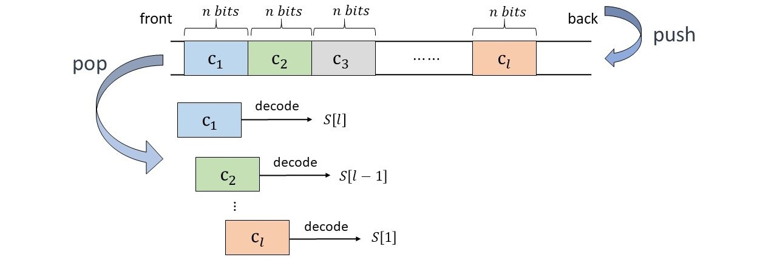
ALGORITHM
As the proposed coding uses $n$-bit as the basic unit for popping and pushing data from deque, the encoded bit sequence is $n$-bit aligned. Therefore, $c$ $n$-bit can be decoded in parallel to obtain $c$ symbols, where $c∈ℕ^{+}.$

Slide 10
CONTENTS
Part 1
Part 2
Part 3
Background
Algorithm
Results

Slide 11
Results
Table 1: Compression Performance Comparison
The proposed scheme is comparable in terms of compression ratio with the baseline(rANS).
The proposed coding has a higher throughput with the speed-up factor about 2× compared to rANS.
The decompression performance of the proposal in serial mode outperforms that of 2-way interleaving.

Slide 12
CONTACT
wna@usst.edu.cn
yan1993@mail.ustc.edu.cn
{lin.sian.jheng1, huangyuliang1}@huawei.com
Thanks!
Detailed paper link

