Slide 1
Sibling Neural Estimators: Improving Iterative Image Decoding with Gradient Communication
Ankur Mali*, Alexander G. Ororbia**, C. Lee Giles*
* Pennsylvania State University, University Park, PA
**Rochester Institute of Technology, Rochester, NY

Slide 2
Outline
Motivation
Problem description
Iterative refinement for lossy compression
Model Architecture
Results on various compression benchmarks
Conclusions/Future work

Slide 3
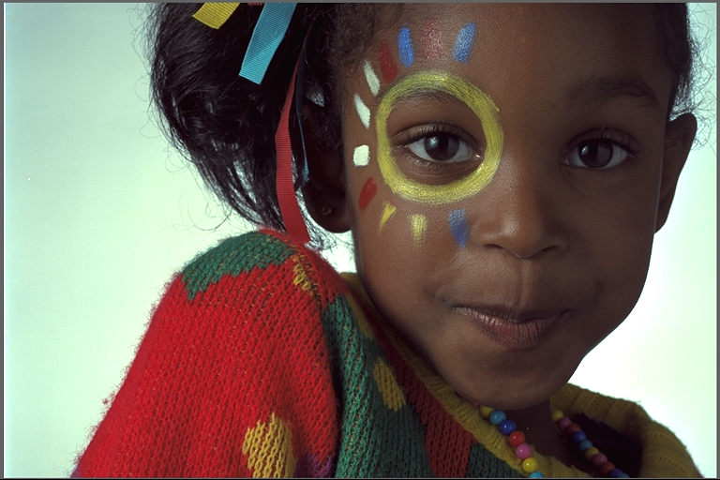
What we need from compression system
To achieve better visual quality at lowest bit rates
Preserve important features of images while conversation

Slide 4
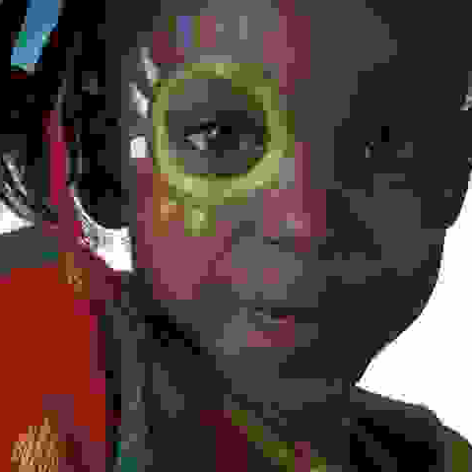
Issues with traditional methods
Transform/Block artifacts
Deformed Edges
Ringing
Flattened Textures
Staircasing

Slide 5
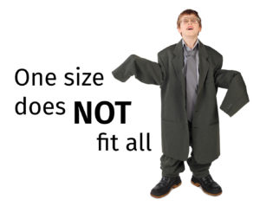
Motivation
Hard coded transformation cannot work for all problems/images
Learned features/domain adaptation and Reduce the redundancy in the system

Slide 6
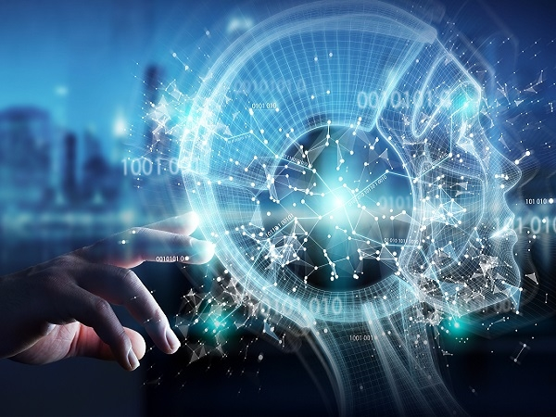
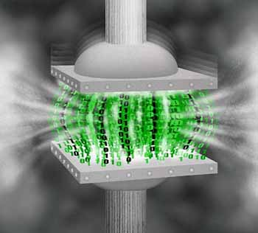
Why ML?
Machine Learning meets Compression
Compression model
Machine Learning system
Goal :- Reducing the size of the image, better transmission over web, higher visual quality with minimal loss
Goal :- Better and automatic feature representation, Domain adaptation, continual learning

Slide 7
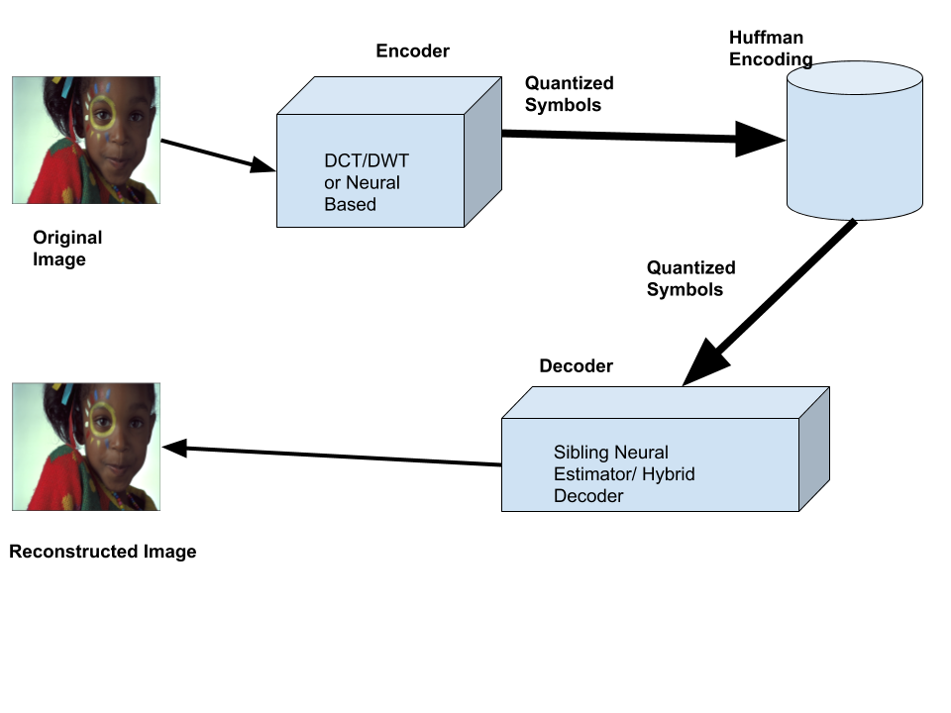
Sibling Neural Estimator- Overall working Architecture

Slide 8
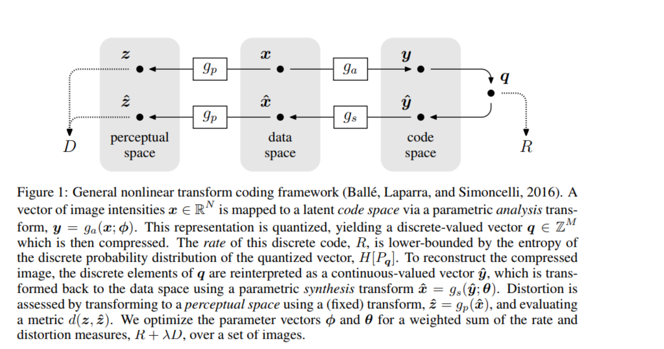
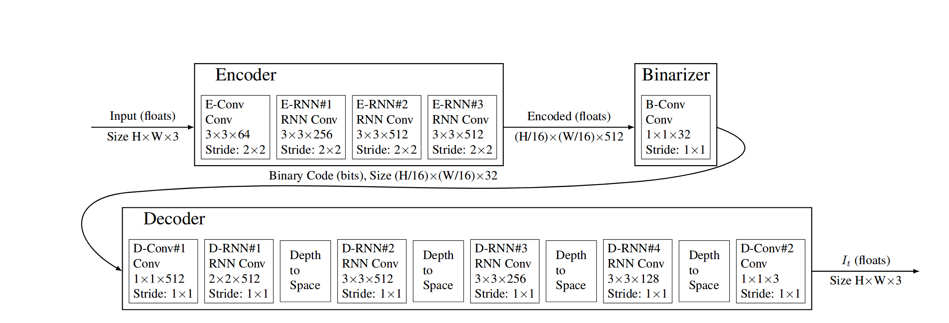
Neural Image Compression architecture
Google Architecture
End to End Compression architecture

Slide 9
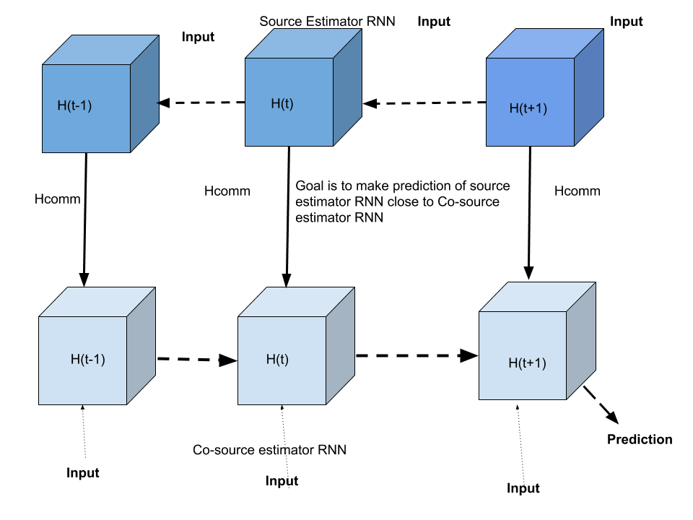
Sibling Neural Estimator-Decoder

Slide 10
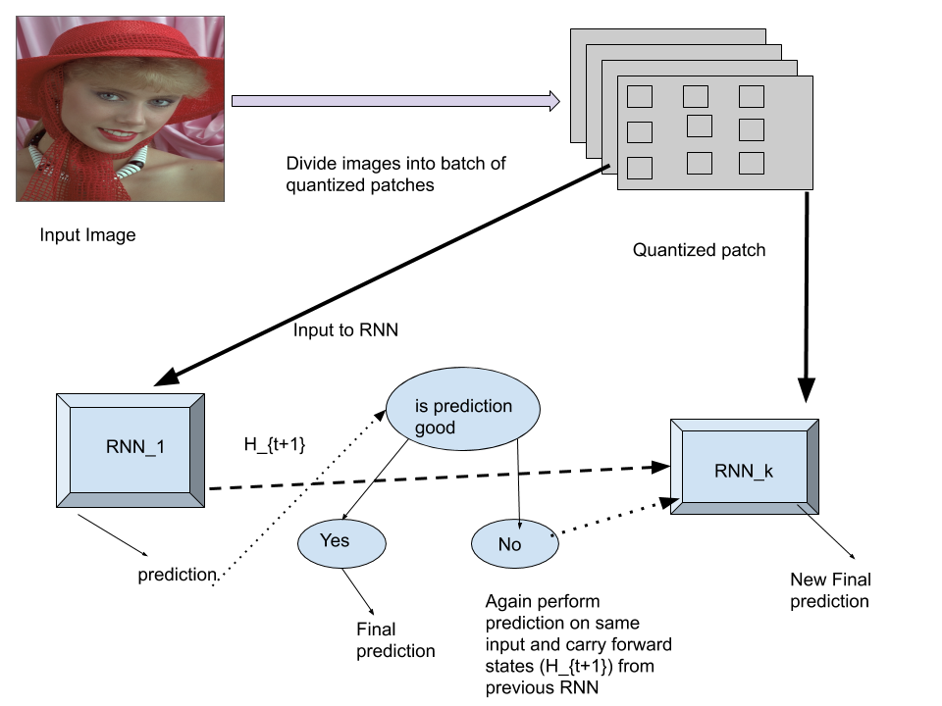
Iterative Refinement overall working
We check quality of each prediction and repeat this step k times. Hence Kth RNN has iteratively corrected its prediction with the help of k-1 RNN states.

Slide 11
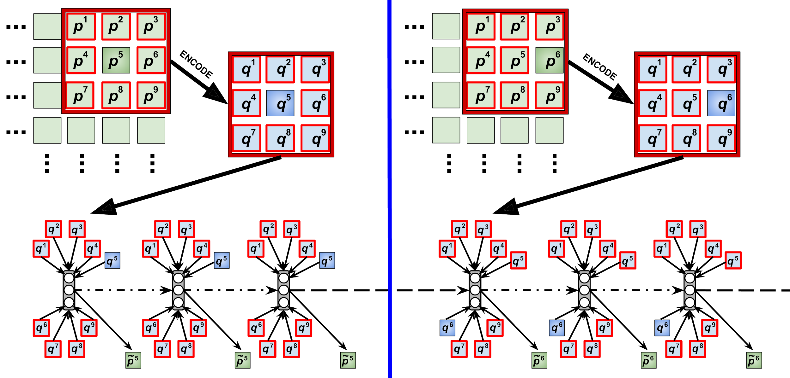
Iterative Refinement: How it works
Patch
Next patch
Decoding & reconstruction
K -> 1,3
K -> 1,3

Slide 12
Iterative Refinement: 2 Episode Depiction

Slide 13
Iterative Refinement: How it works
Input
JPEG, etc. used to get symbol stream
RNN decoder/estimator
Output

Slide 14
Iterative Refinement: How it works
K = 3 refinement steps
RNN is “copied” 3 times w/in an episode

Slide 15
Iterative Refinement: How it works
Non-causal information

Slide 16
Iterative Refinement: How it works
Causal information

Slide 17
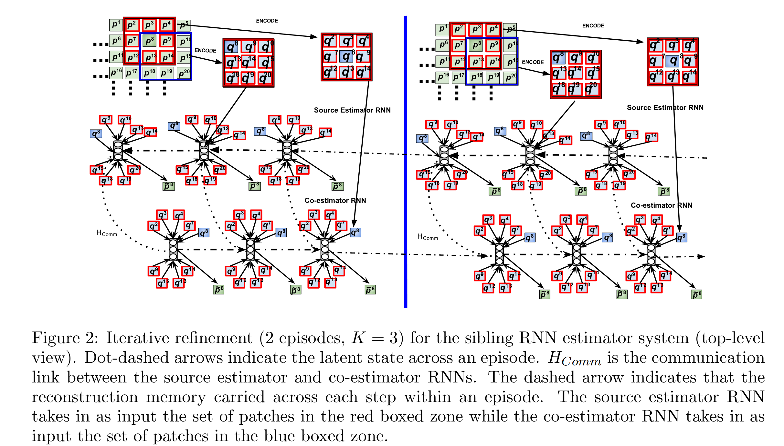
Learning of our model with iterative refinement procedure

Slide 18
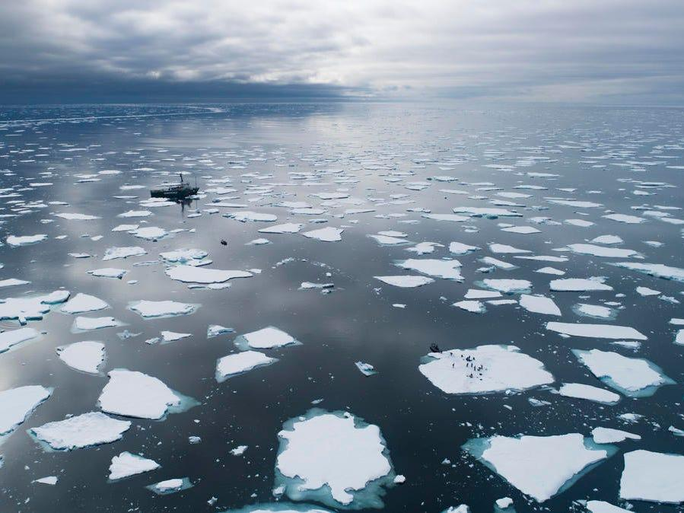
Computational Complexity?
How fast is your system

Slide 19
Computational Complexity
Many neural based learned compression models are relatively slow.
Google Model - Takes 412 ms to encode or decode an image of size 512 x 768 pixels on CPU
Requires image to be divisible by 32.
Numbers of parameters to be optimized is large.
Requires at least 16GB of GPU memory to encode images
E2E - Takes 345 ms to encode or decode an image of size 512 x 768 pixels on CPU
Training is unstable, but once optimized model is efficient.
Works on out of domain samples and provides a general purpose framework for image compression.
Requires at least 11GB of GPU memory
One solution is to optimize these models on GPU which can reduce the time upto 40-93 milliseconds
Our model - Takes 192 ms to decode an image of size 512 x 768 pixels on CPU
Image divisible by 8 can also work with our network
Requires at least 6GB of GPU memory to decode

Slide 20
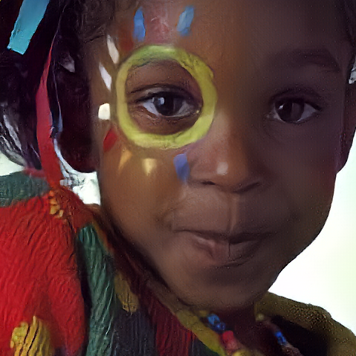
Results - Reconstructed Images
Ours
JPEG
Original

Slide 21
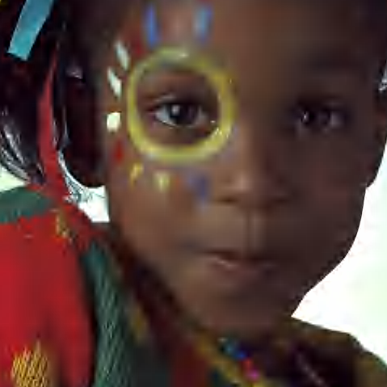
Results Continued
Jpeg2000
Ours
Original

Slide 22
Results
Ours
Google
Original

Slide 23
Results
E2E
Ours
Original

Slide 24
Limitations
Image Compression Model
Signals are highly non-gaussian
Rate -Distortion optimal transform is very likely not linear
DCT - Encoder
Assumptions
Gaussian (AR-1) Signal
Linear Transform
No Context
No Adaptivity

Slide 25
Ongoing and Future Research Direction
Integrating hybrid decoder with neural encoders.
Creating better probabilistic models
Developing differentiable quality metrics to achieve better visual quality.
Implementing algorithms which are hardware friendly and can be used by many.
Reducing the number of parameters to improve inference time.
Model compression after training without losing compression quality.
Creating a progressive/scalable model.
Need to integrate more types of signals.
Working on joint source channel encoding for image compression.

Slide 26
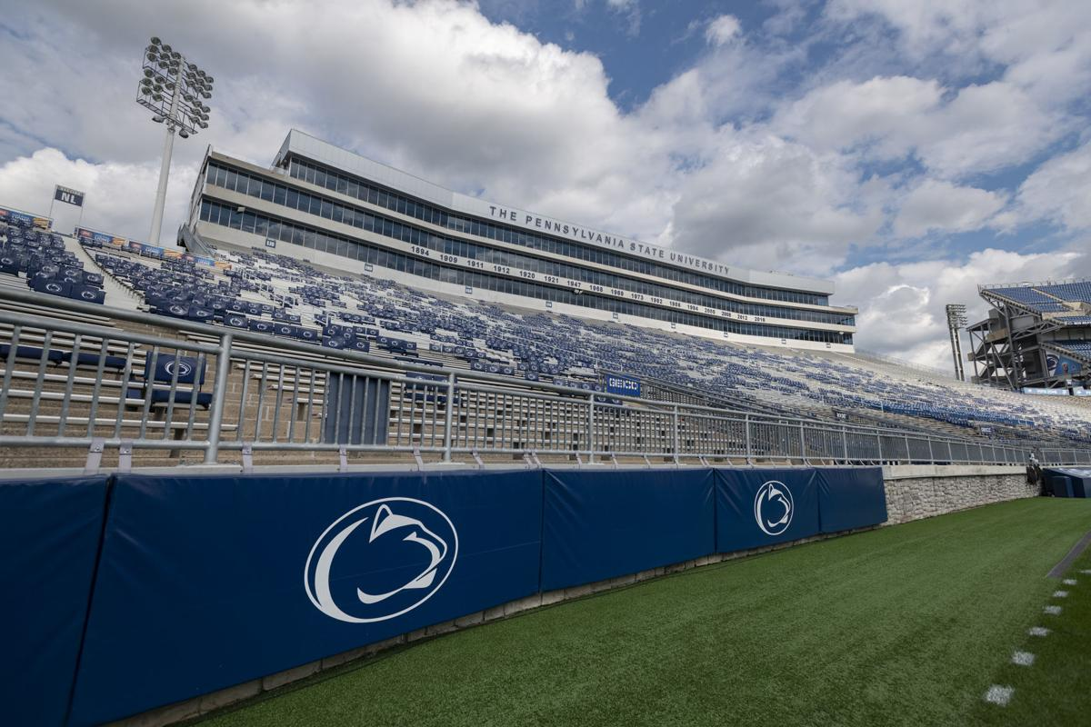
Thank you- The Intelligent Information System Laboratory

