Slide 1
Optimized Coded Aperture Design in Compressive Spectral Imaging via Coherence Minimization
Jianchen Zhu, Bochao Zhao
East-China Research Institute of Computer Technology, Shanghai, 201808, China
School of Electrical and Information Engineering,
Tianjin University, Tianjin, 300072, China
Oct. 09, 2023

Slide 2
Outline
Hyperspectral Imaging
Coded Aperture Snapshot Spectral Imager
CASSI Forward Model
Proposed Coded Apertures
Simulation Results
Conclusion

Slide 3
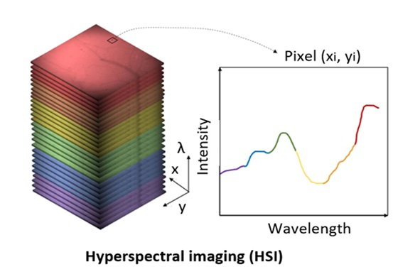
1. Hyperspectral Imaging
Hyperspectral imaging collects and processes information from across the electromagnetic spectrum.
Advantage and Disadvantage of Hyperspectral Imaging
Advantage
hyperspectral imaging provides more information
Disadvantage
Fast computers, sensitive detectors, and large data storage capacities are needed
Hyperspectral imaging is used for various applications, including:
1. Environmental monitoring; 2. Mineral exploration; 3. Quality control; 4. Waste management.

Slide 4
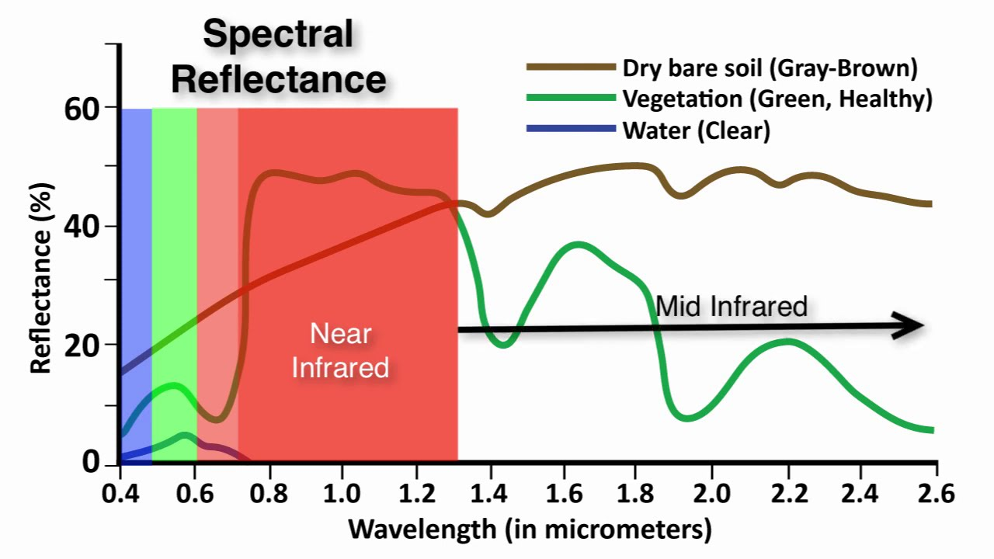
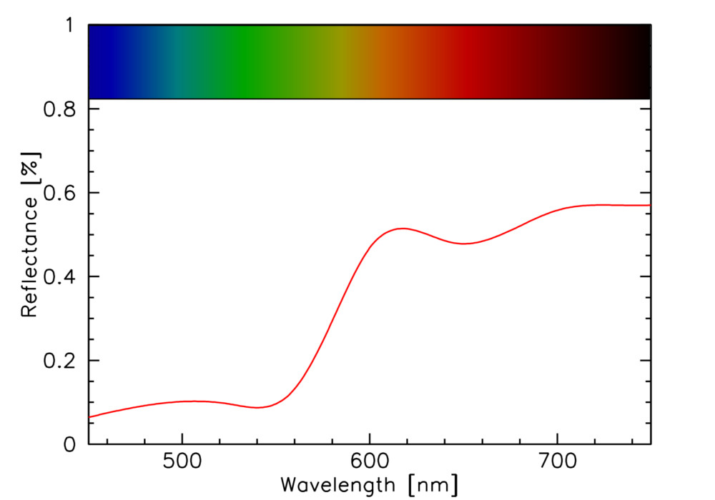
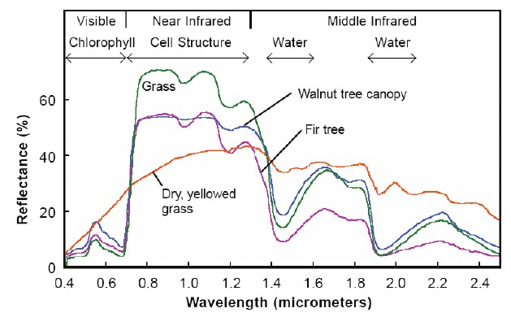
1. Hyperspectral Imaging
Spectral reflectance is the ratio of upwelling to down-welling radiant fluxes for given surface, illumination and observation properties, including the sensor's spectral sampling properties.

Slide 5
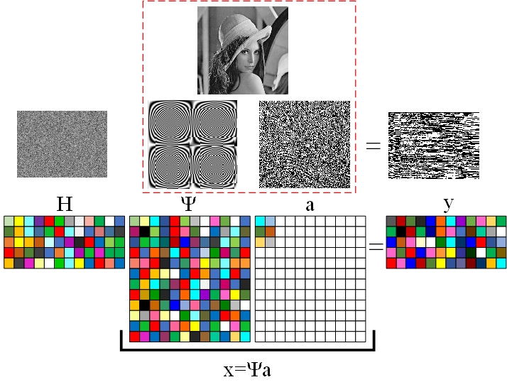
2. Coded Aperture Snapshot Spectral Imager
1. What is the compressive sensing (CS)
Sparsity property
2. Under sampling and sparse signal reconstruction
3. CS reconstruction
Restricted isometry property or mutual coherence
4. CS applications
Incoherence sampling
Random sensing realized by using Random Gaussian matrix
Robust signal reconstruction from noisy measurements
General data reconstruction from noise-free measurements

Slide 6
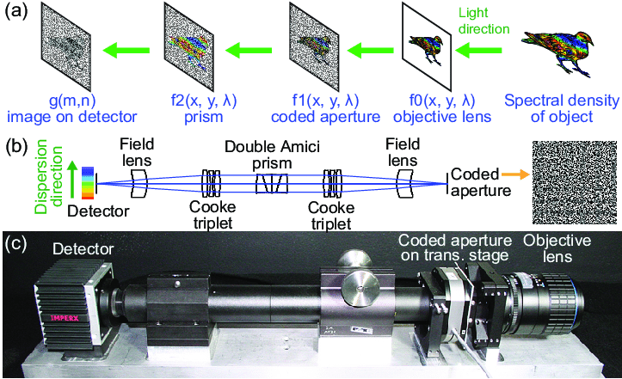
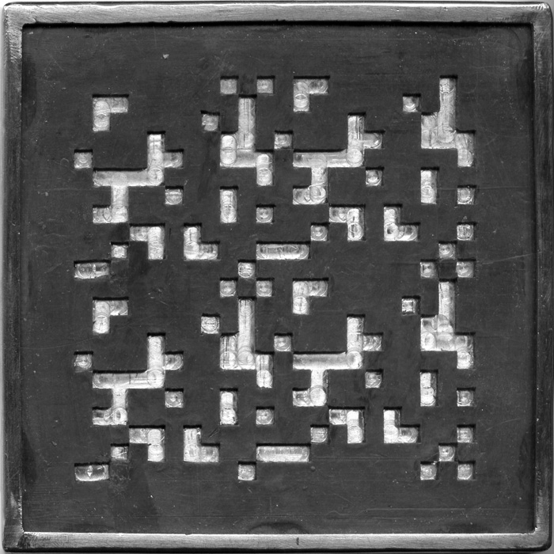
2. Coded Aperture Snapshot Spectral Imager
The CASSI system includes the coded apertures, a dispersive element, and the sensor responsible for capturing the spatial and spectral information of the scene encoded.

Slide 7
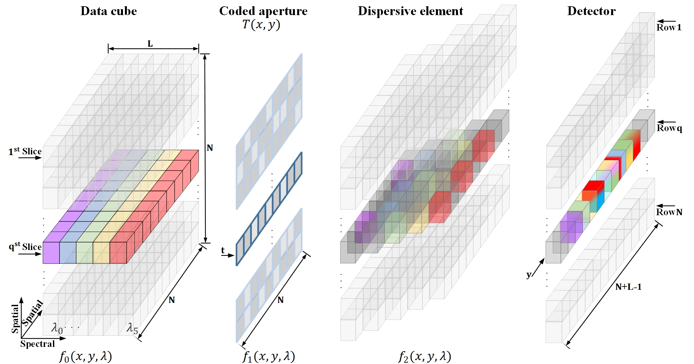
3. CASSI Forward Model
Multiple colored coded apertures can be implemented by coating a DMD or by moving a colored lithographic mask using a micro-piezo electric device.
1. The CASSI continuous measurements
$f_{2}\left(x,y,λ\right)$=$\iint{T\left(x^{′},y^{′}\right)f_{0}\left(x^{′},y^{′},λ\right)×h\left(x^{′}−αλ−x,y^{′}−y\right)}dx^{′}$ $dy^{′}$
𝑓_2 (𝑥,𝑦,λ)=∬1▒〖𝑇(𝑥^′,𝑦^′ ) 𝑓_0 (𝑥^′,𝑦^′,λ)×ℎ(𝑥^′−αλ−𝑥,𝑦^′−𝑦) 〗 𝑑𝑥^′ 𝑑𝑦^′
2. The discrete single-snapshot model
3. The discrete model in matrix form
$y^{s}$=$H^{s}$f+$w^{s}$
𝑦^𝑠=𝐻^𝑠f+𝑤^𝑠
4. Multi-snapshots model
$Y_{i,j}^{s}$=$\sum_{K=0}^{L−1}{F_{i,j−k,k}T_{i,j−k}^{s}+w_{i,j}^{s}}$
𝑌_(𝑖,𝑗)^𝑠=∑_(𝐾=0)^(𝐿−1)▒〖𝐹_(𝑖,𝑗−𝑘,𝑘) 𝑇_(𝑖,𝑗−𝑘)^𝑠+𝑤_(𝑖,𝑗)^𝑠 〗
$y^{S}$=$H^{S}$f+$w^{S}$
𝑦^𝑆=𝐻^𝑆f+𝑤^𝑆

Slide 8
4. Proposed Coded Apertures
Question: what is the purpose of coded aperture optimization?
Reason: Commonly-used coded apertures includes Gaussian random and Bernoulli random matrices. However, these codes usually results in suboptimal reconstruction solutions.
How: Restricted Isometry Property (RIP) or mutual coherence
The mutual coherence of a matrix $A$ measures the largest absolute correlation between two columns [1][2]:
$$μ\left(A\right)=\max_{i≠j}{\frac{\left|\left\langle A_{i},A_{j}\right\rangle \right|}{{\left\|A_{i}\right\|}_{2}{\left\|A_{j}\right\|}_{2}}}$$
(1)
The mutual coherence ensures good reconstruction guarantees: the smaller its value, the fewer sample are need.
Motivation: mutual coherence provides optimization criteria to design the optimized coded apertures, in order to improve the quality of reconstructed hyperspectral images.
[1] Donoho D L. Compressed sensing[J]. IEEE Transactions on information theory, 2006, 52(4): 1289-1306.
[2] Candes E J, Tao T. Decoding by linear programming[J]. IEEE transactions on information theory, 2005, 51(12): 4203-4215.

Slide 9
4. Proposed Coded Apertures
The mutual coherence property of the sensing matrix A is critical to the optimal coded aperture design, whereas it guarantees CASSI reconstruction performance
$$μ\left(A\right)=\max_{i≠j}{\frac{\left|\left\langle A\left(:,i\right),A\left(:,j\right)\right\rangle \right|}{{\left\|A\left(:,i\right)\right\|}_{2}{\left\|A\left(:,j\right)\right\|}_{2}}}$$
(2)
The absolute inner product between $A\left(:,i\right)$ and $A\left(:,j\right)$ is expressed as
$\left|\left\langle A\left(:,i\right),A\left(:,j\right)\right\rangle \right|$=$\left|\sum_{i,j=1}^{N^{2}L}{\left\langle h_{i},h_{j}\right\rangle }ψ_{i}^{∗}ψ_{j}\right|$=$\left|\sum_{i,j=1}^{N^{2}L}{φ_{i,j}}R_{i,j}\right|$
(3)
Given that a set $Q$ distinguishes two distinct columns in $H$, the term $\left|\sum_{i,j=1}^{N^{2}L}{φ_{i,j}}R_{i,j}\right|$ can be rewritten as:
$\left|\sum_{i,j=1}^{N^{2}L}{φ_{i,j}}R_{i,j}\right|$= $\left|\sum_{i=1}^{N^{2}L}{φ_{i,i}}R_{i,i}\right|$+ $\left|\sum_{i,j∈Q}{φ_{i,j}}R_{i,j}\right|$
(4)
Combing the above two equations, the mutual coherence in Eq. 1 can be reformulated as
$μ_{i,j}\left(A\right)$= $\max_{i≠j}\left(\frac{\left|σ_{i,i}\right|}{{\left\|σ_{i,i}\right\|}_{2}{\left\|σ_{j,j}\right\|}_{2}}+\frac{\left|σ_{i,j}\right|}{{\left\|σ_{i,i}\right\|}_{2}{\left\|σ_{j,j}\right\|}_{2}}\right)$= $\max_{i≠j}\left({\check{μ}}_{i,j}+{\hat{μ}}_{i,j}\right)$
(5)

Slide 10
4. Proposed Coded Apertures
Assume that $f\left(σ\right)={\hat{μ}}_{i,j}$, where $σ$ is the matrix of designed variables. Therefore, the coherence minimization can be formulated to reduce $μ\left(A\right)$ as
$$\underset{H}{minimize}{μ\left(A\right)}$$
subject to ${\hat{μ}}_{i,j}$ = $f\left(σ\right)$
(6)
Since the Augmented Lagrangian-based methods can transform the constrained minimization problem into an unconstrained form, Eq. (6) can be reformulated as
$ℒ\left(μ,α,β\right)$=${\left\|μ\left(A\right)\right\|}_{1}$+$\sum_{i,j∈Q}{\frac{β}{2}}{\left\|{\hat{μ}}_{i,j}−\frac{\left|σ_{i,j}\right|}{{\left\|σ_{i,i}\right\|}_{2}{\left\|σ_{j,j}\right\|}_{2}}+\frac{α}{β}\right\|}_{2}^{2}$
(7)
The proposed optimized sensing matrix $A_{opt}$ can be described as
$A_{opt}$= $\underset{A}{argmin} \min_{μ,α,β>0} ℒ\left(μ_{opt},α_{opt},β_{opt}\right)$
(8)
Using singular value decomposition (SVD) for the Gram matrix $\hat{G}$=$A_{opt}^{T}A_{opt}$, i.e. , $\left\{U, ,V\right\}=SVG\left(G\right)$, such that
$H_{opt}$=π$\left\{U\left(1:V,:\right)\right\}$
(9)

Slide 11
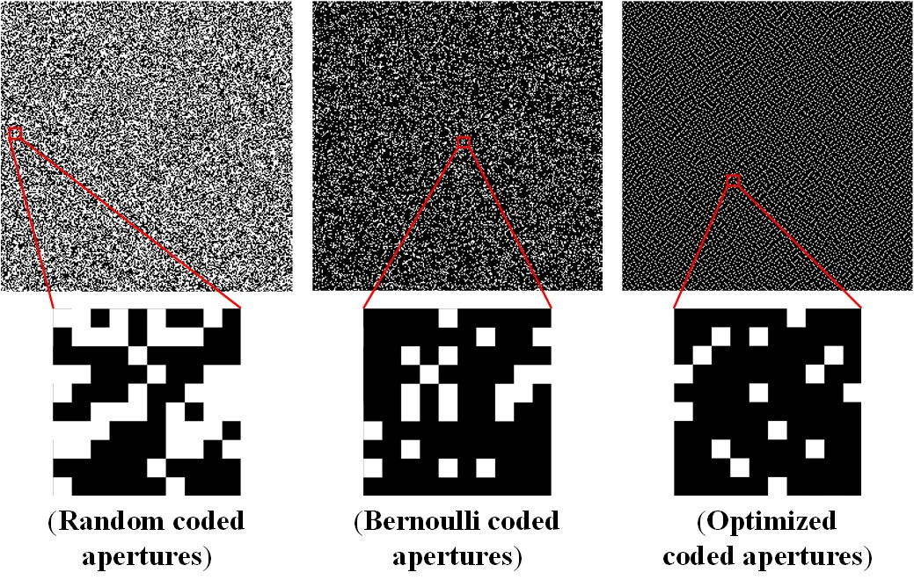
4. Proposed Coded Apertures
Conclusion: the nonzero entries of proposed coded aperture pattern at given snapshot should be distributed as uniformly and separately as possible.

Slide 12
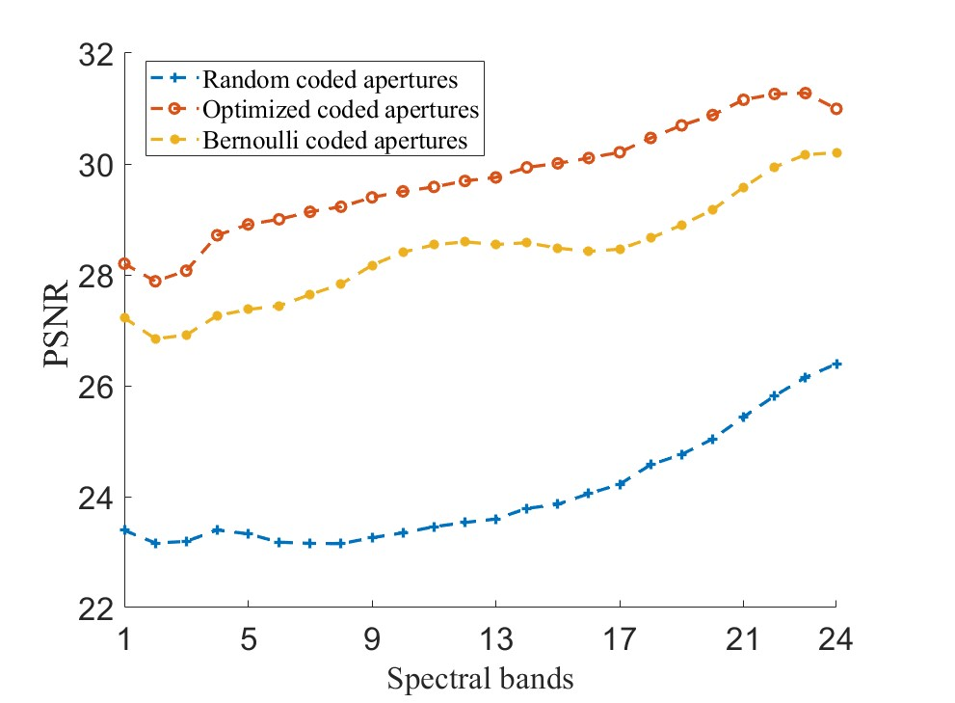
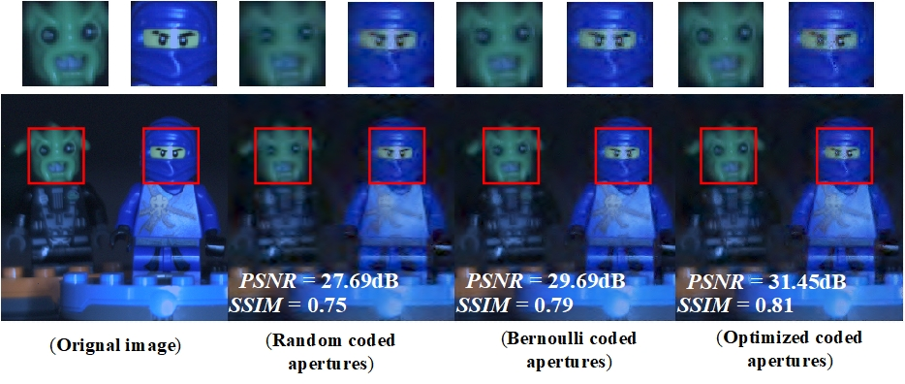
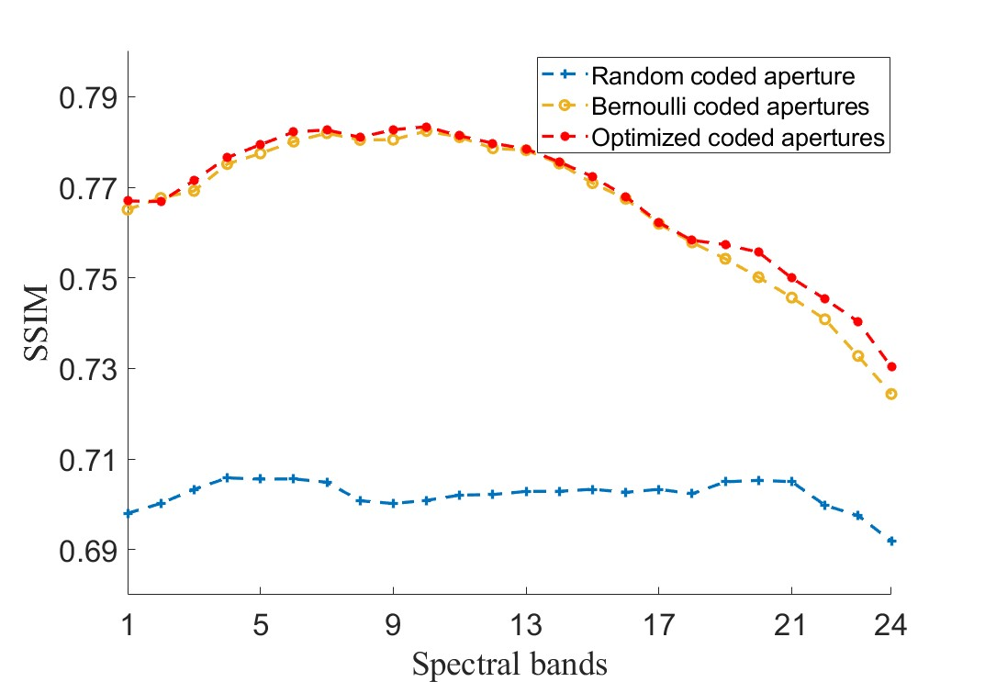
5. Simulation Results

Slide 13
6. Conclusion
Contributions
We develops a fast and simple alternative minimization algorithm based on the mutual coherence concept to optimize the coded aperture design.
As coded apertures determine sensing matrix structure, they can be seen as optimal when the value of mutual coherence of sensing matrix is minimized.
Benefiting from the extracted spatial and spectral characteristics of blue noise patterns, the clusters of one-valued entries tend to vanish in the designed coded patterns.

Slide 14
THANK YOU!
Jianchen Zhu, Bochao Zhao
East-China Research Institute of Computer Technology, Shanghai, 201808, China
School of Electrical and Information Engineering,
Tianjin University, Tianjin, 300072, China
Oct. 09, 2023

