Slide 1
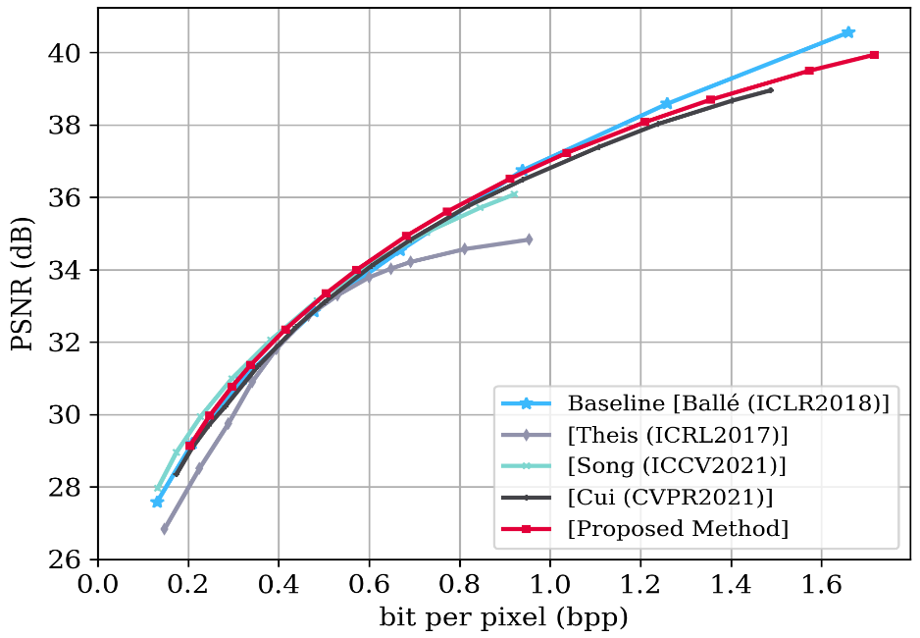
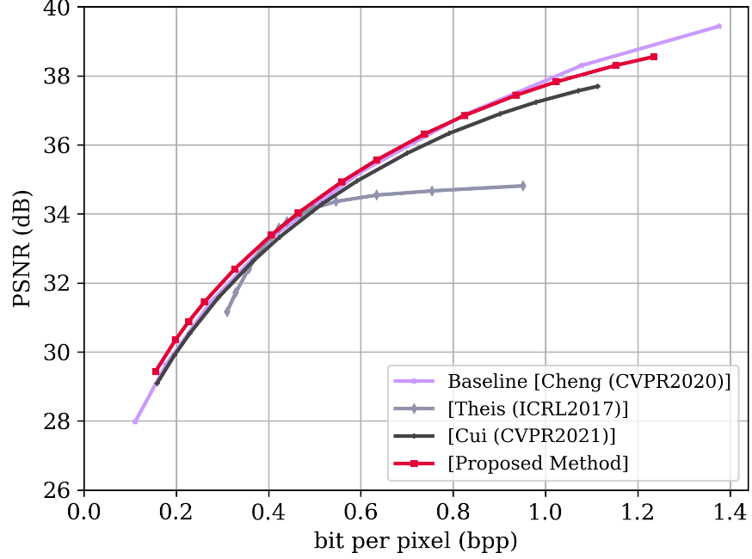
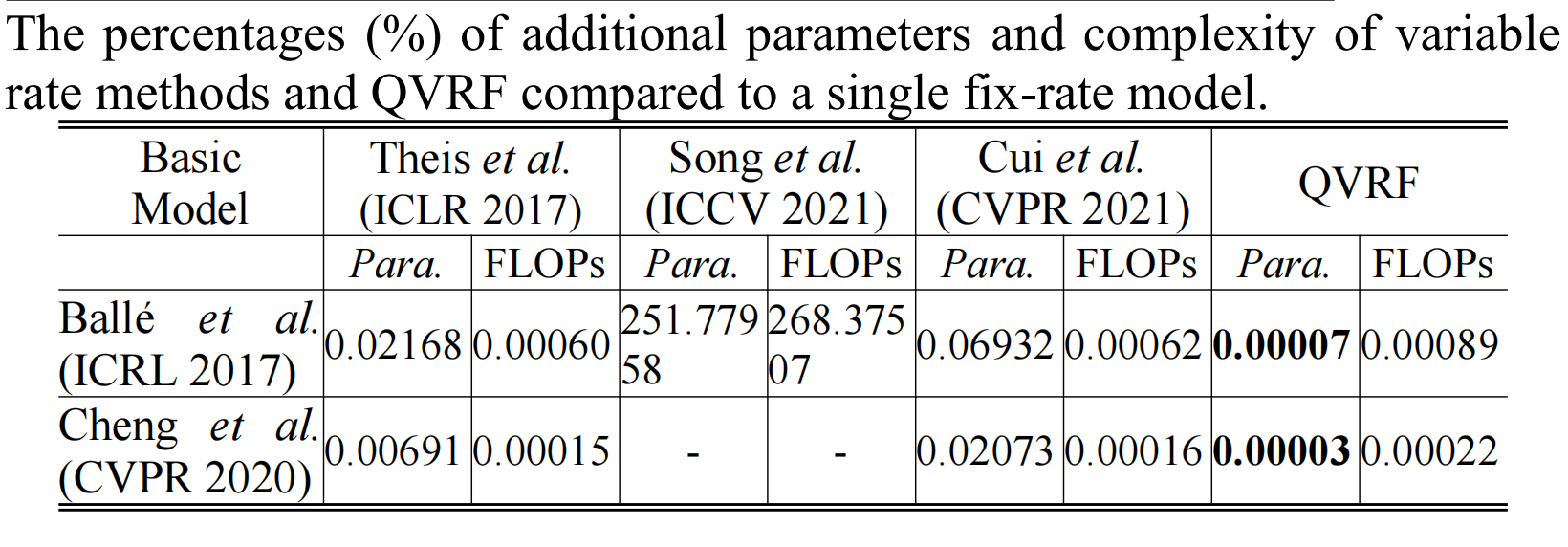
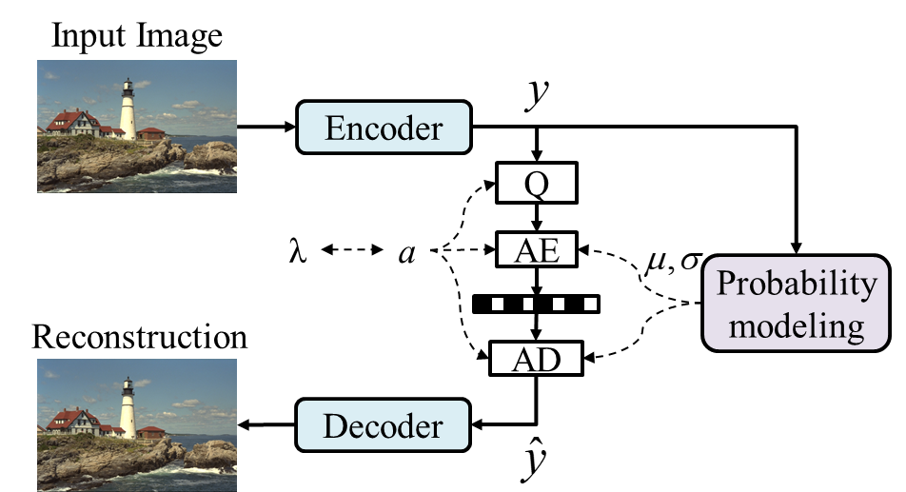
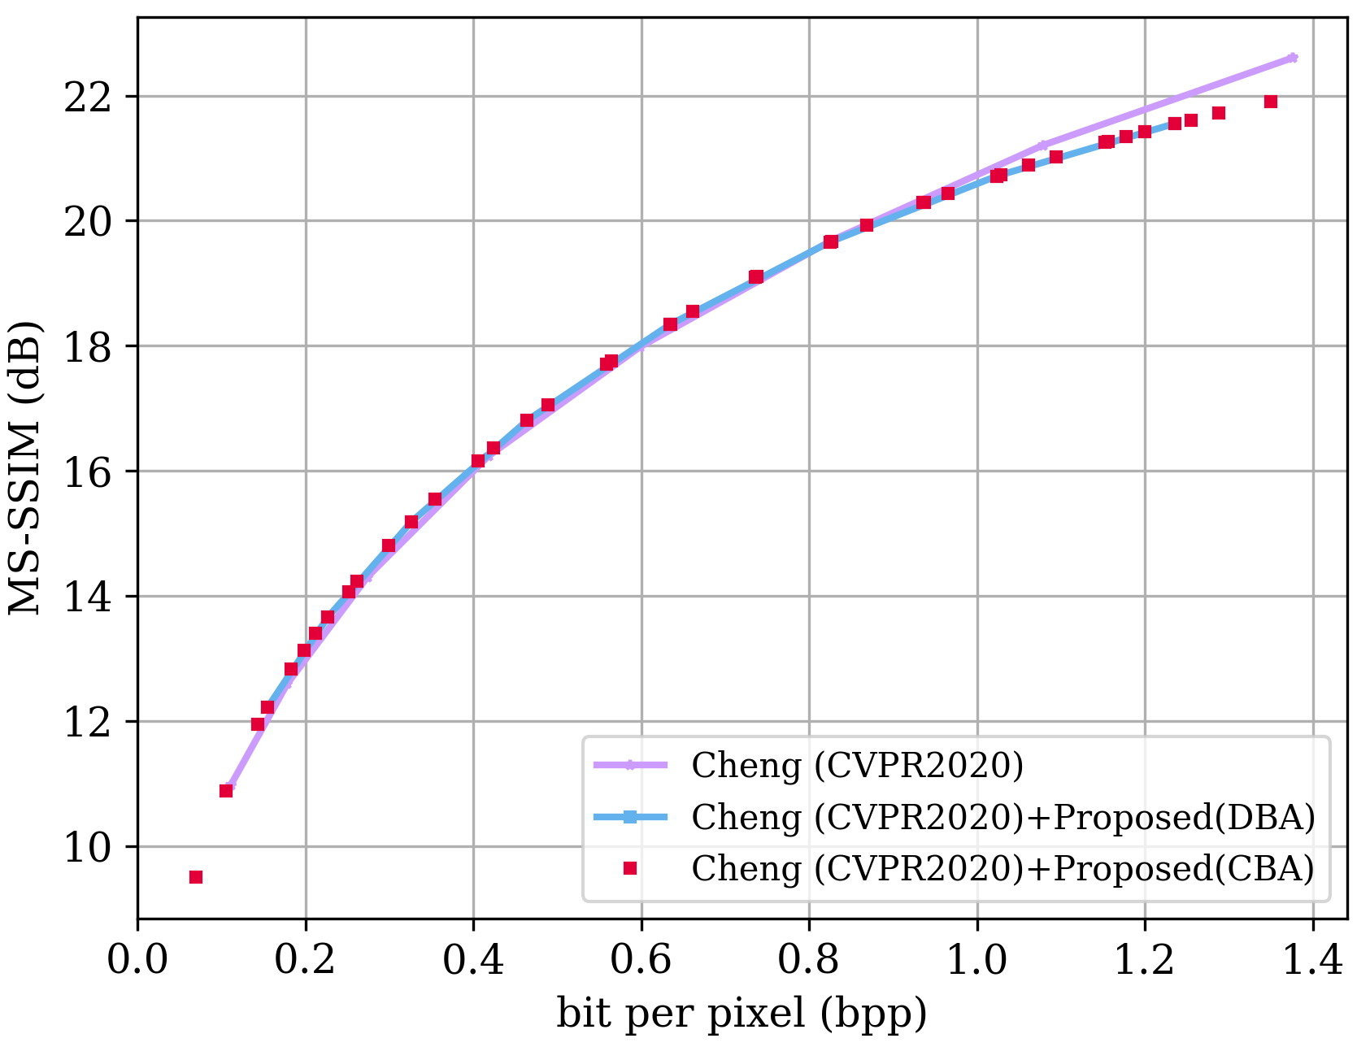
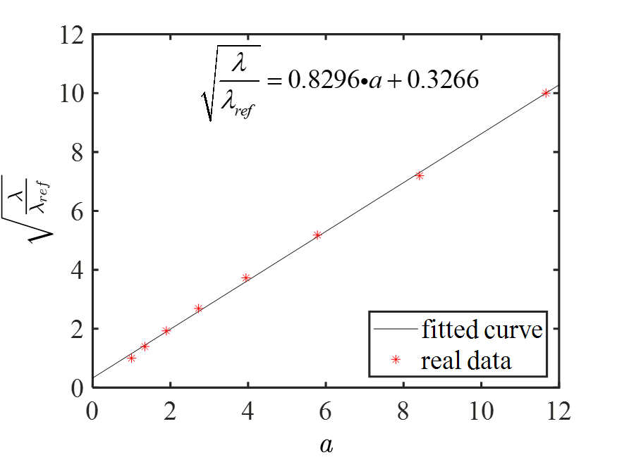
QVRF: A Quantization-error-aware Variable Rate Framework for Learned Image Compression
Kedeng Tong^{1*} , Yaojun Wu² , Yue Li² , Kai Zhang² , Li Zhang² and Xin Jin¹
¹Shenzhen International Graduate School, Tsinghua University. ²Multimedia Lab, Bytedance Inc.
Introduction
Proposed Method
Quantization-error-aware Variable Rate Framework (QVRF) that utilizes a univariate quantization regulator a to achieve wide-range variable rates within a single model. Specifically, QVRF defines a quantization regulator vector coupled with predefined Lagrange multipliers to control quantization error of all latent representation for discrete variable rates. A reparameterization method makes QVRF compatible with round quantizer and integer entropy coding. Experiments demonstrate that existing fixed-rate VAE-based methods equipped with QVRF can achieve wide-range continuous variable rates within a single model without significant performance degradation. Furthermore, QVRF outperforms contemporary variable-rate methods in rate-distortion performance with minimal additional parameters. The code is available at https://github.com/bytedance/QRAF.
Fixed-rate model:
QVRF:
variable rate methods comparison
Reparameterization
method:
QVRF uses the univariate a in quantization and entropy coding process to quantization error of y for variable rates. Reparameterization method make QVRF compatible with round quantizer for quantization and integer entropy coding.
Framework
QVRF uses minimal additional parameters and negligible computational increment but achieves the best rate-distortion performance compared to the variable rate methods.
Experimental Results
Conclusion
By incorporating a univariate quantization regulator a into the quantization and entropy coding process, the proposed QVRF enhances the existing VAE-based compression methods to achieve continuous variable rates without obvious performance degermation within a single model by altering the value of a. The reparameterization method makes QVRF compatible with the round quantizer and entropy coding. We demonstrated that square root of Lagrange multiplier and a are linear. QVRF outperforms the current variable rate methods in terms of RD performance, additional parameters and complexity.
QVRF can achieve discrete and continuous variable rate. Linear relationship of a and the squared root of λ in the QVRF and may contribute to rate adaption .

