Slide 1
Convolutional neural network-based coefficients prediction for HEVC intra-predicted residuals
Changyue Ma, Dong Liu, Li Li, Yao Wang, Feng Wu
University of Science and Technology of China
University of Missouri, Kansas City
New York University
Email: cyma@mail.ustc.edu.cn

Slide 2
Outline
Introduction
Prior works
Proposed algorithms
Experimental results
Conclusion and future work

Slide 3
Outline
Introduction
Prior works
Proposed algorithms
Experimental results
Conclusion and future work

Slide 4
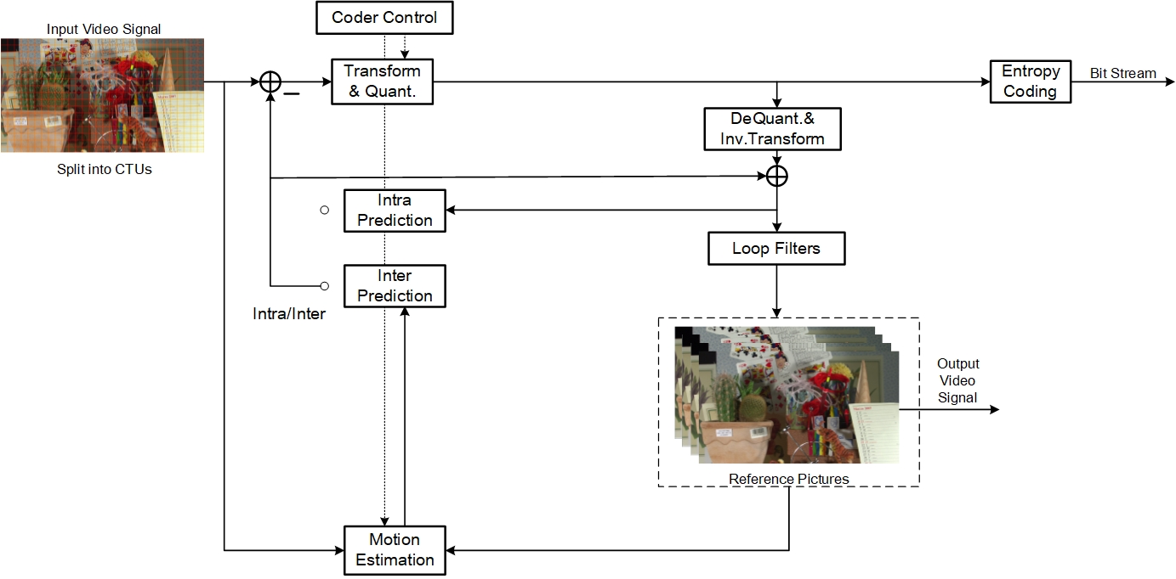
Introduction
Hybrid Video Coding Structure
Block based prediction, transform, quantization, and entropy coding
Notes:
Not only the intensity of light in space but also the direction of light rays in space.
For the light field raw data captured by plenoptic camera,

Slide 5
Introduction
Angular intra prediction
partial correlations between current block and neighboring blocks
DCT or DST : Non-optimal linear transform
partial linear correlations among current block
non-linear correlations among current block
Quantization and entropy coding
Dealing transform coefficients independently
How to utilize the correlations between current block and neighboring blocks and the correlations among current block to further improve the coding performance?
Notes:
Since LF images record the light rays of a scene of interest, it can naturally provide the benefits of rendering new views not only for changed viewpoint but also for changed focal point. Especially, due to the emergence of the commercial LF camera,
However, one of most urgent challenges is how to compress the light field image efficiently.

Slide 6
Outline
Introduction
Prior works
Proposed algorithms
Experimental results
Conclusion

Slide 7
Prior works
Transform coefficients (DCT) prediction
Set some coefficients to zero -> obtain the image with left coefficients -> restore the image with Total Variation (TV) minimization method -> obtain the predicted coefficients
M. Moinard, I. Amonou, P. Duhamel, and P. Brault, “Prediction of transformed (DCT) video coding residual for video compression,” arXiv preprint arXiv:1404.4181, 2014.
Notes:
Bi-prediction and weighted prediction can also be used to better improve the coding efficiency.

Slide 8
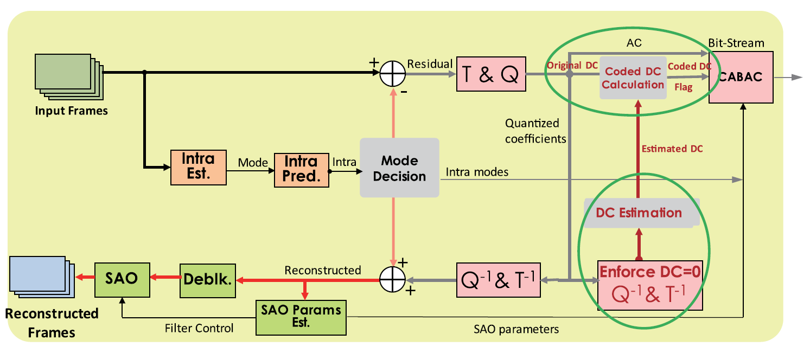
Prior works
DC coefficients (DCT) prediction
Set DC coefficients to zero -> obtain the image with AC coefficients -> restore the image with hand-crafted criteria -> obtain the predicted coefficients
C. Chen, Z. Miao, X. Meng, S. Zhu, and B. Zeng, “DC coefficient estimation of intra-predicted residuals in HEVC,” IEEE Transactions on Circuits and Systems for Video Technology, vol. 28, no. 8, pp. 1906–1919, 2017.
Notes:
Bi-prediction and weighted prediction can also be used to better improve the coding efficiency.

Slide 9
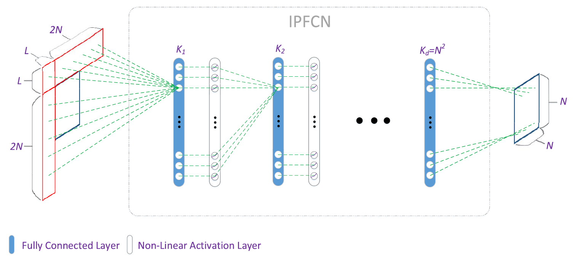
Prior works
Neural network based intra prediction
Feed the neighboring reconstructed pixels into fully connected neural network to predict the pixel values.
J. Li, B. Li, J. Xu, R. Xiong, and W. Gao, “Fully connected network-based intra prediction for image coding," IEEE Transactions on Image Processing, vol. 27, no. 7, pp. 3236–3247, 2018.
Notes:
Bi-prediction and weighted prediction can also be used to better improve the coding efficiency.

Slide 10
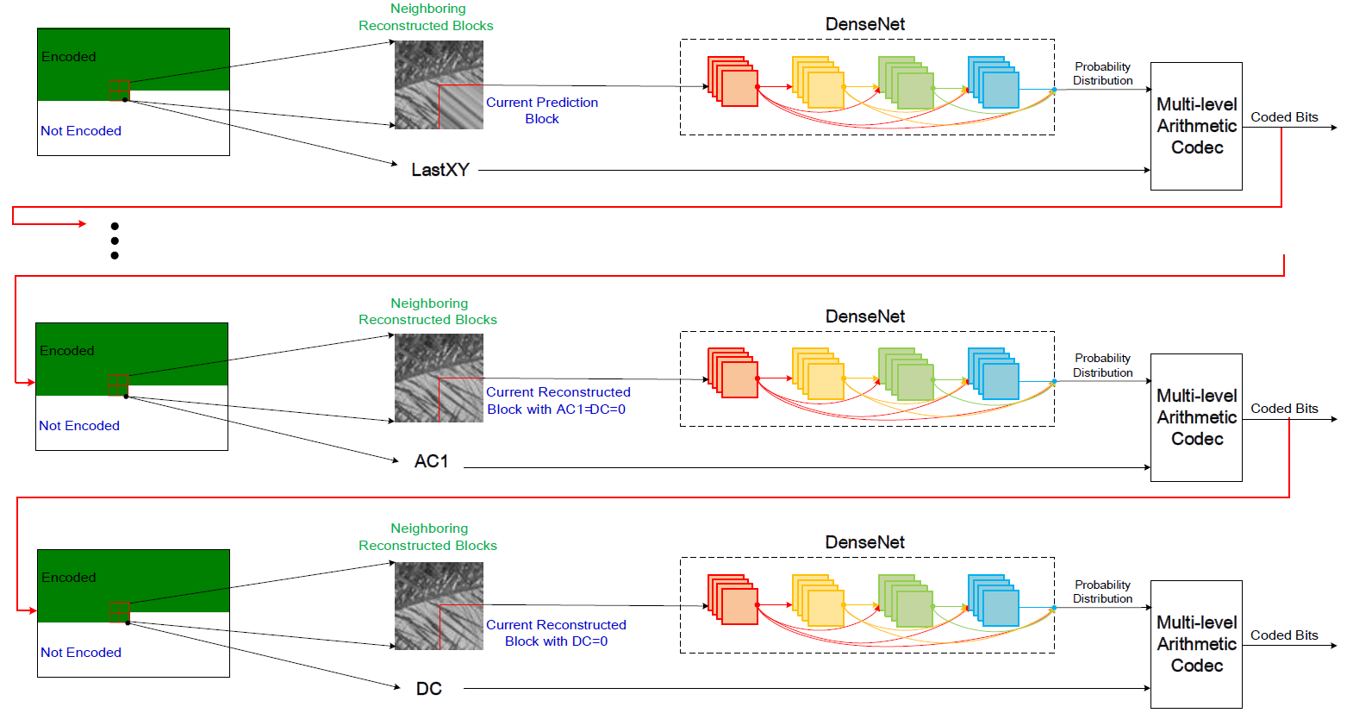
Prior works
Neural network based entropy coding
Predict the transform coefficients probability distribution with convolutional neural networks (CNNs).
C. Ma, D. Liu, X. Peng, L. Li, and F. Wu, “Convolutional neural network-based arithmetic coding for HEVC intra-predicted residues," IEEE Transactions on Circuits and Systems for Video Technology, 2019.
Notes:
Bi-prediction and weighted prediction can also be used to better improve the coding efficiency.

Slide 11
Outline
Introduction
Prior works
Proposed algorithms
Experimental results
Conclusion

Slide 12
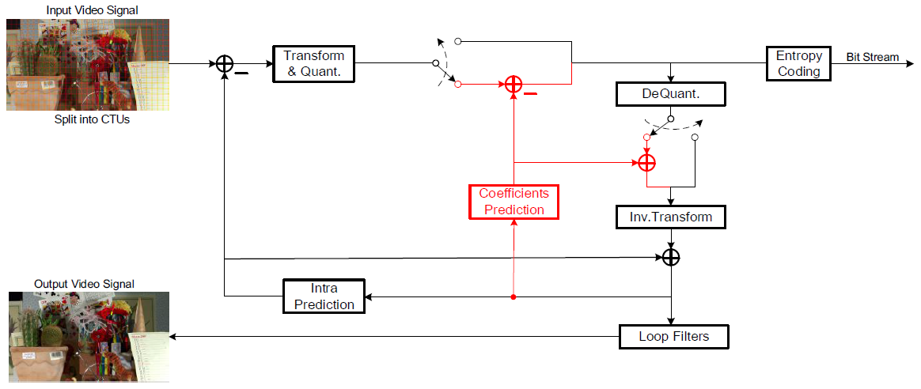
Overview of the proposed scheme
Position of the proposed scheme in HEVC
Locate between quantization and entropy coding
One flag is added in CU level to control on/off of the proposed scheme
Notes:
In this way, except for the frames in the border of two quadrants, each quadrant can be considered as an independent quadrant. Therefore, the reference frames belonging to only one quadrant can be pop out of the reference frame buffer as soon as possible to keep a relatively small reference buffer without influencing the coding efficiency.

Slide 13
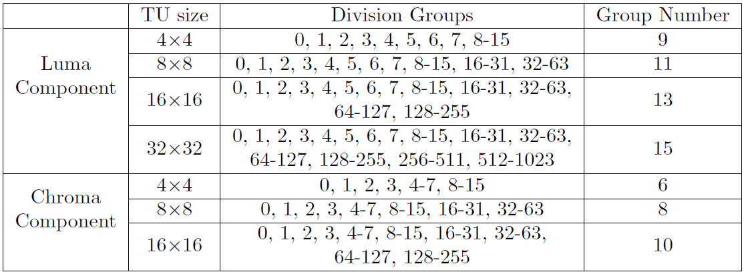
Overview of the proposed scheme
Coefficients Division Groups
Divide finer in lower frequencies and rougher in higher frequencies
Divide finer in luma channel and rougher in chroma channels
Notes:
In this way, except for the frames in the border of two quadrants, each quadrant can be considered as an independent quadrant. Therefore, the reference frames belonging to only one quadrant can be pop out of the reference frame buffer as soon as possible to keep a relatively small reference buffer without influencing the coding efficiency.

Slide 14
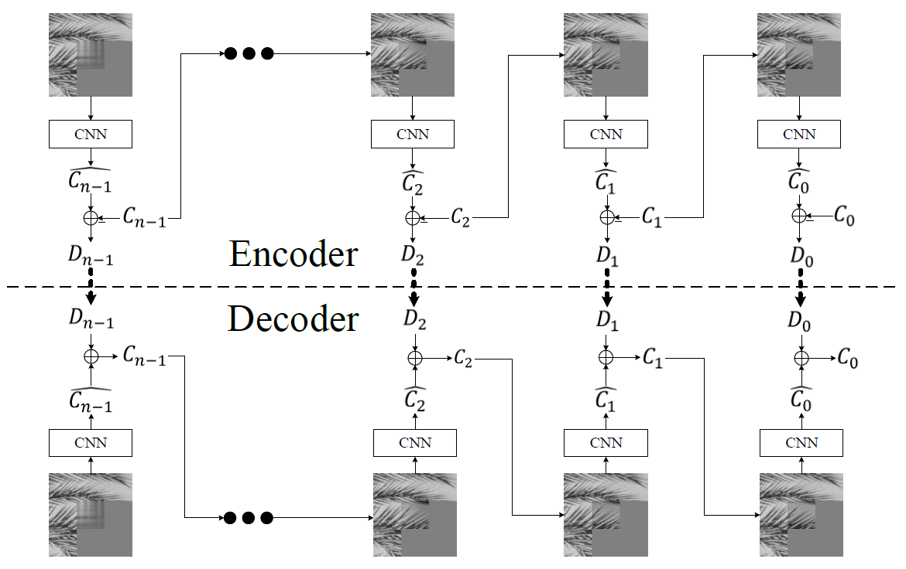
Overview of the proposed scheme
Flowchart of the proposed scheme
Predict the coefficients from higher frequency to lower frequency
Compare original coefficients and residual coefficients with RDO
Notes:
In this way, except for the frames in the border of two quadrants, each quadrant can be considered as an independent quadrant. Therefore, the reference frames belonging to only one quadrant can be pop out of the reference frame buffer as soon as possible to keep a relatively small reference buffer without influencing the coding efficiency.

Slide 15
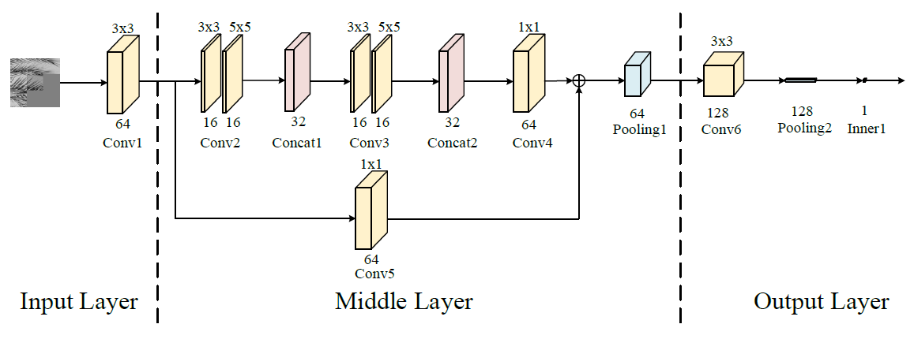
Neural Network Details
Neural network structure
Divide the neural network into input, middle, and output layer
4x4, 8x8, 16x16, 32x32 transform block correspond to 1,2,3,4 middle layer with the same input and output layers
Notes:
In this way, except for the frames in the border of two quadrants, each quadrant can be considered as an independent quadrant. Therefore, the reference frames belonging to only one quadrant can be pop out of the reference frame buffer as soon as possible to keep a relatively small reference buffer without influencing the coding efficiency.

Slide 16
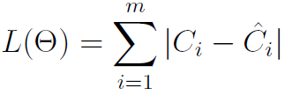
Neural Network Details
Neural network inputs
Joint the neighboring left-top, top, right-top, left and left-bottom normal reconstructed blocks with current partial reconstructed block with predicted coefficients. Fill right, right-bottom, bottom blocks with default values.
Neural network training
Loss function:
: the parameter set
: the ith target label
: the ith predicted coefficients group
Notes:
In this way, except for the frames in the border of two quadrants, each quadrant can be considered as an independent quadrant. Therefore, the reference frames belonging to only one quadrant can be pop out of the reference frame buffer as soon as possible to keep a relatively small reference buffer without influencing the coding efficiency.

Slide 17
Outline
Introduction
Prior works
Proposed algorithms
Experimental results
Conclusion

Slide 18
Experimental result
Experiments setup
Implement the proposed algorithm in the HM reference software
Test sequences: 18 8 bit natural sequences come from HEVC CTC;
7 sequences come from UVG
BD-rate is calculated for coding performance evaluation
Configuration: All Intra (AI)
Comparison with HEVC anchor with SDH on and off
QP tested: 22, 27, 32, 37

Slide 19
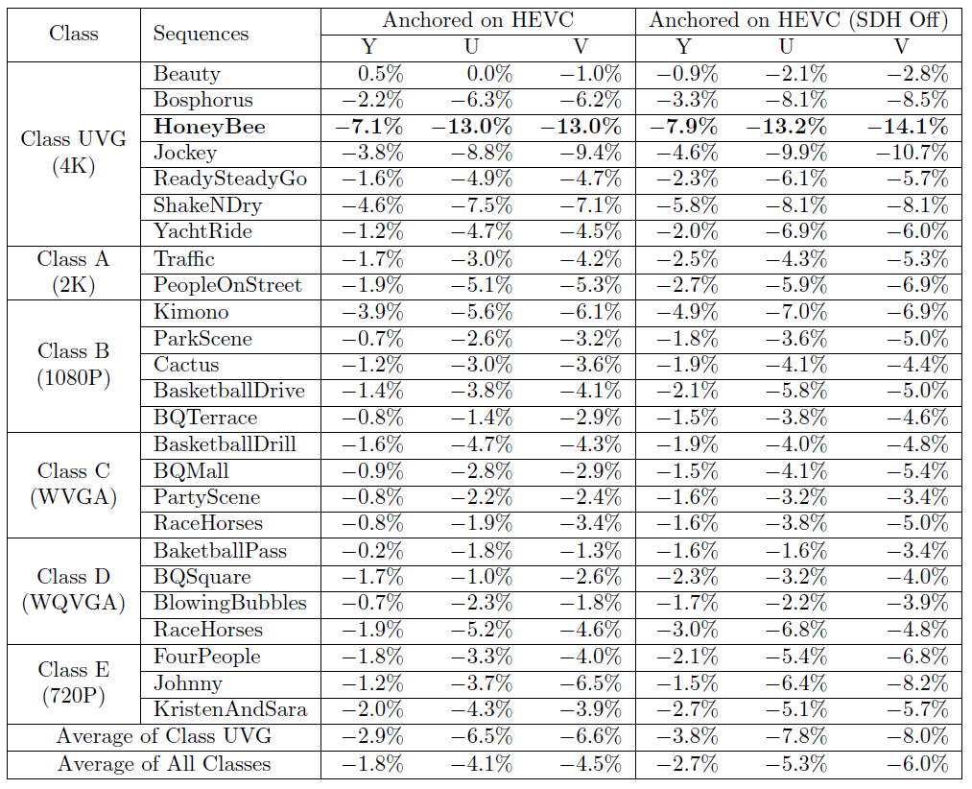
Experimental result
The coding performance
1.8% and 2.7% BD-rate reductions compared with SDH on and off
2.9% and 3.8% BD-rate reductions for Class UVG (4K)

Slide 20
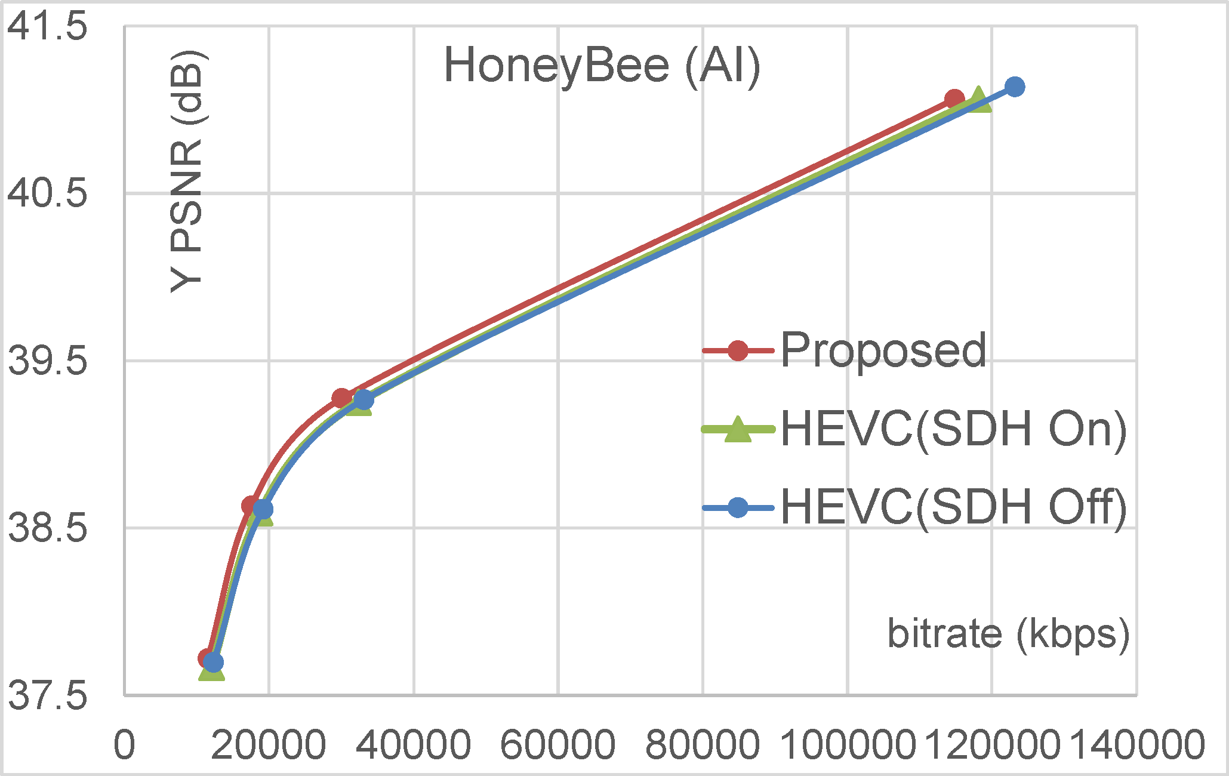
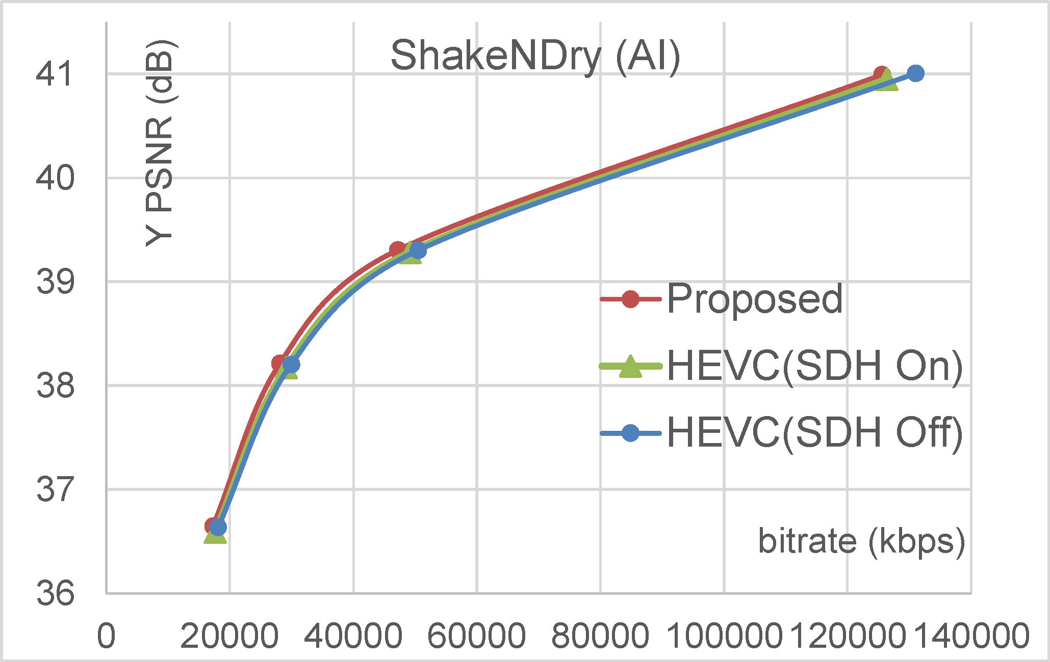
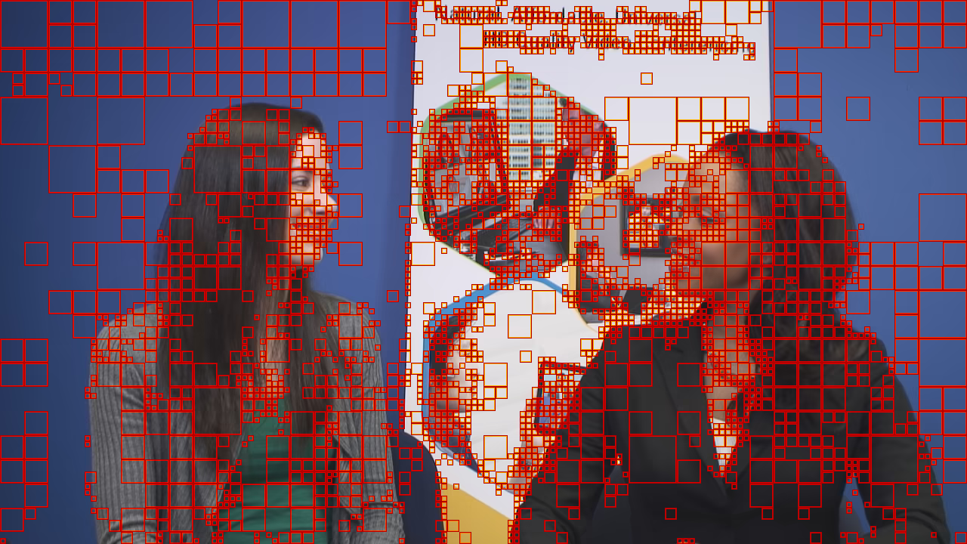
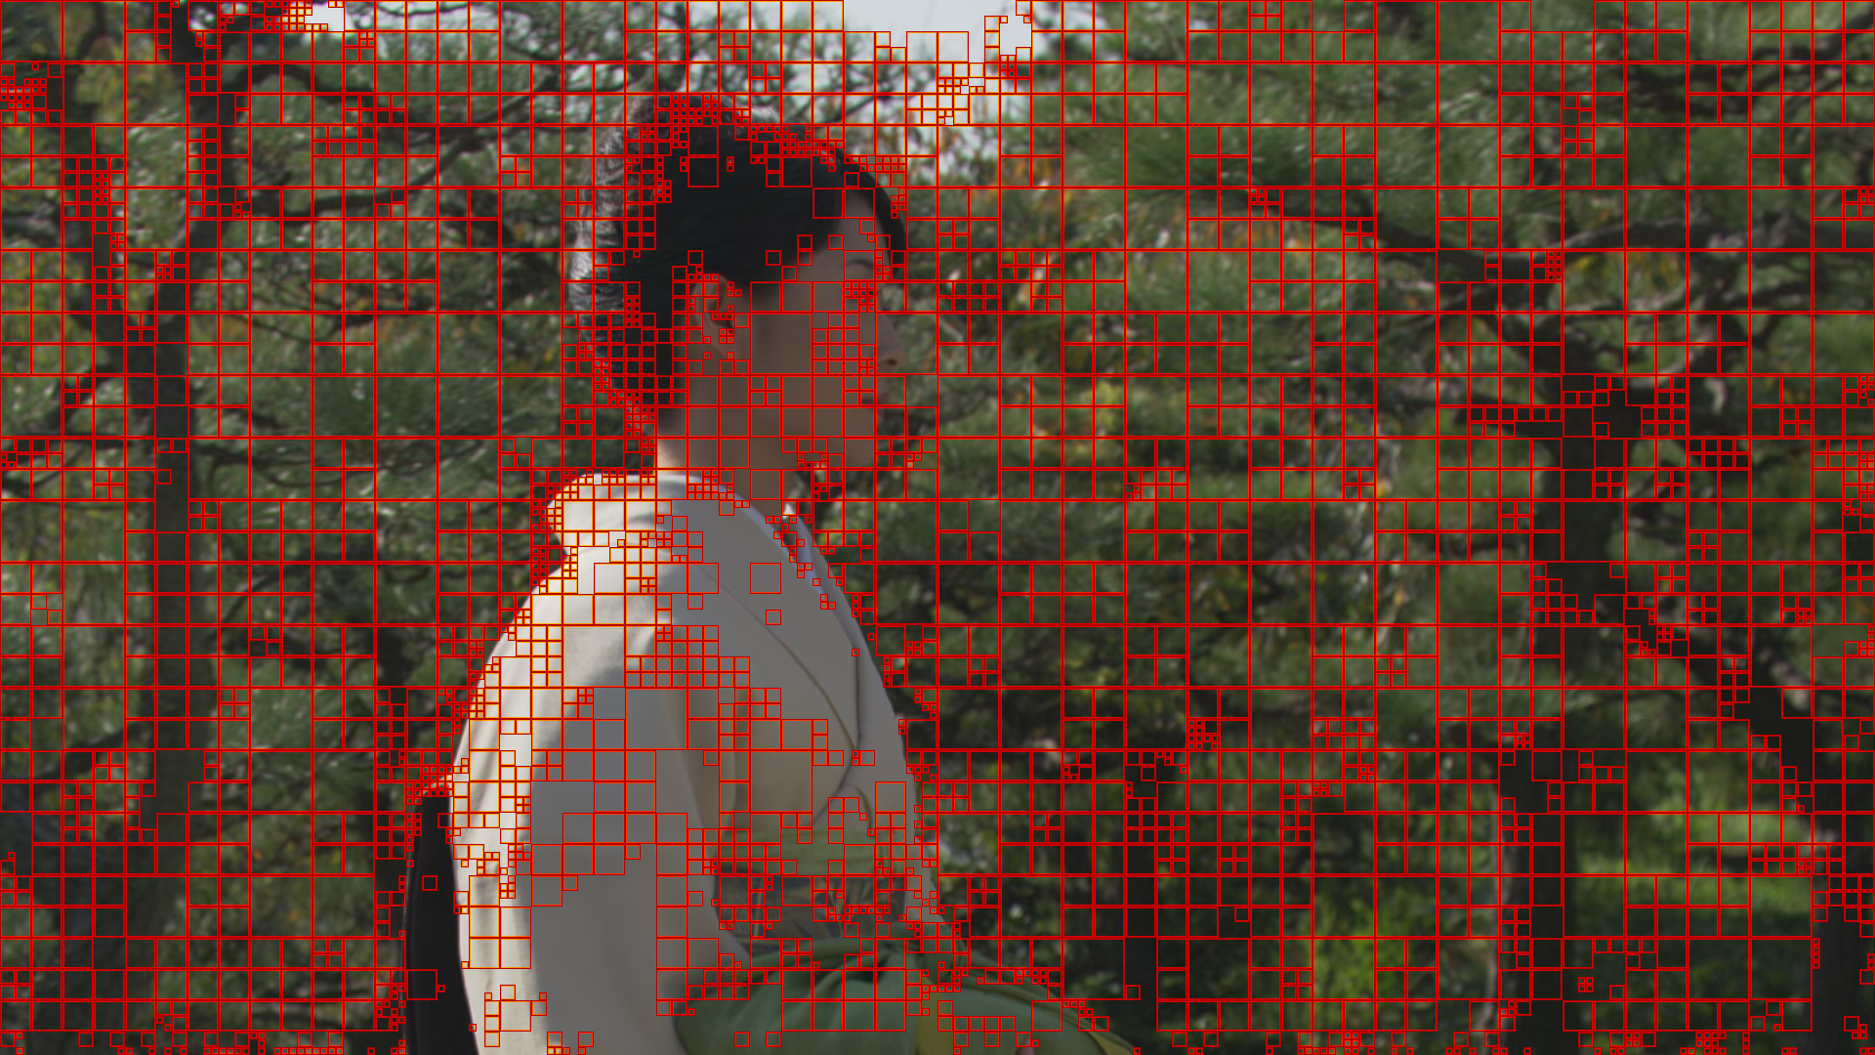
Experimental result
RD curves
Mode Selection

Slide 21
Outline
Introduction
Prior works
Proposed algorithms
Experimental results
Conclusion

Slide 22
Conclusion and future work
Contributions
Proposed a convolutional neural network based coefficients prediction method to decrease the correlations between the coefficients in neighboring blocks and current block and the correlations among different coefficients in current block
Future work
Design more efficient network structure to decrease the computational complexity
Expand the proposed scheme to inter coding scenario

Slide 23
Thank you!

