Slide 1
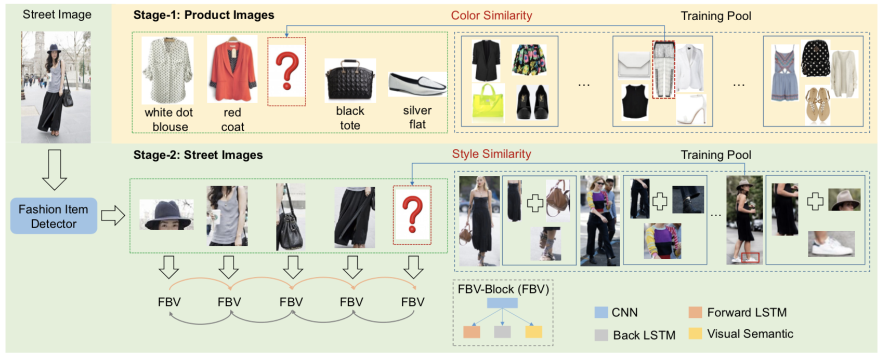
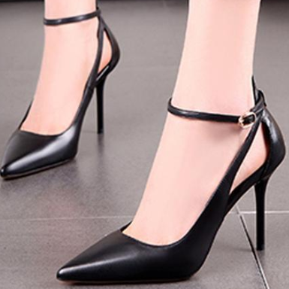
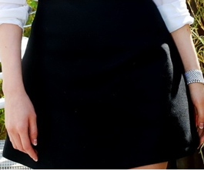
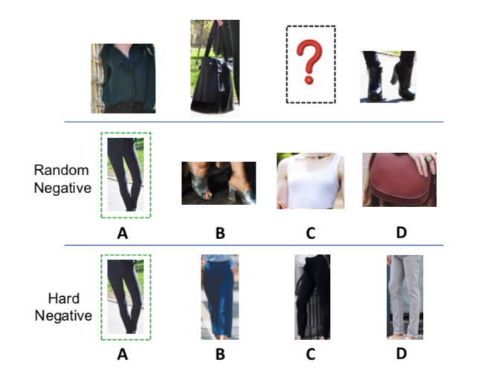
Fashion Recommendation on Street Images
Huijing Zhan¹, Boxin Shi², Jiawei Chen¹, Qian Zheng¹, Ling-Yu Duan², Alex C. Kot¹
¹ School of Electrical and Electronic Engineering, Nanyang Technological University
² National Engineering Lab for Video Technology, Peking University
Introduction
Proposed Framework
Goal: Recommend the compatible items given the query item in the street scenario.
Query
Few works investigate the matching rules of street images abound over the social media.
Challenges Our Solutions:
Cluttered background Fashion apparel detector
Sparsely annotated tags Curriculum learning
Incomplete outfits Domain-aware missing item imputation
Experimental Setup and Results
Collected Datasets:
60,180 street outfits in different occasions and styles.
18,203 product image outfits with rich meta-data.
Qualitative Results:
Missing Item Imputation
Style Similarity (street images):
Color Similarity (product images):
Evaluation Metrics:
FITB accuracy
AUC score
Query
Bi-LSTM[Han17]]
CSN[Mariya18]
Proposed
Ablation study:
Fill In The Blank Settings:
Random Negative (RN)
Hard Negative (HN)
Approach | FITB Accuracy |  | AUC Score
 | RN | HN | RN | HN
w/o MII | 0.74 | 0.69 | 0.81 | 0.84
w/o CL | 0.75 | 0.70 | 0.82 | 0.86
Proposed | 0.77 | 0.72 | 0.83 | 0.86

