Slide 1
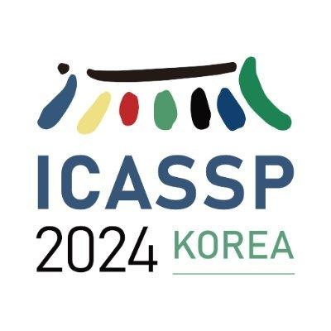
BRAVEn: Improving Self-supervised Pre-training for Visual and Auditory Speech Recognition
Alexandros Haliassos*, Andreas Zinonos*, Rodrigo Mira, Stavros Petridis, Maja Pantic
Notes:
Our work focuses on automatic speech recognition (ASR) and visual speech recognition (VSR), which are the related tasks of predicting which words were uttered from a given audio waveform or video of lip motion, respectively.

Slide 2
Continuous speech recognition
Auditory speech recognition (ASR)
“WITH WHOM YOU DO NOT ENGAGE IN ANY SOCIAL MEDIA INTERACTION AT ALL”
Visual speech recognition (VSR)
Notes:
Our work focuses on automatic speech recognition (ASR) and visual speech recognition (VSR), which are the related tasks of predicting which words were uttered from a given audio waveform or video of lip motion, respectively.

Slide 3
Self-supervised audio-visual learning
Large datasets + high-capacity models => strong performance
Labelled data => costly text transcriptions
Leverage unlabelled audio-visual data
Pre-training dataset
Fine-tuning dataset
Unlabelled
Labelled
Notes:
It is known that speech recognition benefits greatly from large datasets coupled with large models. However, labelled data are costly to obtain and thus some recent efforts pre-train models on large unlabelled datasets in a self-supervised way and then fine-tune them on smaller labelled datasets.

Slide 4
Cross-modal learning
Masked prediction
Speech waveform and lip movements provide rich speech information
Enforcing correspondence induces highly semantic representations
Predicting missing information enforces context understanding

Slide 5
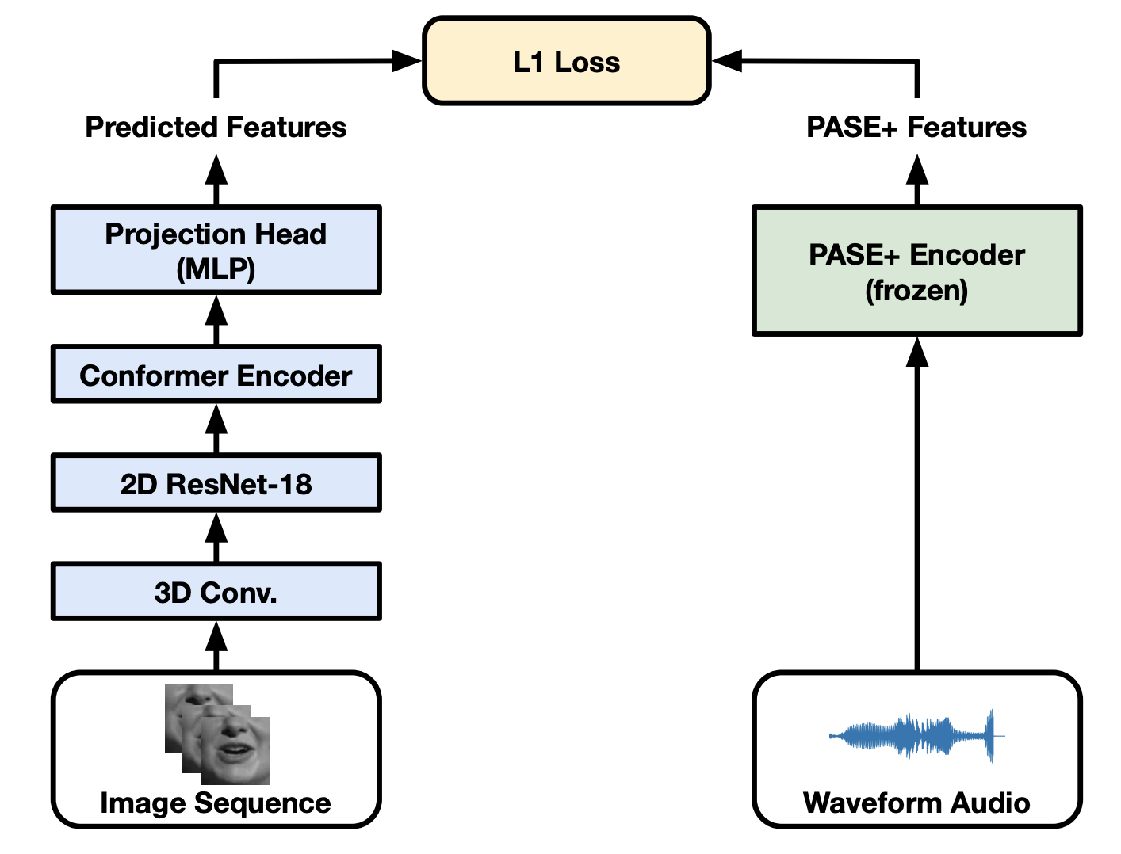
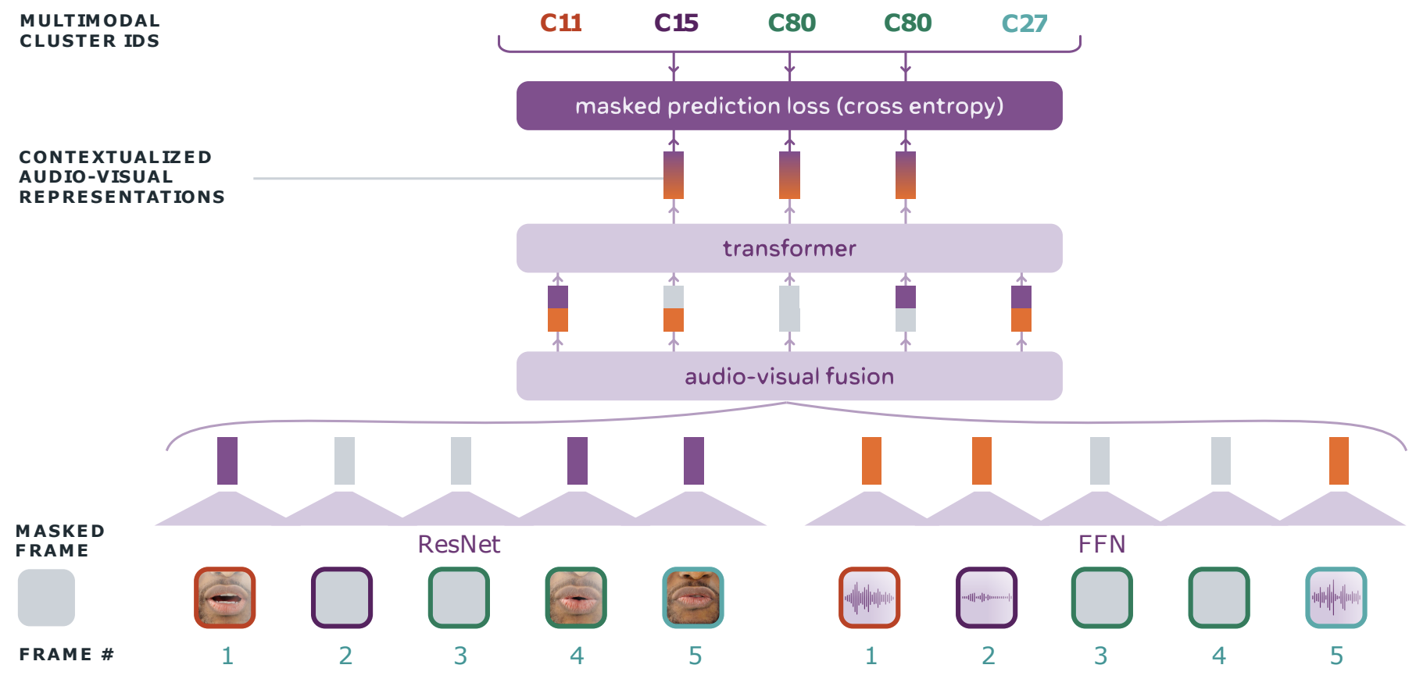
Related work
LiRA
Other audio-visual self-supervised frameworks either
work only for isolated words,
use handcrafted features (e.g., MFCCs),
use multi-stage pre-training,
and/or use separate pre-training strategies for VSR and ASR.
AV-Hubert
Ma, Pingchuan, et al. "LiRA: Learning visual speech representations from audio through self-supervision." INTERSPEECH2021.
Shi, Bowen, et al. "Learning audio-visual speech representation by masked multimodal cluster prediction." ICLR2022
Notes:
In particular, a successful line of research uses the correspondence between the visual and auditory modalities to learn strong representations invariant to nuisance factors unshared between the two modalities. However, these works work only for isolated words, use handcrafted features which may introduce bias; use costly multi-stage pre-training; and/or separate pre-training strategies for VSR and ASR.

Slide 6
RAVEn: Raw Audio-Visual Speech Encoders
Works for continuous inputs
Uses raw data only
Uses a single pre-training stage
Haliassos, Alexandros, et al. "Jointly Learning Visual and Auditory Speech Representations from Raw Data." ICLR2023
Notes:
To address these issues, our recently proposed RAVEn, which stands for Raw Audio-Visual speech Encoders. RAVEn works for continuous inputs, learns from raw data only, and uses a single pre-training stage to produce both video and audio encoders.

Slide 7
Background:
RAVEn pre-training
audio teacher
audio student
EMA
Used at inference
Feature Extractor
Feature Extractor
Transformer Encoder
EMA
Transformer Encoder
M
M
Two Shallow Predictors in Parallel
Shallow Predictor
M
M
Used at inference
Transformer Encoder
EMA
Transformer Encoder
EMA
Feature Extractor
Feature Extractor
video student
video teacher
Notes:
It works as follows: Video and audio are first masked and then fed to student networks, each consisting of a modality-specific convolutional feature extractor followed by a Transformer encoder. At the same time, unmasked data are fed through teacher networks which are exponential moving averages of the student counterparts and produce targets for the student networks to predict. The audio student is associated with two predictors, each intaking the student representations as well as masked tokens and predicting either video or audio targets. In contrast, the video student only predicts the audio targets.

Slide 8
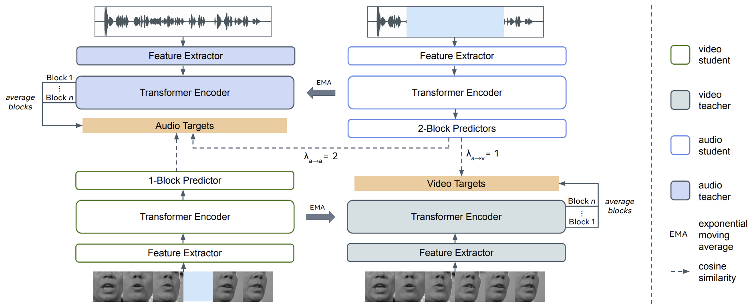
BRAVEn: Better RAVEn
Baevski, Alexei, et al. "Data2vec: A general framework for self-supervised learning in speech, vision and language." ICML2022
Notes:
BRAVEn is a direct extension to RAVEn, which we submitted to ICASSP 2024. Our enhancements are as follows: First, we use the average of the outputs of each Transformer encoder block as our targets, as in AV-data2vec, rather than simply the output of the last block, in order to create smoother and higher-quality targets. Second, we use a shallower predictor for the video student, which encourages the video encoder to better capture the information embedded in the predicted audio targets. Third, we use stronger masking for the audio inputs to address the difference in relative difficulty between VSR and ASR, and finally fourth, we use different loss weights for the audio predictors, which empirically benefits ASR performance.

Slide 9
Fine-tuning
CE loss
CTC loss
Transformer Decoder / Linear Projection
prefixes
Append Transformer decoder and a linear projector for joint CTC / Attention training
Transformer Encoder
pre-trained
Feature Extractor
Kim, Suyoun, et al. "Joint CTC-attention based end-to-end speech recognition using multi-task learning." ICASSP2017
Notes:
After pre-training, we discard all network components except the student encoders to perform either VSR or ASR. We append a decoder and a linear projector to perform joint CTC/attention training.

Slide 10
Self-training
Pre- and self-training are complementary
Pre-training
ASR fine-tuning
Unlabelled data pseudo-labelling
VSR / ASR fine-tuning w/ labels + pseudo-labels
Xu, Qiantong, et al. "Self-training and pre-training are complementary for speech recognition.” ICASSP20221

Slide 11
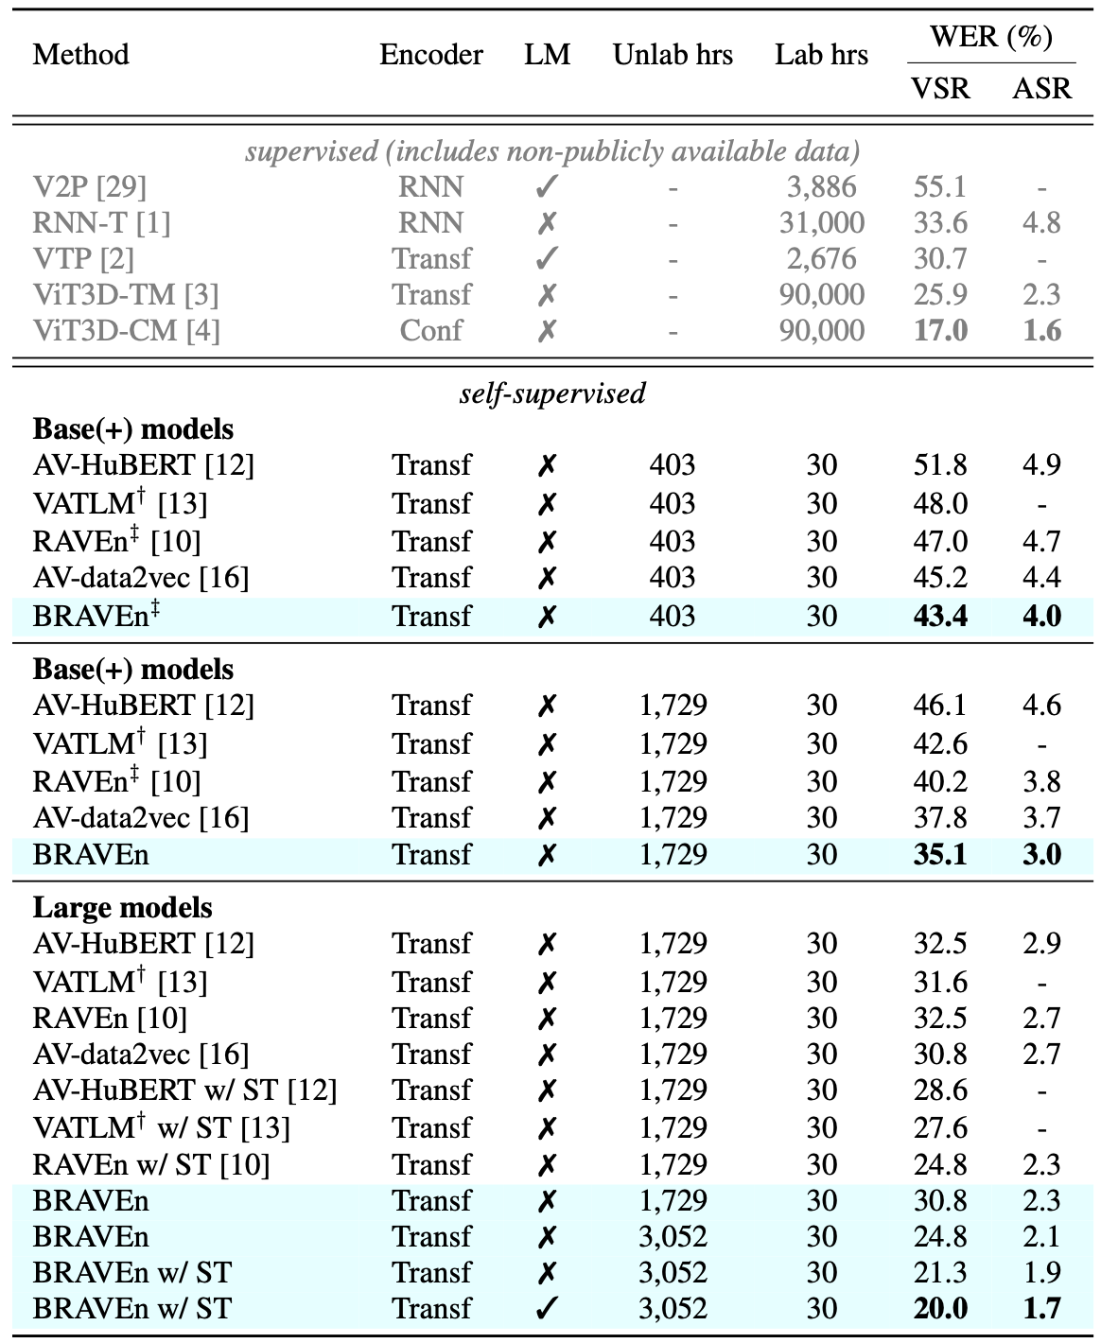
Low-resource labelled data setting
Setting
Fine-tune on only 30 hours of LRS3
Use LRS3, VoxCeleb2, and/or AVSpeech for pre-training
Use Base and Large models
BRAVEn achieves sota results in each setting
Findings
More pre-training data is important
More unlabelled data + larger models => large improvements
Self-training and language model help
Notes:
We first show word error rate (WER) results for the low-resource labelled data setting, where the networks are fine-tuned on only 30 hours of data from the LRS3 dataset. We compare with other recent audio-visual self-supervised methods and show results for supervised methods that use much more labelled hours of data for comparison.
We observe that BRAVEn achieves state-of-the-art results in each setting.

Slide 12
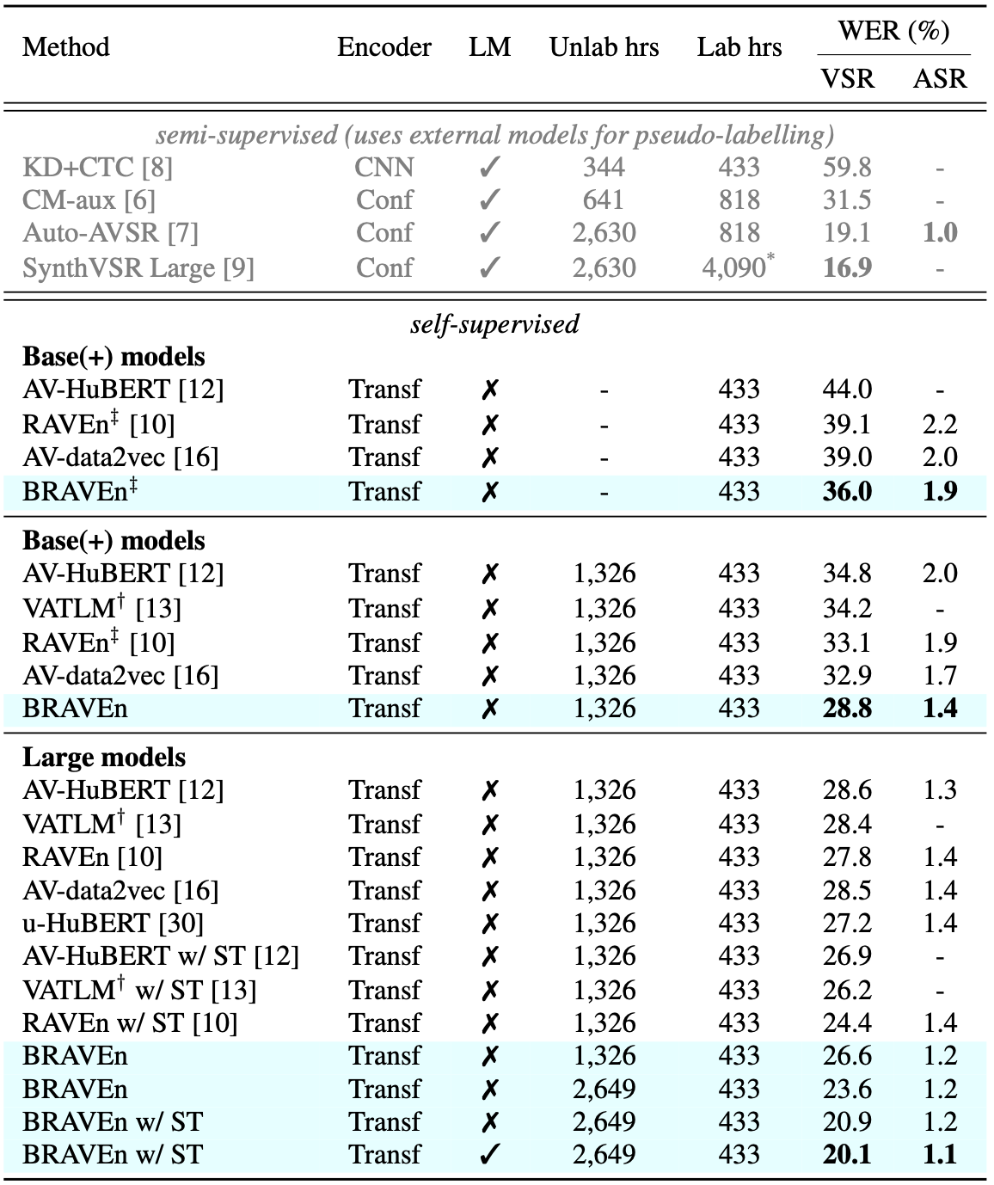
High-resource labelled data setting
Setting
Fine-tune on full LRS3 (433 hours)
BRAVEn achieves sota results in each setting
Findings
External ASR models not strictly necessary for self-training
Notes:
We also test our method in the high-resource setting, which uses the full LRS3 as the labelled data.

Slide 13
High-resource labelled data setting
High-quality transcriptions more important for ASR than VSR
Notes:
Interestingly, BRAVEn-Large coupled with self-training and a language model yields similar VSR results in both low- and high-resource settings, but better results are obtained in the high-resource setting for ASR. This suggests that high-quality transcriptions are more important for ASR than VSR.

Slide 14
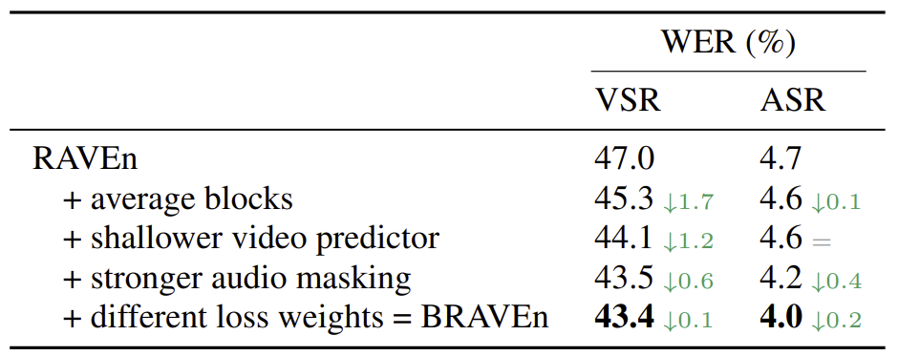
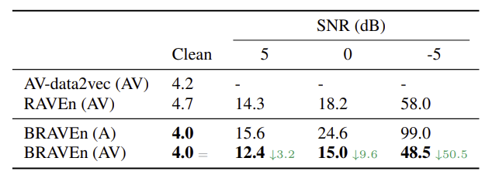
Ablations and AV results
Averaging targets / shallower video predictor better for VSR
Stronger audio masking and different loss weights better for ASR
Better than RAVEn at all noise levels
Better than AV-data2vec even with only audio modality
Notes:
Our ablation study shows the effect of each design choice on the VSR and ASR performance using the low-resource protocol and the Base model. Each new addition improves the VSR and / or ASR performance. We observe that averaging targets and using a shallower video predictor has a larger effect on VSR than ASR performance, while stronger audio masking and different loss weights have a more significant impact on ASR.
We also run results for audio-visual speech recognition using the late-fusion method proposed by Ma. We experiment with different levels of audio babble noise. It is evident that as the audio noise level increases, so does the difference in performance between the audio-only and audio-visual models. BRAVEn outperforms RAVEn at all noise levels and achieves better WER than AV-data2vec, even when BRAVEn uses only the audio modality.

Slide 15
Recap
BRAVEn’s improvements cumulatively have significant impact on WER, achieving state-of the art results
BRAVEn scales very well with amount of unlabelled data
Compelling evidence that readily accessible unlabelled audio-visual data can effectively substitute costly annotated samples, especially for VSR

