Slide 1
ESVC: Combining Adaptive Style Fusion and Multi-level Feature Disentanglement for Expressive Singing Voice Conversion
ICASSP 2024, Soul, April 16, 2024
Zeyu Yang, Minchuan Chen, Yanping Li, Wei Hu, Shaojun Wang, Jing Xiao, Zijian Li

Slide 2
Motivation

Slide 3
Background
Singing Voice Conversion (SVC)
SVC aims to convert singing voice from the source singer to the target singer with out altering the singing content.
Needs to handle a wider range of varieties in pitch, energies, expressions and singing style.
It has made great strides in both naturalness and similarity for common SVC with a neutral expression.
Most SVC systems can not effectively support emotional expression.
[1] Wen-Chin Huang et al. "The Singing Voice Conversion Challenge 2023"

Slide 4
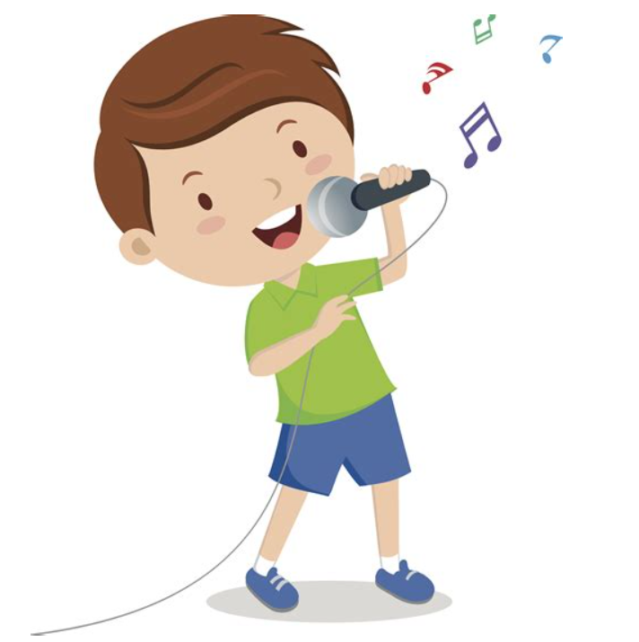
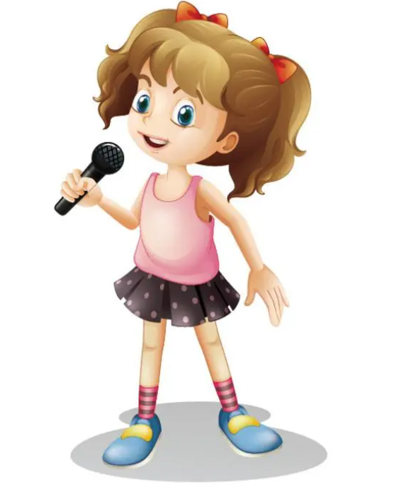
Background
mapping
Speaker identity
Emotional style
Expressive Voice Conversion
Converts input speech towards a target speaker both in terms of speaker identity and emotional style.
Differs from Emotional Voice Conversion (only converts emotional state).
Emotional Singing Voice Synthesis
Singing voice synthesis (SVS) converts texts (lyrics) into speech signals.
To express emotional types and emotional intensities.
[2] Zongyang Du et al. "Disentanglement of Emotional Style and Speaker Identity for Expressive Voice Conversion“ [3] Sungjae Kim et al. "MuSE-SVS: Multi-Singer Emotional Singing Voice Synthesizer That Controls Emotional Intensity"

Slide 5
Background
Current works
SVC systems mainly focus on conversion of the singer’s identity.
Few works pay attention to the emotional state of singing songs.
ESVC
An expressive SVC framework.
New style fusion and feature disentanglement methods are introduced to improve the fidelity and expressiveness of the converted songs.
The first SVC system to jointly convert singer identity and emotional style.

Slide 6
Framework
Model architecture
x2
x2
x2
x2
[4] https://github.com/svc-develop-team/so-vits-svc [5] Kim, Jaehyeon et al. "Conditional Variational Autoencoder with Adversarial Learning for End-to-End Text-to-Speech"

Slide 7
Framework
AdaIN ResBlock
Adaptive instance normalization (AdaIN) is an effective approach in neural style transfer.
Apply in four modules: posterior encoder, normalizing flow, F0 decoder and decoder.
Each adds two residual blocks with AdaIN.
x2
x2
x2
x2
[6] Xun Huang et al. "Arbitrary style transfer in real-time with adaptive instance normalization"

Slide 8
Training Strategy
Mutual Information Loss
To reduce the correlations among the content, F0, and expressive features.
Use variational contrastive log-ratio upper bound (vCLUB) to measure the MI, defined as where X,Y ∈ {x_{c}, g, f0}.
The total MI loss:
-x_{c} content representation
-g expressive representation
-f0 F0 representation
[7] Pengyu Cheng et al. "CLUB: A Contrastive Log-ratio Upper Bound of Mutual Information"

Slide 9
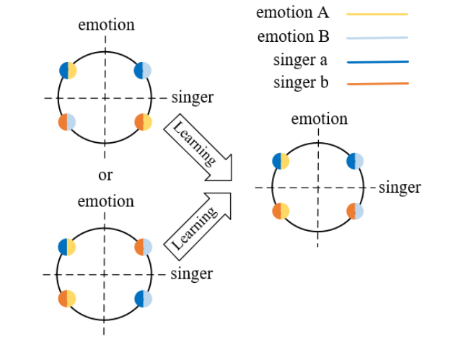
Training Strategy
Adversarial Triplet Loss
To decouple singer identity and emotional style adversarially in the same expressive space.
Use triplet loss as the guidance of clustering
Emotion-guided triplet loss
Singer-guided triplet loss
The training will be ended with a balance
between emotion and identity elements.

Slide 10
Training Strategy
Emotion-guided triplet loss & Singer-guided triplet loss
x2
x2
x2
x2

Slide 11
Setup

Slide 12
Training Setup
2 Nvidia Tesla V100
Singing datasets
Opencpop (pre-training): a female singer, 100 Mandarin songs
OpenSinger (evaluation): Chinese traditional and pop songs
Speech dataset
ESD (fine-tune): three emotions (neutral, happy, sad), two speakers (one male, one female)
✗ In-domain SVC - lack of emotional singing corpus
Cross-domain SVC - this work
[7] Kun Zhou et al. "Emotional voice conversion: Theory, databases and ESD"

Slide 13
Baseline and models for comparison
Baseline model
so-vits-svc
Compared models
so-vits-svc-AdaIN
so-vits-svc-AdaIN-MI
ESVC (w/ L_{emo} and w/o L_{sin})
ESVC (w/ L_{emo} and w/ L_{sin})

Slide 14
Results

Slide 15
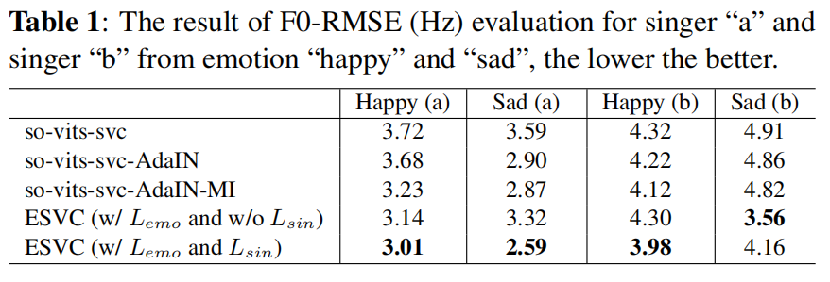
Evaluation
Objective Evaluation

Slide 16
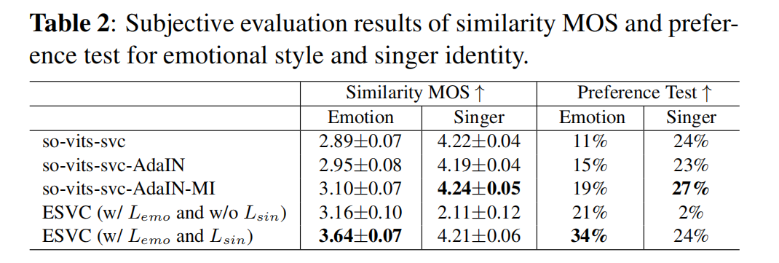
Evaluation
Subjective Evaluation

Slide 17
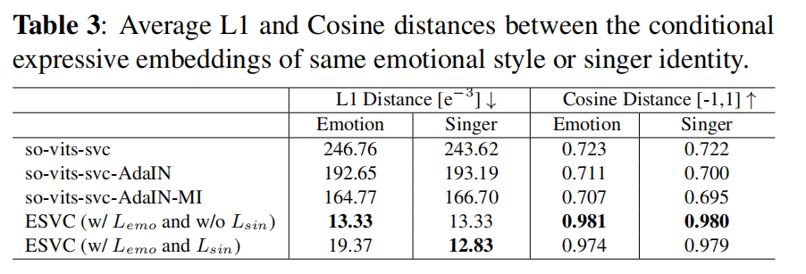
Ablation Study
Evaluate the effectiveness of adversarial triplet loss in feature decoupling

Slide 18
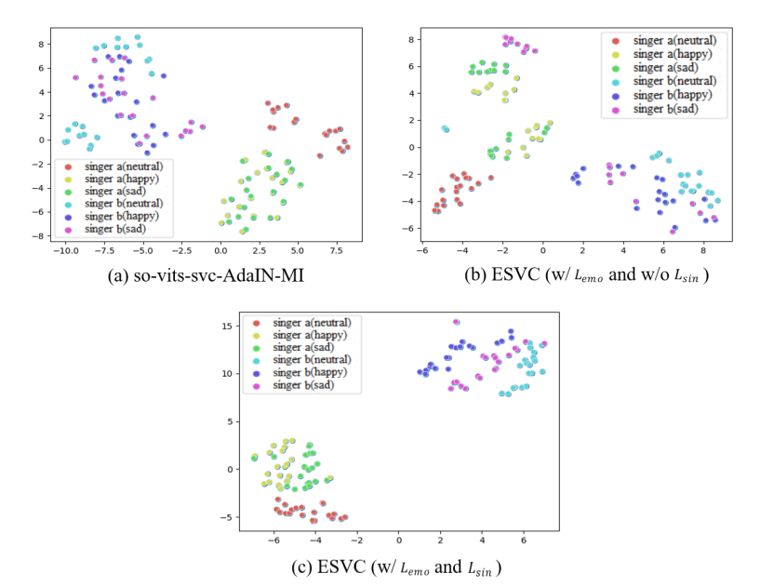
Ablation Study
Visualization of deep expressive features of the converted songs
Select 20 converted samples for each singer and each emotion
2 singers (female, male)
3 emotions (neutral, happy, sad)

Slide 19
Demo
Audio generated by ESVC (w/ L_{emo} and w/ L_{sin})
 | Source | Target | Converted
Neutral
Happy
Sad

Slide 20
Demo
Comparison of the baseline and ESVC models
 | Source | Target | so-vits-svc | ESVC (w/ L_{emo} and L_{sin})
Male (Happy)
Male (Sad)
Female (Happy)
Female (Sad)

Slide 21
Thank you !
More samples can be found at
https://99sunny.github.io

