Slide 1
Time-Domain Audio-Visual Speech Separation On Low Quality Videos
Yifei Wu¹, Chenda Li¹, Jinfeng Bai², Zhongqin Wu², Yanmin Qian¹
¹MoE Key Lab of Artificial Intelligence, AI Institute
X-LANCE Lab, Department of Computer Science and Engineering
Shanghai Jiao Tong University, Shanghai, China
²TAL Education Group, China

Slide 2
Introduction
Task definition
Speech separation procedure
Speech
Separation
System

Slide 3
Introduction
Task definition
Audio-visual speech separation procedure
Audio-Visual Speech Separation System

Slide 4
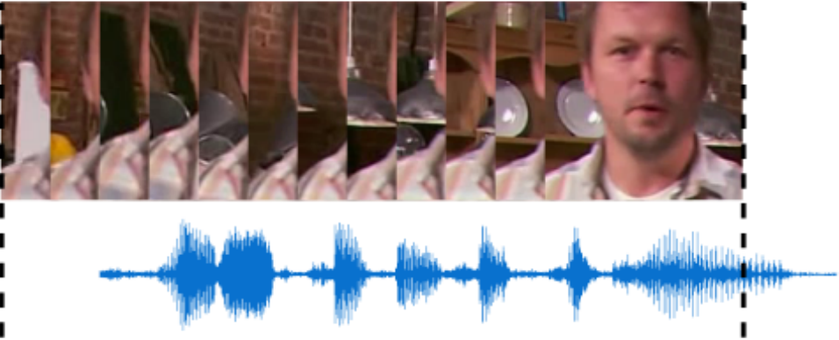
Introduction
Task definition
Low quality videos
(a) Low Resolution
(b) Lip Concealment
(c) Out of sync

Slide 5
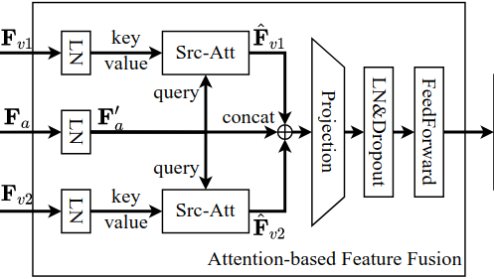
Method
Model architecture
Backbone: Conv-TasNet
Visual feature extractor: pretrained TCN
Audio-visual feature fusion: Query Vision
with local attention
Attention-based
Feature Fusion Module

Slide 6
Method
Data augmentation
Low resolution
Down-sample and up-sample each video frame using nearest neighbor interpolating algorithm.
Lip concealment
Conceal the lip region in some consecutive frames by a uniform noise square.
Use emoji in testing.
Random audio-video offset
Advance or delay the visual features by several frames.

Slide 7
Method
Loss function
Scale-invariant signal-to-noise ratio (SI-SNR)
Permutation is assigned according to the visual input order
$$ℒ\left({\hat{y}}_{1},{\hat{y}}_{2},y_{1},y_{2}\right)=\frac{1}{2}(\text{SI}\text{−}\text{SNR}\left({\hat{y}}_{1},y_{1}\right)+\text{SI}\text{−}\text{SNR}({\hat{y}}_{2},y_{2}))$$
${\hat{y}}_{1},{\hat{y}}_{2}$: Predicted waveform of each speaker
$y_{1},y_{2}$: Ground truth waveform of each speaker

Slide 8
Experimental Setup
Dataset
LRS2
Mixtures are generated with SNR in [-10,10] dB
Data augmentation
Low resolution: 80x80, 40x40, 20x20
Lip concealment: 25%, 50%, 75% of duration
Random offset: maximum 5 frames
Low quality test sets
LR10: 10x10 low resolution
LE75: 75% of duration is patched with an emoji
RO10: maximum 10 frames

Slide 9
Results
$Q$: Number of augmented input visual streams.
Baseline: Replace the AV feature fusion module with an concat-and-conv layer.
Each column contains SDRs evaluated with one/two low quality visual streams, if any.

Slide 10
Conclusions
Explore the attention-based multi-modal fusion method to build a robust time-domain audio-visual speech separation system.
To force the model to adapt to the low quality video inputs, 3 types of data augmentation are introduced.
The proposed system outperforms the concatenation-based baseline on all the 3 types of low quality video inputs, and is robust to low quality training dataset.

