Slide 1
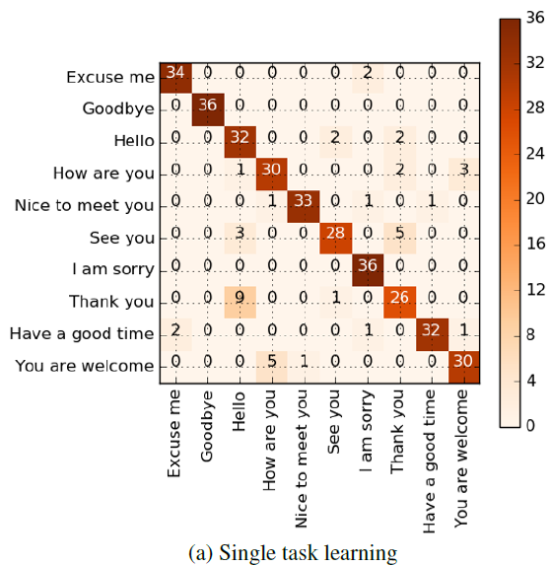
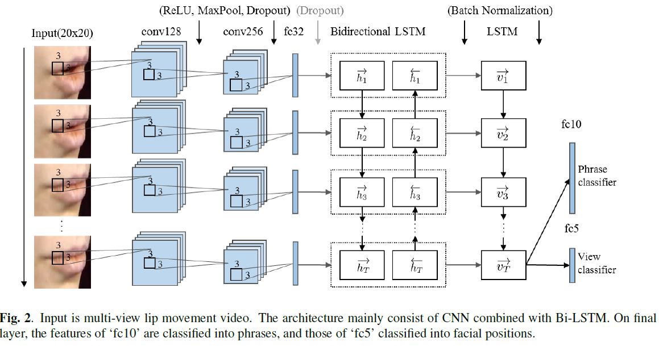
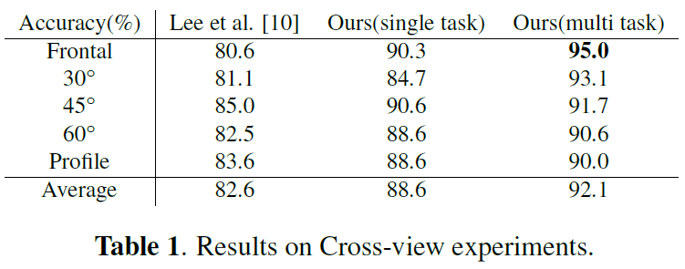
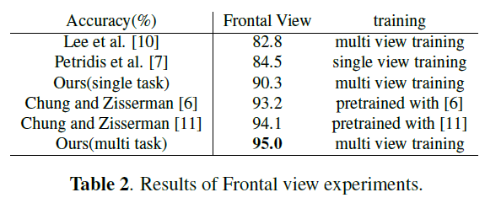
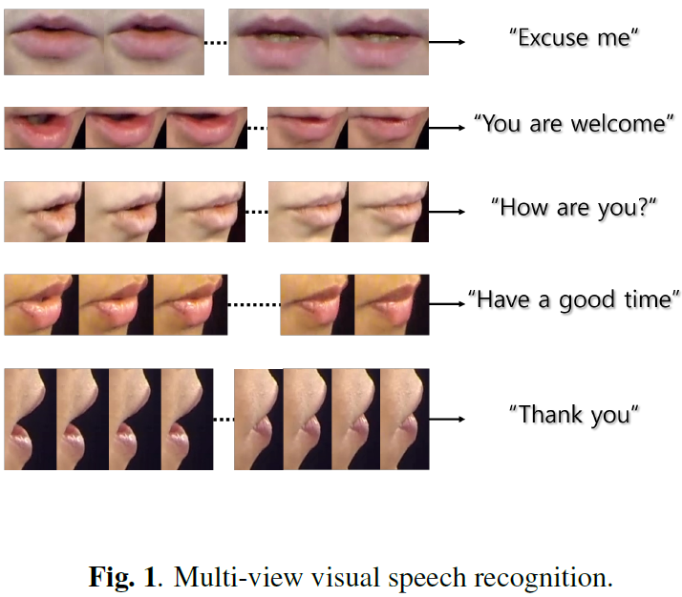
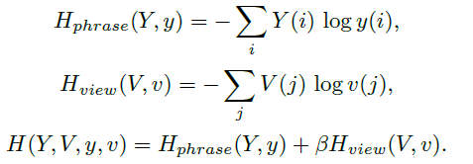
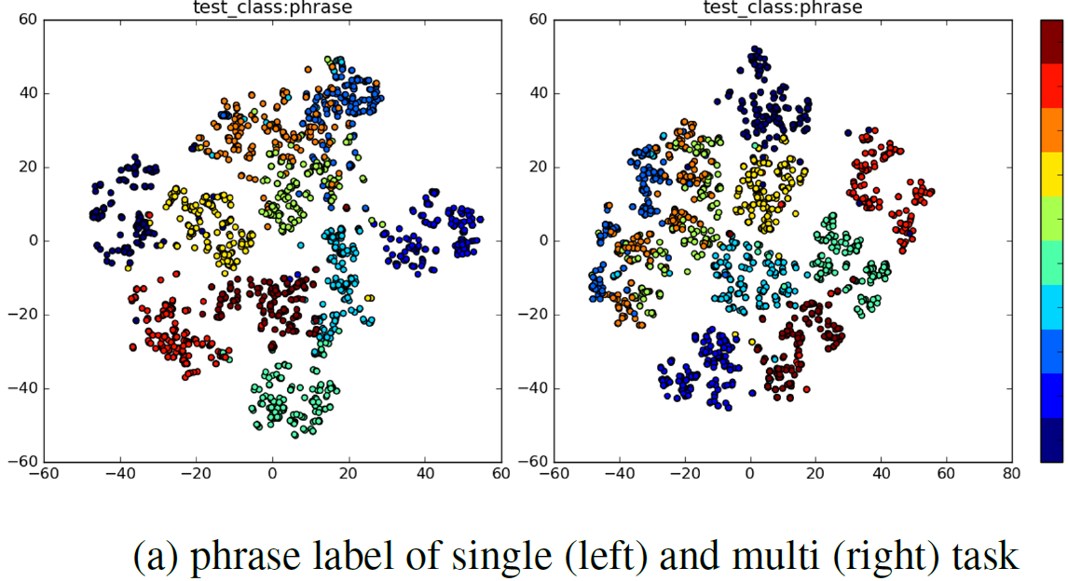
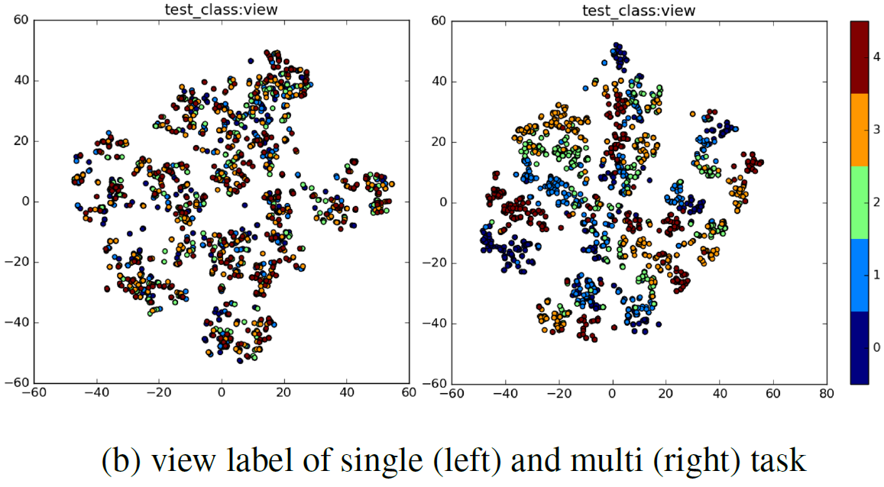
MULTI-VIEW VISUAL SPEECH RECOGNITION BASED ON MULTI TASK LEARNING HouJeung Han, Sunghun Kang and Chang D. Yoo Dept. of Electrical Engineering, KAIST, Republic of Korea
Abstract
Proposed Framework
Result
This paper proposes a pose-invariant network which can recognize words spoken from any arbitrary view input.
The architecture that combines CNN with bidirectional LSTM is trained in a multi-task manner such that the pose and the word spoken are jointly classified where pose classification is considered as the auxiliary task.
This deep model achieved recognition performance of 95.0% accuracy on OuluVS2 dataset.
Confusion matrix of multi-view training with single task and multi task.
Vertical axis is ground-truth labels and horizontal axis is predicted labels
Introduction
Accuracy of all views and comparison on frontal views with previous work.
Until now, most VSR studies has focused on the frontal view, which may be impractical.
In this paper, we present a model that can recognize visual speech from any arbitrary point of view
To enhance lip reading, we present a learning method that jointly learns the position of the face and the words spoken.
the model also auxiliarily trains with facial position labels.
We believe subsidiary view information can assist better phrase recognition by positioning features of the same class more precisely according to position.
Multi task classification
t-SNE plot of multi-view training with single task and multi task in test phase.
The final loss function ${H(Y,V,y,v)}_{}^{}$ is weighted sum of cross-entropy loss of phrase classification $H_{phrase}^{}(Y,y)$ and view classification $H_{view}^{}(V,v)$, where $Y,V$ are ground truth vector of phrase and view, $y,v$ are predicted probability of phrase and view, and tribute.
Experiments
References
Dataset: OuluVS2[12]
- 52 speakers saying 10 categories of utterances, 3 times each
Simultaneously recorded on five different views: {0, 30, 45, 60, 90} degree.
The mouth region of interests (ROIs) are provided and they are downscaled to 26 by 44 in order to keep the aspect ratio constant.
[6] JS Chung and A Zisserman, “Lip reading in the wild,” in Asian Conference on Computer Vision, 2016.
[7] Stavros Petridis, Zuwei Li, and Maja Pantic, “End-toend visual speech recognition with lstms,”
[10] Daehyun Lee, Jongmin Lee, and Kee-Eung Kim, “Multi-view automatic lip-reading using neural network,”in ACCV 2016 Workshop on Multi-view Lipreading Challenges. Asian Conference on Computer Vision (ACCV), 2016.
[11] Joon Son Chung and Andrew Zisserman, “Out of time: automated lip sync in the wild,” in Workshop on Multiview
Lip-reading, ACCV, 2016.
[12] Iryna Anina, Ziheng Zhou, Guoying Zhao, and Matti Pietik¨ainen, “Ouluvs2: A multi-view audiovisual
database for non-rigid mouth motion analysis,” in Automatic Face and Gesture Recognition (FG), 2015
11th IEEE International Conference and Workshops on. IEEE, 2015, vol. 1, pp. 1–5.

