Slide 1
JQF: Optimal JPEG Quantization Table Fusion by Simulated Annealing on Texture Images and Predicting Textures
Chen-Hsiu Huang and Ja-Ling Wu
Dept. CSIE, CMLab, DSP Group
National Taiwan University
2021 Data Compression Conference
Notes:
Hi, I’m Chen-hsiu Huang from National Taiwan University. Today’s we’re going to present our work - JQF: Optimal JPEG Quantization Table Fusion by Simulated Annealing on Texture Images and Predicting Textures. So let’s start our presentation.

Slide 2
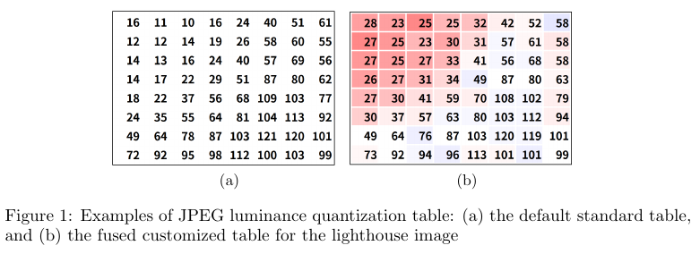
Agenda
Motivation
Proposed JQF Framework
Texture training and mosaic image annealing flow
Texture prediction and quantization table fusion flow
Experimental Results
Conclusion
Notes:
Here is our agenda. First we will talk about our research motivation. Then our proposed JQF framework for training, predicting textures, then fusing an optimized quantization table for JPEG images.
As follows, we provide experimental results and conclusion.
As you can see from the figure 1, left hand side is JPEG default table and right hand side is optimized table. We mark the increased values in red and blue for decreases.

Slide 3
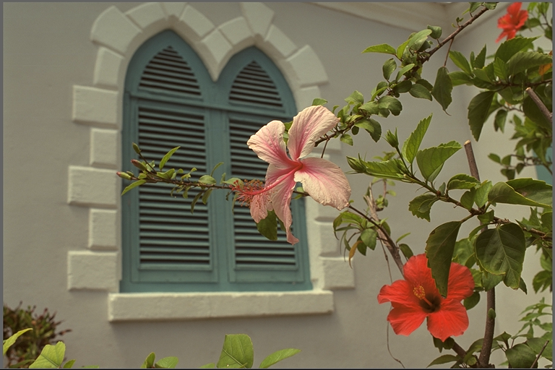
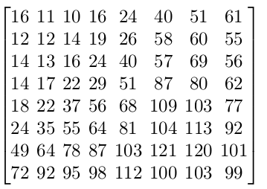
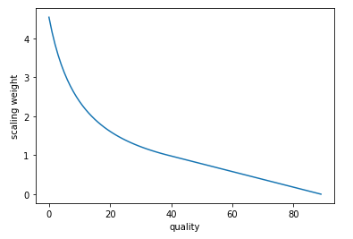
The JPEG Coding Flow
DCT
Quantize
Entropy encode
bitstream
Entropy decode
de-Quantize
IDCT
Quality scaling factor
X
Notes:
The JPEG coding flow uses DCT to transform image blocks to 8x8 DCT coefficients, then a 8x8 quantization table is used to quantize coefficients for entropy coding. JPEG uses quality metric Q to control the bitrate and distortion with the formula listed below, to calculate the quality scaling factor. Then the default quantization table will multiply the scaling factor elementwise to form a targeting quantization table at Q.

Slide 4
Motivation
It’s challenging to find an optimal JPEG quantization table due to the numerous solution space and lack of reliable quality measurement that accurately model the HVS
We try to solve the dilemma of balancing between computational cost [12] and image specific optimality [11] by introducing a new concept of texture mosaic images
[11] Hopkins, Max, Mitzenmacher, Michael, Wagner-Carena, Sebastian: Simulated annealing for jpeg quantization , arXiv preprint arXiv:1709.00649 , 2017
[12] Alakuijala, Jyrki, Obryk, Robert, Stoliarchuk, Ostap, Szabadka, Zoltan, Vandevenne, Lode, Wassenberg, Jan: Guetzli: Perceptually guided jpeg encoder , arXiv preprint arXiv:1703.04421 , 2017
Notes:
Here is our motivation. ... Comparing to the prior arts.

Slide 5
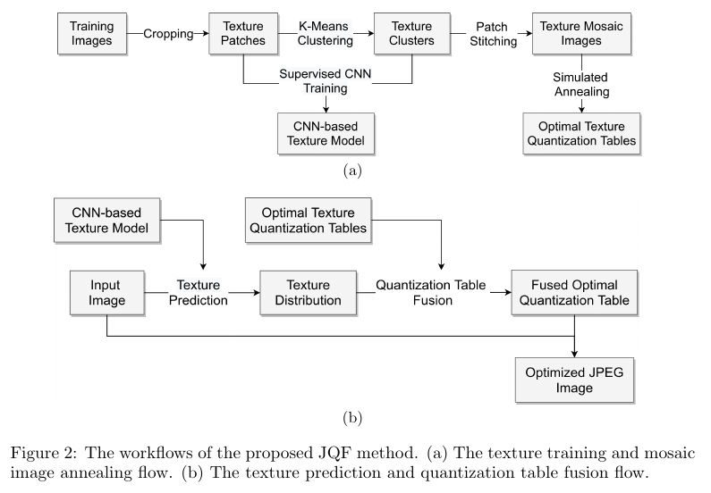
Proposed Framework
Notes:
Our framework has two workflows, The first one is, the texture training and annealing flow. The input image is cropped into texture patches, using K-means algorithm to cluster into different categories. With the texture labels we use CNN to train a texture classification model with supervised learning. The texture patches of the same category are stitched into a texture mosaic image. We apply simulated annealing on the texture mosaic image for optimization. The second flow is for texture prediction and quantization table fusion. Given an input image, we use the CNN-based texture model to predict its texture distribution, then the optimal texture tables are fused to a final optimized table. At last, we encode an JPEG image with the image specific quantization table.

Slide 6
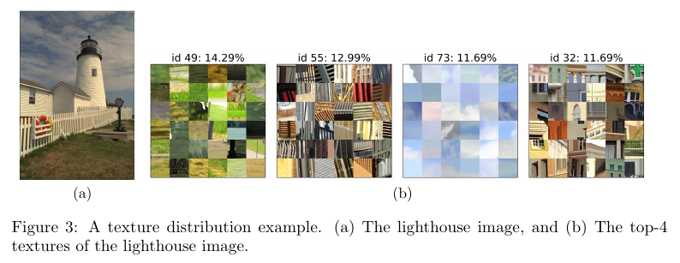
Texture Clustering, Training, and Prediction
We crop the training images into 64x64 patches and use the VGG-16 pre-trained network to extract the bottleneck features from texture patches
The K-Means algorithm is used to cluster textures into 100 categories on the RAISE dataset. Then we use the clustered label to train a CNN-based texture classification network, resulting in top-3 testing accuracy around 99.77%.
For prediction, we crop the input image into 64x64 patches, then execute the forward pass to obtain each patch's texture id, forming a texture distribution of the input image
Notes:
In details, we crop the training images into 64x64 patches and use the VGG-16 pre-trained model to extract the bottleneck features. We use K-Means algorithm to cluster textures into 100 categories on the RAISE dataset. After training, the top-3 accuracy exceeds 99%. For prediction, we crop the input image into same size and execute the forward pass to obtain the texture distribution. Figure 3 shows the top-4 texture distribution of the lighthouse image.

Slide 7
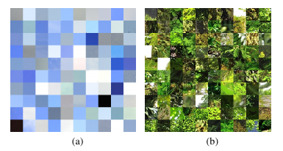
Annealing on Texture Mosaic Images
The cropped image patches are stitched into texture mosaic images
It's unrealistic to enumerate the whole table space for an optimal solution and likely to be trapped in local minimum
We use simulated annealing to optimize the JPEG default luminance quantization table on the texture mosaic images with quality target Q=50 and 95
We anneal 2000 iterations on each texture mosaic image to obtain the optimized texture quantization table*
Finally we fuse textual quantization tables with weighted average based on texture distribution
* See detailed annealing process at the full text: https://arxiv.org/abs/2008.05672
Notes:
Because It's unrealistic to enumerate the whole table space for optimization and it’s likely to be trapped in a local minimum
We use simulated annealing to optimize the JPEG default luminance table with quality Q=50 and 95. We anneal 2000 iterations on each texture mosaic image. The annealing method and parameters are detailed discussed in our full paper listed below. Finally we fuse textual quantization tables with weighted average based on the texture distribution.

Slide 8
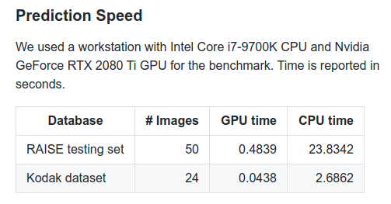
Experimental Results
* Our code for quantization table fusion is available at: https://github.com/chenhsiu48/JQF
Notes:
For experiments, we collect training images from the RAISE dataset and validate on the testing set, then cross-validate on the Kodak dataset. Compared to the prior simulated annealing work, our texture-based approach better fits each individual image and further reduces the compressed size by 8% but increases all the quality metrics. Compared to the JPEG standard, our method has a significant size reduction of 25%, which decreases the perceptual quality FSIM slightly but visually indistinguishable. The prediction speed on a high resolution image is less than one second if GPU is used. We provide our code for quantization table fusion on github.

Slide 9
Conclusion
We propose a novel JPEG Quantization Table Fusion method using simulated annealing on texture mosaic images to search for an optimal quantization table for each texture category.
A VGG-16 pre-trained CNN model is used to learn those texture features and predict the input image's texture distribution, then fuse optimal texture tables to come out an image specific optimal quantization table.
Our method shows superior performance on a larger consumer photo dataset and generalizes well on cross-database evaluation. Our experiment shows a size reduction of 23.5% over the JPEG standard table with a slightly FSIM decrease but visually unperceivable.
The per-image optimality for JPEG encoding is achieved with less than one second additional timing cost.
Notes:
In conclusion, we proposed a novel JPEG Quantization Table Fusion method using simulated annealing on texture mosaic images. The texture-based prediction-then-fusion method can balance the computational cost and image specific optimality to further optimize the JPEG image with imperceivable visual degradation. The per-image optimality for JPEG encoding is achieved with less than one second additional timing cost.

