Slide 1
ICASSP conference 2024
Deep convolution network based super resolution DOA estimation with Toeplitz and sparse prior
Speaker ：Chenkang Duan
School：Faculty of Electrical Engineering and Computer Science,
Ningbo University, Ningbo, China
April 16, 2024 Seoul, Korea

Slide 2
行业PPT模板http://www.1ppt.com/hangye/
CONTENT
1
Background
2
Methodology
2
3
Results
3
3
4
Conclusions
4
4

Slide 3
Part 01
Background

Slide 4
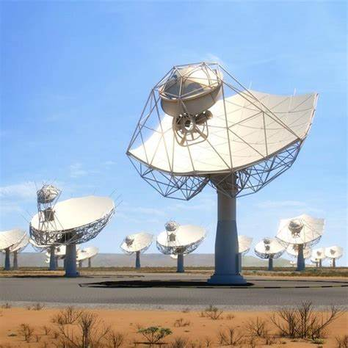
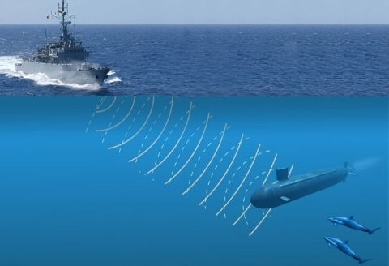
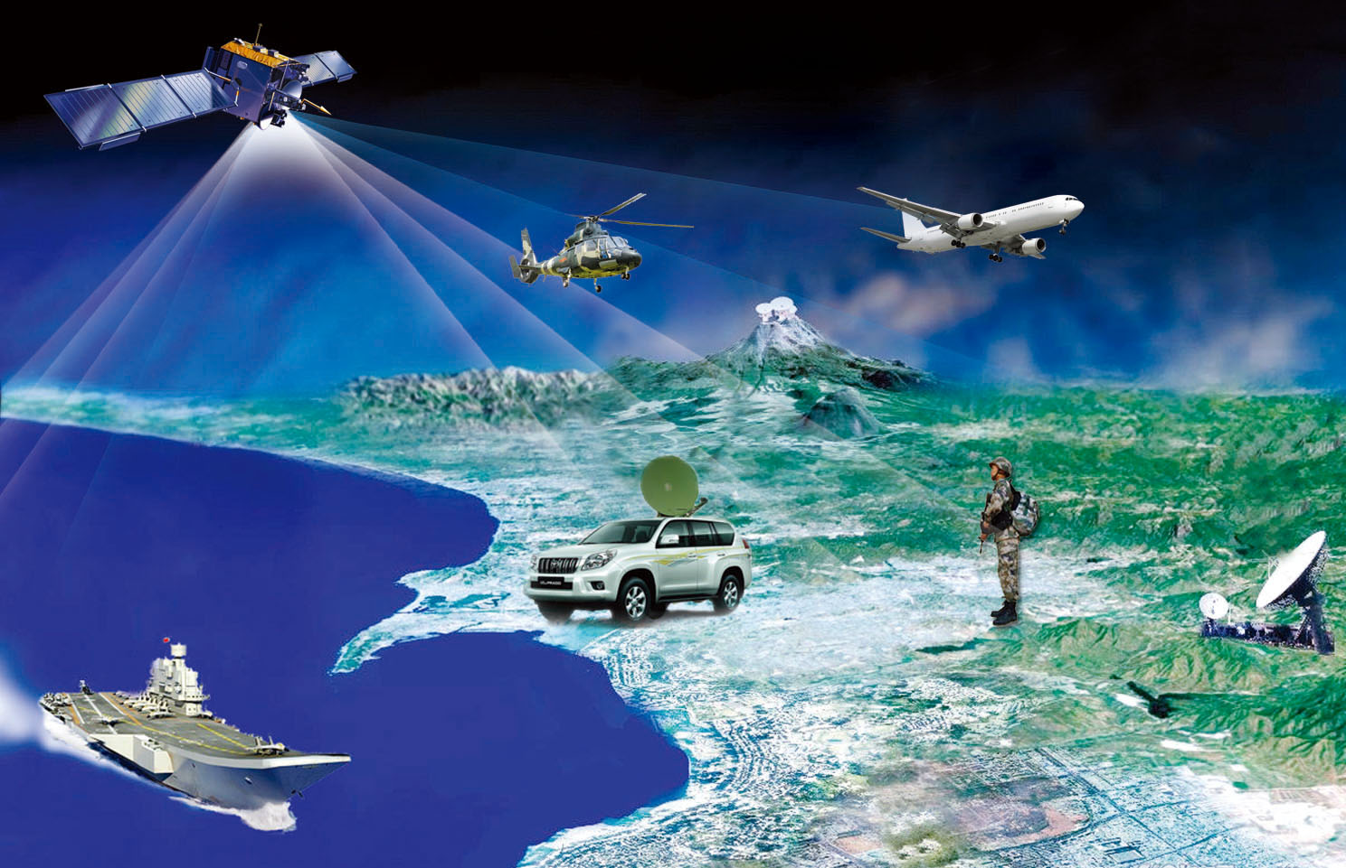
Background
Direction-of-arrival (DOA) estimation is crucial in radar, sonar and communication systems. Through DOA estimation, we can determine the location of the signal source, thus realize positioning, tracking, separation.
Most modern related systems are equipped with large arrays, and excessive sample numbers will lead to a high computational complexity, exacerbating the challenge of practical applications in small data samples.

Slide 5
Background
In recent years, deep learning has emerged as a powerful tool, helping to solve a variety of complex tasks in different domains. It provided a novel approach of end-to-end learning to achieve DOA estimation.
Extensive research has indicated that deep learning models can effectively adjust to complex environments and in noisy conditions, providing them with a competitive advantage in processing real-world signals.

Slide 6
Part 02
Methodology

Slide 7
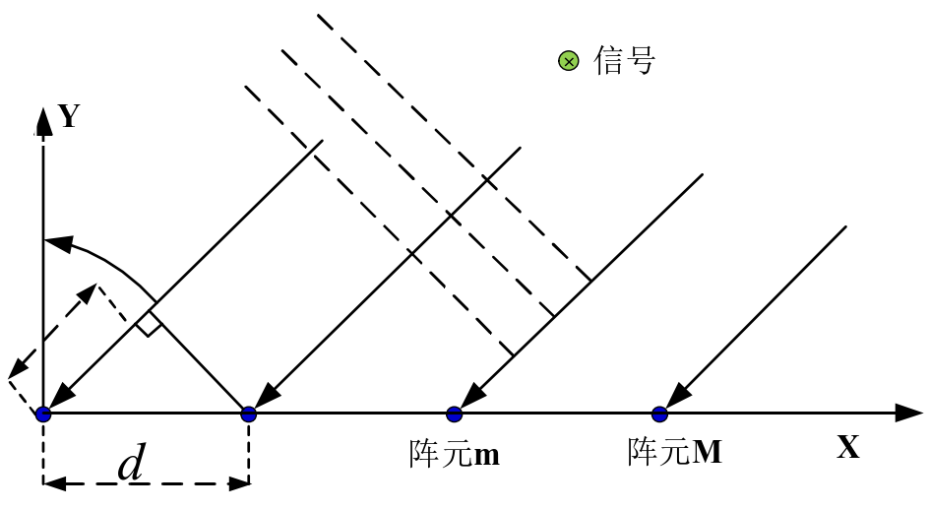
SIGNAL MODEL
Suppose that K narrow-band uncorrelated far-field source signals incident on an M-element uniform linear array (ULA). The received signal vector by the arrays at time index t is
Signal
θ
m-array
M-array
NOTE:
θ ······ Signal direction
The ideal covariance is a Toeplitz matrix:
λ ······ Carrier wavelength
N ······ Sample number
The samples is limited in practice，we can only obtain sample covariance matrix (SCM)
P ······ Signal power
σ² ······ Noise power

Slide 8
PROPOSED METHOD
1. SCM Enhancement With Toeplitz Prior
According to the Toeplitz properties of the ideal matrix, the SCM can be modified by using linear shrinkage technique, which is proved more suitable for large arrays with small samples. By solving the following optimization:
is the Toeplitz matrix obtained after averaging the SCM diagonals，α is shrinkage coefficient.
Let the derivative of α be zero，we have
2. Data Representation With Sparse Prior
First, the enhanced SCM can is vectorized
where is the overcomplete basis matrix, and , and
is a discrete L-dimensional sparse vector with only K elements as one.
Finally，the following vectors serve as inputs to the neural network:

Slide 9
PROPOSED METHOD
3. Deep Convolution Network (DCN)
Network structure
The function of the neural network is to restore sparse spectrum to achieve DOA estimation. The network structure consists of five layers and each layer using Convolution 1D, followed by a BatchNorm layer and non-linear activation layer ReLU.
Next, We generate large datasets using different combinations of the two sources at different signal-to-noise ratios (SNRs) to train and test the network, using the Adam optimizer and the mean squared error (MSE) loss function.
Input
Layer1
Layer2
Conv 1D
BatchNorm
···
ReLU
Layer5
Output
(DOA spectrum)

Slide 10
PROPOSED METHOD
4. Algorithm Step

Slide 11
Part 03
Results

Slide 12
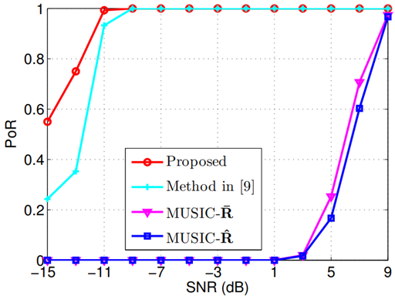
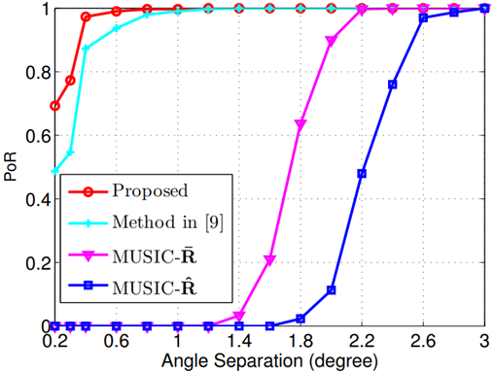
Result (PoR)
Experiment 1
The first experiment is to compare the probability of resolution (PoR) of different methods through 300 independent Monte-Carlo experiments, which is defined as
M = 40 , N = 70 and 1° angle separation
The experiment considers a narrow beamwidth (-6º~6º), and the grid is divided into 0.1º. Method in [9] is a deep learning method based on sparse prior.
Simulation results show that the deep learning method has much higher resolution than MUSIC at low angle separation and SNR, and proposed method exhibits a better resolution.
M = 40, N = 70 and SNR = - 8.5 dB

Slide 13
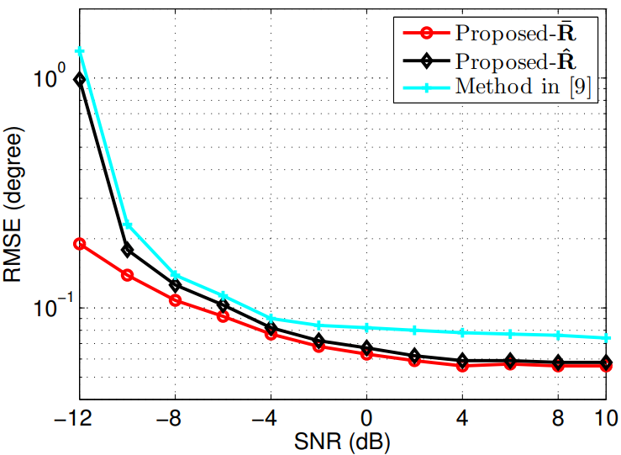
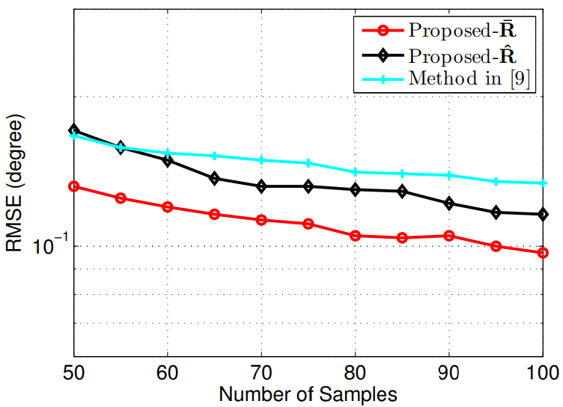
Result (RMSE)
Experiment 2
The second experiment is to compare the root mean square error (RMSE) of different methods through 300 independent Monte-Carlo experiments, which is defined as
M = 40 and N = 70, [ θ₁，θ₂ ] = [-3.33°, -2.57°]
In this configuration, MUSIC can not distinguish between the two signals, so we only consider deep learning methods.
Simulation results show that the enhanced SCM has better performance than SCM under low SNR and small data samples.
M = 40 and SNR = - 8.5 dB， [ θ₁，θ₂ ] = [-3.33°, -2.57°]

Slide 14
Part 04
Conclusions

Slide 15
Conclusions
First, the deep learning method provided a higher resolution than traditional DOA estimation algorithms.
Second, Simulation results show that the proposed enhanced SCM solution can generate an increased resolution and estimation accuracy under the scenarios of large arrays with small data samples. Moreover, the proposed method is shown to be more beneficial for low SNR ranges and can be expanded to solve more difficult problems in the filed.

Slide 16
THANK YOU

