Slide 1
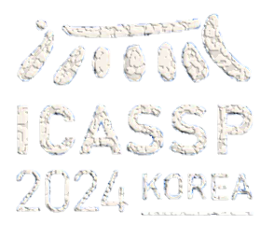
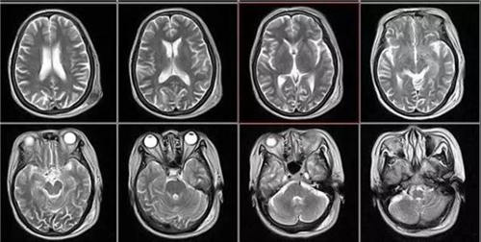
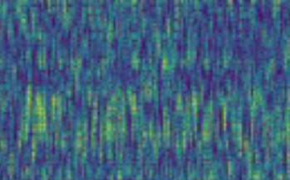
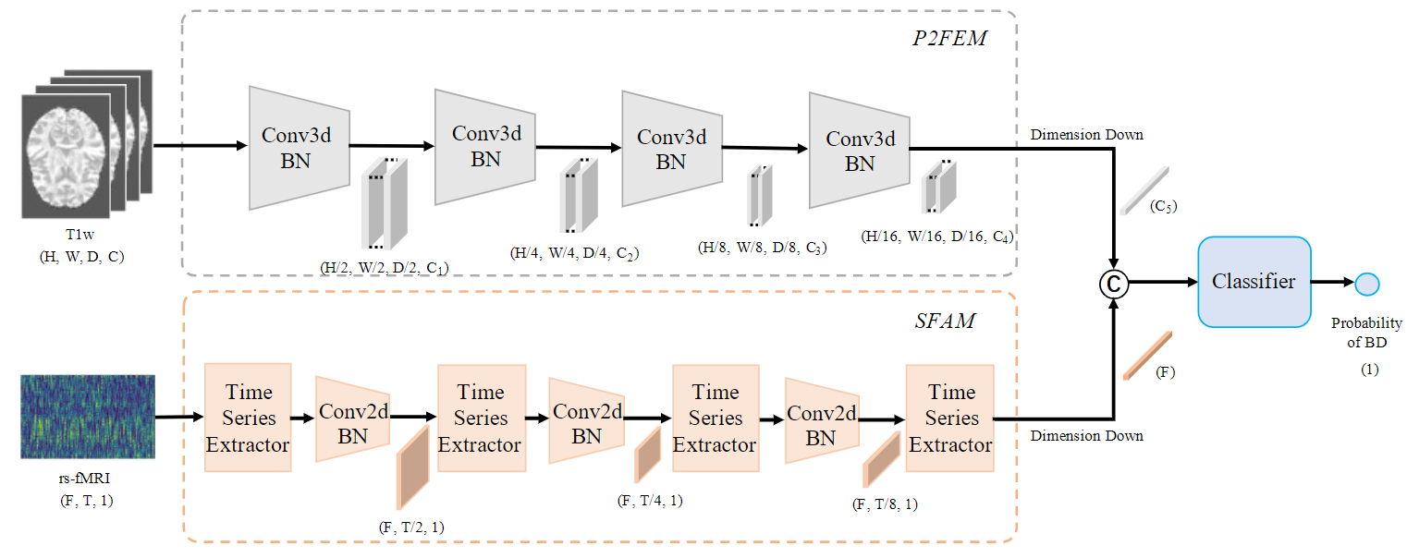
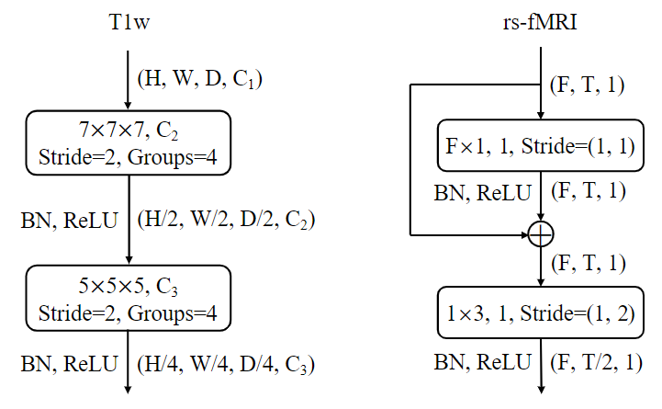
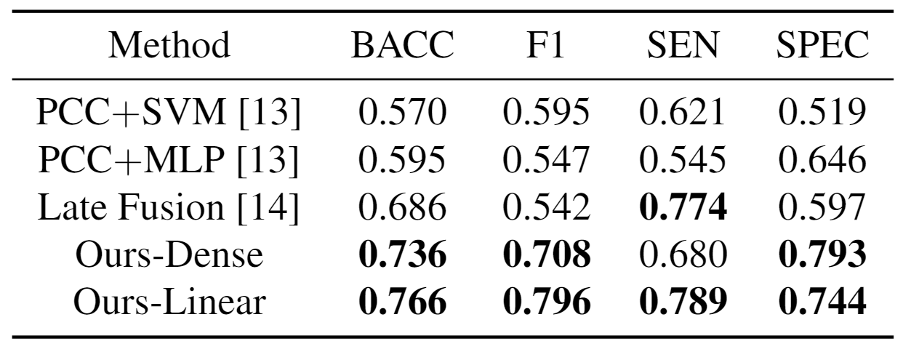
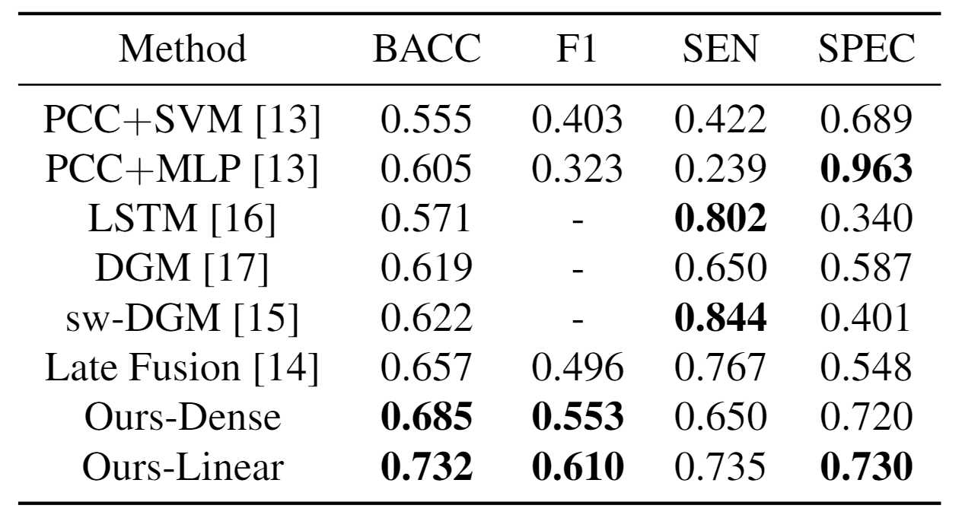
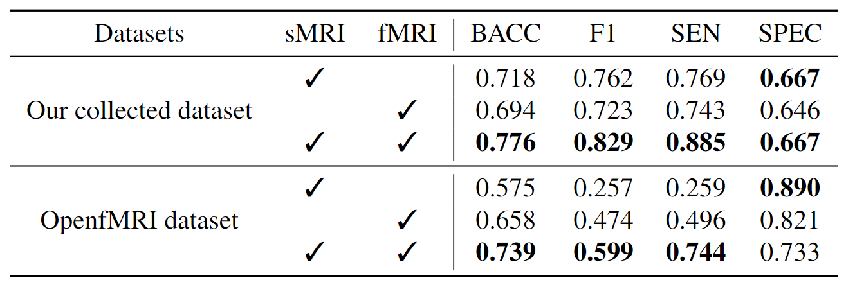
A BI-PYRAMID MULTIMODAL FUSION METHOD FOR THE DIAGNOSIS OF BIPOLAR DISORDERS
Guoxin Wang, Sheng Shi, Shan An, Fengmei Fan, Wenshu Ge, Qi Wang, Feng Yu, Zhiren Wang
Introduction
Bi-Pyramid Multimodal Fusion Method
Probability
of BD
Bipolar disorder (BD) is a severe mood disorder
We introduce a multimodal diagnostic mode. The proposed P2FEM extracts sMRI features, and the SFAM extracts fMRI features.
fMRI and sMRI technologies provide more accurate diagnosis.
The Bi-Pyramid Multimodal Fusion Method (a) with P2FEM (b) and SFAM (c)
(a)
(b)
(c)
Experiments
The results on our collected dataset.
The results on the public dataset OpenfMRI.
Ablation study
Conclusions
We propose a novel bi-pyramid multimodal fusion algorithm (BPM-Fusion) to provide a new perspective on disease diagnosis. The model takes sMRI and fMRI data as inputs. Extensive experiments show that our proposed method outperforms others in balanced accuracy from 0.657 to 0.732 on the OpenfMRI dataset, and achieves the state of the art

