Slide 1
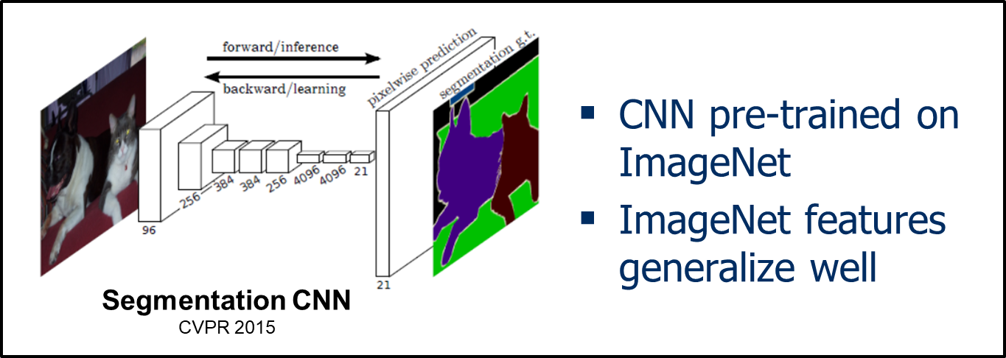
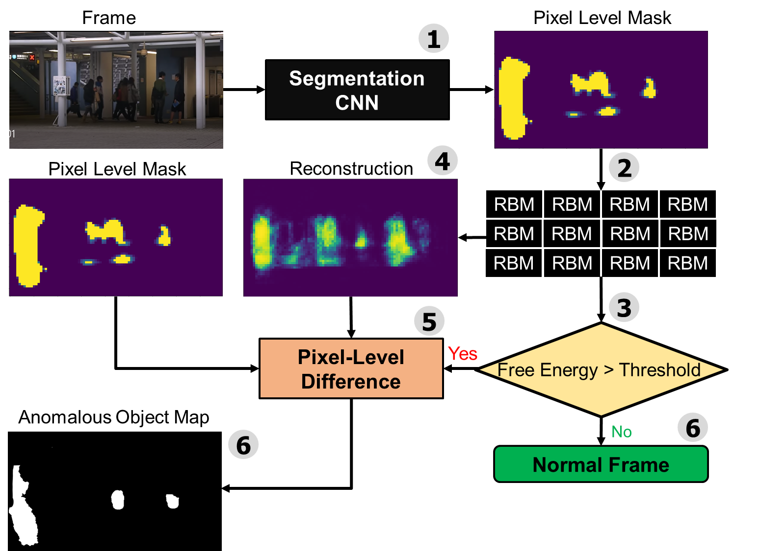
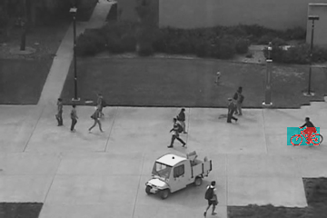
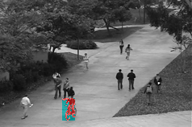
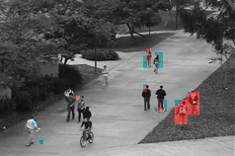
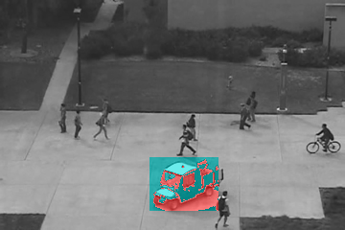
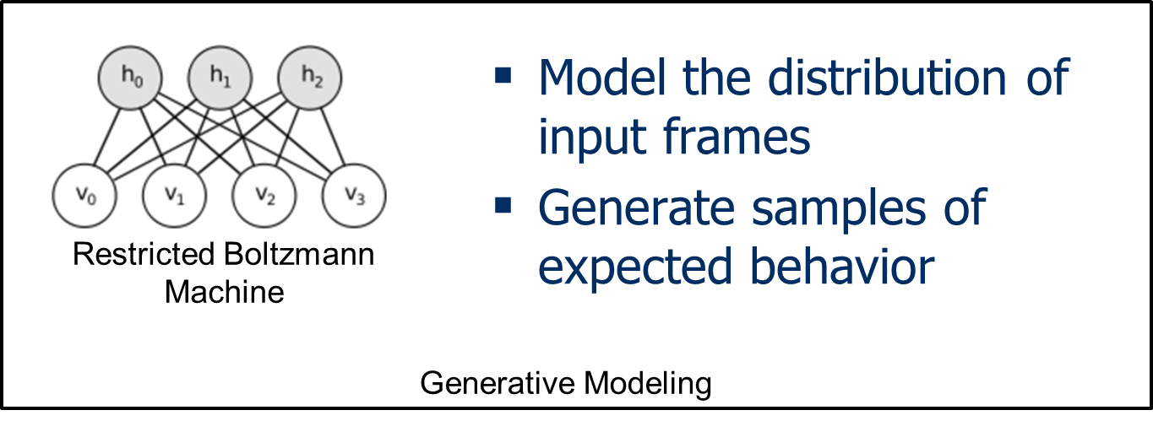
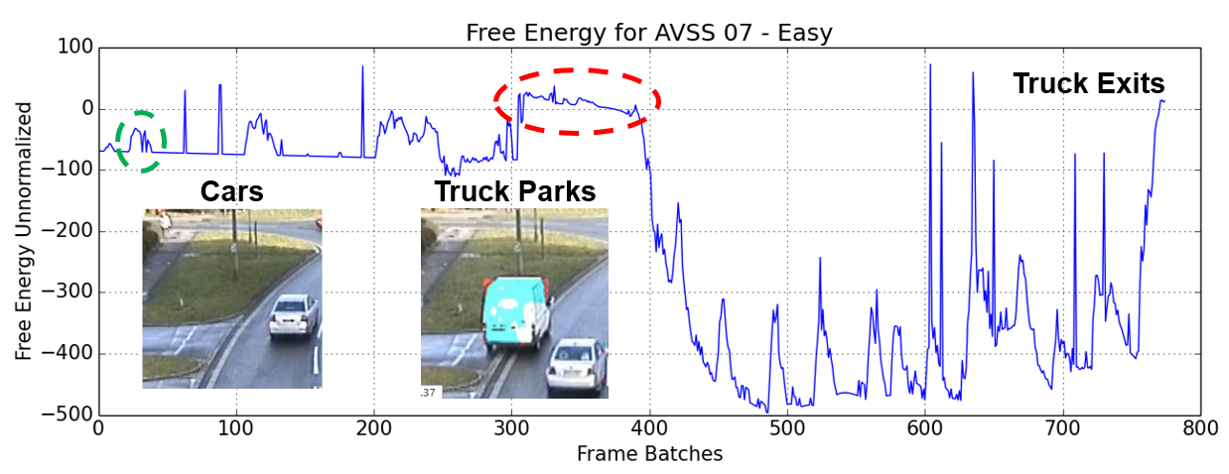
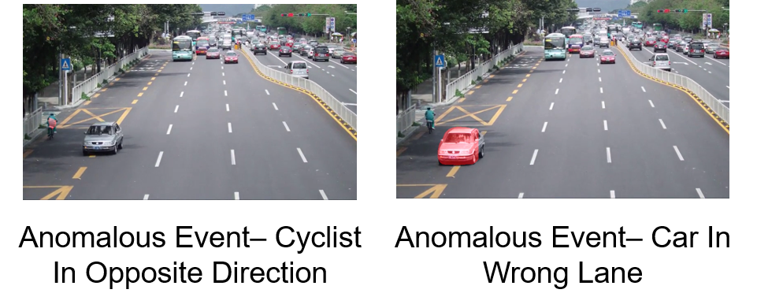
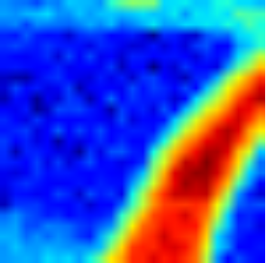
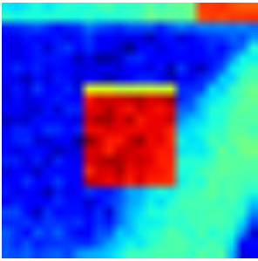
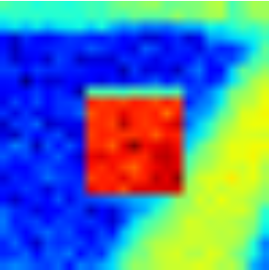
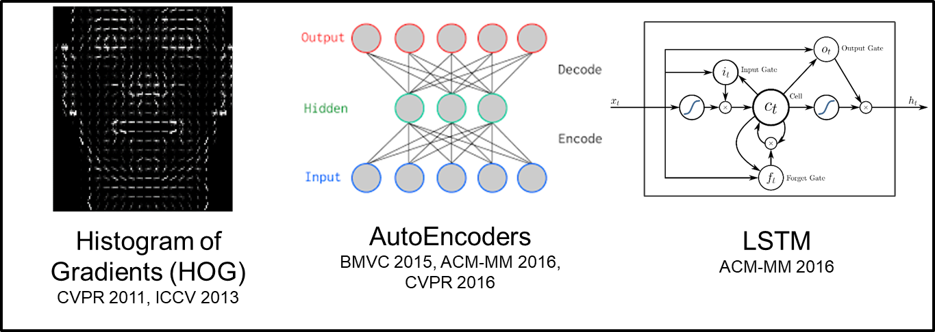
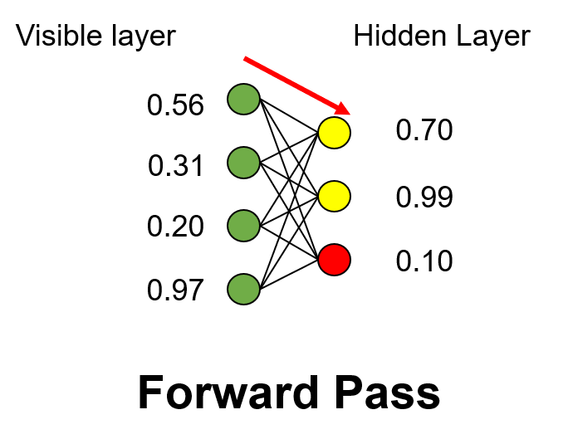
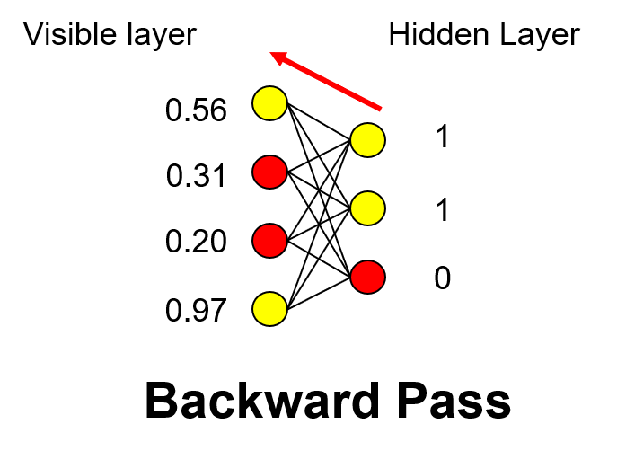
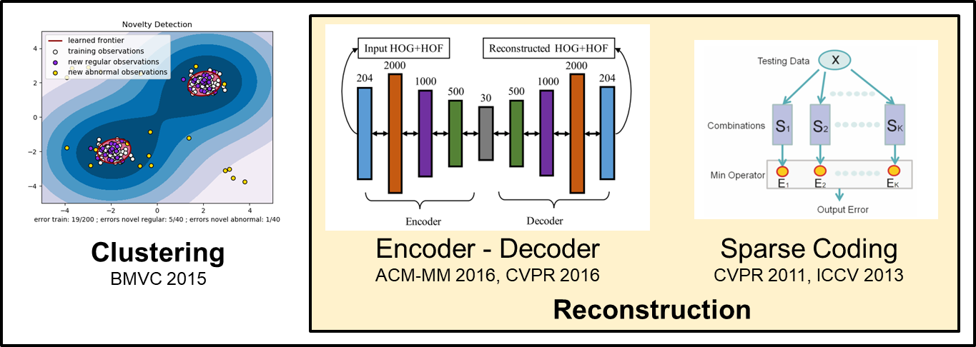
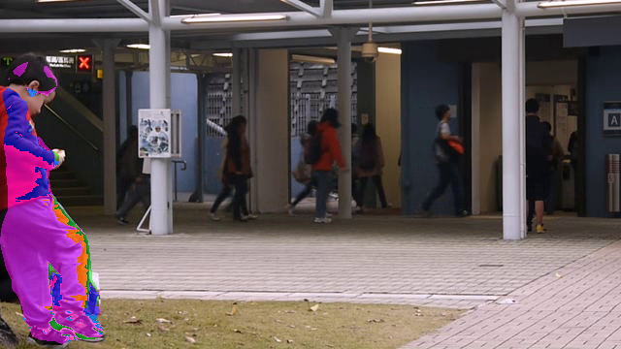
an unsupervised anomalous event detection framework with
class-aware source separation
Burhan A. Mudassar, Jong Hwan Ko and Saibal Mukhopadhyay
School of ECE, Georgia Institute of Technology, Atlanta, GA
Introduction
Proposed Approach
Block Diagram
Tag Frames with Anomalous Events
Feature Extraction
Results on the Avenue Dataset
Anomaly Detector
UCSD Ped Dataset
Video Frames
Tag Anomalous Objects in those Frames
Anomaly Detection
Anomaly due to (a,b) Bicycle (c) Person (d) Car Class on UCSD Dataset
An operator watching a single screen for 30 mins can miss 80% of activity
Video Analytics Industry – 60% compounded annual growth
Scarce wireless bandwidth and transmission energy
Reduce computation and storage overhead at Central Node
Analysis and Evaluation
AVSS 07 PV Dataset
Restricted Boltzmann Machine
Results on UCSD Ped 1 and Ped 2
Class-Aware Separability
Related Work
Feature Extractor
Anomaly Detector
Evolution of Free Energy on the AVSS 07 PV Sequence
Energy Function
Free Energy
Computational Complexity
Feature Extraction
Frame 0
Frame 200
Frame 400
Frame 750
Evolution of filter 0 of the RBM for car class
Avenue Dataset
Training by Contrastive Divergence (CD-1)
Summary and Future Work
Anomaly Detection
Fully unsupervised and physically realizable anomaly detection system for the edge
Separation of anomalous source based on class of interest
Extend current anomaly detection frameworks to moving platform settings i.e. autonomous cars
Filters learned on Avenue Dataset
Sample from Training Set
Reconstructed sample from RBM
Detected Anomaly
Office of Naval Research

