Slide 1
Noise-Disentangled Graph Contrastive Learning via Low-Rank and Sparse Subspace Decomposition
Notes:
Hey everyone, we're a research team from the University of Chinese Academy of Sciences. Today, we're here to talk about our paper titled "Noise-Disentangled Graph Contrastive Learning via Low-Rank and Sparse Subspace Decomposition".

Slide 2
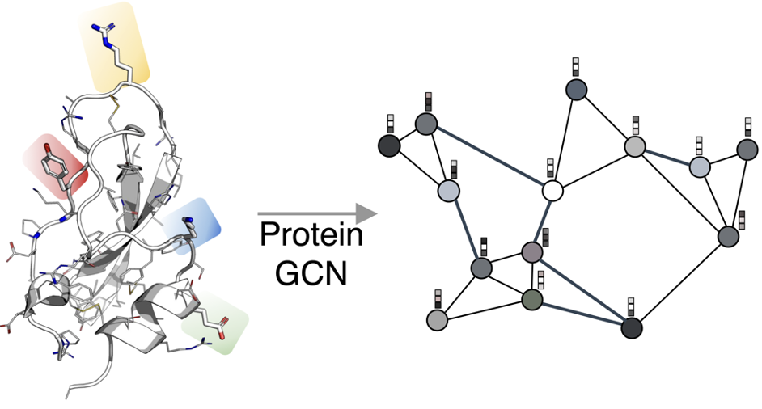
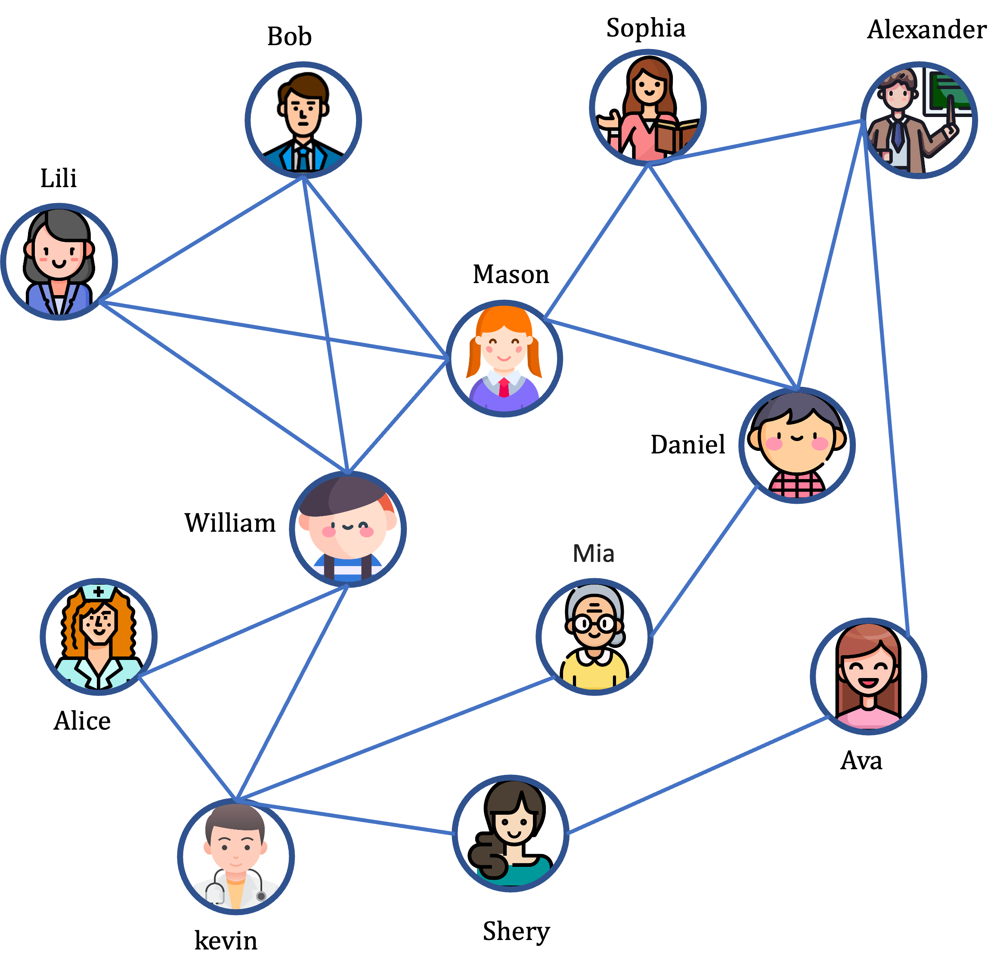
Background
Data as Graphs
(a) Social Graph
(b) Knowledge Graph
(c) Molecular Graph
Notes:
Graphs such as Social networks、Knowledge Graph and molecular （/məˈlekjələ(r)/）graphs are ubiquitous data structures in the real world.
Due to their prevalence, it is of great research importance to extract meaningful patterns from graph structured data so that downstream tasks can be facilitated.

Slide 3
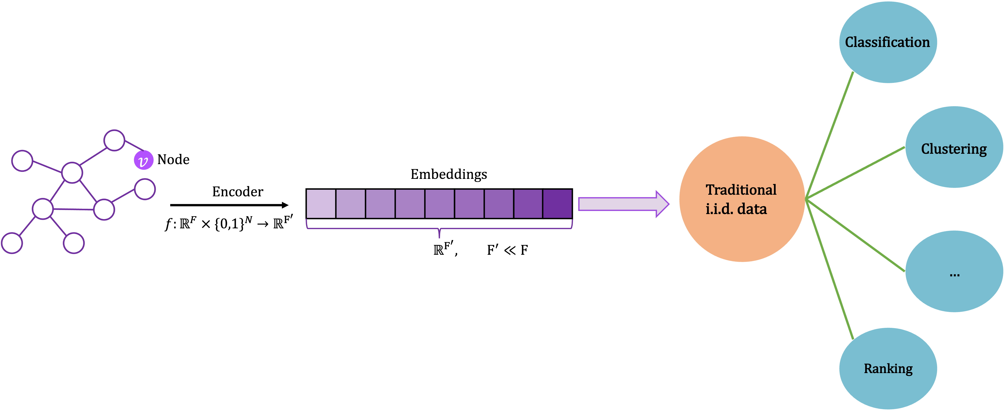
Background
ML on Graphs
Many real-world problems can be summarized as a set of tasks on a graph:
Link prediction
Node Classification
Community Detection
Ranking
…
Notes:
Instead of designing hand-engineered features, graph representation learning has emerged to learn representations that can encode the abundant information about the graph.
It has achieved tremendous success in various tasks such as node classification, link prediction, and graph classification and has attracted increasing attention in recent years.

Slide 4
Background
Paradigm of Graph Contrastive Learning
Generates two views based on different augmentations
Encodes the graphs of two views
Construct the self-supervised signal via contrast
[1] Yukuo Cen, Yuxiao Dong, Jie Tang. Self-supervised Learning and Pre-training on Graphs, WWW 2023 Tutorial
[2] Wu, Lirong, et al. "Self-supervised learning on graphs: Contrastive, generative, or predictive." IEEE Transactions on Knowledge and Data Engineering (2021)
Notes:
The paradigm of graph contrastive learning: First two views are generated based on different augmentations, then the graphs of the two views are encoded, and finally the encoder is trained by constructing a self-supervised signal using contrastive samples

Slide 5
Motivation
Observation：
Low-quality Noise. Such as minor augmentations or inconsistent augmentations, hinders graph contrastive learning.
Lack of within-view constraint information.
Idea:
By utilizing subspace decomposition techniques to model subspaces with different characteristics, low-quality representational noise is decoupled, providing high-quality samples for graph contrastive learning.
By leveraging low-rank and sparse constraints, information within views is mined; through the use of multi-subspace weighted joint learning, information between views is explored.
Notes:
Our observations consist of two points:
1. The impact of low-quality noise, such as minor enhancements (where differences between views are minimal, rendering the contrast less meaningful) or inconsistent enhancements (where augmentations of the same node vary significantly, irrelevant to the essence of the contrastive task), hinders graph contrastive learning.
2.The lack of within-view constraint information, focusing solely on contrastive constraints between augmented views, makes it difficult to capture local and essential information within augmented views, leading to poor performance.
Our idea can be summarized in two aspects:
1. We use subspace tricks to split out the junky noise from our data, giving us top-notch samples for learning from graphs.
2. We dig into the data by adding low-rank and sparse rules, getting valuable info from each perspective. Plus, we join forces across different perspectives for even deeper insights.

Slide 6
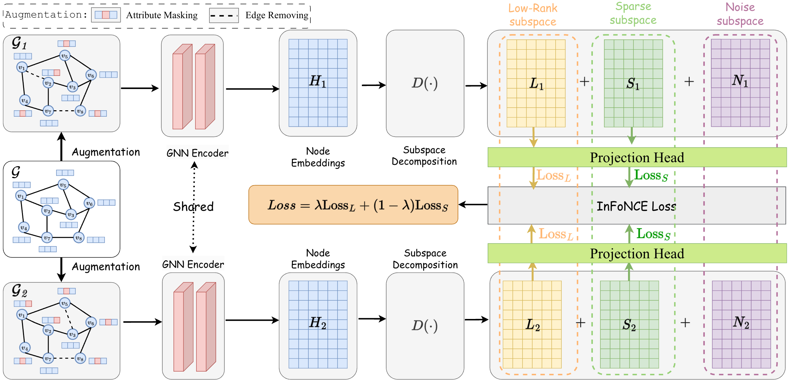
Approach
# Framework
Notes:
So, that's the framework of our model. We'll dive deeper into it in just a bit.

Slide 7
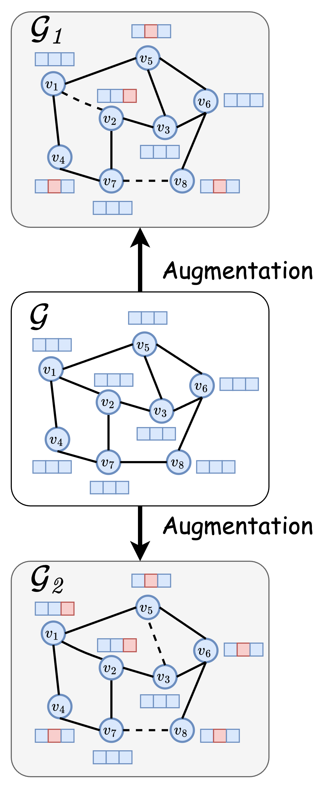
Approach
##1. Graph Augmentation
$$X1=X∘M^{T}$$
$$A1=A∘R$$
$𝒢1=(X1,A1)=t(X,A$)
Attribute augmentation
Edge augmentation
$X⊆ℝ^{n×d}$ node attribute matrix
$A⊆ℝ^{n×n}$ adjacency matrix
$M∈\{0,1\}^{n×d}$ attribute masking matrix
$R∈\{0,1\}^{n×n}$ is a random edge masking matrix
$∘$is the Hadamard product
$t\left(⋅\right)$denotes combining the two augmentations.
Notes:
In this work, we consider utilizing the two classical augmentation techniques to generate different views, the attribute and edge augmentation.
The first formula represents attribute augmentation, while the second formula represents edge augmentation.
时间够，以下可以忽略： where $X$is a node feature matrix , $A$is an adjacency matrix, $M$is an attribute masking matrix, whose entry independently is drawn from a Bernoulli distribution with probability $p_{1}$, $R$ is a random edge masking matrix, it is also drawn from a Bernoulli distribution with probability $p_{2}$, $∘$is the Hadamard product, $t\left(⋅\right)$denotes combining the two augmentations.

Slide 8
Approach
##2. Graph Neural Network Encoder
GNN Encoder : 2-layers Graph Convolutional Network (GCN)
Each GCN layer can be defined as follows:
$$H^{l+1}=f\left(A,H^{l};W^{l}\right)=σ({\overset{ˆ}{D}}^{−\frac{1}{2}}\overset{ˆ}{A}{\overset{ˆ}{D}}^{−\frac{1}{2}}H^{l}W^{l})$$
Notes:
We use the 2-layers graph convolutional network (GCN) as the encoder $f\left(⋅\right)$to obtain the node embeddings. Each GCN layer can be defined as follows.

Slide 9
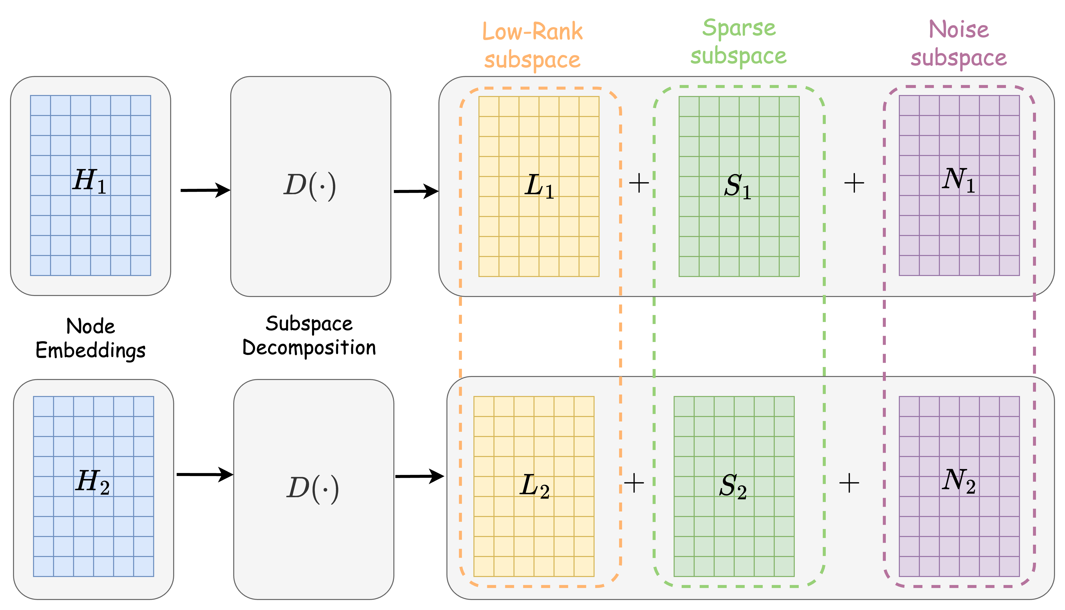
Approach
##3. Low-rank and Sparse Subspace Decomposition
Assuming $H ≈L + S$, where $L$ is a low-rank matrix, $S$ is a sparse matrix, and another noise matrix $N$ is used to complete the approximation.
$$H=L + S+ N$$
The low-rank matrix $L$ allows for linear combinations among nodes, offering rich modeling capabilities for structural relevance, such as triangular structures. ^{[1]}
The sparse matrix $S$ compresses redundant information in the representation ^{[2]}, highlighting the essential features of the nodes.
The noise matrix N retains the residuals in the approximation, decoupling unrelated information for GCL, such as low-quality noise that impedes contrastive learning.
[1] Node embeddings and exact low-rank representations of complex networks. NeurIPS 2020
[2] Network sparse representation: Decomposition, dimensionality-reduction and reconstruction. Information Sciences 2020
Notes:
Assuming that the node representation matrix can be decomposed into three parts: 1. The low-rank matrix L allows for linear combinations among nodes, providing rich modeling capabilities for structural relevance, such as triangular structures. 2. The sparse matrix S compresses redundant information in the representation, highlighting the essential features of the nodes.
3. The noise matrix N retains the residuals in the approximation, decoupling unrelated information for Graph Contrastive Learning (GCL), such as low-quality noise that hinders contrastive learning.

Slide 10
Approach
##3. Low-rank and Sparse Subspace Decomposition
The decomposition objective equation can be transformed into an optimization problem to be solved, which can be defined as:
The optimization problem can be solved using the GoDec algorithm^{[3]}, which achieves this by iteratively solving the following two subproblems:
[3] Zhou T, Tao D. Godec: Randomized low-rank & sparse matrix decomposition in noisy case. ICML 2011
Notes:
The issue described above can be transformed into an optimization problem for solution, and this problem has already been addressed in the field of high-dimensional data analysis.
We have revised one of the methods, GoDec, to achieve this by iteratively solving the following two subproblems.

Slide 11
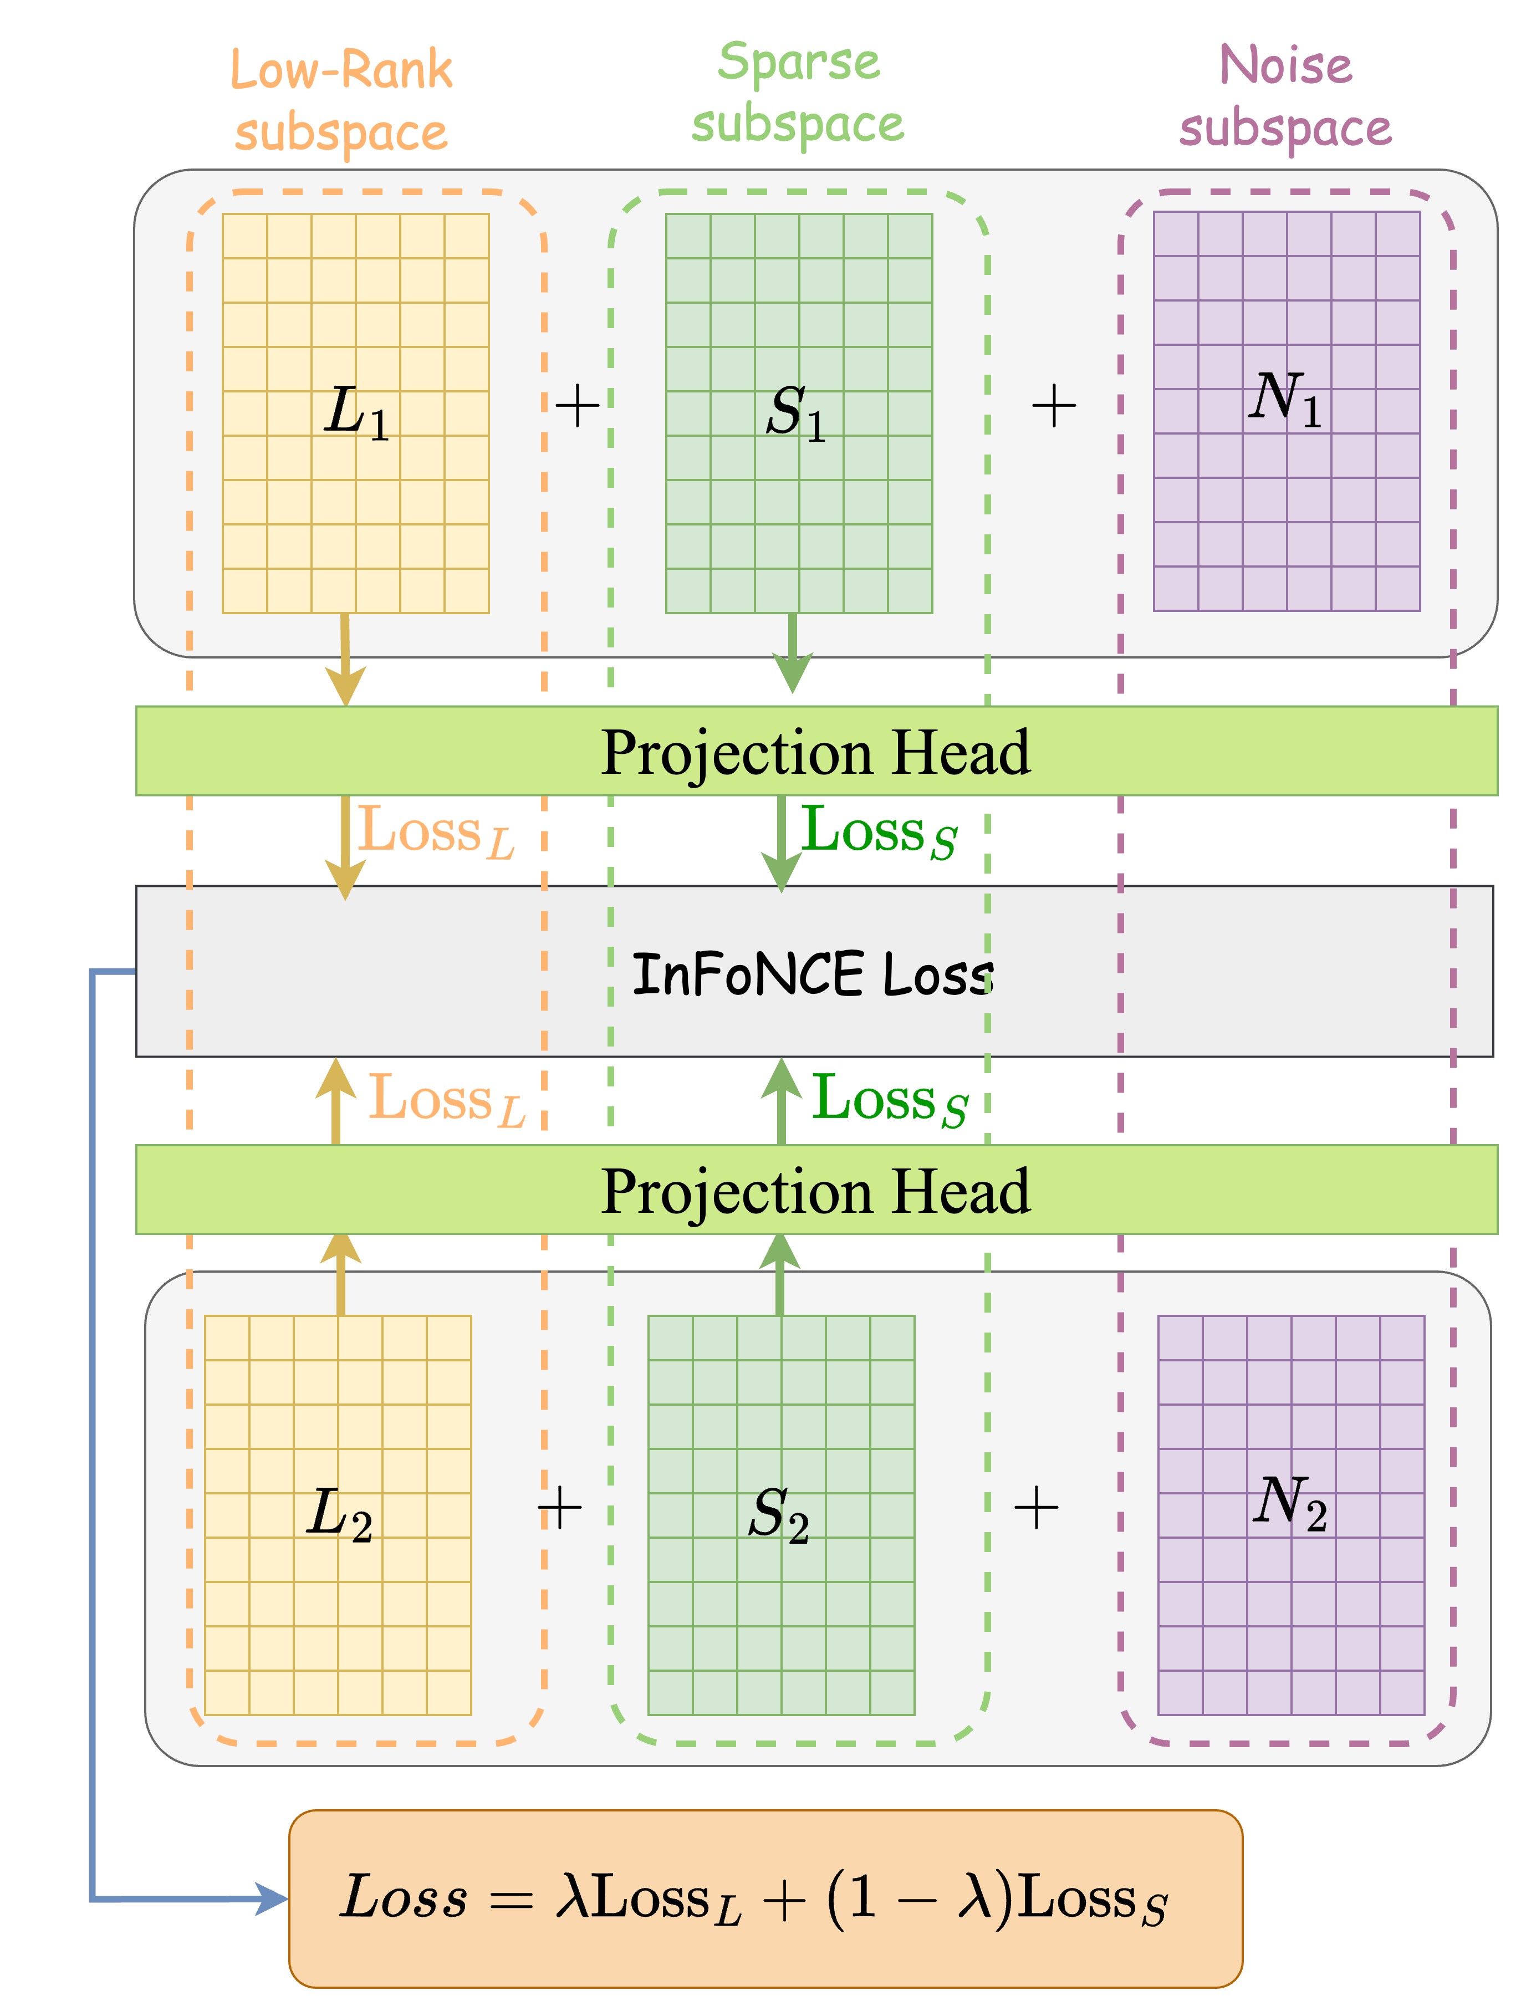
Approach
##5. Loss Function
Low-Rank Subspace Contrastive Loss Function
Sparse Subspace Contrastive Loss Function
Multi-Subspace Joint Contrastive Loss Function
Where $g\left(⋅\right)$denotes a projection head composed of two MLP layers, $τ$is the temperature hyperparameter, and $λ$ is the balance parameter, which balances the weights of different subspaces.
Notes:
First, we do some Contrastive Learning in the low-rank subspace, crunching the loss in that space using the InFoNCE contrastive loss function.

Slide 12
Approach
##5. Loss Function
Low-Rank Subspace Contrastive Loss Function
Sparse Subspace Contrastive Loss Function
Multi-Subspace Joint Contrastive Loss Function
Where $g\left(⋅\right)$denotes a projection head composed of two MLP layers, $τ$is the temperature hyperparameter, and $λ$ is the balance parameter, which balances the weights of different subspaces.
Notes:
Then we move on to some Contrastive Learning in the sparse subspace, again using the InFoNCE contrastive loss function to compute the loss in that space.

Slide 13
Approach
##5. Loss Function
Low-Rank Subspace Contrastive Loss Function
Sparse Subspace Contrastive Loss Function
Multi-Subspace Joint Contrastive Loss Function
Where $g\left(⋅\right)$denotes a projection head composed of two MLP layers, $τ$is the temperature hyperparameter, and $λ$ is the balance parameter, which balances the weights of different subspaces.
Notes:
Finally, we use a weighted combination of the contrastive losses from both the low-rank and sparse subspaces as our ultimate optimization objective function.
Where $g$denotes a projection head composed of two MLP layers, $tao$is the temperature hyperparameter, and $lambda$ is the balance parameter, which balances the weights of different subspaces.

Slide 14
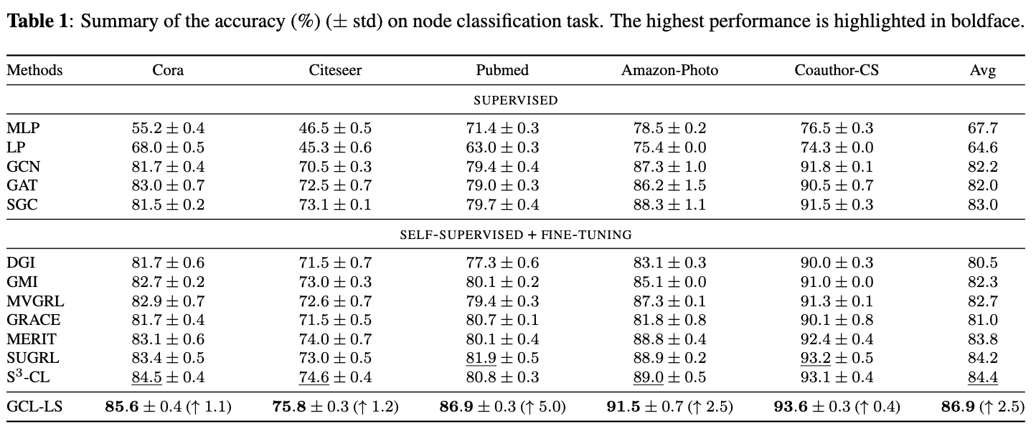
Experiments
##1. Node Classification Task
“Self-supervised Pre-training + Fine-tuning”
Notes:
Compared to previous work, our method achieves higher performance, validating its effectiveness.
Compared to supervised baselines, GCL-LS performs better, indicating that self-supervised contrastive learning can capture more abundant features, enhancing performance in downstream tasks. Compared to self-supervised baselines, GCL-LS shows superior performance, suggesting that subspace decomposition can further exploit structural information and the role of node features.

Slide 15
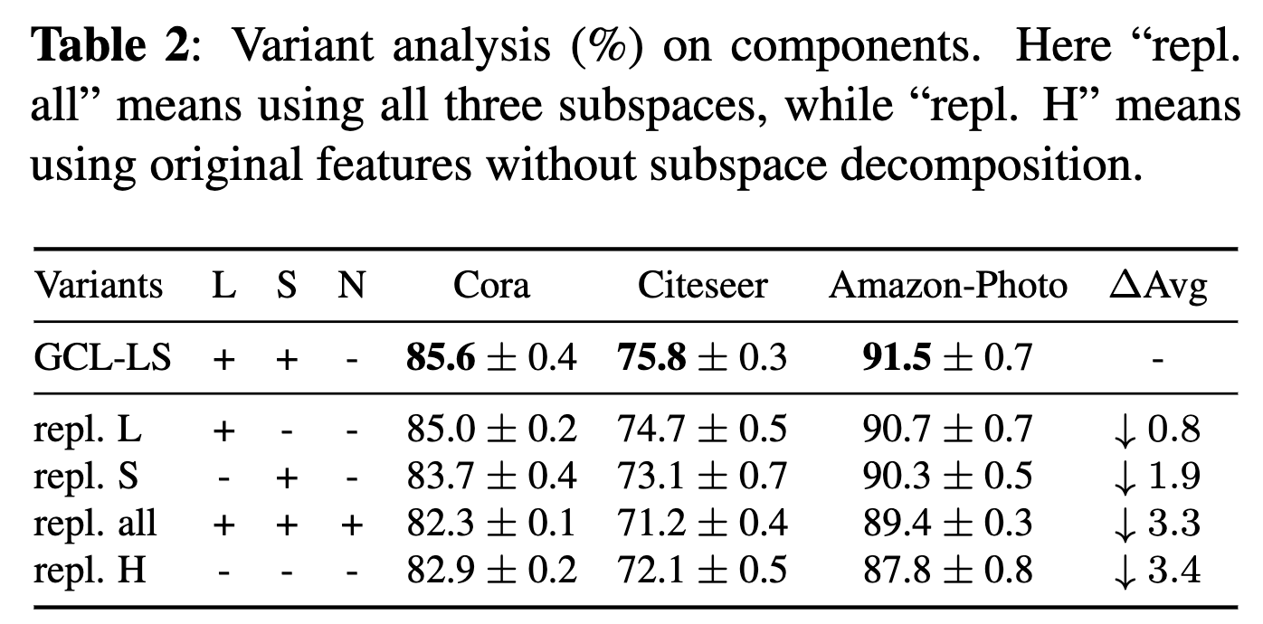
Experiments
##2. Variant Analysis
Both low-rank and sparse subspaces are beneficial for representation learning.
The noise subspace can help deal with low-quality noise.
Notes:
Both low-rank and sparse subspaces are beneficial for representation learning, consistent with previous research findings that low-rank subspaces preserve structural information, while sparse subspaces compress redundant feature information.
The noise subspace can help deal with low-quality noise.

Slide 16
Experiments
##3. Property Analysis
The impact of noise intensity is studied by adjusting the noise rate $ω$ of the enhanced Cora dataset, as shown in the figure:
Excessive or insufficient noise can hinder contrastive learning.
Moderate noise intensity can also benefit regularization, preventing model overfitting.
Notes:
Excessive or insufficient noise can hinder contrastive learning. GCL-LS consistently outperforms the method without subspace decomposition, repl.H, reflecting that subspace decomposition aids in filtering out low-quality noise.
Moderate noise intensity can also benefit regularization, preventing model overfitting. Experiments indicate our model has better noise robustness.

Slide 17
Experiments
##3. Property Analysis
The left image analyzes the impact of the decomposition error ϵ on classification accuracy, reflecting the quality of the subspace decomposition.
The smaller the decomposition error ϵ, the higher the quality of the subspace, and the better the classification accuracy
Notes:
The smaller the decomposition error epsilon, the higher the quality of the subspace, and the better the classification accuracy, indicating that high-quality subspace decomposition is beneficial for representation learning.

Slide 18
Thanks!
Contact: zhanggehang@iie.ac.cn
shengjiawei@iie.ac.cn

