Slide 1
A Dense U-Net with Cross-Layer Intersection
for Detection and Localization of Image Forgery
Rongyu Zhang¹, Jiangqun Ni^{1,2}
¹School of Data and Computer Science, Sun Yat-Sen University, China
²Cyberspace Security Research Center, Peng Cheng Laboratory, Shenzhen, China

Slide 2
Contents
Background
Method
Experiment Results
Conclusion

Slide 3
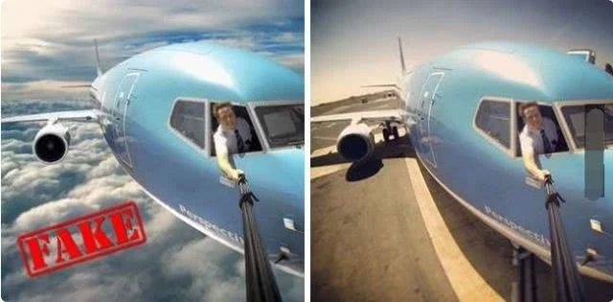
Background
Image Forgery
wrong public opinion, academic disturbance etc.
Passive Forensics
no need for pre-embedded information
Forgery Detection
splicing
copy-move
Source Identification
removal

Slide 4
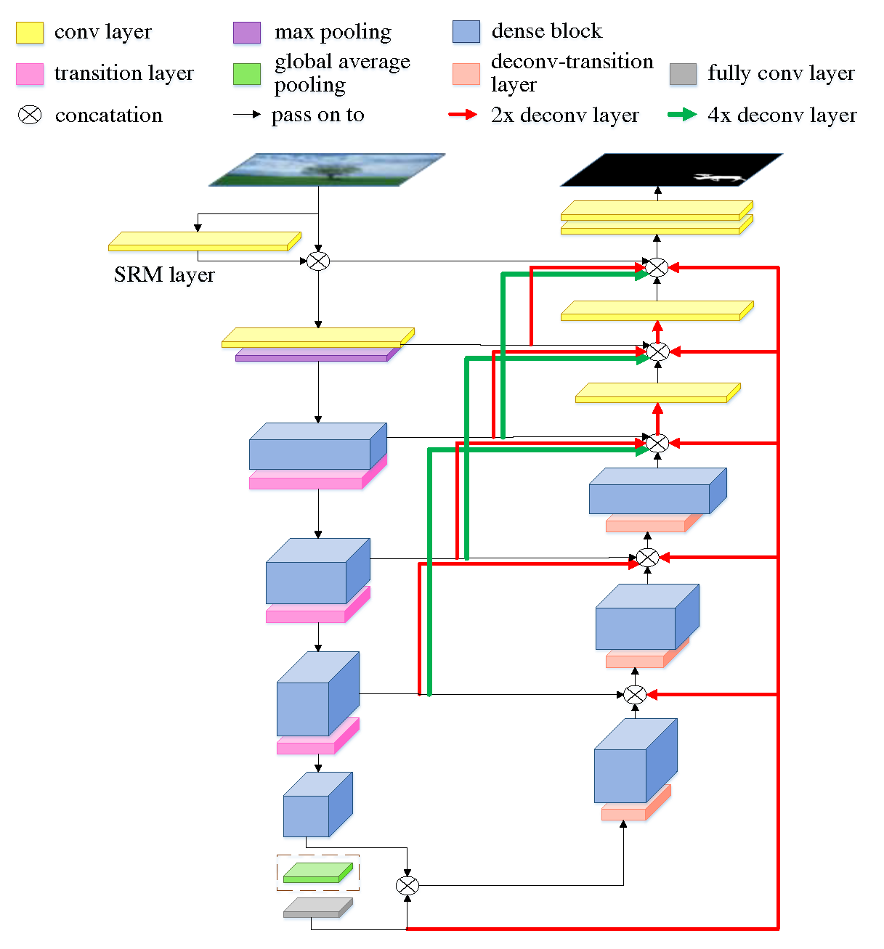
Method
Downsampling Path for Detection
Use 30 high-pass filters of spatial rich model (SRM).
Noise features help capturing inconsistency signals.

Slide 5
Method
U-shaped Network for Localization
Remove the global pooling layer.
Replace the fully connected layer used for forgery detection classification with a 1x1 convolution.

Slide 6
Method
Dense Connection Mechanism
Unify multi-scale features of the network.
Improve the efficiency of extracting image forgery weak features.

Slide 7
Method
Spatial Decision Information
Make full use of weights of classification layer of detection network.
Help deciding on predicted segmentation

Slide 8
Method
Loss for Pixel Classification
$$H_{y}\left(\hat{y}\right)=−\sum_{i}{α_{i}y_{i}log\left(\hat{y_{i}}\right)}$$
$α_{i}$ ： weight between 0 and 1 for i^{th} category，
set as 0.6 for tampered pixels
$y_{i}$ ： actual value（0 or 1）
$\hat{y_{i}}$ ： softmax output

Slide 9
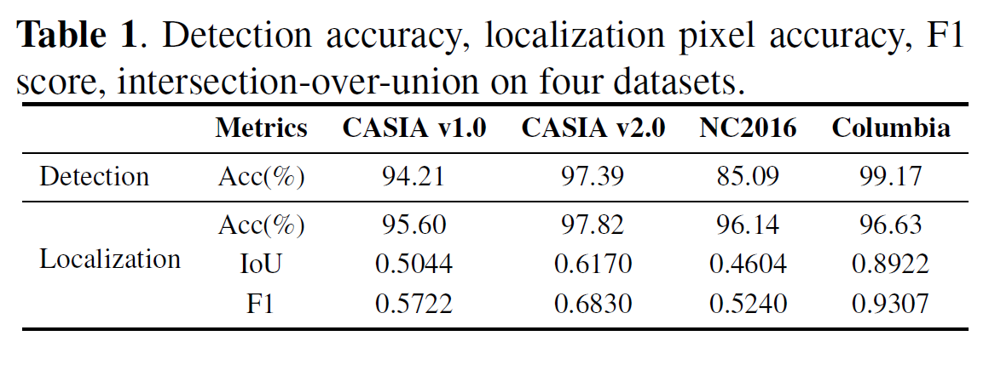
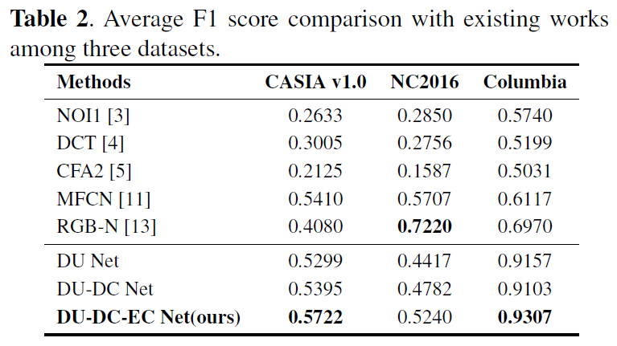
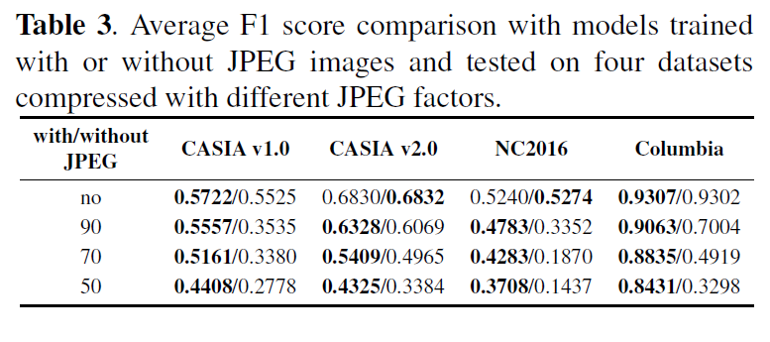
Experiment Results
* DU: U-shaped Network
* DC: Dense Connection Mechanism
* EC: Spatial Decision Information Connection

Slide 10
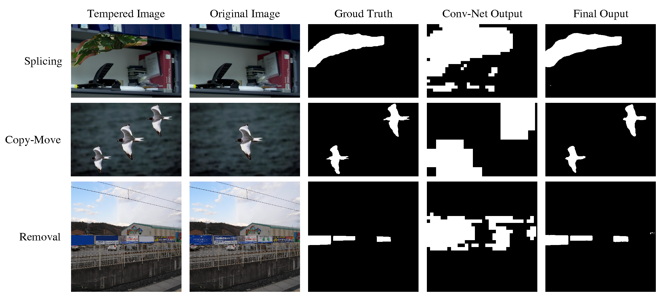
Experiment Results

Slide 11
Experiment Results
* DU: U-shaped Network
* DC: Dense Connection Mechanism
* EC: Spatial Decision Information Connection

Slide 12
Conclusion
Propose a dense u-net for detection and localization of image forgery.
Dense connection mechanism explores the multi-scale contribution of the shallow-layer features.
Spatial decision information connection improves the sensitivity to abnormal areas and benefits gradient back-propagation.
Achieve high-precision image segmentation results.

Slide 13
Thank You for Watching!

