Slide 1
SweepMM: A High-Quality Multimodal Dataset For Sweeping Robots In
Home Scenarios For Vision-Language Model
Weichen Xu¹, Xinxin Xu¹, Tianhao Fu¹, Jian Cao¹, Xiaoyang Xu¹, Yuetian Huang¹, Xixin Cao¹, Xing Zhang^{1,2}
¹School of Software and Microelectronics, Peking University, Beijing, China
²Shenzhen Graduate School, Peking University, China
Presenter: Weichen Xu

Slide 2
Motivation
Method
Results
Discussion

Slide 3
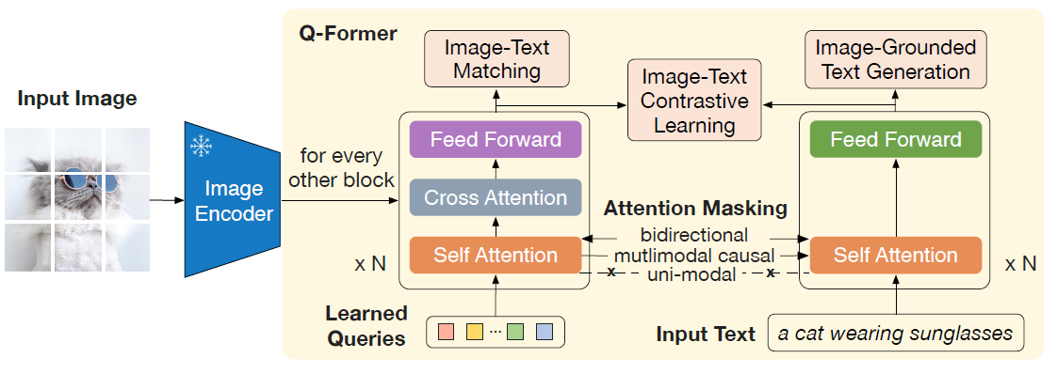
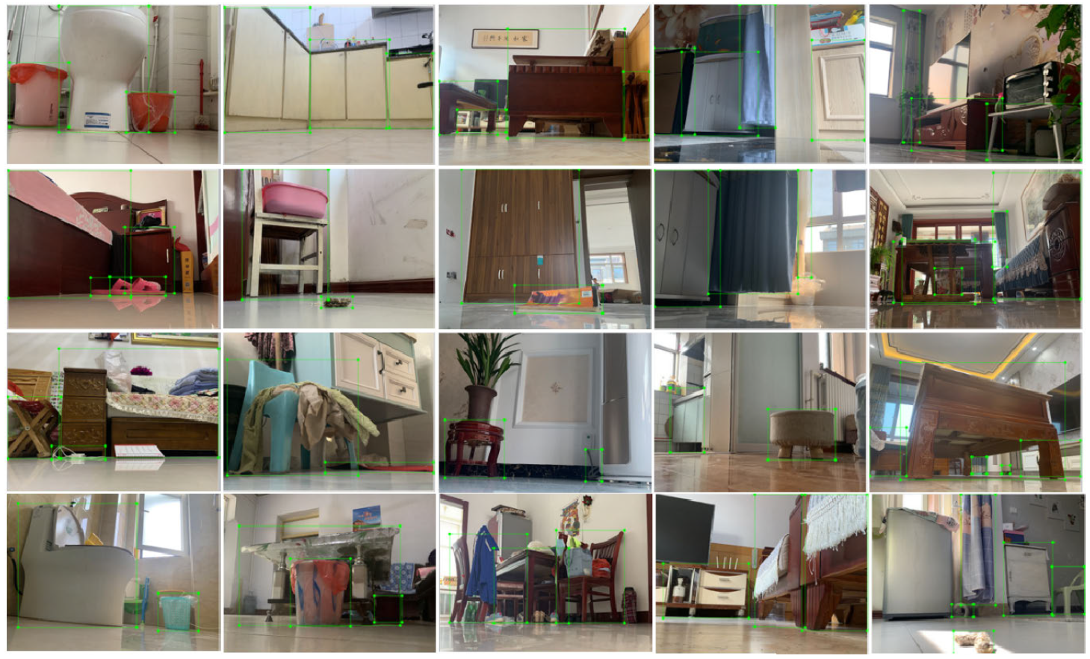
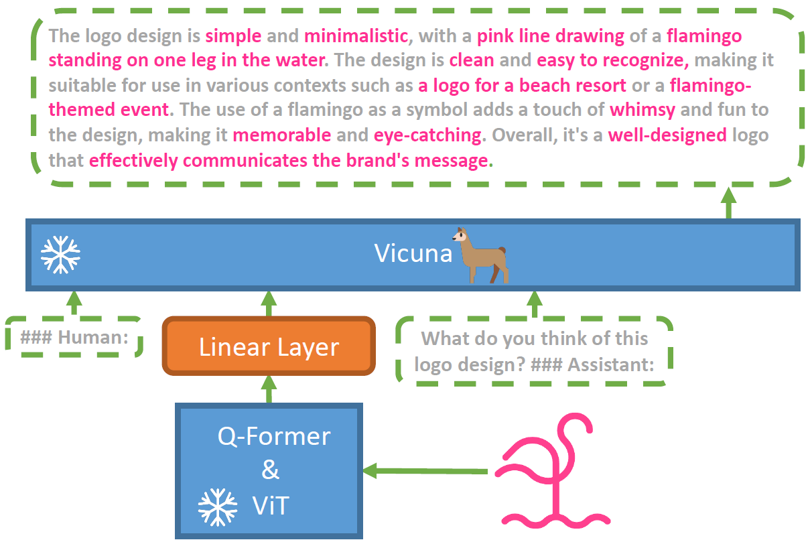
Motivation
General-purpose embodied multimodal models perform poorly in typical service robots, such as sweeping robots, due to a lack of domain knowledge.
relevant research has focused on detection datasets and perception tasks for sweeping robots
BLIP-2 [2]
MiniGPT-4 [3]
ODSR-IHS [1]
[1] Lv Y, Fang Y, Chi W, et al. Object detection for sweeping robots in home scenes (ODSR-IHS): a novel benchmark dataset[J]. IEEE Access, 2021, 9: 17820-17828.
[2] Li J, Li D, Savarese S, et al. Blip-2: Bootstrapping language-image pre-training with frozen image encoders and large language models[C]//International conference on machine learning. PMLR, 2023: 19730-19742.
[3] Zhu D, Chen J, Shen X, et al. Minigpt-4: Enhancing vision-language understanding with advanced large language models[J]. arXiv preprint arXiv:2304.10592, 2023.
< 3 >

Slide 4
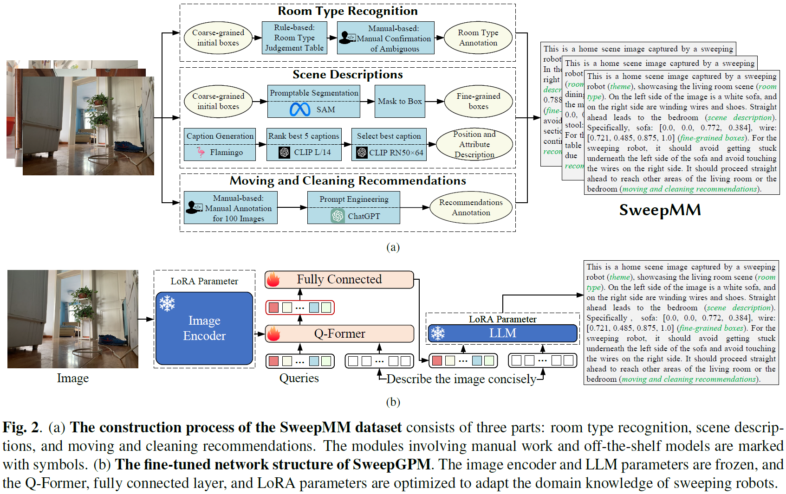
Method
< 4 >

Slide 5
Method
Room Type Recognition: Considering that room types are not static attributes but are determined by the objects placed in the room, we utilized boxes to annotate room categories. Specifically, we initially defined six room categories: toilet, bedroom, living room, dining room, kitchen, and stock room. We then created a room type judgement table , where each item, provides the room category and objects that may be present in it, for example, {’toilet’: ’closestool’, ’trashcan’, ’slippers’, ’socks’, ’carpet’, ’feces’}
< 5 >

Slide 6
Method
Scene Descriptions: On the one hand, we use the coarsegrained initial boxes from the dataset as prompts and input them into the off-the-shelf SAM. We segment the objects and obtain fine-grained boxes Bf . We normalize the bounding boxes and directly use them as precise descriptions of the scene. On the other hand, since the boxes and their categories cannot describe the attributes of the objects, we utilize the off-the-shelf general multimodal model Flamingo to generate descriptions for the image. Subsequently, we use CLIP to retrieve the most similar text, obtaining fuzzy descriptions about the positions and attributes of the objects. The model-based descriptions include additional information about the object’s color, shape, size, and even subclass descriptions. This enhances the model’s comprehension of scenarios in an open-vocabulary manner, which is beneficial for text to image retrieval tasks such as lost item search.
< 6 >

Slide 7
Method
Moving and Cleaning Recommendations: we exploited ChatGPT [14] through prompt engineering to mimic human annotations. Specifically, we manually annotated moving and cleaning recommendations for 100 images. Then, we input the following prompt to ChatGPT: “The inputs are the objects and locations, and the outputs are the moving and cleaning recommendations. Please refer to the provided examples. Given the input, provide the output.
< 7 >

Slide 8
Method
We employ the high-performing ChatGLM-6B as the LLM for text generation. In addition to freezing the image encoder and LLM, we add the LoRA parameter to learn the domain knowledge of the sweeping robot. We train the model to generate text using autoregressive loss and enhance the ability of text-image matching using contrastive loss.
< 8 >

Slide 9
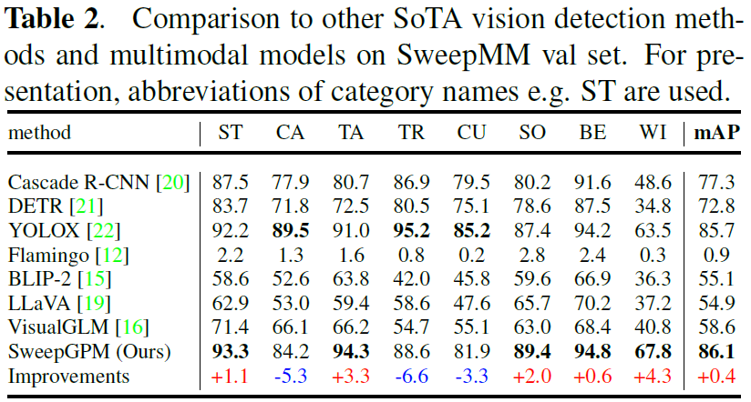
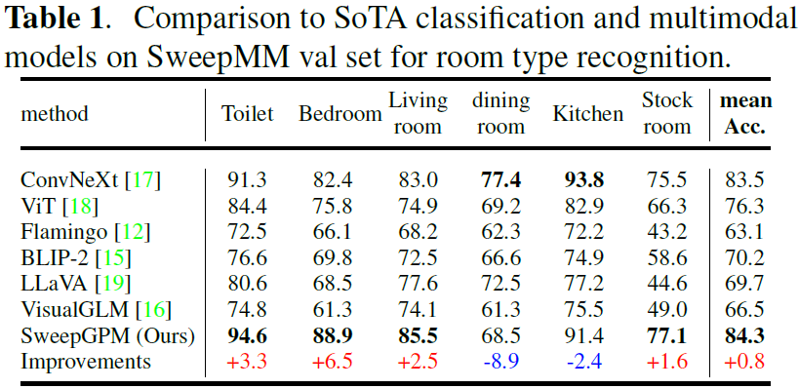
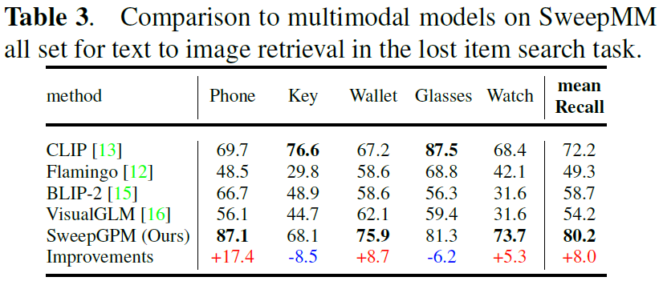
Results
< 9 >

Slide 10
Discussion
1. The application of Agent based on big language model in sweeping robots;
2. Quantitative version implementation of SweepMM model..
3. Adaptation of advanced open-source large language models, such as LLaMA2 and Gemma.
< 10 >

Slide 11
Thank you for listening!
Presenter: Weichen Xu

