Slide 1
Benchmarking Adversarial Robustness of Image Shadow Removal with Shadow-adaptive Attacks
Chong Wang , Yi Yu, Lanqing Guo, Bihan Wen
School of Electrical & Electronic Engineering, Nanyang Technological University, Singapore

Slide 2
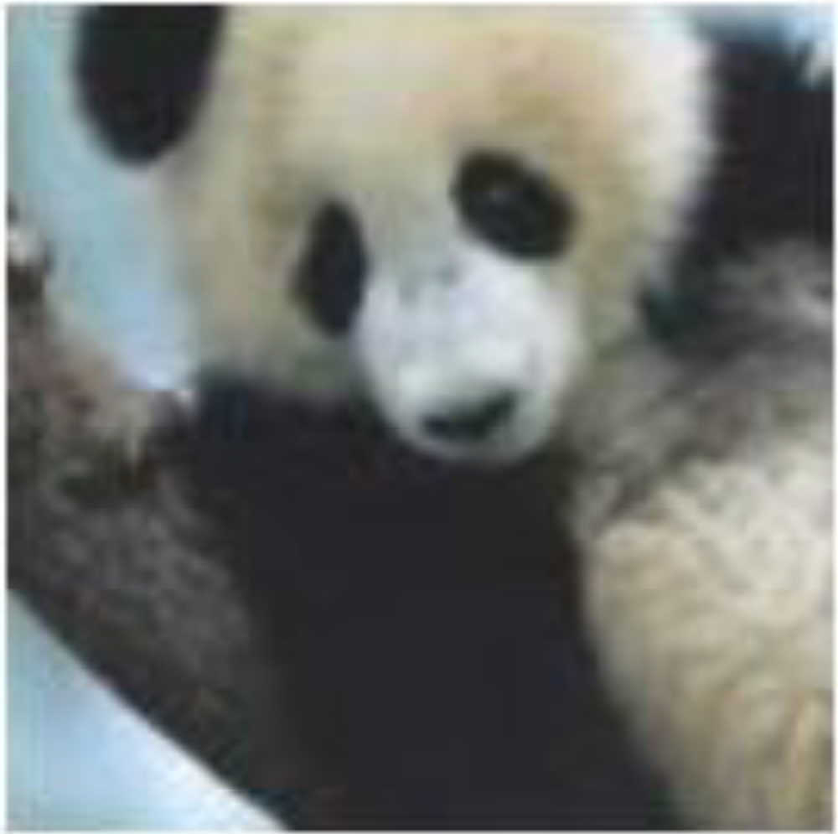
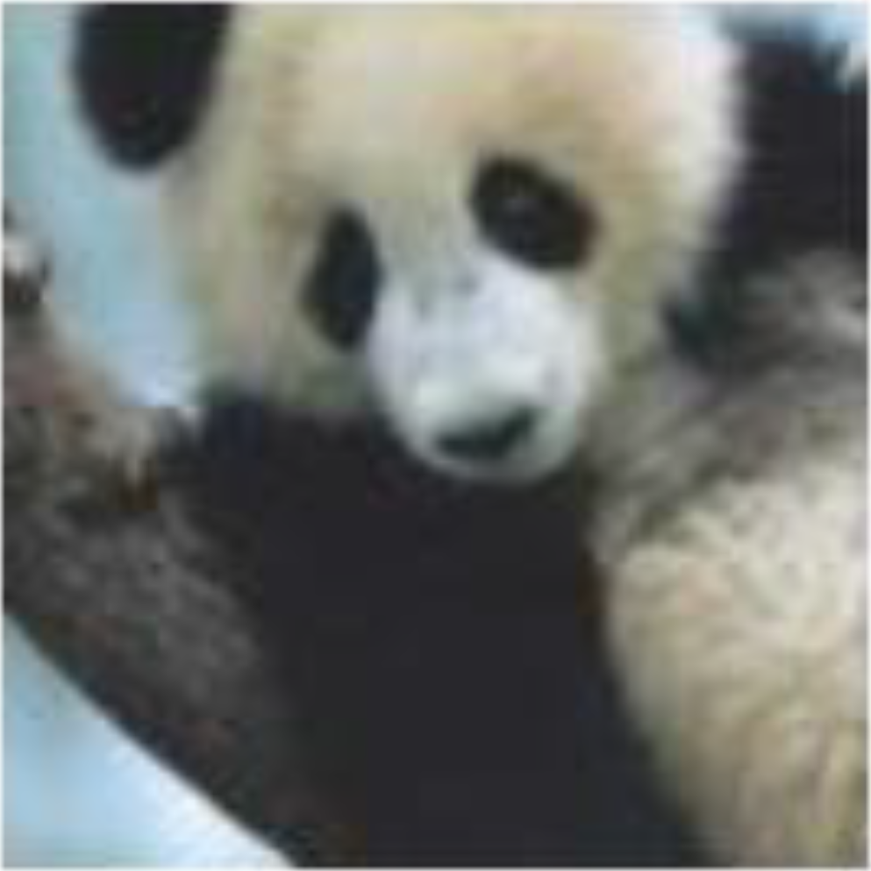
Background: Adversarial Attacks
Adversarial Example:
Crafted by an adversary to mislead the model to make wrong predictions
Indistinguishable (usually small perturbations added to the original image)
Generated through an iterative optimization process
“panda”
57.7% confidence
“nematode”
8.2% confidence
“gibbon”
99.3% confidence

Slide 3
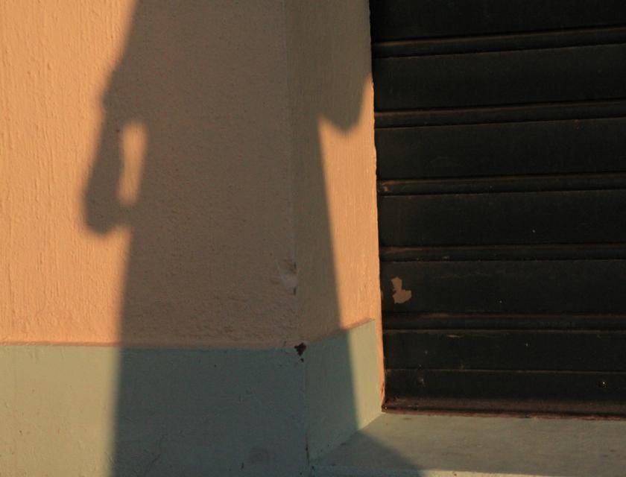
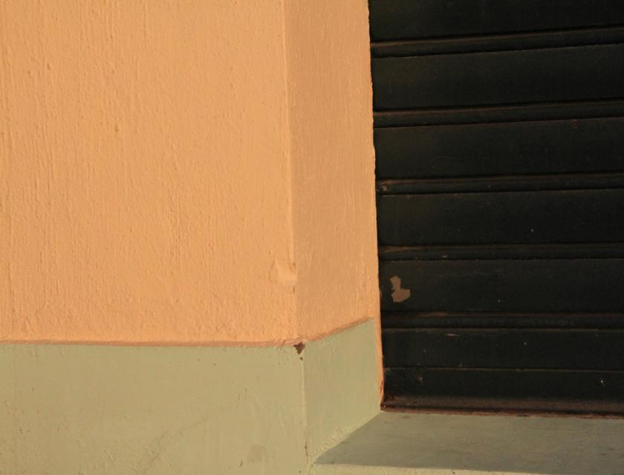
Background: Shadow Removal
Restore a shadow-free image with normal illumination
Shadow
Removal
Network
Challenges
Arbitrary and diverse shadow pattern
Inconsistent color and illumination

Slide 4
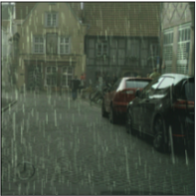
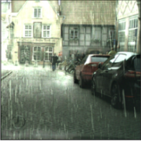
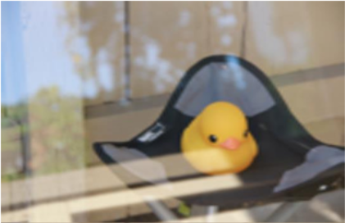
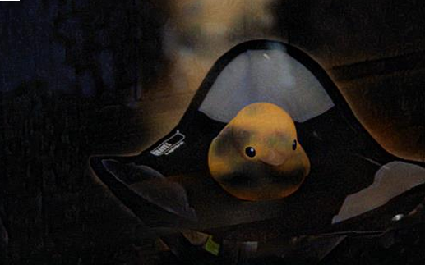
Motivation: Adversarial Attacks on Shadow Removal
Adversarial Attacks on Low-level tasks
Derain
Reflectance
Removal
Perturbation $δ$
Perturbation $δ$
Existing Attack Framework
A network $f_{θ}(∙)$, input image $I$, perturbations $δ$, and metric of distance $D\left\langle ∙, ∙\right\rangle$
Objective: maximize the deviation of the output from the target, e.g., original output

Slide 5
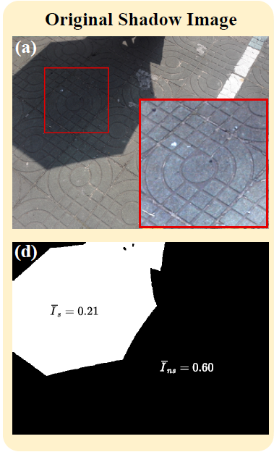
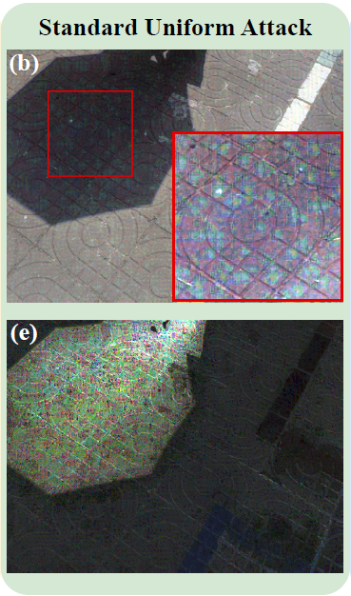
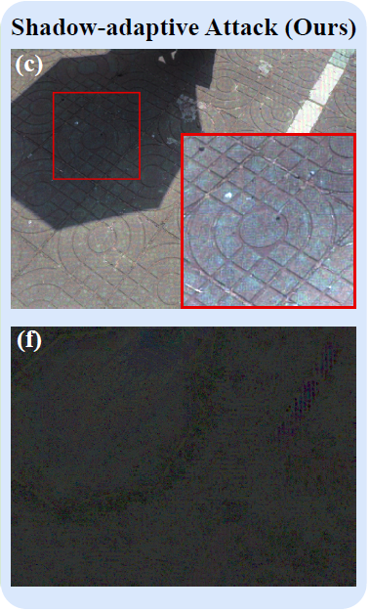
Motivation: Adversarial Attacks on Shadow Removal
Can we directly apply existing attack framework?
NO!
Prominent noise
Imperceptible
Average pixel intensity
Normalized perturbation $δ/I$
Normalized perturbation $δ/I$

Slide 6
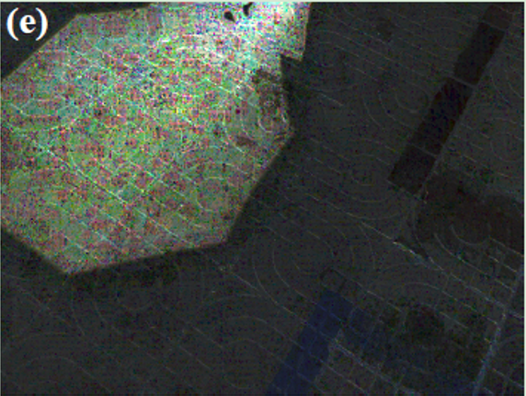
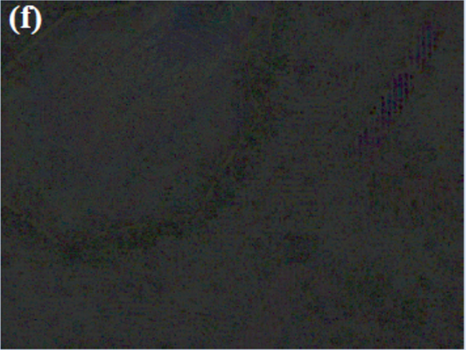
Method: Shadow-adaptive Adversarial Attacks
Learning imperceptible noise in shadow region
Standard Uniform Attacks Objective:
$$δ=\underset{{\left\|δ\right\|}_{∞}≤ε_{u}}{argmax}{{\left\|f_{θ}\left(I\right)−f_{θ}\left(I+δ\right)\right\|}_{2}}$$
Shadow-adaptive Attacks Objective:
$$δ=\underset{{\left\|δ/I\right\|}_{∞}≤ε_{a}}{argmax}{{\left\|f_{θ}\left(I\right)−f_{θ}\left(I+δ\right)\right\|}_{2}}$$
Normalized Perturbation $δ/I$
Optimized Iteratively via PGD

Slide 7
Method: Shadow-adaptive Adversarial Attacks
When Equivalent?
Theorem. Let $ε_{a}$ denotes the attack budget in the proposed shadow-adaptive attacks, we can set the budget $ε_{u}=$ $ε_{a}\overline{I}$ for standard uniform attacks to achieve an equivalent attack strength, where $\overline{I}$ is the mean value of the input shadow image.
Proof. The perturbation on each pixel is bounded by its intensity as $\left|δ_{a}^{(i)}\right|≤ε_{a}I^{(i)}$
shadow-adaptive attacks:
Identical upper bound
standard uniform attacks :
Equivalent attack strength

Slide 8
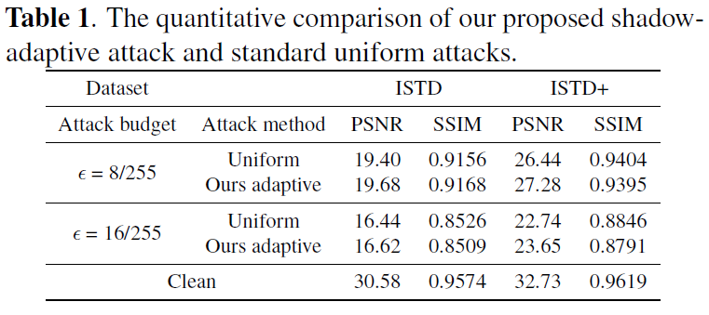
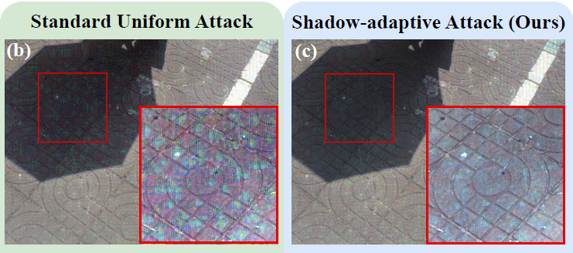
Experiments: Shadow-adaptive vs. Uniform Attacks
Dataset: ISTD and ISTD+
Shadow Removal Model: ShadowFormer
Attacks Details: $ε_{a}=\left\{8/{255},{16}/{255}\right\}, ε_{u}= ε_{a}\overline{I} , T=20$
Quantitative Results:
Qualitative Results:

Slide 9
Experiments: Benchmarking under Proposed Attacks
Dataset: ISTD and ISTD+
Shadow Removal Model:
ShadowFormer, BMNet, Unfold-Shadow, SG-ShadowNet and DC-ShadowNet
Attacks Details: $ε_{a}=\left\{{{1/{255},2}/{255},4/{255}, 8}/{255},{16}/{255}\right\}, T=20$

Slide 10
Experiments: Benchmarking under Proposed Attacks

Slide 11
Experiments: Benchmarking under Proposed Attacks

Slide 12
Experiments: Benchmarking under Proposed Attacks

Slide 13
Discussion
Conclusion:
The first robust benchmark on shadow removal
Shadow-adaptive attack --> visually imperceptible in shadow region
Future Works:
Different attack objectives?
How to defend?

Slide 14
Thank You!

