Slide 1
VARIABLE SPAN TRADE-OFF FILTER FOR SOUND ZONE CONTROL WITH KERNEL INTERPOLATION WEIGHTING
Jesper Brunnström* Shoichi Koyama† Marc Moonen*
IEEE ICASSP 2022
* STADIUS Center for Dynamical Systems
Department of Electrical Engineering (ESAT)
KU Leuven
† Graduate School of Information Science and Technology
The University of Tokyo
This research work was carried out at the ESAT Laboratory of KU Leuven, in the frame of the European Union’s Horizon 2020 research and innovation programme under the Marie Skłodowska-Curie Grant Agreement No. 956369: ”Service-Oriented Ubiquitous Network-Driven Sound — SOUNDS”, KU Leuven Research Council project C14-21-0075 ”A holistic approach to the design of integrated and distributed digital signal processing algorithms for audio and speech communication devices”, and VLAIO O&O Project nr. HBC.2020.2197 ”SPIC: Signal Processing and Integrated circuits for Communications”.
Notes:
Hi im...
Author of variable...

Slide 2
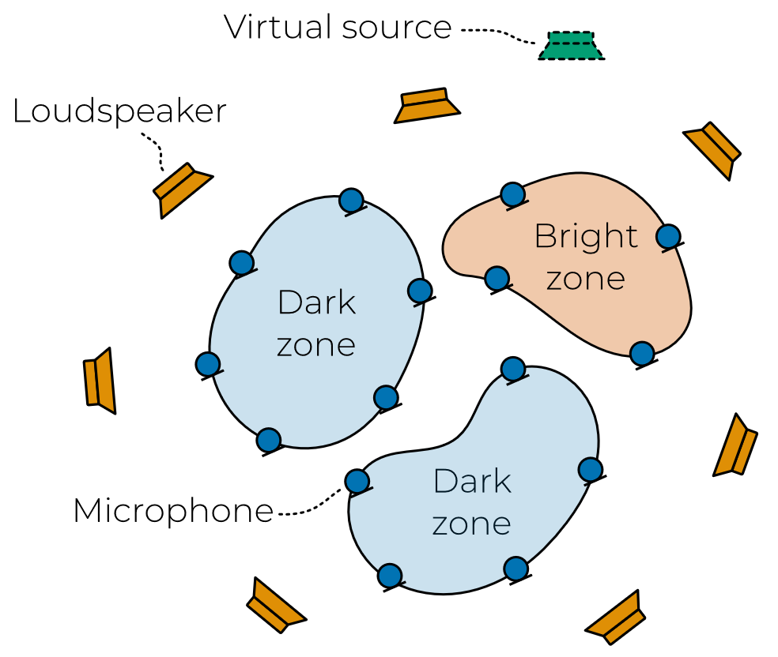
Problem statement
Reproduce sound in the bright zone with minimal sound produced in the dark zones
Minimize sound pressure error over continuous sound zones
Sound pressure
Desired pressure
Position in space
Continuous sound pressure function is unobservable
Only measurements at discrete control points are available
Room transfer functions
Control filter
Audio to be reproduced

Slide 3
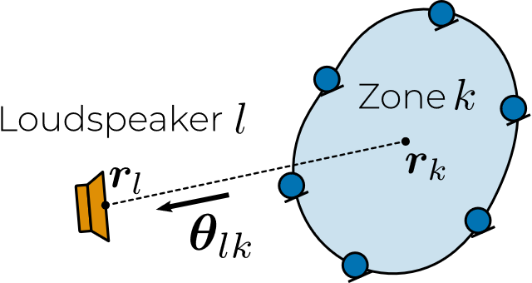
Sound field interpolation
Interpolation filter
Kernel function
Interpolate for each loudspeaker-zone pair separately

Slide 4
Control filter
Control filter minimizing pressure error
Kernel interpolation weighting
Spatial covariance matrices
Variable span trade-off filter (VAST)
Generalized eigenvalue decomposition
Full rank
Rank-1
Pressure matching
Acoustic contrast control

Slide 5
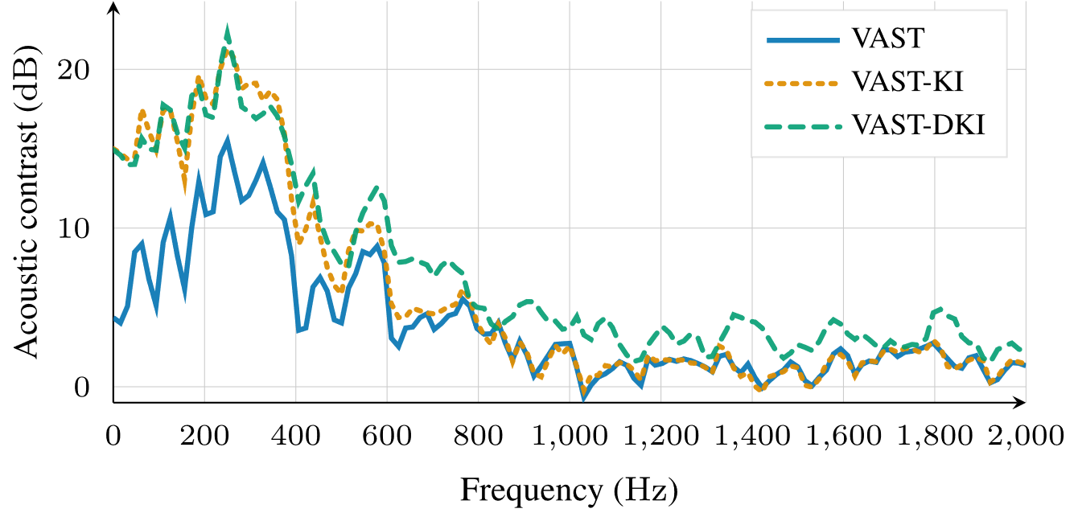
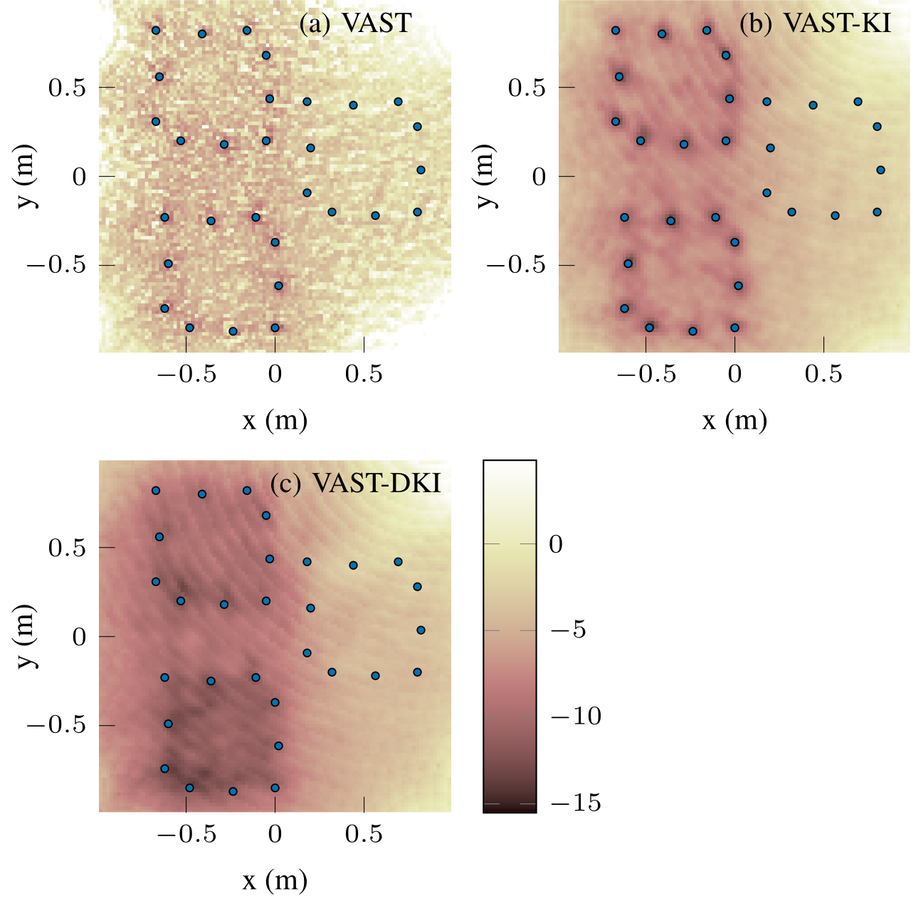
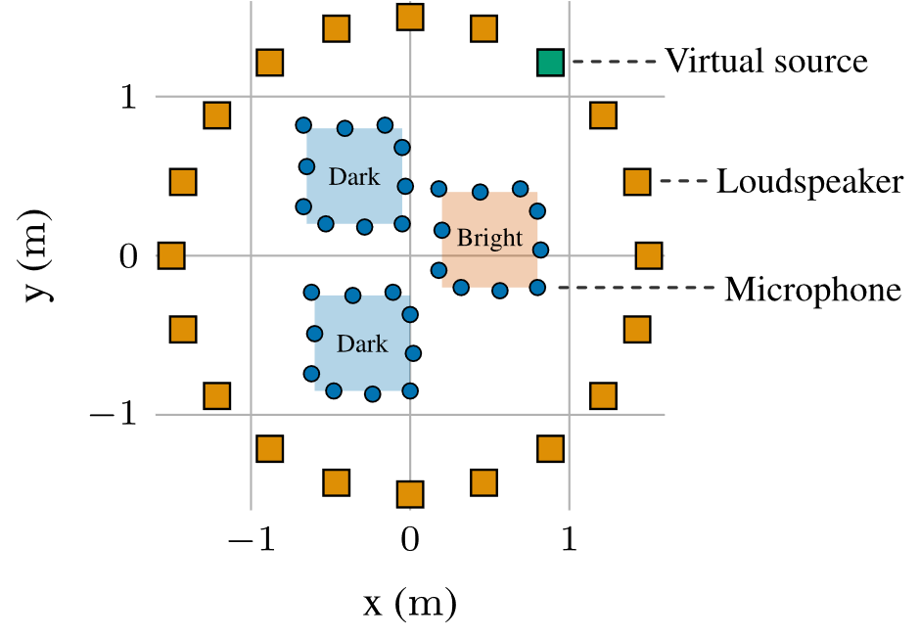
Simulation results

